Slide 1
Saving lives

Slide 2
Vision in healthcare analytics
We advance machine learning algorithms in order to solve data-intensive problems in healthcare.
In terms of impact, we aim to:
save clinician and researchers’ time by using algorithms to sift through large amount of data
work with clinicians and domain experts in order to improve the understanding of a medical problem by developing better models/algorithms that are more adapted to the problem.
From electronic medical records to medical imaging and microarray data
Millions of primary care records, imaging data
Dynamic mode decomposition (DMD), Bayesian network, mixture of experts
Notes:
Do we need a vision? If so, I have one handy

Slide 3
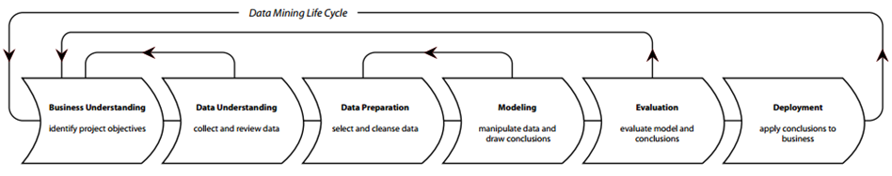
Cross Industry Standard Process for Data Mining (CRISP-DM)
Business understanding
Data understanding
Data preparation
Modelling
Evaluation
Deployment
3
Engage with clinicians (Addressing a need)
Big Data Infrastructure
Formulate hypothesis and ML statements
Analysis of data requirements
Model development & tuning
Conduct literature review
ETL
Validation
Develop study protocol
Data quality assessment
Feedback
API, GUI, demo
Notes:
Do we need to know the process?

Slide 4
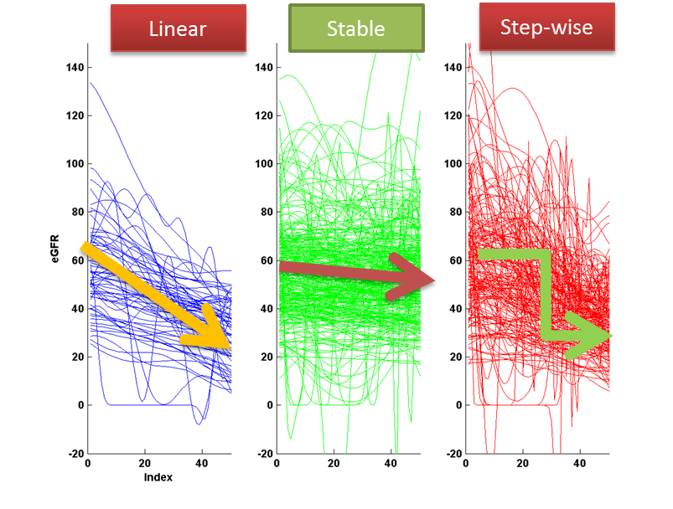
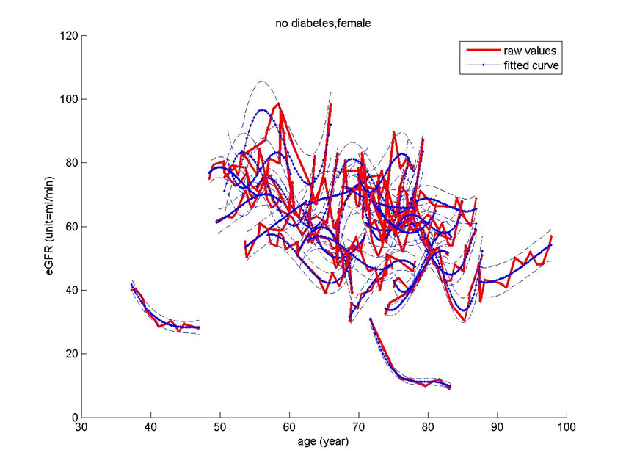
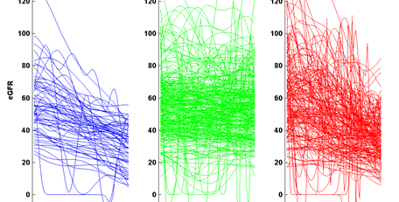
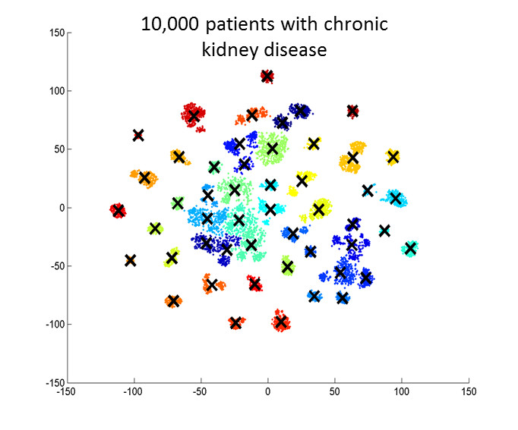
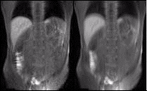
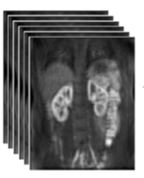
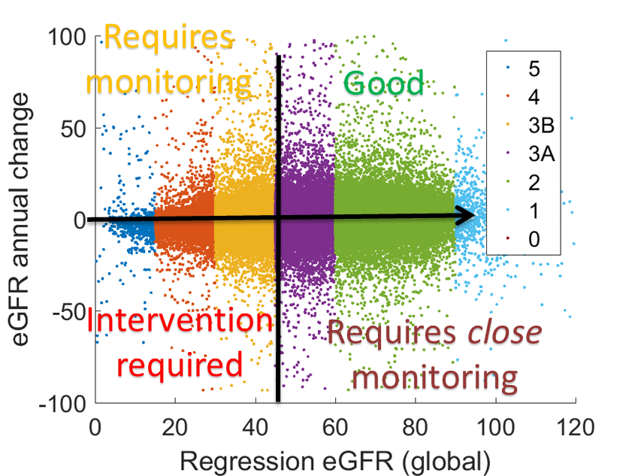
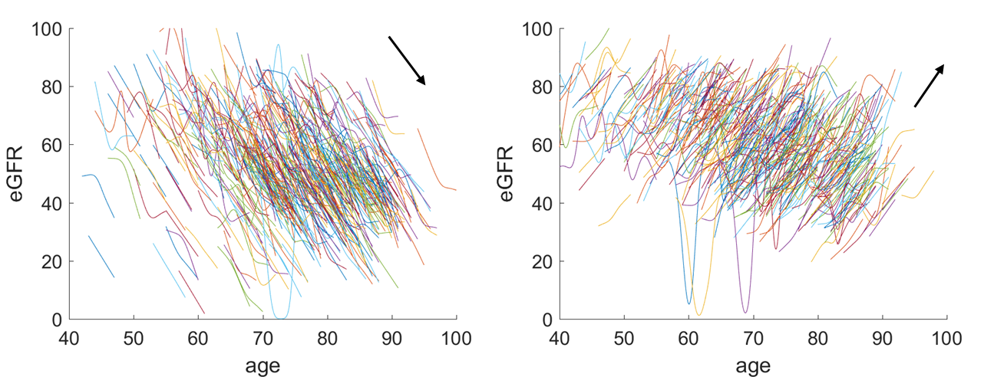
ML in CKD
Automatic classification of eGFR
Hierarchical regression modelling (& forecasting)
Machine learning algorithms
Opportunities
Imaging, textual, EHR, ECG
Video stabilization
High dimensional patient clustering
Long-term conditions
Trends grouping
Patient stratification
MRC Modelling CKD progression (2015-17)
Notes:
If I have only one slide, this is what I will use.
20/80 rule (or there about) - 20% of patients consume 80% of care resources
Target long term conditions (diabetes, CVD, CKD) + mental health
Goal: 1. Identify or even predict patients at risk of disease progression 2. Improve clinician's understanding about disease progression at scale -- help them identify signal from noise
So, here’s an illustrative case study
May be a demo

Slide 5
A series of slides

Slide 8
Proposed solution: Probabilistic broken-stick model
Journal of Biomedical Informatics, Volume 76, 2017, Pages 69-77, ISSN 1532-0464 https://doi.org/10.1016/j.jbi.2017.10.006

Slide 10
Result: Trend classification

Slide 11
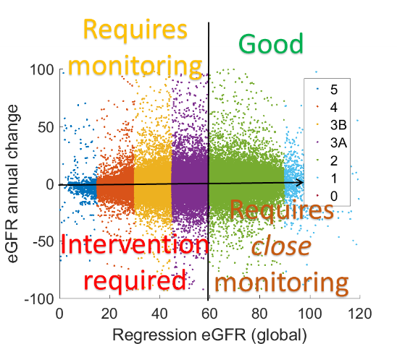
Result: Patient stratification
More refined risk stratification

