Slide 1
Rossmann Sales data analysis
Norman Poh

Slide 2
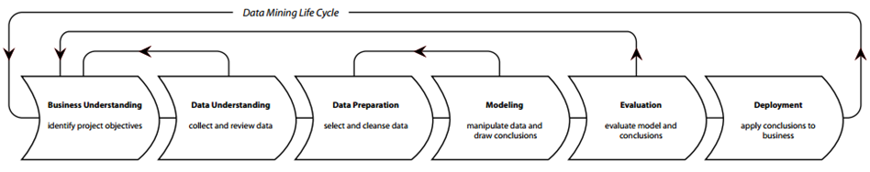
Cross Industry Standard Process for Data Mining (CRISP-DM)
Business understanding
Data understanding
Data preparation
Modelling
Evaluation
Deployment
2

Slide 3
Business objective

Slide 4
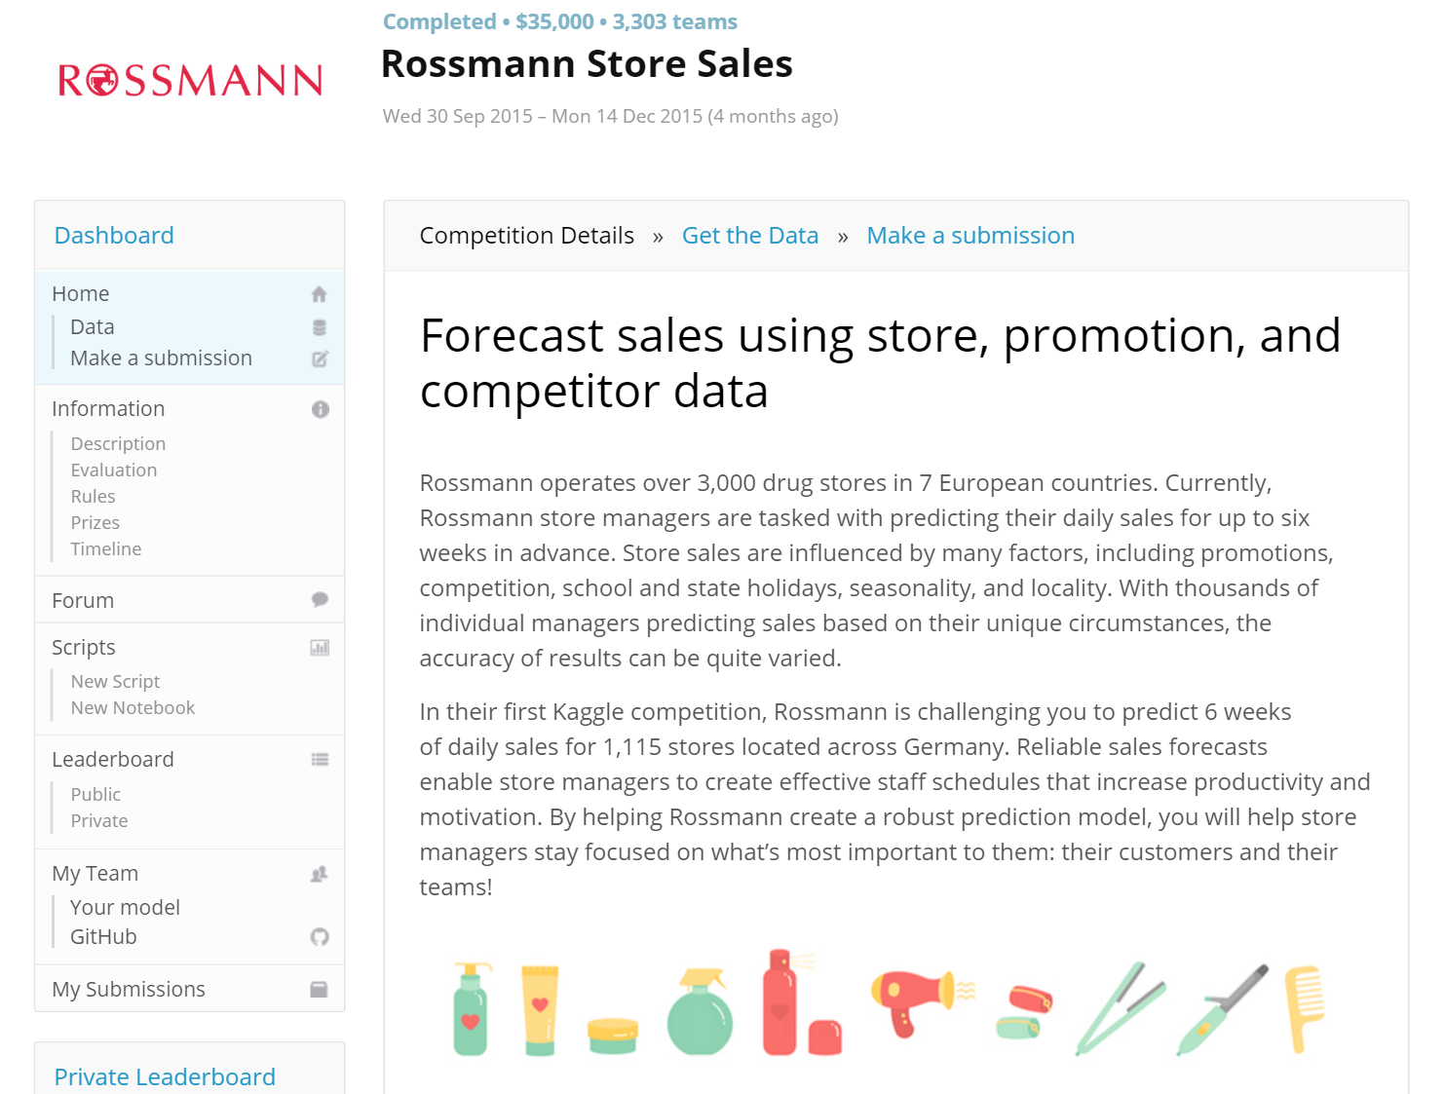
Objective
to predict 6 weeks of daily sales for 1,115 stores located across Germany

Slide 5
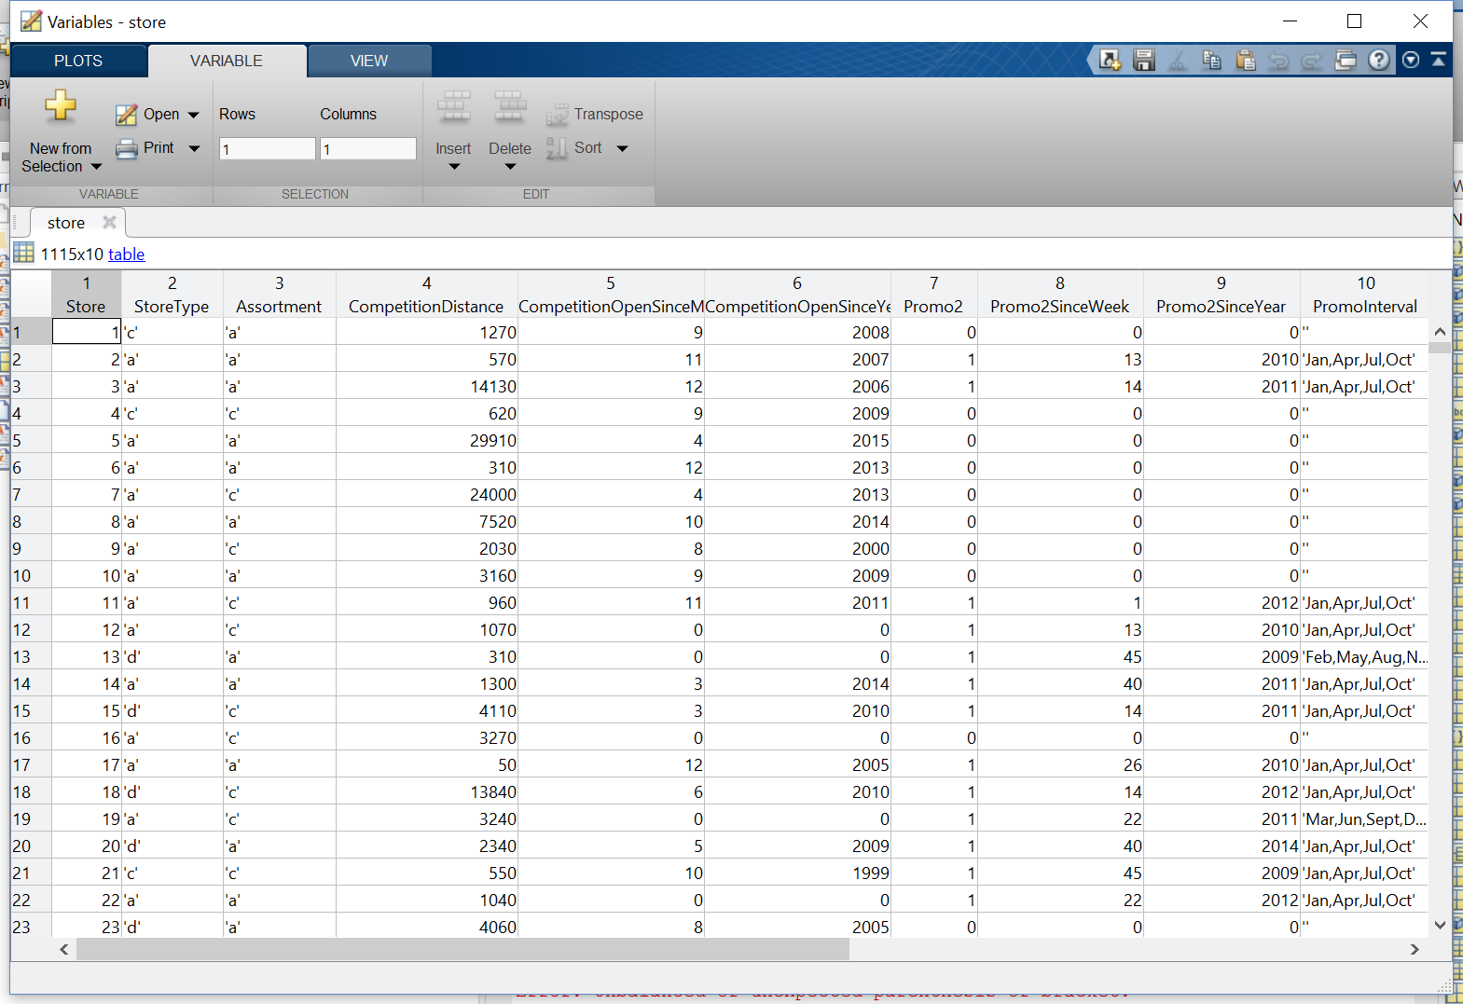
Data import
datastore
can load files in chunks
ds = datastore('../data/store.csv');
ds.MissingValue = 0; % Strategy for missing value
store = read(ds);

Slide 6
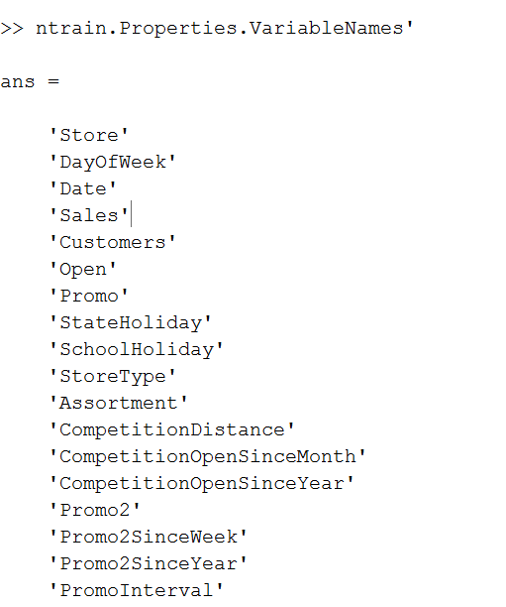
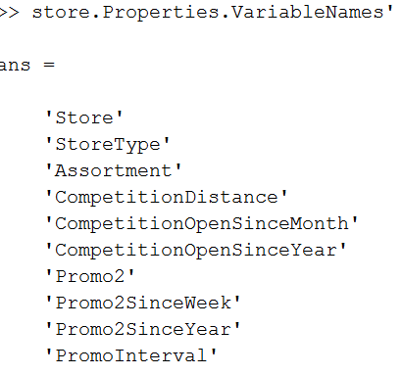
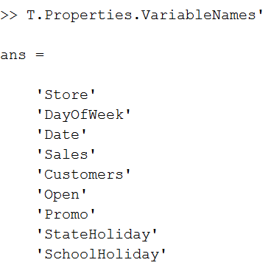
Variables after joining
Complete store daily sales data
744204 rows after joining and cleaning
Store characteristic data
Store daily sales data
1115 rows
1,017,209 rows
ntrain = join(T,store,'Keys','Store');

Slide 7
Data cleaning
Filtering samples

Slide 8
Purpose
Number of variables
Number of samples
More compact data set
Derived variable
Original data set

Slide 9
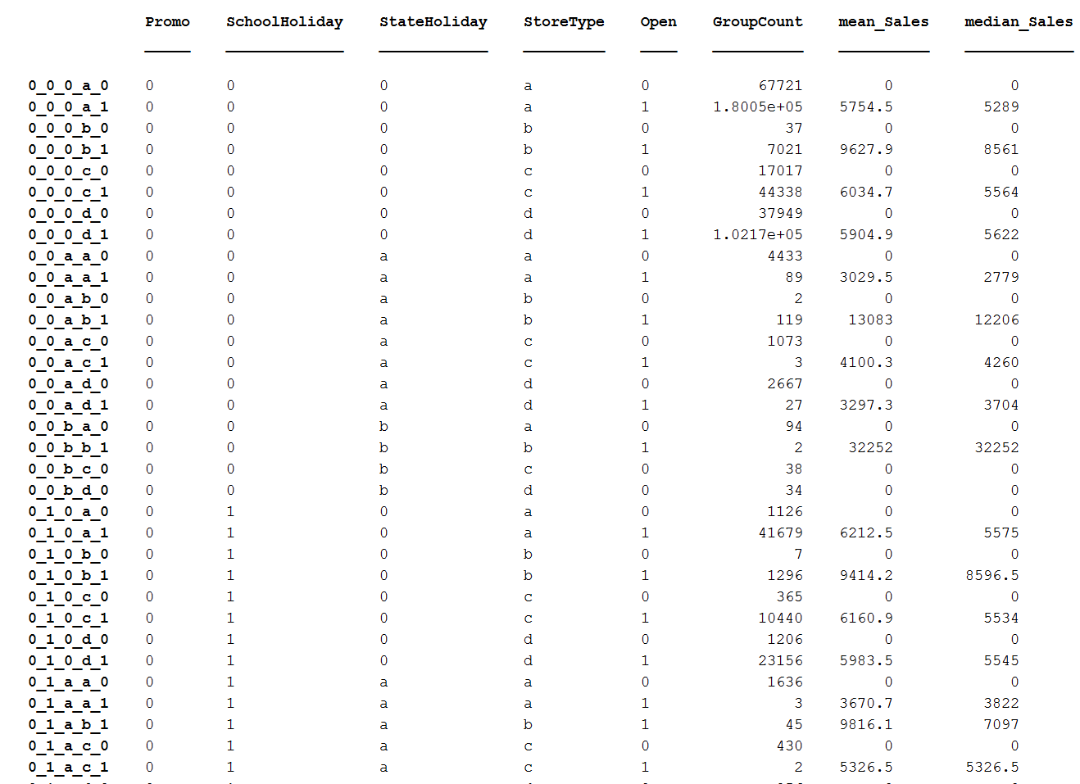
Filtering samples when shop is closed
grpstats(ntrain, {'Promo','SchoolHoliday','StateHoliday','StoreType','Open'}, {'mean','median'} ,'DataVars',{'Sales'})

Slide 10
Data exploration
Explore variables in terms of distribution and scatter plots
Include only relevant predictors

Slide 11
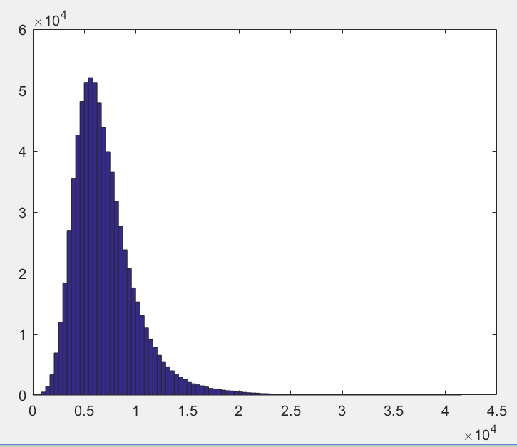
Distribution of the target variable (Sales)

Slide 12
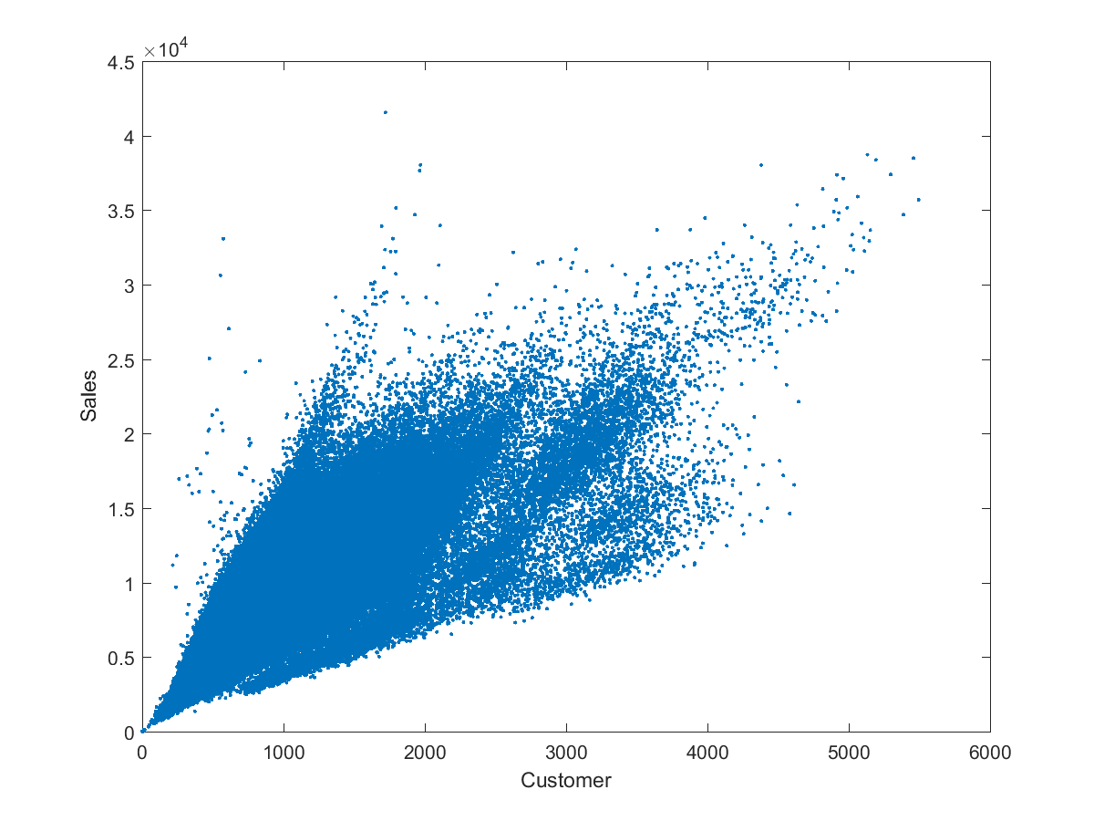
Customer number vs Sales volume (per day)
Correlation coefficient: 0.8933

Slide 13
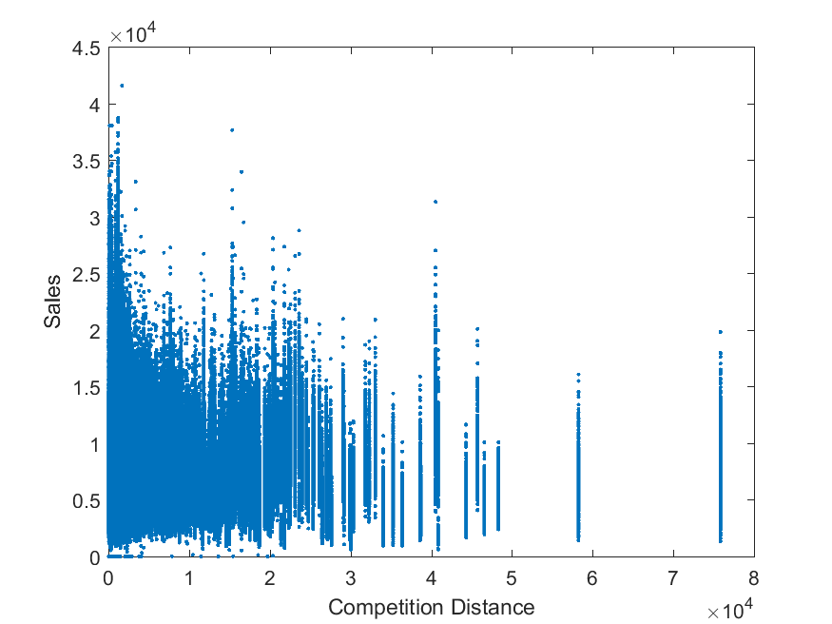
Distance from competitor
Counter-intuitive

Slide 14
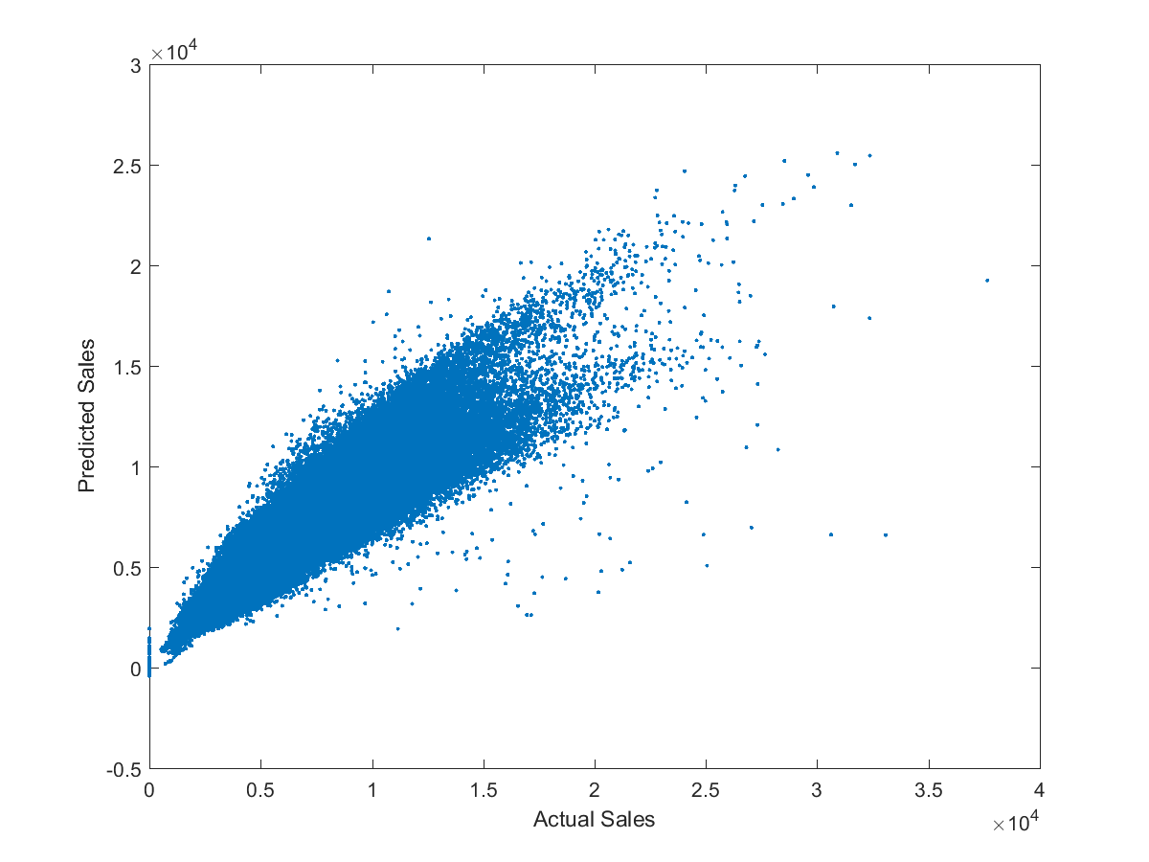
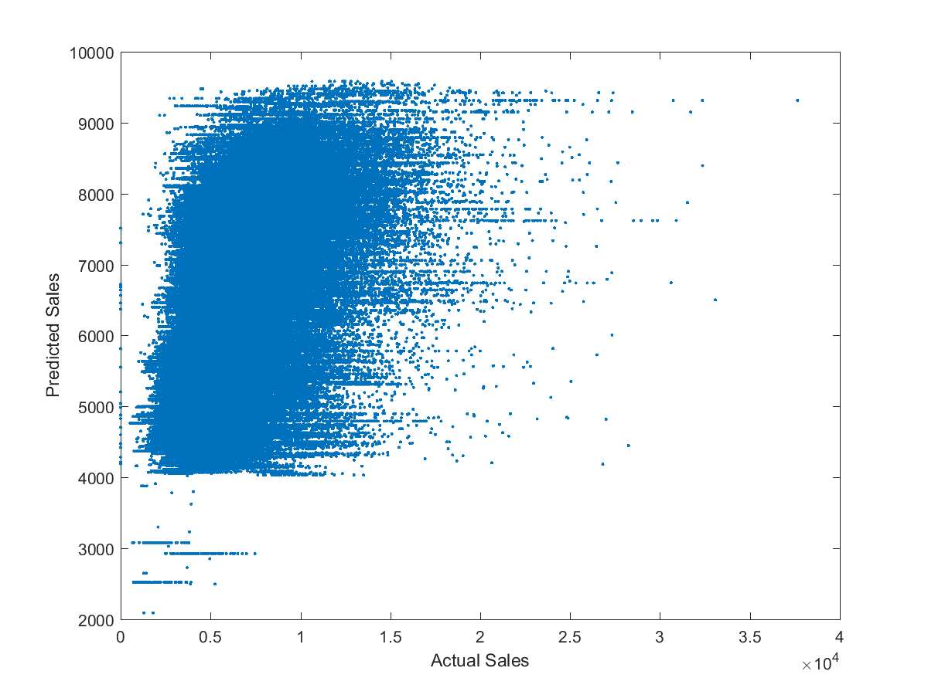
Prediction with or without customer (linear regression)
Response fraction: 0.496 R-squared 0.790
Response fraction: 0.496 R-squared 0.244

Slide 15
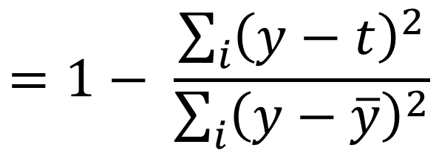
R-squared
r = 1 - ( sum( (ypred-yOrig) .^ 2) / sum( (yOrig - mean(yOrig)) .^ 2) );
$$=1− \frac{\sum_{i}{{\left(y−t\right)}^{2}}}{\sum_{i}{{\left(y−\overline{y}\right)}^{2}}}$$
R-squared

Slide 16
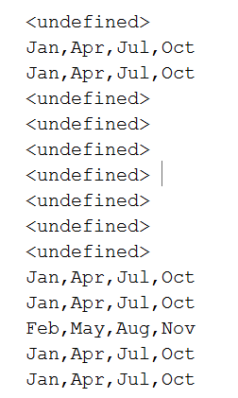
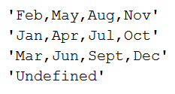

Missing values are recorded as categorical

Slide 17
Models development

Slide 18
Explore a number of predictive models
Linear model, PLSR
Simple, interpretable
Decision tree
Complex
Neural network
General purpose (universal function approximator)
requiring lots of tweaking

Slide 19
Three data sets
Training
(248068 samples)
Validation (pruning/tuning) (248068 samples)
Test (248068 samples)

Slide 20
Linear models

Slide 21
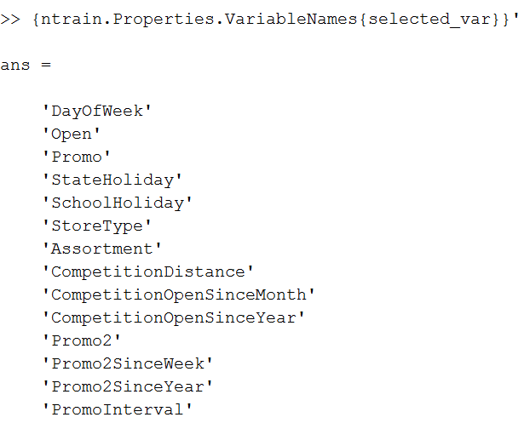
Selected variables

Slide 22
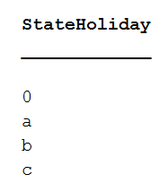

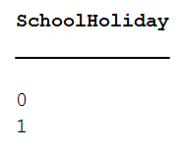
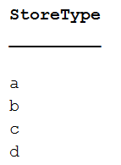
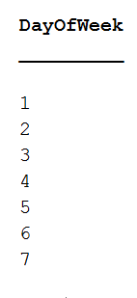
Some examples here
Must consider nominal, ordinal, or continuous variables

Slide 23
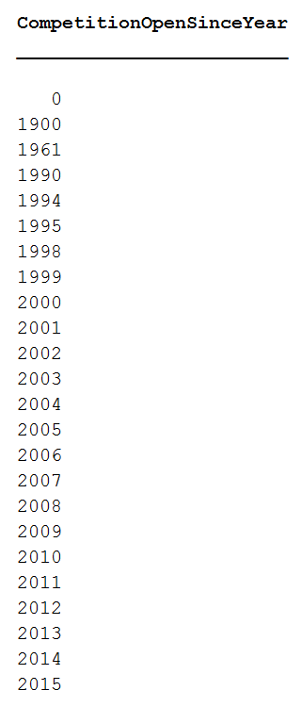
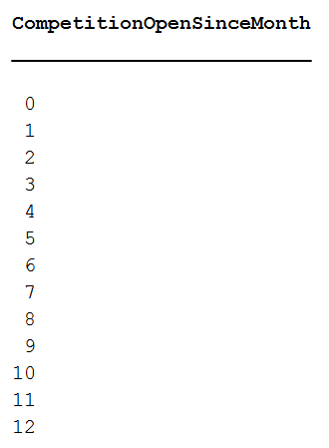
Continuous
Sales

Slide 24
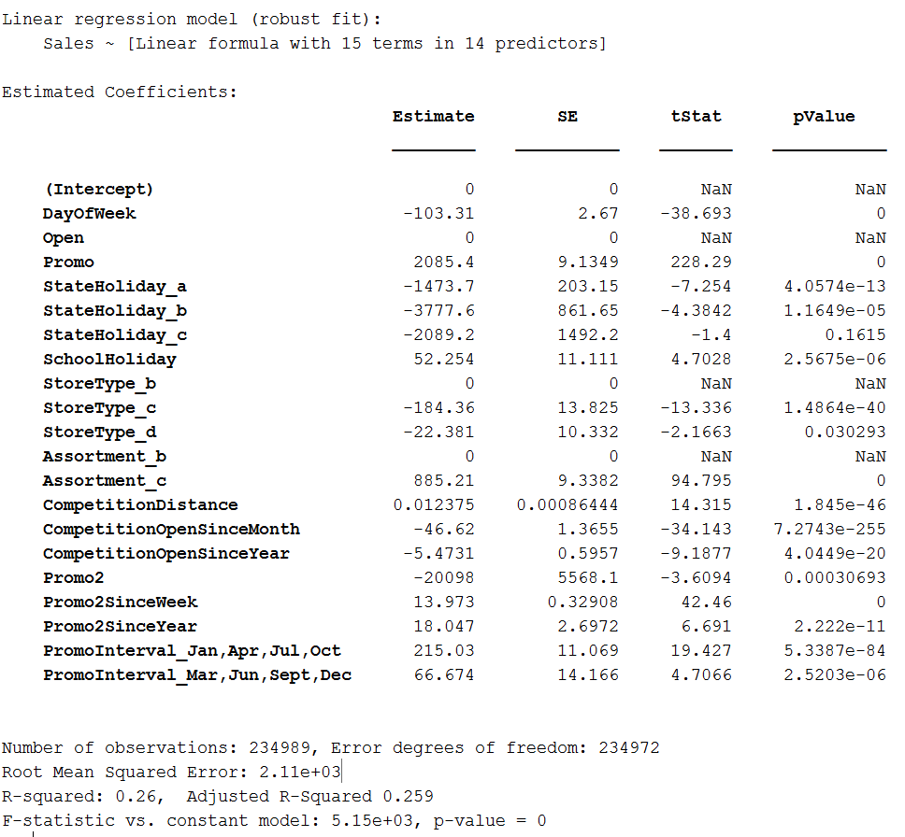
Robust Linear Model
Continuous

Slide 25
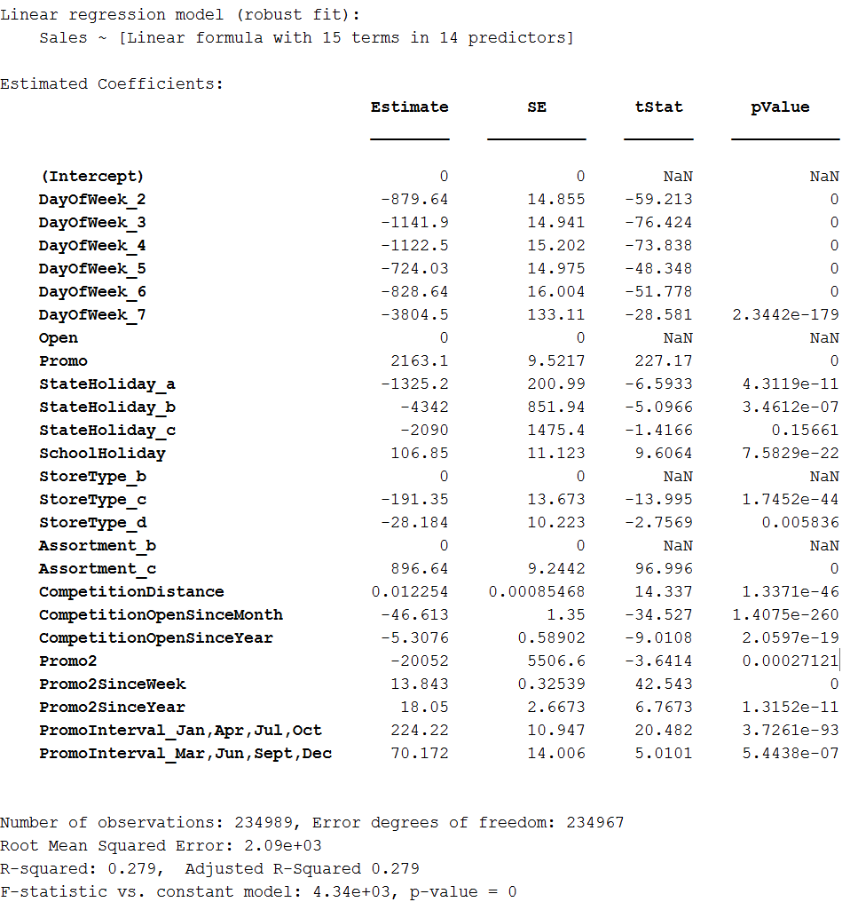
Robust Linear Model
Categorical

Slide 26
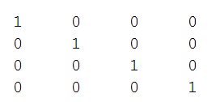
Data recording using dummyvar

Slide 27
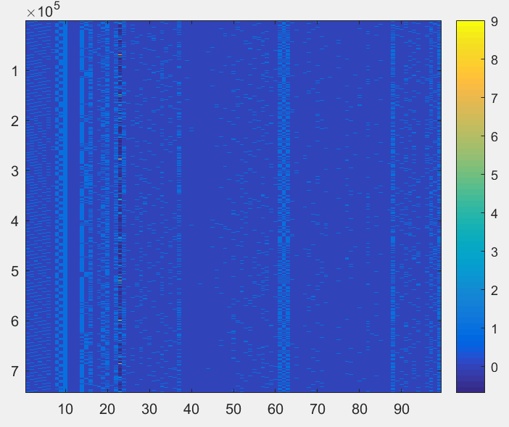
Result – a new data matrix with 99 dimensions

Slide 28
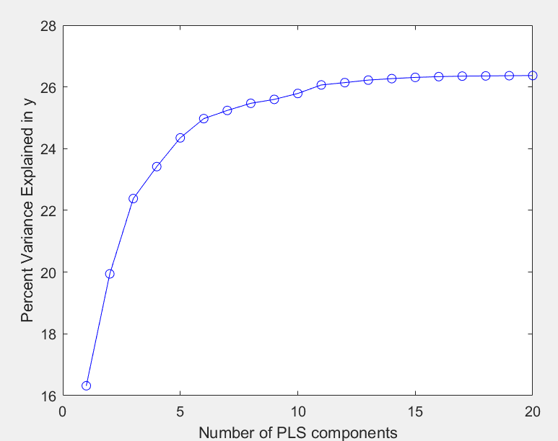
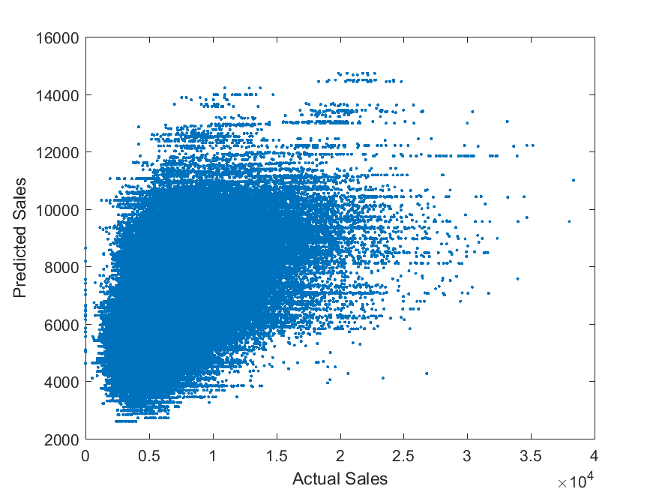
Partial Least Square Regression (PLSR)
Response fraction: 1.000 R-squared 0.262

Slide 29
Feed-forward neural network

Slide 30
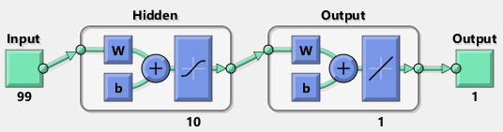
Architecture of neural network (MLP)

Slide 31
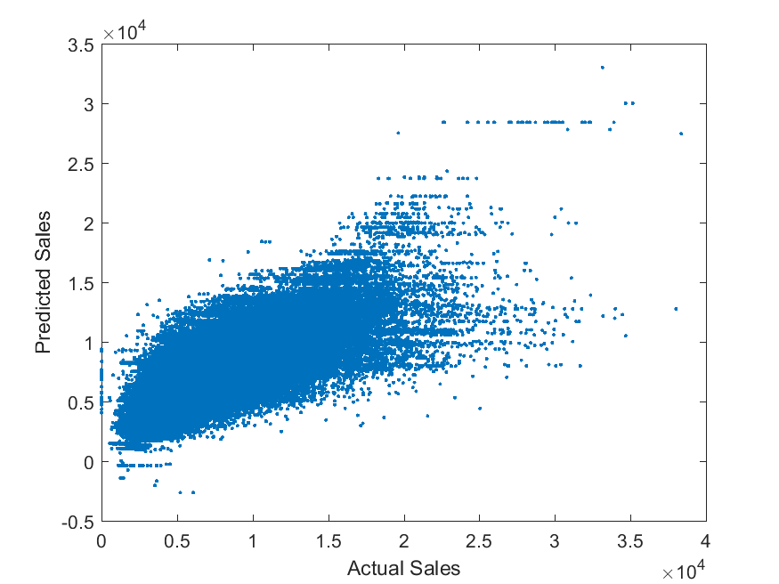
MLP
Response fraction: 1.000 R-squared 0.564

Slide 32
Regression tree

Slide 33
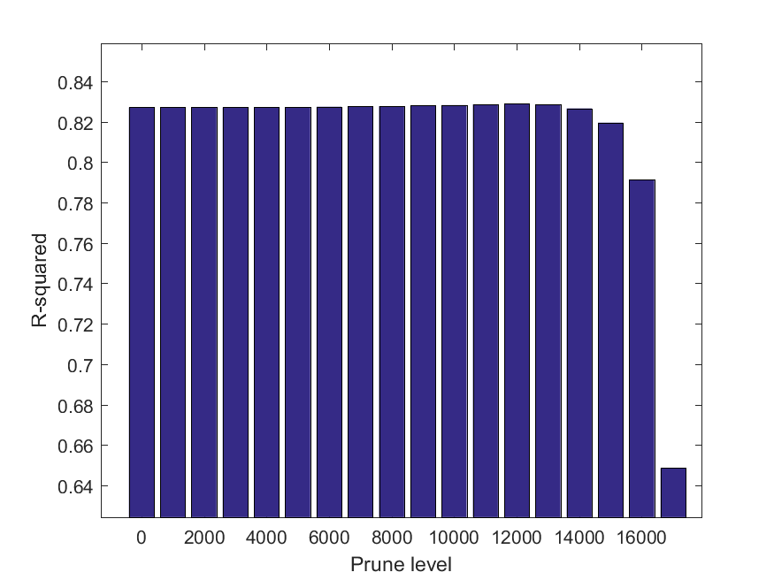
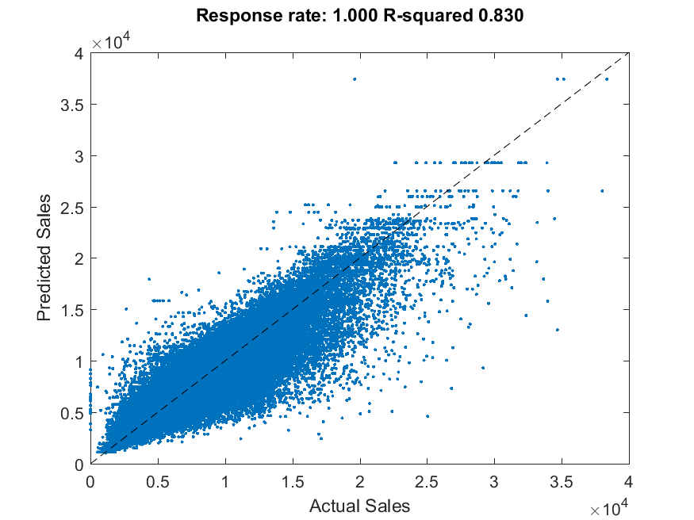
Prune at 12,000

Slide 34
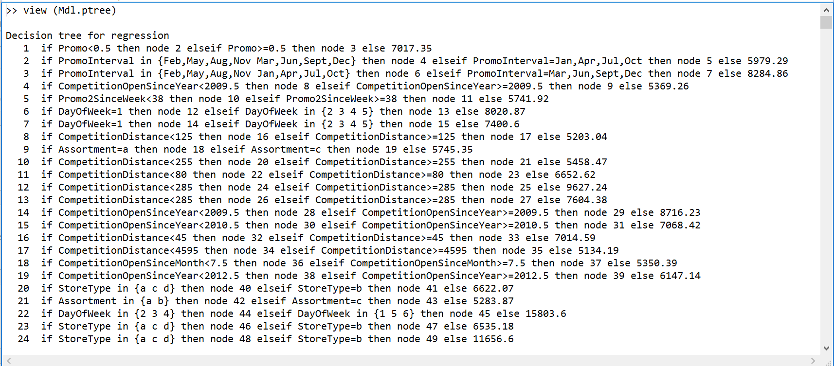

Slide 35
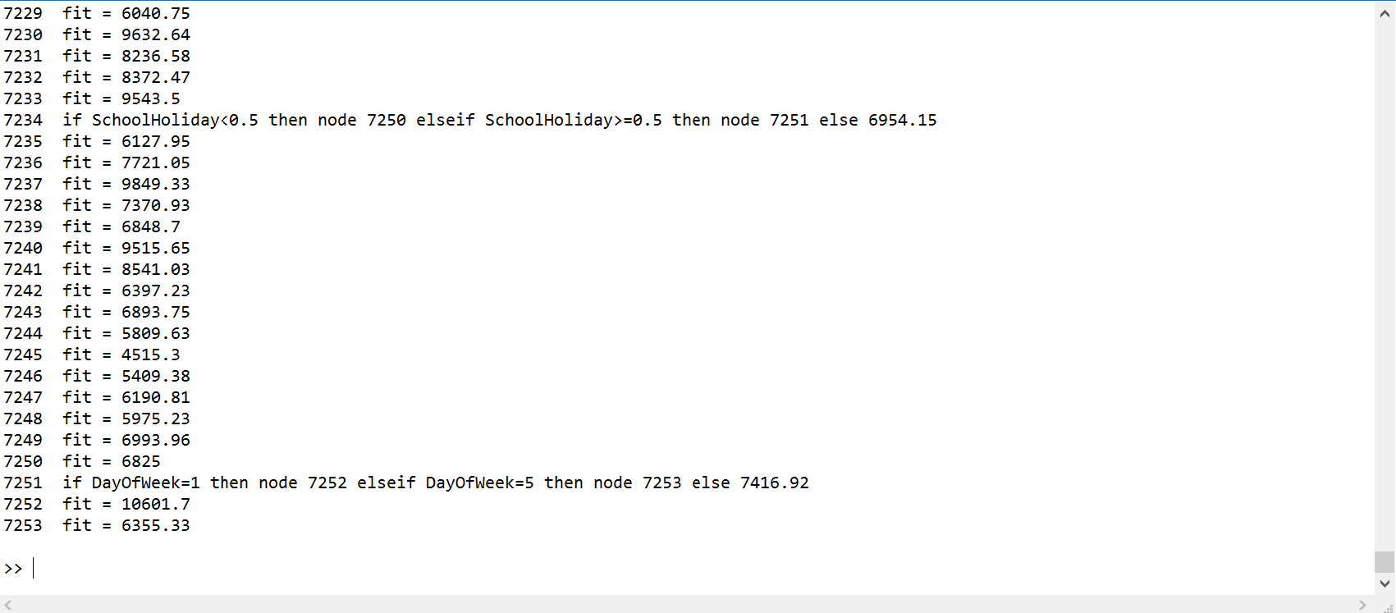

Slide 36
Conclusion
Response fraction: 1.000 R-squared 0.262
Response fraction: 1.000 R-squared 0.564
Response fraction: 1.000 R-squared 0.83
PLSR
MLP
RegTree

