Slide 1
DARC:
The Durham AO Real-time Controller
DARC practical session
Alastair Basden
15th April 2011
Notes:
Setup – needs:
full screen terminal for running darc (2 tabs)
full screen doc of installation instructions
full screen doc empty for writing into.
full screen emacs

Slide 2
Contents
Round-table introductions
Overview
Installation and setup
Directory Structure
Running
Configuring and optimising
Developing
  Cameras
  DMs
    The parameter buffer overview
  Algorithms
  Telemetry
  Control
Scripting
darcmagic
Engineering GUI
Real-time display
Asynchronous operation
The buffer module development
Figure sensing
Notes:
Introductions – who are you, involvement, interest, area of work

Slide 3
DARC overview
Open source, available from sourceforge
GPL licensed
PC based (unix)
  Suitable for any 8-10m class telescope AO system
Easy to install and develop
Highly configurable
  Easy to adapt for different camera and mirror configurations
Modular design
  Hardware modules possible
    e.g. GPU reconstruction on-sky
  Interfaces well defined
Shared memory double buffered parameter buffer
  Control can be decoupled from the real-time pipeline
Shared memory telemetry interface
  Telemetry decoupled from the real-time pipeline
  Telemetry bottlenecks do not slow down or halt the RTCS
Controlled via middleware (CORBA)
  Though this can easily be changed to suit other requirements

Slide 4
DARC components

Slide 5
DARC architecture
Multi-threaded (and optionally multi-process)
Configurable
  User defined number of threads
  User defined thread priorities and affinities
  Allows optimum performance to be achieved
    Many user options to tailor performance for a given AO system
Horizontal processing strategy
  Each thread performs multiple operations (start to finish)
  Lower latency, fewer synchronisation primitives required

Slide 6
Processing strategy
Processing begins as soon as first pixels become available
  Calibration, slope calculation and partial reconstruction

Slide 7
DARC Telemetry
Telemetry outputs include (as separate streams)
  Raw and calibrated pixels (rtcPxlBuf, rtcCalPxlBuf)
  Slopes (rtcCentBuf)
  Phase (rtcMirrorBuf)
  Mirror demands (rtcActuatorBuf)
  Status (rtcStatusBuf)
  And others
    Adaptive window positions
    Correlation centroiding images
    User defined

Slide 8
Telemetry implementation
DARC writes telemetry data to individual SHM circular buffers
  One per telemetry stream
  Optional decimation parameter (individually settable)
    DARC will only write what you want it to
Telemetry sent from RTCS to client nodes via TCP socket
  With a separate data decimation for each client
    Different clients can receive at different rates
      e.g. logging and GU
  On the client node, the receiver writes the data into a shared memory circular buffer
  Data is accessed by clients on the client nodes, by reading the local shared memory circular buffer
  Data can be sent from client nodes to other client nodes
    Reducing DARC workload/network bandwidth
Custom telemetry interface can also be implemented

Slide 9
Telemetry
Client PC 3
Client A
Client B
Client PC 6
Client PC 5
Client A
Client B
Client A
Client B
SHM
Receiver
Receiver
SHM
SHM
Receiver
Client PC 4
Client A
Client B
Client PC 7
Client A
Client B
Receiver
SHM
Receiver
SHM
Client PC 1
Client PC 2
Senders
Client PC 2
Senders
Client B
Client B
Client A
SHM
Receiver
Client A
SHM
Receiver
RTC PC
SHM
Senders
DARC
Notes:
If a sender falls behind – data gets skipped

Slide 10
Telemetry choice?
Why not UDP?
  Data loss – critical for e.g. tomography
Why not broadcast?
  Relies on UDP
Why not CORBA?
  Poor performance for data streaming
Why not a Data Distribution Service (e.g. DDS)?
  Too complicated – increases installation difficulty
  Would introduce problems if one link was much slower than others
    But a user is free to implement if they wish... (as CANARY did with CORBA)
Why not multicast?
  Relies on UDP

Slide 11
DARC installation
Time for us to try installing DARC
  Please follow the instructions provided

Slide 12
Environment variables
Point to the CORBA name server:
    export ORBInitRef=”NameService=corbaname::localhost”
Set you PATH, PYTHONPATH and LB_LIBRARY_PATH variables
The file etc/rtc.bashrc should do this for you
  source etc/rtc.bashrc

Slide 13
Directory structure
bin/ Binary files
conf/ Configuration files (darc and plots)
doc/ Documentation
etc/ Example environment file
idl/ CORBA interface definition files
include/ C headers
lib/ Libraries (when built)
lib/python/ Python files
src/ C source code
test/ Files for testing

Slide 14
Documentation
Lets make some documentation:
cd doc
make

Slide 15
Running DARC
omniNames
  (not part of darc)
darccontrol
  darcmain
darcmagic
  darctalk
darcgui
darcplot
Notes:
Have a full screen terminal that can switch too, to demonstrate these (needs two tabs open).
darccontrol /rtc/conf/configcamfile.py -o
darcmagic status
darcmagic get
darcmagic set
darcmagic get -labels
darcmagic get -decimation
darcgui
darcplot rtcPxlBuf 100 “-mdata.shape=128,128”

Slide 16
darccontrol
Options:
  configuration file name (.py or .fits)
  -bBUFSIZE (in bytes)
    To increase the shared memory parameter buffer
    Default 64MB
    For higher order AO systems
  -o
    Don't redirect stdout – so you can see the output on terminal – useful when debugging
  -eNHDR
    to increase the number of allowable parameters (default 128)
  --prefix=PREFIX
    to change the DARC prefix

Slide 17
Multiple instances
Each DARC instance creates a CORBA object, and files in shared memory
To use multiple instances of DARC simultaneously, you need to specify a prefix:
  Start darc with darccontrol –prefix=WHATEVER
  Then use this prefix whenever you communicate (see later)
  This prefix prefixes anything placed in /dev/shm/
    parameter buffers
    telemetry buffers

Slide 18
DARC configuration files
Lets look at a configuration file...
  conf/configcamfile.py
  Aim to populate a “control” structure with parameters
Missing parameters?
  Default values inserted (if known about)

Slide 19
DARC parameters
What are they, what do they do?
Lets look at doc/man.pdf
Notes:
Have a look at the documentation doc/man.pdf

Slide 20
Important parameters
ncam
npxlx,npxly,nsub
subapLocation
pxlCnt
etc

Slide 21
Performance optimisation
There are lots of ways in which performance can be optimised
  ncamThreads – specify the number of threads
  threadPriority – the priority of these threads
  threadAffinity – the processor(s) on which each thread is allowed to run
  The pixel count array
    Don't read unnecessary pixels
    If several sub-apertures have the same pixel count value, they can be processed together
  subapAllocation – allocate sub-apertures to threads
  Individual module (dynamic library) flags
    e.g. For sFPDP library – the block size and priority/affinity
  Getting rid of unnecessary parameters
    e.g. set flat field to None if all ones.
  Sub-aperture sizes (e.g. reduce once the loop is closed)
  noPrePostThread
    if set, places post processing into a sub-aperture processing thread
    reduces latency, but also reduces maximum achievable framerate

Slide 22
DARC development
As a user you may wish to make changes
  New interface modules
    Cameras and DMs
  New algorithms
  New methods of control
    e.g. to make compliant with observatory X
  New methods for telemetry
    e.g. to make compliant with observatory X

Slide 23
DARC modules
Modular design
  Allows rapid prototyping
  Modules loaded and unloaded dynamically
    Allows changes/new features while the AO pipeline is running
  Front end (cameras)
    Interface control documents
  Calibration
  Slope calculation
  Reconstruction
  Back end (mirror control)
    Interface control documents
  Figure sensing
  Buffer interface
    Change any parameter on a per-frame basis
Fully asynchronous operation possible (cameras with different unrestricted frame rates)
  Also allows distributed processing to be implemented
Full GPU pipeline in development

Slide 24
Loading/unloading modules
Status tells us whether a module is loaded
Module name comes from e.g. cameraName, slopeName, reconName, calibrateName etc
But is it loaded?
  darcmagic get camerasOpen (or slopeOpen or...)
So – write a new module, compile it, and load it into the RTC
  without stopping the RTC!

Slide 25
Camera interfaces
Developing camera interfaces
  You have to produce a shared library which contains a set of defined functions
    DARC can then read this library, and use these functions
  defined in include/rtccamera.h

Slide 26
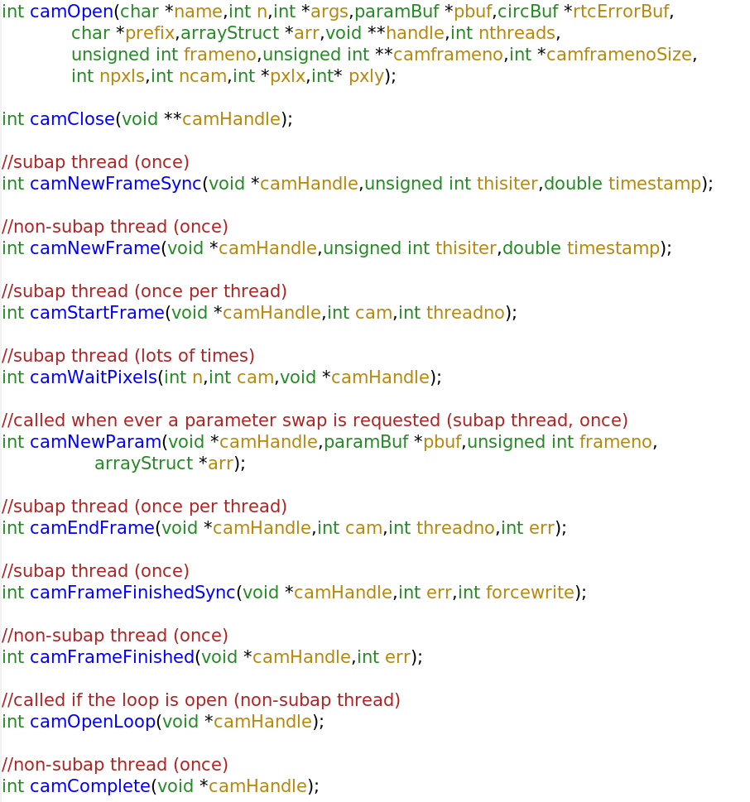
The camera library

Slide 27
Time to panic?
The good news: you don't have to create all of these
  Only 2 are required: camOpen and camClose
  Others are there to help if you wish
    A minimum of 1 extra to do something useful
  libcamfile.so uses only camNewFrameSync
    And this would be sufficient (though maybe not quite optimal) for all full frame imagers
      i.e. ones where you can't access a pixel stream, only a full frame
    see src/camfile.c
Notes:
Look at camfile.c in emacs

Slide 28
A more advanced camera
jaicam.cpp
  For driving a JAI Pulnix camera
    gigE vision, >1kHz frame rates
    CANARY figure sensor
  Delays waiting for pixels for as long as possible
    Waiting for pixels is what the RTC will spend a lot of its time doing
    So use this time for other things...
sl240Int32cam.c
  For reading a sFPDP pixel stream
  CANARY WFSs
Notes:
look at the source files.

Slide 29
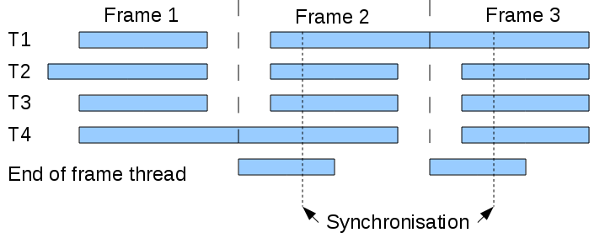
Library hook points
Lets look at the DARC thread structure
  (NOTE: noPrePostThread option)

Slide 30
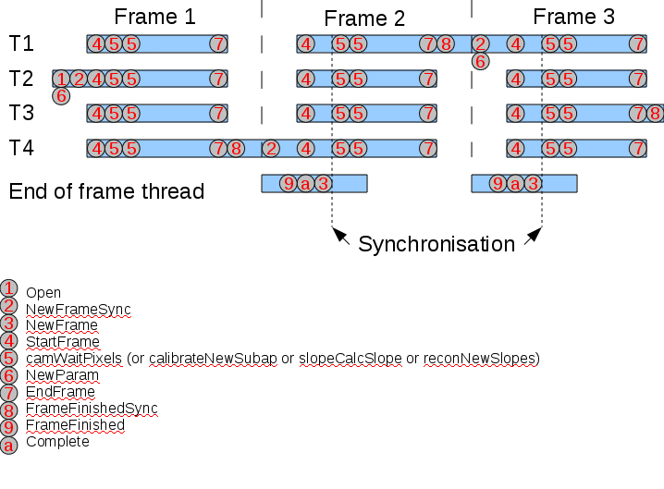
And when the functions are called

Slide 31
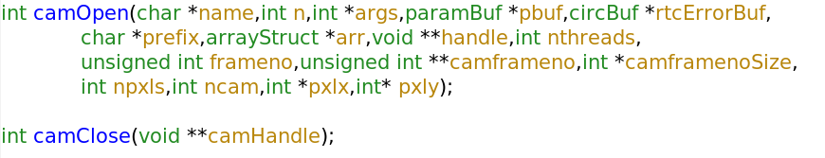
Function args
name – the name of the .so library (not usually used)
n, args – Initialisation arguments are passed in as an int array with n elements
  can be typecast to whatever you like by the library
    e.g. camfile typecasts to char* to get a filename
paramBuf – pointer to the current parameter buffer
rtcErrorBuf – for writing errors too
prefix – the darc prefix
arr – an arrayStruct object – pointers to lots of useful arrays
handle - the library will initialise this, which is then passed to every other camera library function call
nthread – number of threads
frameno – the current RTC frame number
camframeno – can be allocated by the library into which camera frame numbers (or anything else) can be placed – and shows up in the status telemetry stream
camframenosize – number of elements of camframeno
npxls – total number of pixels
ncam – number of cameras to open
npxlx, npxly – image width/height for each camera (array of size ncam)

Slide 32
Function args
camHandle – allocated by camOpen
thisiter – current DARC iteration
timestamp – current DARC timestamp
n – number of pixels that must have arrived for this frame before returning
cam – camera number (0 for single camera configurations
camHandle – allocated by camOpen

Slide 33
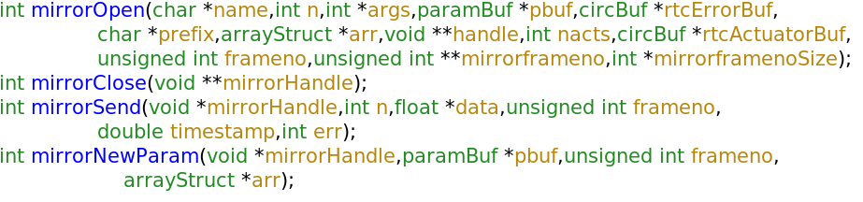
DM interfaces
defined in include/rtcmirror.h
mirrorOpen – parameters as for camOpen
mirrorSend – n is the number of actuators which are stored in data.
  err will be set if the data is invalid (for example partial frame/missing pixels received from camera)
    The mirror library can then choose not to send the actuators, but can update any internal state (for more advanced algorithms)

Slide 34
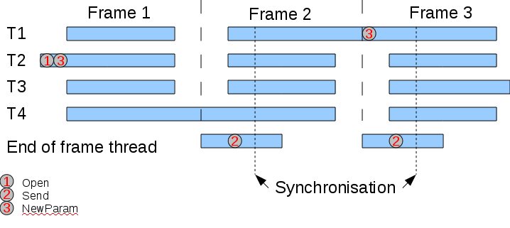
DM Library hook points

Slide 35
The parameter buffer
Used to control DARC – stores all the paramters
  Changed by the control object (double buffered)
Not usually required for camera libraries
  though maybe, e.g. to change exposure time etc
But is typically required for mirror interfaces
  For clipping arrays, scaling and offset arrays.
So, lets have a look
  include/buffer.h

Slide 36
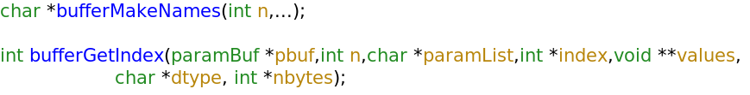
Parameter buffer functions
bufferMakeNames – called with a list of n alphabetically sorted strings, that are the names of parameters required by the library
  e.g. bufferMakeNames(5,”actMax”,”actMin”,”actOffset”,”actScale”,”nacts”)
  This is called once only, during mirrorOpen
  The return value (paramList) is then used in bufferGetIndex
bufferGetIndex is called each time a parameter swap is requested
  Runs through the list of available parameters (in shared memory)
    stores those requested in bufferMakeNames
      The index in the parameter buffer
      The pointer to actual parameter value (typecast to void*)
      The datatype of this parameter (single character)
      The number of bytes for this parameter
    The library should then check that the parameter is of correct type and size, and then use it...
Notes:
Necessary to minimise latency of a buffer swap

Slide 37
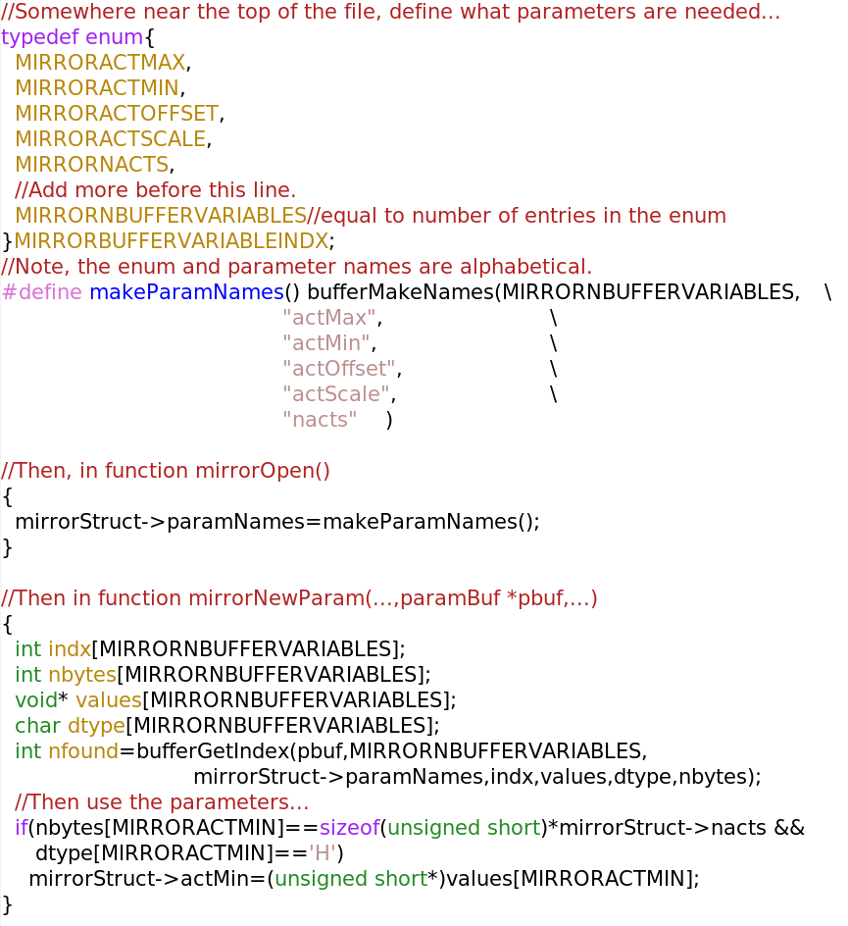
Buffer example (from mirrorSocket.c)

Slide 38
DM examples
src/mirrorSocket.c
  Sends actuator values to a TCP/IP socket
src/mirrorSHM.c
  Writes actuator values to shared memory
src/mirrorSL240.c
  Writes actuator values to sFPDP
src/mirrorPdAO32.c
  Writes actuator values to a DAC card
  Note the removal if statements from loops where possible to improve performance

Slide 39
Algorithm development
You may wish to develop your own algorithms
  These may be adaptations of something existing
    e.g. a new image thresholding routine
    Change an existing library
  Or completely different
    e.g. a new way of doing wavefront reconstruction
    Write a new library
  These can then be inserted into the DARC main development tree for others to download
    via the maintainer (i.e. me)

Slide 40
Image calibration
Currently, only one library exists for image calibration
  src/rtccalibrate.c
New libraries can use any or all of the function declarations found in include/rtccalibrate.h
These are very similar to those for the camera library

Slide 41
Calibration library hooks

Slide 42
calibrateNewSubap
threadno – the thread number that is calling this function
cursubindx – current sub-aperture index
subap – pointer to the temporary subaperture workspace
  The calibrated sub-aperture data is to be placed in here.
  Can be increased in size if necessary by this function
subapSize – the number of elements allocated in subap
  Update if necessary (if this is found not to be enough)
curnpxlx, curnpxly – to be updated with the current number of pixels (x,y) in this sub-aperture
The raw pixel data is obtained from the arrayStruct provided to the calibrateOpen function

Slide 43
The default calibration library
Uses calibrateOpen, calibrateClose, calibrateNewParam, calibrateNewSubap
When calibrateNewSubap is called:
  computes size of sub-aperture
    using subapLocation parameter (actually an internal version to allow for moving windows)
  Copies the raw camera data required for this subaperture into “subap”
    After conversion to float32
  Then proceeds to calibrate “subap” (dark subtraction, flat field, background subtraction, thresholding, brightest pixel selection, raising to power)
  Then copies the calibrated data back into a global calibrated image array (to be used for telemetry, but not internal processing)

Slide 44
Changes?
On the to-do list:
  Add support for arbitrary pixel assignment to this library (already supported in DARC)

Slide 45
Slope computation
Currently, DARC is focussed on Shack-Hartmann sensors
  But the flexibility also allows it to be used with pyramid sensors without change
Other sensor types would require new libraries developing
  e.g. curvature, etc
librtcslope.so, src/rtcslope.c
Header definitions found in include/rtcslope.h
  Very similar to those in the camera library

Slide 46
Slope library hooks

Slide 47

slopeCalcSlope
nsubs – the total number of sub-apertures that should have arrived before continuing
  Useful if have a external slope calculator (e.g. SPARTA)
subap, subapSize – created by the calibration library, containing calibrated pixel data for this sub-aperture
subindx – the sub-aperture number to process (this index includes unused sub-apertures)
slopeindx – the resulting centroid index (this index counts used sub-apertures only)
curnpxlx, curnpxly – dimensions of the current sub-aperture

Slide 48
The default slope library
Uses slopeOpen, slopeNewParam, slopeClose, slopeNewFrameSync, slopeCalcSlope, slopeFrameFinishedSync, slopeComplete
slopeNewFrameSync – to update sub-aperture locations if adaptive windowing
slopeCalcSlope – calculates the slope of the given sub-aperture
  Places results into the arrayStruct->centroids and arrayStruct->flux
slopeFrameFinishedSync – to update global adaptive windows
slopeComplete – to save the correlation image (if used)
  It could be done earlier, for example in slopeFrameFinishedSync, but do it here, to reduce latency

Slide 49
Changes?
On the to-do list:
  Add support for arbitrary pixel assignment

Slide 50
Wavefront reconstruction
Current libraries exist for MVM reconstruction only
  Best performance for non-ELT scale systems
Other algorithms would require new library development
  e.g. PCG, Fourier based reconstruction etc
Header definitions found in include/rtcrecon.h
  very similar to those found in the camera library

Slide 51
Reconstruction library hooks

Slide 52
reconNewSlopes
cam – camera number for this thread
centindx – slope index arriving (counting used sub-apertures only)
threadno – thread number
nsubapsDoing – the number of sub-apertures for which slopes are ready.
Notes:
nsubapsDoing comment – pixels arrive in rows – so row of subaps becomes available all at once – so may improve performance to do the MVM for all of these at once, rather than lots of smaller MVMs.
A performance tradeoff

Slide 53
src/reconmvm.c
Includes (by #defines) a CUDA GPU implementation
Uses:
  reconOpen, reconClose, reconNewParam
  reconNewFrame
    Initialises the state (e.g. gets the integrator ready, etc)
  reconStartFrame
    Per thread initialisation – clears some scratch memory
  reconNewSlopes
    Performs a partial MVM (a few rows of matrix with a few slope measurements)
  reconEndFrame
    Adds together the partial reconstructed wavefront vectors – to give the final vector once this has been called by all threads
  reconFrameFinishedSync
    Housekeeping
  reconFrameFinished
    Bleeding
  reconOpenLoop
    Reinitialises the state vector (i.e. to midrange) if the loop is open
Of course, you could get away with less, at the expense of latency

Slide 54
Partial reconstruction
Reconstruction
matrix
Actuators
. =
Slope vector
. = + + ... =

Slide 55
src/reconKalman.c
Kalman filtering module
reconOpen, reconClose, reconNewParam
reconNewFrame
  Updates the Kalman state vector
reconStartFrame
  Clears some per-thread memory
reconNewSlopes
  Does a row of the MVM (to get a partial result)
reconEndFrame
  Sums the partial results
reconFrameFinishedSync
  Housekeeping
reconFrameFinished
  Produces DM demands from phase (if necessary)
  Bleeding
reconOpenLoop
  Resets the Kalman state vector

Slide 56
src/reconAsync.c
We'll come to this one later...

Slide 57
Telemetry development
The nitty-gritty:
  After actuators have been sent, DARC writes the current frame telemetry data to circular buffers in shared memory (if this stream is switched on)
    At the correct decimation (i.e. not necessarily every frame)
  For each stream, a condition variable is then signalled
  Clients waiting for telemetry will be blocked on this condition variable
    They then wake up, and deal with the new data
  Circular buffers are 100 entries long by default
    Can be changed - 100 frames gives a fraction of a second
    Very slow clients can have their data corrupted (half an old frame, half a new frame)
    But what is the alternative? Block the RTC? No... rather – increase the circular buffer size – or spec a more powerful computer
  The default telemetry clients can either read from the head of the buffers
    always taking the most recent frames – which may mean some frames are skipped
  Or from the tail of the buffers
    But if they fall behind by more than 75% of the buffer size, they jump back to the head

Slide 58
Telemetry clients
src/sender.c
  Reads one telemetry stream
  Sends data to one remote client
    src/receiver.c
    receiver then places the data into shared memory – using a circular buffer identical to that written by DARC
    This can then be read by local clients
User local clients can:
  Use the python library, lib/python/controlCorba.py, and the lower level lib/python/buffer.py
    (see later)
  Or use the c library, src/circ.c, include/circ.h
    circOpenBufReader(name)
    circGenNextFrame()
    circGetFrame()
    circGetLatestFrame()
src/summer.c
  another client – sums telemetry data, producing a new telemetry stream – which can then be sent or read as with standard DARC streams

Slide 59
Telemetry
Client PC 3
Client A
Client B
Client PC 6
Client PC 5
Client A
Client B
Client A
Client B
SHM
Receiver
Receiver
SHM
SHM
Receiver
Client PC 4
Client A
Client B
Client PC 7
Client A
Client B
Receiver
SHM
Receiver
SHM
Client PC 1
Client PC 2
Senders
Client PC 2
Senders
Client B
Client B
Client A
SHM
Receiver
Client A
SHM
Receiver
RTC PC
SHM
Senders
DARC
Notes:
If a sender falls behind – data gets skipped

Slide 60
Your own system?
How do you provide your own telemetry system?
  Write code using circ.c/circ.h or buffer.py/controlCorba.py
    (or any other language for which Posix mutexes and condition variables are available)
  Once you have a new frame of telemetry data
    Do what you like with it
    e.g. publish via CORBA
    Send it over a fibre network
    infiniband
    etc

Slide 61
The CANARY telemetry system
Implemented using CORBA
Uses exactly the method mentioned previously
  A master process sits on DARC PC
    Clients subscribe to it
    When new data becomes available:
      the data is published to each client
Written independently of DARC
  I had nothing to do with it... - so it is usable by others!
Notes:
Completely separate from darc – am mentioning only as an example

Slide 62
Control overview
The real-time core of DARC is again performed using shared memory
  Double buffered – at any given time, one will be active (used by darcmain) and one will be for writing new data into (inactive)
    /dev/shm/rtcParam1, /dev/shm/rtcParam2
  When new parameters are ready in the inactive buffer
    a flag is set in the active buffer
      This is the only time the active buffer should be written too
    At the start of each frame, darcmain checks this flag
      If set, it performs a buffer swap

Slide 63
Buffers
darcmain
darccontrol
/dev/shm/rtcParam1
current active
switch?
/dev/shm/rtcParam2
current inactive

Slide 64
Parameters?
Everything used by darcmain is a parameter:
  A 16 byte name
  A 1 byte data type
  A 4 byte size
    A potential problem for ELT systems – a trade-off to be made
      On the todo list – implement optional large parameters
  Other stuff too
    A comment
    The starting address (relative to base SHM address)
    Dimensions and shape (not used by darcmain)
e.g. darcmagic get -labels
Notes:
The tradeoff:
If make 64 bit integer for sizes, reduces performance, since more memory bandwidth needed to read the data, and 64 bit interger math takes longer than 32 bit.
So currently, use 32 bit only...

Slide 65
Control development
So, if you want to develop your own control process, you can!
  Without touching darcmain (the real-time part)
  Your controller only has to access these buffers, and write the correct things
  But – you would need to be careful with parameter checking
    correct data type, correct size etc
    otherwise darcmain will detect the error and pause itself
  And with synchronisation (a mutex so that only one client can update buffers at a time)
But you might be better writing a control process that talks CORBA to the default controller...
  unless you have good reasons not too (e.g. it is too slow, or you have CORBA allergies)
    If it is because of speed – you might consider using the buffer interface (see later) which allows changing parameters on a frame-by-frame basis guaranteed!

Slide 66
lib/python/buffer.py
If you really want your own control process:
  To write to the parameter buffers, use lib/python/buffer.py
  Note – there is currently no .c that will write to the parameter buffers
    It would have to implement the functionality of buffer.py

Slide 67
Buffer memory layout
Each buffer is a single block of memory
A header:
  The header size
  Maximum number of parameters (N)
  flags
  Mutex structure size
  Condition variable size
  A mutex
    For obtaining the condition variable
  A condition variable
    Signalled by darcmain whenever a buffer swap is performed
Then the parameter buffer
  A data header area:
    Parameter names[N]
    Parameter data type[N]
    Parameter start address offsets[N]
    Parameter sizes[N]
    Parameter dimensions[N]
    Parameter comment length[N]
  A data area:
    The parameter data and comments
Buffer header
hdr size, N, mutex etc
Data header
names, datatypes, sizes,
address offset pointer
Data storage area
(all the data goes here)

Slide 68
Scripting
With Python
With CORBA
With command line tools
Other languages

Slide 69
Python scripting
>>>import controlCorba
>>>ctrl=controlCorba.controlClient()
You can then use ctrl to control DARC:
  ctrl.Set(), ctrl.Get(), ctrl.GetLabels() to set and get parameters
  ctrl.RTCinit(), ctrl.RTChalt() to initialise and stop DARC
  ctrl.SetDecimation(), ctrl.GetDecimation() to control telemetry rates
  ctrl.GetStream() to grab the latest data in a telemetry stream
  ctrl.GetStreamBlock() to get multiple frames of telemetry data
  and others
Provides wrappers for the CORBA calls
Notes:
examples:
ctrl.GetLabels()
ctrl.Get(“nacts”)
ctrl.Get(“gain”)
ctrl.Set(“gain”,numpy.array([0.5]*50+[0.1,0.1]))
ctrl.Get(“gain”)
ctrl.GetStream(“rtcPxlBuf”)
ctrl.GetDecimation()

Slide 70
CORBA IDL
CORBA allows remote control of a process from almost any machine and language
The DARC CORBA interface definition is in src/control.idl
Can be used by any language with a CORBA implementation
Gives a list of all the operations that can be used to control DARC
  Most useful ones include
    Get, Set, RTCinit, RTChalt, SetRTCDecimation, GetStreams, GetStream, GetLabels, StartStream, WatchParam, GetDecimation
  Wrapper functions advisable
    to convert data into datatypes expected by CORBA

Slide 71
Command line tools
darcmagic and darctalk
darcmagic is most powerful
  gives command line control of most of the things you want
darctalk is more restrictive
  and has a more strict notation
    best for inside other languages
These are actually python processes
  That provide a link between command line and controlCorba objects.

Slide 72
darcmagic
help (or no args, or unrecognised args) – prints help message
set
get
read
init
stop
decimate
labels
sum
grab
print
transfer
release
remove
status
swap
param
log
error

Slide 73
darcmagic set
darcmagic set NAME VALUE
  VALUE gets exec'd – so can be simple python code
darcmagic set NAME -file=FILE.fits
darcmagic set -name=NAME -string=STRING
darcmagic set -name=NAME -value=VALUE
darcmagic set NAME VALUE COMMENT
darcmagic set NAME VALUE -comment=COMMENT
Other options include:
  -swap=1/0 (default 1, do a buffer swap)
  -check=1/0 (default 1, check the parameter for validity
  -copy=1/0 (default 1, to copy newly active buffer into inactive buffer)
Notes:
If swap=0, need to ensure that no one else tries to swap while you're doing stuff.
Note – the python interface allows you to send multiple parameters at once – but darcmagic doesn't

Slide 74
darcmagic get
darcmagic get NAME
darcmagic get -labels
darcmagic get -log
darcmagic get -version
darcmagic get -decimation
darcmagic get -name=NAME
darcmagic get NAME -comment
other options:
  -print=1/0 (default 1, to print to terminal)
  -file=FILENAME (to write to a text file)
  -FITS=FILE.fits (to write to a FITS file)
  -plot=0/1 (to plot the result)

Slide 75
darcmagic read
darcmagic read rtcPxlBuf 10
darcmagic read -s1=rtcPxlBuf -s2=rtcMirrorBuf -s3=rtcCentBuf -n=10
darcmagic read -s1=rtcPxlBuf -o1=myPixelData.fits 1000
other options
  -sN=STREAMNAME
  -oN=FILE.fits (filename to which to save this stream N to, defaults to STREAMNAME.fits)
  -f=FRAME (the frame number at which recording should start – must be in the future)
  -d=DECIMATION (the decimation value at which to record, 1 if not specified)
  -n=NFRAMES (can be -1 for an infinite number of frames)
  --save-on-fly (to stream data to disk, rather than to memory – this is the default for n<0 or n>10000)
  -getstate=0/1 (default 0, if set, saves the RTC state with the data)
  -print=0/1 (print data to screen)
  -nosave=0/1 (don't save the data)
  -plot=0/1 (plot the data as it arrives)

Slide 76
darcmagic init
darcmagic init FILENAME.py
darcmagic init -file=FILENAME.py
darcmagic init FILENAME.fits
darcmagic init FILENAME.py -remote
  For files that live on the server, not locally
Note – if the configuration file causes anything to be loaded from disk (e.g. a FITS file background map), this must exist on the server.
  Can use darcmagic remote for this (see later)

Slide 77
darcmagic labels
Gets a list of available parameters
darcmagic labels
darcmagic get -labels
darcmagic labels -file=filename.txt -print=0

Slide 78
darcmagic decimate
darcmagic decimate
darcmagic get -decimation
darcmagic decimate STREAM VALUE
other options
  remote=1/0 (set values on RTC)
  local=1/0 (set values on local SHM buffer)

Slide 79
darcmagic sum
darcmagic sum STREAM NFRAMES
options
  -s=STREAM
  -n=NFRAMES
  -d=DATATYPE (or n for as original data)
  -a=0/1 (to average after summing)
  -print=1/0
  -file=FILE.fits
  -plot=0/1

Slide 80
darcmagic grab
darcmagic grab STREAM
darcmagic grab rtcPxlBuf
options
  -latest=0/1 (if set, gets the latest frame, rather than waiting for a new frame)
  -print=1/0
  -tostring (convert data to ascii – e.g. rtcStatusBuf)
  -file=FILE.fits
  -plot

Slide 81
darcmagic stop
darcmagic stop
  Stops the RTC
darcmagic stop -c
  Also stops the control object

Slide 82
darcmagic print
darcmagic print
darcmagic print -file=FILE.txt -print=1/0

Slide 83
darcmagic transfer
darcmagic transfer FILE
options
  -remote=REMOTEFILE
    allows name change, i.e. copies local FILE to remote REMOTEFILE

Slide 84
darcmagic release
Used in emergencies
  Releases the CORBA lock
  Shouldn't be required but may be useful during development

Slide 85
darcmagic param
Subscribe to changes in the parameter buffer
  Will be notified when a parameter changes
options
  -file=FILENAME
  -print=1/0

Slide 86
darcmagic log
Reads the RTC logs
  control log and darc log
Options:
  -file=FILENAME
  -darc=1/0 (subscribe to DARC log)
  -control=1/0 (subscribe to control log)

Slide 87
darcmagic error
Gets a list of current errors
darcmagic error clear
  clears all errors
  Options:
    -file=FILENAME.txt
    -print=1/0
    -log
      Logs the errors (i.e. doesn't return)
darcmagic error clear “ERRORSTRING”
  clears a specific error

Slide 88
Other languages
Either:
  implement CORBA
  Or python bindings
  Or use the command line tools
    For CANARY this is what Yorick uses

Slide 89
Errors and logs
darcmain writes errors to a telemetry buffer
  /rtcErrorBuf
  Clients can then read this
To write an error from your own modules:
  writeErrorVA(rtcErrorBuf,-1,iter,”Error string”)
    where rtcErrorBuf has been provided by the *Open() function
    iter is the current iteration

Slide 90
The engineering GUI
darcgui
Used to control parameters and view data
  control of telemetry too
Basic functionality
Users will also eventually need to implement their own tools...
  eg. STYC for CANARY

Slide 91
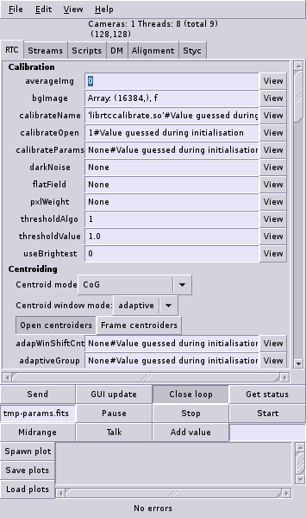
GUI parameters
Basic info
Parameters
  name, value#comment
  view button
  Obtained from the RTC
  User can update
    Green if valid
    Red if invalid python
    Purple if invalid type/size
    Black if same as in RTC
Other stuff
  Starting/stopping
  Opening/closing loop
  Status
  Send/update
  Plotting

Slide 92
Plotting
Spawn plot
  Starts a new plot process
  User then selects what to plot
Load plots
  Starts plots based on a pre-written plot configuration file
Save plots
  Saves current plot configurations to a plot configuration file – which can later be loaded

Slide 93
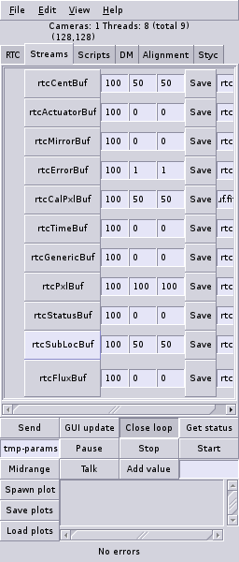
GUI telemetry
Turn on/off
Grab (right click)
Set RTC decimation
Set local decimation
Set GUI decimation (only for saving)
Save data

Slide 94
Telemetry
Client PC 3
Client A
Client B
Client PC 6
Client PC 5
Client A
Client B
Client A
Client B
SHM
Receiver
Receiver
SHM
SHM
Receiver
Client PC 4
Client A
Client B
Client PC 7
Client A
Client B
Receiver
SHM
Receiver
SHM
Client PC 1
Client PC 2
Senders
Client PC 2
Senders
Client B
Client B
Client A
SHM
Receiver
Client A
SHM
Receiver
RTC PC
SHM
Senders
DARC
Notes:
If a sender falls behind – data gets skipped

Slide 95
Real-time displays
From the engineering GUI or...
Command:
  darcplot (lib/python/plot.py)
  darcplot STREAM DECIMATION
  Other options:
    A plot configuration filename
    -s=STREAM,STREAM,STREAM
    -d=DECIMATION
    -mPre-plot command
      e.g. darcplot rtcPxlBuf 100 -mdata.shape=128,128
Note, the plotter is generic
  It receives a 1D array of whatever stream(s) subscribed too
  The user can then configure it to display this as they wish

Slide 96
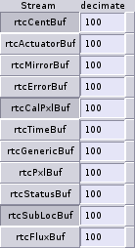
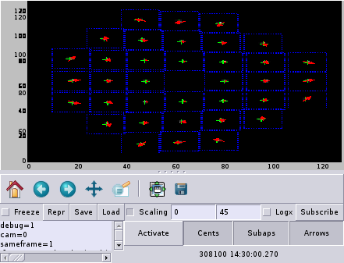
The plotter
Multiple subscriptions
Reformat however you like...
Control local decimation rate
This shows a calibrated image, the current sub-aperture locations and measured slopes
A right click hides/shows the full image (removes the stuff at the bottom)
Click “subscribe” to display currently available streams, and current subscriptions

Slide 97
the plot GUI
A right click gives a menu
  Can then subscribe/unsubscribe
  Change how the data is displayed
  e.g.
  data.shape=128,128
  data=data[30:40]
  dim=1
  axis=numpy.arange(128)
Also shows the min/max values
And gives some user configurable buttons

Slide 98
Plot configuration file example
For complex displays, a plot configuration file can be used
e.g. darcplot conf/plotcalimg1cam.xml
  Note, here again, the plotter is generic – but the xml file has told it how to display the data.
Now turn on adaptive windowing...
  darcmagic set windowMode -string=adaptive

Slide 99
Asynchronous operation
Using multi-rate cameras can give AO performance improvements
  Slower frame rates for fainter guide stars
To make use of this, we have to run DARC in asynchronous mode
  This is done by running several instances of DARC
  Lets have a go...
    darccontrol conf/configAsync.py
    darccontrol conf/configAsync.py --prefix=1
    darccontrol conf/configAsync.py --prefix=11
  darcmagic status (--prefix=1, --prefix=11)
  darcmagic sum rtcTimeBuf 100 -a (--prefix=1, --prefix=11)
    computes average frame time

Slide 100
Asynchronous details
How does this work?
Multiple instances process their pixel data, and perform the reconstruction relevant for this WFS
  in our example, prefix's 1 and 11
The reconstructions are then sent to a “master” DARC instance
  Which combines them and drives the mirror
  The mirror is updated every time the master gets new commands
  The master can be configured to group “slaves” together
    so that update only occurs once all slaves have sent commands
Master receives the partial commands by socket or shared memory
But since it is just a reconstruction module, it can be easily changed

Slide 101
Async partial reconstruction
Reconstruction
matrix
. =
Slope vector
Actuators
. =
--prefix=1
+ =
. =
Master
--prefix=11

Slide 102
To note
Async operation requires multiple instances of DARC
Makes it slightly harder for the end user to interface
  i.e. multiple pixel streams, rather than just one
  multiple control objects
  if this feature is likely to be an asset, should be designed into the end user software from the start

Slide 103
Distributed processing
If you have a CPU cluster:
  Can use the asynchronous operation principals to distribute DARC over available PCs
  Either:
    Split on a sub-aperture basis
      e.g. all cameras → partial reconstruction on separate PCs
        Recombined on another
      Or even split up pixel data using a cable splitter
        e.g. Half pixels to one PC, half to another
          Then partial reconstruction on each, followed by recombination
    Or split on a processing chain basis
      Calibration on one (or more) PC
      Slope processing on another (or >1)
      Reconstruction on another (or >1)
      Mirror control on another (or >1)
        You just need to develop modules to send and receive data at appropriate points
    Or a combination of both
  So – highly scalable

Slide 104
The buffer module
Changing a parameter can be slow
  network delays
  CORBA delays
  python delays
At best it may take several frames to update, before the next parameter can be changed
But what if you want a parameter to change on a frame-by-frame basis?
  (note – for DM offsets, can just send a 2D array – e.g. when poking)
  But for anything else, need to use the buffer module
Currently available: src/rtcbuffer.c
  primarily as an example, but does have a use for pre-known parameters
To be able to stream parameters into DARC (e.g. over TCP/sFPDP/infiniBand etc) need to implement your own

Slide 105
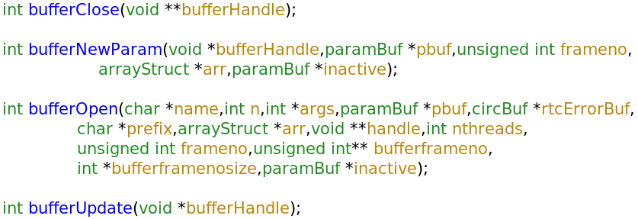
rtcbuffer.h
bufferNewParam – called when the parameter buffer is updated in the standard way
bufferUpdate – called before any newFrameSync functions
  This is called every iteration and can be used to update the active (or inactive) parameter buffers
  e.g. with new data received from a socket
  It can also trigger a parameter buffer swap

Slide 106
bufferUpdate position
bufferUpdate()
called
bufferUpdate()
called
bufferUpdate()
called

Slide 107
Current buffer module src/rtcbuffer.c
librtcbuffer.so
Requires a bufferSeq parameter in the parameter buffer
If this is present, it is used as a sequencer for the bufferUpdate() function
  e.g. allows changing of reference slopes each frame, for example for modulation
    But not in response to feedback

Slide 108
Figure sensing
Open-loop AO systems with non-linear DMs require a figure sensor
  We know what shape we want the mirror to take
    Using on-sky WFSs and wavefront reconstruction
    The “desired shape” (actuators)
  A figure sensing WFS images the DM with a bench laser source
    Gets the actual shape of the DM
    This is adjusted until actual shape matches “desired shape”
    FS WFS usually operates at higher frame rate than on-sky WFS
      Allows several iterations to adjust the DM shape
  But – how do we get the “desired shape” into the FS DARC?
    Using the figure sensing module

Slide 109
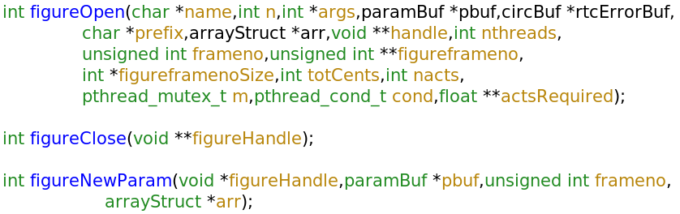
The figure sensing module
3 functions only
The figureOpen function should start a new thread:
  This thread accepts the “desired shape” from the on-sky DARC
  Once a new shape is received, locks the mutex (provided to figureOpen() call)
  Writes required shape to actsRequired
  Signals the condition variable
  unlocks the mutex
The new mirror demands are then calculated and sent immediately – at the on-sky WFS frame rate
Also – the main loop of this FS DARC:
  Reads the WFS, reconstructs, factors in the desired shape, and sends
    At the FS WFS frame rate

Slide 110
Figure sensing examples
For CANARY we used
  src/figureSL240SC.c
    A version for receiving actuators over sFPDP
  src/figureSL240SCPassThrough.c
    A version that received actuators, and placed them straight onto the mirror
      dumb mode – actuators unmodified

Slide 111
Note: As a camera tool...
At Durham, we're also using DARC as a generic camera tool
  Easy to write a camera module for new cameras
    Provided they have Linux drivers...
  We then have a standard, reliable way of getting pixel data, standardised around the lab...
  Saves effort

Slide 112
Kernels
Stock kernels may not be optimised for DARC
  Server kernels can have high latency
  Different kernel numbers offer different performance
Real-time kernels will reduce jitter
  May also improve average latency (but may not)
  Usually available from Distro repository

Slide 113
Notes
DARC isn't a finished product
  Continued future development
    Large array support (>4GB control matrices)
    Additional algorithms
    etc
Can you use it?
  Do you require any modifications?
Have we missed anything?
Bugs?
Anything else?

