Slide 1

Beyond Trigram: Learning to distinguish fake articles
Yanran Hao, Yulan Huang, Ang Lu, Heqing Ya

Slide 2
Task Description
Distinguish fake articles generated by trigram model from real articles
Binary classification problem
Article → Features → Label

Slide 3
Why not (only) trigram
Strong assumption
Focus only on local information
Syntax vs Semantics
Generation != Prediction
<s> IT'S A GREAT LINE THAT I RESIGN SCHOOL BUT THE PRESIDENT HIS TAX BILL PASSED DAYS NOW THE PEOPLE IT'S A TRAGEDY TO SEE </s>

Slide 4
Feature Engineering
Type of features: 12
Category of features:
Semantic
Syntactic
Statistical
Most powerful features:
Perplexity ratio of quad-gram and tri-gram (Avg. cv: 85%, Dev: 88% )
Percentage of phrases repetition (Avg. cv: 71%, Dev: 70% )
Number & percentage of unseen pairs (Avg. cv: 62%, Dev: 63%)

Slide 5
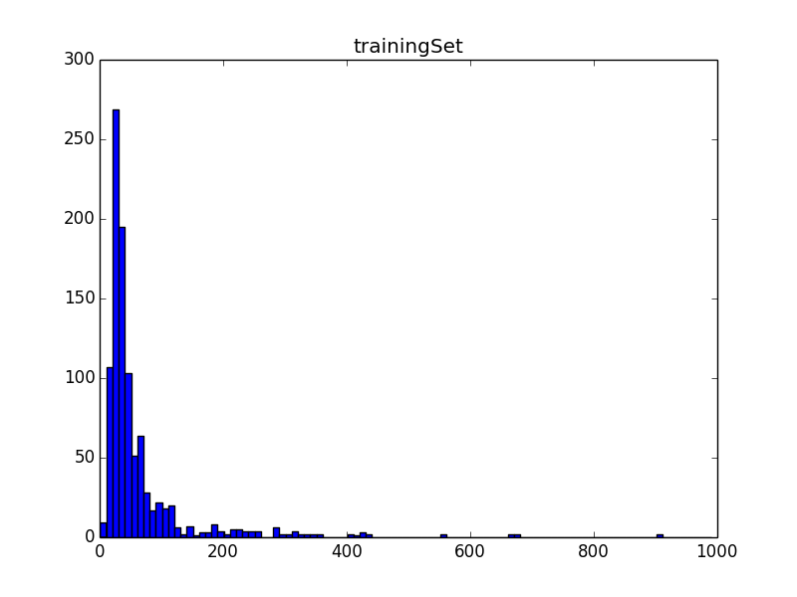
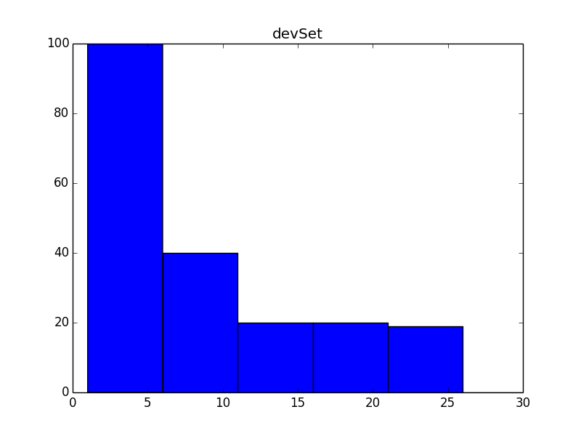
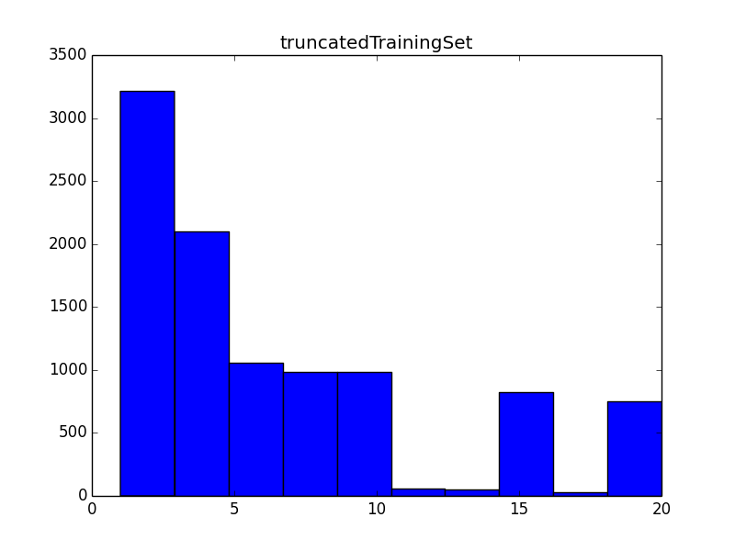
Preprocessing
Handle inconsistent doc length in training and dev set
Notes:
Does this introduce bias?
Maybe. But since we don’t know how the dev and test set are truncated, it’s worth trying. And the results show that we don’t suffer from overfitting.

Slide 6
Choose your classifier
Accuracy
Xgboost
SVM
LR
KNN
Efficiency

Slide 7
Choose your classifier
Accuracy
Xgboost
SVM
LR
KNN
Efficiency

Slide 8
Results

Slide 9
Conclusion
Language
Statistics
XXX
YYY

Slide 10

Thank you!
Trigram

