Slide 1

Beyond Trigram: Learning to distinguish fake articles
Yanran Hao, Yulan Huang, Ang Lu, Heqing Ya

Slide 2
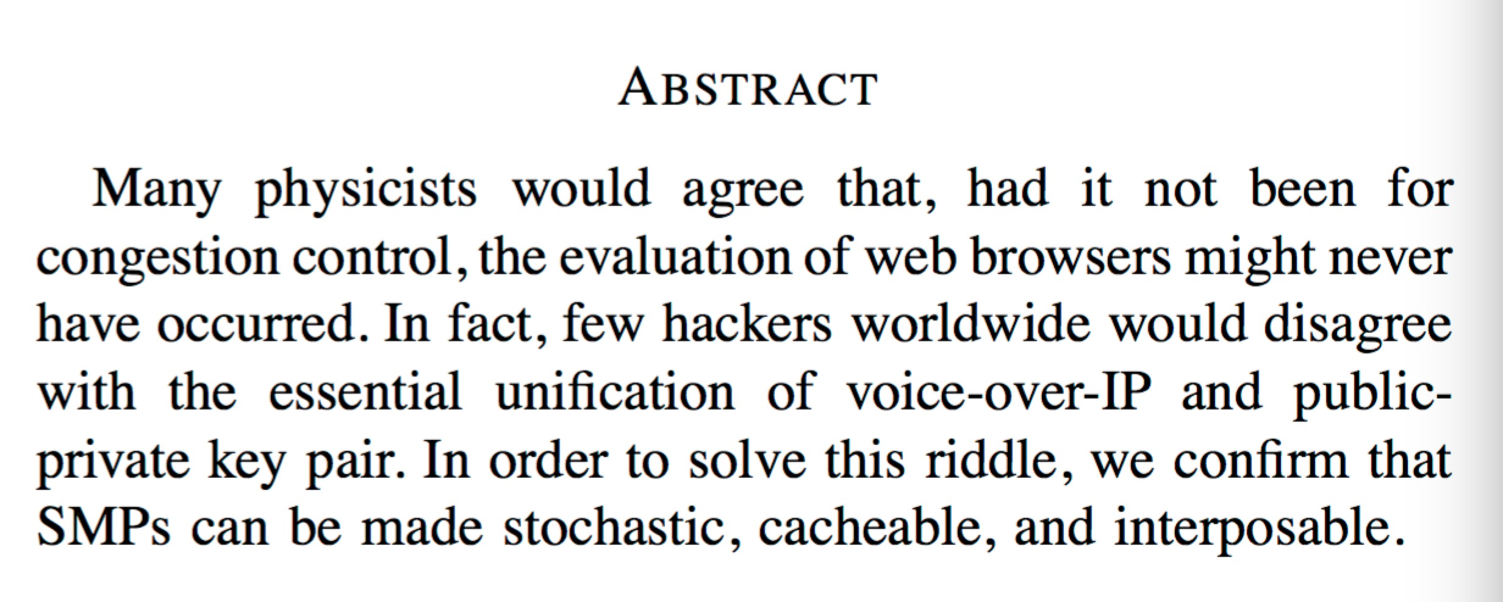
Before We Start

Slide 3
Before We Start
All models are wrong
But some are useful
Others not that useful

Slide 4
Task Description
Distinguish fake articles generated by trigram model from real articles
Binary classification problem
Article → Features → Label

Slide 5
Why not (only) trigram
Strong assumption
Focus only on local information
Syntax vs Semantics
Generation != Prediction
<s> IT'S A GREAT LINE THAT I RESIGN SCHOOL BUT THE PRESIDENT HIS TAX BILL PASSED DAYS NOW THE PEOPLE IT'S A TRAGEDY TO SEE </s>

Slide 6
Feature Engineering
Type of features: 12
Category of features:
Semantic
Syntactic
Statistical
Most powerful features:
Perplexity ratio of quad-gram and tri-gram (Avg. cv: 85%, Dev: 88% )
Percentage of phrases repetition (Avg. cv: 71%, Dev: 70% )
Number & percentage of unseen pairs (Avg. cv: 62%, Dev: 63%)

Slide 7
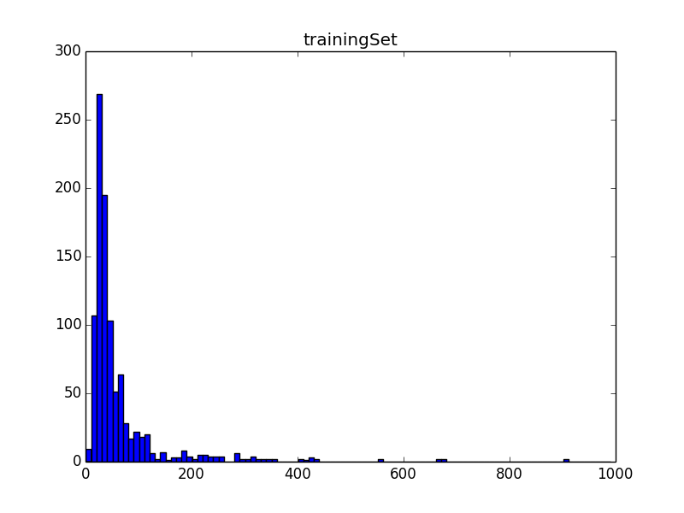
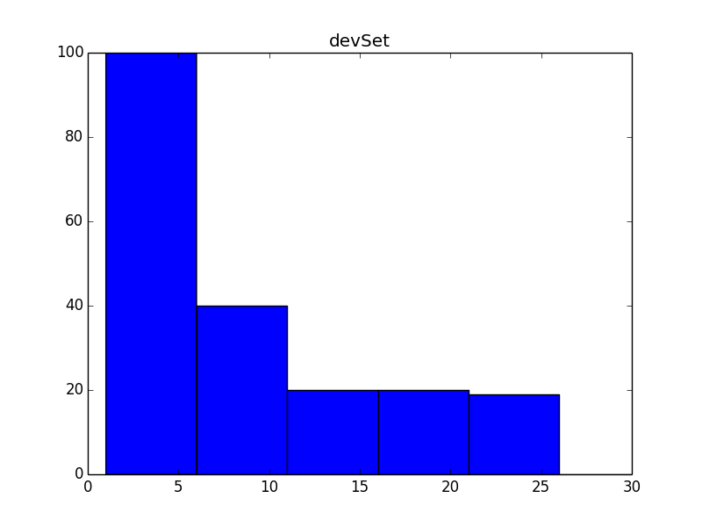
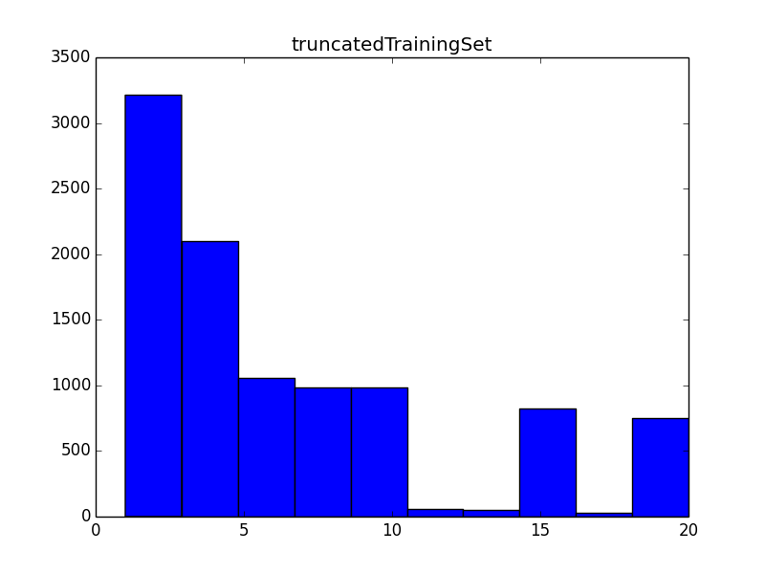
Preprocessing
Handle inconsistent doc length in training and dev set
Notes:
Does this introduce bias?
Maybe. But since we don’t know how the dev and test set are truncated, it’s worth trying. And the results show that we don’t suffer from overfitting.

Slide 8
Choose your classifier
Accuracy
Xgboost
SVM
LR
KNN
Efficiency

Slide 9
Choose your classifier
Accuracy
Xgboost
SVM
LR
KNN
Efficiency

Slide 10
Results
Features | Avg. cv Train | Dev Accuracy | Soft Score
Semantic | 80.2 | 80.0 | 74.9
Syntactic | 52.3
Statistical | 85.4 | 88.0 | 81.7
All | 89.4 | 89.0 | 86.0

Slide 11
Conclusion
Language
Statistics
Language specific knowledge can help us generate better features
Some insights are hard to transform into features. Sometimes we need help from statistics.
Data really helps!
Language insight matters!
Beware to choose the right statistic!

Slide 12

Thank you!
Trigram

