Slide 1
Using JSON Mocks to Speed Up Early Front End Development

Slide 2
Using JSON Mocks to Speed Up Early Front End Development
Who is CoStar?
Leading provider of commercial real estate information, analytics and online marketplaces.
Conducts expansive, ongoing research to produce and maintain the largest and most comprehensive database of commercial real estate information.
Online services enables clients to analyze, interpret and gain unmatched insight on commercial property values, market conditions and current availabilities
Notes:
Before we can talk about using JSON Mocks, we need to understand what JSON is. JSON is short for Javascript Object Notation. Simply put it is an organized, easy to access, human readable collection of data. That follows the the pattern of JavaScript Objects. Almost all modern programming languages support the serialization of objects to JSON and deserialization JSON to objects. In Javascript, you can use the built-n JSON object to serialize and deserialize objects.
If we look at the image we can quickly determine that what the object structure looks like. In this case it is a bowler profile, that contains the normal information about a person and includes and array of leagues, which holds the leagues the bowler belongs to.

Slide 3
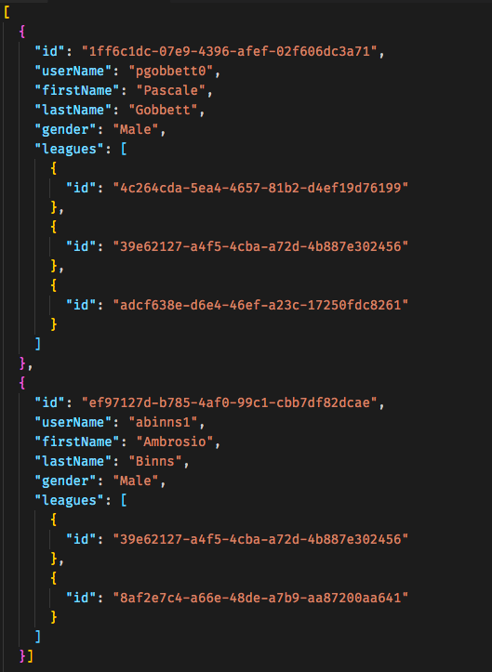
Using JSON Mocks to Speed Up Early Front End Development
JSON….What is it?
Short for JavaScript Object Notation
Human Readable
Easy To Access
Most programming languages support JSON.
JavaScript Deserialize: JSON.parse(someJSONString)
JavaScript Serialize: JSON.stringify(someObject)
Notes:
Before we can talk about using JSON Mocks, we need to understand what JSON is. JSON is short for Javascript Object Notation. Simply put it is an organized, easy to access, human readable collection of data. That follows the the pattern of JavaScript Objects. Almost all modern programming languages support the serialization of objects to JSON and deserialization JSON to objects. In Javascript, you can use the built-n JSON object to serialize and deserialize objects.
If we look at the image we can quickly determine that what the object structure looks like. In this case it is a bowler profile, that contains the normal information about a person and includes and array of leagues, which holds the leagues the bowler belongs to.

Slide 4
Using JSON Mocks to Speed Up Early Front End Development
Example: bowler.json
Represents one single bowler
Represents a collection of bowlers

Slide 5
Using JSON Mocks to Speed Up Early Front End Development
A typical front-end backend setup
Backend
JSON
Front-End
JSON
Notes:
What are we talking about when we say use JSON Mocks to speed up early front end development?
Most new projects consist of at least two layers. The front-end and back-end. Most of the time the front end is some sort of User Interface, though with things like the internet of things, the front end does not necessarily need to be a UI. We normally associate the back-end with storing and retrieving data that our front-end produces and consumes.
As we start a project we are preparing to develop both the front-end and back-end. If your team is large enough, more than one person, these can be done simultaneously.
How do I create the front end if I do not know what the back end is going to look like? We use Mocks. In particular JSON mocks. Most applications today transfer data between the front end and back end using JSON.

Slide 6
Architecture Overview
JSON Mocks Setup
Backend
JSON
Front-End
JSON
Mocks
JSON
JSON
Notes:
To use mocks we can simply insert the json mocks in place of the backend. This removes the depedency on the backend in order to develop the front-end

Slide 7
Why Use JSON Mocks?
Prototyping
Quicker Front-End Iterations
Testing
Notes:
Why use JSON Mocks.
-- Mocks allow us to quickly prototype applications, the remove the need to have a backend system built in order to quickly see if a design will work.
-- Mocks allow us to iterate over the front-end faster. As the backend developers are working on the database and the api routes, you can work on the front-end with the data.
-- Most of the time the same mocks you used to iterate over the front-end, can be used directly in your unit test, because we know that we all do unit testing.

Slide 8
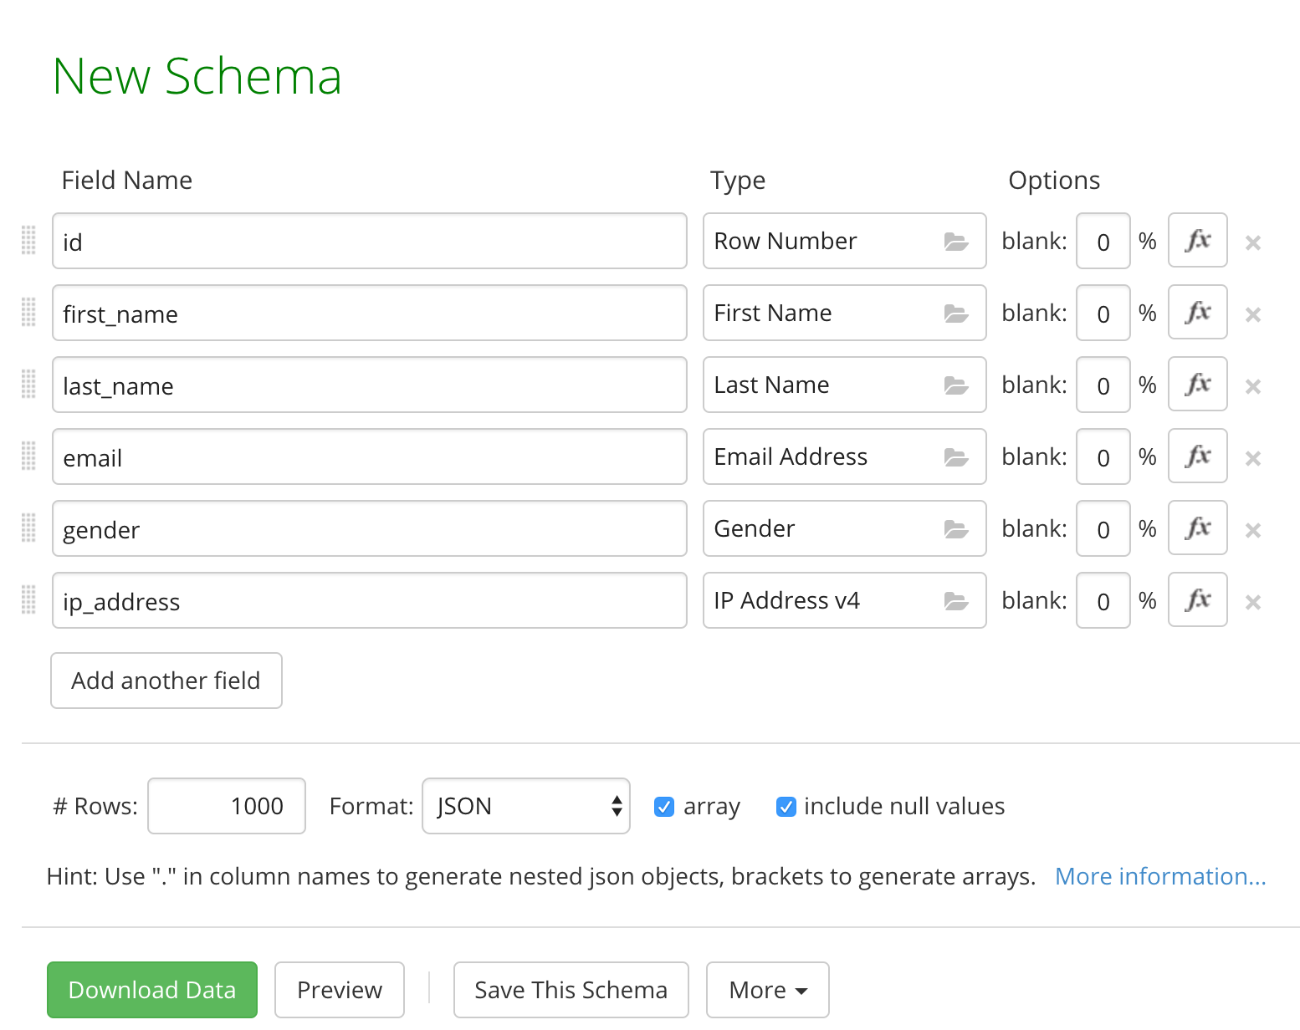
Tools For Creating Mock Data
Are there tools to help me?
Mockaroo (https://www.mockaroo.com)
Faker.js (https://github.com/marak/Faker.js/)
JSON-Server (https://github.com/typicode/json-server)
Notes:
Mockaroo - https://www.mockaroo.com/ - create schemas that can be reused. We will be talking about this one.
Faker.js - demo https://cdn.rawgit.com/Marak/faker.js/master/examples/browser/index.html
JSON-Server Get a full fake REST API with zero coding in less than 30 seconds. (Quick Demo)

Slide 9
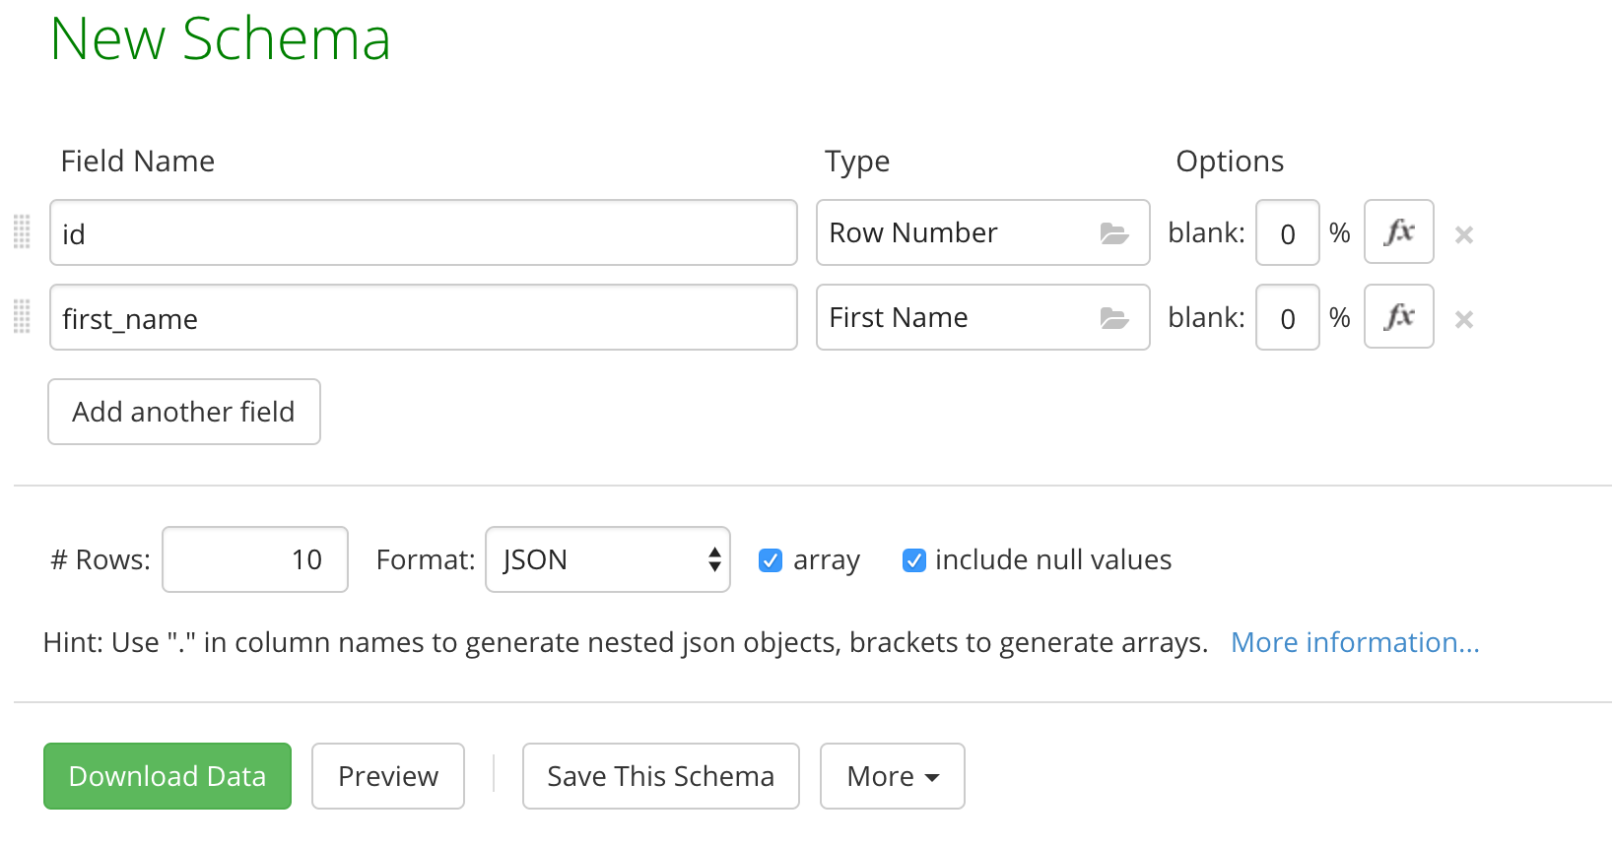
Creating Mocks with Mockaroo.com

Slide 10
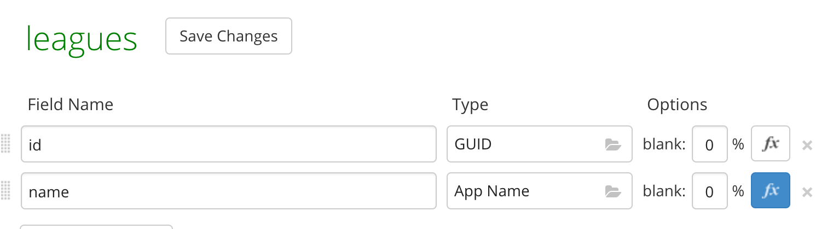
Creating Mocks with Mockaroo.com
Notes:
The small demo application has leagues.

Slide 11
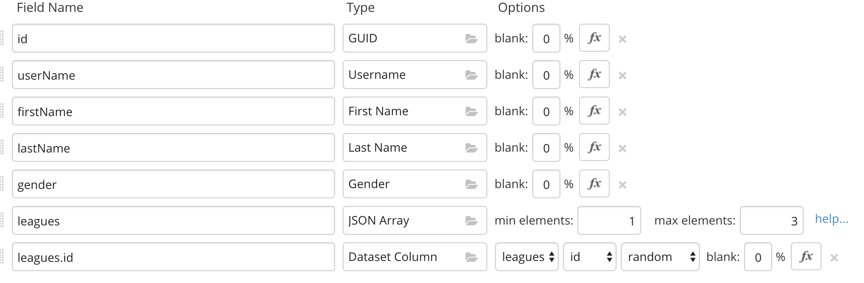
Creating Mocks with Mockaroo.com
Notes:
Our demo application requires us to have a bowler, with an id, username, first name, last name, gender and an array of leagues, which contains the league ids that the bowler bowls on.
So we set up our schema to have look like the image.

Slide 12
Creating Mocks with Mockaroo.com
Results from building the two schemas.
Notes:
After grabbing the objects created bowler JSON will look like the image. -- bring up code in VS Code

Slide 13
Using the Mocks in Code
Create methods that will load your JSON or include the JSON in the file.
Instead of returning JSON from a service just return the JSON from your file.
When you are ready to use the server, just change the method you are getting you data from.
Notes:
Our demo application requires us to have a bowler, with an id, username, first name, last name, gender and an array of leagues, which contains the league ids that the bowler bowls on.
So we set up our schema to have look like the image.

Slide 14
Using JSON Mocks to Speed Up Early Front End Development
Who am I
Front-End Developer at CoStar
Twitter: @normcrandall
GitHub: https://github.com/normcrandall

Slide 15
Code
Mock bowlerApi.js
import bowlers from "../mocks/bowler";
export const get = (id = null) => {
if (id === null) {
return bowlers;
}
return bowlers.find(b => b.id === id);
};
Notes:
Our demo application requires us to have a bowler, with an id, username, first name, last name, gender and an array of leagues, which contains the league ids that the bowler bowls on.
So we set up our schema to have look like the image.

Slide 16
Code
Mock leagueApi.js
export const get = bowlerId => {
let bowler = getBowler(bowlerId);
if (bowler) {
let theleagues = bowler.leagues;
let bowlerLeagues = [];
bowler.leagues.forEach(league => {
let leagueIndex = leagues.findIndex(l => l.id === league.id);
if (leagueIndex > -1) {
bowlerLeagues.push(leagues[leagueIndex]);
}
Notes:
Our demo application requires us to have a bowler, with an id, username, first name, last name, gender and an array of leagues, which contains the league ids that the bowler bowls on.
So we set up our schema to have look like the image.

Slide 17
Code
Mock leagueApi.js
if (leagueIndex > -1) {
bowlerLeagues.push(leagues[leagueIndex]);
bowler.leagues.forEach(league => {
let leagueIndex = leagues.findIndex(l => l.id === league.id);
if (leagueIndex > -1) {
bowlerLeagues.push(leagues[leagueIndex]);
}
});
return bowlerLeagues;
}
return [];
};
Notes:
Our demo application requires us to have a bowler, with an id, username, first name, last name, gender and an array of leagues, which contains the league ids that the bowler bowls on.
So we set up our schema to have look like the image.

Slide 18
Code
Using the Mock Apis
import { get as getBowlers } from "./mockApi/bowlerApi";
import { get as getLeagues } from "./mockApi/leagueApi";
componentDidMount() {
let bowlers = getBowlers();
this.setState({ bowlers: bowlers });
}
Notes:
Our demo application requires us to have a bowler, with an id, username, first name, last name, gender and an array of leagues, which contains the league ids that the bowler bowls on.
So we set up our schema to have look like the image.

Slide 19
Code
Real bowlerApi.js
export const get = async id => {
if (id) {
let response = await fetch(`/api/bowler/${id}`);
let bowler = await response.json();
return bowler;
} else {
let response = await fetch("api/bowler");
let bowlers = await response.json();
R eturn bowlers;
}
};
Notes:
Our demo application requires us to have a bowler, with an id, username, first name, last name, gender and an array of leagues, which contains the league ids that the bowler bowls on.
So we set up our schema to have look like the image.

Slide 20
Code
Real leagueApi.js
export const getBowlerLeagues = async bowlerId => {
let response = await fetch(`/api/leagues/bowler/${bowlerId}`);
let leagues = await response.json();
return leagues;
};
Notes:
Our demo application requires us to have a bowler, with an id, username, first name, last name, gender and an array of leagues, which contains the league ids that the bowler bowls on.
So we set up our schema to have look like the image.

