Slide 1
Hardware–Software Co-Design of a Multiplier-Less SiLU Custom Instruction for RISC-V
In-order vs out-of-order in gem5, with YOLOv8n as the workload
Ayush Krishna · B.Tech Electronics & VLSI, VIT Vellore · BAEVD202 Computer Architecture
Notes:
One-line pitch: does a SiLU instruction actually pay off once you measure it with the iron law and Amdahl's law?

Slide 2
Does the instruction actually pay off?
SiLU(x) = x · σ(x)
Needs an exponential and a division. On a simple RISC-V core that is a library call: about 114 instructions.
Iron law
T = IC × CPI × clock
Amdahl's law
bounded by the activation share
The question
Not “is the circuit small?” but: how do instruction count, CPI and clock change on in-order and out-of-order cores, and how much of a real network does it touch?
Hazards
latency and pipelining
Branch prediction
software f4 is a compare chain
Notes:
SiLU = x*sigmoid(x), used in YOLOv8. No hardware exp on a simple core, so software uses a library call. The question is architectural, not circuit-level.

Slide 3
The approximation: six segments, no multiplier
x ≤ −4: 0
−4 < x ≤ −1: −x/16 − 0.375
−1 < x ≤ 0: x/4 − 0.037
0 < x ≤ 1: 3x/4 − 0.037
1 < x ≤ 4: x + x/16 − 0.375
x > 4: x
0.028
0.072
mean abs. error on (−4,4)
max error at the edges
191
8.06 ns
logic elements, 0 multipliers
data delay (Quartus)
Divisions are arithmetic shifts. No multiplier, no table, no memory.
Checked on all 65,536 inputs: RTL, C, PyTorch and the gem5 instruction agree with the golden model, 0 mismatches.
Notes:
Spagnolo, Perri, Corsonello, ISVLSI 2025. Q6.10 fixed point, constants 384 and 38. Max error and mean error over (-4,4).

Slide 4
Synthesis delay to gem5 latency, by script
RTL
Quartus
run_gem5.py
gem5
→
→
→
silu.v, combinational
8.058 ns, 191 LEs
latency = ceil(d / T)
custom op class + own FU
Latency at each clock (8.058 ns delay)
100 MHz → 1 cycle 200 MHz → 2 500 MHz → 5
1 GHz → 12 stages (pipelined) or 9 cycles (multi-cycle)
Custom-0 opcode 0x0B, rd = f4(rs1). Same binaries run on MinorCPU (in-order) and O3CPU (out-of-order). 296 gem5 runs.
Notes:
The professor's objection: hand-typing '1 cycle' into gem5. Now run_gem5.py computes latency from the Quartus delay and the clock. Multi-cycle: ceil(d/T). Pipelined: smallest N with d/N + 0.3 ns <= T (0.3 ns is an assumption).

Slide 5
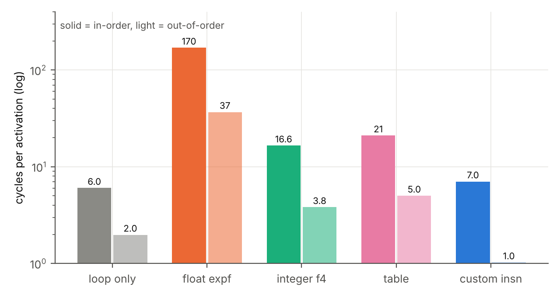
Iron law: the loop is 24–36× faster than expf
24×
36×
vs expf, in-order
vs expf, out-of-order
2.4×
3.7×
vs integer f4, in-order
vs integer f4, out-of-order
6 instructions per activation (5 are loop overhead) vs 12.8 for integer f4 and 114 for expf. Out-of-order reaches 1.03 cycles: the front end is the limit. CPI alone misleads: in-order CPI rises vs the table (1.17 vs 1.00) yet it is 3× faster.
Notes:
Table: one loop of 1024 inputs in [-4,4), 20 passes, 100 MHz, latency 1. The 10.8x headline was a loop number vs the weakest baseline. Only 2.4x/3.7x vs integer f4.

Slide 6
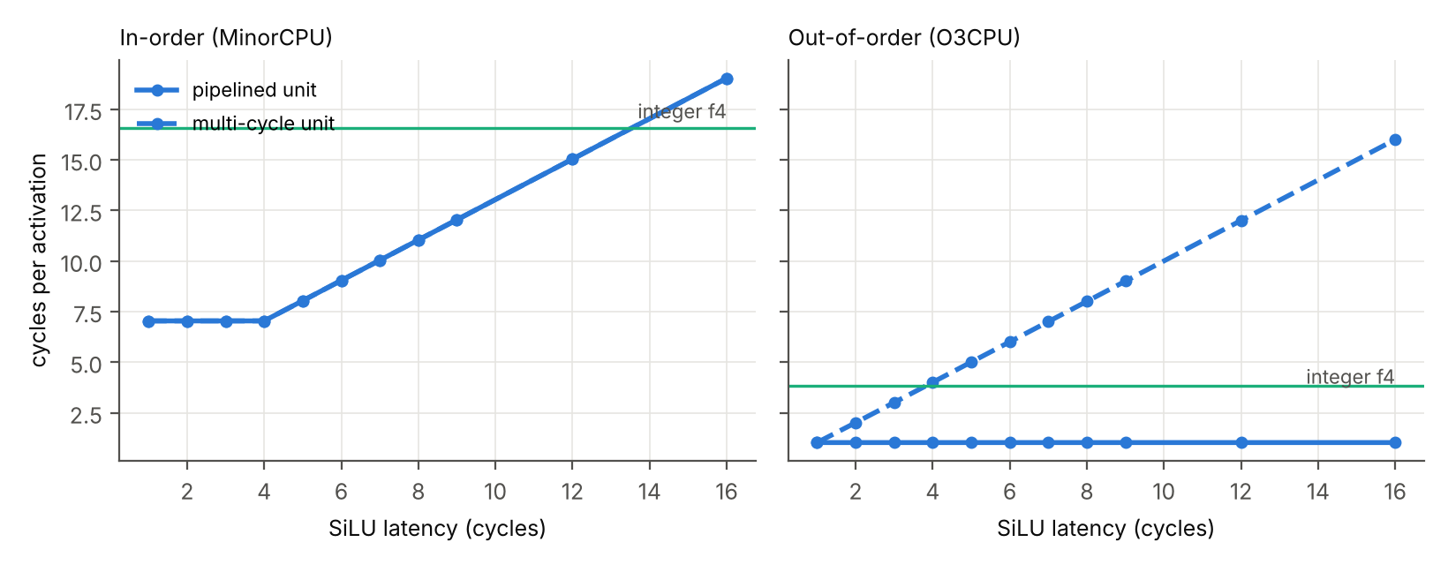
Hazards: pipeline the unit for out-of-order
Out-of-order: pipelined hides every latency to 16 cycles (1.03). Unpipelined 5-cycle unit at 500 MHz is 0.76× the speed of integer f4.
Notes:
In-order: flat to latency 4 then one-for-one. OoO pipelined hides 16 cycles, unpipelined exposes all of it: structural hazard.

Slide 7
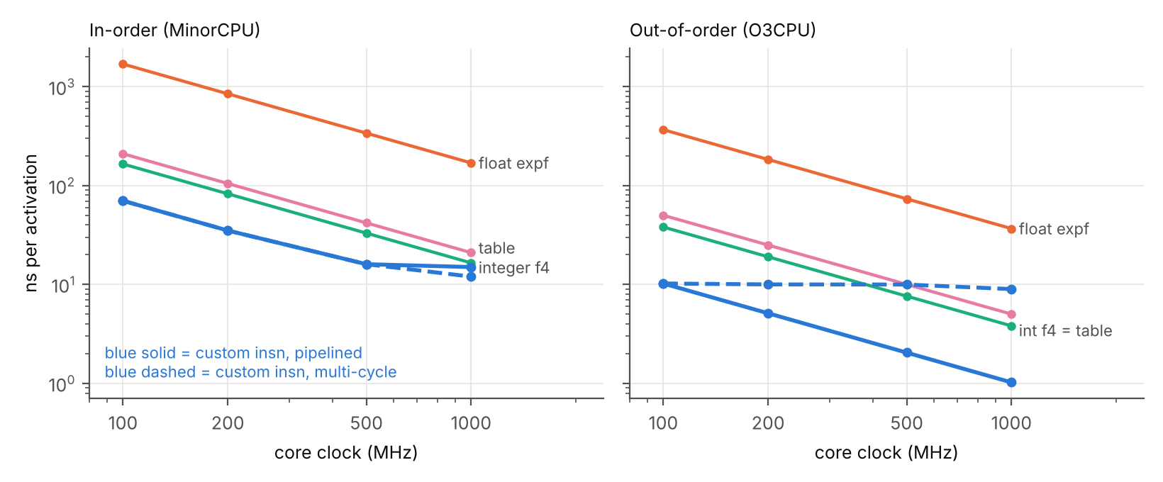
Faster clock means more cycles of latency
Clocks above about 123 MHz extrapolate an FPGA slow-corner delay: illustrative.
Notes:
At 1 GHz in-order: 1.1x (12-stage) to 1.4x (9-cycle multi-cycle) vs integer f4. Above 123 MHz the FPGA delay is extrapolated.

Slide 8
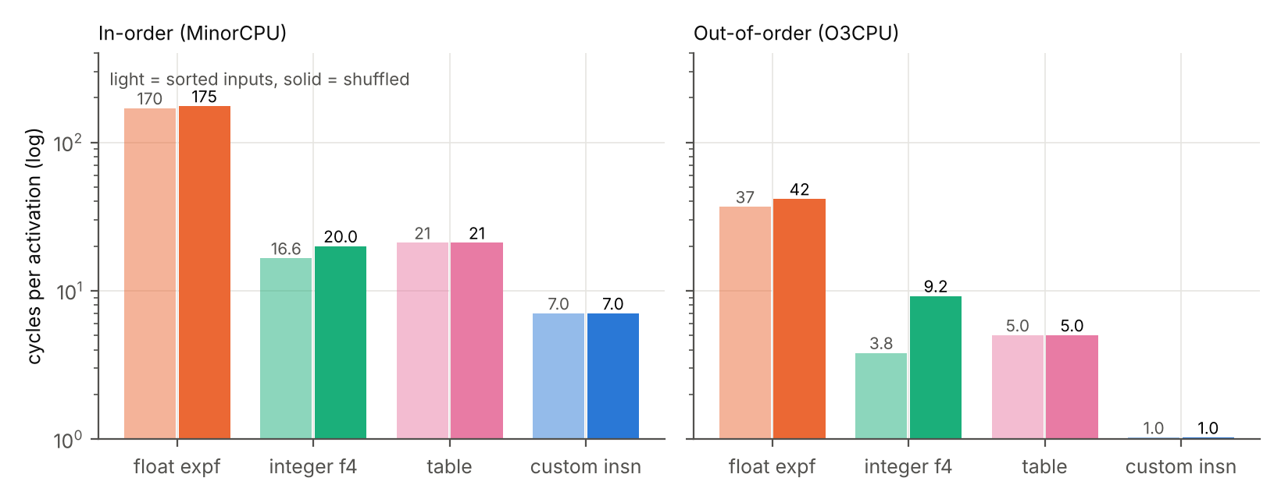
Branch prediction flatters sorted inputs
0.41
9.0×
mispredicts per activation (f4)
instruction vs f4, OoO, shuffled
The table and the instruction have no data-dependent branch. With shuffled data the OoO core takes 9.2 cycles for software f4 and 1.03 for the instruction: much of the gap is removed mispredictions, not just fewer instructions.
Notes:
Software f4 is a compare chain. Sorted inputs are perfectly predictable. Shuffled: 0.41 mispredicts per activation, +3.4 cycles in-order, +5.4 OoO.

Slide 9
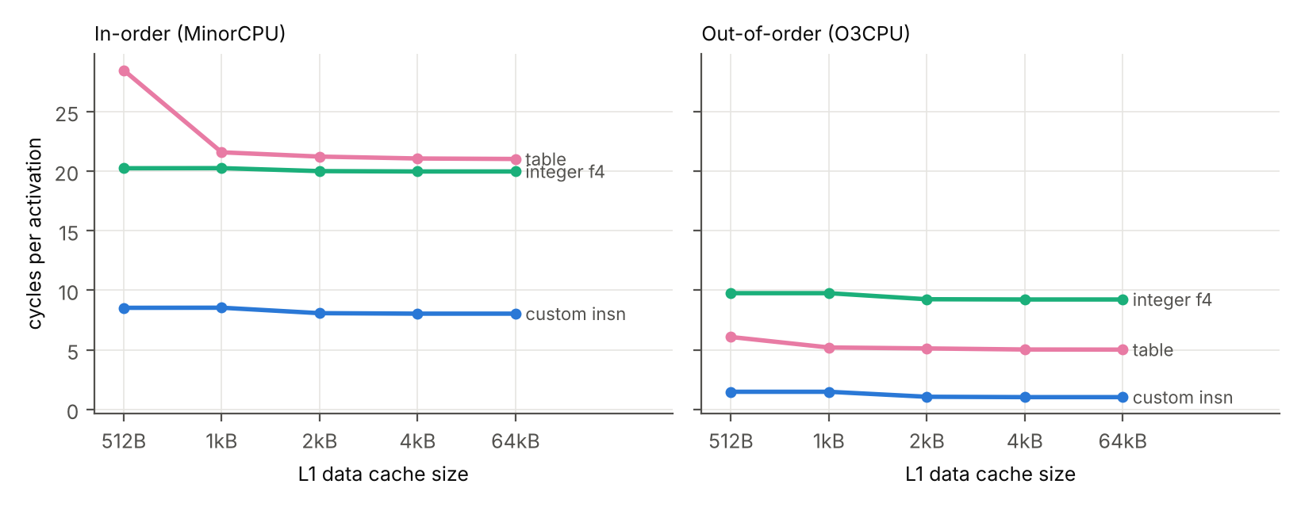
Controls: code placement and cache pressure
1–4 cycles
OoO instruction loop swings with code alignment alone
Placement noise
Differences of ±1–3 cycles between cheap variants are not conclusions. Only expf is cleanly separated in the conv layer.
Cache
Shrinking L1D to 512 B costs the table 35% in-order, 21% OoO; ≥1 kB costs ≤3%. The win over the table is mainly instruction count.
Notes:
Alignment: OoO custom loop 1.0 to 4.0 cycles by alignment. Cache: table 21.0 -> 28.5 in-order at 512 B; fine at 1 kB+.

Slide 10
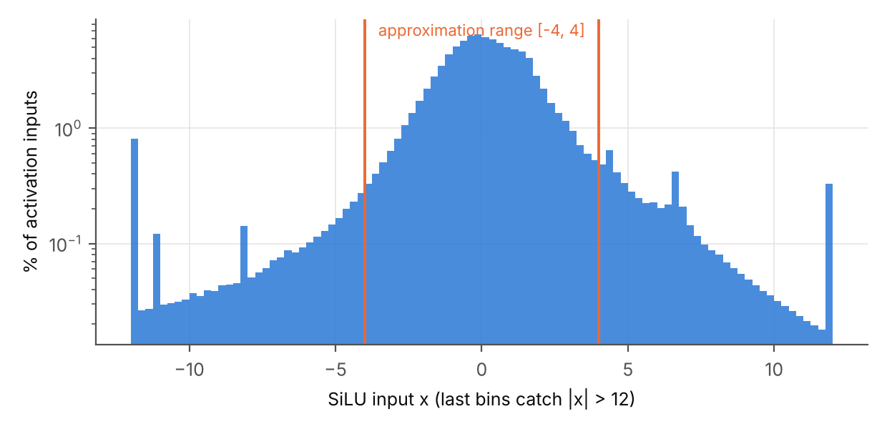
In YOLOv8n: accuracy cost is within noise
Activation | mAP50 | mAP50–95 | Δ
exact SiLU | 0.6024 | 0.4439 | —
exact, Q6.10 rounding | 0.5924 | 0.4374 | −0.0066
f4 (strict 16-bit) | 0.5991 | 0.4359 | −0.0081
257-entry table | 0.5958 | 0.4373 | −0.0066
8.8% of real activation inputs fall outside [−4,4], so the tails matter in a real model.
Most of the drop is Q6.10 rounding itself. f4 adds about 0.0015 mAP50–95, below the noise of 128 images.
Notes:
57/57 SiLU modules replaced, 969 calls confirmed. COCO128, 128 images: relative comparison only, not a published mAP. 8.8% of inputs outside [-4,4].

Slide 11
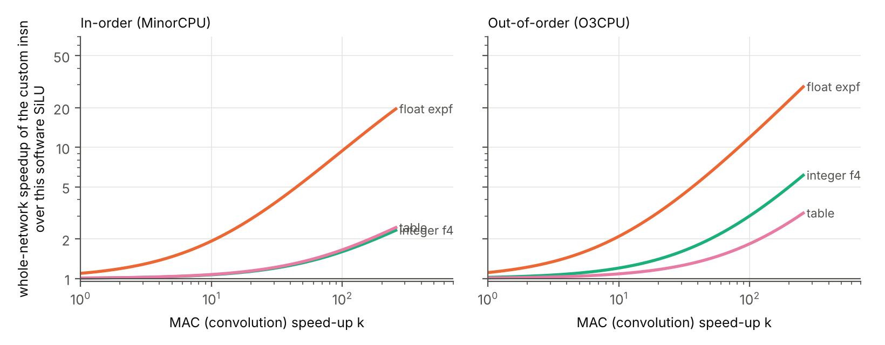
Amdahl: small on scalar cores, large with fast MACs
1.1×
1.01×
vs expf, scalar core
vs integer f4
2.5–2.7×
vs expf if MACs are 16× faster
The instruction matters when the multiply-accumulate part is accelerated, not on a scalar core.
Notes:
YOLOv8n 4.37 GMAC, 13.9 M SiLU elements, 315 MACs per activation. Cycles/MAC from conv layer, cycles/activation from shuffled loop at 500 MHz. Estimate, not a simulation of YOLOv8n.

Slide 12
Conclusions
24–36× on the loop vs expf, but 2.4–3.7× vs integer C
~1.1× whole network on a scalar core; 2.5–2.7× if MACs are 16× faster
Must be pipelined for out-of-order; unpipelined it is slower than integer C
Latency is derived from synthesis by script, not typed by hand
Accuracy cost beyond Q6.10 rounding ≈ 0.0015 mAP50–95 (128 images)
Limits: one loop and one scalar conv layer; ±1–3 cycle placement noise; FPGA slow-corner delay; 0.3 ns/stage assumed. Future work: GPU (Vortex) comparison.
github.com/normie2099/SiLU-Architecture
Notes:
Close with honest limits and future work (GPU/Vortex comparison).

