Slide 1
MobileCropNet 학습 데이터 생성
온디바이스 이미지 크롭핑을 위한 후보 중심, Teacher 라우팅, 정책 인식 라벨 팩토리
Source
C1-C7
Route
Candidates
Teacher
Labels
Benchmark
- 대상 문서: Implement_Docs/MobileCropNet_Training_Data_Generation_Master_Report_KO_2026-04-24.md
- 학술보고용 core deck + appendix 구조로 렌더링
- 핵심 결론: teacher ceiling보다 student internalization이 현재 병목
MobileCropNet Training Data Generation Master Report, 2026-04-24
1/38

Slide 2
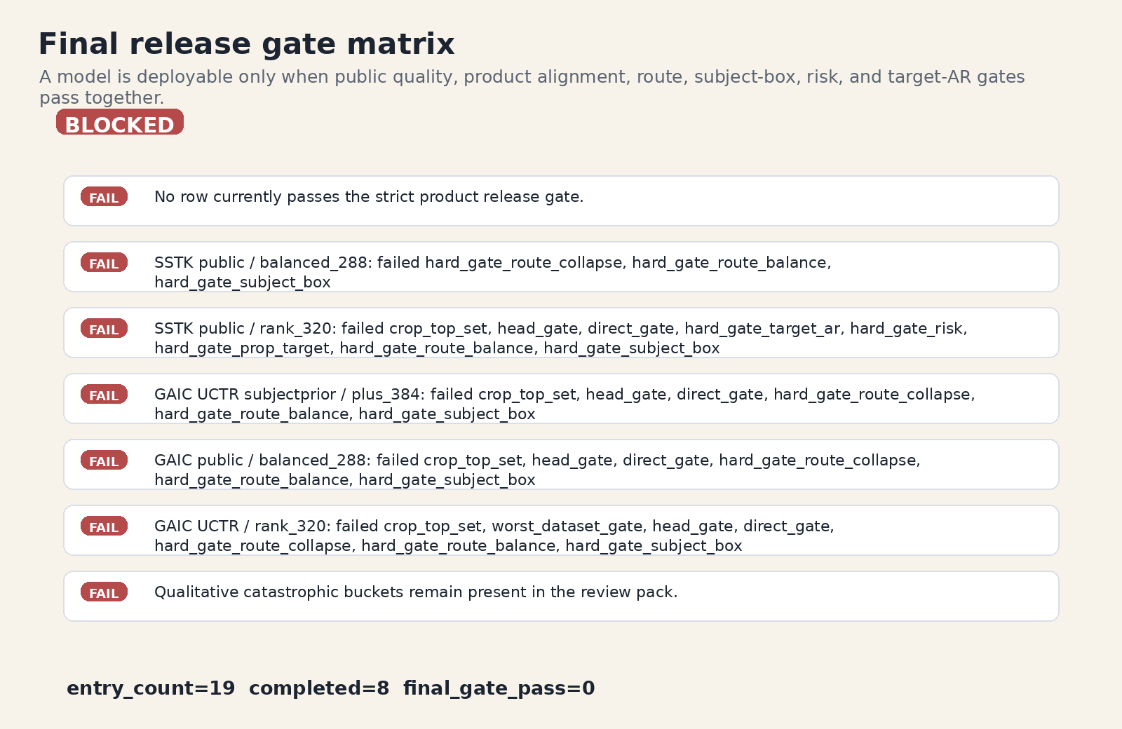
한 장 요약
Core
현재 문제는 좋은 teacher가 없는 것이 아니라, no-prior student가 route, subject, policy, explanation 구조를 충분히 내재화하지 못하는 것이다.
- production_final_hybrid는 equal-4 raw 0.882696, z 1.148158로 강한 teacher ceiling을 보임
- 최종 student shortlist 19/19가 route-collapse hard gate 실패
- 다음 개선은 route-balanced sampling, subject-aware proposal, portrait-sensitive checklist에 집중
Final release gate pass/fail matrix
MobileCropNet Training Data Generation Master Report, 2026-04-24
2/38

Slide 3
왜 단일 BBox 회귀가 아닌가
Core
동일 이미지라도 target AR, 인물/객체/장면 구조, 텍스트와 copy-space, 안전한 잘림 여부에 따라 정답 crop이 달라진다.
Candidate Ranking
MOS Benchmarks
Coordinate Regression
VLM / Intent
MobileCropNet Label Factory structured contract
Subject-aware Composition
MobileCropNet Training Data Generation Master Report, 2026-04-24
3/38

Slide 4
문제 정식화
Core
학습 label은 하나의 box가 아니라 candidate availability, local ranking, policy decision, explanation consistency를 동시에 담는 contract다.
Image I + target r
Candidate set C(I,r)
Candidate Error
Ranking Error
Policy Error
Explanation Error
E_total = E_candidate + E_ranking + E_policy + E_explain
MobileCropNet Training Data Generation Master Report, 2026-04-24
4/38

Slide 5
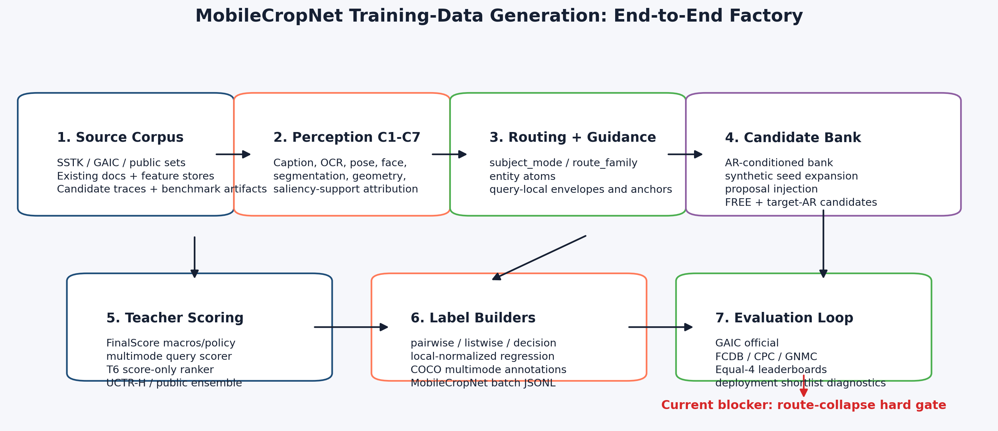
End-to-End Label Factory
Core
source corpus부터 benchmark feedback까지 이어지는 데이터 팩토리가 MobileCropNet의 행동 공간을 정의한다.
Source Corpora
Curation + Splits
C1-C7 Precompute
Routing Guidance
Candidate Bank
Teacher Scoring
Student Contract
Benchmark Feedback
Existing pipeline overview
MobileCropNet Training Data Generation Master Report, 2026-04-24
5/38

Slide 6
Source Corpus Roles
Core
SSTK는 product semantics를, GAIC는 public MOS/ranking benchmark signal을 제공한다. 두 source를 같은 의미로 합치면 안 된다.
SSTK route / decision checklist / safety provenance
GAIC dense candidates MOS / public ranking official split
Image-level deterministic split leakage guard
- SSTK: route, decision, checklist, safety, provenance 중심
- GAIC: dense candidate MOS와 public ranking 중심
- split은 image-level deterministic policy로 관리해 leakage를 막는다
MobileCropNet Training Data Generation Master Report, 2026-04-24
6/38

Slide 7
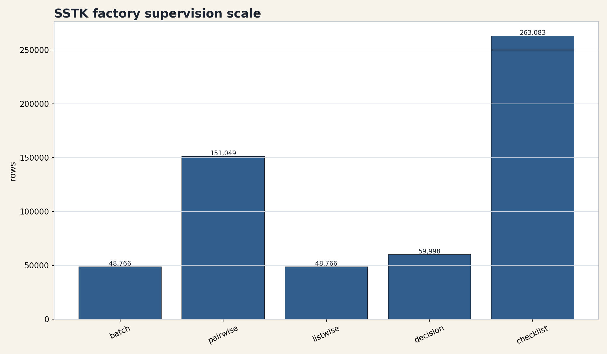
SSTK Factory Scale
Core
10,000 curated image는 image-targetAR task와 sidecar supervision으로 확장되어 단순 coordinate dataset보다 훨씬 조밀한 학습 신호를 만든다.
10,000 Curated images
48,766 Batch rows
151,049 Pairwise rows
48,766 Listwise rows
341,665 Candidate slots
7,533,038 Candidate bank
SSTK factory supervision scale
MobileCropNet Training Data Generation Master Report, 2026-04-24
7/38

Slide 8
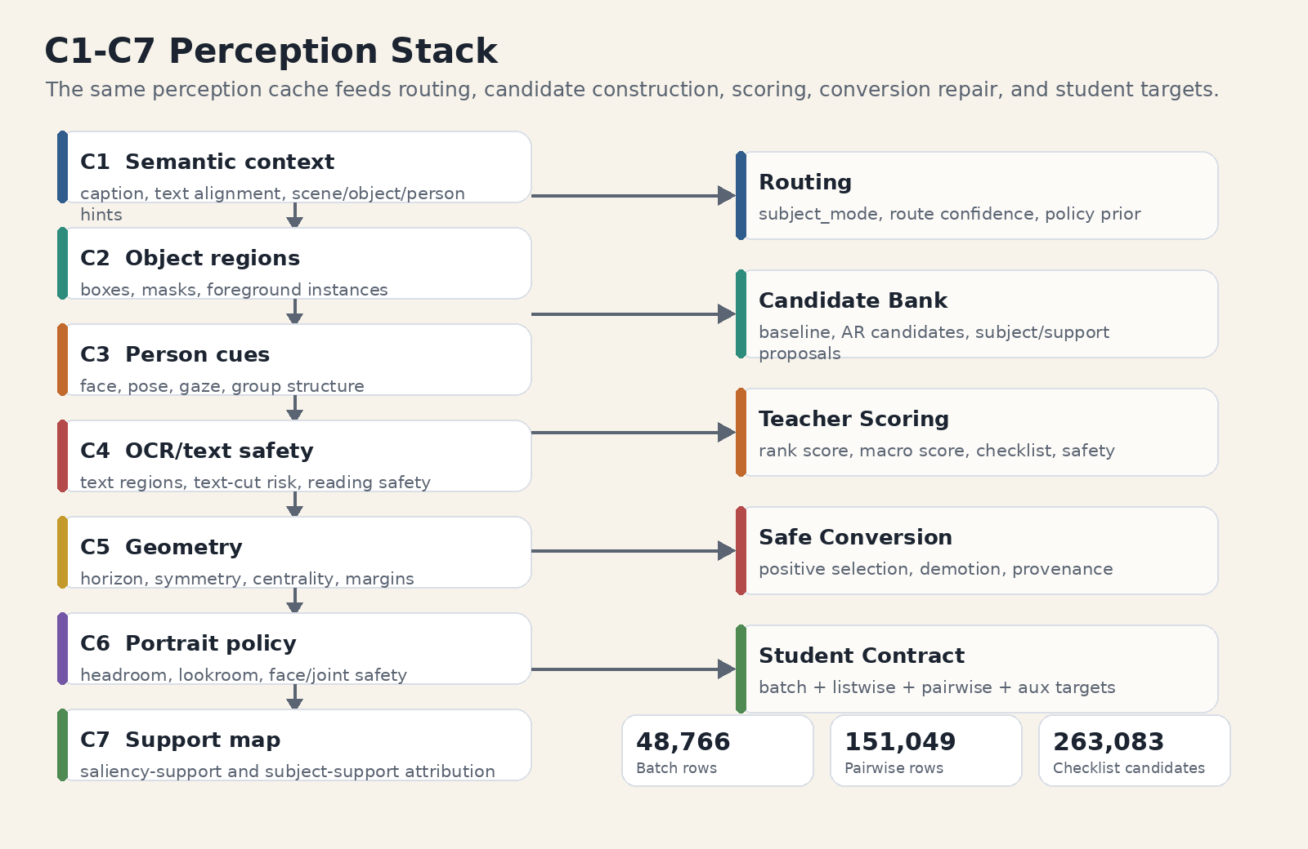
C1-C7 Perception Stack
Core
C1-C7은 feature cache가 아니라 routing, candidate generation, scoring, label repair가 공유하는 관측 기반이다.
- C1 caption/semantic, C2 object/segmentation, C3 face/pose/gaze
- C4 OCR/copy-space, C5 geometry, C6 portrait refinement, C7 saliency-support
- downstream label은 이 관측을 route, subject, checklist, risk target으로 번역
C1-C7 stack and downstream label uses
MobileCropNet Training Data Generation Master Report, 2026-04-24
8/38

Slide 9
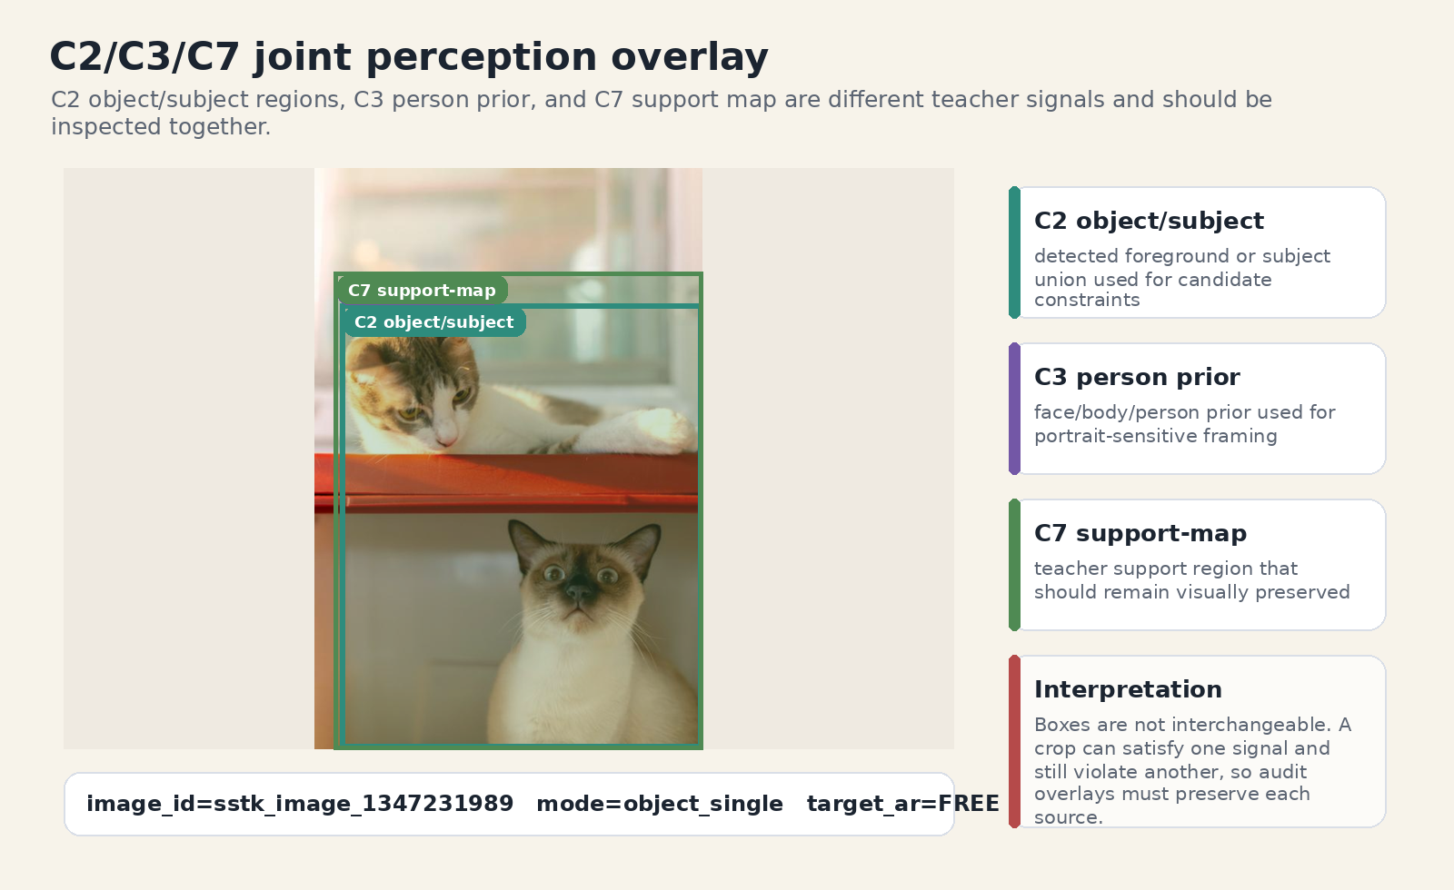
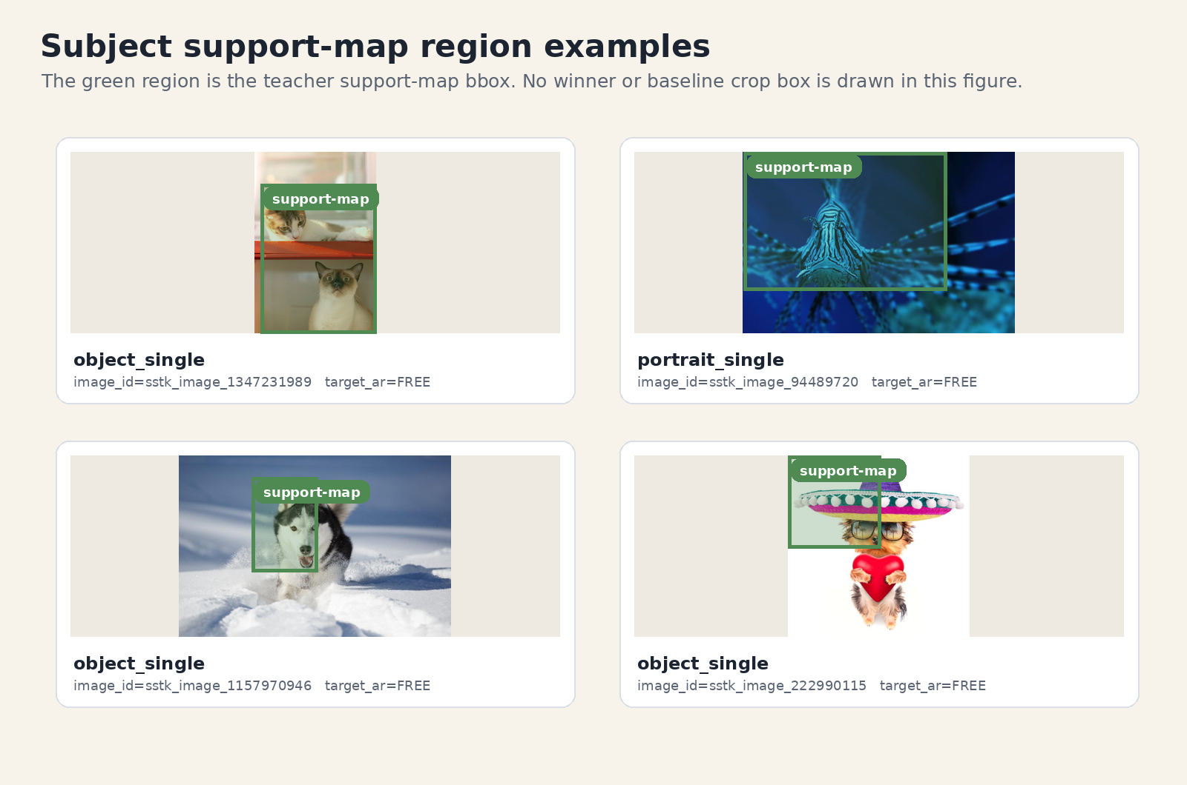
Subject Support Is Not Crop Box
Core
C2 object box, C3 person prior, C7 support map은 서로 다른 supervision이며 winner crop과 동일시하면 안 된다.
C2/C3/C7 joint perception overlay
Subject support-map region examples
MobileCropNet Training Data Generation Master Report, 2026-04-24
9/38

Slide 10
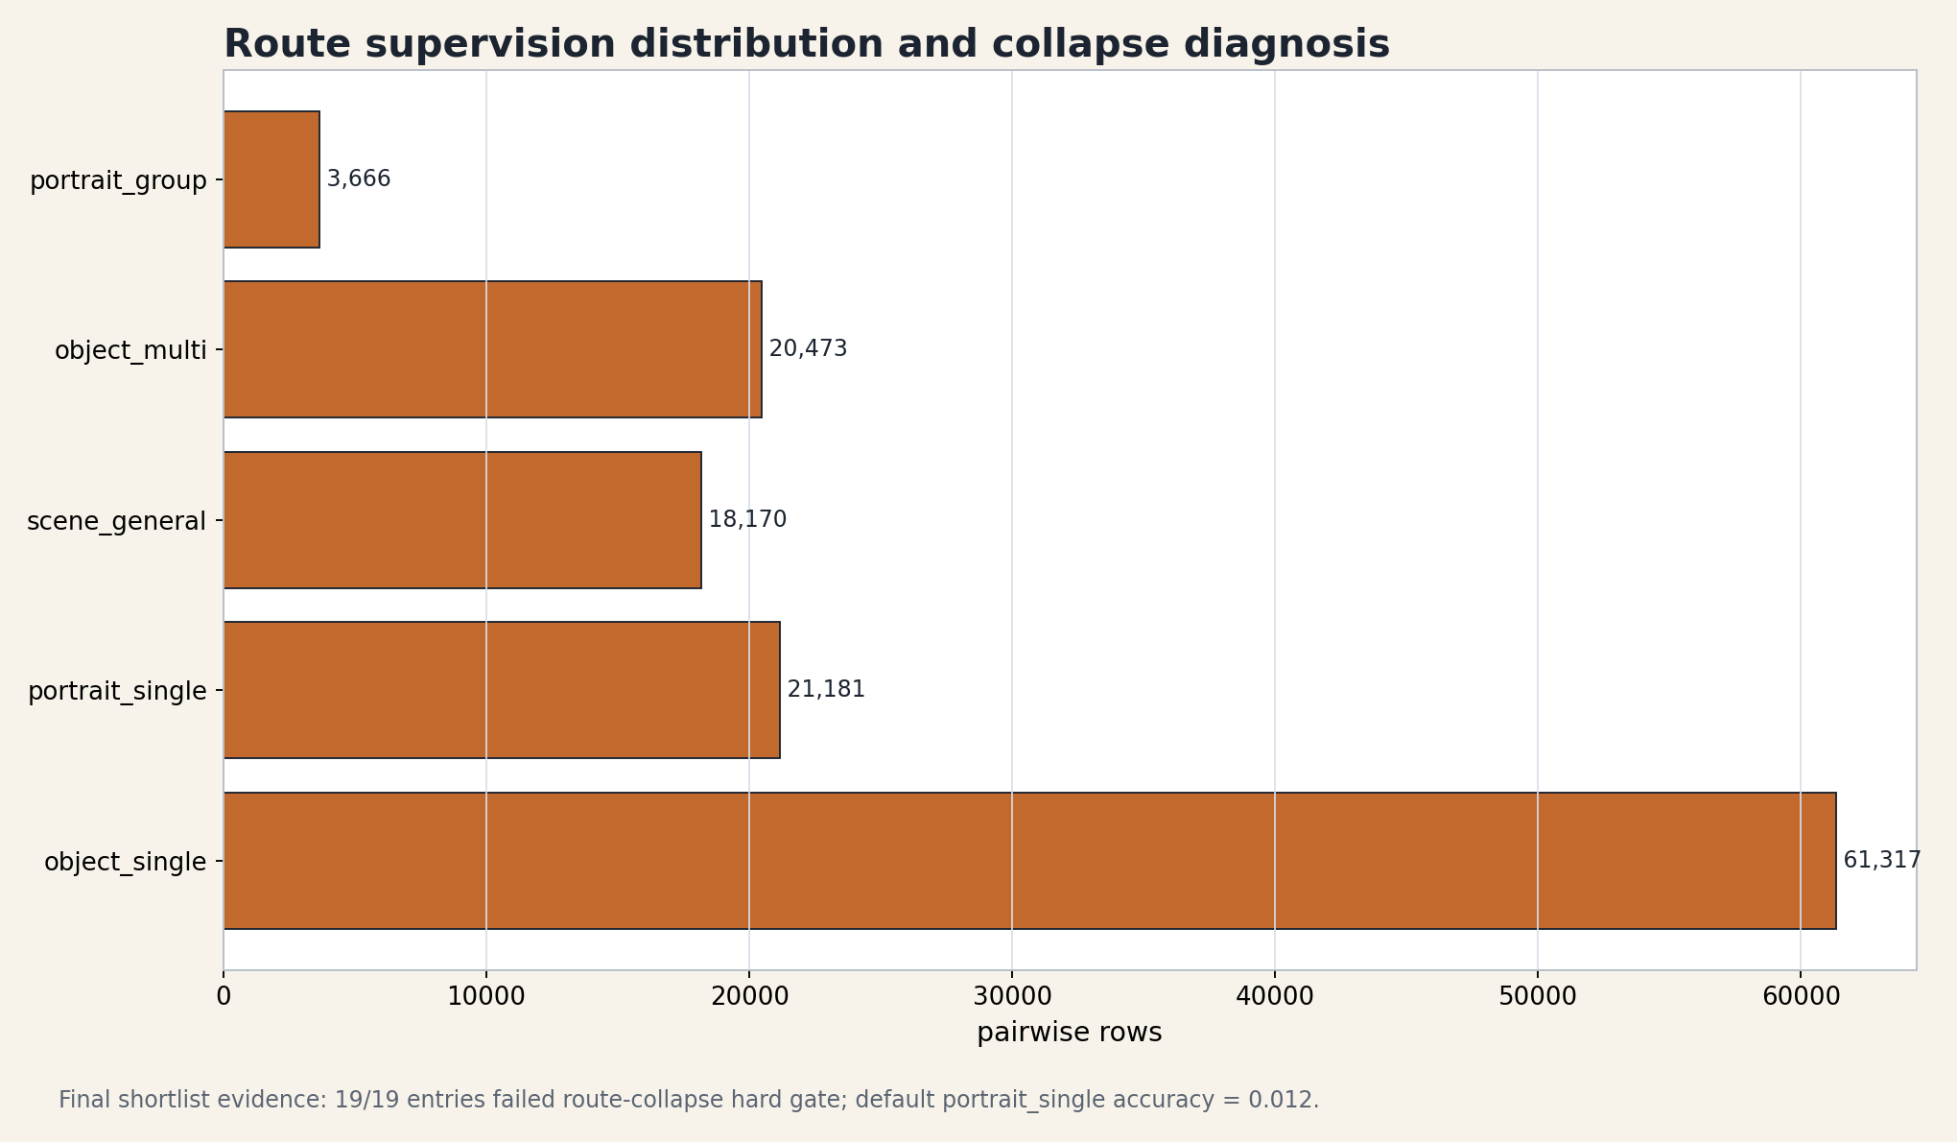
Routing as Policy Control
Core
subject_mode는 auxiliary label이 아니라 candidate seed, scoring weights, checklist applicability, action decision을 바꾸는 control variable이다.
subject_mode policy prior
Candidate Seeds
Scoring Weights
Checklist Applicability
Action Decision
Failure path: collapse to object_single wrong candidates + weak portrait checklist + wrong action
MobileCropNet Training Data Generation Master Report, 2026-04-24
10/38

Slide 11
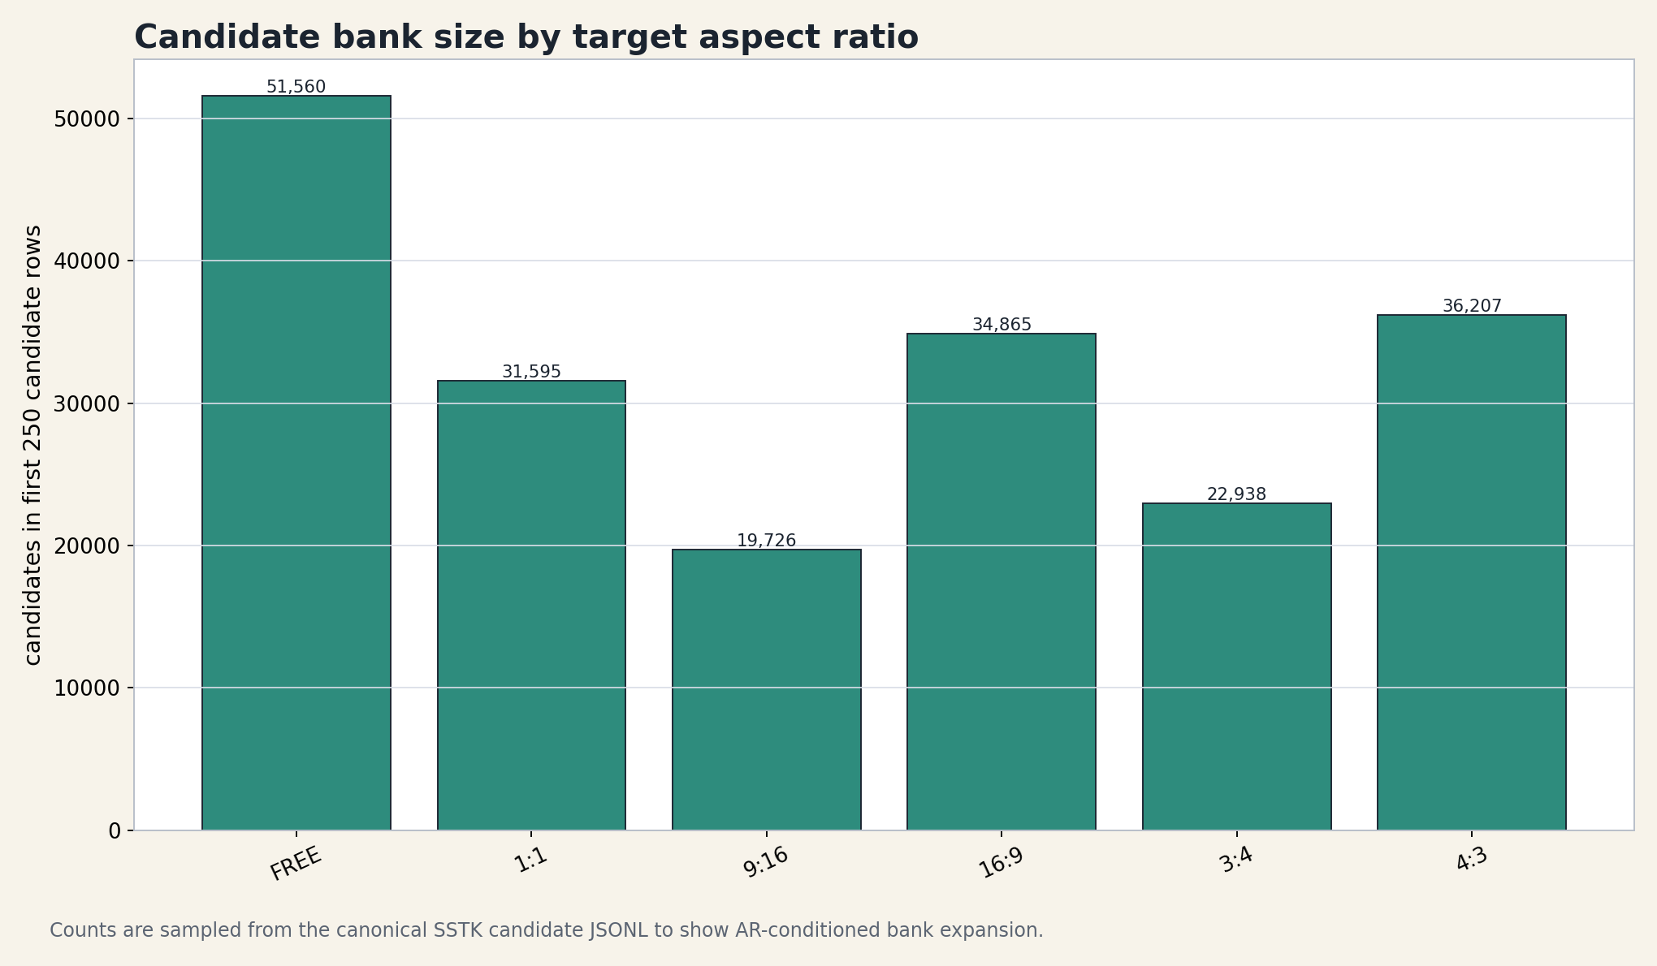
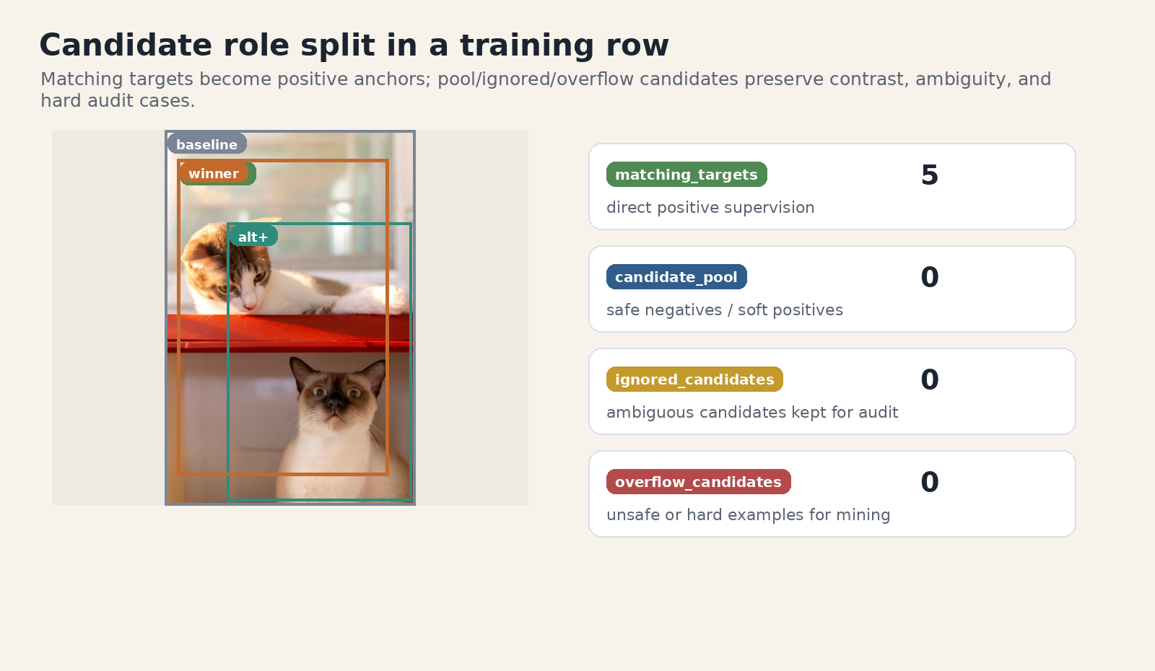
Candidate Bank and Roles
Core
좋은 crop이 후보 bank에 없으면 ranking, policy, explanation head가 복구할 수 없다.
Candidate bank by target AR
Candidate role split
MobileCropNet Training Data Generation Master Report, 2026-04-24
11/38

Slide 12
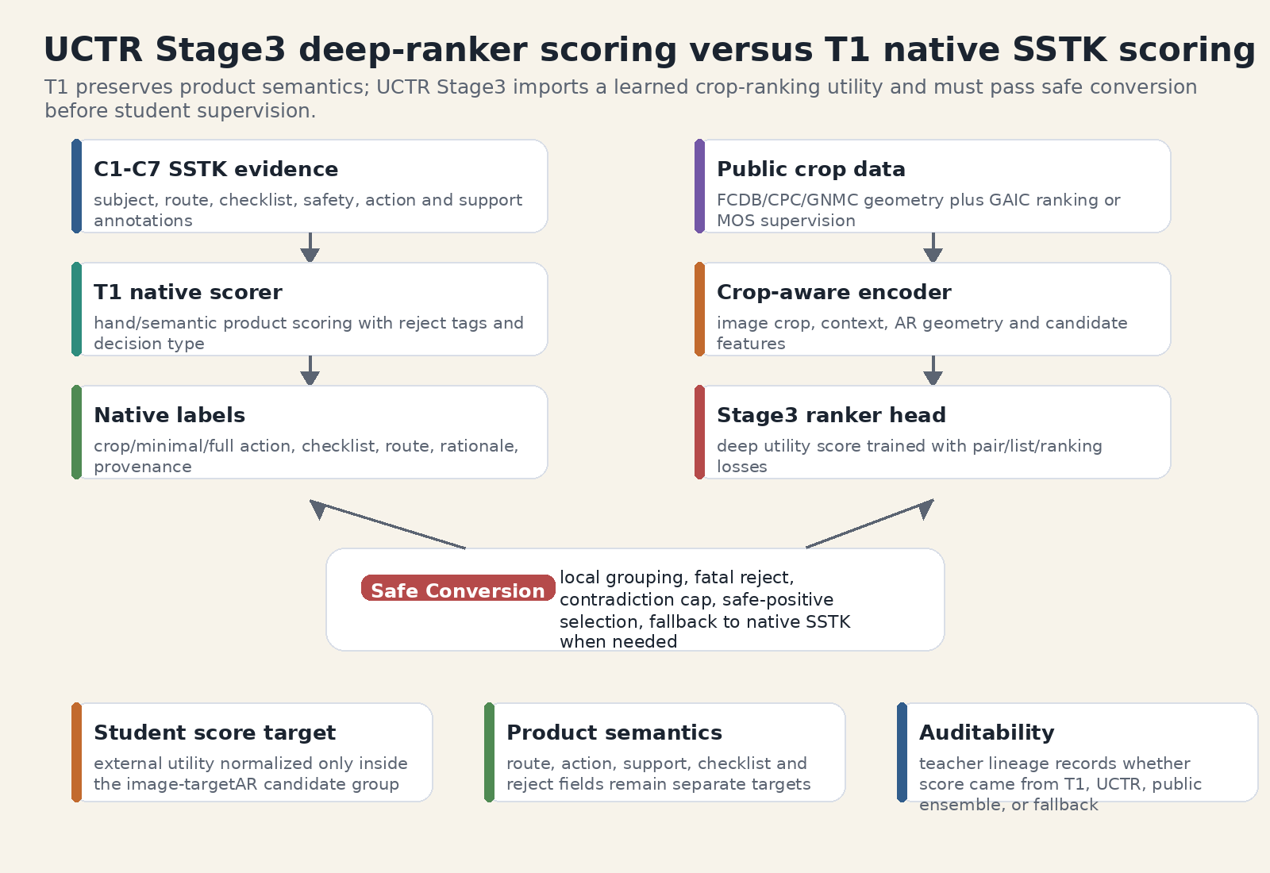
Teacher Lineage
Core
T1, T6, UCTR-H stage3, public ensemble, production hybrid는 같은 score가 아니라 서로 다른 의미의 teacher lineage다.
- T1: native product semantics와 checklist/safety
- UCTR-H stage3: public geometry와 GAIC ranking을 함께 학습한 deep ranker
- public ensemble: GAIC/CGS ranking strength, product safety는 별도 gate 필요
UCTR stage3 deep ranker scoring flow
MobileCropNet Training Data Generation Master Report, 2026-04-24
12/38

Slide 13
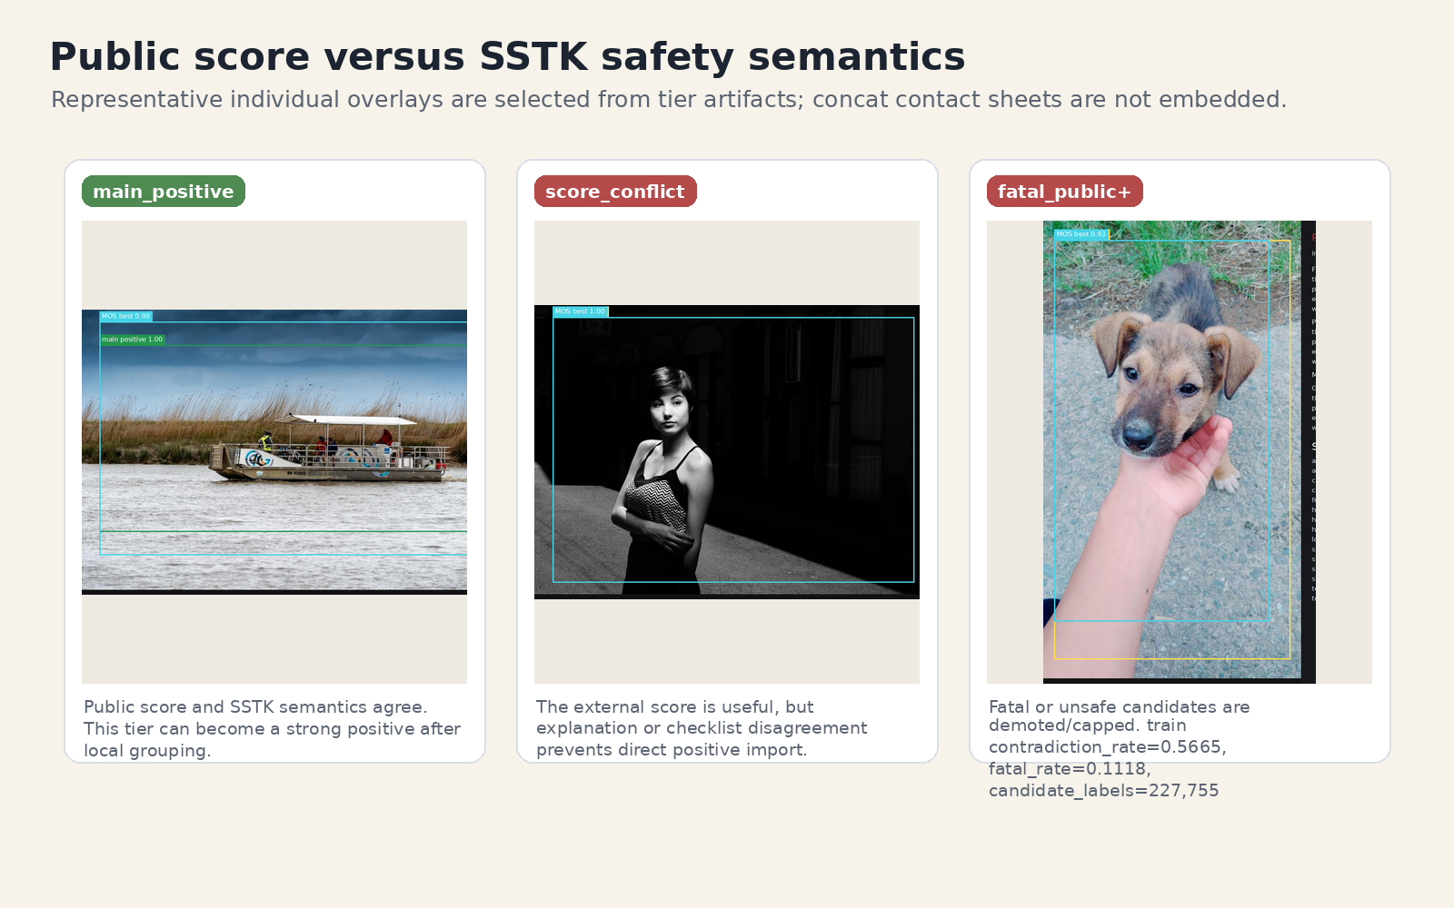
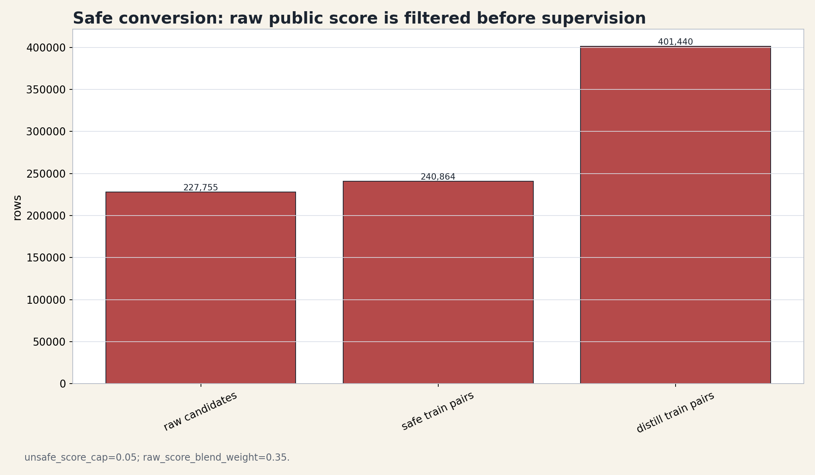
Safe Pseudo-Label Conversion
Core
raw public score는 강력하지만, explanation/safety contradiction 때문에 fatal demotion과 unsafe cap 이후에만 student supervision이 된다.
Public score vs SSTK safety disagreement
Safe conversion demotion/capping
MobileCropNet Training Data Generation Master Report, 2026-04-24
13/38

Slide 14
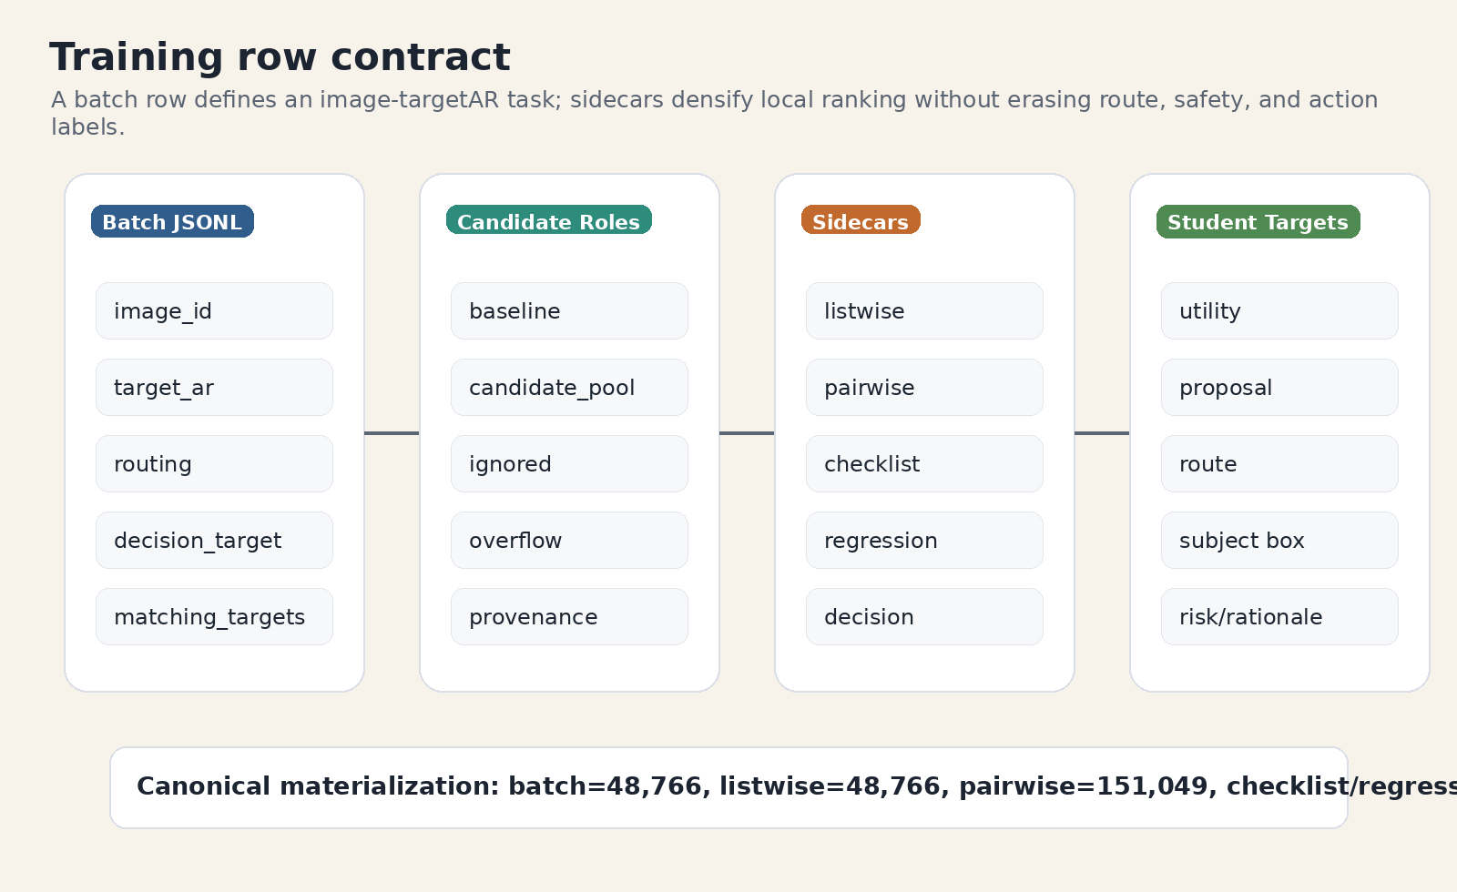
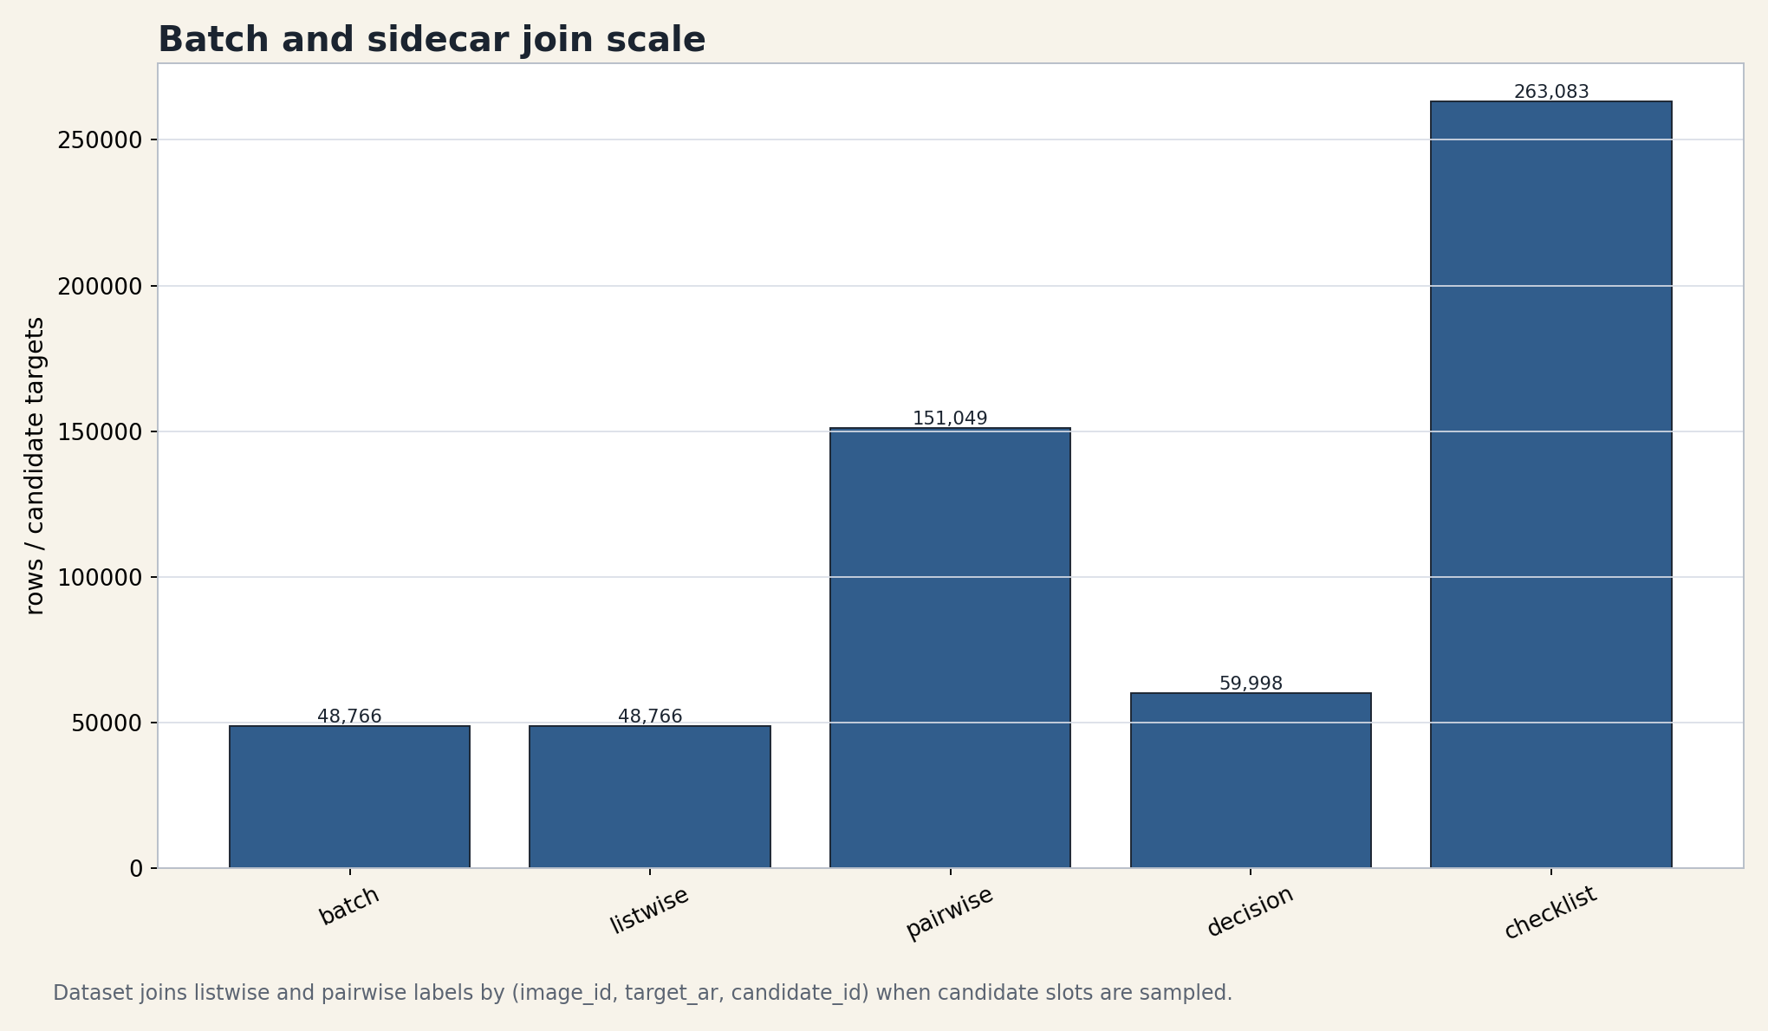
Student Training Contract
Core
batch JSONL과 pairwise/listwise/checklist sidecar는 image-targetAR-local key로 결합되어 multi-head target을 만든다.
Training row contract
Batch and sidecar join scale
MobileCropNet Training Data Generation Master Report, 2026-04-24
14/38

Slide 15
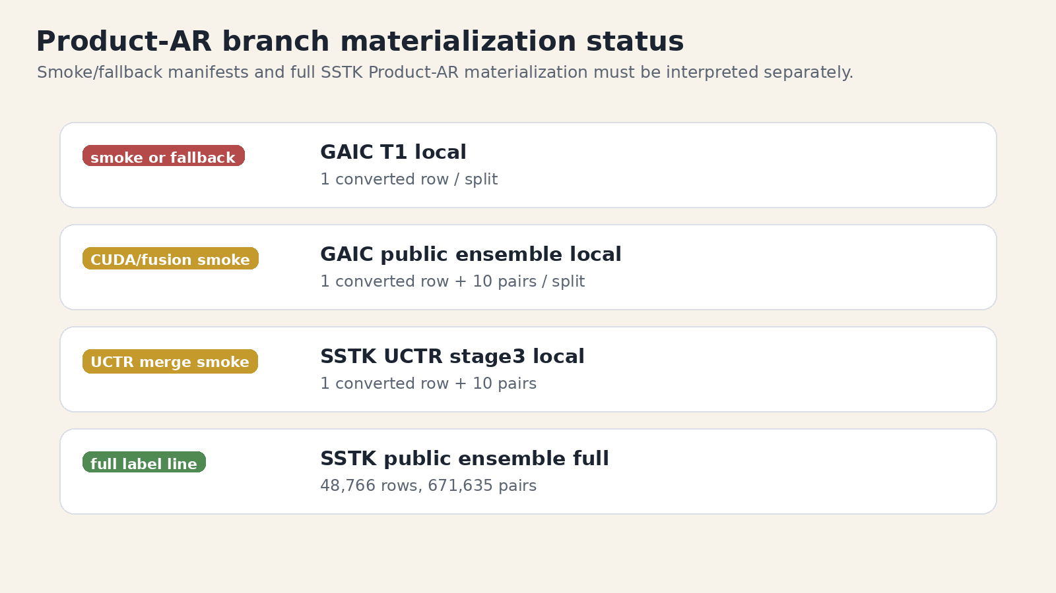
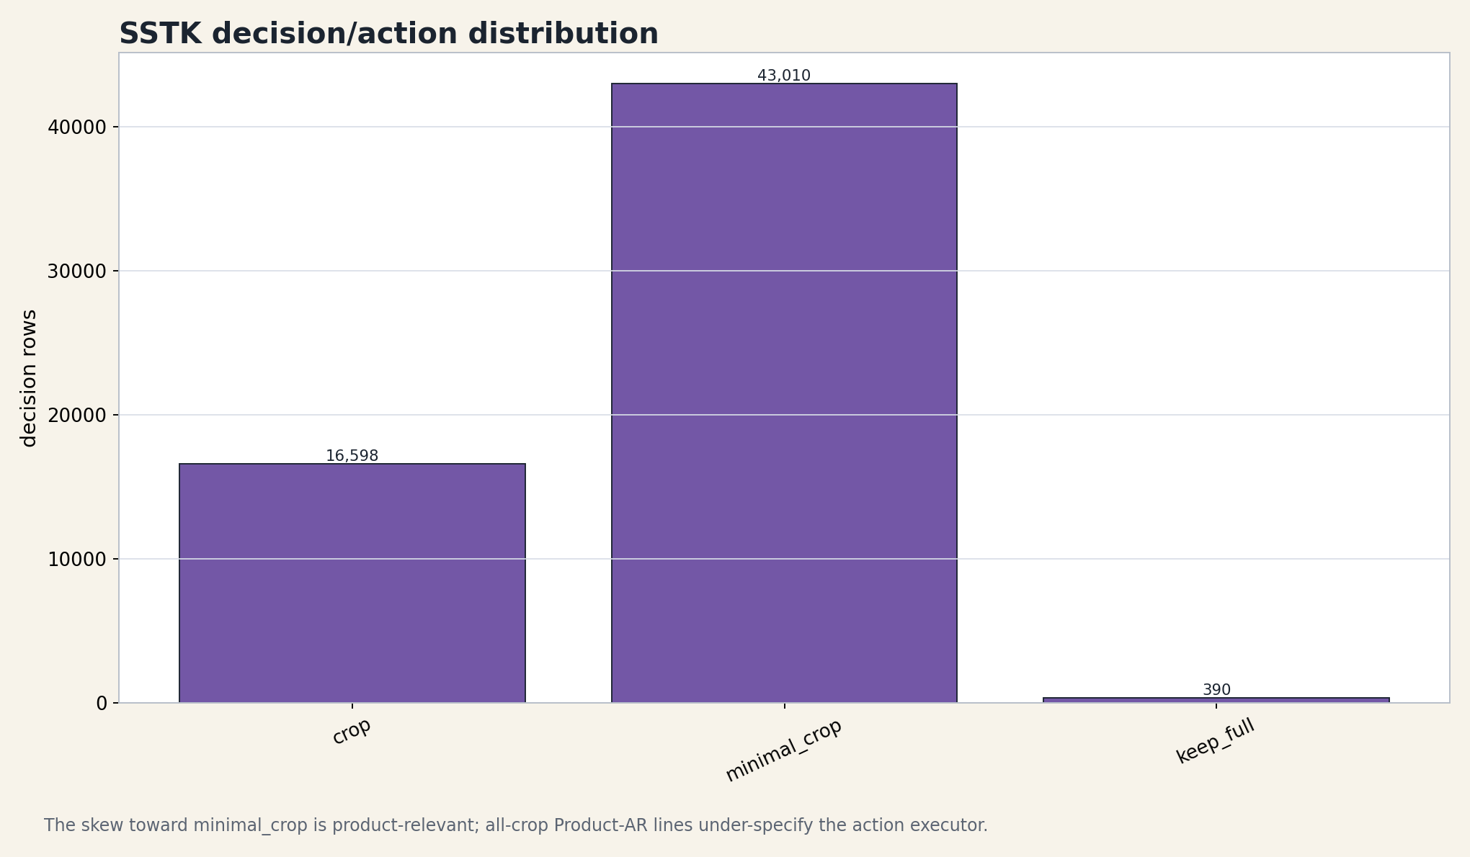
Product-AR and Decision Semantics
Core
Product-AR는 deployment에 가까운 image-targetAR task이지만, branch materialization과 decision diversity를 분리해서 해석해야 한다.
Product-AR branch status
SSTK decision/action distribution
MobileCropNet Training Data Generation Master Report, 2026-04-24
15/38

Slide 16
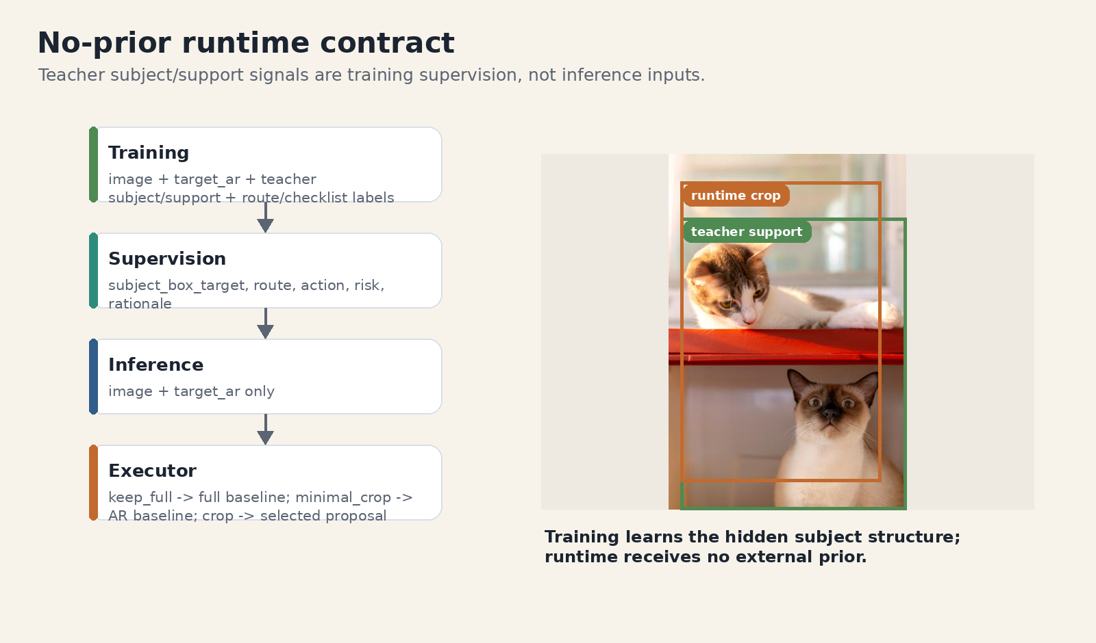
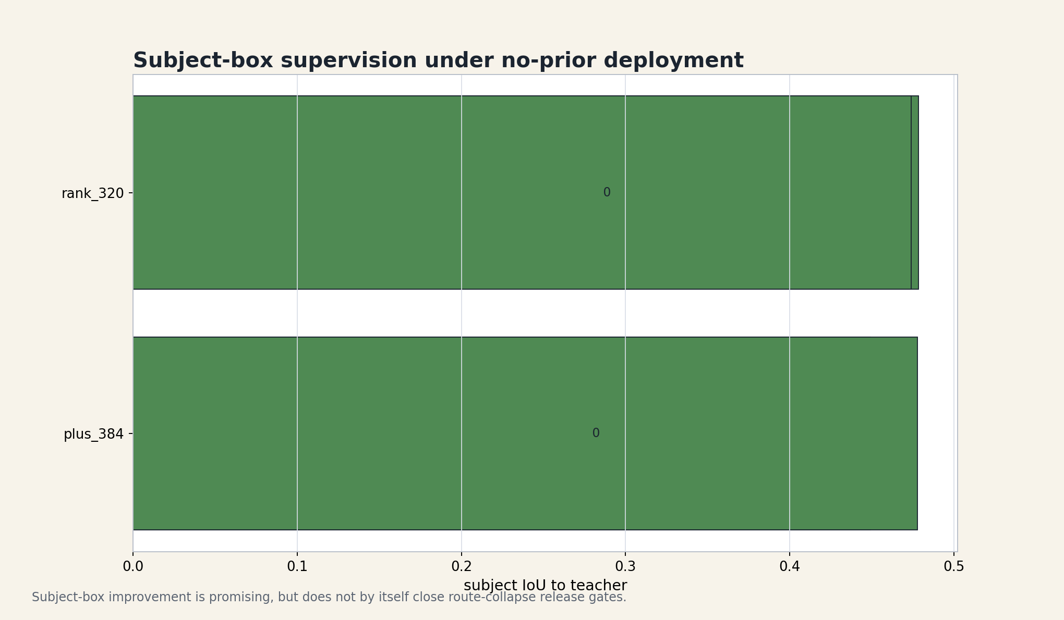
No-Prior Runtime Contract
Core
teacher subject/support는 training supervision일 뿐 runtime input이 아니다. Product inference는 image + target_ar만 받는다.
No-prior runtime executor
No-prior subject-box supervision
MobileCropNet Training Data Generation Master Report, 2026-04-24
16/38

Slide 17
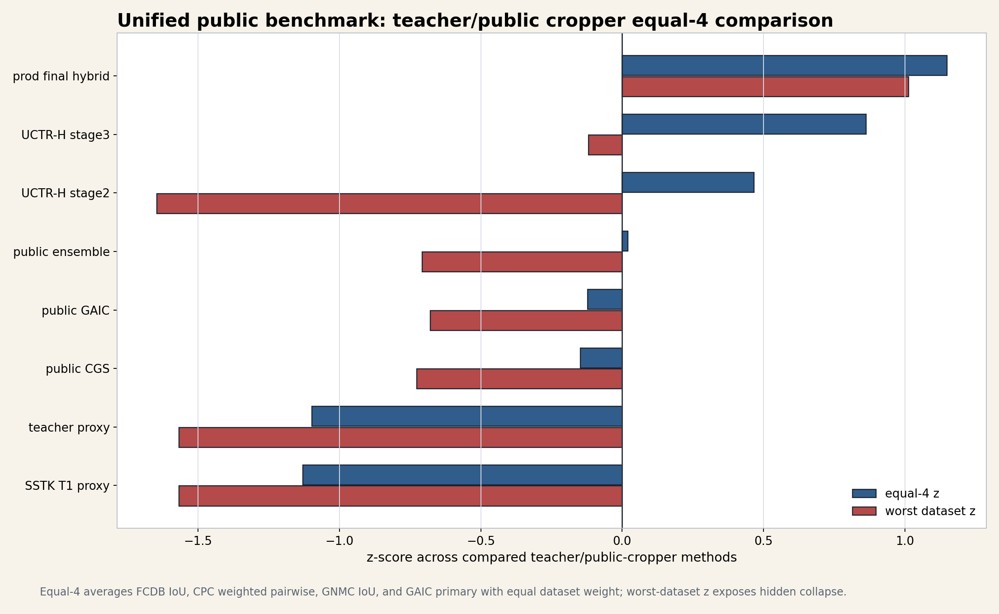
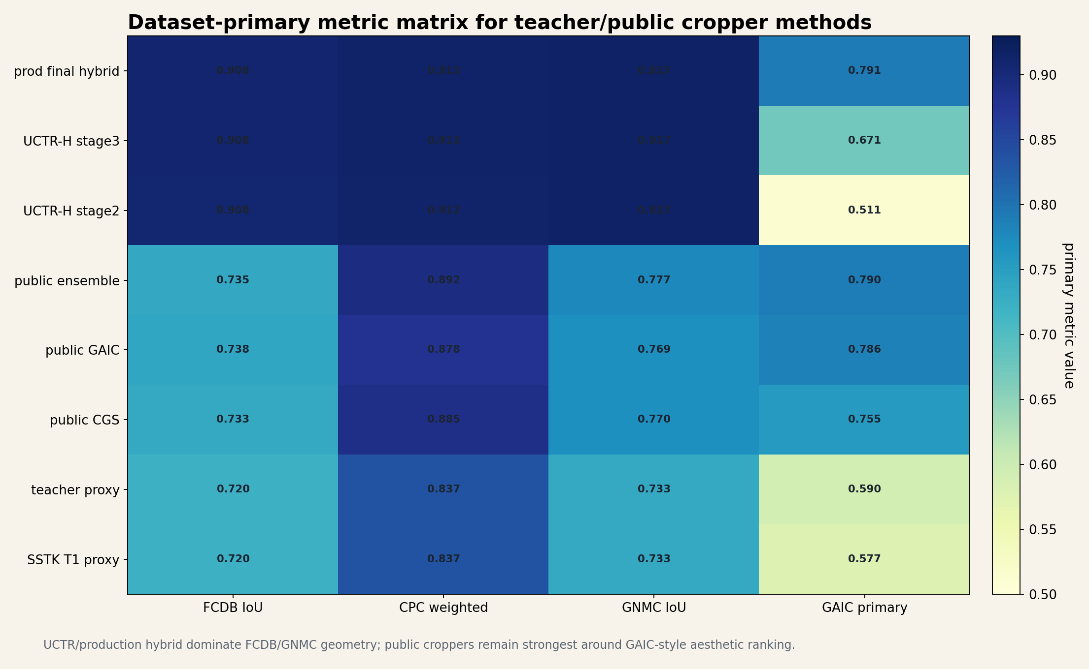
Teacher Ceiling
Core
teacher benchmark ceiling은 이미 강하다. 다음 병목은 teacher discovery보다 transfer와 student internalization이다.
0.882696 Hybrid equal4 raw
1.148158 Hybrid equal4 z
0.852693 UCTR stage3 raw
0.798613 Public ensemble raw
Equal-4 teacher/cropper leaderboard
Dataset-primary metric matrix
MobileCropNet Training Data Generation Master Report, 2026-04-24
17/38

Slide 18
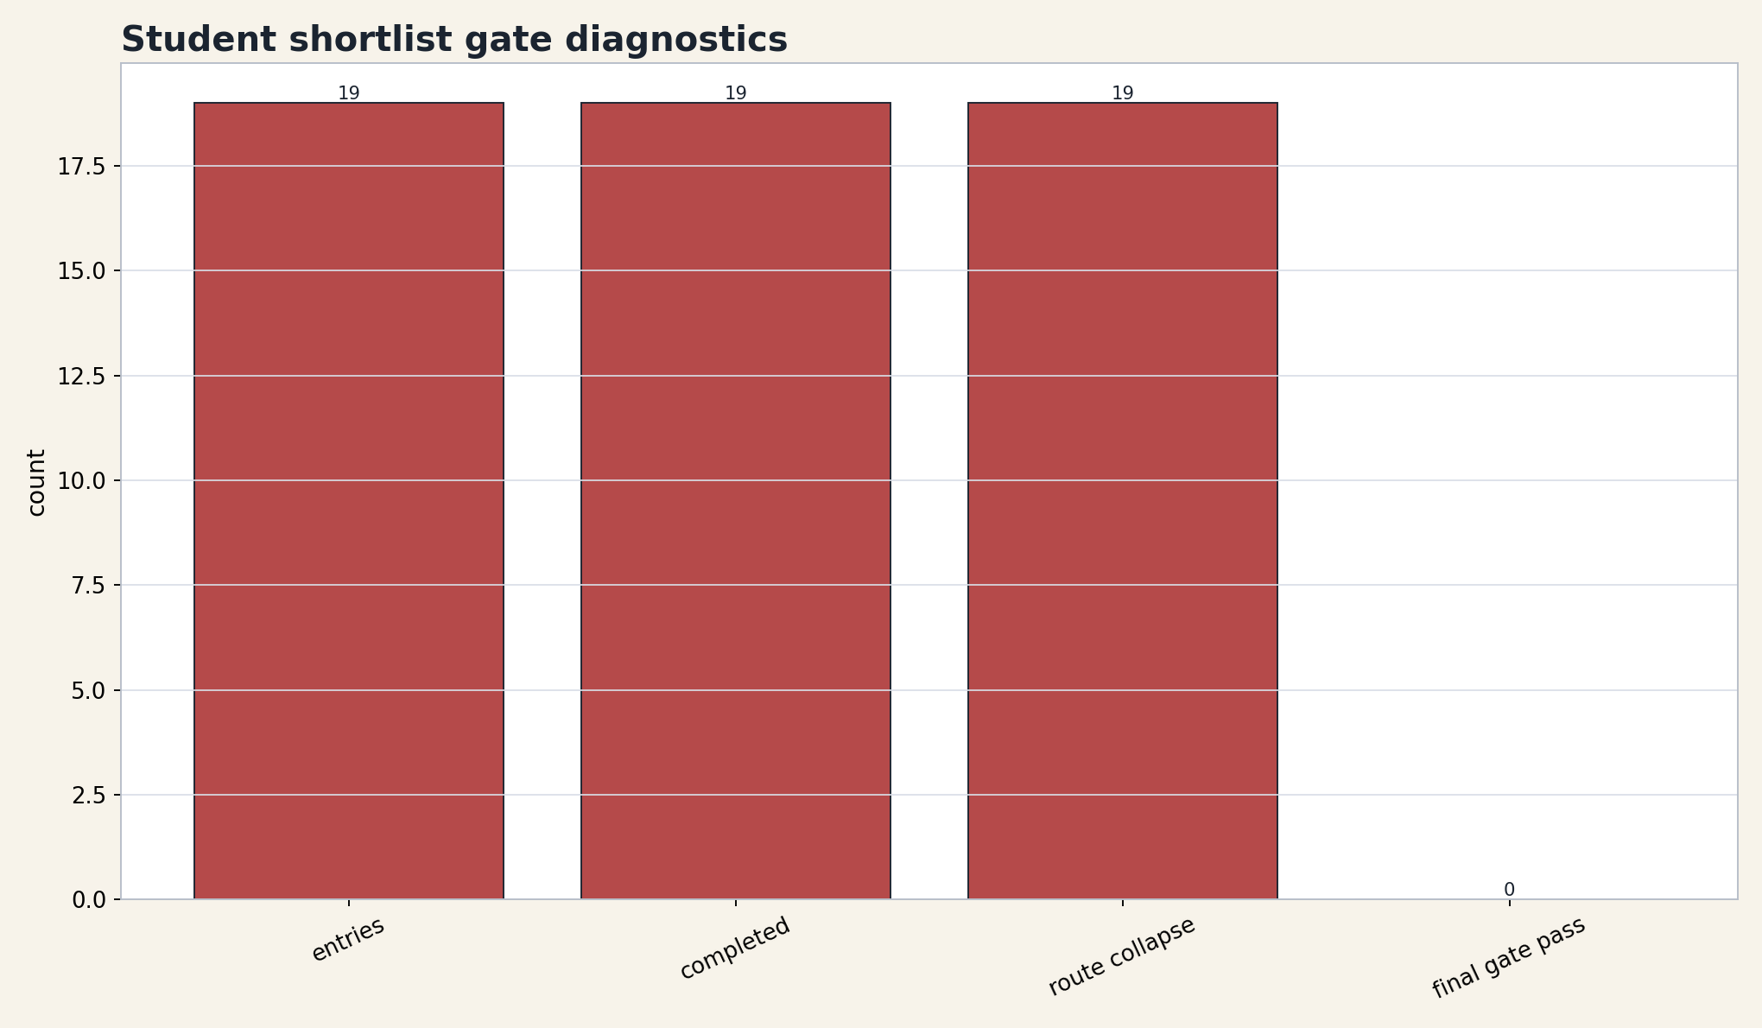
Student Shortlist Blocker
Core
best-available student는 있으나 final shipping model은 아니다. public crop quality는 일부 보존되지만 route-collapse hard gate를 실패한다.
19 Shortlist entries
19 / 19 Route collapse
0 Final gate pass
balanced_288 Default winner
0.01204 Portrait single acc
0.760155 Equal4 raw mean
Student shortlist route-collapse diagnostic
MobileCropNet Training Data Generation Master Report, 2026-04-24
18/38

Slide 19
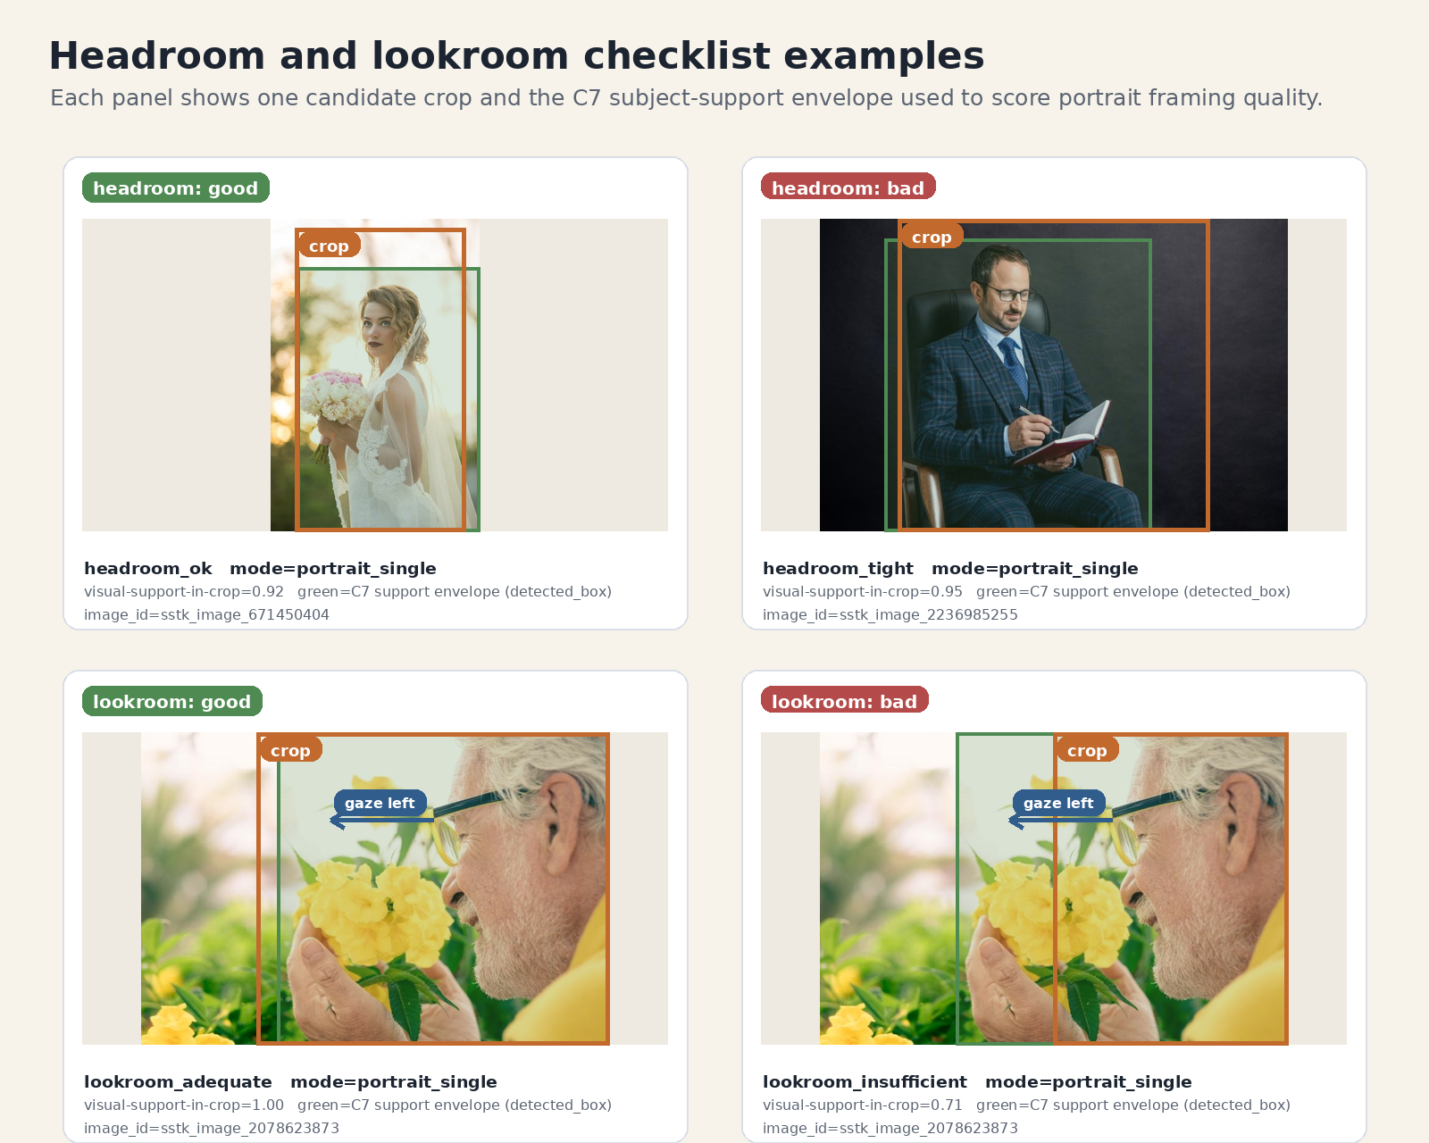
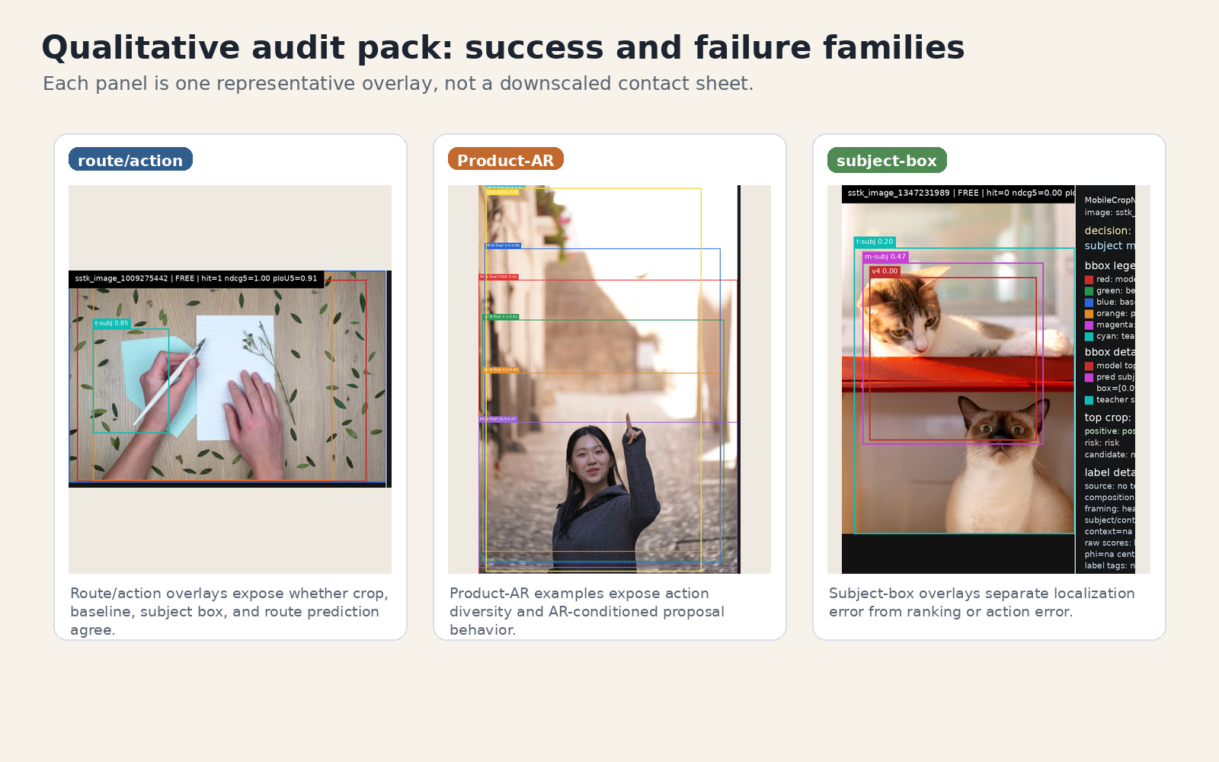
Qualitative Failure Taxonomy
Core
deployment sign-off는 visual crop 품질뿐 아니라 route, action, subject-box, checklist, why-tag 일관성을 함께 본다.
Failure taxonomy panel
Headroom/lookroom examples
MobileCropNet Training Data Generation Master Report, 2026-04-24
19/38

Slide 20
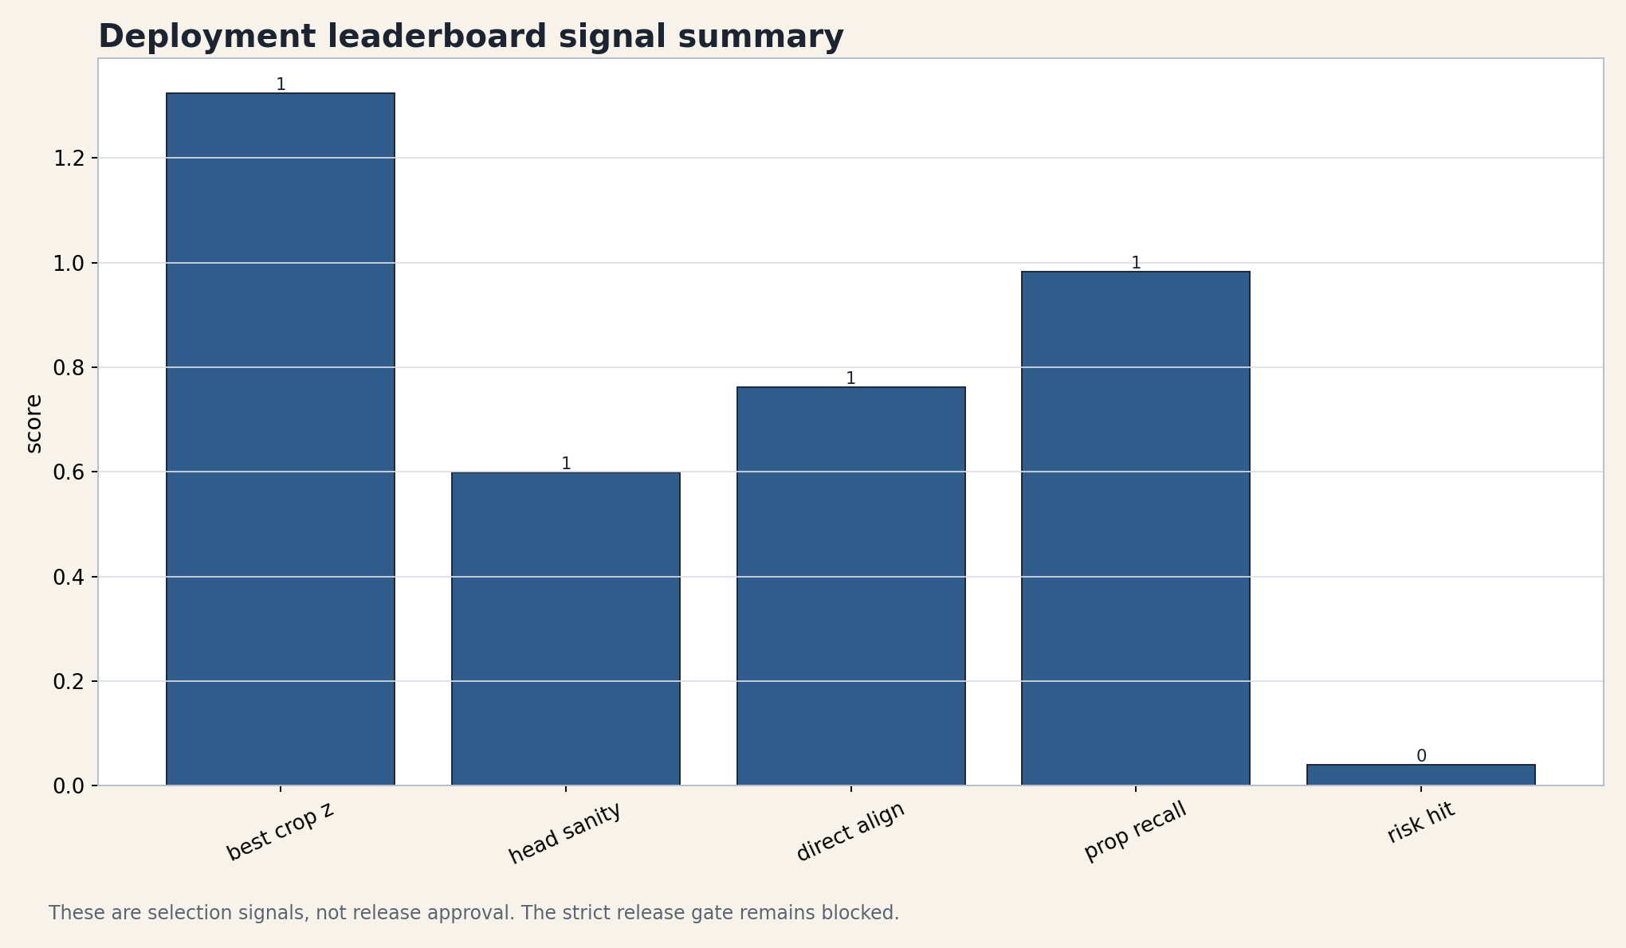
Conclusion and Next Experiments
Core
핵심 기여는 이질적인 crop knowledge를 structured student contract로 번역한 것이다. 다음 과학적 단계는 route/action/safety gate를 통과하는 deployable student를 가르치는 것이다.
- route-balanced sampling과 route별 hard negative로 collapse를 깨는 bounded rerun
- subject-aware proposal coupling과 pose-aware portrait prior 강화
- dense support-map supervision과 standardized qualitative review pack 승격
Deployment leaderboard signal summary
MobileCropNet Training Data Generation Master Report, 2026-04-24
20/38

Slide 21
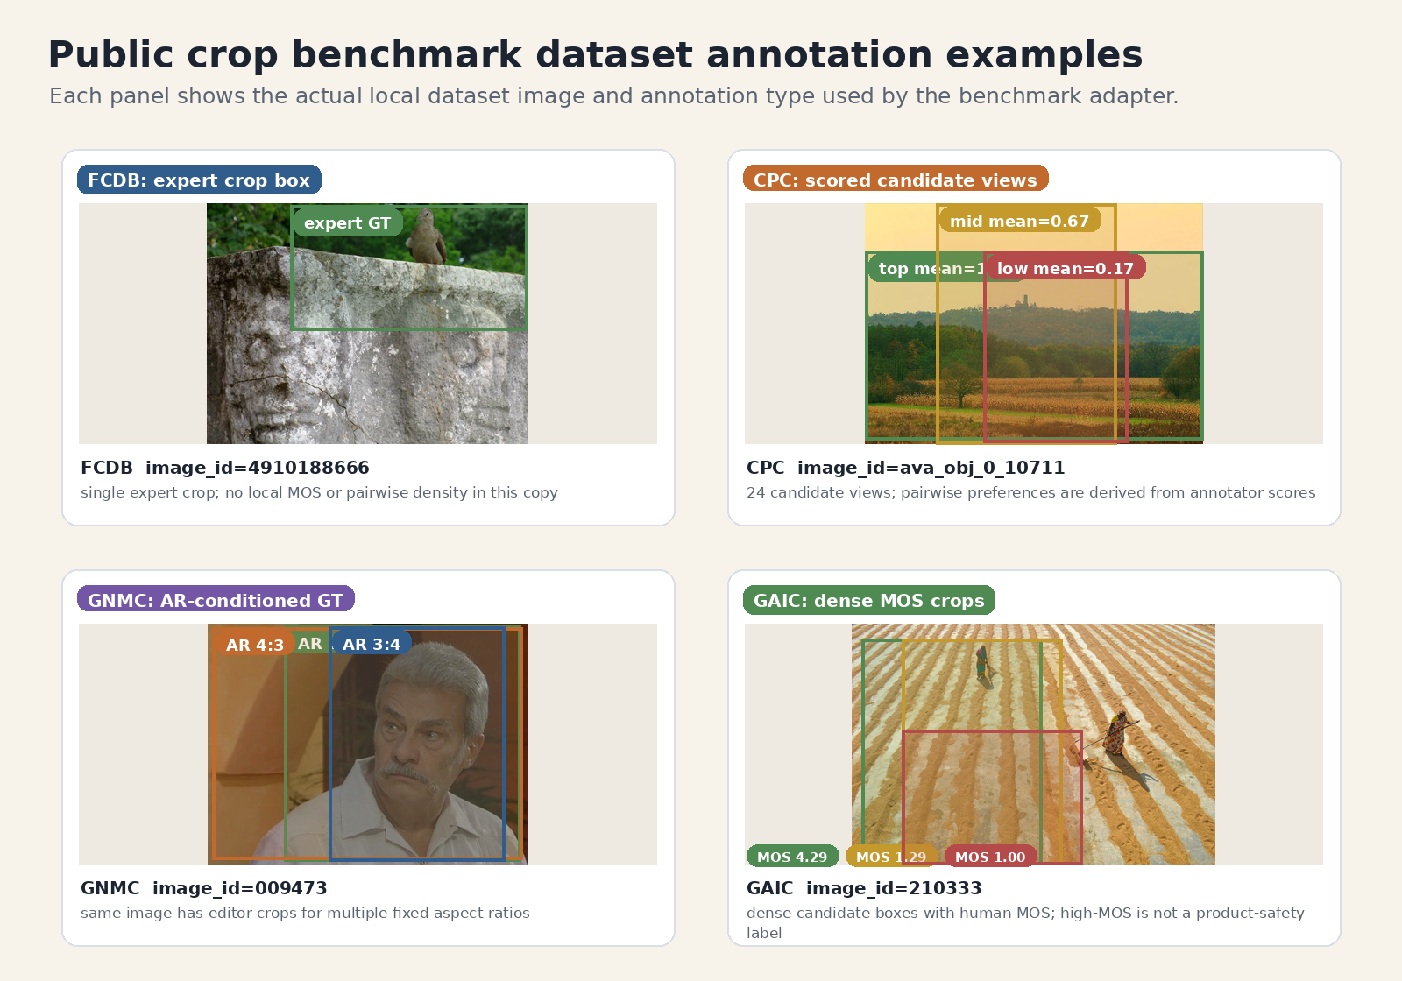
A1. Full Related Work Matrix
Appendix
기존 crop supervision은 각자 강점이 다르며, MobileCropNet은 이를 structured contract로 결합한다.
- 좌표 회귀: 빠른 단일 crop 좌표
- 후보 순위화 / GAIC MOS / VLM instruction / subject-aware composition은 서로 다른 supervision axis
- raw dataset metric을 product policy로 오해하지 않는 것이 핵심
Public crop benchmark annotation examples
MobileCropNet Training Data Generation Master Report, 2026-04-24
21/38

Slide 22
A2. Full Objective Formulas
Appendix
본문에는 핵심만 남기고 자세한 수식은 appendix에서 참조한다.
S_rank aesthetic + subject + composition + external teacher
S_policy S_rank + area prior - safety penalty
y_rank image-task-local rank target
p_i softmax listwise distribution
L_pair positive-vs-negative preference
y_decision keep / minimal / crop action target
MobileCropNet Training Data Generation Master Report, 2026-04-24
22/38

Slide 23
A3. SSTK Category Distribution
Appendix
Full_10000 materialized corpus는 category-balanced curation을 목표로 한다.
12 Super-categories
10,000 Image files
833 people_single
833 people_multi
833 sports
836 architecture
MobileCropNet Training Data Generation Master Report, 2026-04-24
23/38

Slide 24
A4. Split Governance
Appendix
pairwise/listwise와 Product-AR task 확장 때문에 split은 row가 아니라 image id와 seed 기준으로 관리해야 한다.
Image ID
Deterministic Split
Batch JSONL
Sidecars
Product-AR Tasks
MobileCropNet Training Data Generation Master Report, 2026-04-24
24/38

Slide 25
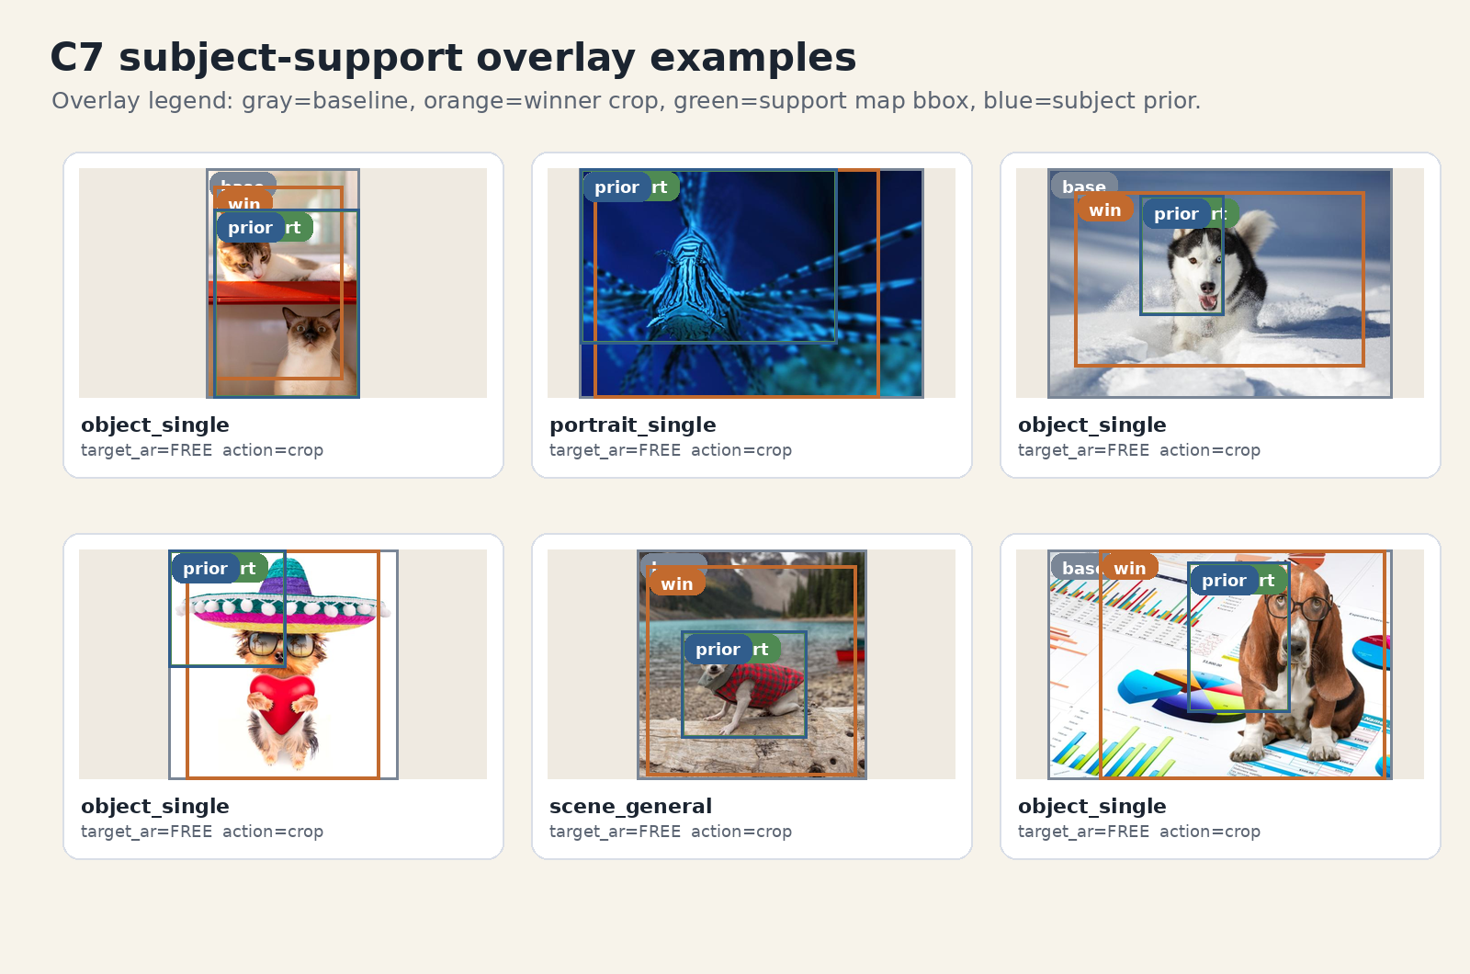
A5. C1-C7 Stage Details
Appendix
각 C-stage는 downstream label의 일부로 직접 또는 간접 반영된다.
- C1 semantic context, C2 object/segmentation, C3 face/pose/gaze
- C4 OCR/text/copy-space, C5 horizon/symmetry/layout
- C6 person refinement, C7 saliency/support attribution
C7 subject-support examples
MobileCropNet Training Data Generation Master Report, 2026-04-24
25/38

Slide 26
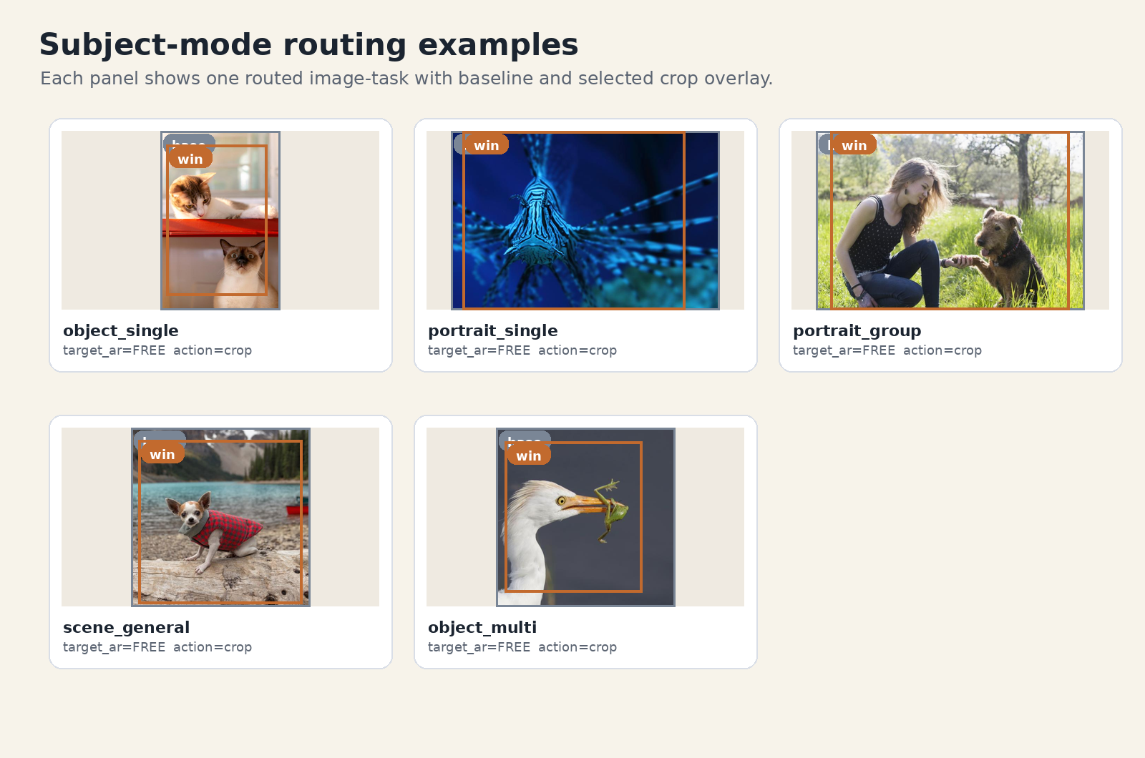
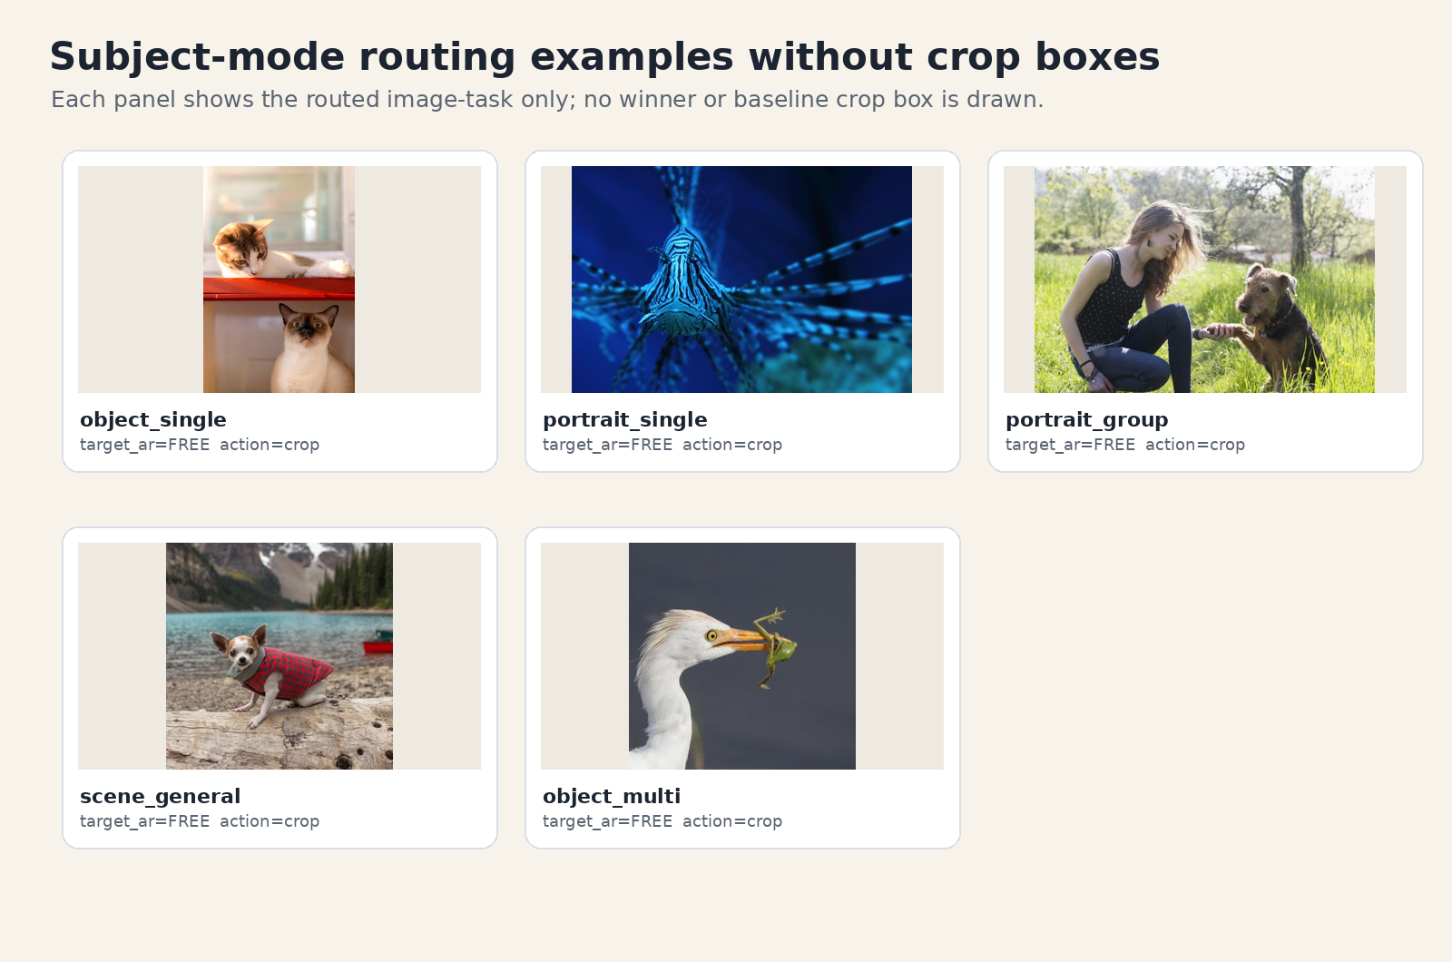
A6. Route Policy Table
Appendix
route family별 구성 정책과 collapse 증상은 core deck의 route-control slide를 보완한다.
Subject-mode routing examples
Plain routing gallery
MobileCropNet Training Data Generation Master Report, 2026-04-24
26/38

Slide 27
A7. Candidate Algorithm
Appendix
Candidate bank는 baseline, AR proposal, subject/support expansion, teacher proposal을 합친 뒤 staged NMS와 role assignment를 수행한다.
baseline_full
baseline_minimal
AR grid
subject expansion
support proposal
teacher proposal
NMS
role assignment
MobileCropNet Training Data Generation Master Report, 2026-04-24
27/38

Slide 28
A8. Candidate Bank Numeric Table
Appendix
FREE와 fixed-AR task는 서로 다른 후보 분포를 만들며, main batch는 전체 bank를 압축한 slot만 사용한다.
1,951,872 FREE total
1,350,612 4:3 total
1,325,602 16:9 total
1,211,483 1:1 total
906,683 3:4 total
786,786 9:16 total
Target-AR candidate bank size
MobileCropNet Training Data Generation Master Report, 2026-04-24
28/38

Slide 29
A9. Label Role Tables
Appendix
positive가 많다는 것은 쉬운 dataset이라는 뜻이 아니라 soft positive, baseline positive, hard negative audit이 공존한다는 뜻이다.
179,494 matching_targets
83,589 candidate_pool
62,128 ignored
16,454 overflow
48,766 top1
120,996 soft_positive
Candidate role split
MobileCropNet Training Data Generation Master Report, 2026-04-24
29/38

Slide 30
A10. T1 vs UCTR Stage3
Appendix
T1은 product-safe native utility, UCTR-H stage3는 public benchmark utility에 강한 deep crop ranker다.
- T1: C1-C7 evidence, route, checklist, safety, decision type을 직접 보존
- UCTR-H: FCDB/GNMC IoU, CPC pairwise, GAIC MOS/ranking을 통합 학습
- UCTR branch도 safe conversion을 통과해야 product label이 된다
T1 native score vs UCTR stage3
MobileCropNet Training Data Generation Master Report, 2026-04-24
30/38

Slide 31
A11. Pseudo-Label Semantic Layers
Appendix
external teacher override 가능 범위는 geometry/rank/policy/safety/explanation/provenance 계층마다 다르다.
Geometry
Rank score
Policy decision
Safety / reject
Explanation
Provenance
external teacher는 rank를 강화할 수 있지만 safety/reject와 provenance를 지울 수 없다.
MobileCropNet Training Data Generation Master Report, 2026-04-24
31/38

Slide 32
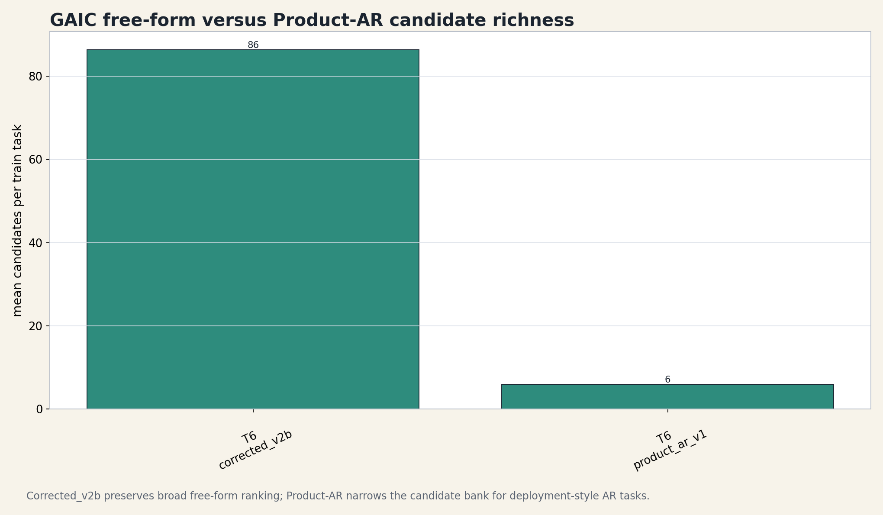
A12. GAIC Corrected vs Product-AR
Appendix
corrected_v2b는 broad free-form ranking, product_ar_v1은 narrow AR-conditioned product task다.
2,509 corrected train
14,915 product-AR train
~86 corrected cand/task
~6 product cand/task
240,864 corrected pairwise
251,239 product pairwise
GAIC lineage candidate richness
MobileCropNet Training Data Generation Master Report, 2026-04-24
32/38

Slide 33
A13. Public Explain-Safe Details
Appendix
public ranker score는 raw truth로 쓰기보다 safety-aware distillation으로 사용하는 것이 안전하다.
227,755 Raw labels
0.5665 Contradiction
0.1118 Fatal
4.0516 Top1 MOS
240,864 Safe pairwise
401,440 Distill pairwise
Safe conversion effect
MobileCropNet Training Data Generation Master Report, 2026-04-24
33/38

Slide 34
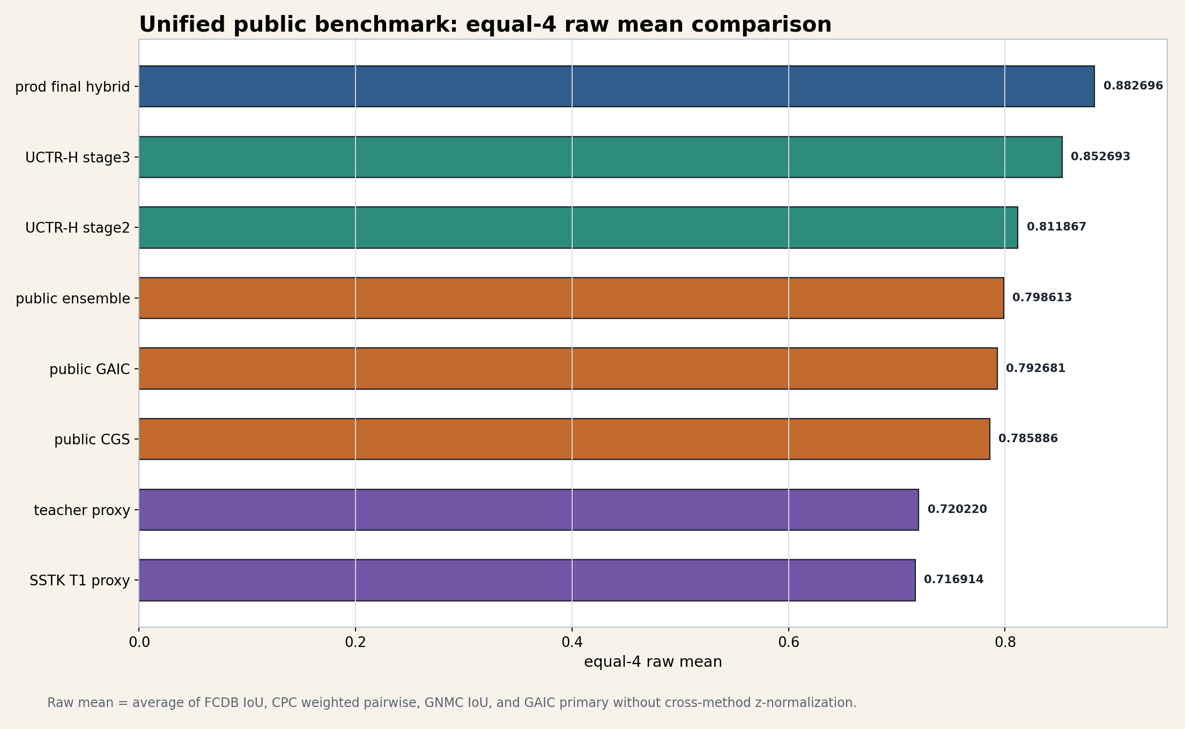
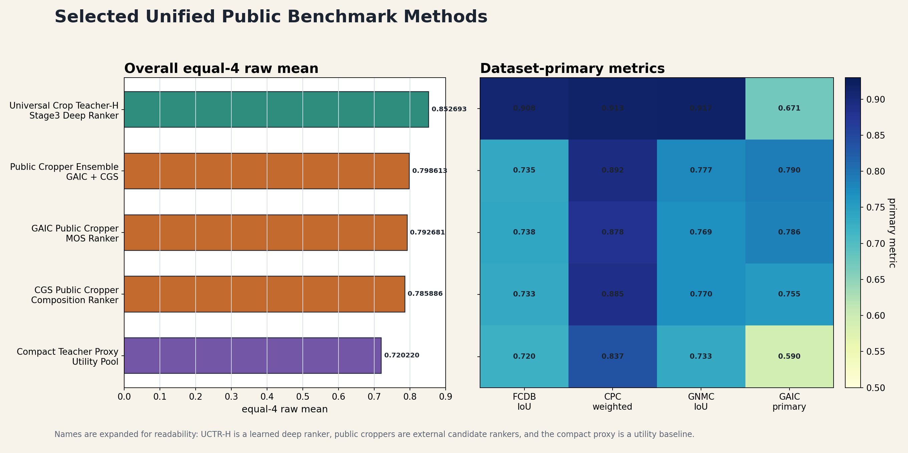
A14. Full Teacher Leaderboard
Appendix
equal-4 평균과 worst-dataset z를 함께 봐야 특정 dataset collapse를 놓치지 않는다.
Equal-4 raw mean
Selected method comparison
MobileCropNet Training Data Generation Master Report, 2026-04-24
34/38

Slide 35
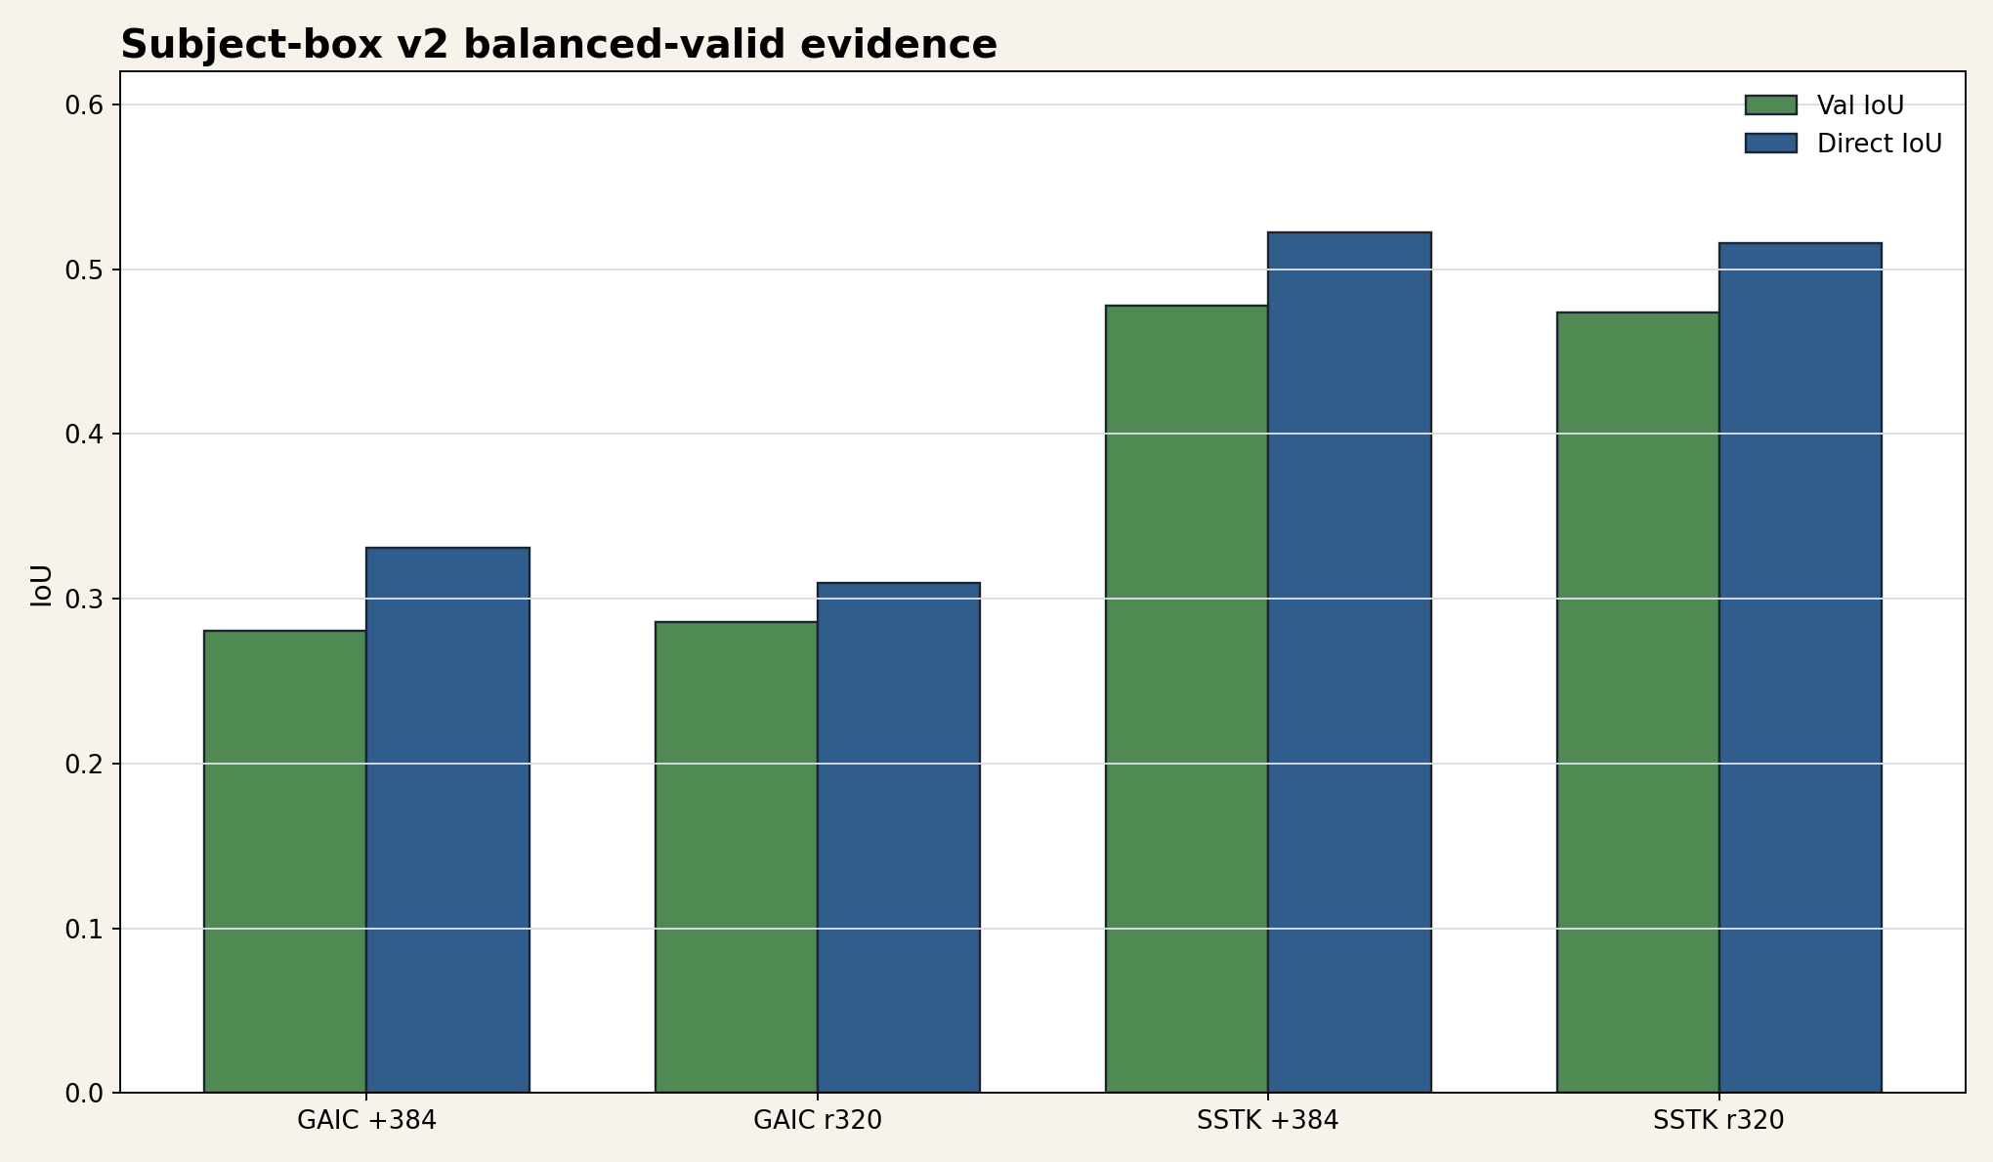
A15. Subject-Box Follow-Up
Appendix
SSTK subject-box v2는 subject IoU를 개선하지만 route-collapse 해결을 자동으로 보장하지 않는다.
0.477671 SSTK plus Val IoU
0.522159 SSTK plus Direct IoU
0.740658 SSTK plus Neg acc
0.969483 SSTK plus Hit@0.5
Subject-box v2 quantitative comparison
MobileCropNet Training Data Generation Master Report, 2026-04-24
35/38

Slide 36
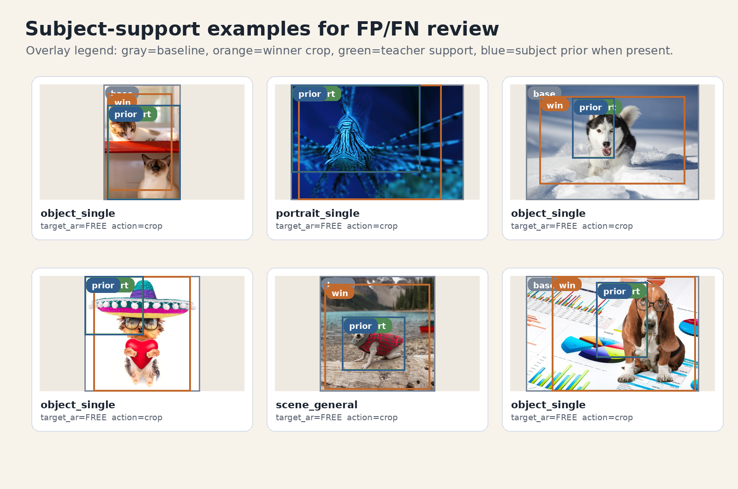
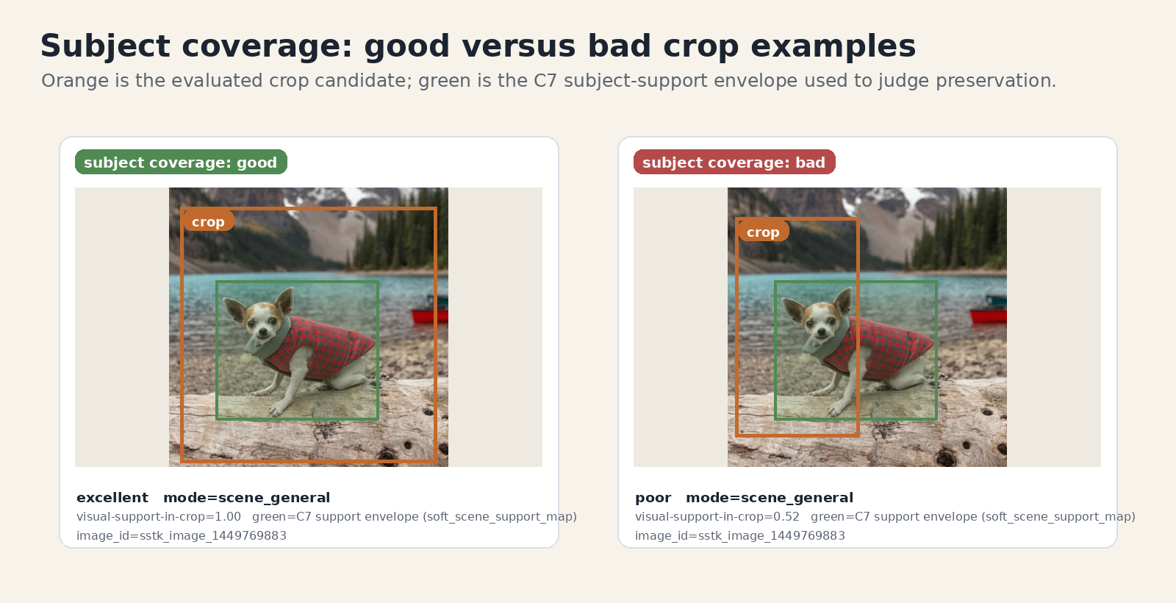
A16. Qualitative Gallery
Appendix
정성 gallery는 성공 crop만이 아니라 subject FP/FN, support mismatch, portrait checklist failure를 포함해야 한다.
Subject-box FP/FN examples
Subject coverage good/bad examples
MobileCropNet Training Data Generation Master Report, 2026-04-24
36/38

Slide 37
A17. Limits
Appendix
현 상태의 한계는 명확히 보고해야 한다. 특히 Product-AR smoke/full 혼재와 route collapse를 과장 없이 분리한다.
- Product-AR artifact 상태가 branch별로 full/smoke/fallback으로 혼재
- final shortlist 19/19 route-collapse hard gate 실패
- raw public score를 global regression truth로 쓰면 product semantics가 손상
- dense subject-support map supervision은 아직 충분히 활용되지 않음
MobileCropNet Training Data Generation Master Report, 2026-04-24
37/38

Slide 38
A18. Artifact and Reproducibility Index
Appendix
deck은 source markdown, figure manifest, generated PPTX, validation summary를 같은 asset directory 아래에서 추적한다.
- source report: Implement_Docs/MobileCropNet_Training_Data_Generation_Master_Report_KO_2026-04-24.md
- figure manifest: Implement_Docs/assets_mobilecropnet_training_data_master_20260424/figure_manifest.json
- renderer: src/scripts/build_mobilecropnet_training_data_master_deck.py
- validation JSON: generated next to the PPTX
MobileCropNet Training Data Generation Master Report, 2026-04-24
38/38

