Slide 1

A Mechanistic Kidney Physiologically-Based
PharmacoKinetic (PBPK) Model to Quantify
Transporter-Mediated Furosemide-Toxin Interactions
Leyla Noroozbabaee, 09/2026
Notes:
ood morning everyone. And thanks for your time today

Slide 2
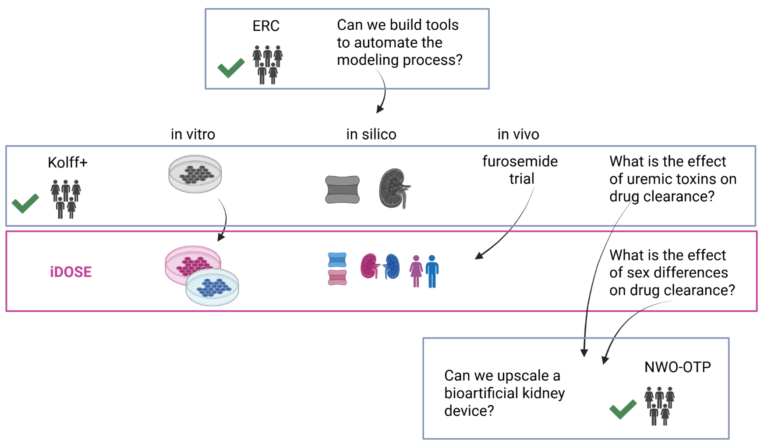







Connection to other projects
Notes:
Before I start, a quick map of where this work sits and also my envolvement in different projects. We are currently the engine behind the modeling and analysis in the Kolff project. We built the PBPK model that captures the drug toxin interaction but the model is only half the story. We also have in vitro data , and part of my role is finding the right way to analyse this data and extract meaningful pharmacokinetic parameters for the compounds in the model.
I’m also involved in improving the experimental design, and also in translating in vitro data into in vivo parameters that feed into the model.
The same model is the starting point for the iDOSE question: how do sex differences affect drug clearance?
And I’m part of the NWO-OTP project, where we use the same modeling logic to inform the design of a bioarti cial kidney, through fuid- flow simulations in COMSOL.

Slide 3
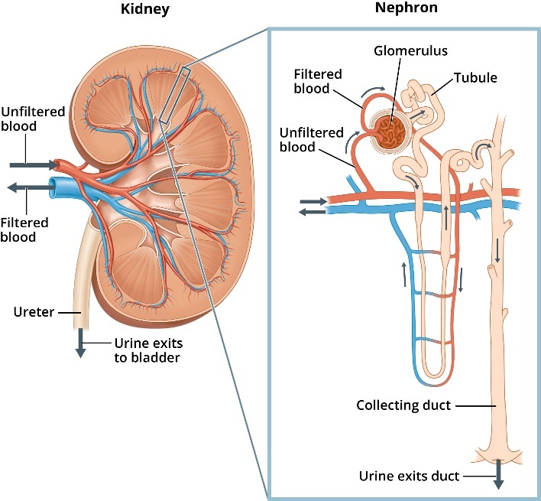
Kidneys
3
Regulates fluid balance, electrolytes, and blood pressure
Four processes: filtration, reabsorption, secretion, excretion
Unfiltered blood enters via the renal artery
Cleared of waste before it leaves
Notes:
Here’s a little bit about the kidney.
It balances fuid, electrolytes and blood pressure through four processes:filltration, reabsorption, secretion and excretion. Unfiltered blood enters through the renal artery, and it is cleared of waste before it leaves the kidney.
The one process I want you to remember for the rest of this talk is secretion. It happens mainly in the proximal tubule the longest segment of the nephron, which is the functional unit of the kidney. This is where transporters actively pull compounds out of the blood and push them into the urine.

Slide 4
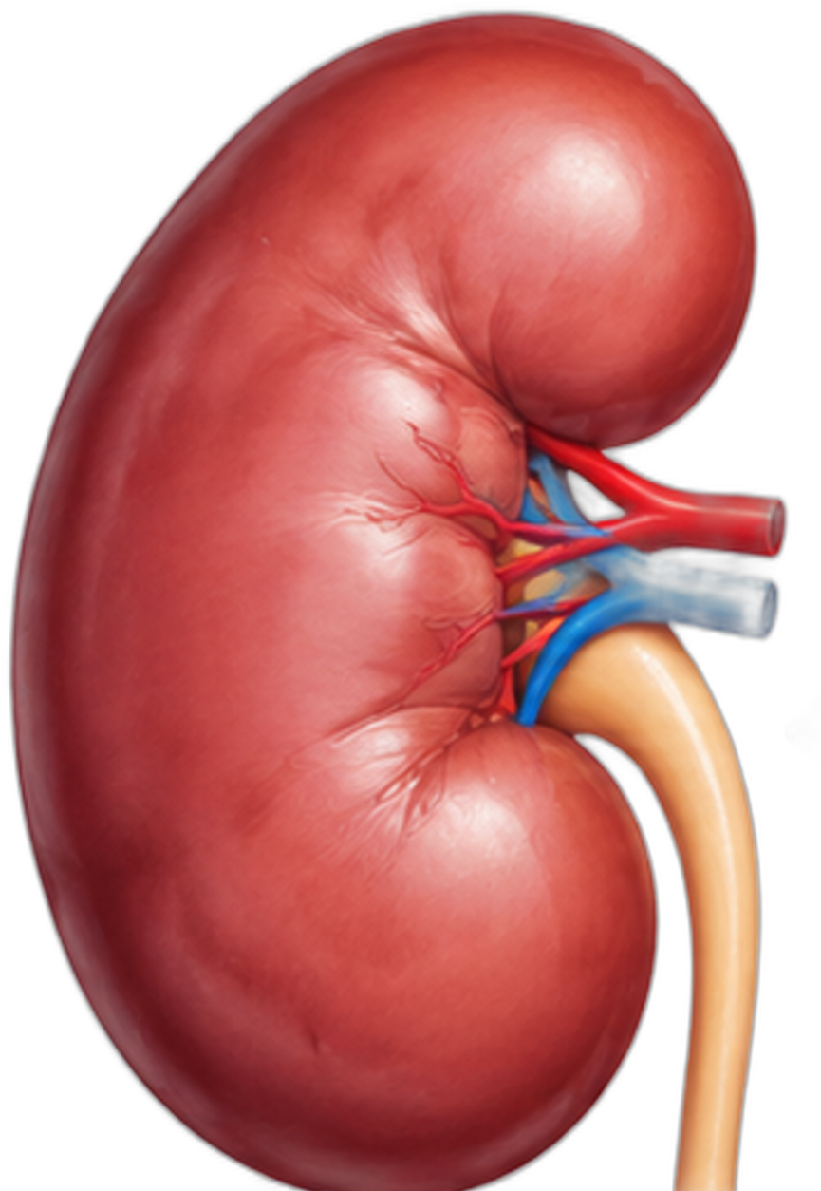
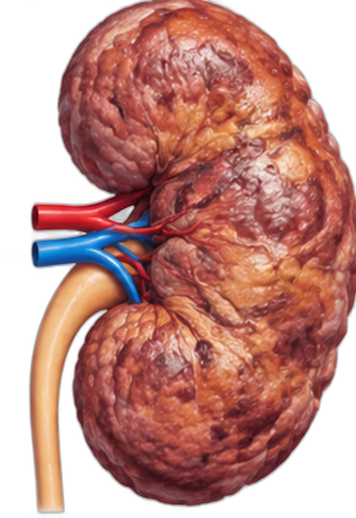

Polypharmacy and the Kidney: A Double-Edged Sword
4
Notes:
CKD patients often take 12+ medications daily, many competing for the same kidney transporters.
So the question is: are these drugs only helping or is the competition for transporters costing more than we realise

Slide 5
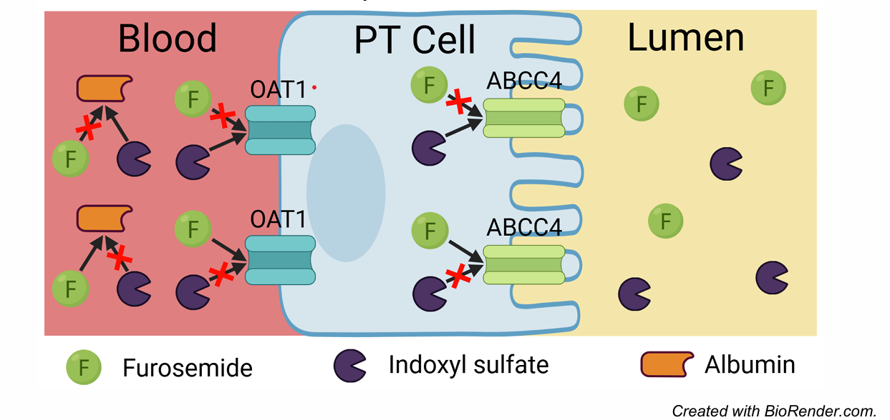
Hypothesis
5
Notes:
Here’s the mechanism we’re proposing.
Protein-bound uremic toxins sulfate for example indoxyl travel in the blood bound to albumin.
The free fraction is taken up by OAT1 on the blood side of the proximal tubule cell, and is then pumped out into the urine, by apical transporter.
Furosemide uses exactly the same route.
But, here is the problem: in CKD the toxin levels are already high and there are fewer working nephrons, so the competition matters more.
When furosemide is present, the toxin has to wait for its turn at the transporter or it may never get its turn.
That’s our hypothesis: competitive inhibition at the same transporter, OAT1.

Slide 6
  Does furosemide interfere with uremic toxin clearance
  through OAT1 competition?
Notes:
Here's the question we want to answer. To answer it, we built a mechanistic kidney PBPK model, explicitly representing OAT1-mediated competition between furosemide and three uremic toxins and used this model to identify what actually drives the interaction: dose, dosing schedule, or CKD stage.

Slide 7
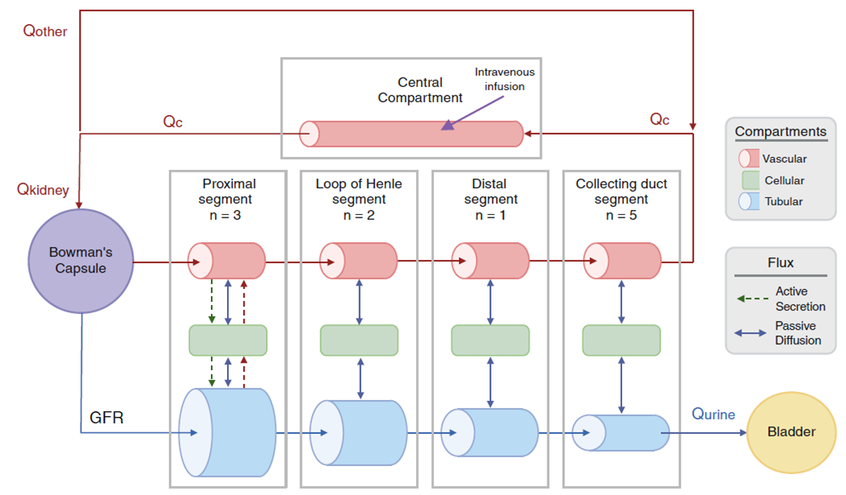
A physiologically based kidney model
7
37 compartments,
142 coupled ordinary differential equations
Huang W et al. (2018) CPT
Pharmacometrics Syst. Pharmacol
Notes:
This is the model itself. Each nephron segment has a vascular, a cellular and a tubular compartment. On top of that we explicitly represent OAT1 uptake on the basolateral side, apical efflux, passive transport, albumin binding, and competitive inhibition between furosemide and the three toxins, under both healthy and CKD stage 5 conditions. In total: 37 compartments and 142 coupled ODEs. I won’t walk through every compartment. The segment to focus on is the proximal tubule, where most of these processes including secretion is happeing

Slide 8
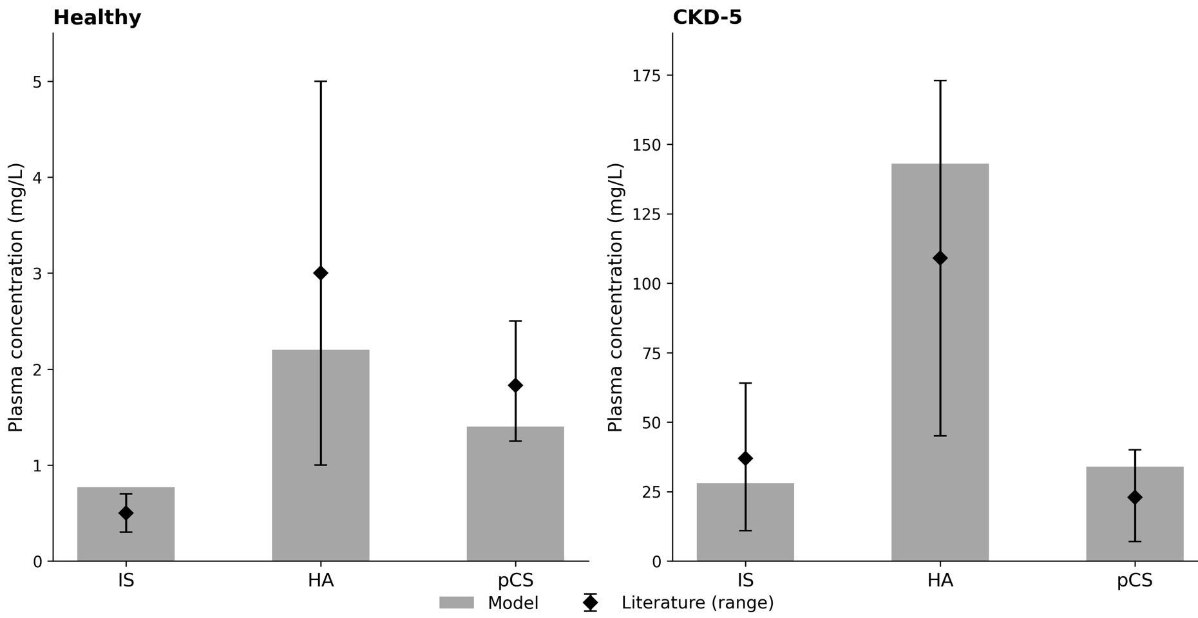
PBUTs kinetics
8
All bars and literature ranges: TOTAL plasma (bound + unbound), not free. Model: C_plasma = C_blood / BP (IS 0.70, HA 0.84, pCS 0.55). OAT1 uses unbound plasma C_u = C_plasma × f_u,p (CKD-5: IS 0.10, HA 0.52, pCS 0.05).
Notes:
Bars and diamonds are TOTAL plasma, not free.
Model blood C_ven is converted: C_plasma = C_blood / BP.
OAT1 and GFR see only unbound plasma C_u = C_plasma × f_u,p.
Left healthy, right CKD-5; model sits in the literature range on both.

Slide 9
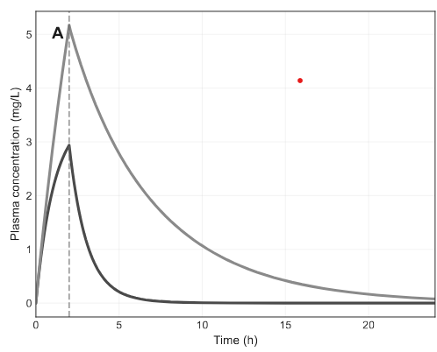
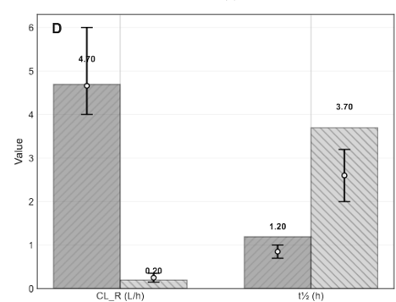
Furosemide PK
9
B
Panel A is TOTAL BLOOD (ODE C_ven); the axis label 'plasma' is wrong. Total plasma = blood / 0.82. Unbound plasma = total plasma × f_u,p (healthy 0.02, CKD-5 0.05). Panel D CL_R = Ae / AUC(C_ven) is blood clearance; t½ is the same in blood or plasma.
Notes:
Panel A: total BLOOD furosemide vs time, mislabeled as plasma.
Say the numbers as total plasma if you convert: divide by 0.82.
OAT1 sees unbound plasma only (2% healthy, 5% CKD-5 of total plasma).
Panel D: CL_R ~4.7 → 0.2 L/h (from blood AUC); t½ ~1.2 → 3.7 h.

Slide 10
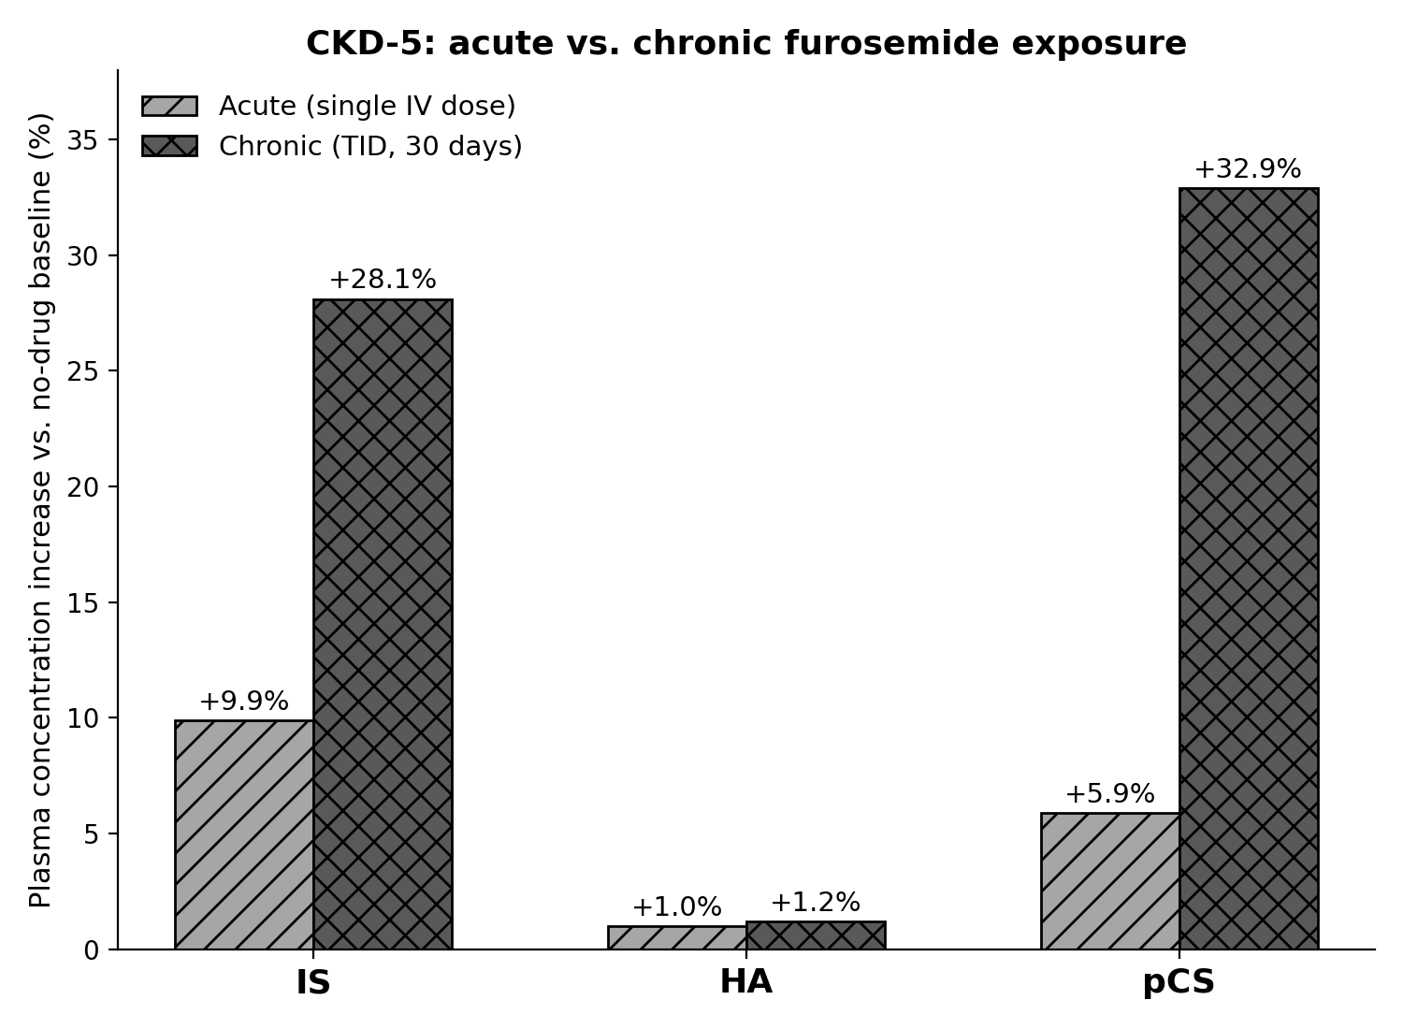
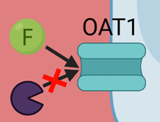
Chronic dosing vs single IV dose
10
% change in time-averaged TOTAL plasma vs no-drug CKD-5. Not a free-concentration plot. At constant f_u,p this % is identical for total, bound, and unbound. Chronic bars: TID 3×80 mg, 30 days (IS +28.1%, pCS +32.9%, HA +1.2%).
Notes:
%Δ of time-averaged TOTAL plasma vs no-drug CKD-5.
Same % for unbound because f_u,p is fixed.
Acute IV: small. Chronic TID 30 days: IS +28.1%, pCS +32.9%, HA +1.2%.
HA barely moves: high f_u,p so much of its CL is GFR, which furosemide does not block.

Slide 11
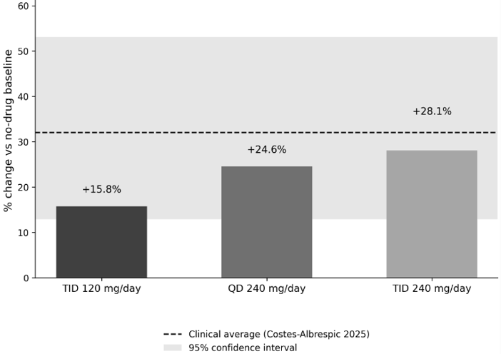
Clinical cohort matches chronic oral dosing
11
Indoxyl sulfate only: % change in time-averaged TOTAL plasma vs no-drug CKD-5 (Css = 28.16 mg/L plasma). Costes-Albrespic 2025 dashed line and grey band are the same total-plasma % (mean +31.9%, 95% CI 13.5–53.3). Unbound %Δ is the same at f_u,p = 0.10.
Notes:
IS, total-plasma %Δ. TID 120 +15.8%; QD 240 +24.6%; TID 240 +28.1%.
All inside the Costes 95% CI. Ki was calibrated to this cohort; the dose–schedule trend was not fitted separately.

Slide 12
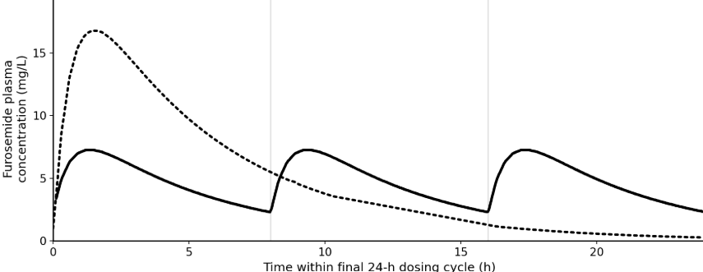
Dosing schedule matters, not just total dose
12
Y-axis 'plasma' is wrong: traces are TOTAL BLOOD C_ven (QD peak 16.6 mg/L, TID peak 7.17 mg/L). TOTAL plasma Cmax = blood / 0.82 → QD 20.3 mg/L, TID 8.75 mg/L. Unbound plasma = total plasma × 0.05 (CKD-5). OAT1 follows unbound, not the plotted peak.
Notes:
Dashed QD 240 mg; solid TID 3×80 mg; last 24 h, CKD-5.
Plotted height is total blood. Quote plasma Cmax 20.3 vs 8.75 mg/L.
QD: high peak, long trough. TID: lower peaks, OAT1 occupied all day → more toxin accumulation at the same daily dose.

Slide 13
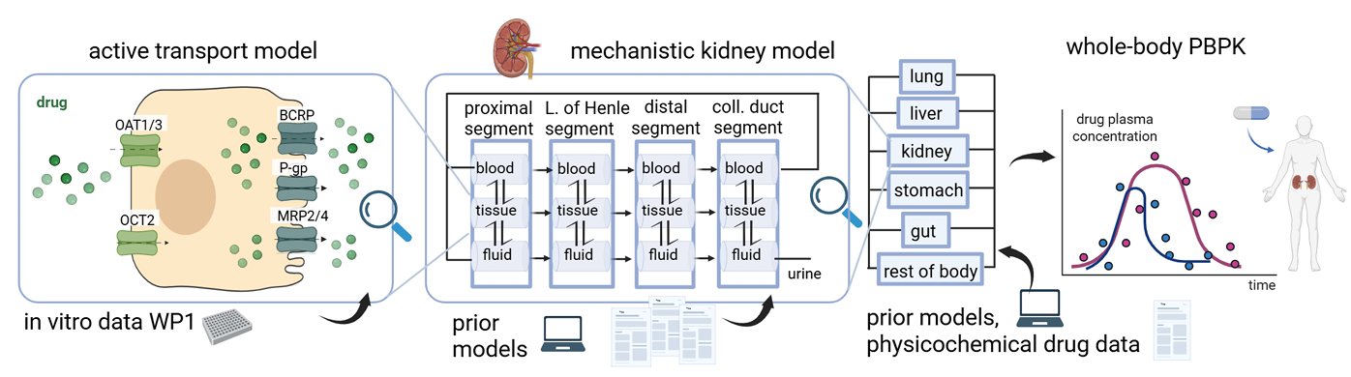
Summary
13
Notes:
To summarise: we built a mechanistic PBPK model of OAT1-mediated competition between furosemide and three uremic toxins, we checked it against clinical data, and we showed that the dosing schedule, not just the total daily dose, independently drives toxin exposure.
Stepping back, here's where this sits in the bigger picture. Transporter kinetics come from in vitro data, through the active transport model on the left. They feed the mechanistic kidney model in the middle, which is what I've shown you today. The kidney model then plugs into a whole-body PBPK model, so we can predict plasma profiles like the ones clinicians actually measure.
The take-home message: for a CKD patient, how you give a drug can matter as much as how much you give.

Slide 14
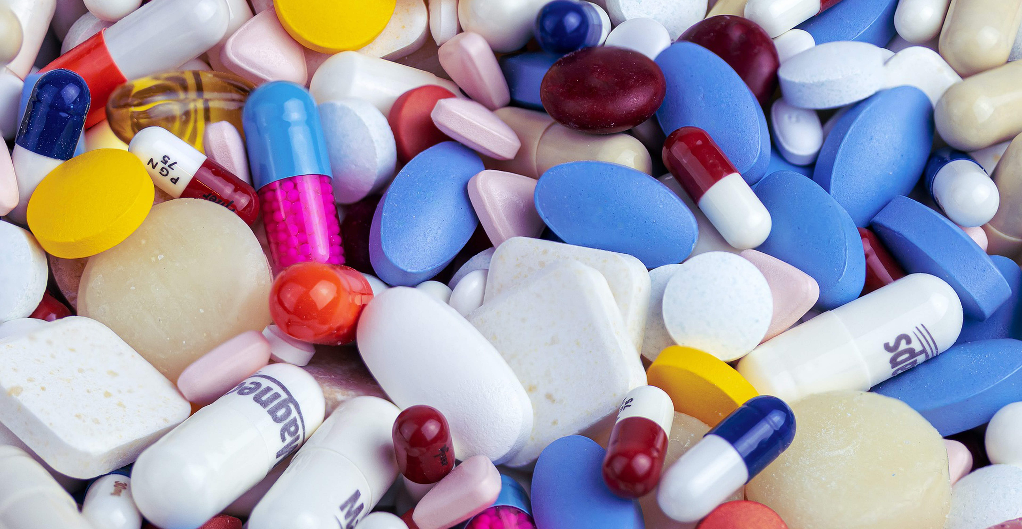
Thank you
Questions & discussion
Leyla.Noroozbabaee@maastrichtuniversity.nl

Slide 15
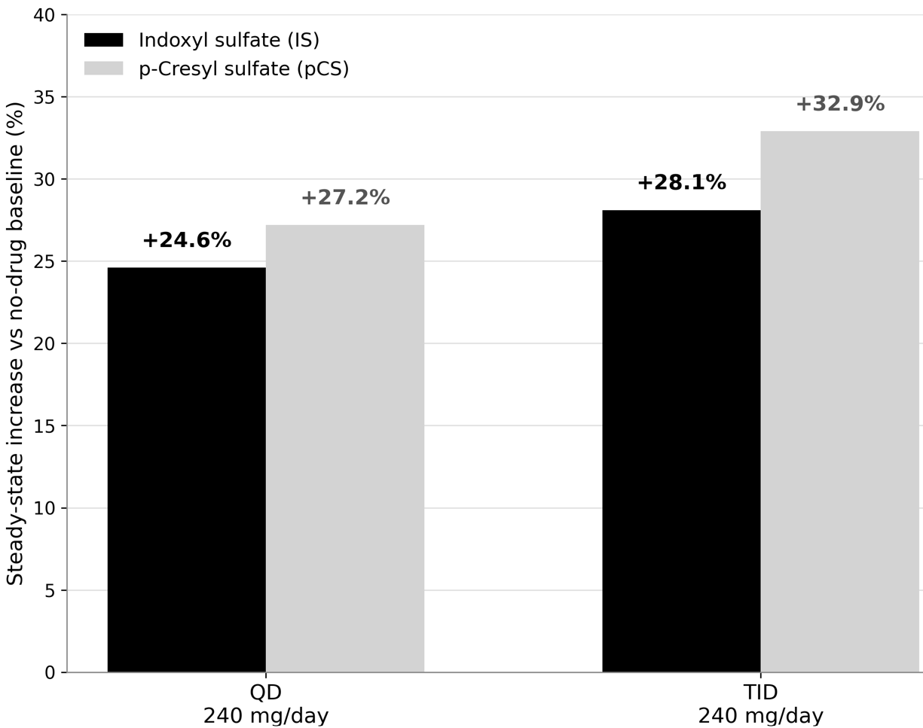
Dosing schedule matters, not just total dose
% change in time-averaged TOTAL plasma vs no-drug CKD-5 (same % for unbound at constant f_u,p). Same 240 mg/day: QD IS +24.6% / pCS +27.2%; TID 3×80 mg IS +28.1% / pCS +32.9%.
Notes:
Same daily dose, two schedules. Bars would match if only total dose mattered; they do not.
TID keeps OAT1 occupied; QD leaves a trough for toxin clearance.

Slide 16
Summary
Mechanistic PBPK model of OAT1-mediated furosemide–toxin competition
Validated against independent clinical data
Dosing schedule independently drives toxin exposure
Notes:
To summarise: we built a mechanistic PBPK model of OAT1-mediated competition between furosemide and three uremic toxins;
we checked it against clinical data; and
we showed that the dosing schedule not just the total daily dose independently drives toxin exposure.
The take-home message: for a CKD patient, how you give a drug can matter as much as how much you give.

Slide 17
Next Steps
Add OAT3-mediated secretion
Add inter-patient variability
Extend to polypharmacy
Notes:
A few natural next steps. First, adding OAT3-mediated secretion alongside OAT1. Second, adding inter-patient variability through a virtual population, so we can see who is most at risk. And third, extending the model to polypharmacy other OAT1/OAT3 substrates like hydrochlorothiazide, and multi-drug competition more broadly

