Slide 1

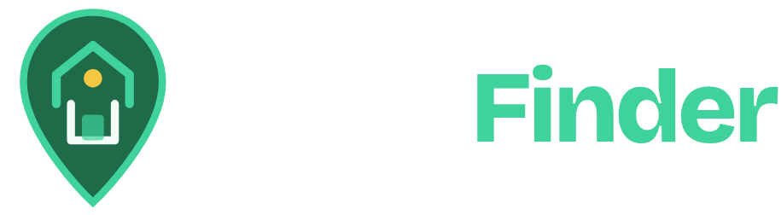
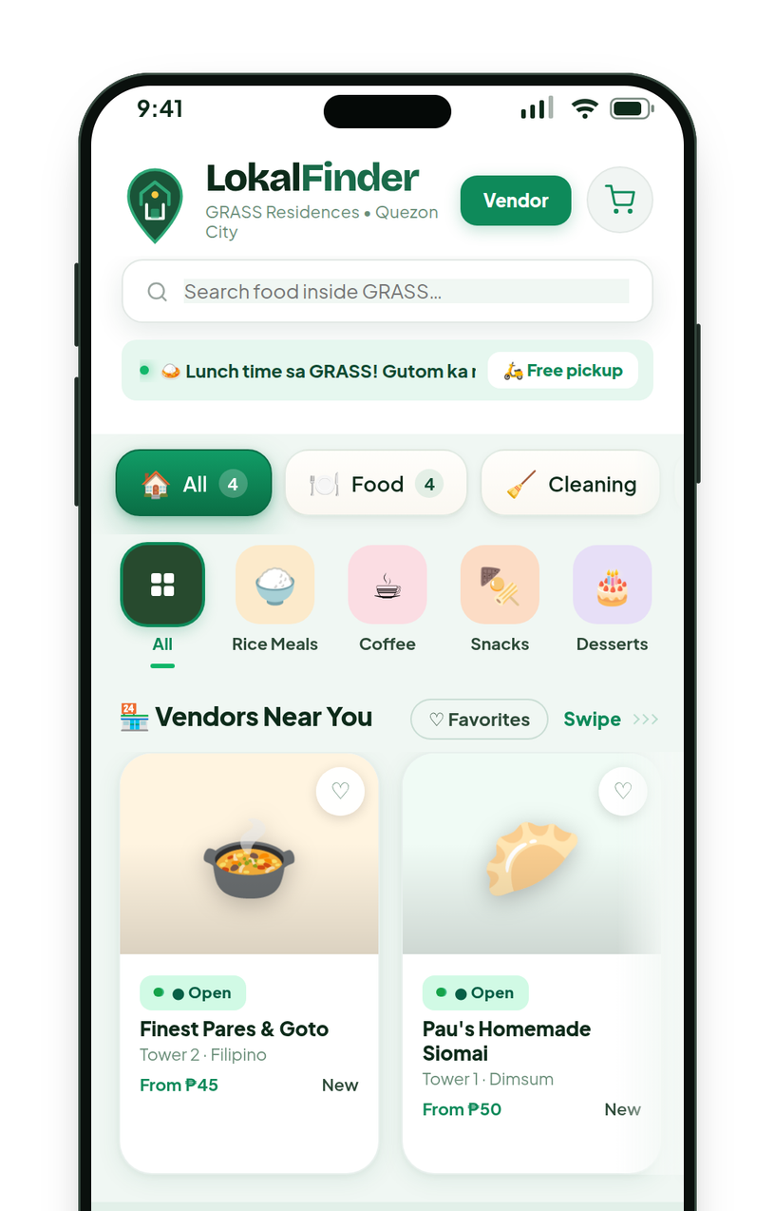
Everything local.
One place.
COMMUNITY COMMERCE, REIMAGINED
Order from, and sell to, the people nearby.
Notes:
OPENING (about 30 seconds)
Lokal Finder is a neighborhood marketplace. The idea in one line: order from, and sell to, the people nearby.
What you are looking at: the headline is the product's own tagline from the Lokal Finder website ("Everything local. One place."). The skyline is original artwork made for this deck in the brand colors: it is an illustration, not a photograph and not a picture of any real building. The two lit windows joined by a dotted line stand for one neighbor ordering from another. The phone is the real Lokal Finder home screen, captured from the actual app with demo data.
Say: "I want to show you what Lokal Finder is, what we have actually seen so far, what we still have to prove, and how we plan to find out."

Slide 2

Getting dinner shouldn’t mean going downstairs.
THE EVERYDAY PROBLEM
2
YOU
Residents either head down and out, or lean on delivery platforms built for an entire city. Neither starts with the neighbor who may be cooking a few floors away.
3
1
Go downstairs and out
Leave the unit, walk, queue, carry it back.
SELLER
2
Use a large delivery platform
Built to reach a whole city.
1
3
Order from a neighbor
The use case Lokal Finder is built for.
Intended use case, not a claim about every customer or every condominium.
Notes:
THE EVERYDAY PROBLEM (about 1 minute)
The founder's core proposition, stated as the intended use case and not as a claim about every customer: a resident who wants dinner may be able to order it from a nearby neighbor instead of going downstairs, or instead of relying only on large delivery platforms.
Walk the picture: one tower. You are in one window. A neighbor who sells food is a few floors away (route 3). The alternatives are to go downstairs and out (route 1), or to order from a platform that is built to cover a whole city (route 2).
Be careful with the claim: we are not saying large platforms are bad, or that every condominium has neighbors who sell food. We are saying there is a convenience gap we want to test.
The tower is original artwork made for this deck, not a photograph and not a real building.

Slide 3

Neighbors who want it. Neighbors who have it.
THE INSIGHT
HYPOTHESIS, NOT A PROVEN FACT
If finding and ordering from a neighbor is easy and reliable, residents will order, and sellers will keep selling.
Residents
Need convenient access to food
Lokal Finder
discovery + reliable ordering
Nearby sellers
Have products they can offer
WHAT MUST BE TRUE
1
Enough residents want nearby food.
2
Enough sellers have something to offer.
3
Ordering is reliable enough to repeat.
We do not assume every condominium has enough demand. This is what Lokal Finder is designed to test.
Notes:
THE INSIGHT (about 1 minute)
The logic is simple, and it is a hypothesis, not a result.
1. Residents need convenient access to food.
2. Nearby sellers may have products they can offer.
3. Discovery and reliable ordering can connect the two.
What has to be true: enough residents want food from nearby sellers; enough sellers have something worth ordering; and ordering is reliable enough that people come back.
Be explicit that we are not claiming every condominium has enough demand or enough sellers. The next slides show how we are testing this and what we have learned so far.

Slide 4



A marketplace for the neighborhood you live in.
THE SOLUTION
Lokal Finder is a neighborhood-focused discovery and ordering platform: find a nearby seller, order, and follow it to your door.
Search your community
Browse by category
Find a seller nearby
Browse stores by category and see who is open right now.
Order in a few taps
Pick items, add your unit and number, pay cash or GCash.
Follow it to your door
Live status from the seller, with chat.
See who is open now
Real app screen (v86 build) with demo data.
Notes:
THE SOLUTION (about 1 minute)
Lokal Finder is a neighborhood-focused discovery and ordering platform.
For a resident: find a seller nearby, order in a few taps, and follow the order to your door. The screen on the right is the real home screen of the app, captured from the actual build with demo data: search, categories, and nearby stores marked open.
For a seller: a storefront and an order desk in the same app (next slides).
Payment note, stated plainly: today the customer pays the seller directly, in cash or by GCash. The app records the order and the payment method; it does not process payments.

Slide 5
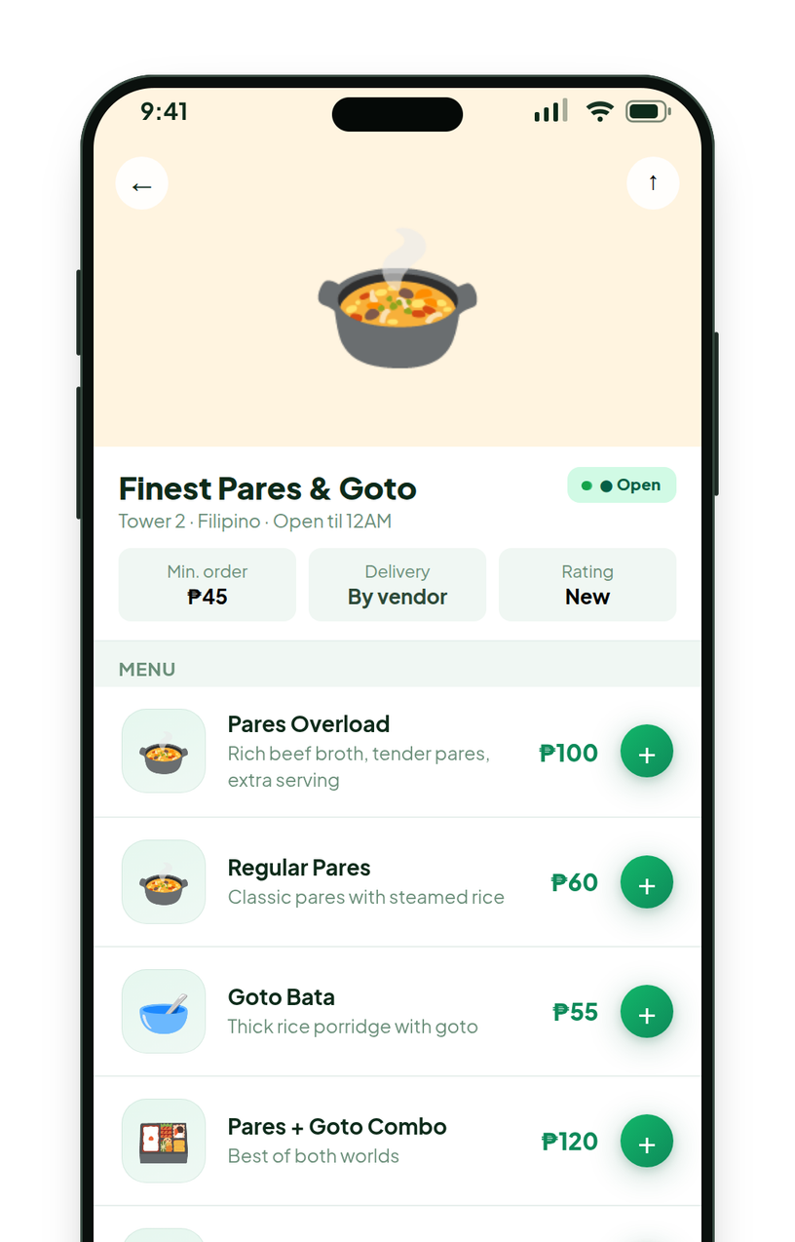
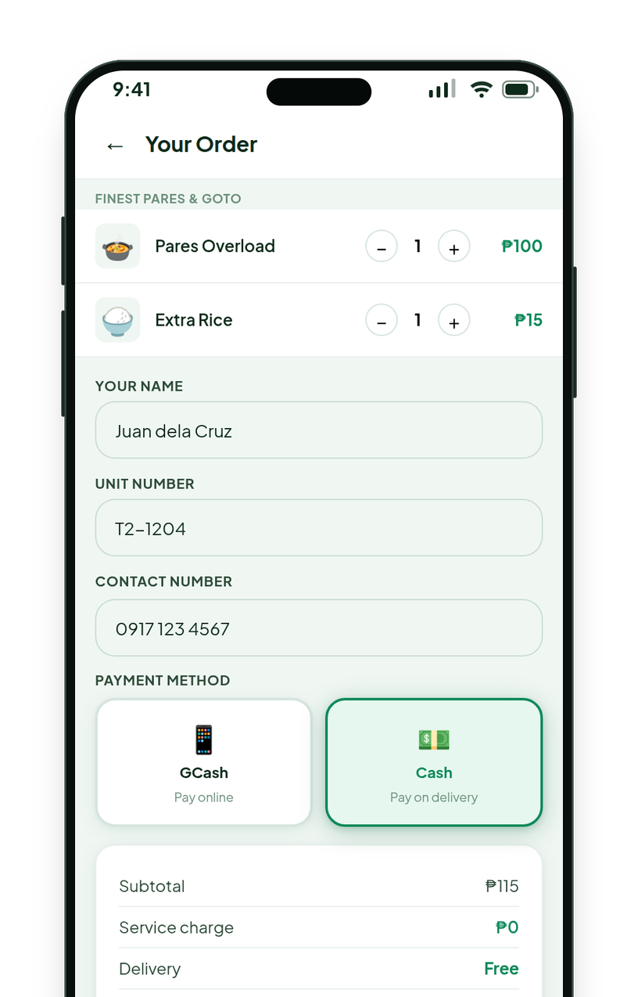
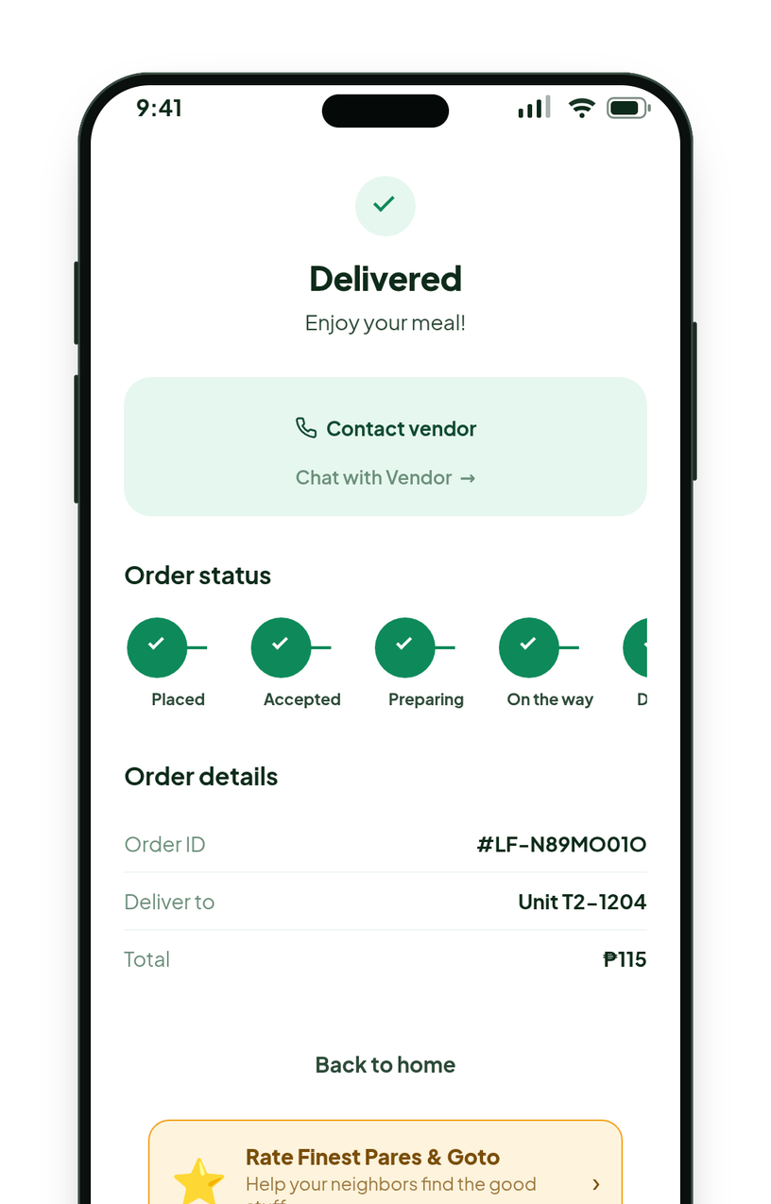
From craving to doorstep in four steps.
HOW IT WORKS
Real app screens (v86 build) with demo data. Customers pay the seller directly; the app records the order, it does not process payments.
1
2
3
4
Discover
Browse nearby stores by category. See who is open.
Browse
Open a store: menu, prices and opening hours.
Order
Add items, enter your unit, pay cash or GCash.
Receive
Follow it live. The seller brings it to your unit.
Notes:
HOW IT WORKS (about 1 minute)
The workflow below is the one the product actually implements.
1. Discover: the home screen lists nearby stores by category and shows who is open.
2. Browse: a store page shows the menu, prices and opening hours.
3. Order: the customer adds items, gives a unit number and contact number, and chooses cash or GCash. The seller is paid directly.
4. Receive: the order moves through Placed, Accepted, Preparing, On the way and Delivered, and the customer can chat with the seller. The seller delivers; the app does not run couriers.
One difference from the generic four-step story: the app also supports scheduled bookings for services (cleaning, aircon, laundry) with a date and time slot instead of a cart. Those verticals exist in the product; the stores shown for them in the demo are demo data.

Slide 6
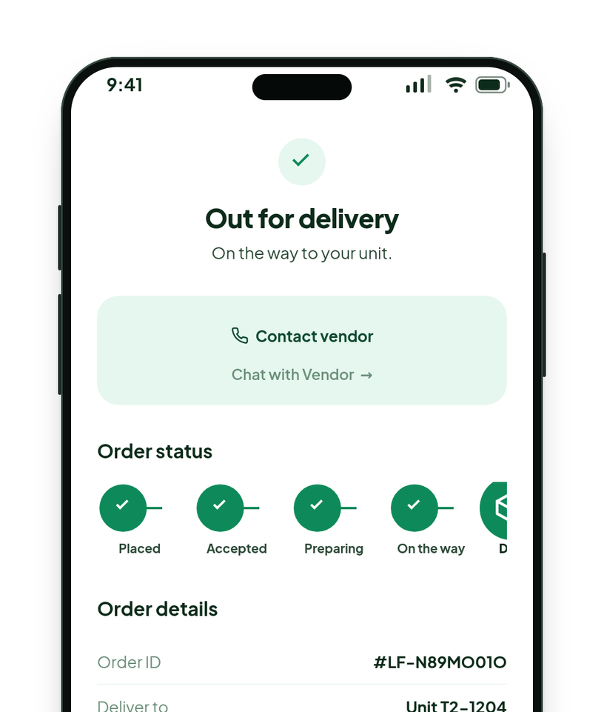
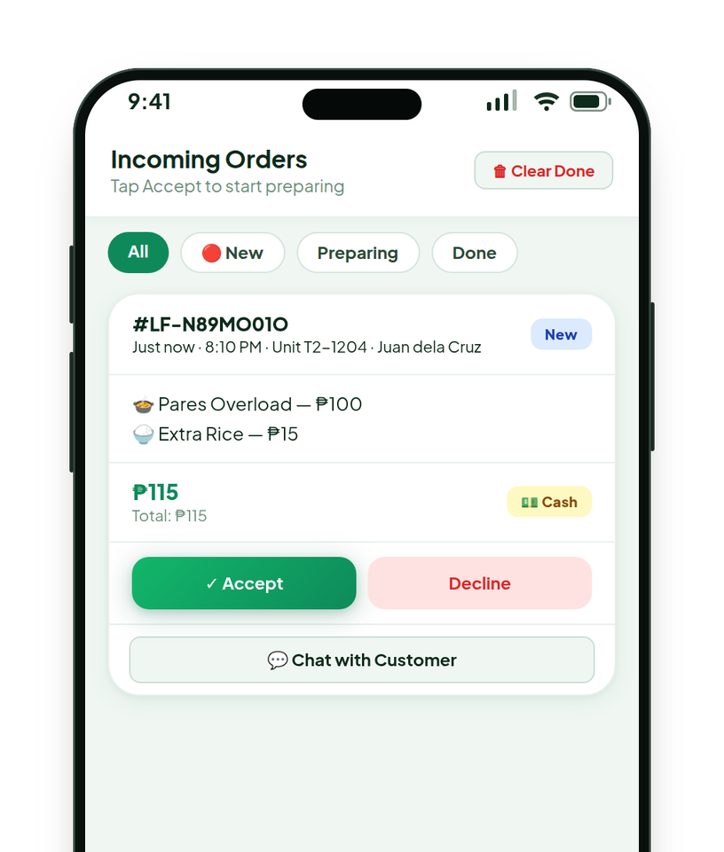
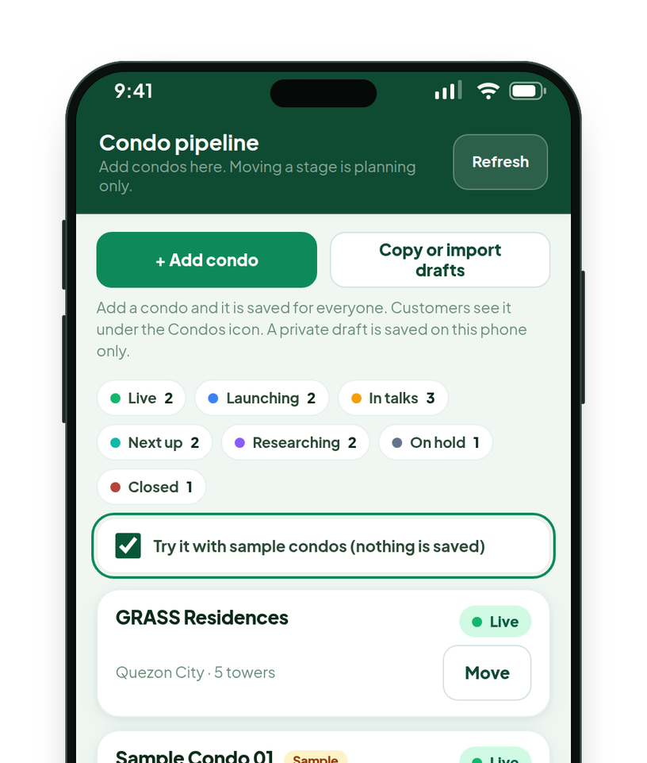
What exists today: one app, three sides.
THE PRODUCT EXPERIENCE
Real app screens (v86 build) with demo data. The admin screen shows sample condos, not real ones.
RESIDENTS
SELLERS
THE LOKAL FINDER TEAM
Order and track
Accept and fulfill
Approve and plan
Browse stores, order in a few taps, follow it live and chat with the seller.
Orders arrive in one list. Accept, prepare, deliver; keep the menu up to date.
Approve new stores, watch each store, and plan which communities come next.
Notes:
THE PRODUCT EXPERIENCE (about 1.5 minutes)
This is one installable web app with three sides. Everything on screen exists in the current build; the data inside is demo data.
Residents: the order tracker. A customer follows the order through Placed, Accepted, Preparing, On the way and Delivered, and can chat with the seller. There is also a community feed where stores and neighbors post, and an order history.
Sellers: the order desk. Orders arrive in one list with Accept and Decline. A seller can update status, switch menu items on and off, post to the feed, and see recorded sales. Stores can apply on their own and are approved by the team. Sign-in is a PIN and stays signed in for 30 days.
The Lokal Finder team: the admin console. It approves new stores, shows activity per store, and holds the condo launch pipeline (seven stages from Researching to Live). The pipeline screen here shows sample condos so no real community is implied.
Also in the product but not shown: scheduled bookings for services (date and time slots) for cleaning, aircon and laundry. Those categories exist in the app, but no real store has been onboarded in them; the stores in the demo are demo data.

Slide 7




Lean to run. Tested before every release.
UNDER THE HOOD
The app
One installable web app. No application server to run.
AUTOMATED CHECKS BY RELEASE
1,651 checks across 22 suites
The data
Firebase Realtime Database, called directly by the app.
The release line
GitHub tests every change, then publishes it automatically.
The switches
New features can ship dark and be turned on from one settings file.
Selected releases. v77 is before the condo work (13 suites).
Source: the project’s own test records. On the latest release, 126 deliberate code breakages were tried: 122 caught, 4 equivalent.
Notes:
UNDER THE HOOD (about 1 minute; skip if the audience is not technical)
The point for a business audience: Lokal Finder is cheap to run and disciplined to change.
The app: one installable web app, written by hand with no framework and no build step. There is no application server to operate. (Trade-off to be honest about: everything lives in one large file, which is fast to ship and will need to be split up as the team grows.)
The data: Firebase Realtime Database, called directly from the app. Hosting is GitHub Pages.
The release line: every change goes through automated tests that drive the real app in a headless browser, against an in-memory copy of the database, so a test can never touch real data. Only if everything passes is the new version published.
The switches: a settings file lets the team ship a feature switched off (dark), then turn it on for admins first, then for everyone, and turn it off again without a new release. The condo features were shipped this way.
The chart: automated checks grew from 550 (13 suites) to 1,651 (22 suites) across the releases shown. The numbers come from the project's own records. As a test of the tests, the team deliberately broke the latest release in 126 ways: 122 were caught and 4 were harmless equivalents.
What this does not mean: tests do not prove demand, and the app has not been tested on every real phone. Security hardening is on the roadmap.

Slide 8



Why start in a condominium? Four hypotheses.
THE INITIAL MARKET
STRATEGIC HYPOTHESES, NOT PROVEN DEMAND
Nearby communities, later
Your community
Your tower
Proximity
The nearest seller can be a few floors away, not across the city.
Concentration
Many households live in one place, close to each other.
You
Convenience
A door-to-door order that never leaves the building.
Access
Neighbors who sell can be found without needing a storefront.
Residents
Nearby sellers
Pilot community: GRASS Residences, Quezon City (5 towers)
No market-size estimate is claimed.
Notes:
THE INITIAL MARKET (about 1 minute)
Why condominiums and dense residential communities are a logical place to start. These are strategic hypotheses, not proven customer demand, and no market-size estimate is claimed.
1. Proximity: the nearest seller can be a few floors away, not across the city.
2. Concentration: many households live in one place.
3. Convenience: an order can go door to door without leaving the building.
4. Access: neighbors who sell from home or a small kitchen can be found without needing a storefront.
The rings are the brand's ripple motif: you in the middle, your tower, your community, and only later other communities. Mint dots are residents and amber dots are sellers. It is a schematic, not a map.
The one verified fact about where: the pilot community is GRASS Residences in Quezon City (the app lists five towers). No other community has been launched, and no condominium partnership or access agreement is claimed here.

Slide 9

What we have seen so far.
CURRENT TRACTION
FOUNDER-REPORTED · NOT AUDITED
HOW TO READ THIS NUMBER
≈ ₱23,000
It is
Sales reported by the founder from the earlier web app.
It is not
Profit
in sales through the earlier web app, over several months.
Lokal Finder’s revenue
An audited figure
ANDROID
Available on Google Play.
IPHONE
App Store approval pending as of October 2026.
RELIABILITY
Sales came despite notification problems.
A count of customers or orders
Not claimed: orders, repeat rate, growth, or customer and seller counts. They have not been measured yet.
Sales figure and store status are founder-reported; no store listing or sales record was checked for this deck.
Notes:
CURRENT TRACTION (about 1.5 minutes)
Lead with the number, then immediately say what it is and what it is not.
About ₱23,000 in sales over several months through the earlier web application, even though notifications were not working reliably. This is a founder-reported figure, not independently audited.
It is sales, not profit, and it is not Lokal Finder's revenue. It is not a count of customers or orders either. We are not claiming order counts, retention, conversion, monthly growth, or numbers of customers or sellers, because they have not been measured.
Availability, as reported by the founder: the current app is available on Google Play. App Store approval was still pending as of October 2026. (We looked in the project files for any newer evidence on either store and found none, so please confirm the current status before presenting, and update this slide if it has changed.)
What this does establish: some real sales happened through the earlier version. What it does not establish: repeatable or scalable demand. The next slide separates the two.

Slide 10



What the evidence says, and what it doesn’t.
WHAT WE HAVE LEARNED
Demonstrated
Evidence on file
Believed possible
The founder’s view
Needs validation
Not yet known
Real sales: about ₱23,000 through the earlier web app (founder-reported).
Real stores have listed their own menus and prices in the app.
The full order flow works in the product, covered by 1,651 automated checks.
Residents will choose nearby sellers for everyday food.
One platform can serve food, cleaning, laundry and aircon.
A launch playbook can repeat across communities.
Repeat ordering and retention.
Reliable alerts for sellers and customers.
Economics for sellers and for Lokal Finder.
Demand in a second community.
The sales so far show the concept can work. They do not yet show demand that repeats or scales.
Evidence ladder: demonstrated, believed, not yet known.
Notes:
WHAT WE HAVE LEARNED (about 1 minute)
Credible and analytical, not promotional. Three columns, three levels of confidence.
Demonstrated: real sales happened through the earlier web app (about ₱23,000, founder-reported); real stores listed their own menus and prices; and the order flow works in the product, which is verified by 1,651 automated checks. (The automated checks prove the software behaves as designed, not that customers want it.)
Believed possible, the founder's view: residents will choose nearby sellers for everyday food; one platform can serve several kinds of local service; a launch playbook can repeat across communities.
Needs validation: repeat ordering and retention; reliable alerts for sellers and customers; the economics for sellers and for Lokal Finder; and demand in a second community.
Close on the line at the bottom: the sales so far show the concept can work, not that demand is repeatable or scalable.

Slide 11
How we could earn, and what exists today.
THE BUSINESS MODEL
Residents
Pay the seller directly: cash or GCash
Sellers
Today this payment does not pass through Lokal Finder.
Lokal Finder
discovery, ordering, status and chat
POSSIBLE WAYS TO EARN
BUILT, NOT ACTIVE
PROPOSAL
EARLY TOOLING
PROPOSAL
Transaction commission
Seller plans or fees
Paid visibility
Local advertising
A percent per seller, recorded on delivered orders. Default 0%; not collected.
A monthly plan or per-order fee for extra tools. Nothing is charged today.
Admins can mark a store Featured. No paid placement exists yet.
Local promotions relevant to residents. Not started.
No revenue stream is confirmed as operating today. Principle: add one only when it improves the marketplace for both sides.
Notes:
THE BUSINESS MODEL (about 1.5 minutes)
Start with what is true today, then separate what is built from what is only proposed.
Today: a resident pays the seller directly, in cash or by GCash. Lokal Finder helps the two find each other, place the order and follow it, but the payment does not pass through Lokal Finder. No revenue stream is confirmed as operating today.
Four ways Lokal Finder could earn, with honest status:
1. Transaction commission: built into the admin tools. A percentage can be set per seller (the default is 0%) and is recorded on delivered orders. It is recorded, not collected, and not active.
2. Seller plans or service fees: a proposal. A monthly plan or a per-order fee for tools beyond the basic listing. Nothing is charged.
3. Paid business visibility: early tooling only. Admins can mark a store as Featured; there is no paid placement.
4. Local advertising partnerships: a proposal. Not started.
We are not showing margins, take rates, profitability or revenue projections because none of them has been measured. The principle: add a revenue stream only when it improves the marketplace for both sides, never just because it is possible.

Slide 12


Where we aim to be different, and what we must still prove.
THE COMPETITIVE LANDSCAPE
Structured
menus, status, tracking
WHAT WE AIM TO DO DIFFERENTLY
TO PROVE
Hyperlocal discovery
Stores in your own community, not a whole city’s.
Lokal Finder
One community, structured
Large delivery platforms
Whole city, structured
Nearby sellers
Neighbors can open a store without a storefront.
Community convenience
Orders go to a unit in the same building.
Informal neighborhood selling
Close to home, but manual
Seller accessibility
Stores apply themselves and sign in with a PIN.
Manual
chats, posts, DMs
Ordering convenience
Menus, status and chat in one place.
One community
Whole city
Still to prove: that the difference is big enough to win repeat orders and keep sellers.
A qualitative map. No advantage is claimed and no competitor pricing or features are quoted.
Notes:
THE COMPETITIVE LANDSCAPE (about 1 minute)
Compare intended positioning, not proven superiority.
The map has two simple axes: how structured the ordering is (menus, status, tracking versus chats, posts and direct messages) and how wide the reach is (one community versus a whole city). Large delivery platforms are structured and city-wide. Informal neighborhood selling is close to home but manual. Lokal Finder is trying to be structured and community-sized. That position is the hypothesis, and it is marked To prove.
On the right, the five differences we aim for: hyperlocal discovery, nearby sellers, community convenience, seller accessibility and ordering convenience. Each is an intention, not a measured advantage.
We are deliberately not quoting any competitor's prices, fees or features, and we do not claim superiority. What Lokal Finder must still prove is that the difference is big enough to win repeat orders and keep sellers.

Slide 13

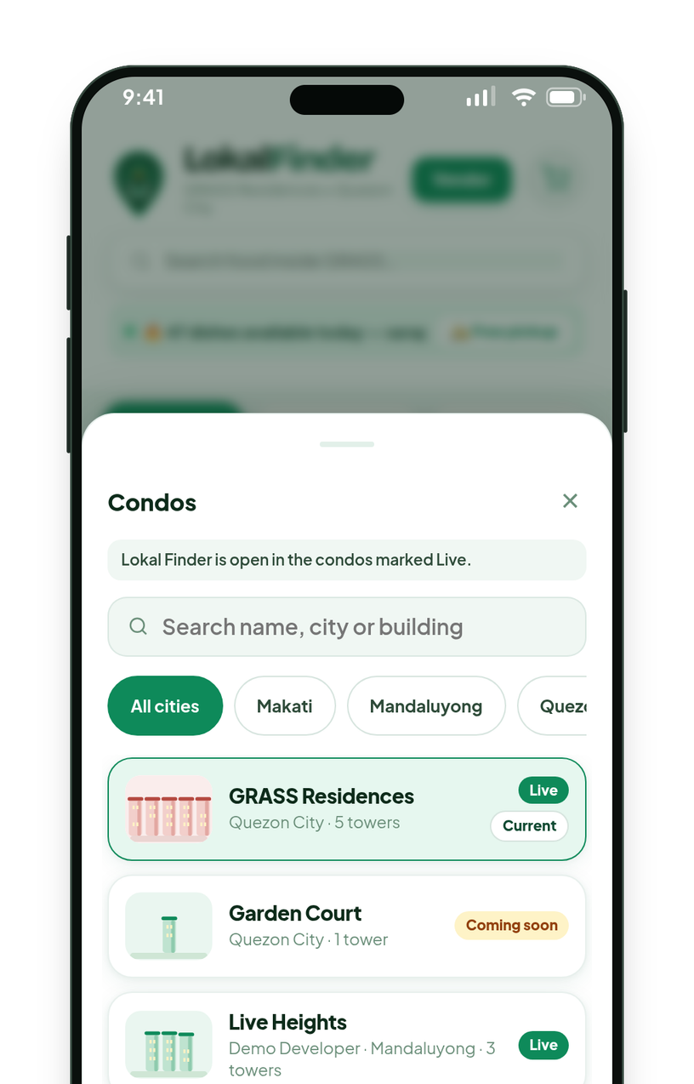
Prove one community. Then repeat it.
THE GROWTH STRATEGY
NOW
NOW
NEXT
NEXT
WHEN EARNED
1
2
3
4
5
Validate one community
GRASS Residences, Quezon City.
Measure
Orders, repeat ordering, seller activity.
Improve
Product and operations, from what we see.
Write the playbook
A repeatable launch process.
Expand
To comparable communities.
Sample condos
PROPOSED GATE Repeat ordering shown, sellers staying active, economics understood.
ALREADY BUILT FOR THE LAUNCH PROCESS
CONDO DIRECTORY
7-STAGE LAUNCH PIPELINE
SEPARATE COMMUNITY ROOMS
ADMIN-ONLY SWITCH
No second community is live. No condominium partnership or access is claimed.
Plan, not a result. The community tools are built; no second community is live.
Notes:
THE GROWTH STRATEGY (about 1 minute)
A disciplined sequence, not an expansion map. Start by validating one residential community, measure performance, improve the product and operations, write down how a launch works, and only then expand to comparable communities, and only when the evidence supports it.
Where we are: step one and two. The pilot community is GRASS Residences in Quezon City. The proposed gate before stage five is repeat ordering shown, sellers staying active, and the economics understood. These criteria are proposals for the team to agree, not targets that have been set.
What is already built to make launching the next community cheaper (verified in the product): a directory of condominiums, a seven-stage launch pipeline (Researching, In talks, Next up, Launching, Live, On hold, Closed), separate community rooms so each condo has its own stores, menus and orders, and an admin-only switch so a community can be tried before customers can enter it. The screen on the right is the customer Condos list with sample condos.
What we are not claiming: no second community is live, and no condominium partnership or access agreement is claimed here.

Slide 14
The next steps, in order.
THE ROADMAP
NOW
NEXT
LATER
ON EVIDENCE
1
2
3
4
5
6
PLAN
PLAN
PLAN
PLAN
PLAN
GATED PLAN
Improve reliability and notifications
Measure usage and repeat ordering
Validate seller and customer economics
Improve acquisition and retention
Build a repeatable launch process
Expand when performance justifies it
SIGNAL
SIGNAL
SIGNAL
SIGNAL
SIGNAL
SIGNAL
Alerts reach sellers and customers.
Orders and repeat rate, tracked weekly.
What an order is worth to each side.
More first orders, more second orders.
A written, tested launch checklist.
A second community, only on evidence.
Plans, not achievements. No dates or numeric targets are committed on this slide.
Notes:
THE ROADMAP (about 1 minute)
Six steps in order, all labeled as plans. Nothing here is a completed achievement and no dates or numeric targets are committed.
Now: improve reliability and notifications (alerts must reach sellers and customers; today delivery of closed-app alerts is not verified), and measure actual usage and repeat ordering (the product has no analytics layer yet, so this is real work).
Next: validate seller and customer economics (what an order is worth to each side), and improve acquisition and retention (more first orders, more second orders).
Later: build a repeatable launch process (a written, tested checklist for opening a new community).
When evidence supports it: expand to comparable communities.
Also planned on the engineering side, behind the scenes and not shown as a step: security hardening and moving the database to a paid plan. The team treats these as top priority.

Slide 15






Everything you need,
around you.
THE VISION
Food
Live in the pilot
Our ambition is to make it easier for residents to discover and buy from nearby sellers, and to help local businesses reach the customers already in their community.
Cleaning
Built
Food first. The rest only when it earns its place.
Laundry
Built
Aircon
Built
Built in the product; real sellers still to come.
Notes:
THE VISION (about 45 seconds)
Ambitious, but grounded in what the product is and what has been shown.
The ambition, in plain words: make it easier for residents to discover and buy from nearby sellers, and help local businesses reach the customers already in their community.
The picture: the pin in the middle is a resident; around it are the categories the product is built for. Food is the wedge and the only category that has real stores in the pilot. Cleaning, aircon and laundry are built (including scheduled bookings with date and time slots) and are waiting for real sellers; the stores shown for them in the demo are demo data. The website also mentions housekeeping, services and local retail as possibilities.
The principle at the bottom matters: food first, and everything else only when it earns its place. A long-term vision is not a validated business model, and this deck does not present it as one.
The skyline is original artwork, not a photograph.

Slide 16

Your community.
Connected.
Lokal Finder is building the easiest way to buy from,
and sell to, the people nearby.
ONE COMMUNITY FIRST · PROVE REPEAT ORDERING · THEN REPEAT IT
Business and product overview · October 2026
Notes:
THE CLOSING (about 30 seconds)
End on the purpose, not on "thank you".
Lokal Finder is building the easiest way to buy from, and sell to, the people nearby. Why it matters: a convenient meal and a small livelihood can be a few floors apart, and today they are hard to connect.
What we do next is deliberately modest: one community first, prove repeat ordering, then repeat it.
There is no investment ask in this deck. If the audience is partners, the natural next conversation is about a community, or a group of sellers, to learn with. If the audience is investors, the natural next conversation is about what evidence would justify the next step.

