Slide 1


WaitLess
Digital Queue Management for Public Hospitals
Skip the queue. Not the care.
Final Year Project Presentation
Chinhoyi Provincial Hospital • Zimbabwe • 10-minute walkthrough
Notes:
Welcome the audience. Introduce WaitLess as a digital queue management system built for public hospitals in Zimbabwe. Emphasize the tagline: 'Skip the queue, not the care.' State the goal: replace paper queues with a real-time, triage-aware, offline-first system. Set expectations: 10 minutes, then demo/Q&A.

Slide 2

Agenda
10-minute roadmap
01
The problem
Paper queues, blind waits, no communication, no data
02
The solution
Real-time digital queue with triage, WhatsApp, dashboards
03
How it works
Patient journey from check-in to pharmacy
04
Key features
Triage engine, notifications, modules, reports, AI
05
Live demo
Queue board, tracking, staff dashboard
06
Impact & deployment
Benefits, security, offline-first, rollout
WaitLess — Digital Queue Management for Public Hospitals
02 / 14
Notes:
Walk through the agenda quickly. Tell the audience where you are going so they can follow. Keep this to 20 seconds.

Slide 3
The problem
Paper queues are failing patients and staff
Hours of blind waiting
!
Patients arrive at 6 AM and wait 4–6 hours with no idea when they will be seen.
No communication
!
Once a paper ticket is issued, there is zero update until a nurse shouts a number.
Triage ignored
!
First-come-first-served means critical patients wait behind routine check-ups.
No operational data
!
Managers guess at bottlenecks; there is no record of wait times or outcomes.
WaitLess — Digital Queue Management for Public Hospitals
03 / 14
Notes:
Describe the real pain points observed at Chinhoyi Provincial Hospital: patients wait blindly, no communication, triage not enforced, and no data for management. Use a concrete example: a patient with chest pain waiting behind 40 routine patients.

Slide 4
The solution
WaitLess replaces paper with a real-time digital queue
✓
✓
✓
✓
Check in
Triage aware
Live updates
Full visibility
Staff desk, patient phone, or kiosk QR — under a minute.
Red/Yellow/Green/Black priority enforced automatically.
WhatsApp, web push, and audio alerts at every step.
Staff dashboards, public boards, and 10 reports.
Built for Zimbabwean public hospitals: offline-first, multilingual, and WhatsApp-native.
WaitLess — Digital Queue Management for Public Hospitals
04 / 14
Notes:
Position WaitLess as the complete replacement for paper queues. Highlight the four pillars: easy check-in, triage-aware routing, real-time notifications, and operational visibility. Mention it is designed for local constraints: LAN operation, WhatsApp, and local languages.

Slide 5
How it works
One connected patient journey
1
Register
2
Triage
3
Queue
4
Called
→
→
→
Reception, phone, or kiosk. Ticket + QR issued instantly.
Vitals and priority captured; Red jumps the queue.
Patient tracks live position and estimated wait.
WhatsApp + audio alert; patient proceeds to room.
↓
↓
5
Served
6
Complete
Consultation, orders, transfers to Lab/Pharmacy/Radiology.
Visit closed, feedback collected, record updated.
Every step emits a real-time event — boards, dashboards, and patient phones update instantly.
WaitLess — Digital Queue Management for Public Hospitals
05 / 14
Notes:
Walk through the patient journey left to right, then down. Emphasize that every step is tracked and communicated. Mention that transfers (e.g., OPD to Lab to Pharmacy) keep the same patient record and issue department-specific tickets.

Slide 6
Triage-aware queue
The sickest patients are seen first
RED
Resuscitation
Immediate, life-threatening. Auto-fast-tracked to front.
YELLOW
Urgent
Seen within ~60 minutes. Reassessment alerts if delayed.
GREEN
Standard
Routine queue order. Most walk-in patients.
BLACK
Expectant
Deceased or expectant care. Documented and routed appropriately.
Emergency triggers are auto-detected from vitals; nurses can override priority at any time.
WaitLess — Digital Queue Management for Public Hospitals
06 / 14
Notes:
Explain the four-tier triage protocol. Red patients jump the queue automatically. Yellow patients get reassessment alerts if they wait too long. Nurses can override. This is a key differentiator vs. first-come-first-served systems.

Slide 7
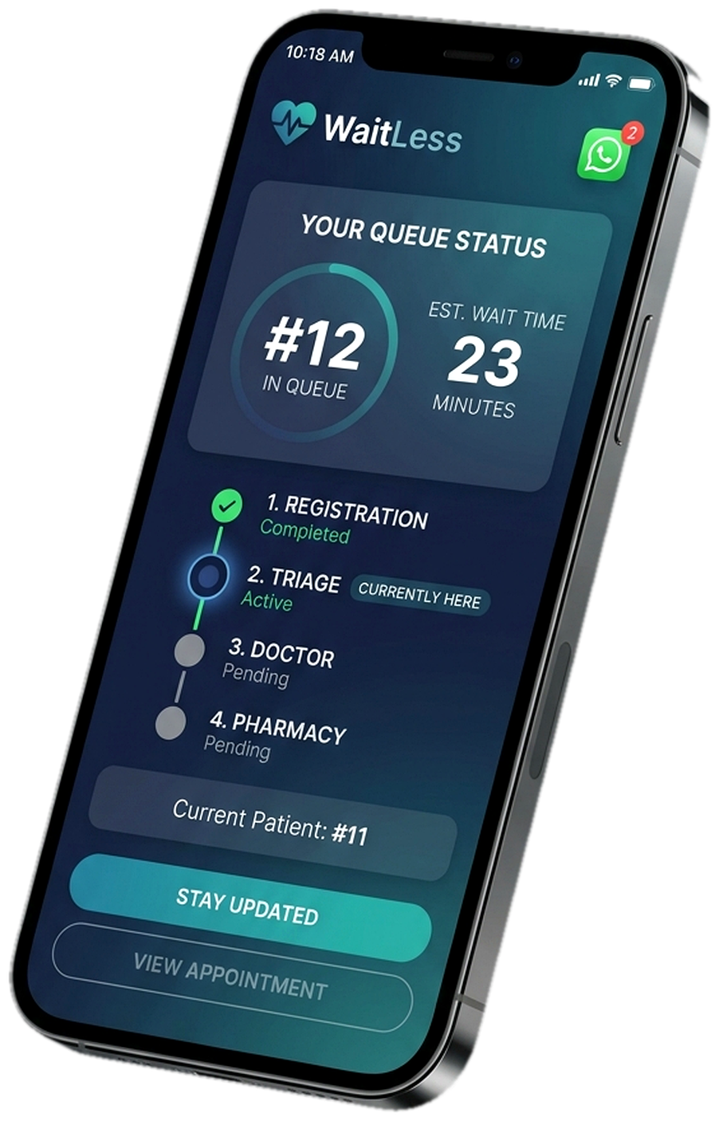
Communication
WhatsApp-native updates at every step
Registration
✓
You're in the queue — OPD-205. Track: waitless.app/track
Near turn
✓
Your turn is approaching. Please return to the OPD waiting area.
Called
✓
OPD-205, please proceed to Room 3.
Transfer
✓
Moved to Laboratory. New ticket: LAB-206.
Prescription
✓
Your prescription is ready at the Pharmacy window.
Uses Meta WhatsApp Cloud API service window — zero per-message cost to the hospital.
WaitLess — Digital Queue Management for Public Hospitals
07 / 14
Notes:
Show the phone mockup and the WhatsApp message examples. Emphasize zero-cost WhatsApp via the service conversation window, plus web push and audio announcements. Patients can leave the waiting area and return when near their turn.

Slide 8
Platform capabilities
Everything staff and patients need
Real-time boards
Staff dashboard
•
Public and department displays updated via SSE — ticket codes only, no names.
•
Live queue counts, wait times, bottlenecks, and reassessment alerts.
Department modules
Reporting suite
•
Pharmacy, Laboratory, Radiology, and confidential OI Clinic streams.
•
10 reports: wait times, performance, no-shows, triage, peak hours, and more.
AI insights
Offline-first
•
Wait-time prediction, bottleneck analysis, resource allocation, and a patient chatbot.
•
Runs on hospital LAN; WhatsApp messages queue and send when connectivity returns.
WaitLess — Digital Queue Management for Public Hospitals
08 / 14
Notes:
Cover the platform breadth: public boards, staff dashboard, department modules (pharmacy, lab, radiology, OI clinic), 10 reports, AI insights, and offline-first architecture. Mention SSE real-time updates and anonymous ticket codes on public boards.

Slide 9
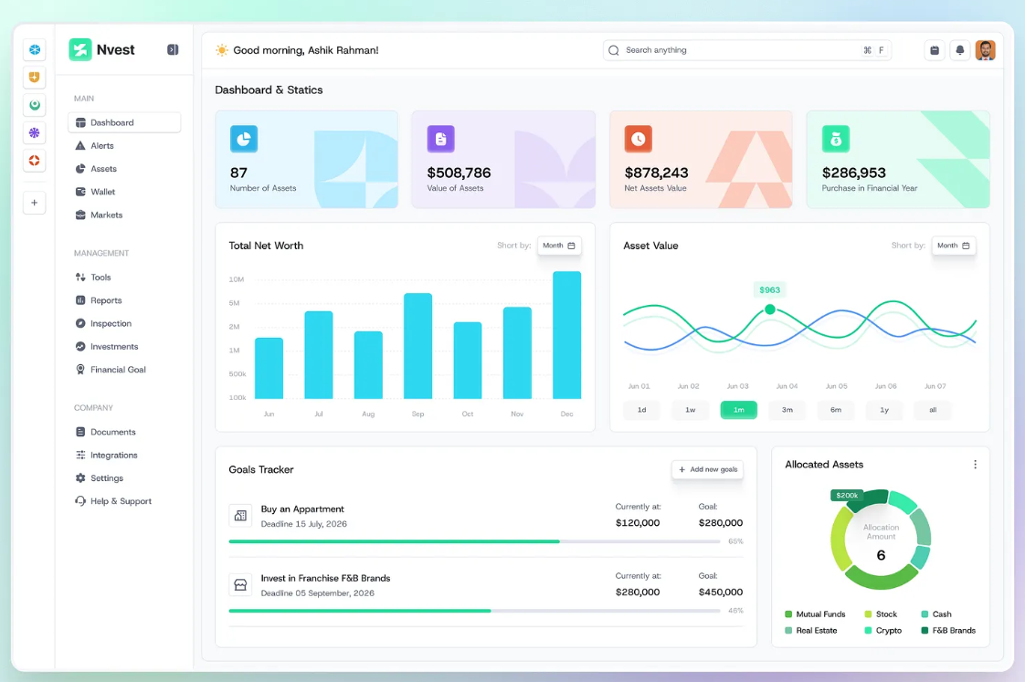
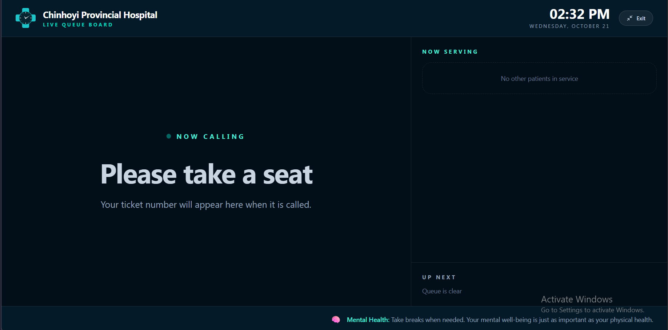
See it in action
Live interfaces staff and patients use
Public queue board
Staff dashboard
Patient tracking
Ticket codes only — no patient names.
Real-time metrics and actions.
Live position and wait estimate.
Demo tip: open /queue for the public board, /admin/dashboard for staff, and /track for patient view.
WaitLess — Digital Queue Management for Public Hospitals
09 / 14
Notes:
If time allows, switch to the live app: show the public queue board, the staff dashboard with call-next, and the patient tracking page. Otherwise, use these screenshots to orient the audience.

Slide 10
Trust & security
Built for clinical and public-sector use
Role-based access
Admin, reception, triage, clinician, pharmacist, lab-tech, dentist — least-privilege by default.
✓
Tamper-evident audit
Every action is recorded in a SHA-256 hash-chained log for medical-legal compliance.
✓
Privacy by design
Public boards show ticket codes only; OI Clinic uses masked routing and restricted views.
✓
Secure auth
bcrypt password hashing (12 rounds), session management, and idle timeouts.
✓
Offline resilience
Core queue operations continue on LAN; WhatsApp messages queue and retry automatically.
✓
Multilingual
Full UI in English, chiShona, and isiNdebele.
✓
WaitLess — Digital Queue Management for Public Hospitals
10 / 14
Notes:
Reassure stakeholders: RBAC, bcrypt, SHA-256 audit trail, anonymous public boards, confidential OI clinic handling, offline-first operation, and trilingual support. This addresses common hospital concerns about security and privacy.

Slide 11
Impact
What changes when queues go digital
40%
12,480+
45,600+
97%
Reduction in average wait time
Patients served
WhatsApp alerts
System uptime
Reported in early deployments
Across departments and clinics
Delivered at zero per-message cost
On hospital LAN infrastructure
For patients: less waiting, clear updates, and the ability to leave and return.
For staff: less shouting, fewer missed turns, and real-time operational control.
For management: data to optimize staffing, capacity, and patient flow.
WaitLess — Digital Queue Management for Public Hospitals
11 / 14
Notes:
Present the impact stats, but caveat that they are illustrative/early-deployment figures. Emphasize the three audiences: patients, staff, and management. Tie back to the original problems.

Slide 12
Deployment
Simple to run, easy to scale
Backend
Node.js 18+, Express/custom router, MySQL 8+ (or file storage for dev).
Frontend
Vite + React, served as static files or via the same server.
Notifications
Meta WhatsApp Cloud API for production; optional web push.
Deployment options
• Local hospital LAN (offline-first, recommended for public hospitals)
• Cloud-hosted (Render blueprint included) for internet-connected facilities
• Multi-hospital networks with per-facility configuration
WaitLess — Digital Queue Management for Public Hospitals
12 / 14
Notes:
Explain deployment is lightweight: Node.js backend, React frontend, MySQL. WhatsApp Cloud API for production notifications. Recommend LAN deployment for public hospitals to keep core operations online even without internet. Mention Render blueprint for cloud option and multi-hospital support.

Slide 13

Replacing confusion with a queue patients can trust.
WaitLess — Digital Queue Management for Public Hospitals
Questions? • Demo? • Feedback?
Notes:
Close with the tagline. Invite questions and offer to demo the live system. Thank the audience.

Slide 14
Q&A
Thank you for watching.
Contact: [Your Name] • [Email] • [GitHub]
Notes:
Open the floor for questions. Have the live app ready if asked to demo.

