Slide 1


BNP PARIBAS
OPERATIONAL RISK INTELLIGENCE WITH NLP
From Data Aggregation to Proactive Insights: Overcoming Complexity and Language Barriers
PROJECT UPDATE | RISK MANAGEMENT & DATA ANALYTICS | 2026

Slide 2

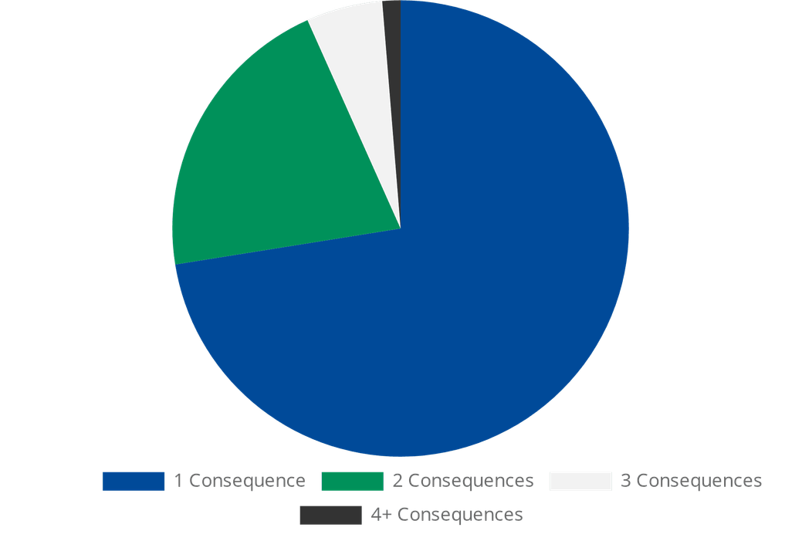

Managing 1-to-N Relationships
CONSEQUENCES PER INCIDENT
AGGREGATION RESOLUTION
Aggregated Causes and Consequences per incident to normalize the dataset.
Applied field-specific logic: Sum of Loss Amounts in consequences matches the incident's total loss field.
Achieved 100% consistency across 10,105 incidents for downstream NLP analysis.
This step ensures that each incident is represented by a single, comprehensive record while preserving all granular details.
Distribution of 10,105 Incidents by Number of Consequences

Slide 3
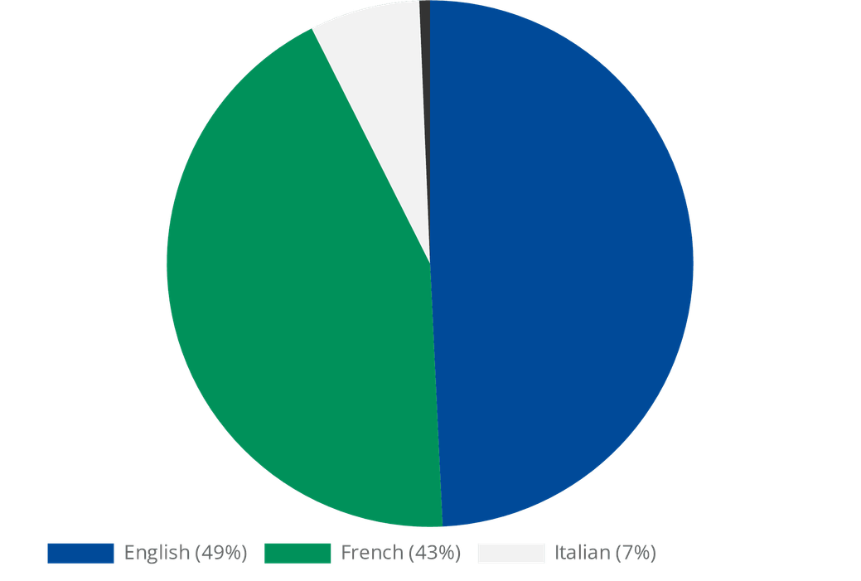



Overcoming the Language Barrier
LANGUAGE DISTRIBUTION
BOTTLENECK & RESOLUTION
THE BOTTLENECK
Lack of Dataiku offline translation plugin prevented standard
processing of French (43%) and Italian (7%) descriptions.
THE RESOLUTION
Leveraged internal BNP Paribas tool
translate.analytics.cib
. Extracted descriptions, ran
translation jobs, and reintegrated results.
Achieved a
100% English dataset
, enabling the continuation of
the NLP flow.
~51% of incidents required translation for unified NLP analysis.

Slide 4


UPDATED NLP WORKFLOW
01
INGEST & JOIN
Unifying Incidents, Causes, and Consequences datasets.
02
RESOLUTION: Aggregated 10k+ incidents with 100% loss consistency.
DATA AGGREGATION
Resolving 1-to-N relationships via field-specific logic.
03
RESOLUTION: Leveraged translate.analytics.cib for FR/IT extracts.
TRANSLATION
Converting multi-language descriptions to English.
04
CLEAN & NORMALIZE
Standardizing text for feature extraction.
05
FEATURES & ENRICHMENT
Vectorization and semantic similarity mapping.
06
CLUSTERS & MODELS
Root-cause discovery and automated tagging.
07
DASHBOARDS & APIS
Exposing proactive risk intelligence to stakeholders.

Slide 5




Strategic Business Outcomes
INTELLIGENCE
PROACTIVITY
REPORTING
Discover granular root-cause groups.
Predict severity and likelihood.
Improve management reporting.
Automatically tag new incidents.
Generate early-warning risk scores.
Enhance regulatory compliance.
Identify hidden failure patterns.
Support mitigation dashboards.
Data-driven control design.
Transforming Operational Risk into a Proactive Intelligence Engine.

