Slide 1
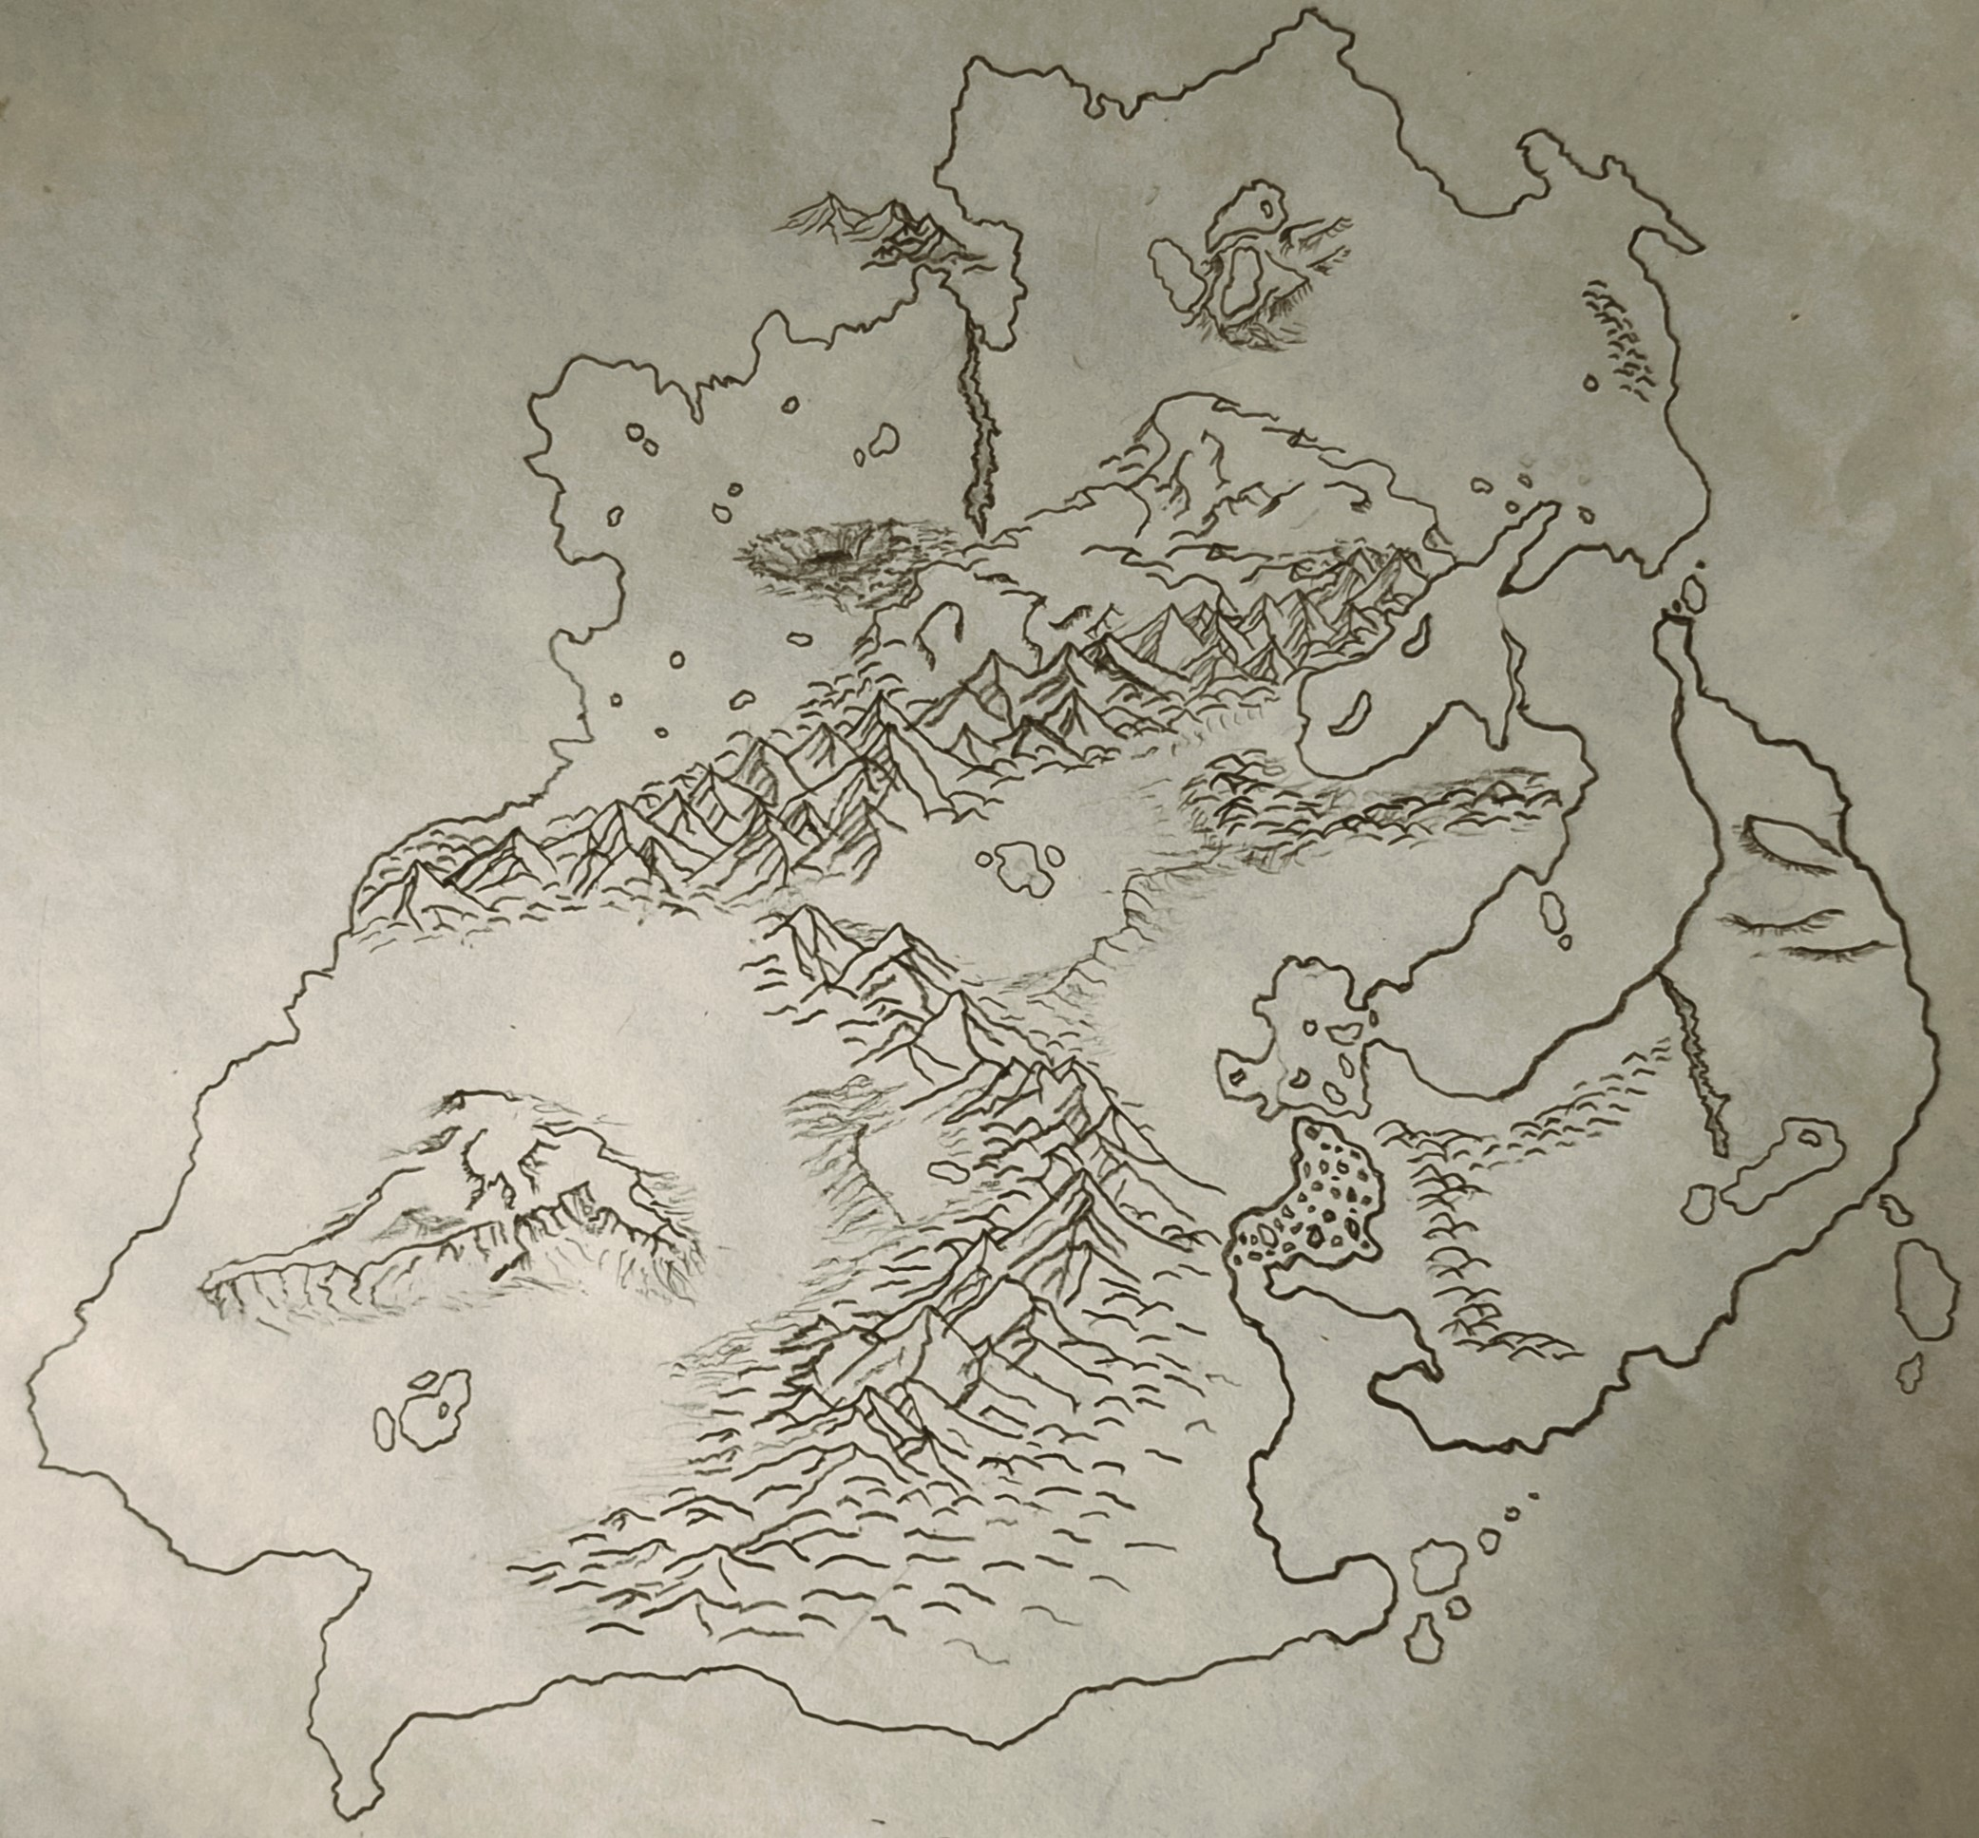
HTRÆ

Slide 2
Regions and Seas
Nythravold
Iboraionia
Sea of Dragons
Jungles of Arcum
Kyros
Aurion Rise
Gerconia
Radamle
Creath
Fissure of Alathor
Bulbous Sea
Lymoro Pass
Nefeli
Levendavia
Sea of Syrvash
Bay of Whispers
Veimir Ridgeland

Slide 3
Key Locations:
Gerconia:
  Comparable to western/central Europe.
  Home to Holy Gerconian Empire (akin to Holy Roman Empire)
Nefeli
Radamle:
  Comparable to eastern America, temperate climates
Creath:
  Comparable to lands of the western Baltic states
  The lands west of Gerconia. The small pass between the two continent’s supermassive mountain chains separate these lands. The river which runs through, one of the most critical choke points in the entire southern half of he continent.
Levendavia
Iboraionia
Kyros
Lymoro Pass
Veimir Ridgeland
Jungles of Arcum
  The lands east of of Gerconia only reachable by a small pass between both the massive mountain range to the north and the Hills to the south. This small pass should be difficult to navigate akin to Gibraltar with wicked wind gusts and tumultuous conditions. These jungles lie North of Radamle over the <TO NAME> Hills. North of these area is the Sea of Dragons. The land is dominated by jungle of both frozen climates and hot and humid climates that constantly shift through out the jungles switching from a magical frozen winterland to an Amazonian rainforest at a mere whim

Slide 5
Aurion Rise:
Rolling mounds, mountains that divide the magical jungles of danger from the regions of Radamle and Gerconia.
Fissure or Alathor:
The massive cliffs that divide theses isolated lands in half, into two distinct regions. It is a massive cliff side that defines the elevated Gerconia to the low lying Radamle and Nefeli. Some steep drop-offs, some smoother, regardless that dangerous travel.
Sea of Dragons
Jungles of Arcum
Aurion Rise
Lake Muyrm
Gerconia
Radamle
Fissure of Alathor
Bulbous Sea
Nefeli

Slide 6
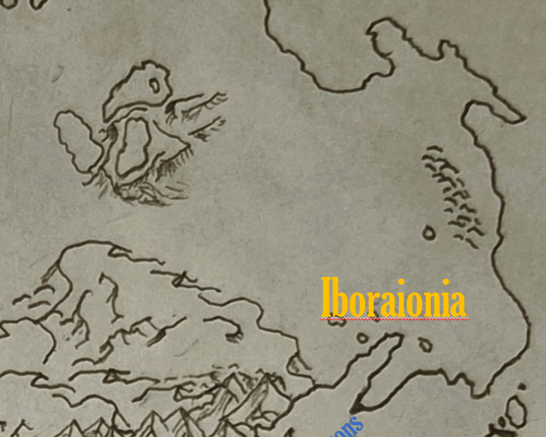
Far North
The Glacial Lakes Region:
Physical Features:
The Frozen Three:
  The lakes (we could name them if you’d like) are partially frozen year-round, with massive floating icebergs that shift unpredictably.
  Jagged cliffs surround the lakes, creating natural wind tunnels that amplify the already frigid gusts.
  Narrow, icy paths wind through the cliffs, some leading to dead ends or hidden caves.
Floating Icebergs:
  Some icebergs are stable enough to walk on, while others shift dangerously.
  The largest iceberg, housing the legendary tribe, is said to glow faintly under the moonlight, rumored to be enchanted with ancient magic.
Treacherous Valleys:
  Steep, icy inclines connect the lakes, with avalanche-prone ridges and crevices hidden under snow drifts.
  Illusions caused by the magical storm make navigating these valleys even more perilous.
Waluigi Majioni

