Slide 1
小型园区网的设计模拟
[你的课题]
[姓名]

Slide 2
课题介绍
园区网共有一个总部，分成三个子部，每个子部门划分成两个VLAN，使其隔离及管理方便。用一组实验设备构建一个园区网，通过防火墙与校园网相连，实现到Internet的访问。在一台两层交换机SW1上划分2个VLAN（Vlan 100和Vlan200）。两个VLAN均能通过路由器访问外网，但两个VLAN之间不能通信。
在一台三层交换机SW3上划分2个VLAN（Vlan 300和Vlan 400），两个Vlan之间能够通信。两个Vlan均只能通过路由器访问校园网(10.X.X.X)，而不能访问Internet。
另外一台两层交换机SW2和一台三层交换机SW4之间使用冗余连接，在两台交换机上均划分两个Vlan（Vlan 500和Vlan 600），要求Vlan500可以访问内网所有VLAN，Vlan600既可以访问内网，又可以访问Internet。
园区网路由器内采用静态路由或OSPF路由协议，使全网联通。
采用路由器将此园区网再与外网（校园网）相连，配置NAT协议。
采用Packet Tracer或者GNS模拟网络拓扑，给各VLAN划分IP地址、掩码、网关以及各网络设备接口的IP地址。
需要在SW1中的VLAN100里安装WWW、FTP、电子邮件等基本服务。用访问控制列表使VLAN300和VLAN500中的用户在上班时间(9:00-17:00) 不能访问服务器。
IP分配规则：IP范围：192.168.24.0-192.168.31.255
路由器Serial口使用：192.168.254.48-192.168.254.63
采用VLAN、三层交换、动态路由协议OSPF、ACL和NAT等技术实现多自治系统场景下园区网络的互通。

Slide 3
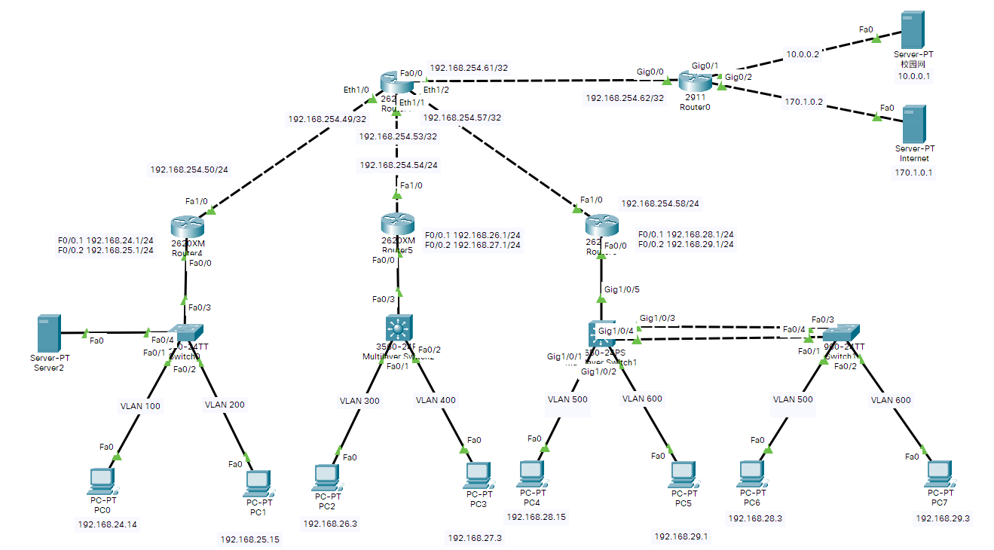
拓扑图

Slide 4
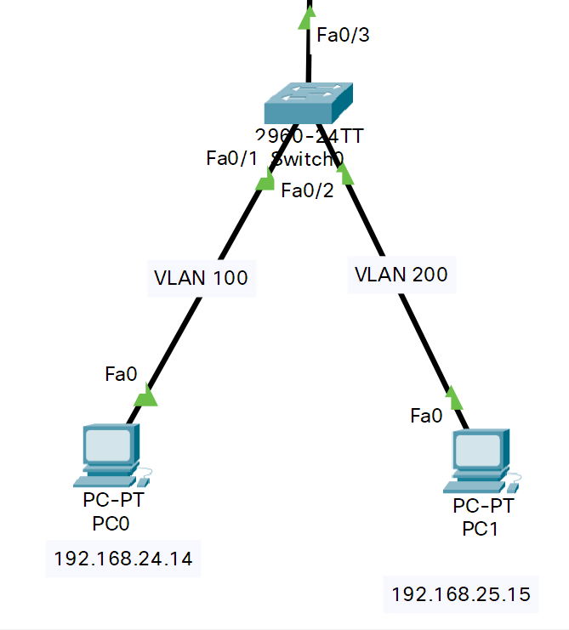
三层交换机SW1

Slide 5
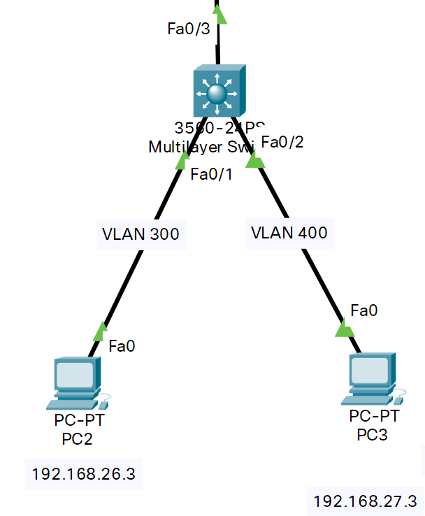
三层交换机SW3

Slide 6
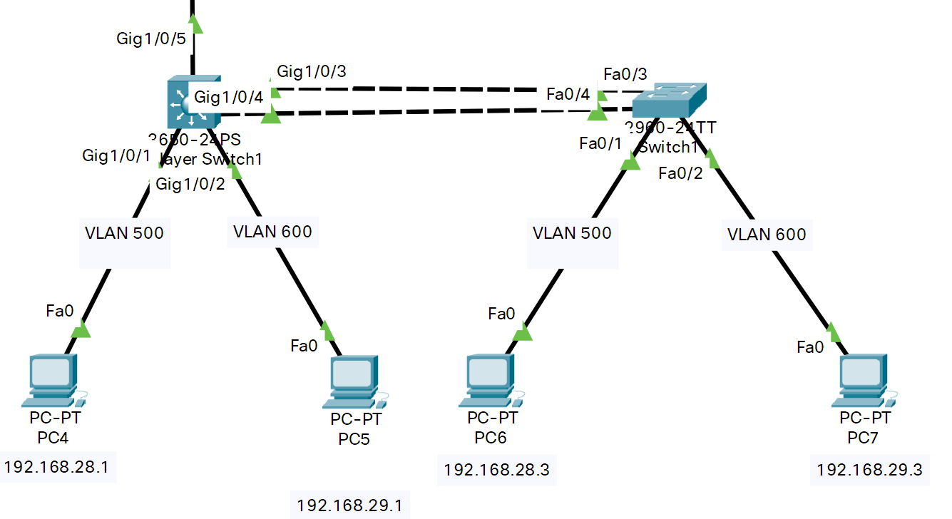
SW2 & SW4

Slide 7
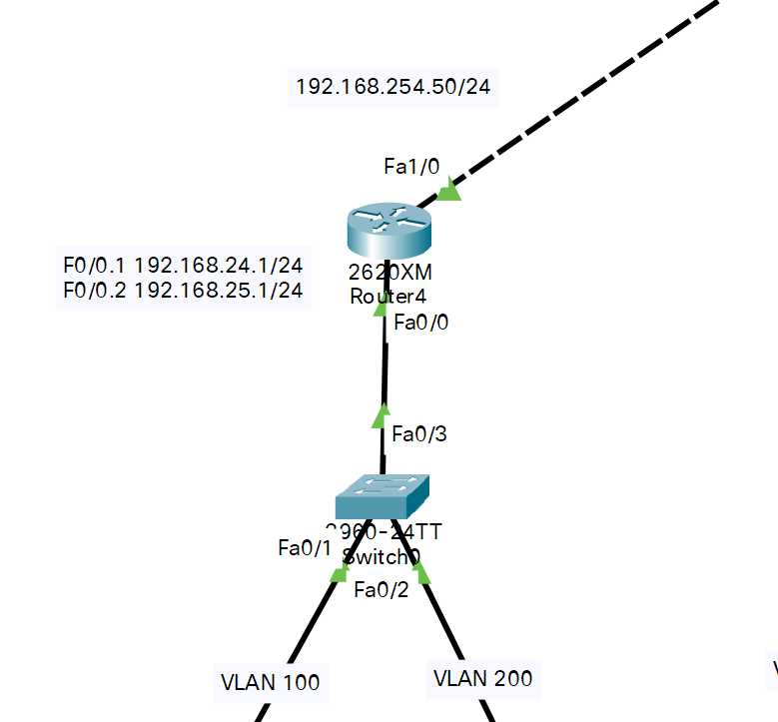
路由器R1
R1#sh ip access-lists
Extended IP access list 100
10 deny ip 0.0.0.0 255.255.255.0 0.0.0.0 255.255.255.0
20 permit ip any any
Extended IP access list 101
10 deny ip 0.0.0.0 255.255.255.0 0.0.0.0 255.255.255.0
20 permit ip any any
R1#sh ip route ospf
O 192.168.26.0 [110/12] via 192.168.254.49, 01:12:29, FastEthernet1/0
O 192.168.28.0 [110/12] via 192.168.254.49, 01:12:29, FastEthernet1/0
192.168.254.0/30 is subnetted, 4 subnets
O 192.168.254.52 [110/11] via 192.168.254.49, 01:12:39, FastEthernet1/0
O 192.168.254.56 [110/11] via 192.168.254.49, 01:12:39, FastEthernet1/0
O 192.168.254.60 [110/2] via 192.168.254.49, 01:09:45, FastEthernet1/0

Slide 8
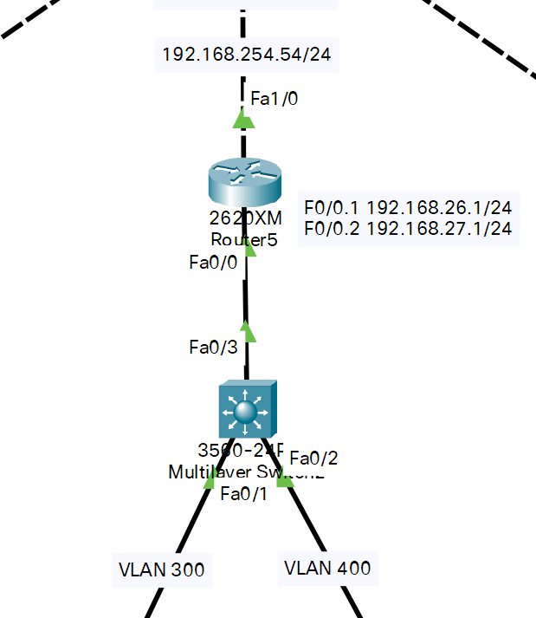
路由器R2
R2#sh ip access-lists
Extended IP access list 102
10 permit ip any 0.0.0.0 255.0.0.0
20 permit ip any 0.0.0.0 255.255.0.0
30 deny ip any any
R2#sh ip route ospf
O 192.168.24.0 [110/12] via 192.168.254.53, 01:13:46, FastEthernet1/0
O 192.168.25.0 [110/12] via 192.168.254.53, 01:13:46, FastEthernet1/0
O 192.168.28.0 [110/12] via 192.168.254.53, 01:13:46, FastEthernet1/0
192.168.254.0/30 is subnetted, 4 subnets
O 192.168.254.48 [110/11] via 192.168.254.53, 01:13:46, FastEthernet1/0
O 192.168.254.56 [110/11] via 192.168.254.53, 01:13:46, FastEthernet1/0
O 192.168.254.60 [110/2] via 192.168.254.53, 01:10:52, FastEthernet1/0

Slide 9
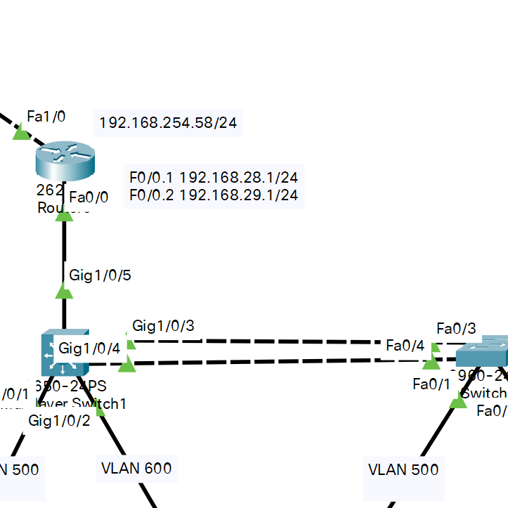
路由器R3
R3#sh ip access-lists
Extended IP access list 103
10 permit ip 0.0.0.0 255.255.255.0 0.0.0.0 255.255.0.0
20 permit ip 0.0.0.0 255.255.255.0 any
30 deny ip any any
R3#sh ip route ospf
O 192.168.24.0 [110/12] via 192.168.254.57, 01:14:58, FastEthernet1/0
O 192.168.25.0 [110/12] via 192.168.254.57, 01:14:58, FastEthernet1/0
O 192.168.26.0 [110/12] via 192.168.254.57, 01:14:58, FastEthernet1/0
192.168.254.0/30 is subnetted, 4 subnets
O 192.168.254.48 [110/11] via 192.168.254.57, 01:15:08, FastEthernet1/0
O 192.168.254.52 [110/11] via 192.168.254.57, 01:15:08, FastEthernet1/0
O 192.168.254.60 [110/2] via 192.168.254.57, 01:12:14, FastEthernet1/0

Slide 10
拓扑图

Slide 11
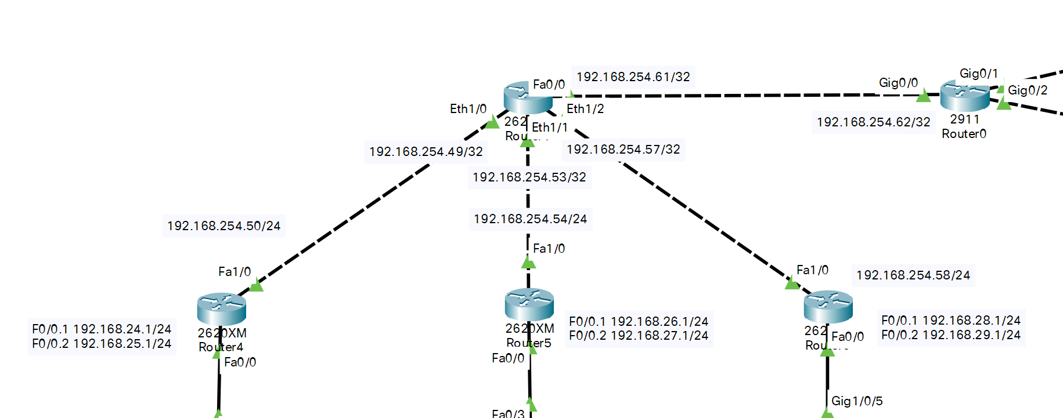
路由器Core
CORE-ROUTER#sh ip route sta
S 10.0.0.0/8 [1/0] via 192.168.254.62
S 172.1.0.0/16 [1/0] via 192.168.254.62
S 192.168.27.0/24 [1/0] via 192.168.254.54
S 192.168.29.0/24 [1/0] via 192.168.254.58

Slide 12
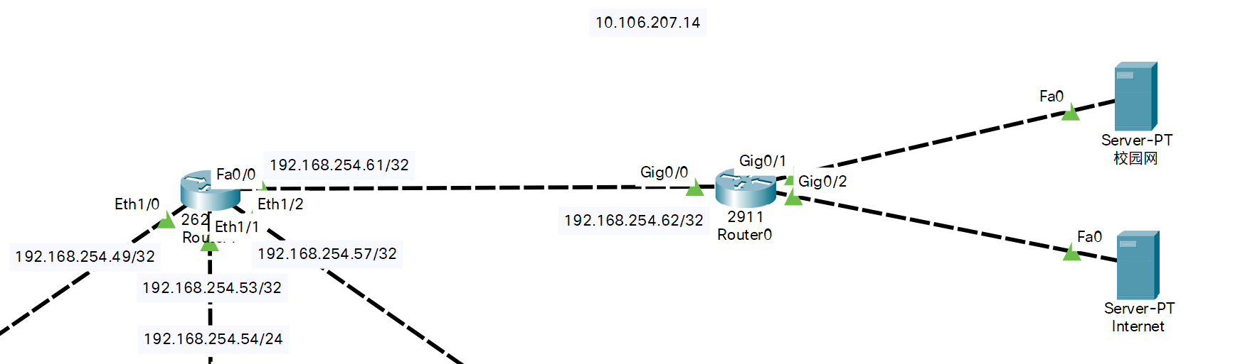
防火墙和服务器
Router#sh ip route sta
10.0.0.0/8 is variably subnetted, 3 subnets, 3 masks
S 10.0.0.0/8 [1/0] via 10.0.0.1
S 192.168.27.0/24 [1/0] via 192.168.254.61
S 192.168.29.0/24 [1/0] via 192.168.254.61

Slide 13
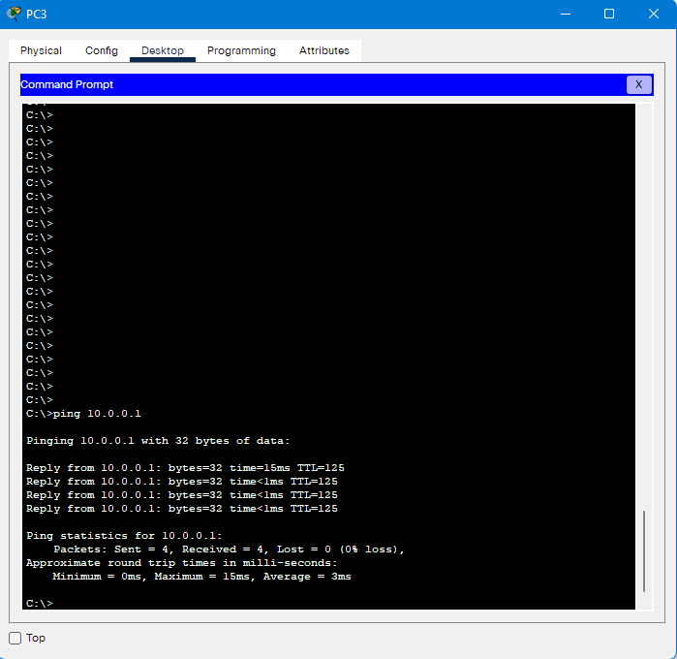
拓扑图

Slide 14

感谢观看

