Slide 1
Introduction to software installation on Discovery
Summer Bootcamp 2021

Slide 2
Software installation overview:
Advanced installation using the Spack package manager.
Installation from source code using ‘configure’ + ‘make’.
Installation with library dependencies (MPI, HDF5).
Setting up shell environment variables (instead modules).
Compilation flags, vendor-specific optimization flags (Intel & GNU).
NOTE: This tutorial is designed to be interactive.
We recommend using a shell on Discovery to execute the commands.

Slide 3
Accessing the training material
Download the Advanced_software_installation_on_Discovery.zip to your local machine.
Copy the training material to your $HOME directory on Discovery. You can use one of these options:
Using the File Explorer on OOD: https://ood.discovery.neu.edu/ Instructions: https://rc-docs.northeastern.edu/en/latest/using-ood/fileexplore.html
Using ’scp’ through the terminal/shell: https://rc-docs.northeastern.edu/en/latest/using-discovery/transferringdata.html?highlight=scp#
Access a Discovery Linux shell/terminal (use one of the following options):
Terminal/shell SSH: https://rc-docs.northeastern.edu/en/latest/get_started/connect.html
OOD shell: https://ood.discovery.neu.edu/pun/sys/shell/ssh/ood.discovery.neu.edu
Unzip and access the material using these commands:
$ unzip Advanced_software_installation_on_Discovery.zip $ cd Advanced_software_installation_on_Discovery

Slide 4
Why build your own software?
Create a controlled and consistent software environment that allows reproducibility of results
Leverage the full power of the cluster through usage of hardware optimizations and parallel libraries.
Add flexibility - benchmark performance of different versions/configurations and build software to fit your scientific needs.
Familiarize with the open-source scientific package managers that help with the heavy lifting of software installations.
Notes:
The Discovery HPC cluster contains powerful and sophisticated hardware, consisting of multiple cutting-edge processors and fast interconnect network. However, this hardware is completely useless without software that is able to leverage the full potential of a supercomputer. The cluster offers some software packages through the module system (https://rc-docs.northeastern.edu/en/latest/software/modules.html), yet their already-compiled configuration may not always suite your needs. Here are a few other reasons to compile your own code:
Better control the conditions of your research - create a controlled and consistent working environment that allows reproducibility of results.
Get to know your "lab" equipment - understand and troubleshoot your code and results by getting familiar with the different software and hardware configurations.
Leverage the full power of the cluster - incorporate parallel libraries and powerful compilers. Learn about different compilation options such as compiling with parallel libraries and switching compilers.
Flexibility of use - install your code locally, try multiple code variations, benchmark performance and control of any code updates and bugs fixes.
Familiarize with the open-source scientific software community - get to know about the multiple useful collaborative programs that handle the vast majority of the heavy lifting of software installations.

Slide 5
System-wide vs. user software
System-wide software: All users can read/execute but cannot write into these locations.
Discovery modules – available in the /shared file system for more info: https://rc-docs.northeastern.edu/en/latest/software/modules.html
Local to each compute node – the /usr directory has some common libraries and tools.
User software:
Available only to users who own the directory.
The file systems /home & /scratch can be used for user software installations with read/write/execute privileges.
Group software:
The file system /work can be used to install software that can be shared by multiple group members (that belong to the same unix group).
Software can be set up with read/write/execute privileges for group members only. For more info on storage options: https://rc-docs.northeastern.edu/en/latest/storage/discovery_storage.html
Notes:
System-wide vs. user installations:
Users on Discovery get to be the owners of directories /home/<username> and /scratch/<username>, with read/write/execute privileges. This allows user to install software "locally" in their directories. The software access will be exclusive to the user, even on compute nodes.
"Global"/"System-wide" installs are located in system locations owned by the "root" user, such as /usr/bin or /usr/local. On Discovery, the /shared filesystem also contains global installs such as modules at /shared/centos7. All users are allowed to read and execute from this location, with no write permissions. For system-wide Discovery Cluster Software Requests (including OOD software): https://bit.ly/NURC-Software
Group-accessible locations - we encourage groups using same software to have it installed in group directories (such as /work/groupname). Group members can then access, modify, install and benchmark their own code without the need to have it system-wide. For Storage Space Extension Requests (expanding /work capacity or other solutions): https://bit.ly/NURC-StorageExtension.

Slide 6
Installing software from source considerations
Reasons to compile from source:
The software is not available in the package manager repositories.
The user prefers compile manually to include specific features such as optimization flags, parallel builds (MPI), link dependent libraries, etc.
The user may need a build using specific compilers and libraries or specific hardware types.
The compilation process from source requires:
Knowledge of the system (hardware, network, drivers, kernals).
Knowledge of the environment and software stack available (compilers and libraries.)
Knowledge of the compilation options (configuration, compilation and optimization flags).

Slide 7
Installing software from source - stages
Most installations follow these stages:
Review the developer’s manual webpage or README/INSTALL files inside the source code directory. They often recommend an installation procedure.
Select and load a compiler module – converts code to binary executables. For more info on the compilation process: 24. The compilation process and compilers: 23. Table 1 - Compilers on Discovery).
Select and load any dependency modules:
Many basic libraries are already available in system-wide locations: /usr/lib , /usr/lib64 , /usr/include . They will be automatically visible during installation.
MPI (compatible with the compiler) needs to be loaded as a module. See 26. Table 3 – MPI on Discovery for more info.
Additional libraries can also be loaded as modules (if available/compatible) or installed from source.
Configuration stage – configuration scripts ensure all necessary parts are loaded, It also checks for specific user settings (such as installations modes, paths etc.): ./configure [configuration options]

Slide 8
Installing software from source - stages
5. Configuration notes:
Check the configuration options with the command: ./configure –help Some features can be enabled/disabled: --enable-FEATURE[=ARG] or --disable-FEATURE
You can define the installation path with: --prefix=/my/path . Select a user-readable location (/home , /work or /scratch) instead of the default /usr/local.
You can customize your optimization flags: 26. Table 2 – Useful compilation flags .
Most dependency libraries will be found using $LD_LIBRARY_PATH or $LIBRARY_PATH variables. Header files will be found by setting $CPATH. (see 23. Setting up your installation environment ). Those are being set when modules are loaded automatically.
When configure doesn’t exist – you’ll need to edit the Makefile to point to specific libraries and paths.
Build the software using command “make” or “make -j <N>” if parallel build is supported (<N> refers to the number of cores).
Install (copy executables and libraries to the desired location) with: ”make install”

Slide 9
Exercise 1 Installation using advanced Spack options

Slide 10
Exercise 1 Task 1 – Setting up Spack
In this example, we’ll set up Spack and then install the NETCDF software package.
Download Spack to your $HOME directory (optional – load a newer python version):
Set up the Spack environment by sourcing the following shell script (or add to ~/.bashrc):
Check available software (note – this takes a long time to load):
Get more information about a particular package (versions, options, dependencies etc.):
Add a compiler:
$ srun --partition=express --nodes=1 --ntasks=16 --pty --time=01:00:00 /bin/bash $ module load python/3.8.1 $ git clone https://github.com/spack/spack.git
$ source ~/spack/share/spack/setup-env.sh
$ spack list; $ spack list sql
$ spack info mysql; spack info gromacs;
Note that copy+paste of some commands may not work due to Microsoft font formatting.
Please use the commands provided in the “interactive_commad_list” instead
$ module load gcc/10.1.0
$ spack compiler find
$ spack compilers
For the full Spack tutorial, visit: https://spack-tutorial.readthedocs.io/en/latest/

Slide 11
Exercise 1 Task 2 – add user config files to spack
We’ll use Spack to install NetCDF-C (C libraries for array-oriented scientific data) with the following features:
GNU compiler 10.1.0 will be loaded.
MPI support – set up to use the cluster MPI module instead of installing it.
Additional dependency libraries such as hdf5, libtool etc. will be installed.
First, let’s login into a compute node to make the build faster. Then find NETCDF-C:
To see the full dependency tree, versions and options we can use the “spec” command:
Copy the configuration files into ”~/.spack” directory, and then re-source Spack to apply the new changes:
$ spack info netcdf-c
$ spack spec netcdf-c
$ cd $HOME/Advanced_software_installation_on_Discovery
$ cp Exercise_1/packages.yaml ~/.spack/packages.yaml
$ cp Exercise_1/config.yaml ~/.spack/config.yaml
$ source ~/spack/share/spack/setup-env.sh ##apply changes to spack
Notes:
Note that copy+paste of some commands may not work due to Microsoft font formatting.
Please use the commands provided in the “interactive_commad_list” instead.

Slide 12
Exercise 1 Task 3 – Install NETCDF-C with Spack
Configuration files info: https://spack.readthedocs.io/en/latest/configuration.html
config.yaml - Spack’s basic configuration options (install locations etc.).
packages.yaml - customize how your software is built through specific rules.
compilers.yaml – compiler info file (no need to edit directly).
1. Inspect the NETCDF-C with MPI support dependencies and options chart. See: 20. Spack - additional features
2. Install NETCDF-C with MPI using 16 cores (-j16), using GNU 10.1.0 compilers:
3. Load the package into your environment once installed. Inspect the sample SLURM sbatch script that loads and runs the software:
$ spack spec netcdf-c%gcc@10.1.0 +mpi
$ spack install –j 16 netcdf-c%gcc@10.1.0 +mpi
$ cd Exercise_1
$ cat submit-netcdf-c-example.bash $ sbatch submit-netcdf-c-example.bash

Slide 13
Exercise 2 Build from source
With Intel Compilers

Slide 14
Exercise 2 Task 1 – Setting up your shell environment
In this example, we’ll install NETCDF-C from source using Intel Compilers + Intel MPI.
Allocate a compute node with 16 CPUs:
Download the NETCDF-C source code tarball:
Create & define a directory to install to. Here, we assume its $HOME/NETCDF-C. We export a shell variable “netcdf_dir” to hold this path for convenience:
Load the dependency libraries(compilers, MPI, HDF5) into your shell environment. Note that all modules have the same compiler version:
Note that copy+paste of some commands may not work due to Microsoft font formatting.
Please use the commands provided in the “interactive_commad_list” instead
$ srun --partition=express --nodes=1 --ntasks=16 --pty --time=01:00:00 /bin/bash
$ cd $HOME; wget ftp://ftp.unidata.ucar.edu/pub/netcdf/netcdf-c-4.8.0.tar.gz
$ export netcdf_dir=$HOME/NETCDF-C
$ module load intel/compilers-2021.2.0
$ module load intel/mpi-2021.2.0
$ module load hdf5/1.12.0-intel2021.2

Slide 15
Exercise 2 Task 2 – Configure the software
Unzip the source code into a directory in $HOME:
Make sure to read the developer’s notes before each installation (README.md/INSTALL.md).
Use the “configure” script to set up the compilation options:
To learn more about configure and compiler additional options:
Variables: CC, CXX and FC define the C/C++ & Fortran compilers.
Here, they are set to the Intel MPI parallel wrappers of the Intel compilers (see 22. Table 1 - Compilers on Discovery ).
Variables CFLAGS, CXXFLAGS and CPPFLAGS hold additional compiler flags (see 24. Table 2 – Useful compilation flags).
$ tar –zxvf netcdf-c-4.8.0.tar.gz
$ cd netcdf-c-4.8.0
$ CC="mpicc -cc=icc" FC="mpiifort -fc=ifort" CXX="mpiicpc -cxx=icpc" CFLAGS='-O2 -fpic' CXXFLAGS='-O2 -fpic' CPPFLAGS='-O2 -fpic' ./configure --prefix=$netcdf_dir
$ ./configure --help

Slide 16
Exercise 2 Task 3 – Install & use the software
Now we can build the software using “make”, following “make install” to copy executables and libraries to the desired location $netcdf_dir :
To use the new software, we need to tell the shell environment where the binaries and libraries are located. Set the environment by appending the software paths to the commonly-used shell variables:
For more info, review 20. Setting up your installation environment and 21. Additional notes on environment setup.
To use this software in the future in a convenient manner, use a shell script as shown here:
$ make –j 16
$ make install
$ export PATH=$netcdf_dir/bin:$PATH
$ export LD_LIBRARY_PATH=$netcdf_dir/lib:$LD_LIBRARY_PATH
$ cd Exercise_2
$ cat submit-netcdf-c-example.bash $ sbatch submit-netcdf-c-example.bash ##run to test if works

Slide 17
Thank you for your participation in RC tutorial! Visit our website: https://rc.northeastern.edu/ Enjoy your computing!

Slide 18
Supplemental Material

Slide 19
Spack - additional features
Spack allows fine-grained control over package installations:
Each package descriptor that defines its configuration is called a “spec”
Spack has its own syntax for controlling dependencies – how they are configured and built. For example:
0 - the package to install 1 - a dependency of the package is perfixed using ^ 2 - the dependency version, denoted by @ following by the version. Can also be a range of versions (e.g. 1.2:1.4) 3 - a compile-time variant of the package (openmen with the debug mode) 4 - the name of the compiler to build with 5 - the version/s of the compiler to build with 6 - the architecture to build with – needed on machines where cross-compilation is required.
$ spack spec mpileaks $ spack install mpileaks ^openmpi @1.2:1.4 +debug %intel@12.1 target=zen 0 1 2 3 4 5 6
For more info: https://spack.readthedocs.io/en/latest/basic_usage.html#specs-dependencies

Slide 20
Spack installation – additional notes
Spack builds the full dependency tree from source – installations may take a while! (parallel builds can be used to speed up installs: https://spack.readthedocs.io/en/latest/packaging_guide.html#parallel-builds).
Each program lives in a self-contained environment – all needed libraries will be installed from source each time. Be aware of the memory space it consumes in your $HOME, and move to /work if needed.
Use the garbage collection feature to remove software not use at runtime: https://spack.readthedocs.io/en/latest/basic_usage.html?highlight=garbage#garbage-collection
Spack also provides the ability to create virtual environments with multiple programs – helps to save space and deploy containers: https://spack.readthedocs.io/en/latest/environments.html

Slide 21
Getting to know the Operating System (OS)
The Discovery OS is Linux CentOS 7. The main components are:
Bootloader - the software that boots the OS
Linux Kernel - the core software that runs Linux on the lowest level of communication with hardware.
Init system - the sub-system that bootstraps the user space and controls daemons
Daemons – the background services
Interface between users and the OS (shell, Desktop etc.)
Applications – software that is not directly related to the OS and runs as an executable on as an OS process.
Notes:
To install and run a software application requires some level of knowledge of the computer it will run on. This includes knowledge of the architecture and the operating system (OS), which manages communication between software and hardware. HPC systems typically consist of Intel 64-bit processors (x86_64 architecture) and use CentOS 7/8 OS (a free open-source OS, which is a detivative of the Red Hat Enterprise Linux).
The main Linux components are:
Bootloader - the software that boots the OS
Linux Kernel - the core software that runs Linux on the lowest level of communication with hardware. Some of its functions include managing the CPUs/GPUs, memory and peripheral devices.
Init system - the sub-system that bootstraps the user space and controls daemons
Daemons – the background services (for example, SchedMD which is the Slurm workload manager software) that either start up during boot or after you log into the OS at user/root.
Graphical server – a sub-system which displays graphics (commonly referred to as the X server).
Desktop/Shell environment – the interface between users and the OS. There are many desktop environments such as GNOME, Cinnamon, Mate, Pantheon, Enlightenment, KDE, Xfce, etc. While for HPC, it is common to use the Shell environment, where a program called "bash" acts as the shell program. Besides bash, there are other shell programs that can be installed in a Linux system. These include: ksh, tcsh and zsh.
Applications – software that is not directly related to the OS and runs as an executable on as a OS process.

Slide 22
Setting up your installation environment
The following shell environment variables store important locations to help access different programs and libraries:
$PATH - usually points to <path>/bin directories with executable programs.
$LIBRARY_PATH - stores locations of static/shared libraries that can be linked to a program during installation (<path>/lib, <path>/lib64)
$LD_LIBRARY_PATH - used during runtime to locate linked shared libraries (<path>/lib, <path>/lib64)
$CPATH/$C_INCLUDE_PATH/$CPLUS_INCLUDE_PATH - specifies a list of directories to be searched for header files (<path>/include).
Each installation will require to use these variables to some extent.
Modules also use these variables. To check which variables your module uses, type “module show <modulename>”.
Notes:
Setting up your environment
Shell scripts can make use of environment variables, storing important paths and locations of libraries in the OS. Some common ones include $HOME, $SHELL and $USER. Additionaly, the following environment variables are used for compilers to find packages and libraries:
$PATH - specifying a set of directories where executable programs (binaries) are located.
$LIBRARY_PATH - used by the compiler prior to compilation to find static and shared libraries so that they can be linked to the program being installed.
$LD_LIBRARY_PATH - is used by your program to search directories containing shared libraries after it has been successfully compiled and linked.
$CPATH - this environment variable affects the behavior of the pre-processor. It specifies a list of directories to be searched for header files (like the -I option used for controlling the C preprocessor and run on each C source file before actual compilation), but after any paths given with -I options on the command line. Used regardless of which language is being preprocessed. For more details on CPATH and -I, refer to following websites:
https://gcc.gnu.org/onlinedocs/gcc/Environment-Variables.html
https://gcc.gnu.org/onlinedocs/gcc-3.4.6/gcc/Preprocessor-Options.html#Preprocessor-Options

Slide 23
Additional notes on environment setup
Important: We do not recommend setting environment variables inside shell files such as .bashrc, .bash_profile, .login, or .profile:
The wrong environment setup can lead to conflicting settings, which may cause your program to not work properly or not work at all.
Have more control inside your work environment by "turning off" settings.
You can accidently modify important variables such as $PATH and may need admin permissions to retrieve your environment.
For more info: https://rc-docs.northeastern.edu/en/latest/using-discovery/bashrc.html?highlight=bashrc
Best practice advice - create different environment setup scripts that can be loaded into each different project you run. As an example, you can refer to the follow shell script which you can run instead of the former commands:
$ cd ~/software_training/Exercise_4
$ bash env.sh

Slide 24
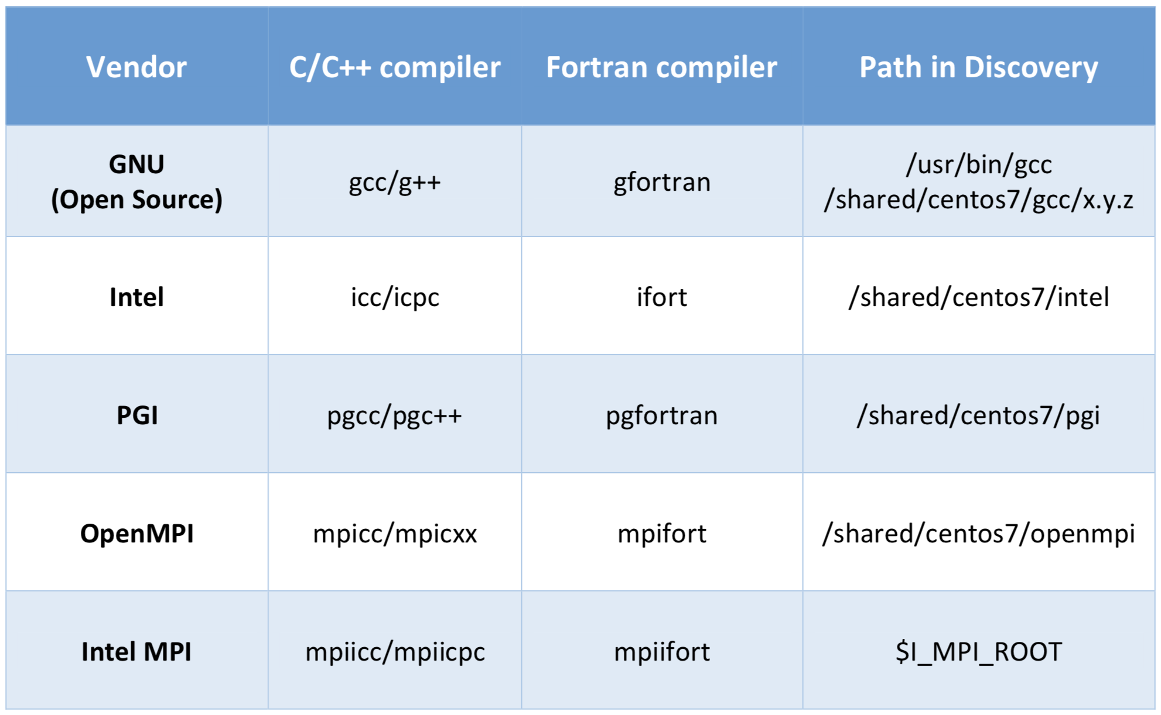
Table 1 - Compilers on Discovery
Discovery supports multiple compilers: GNU, Intel, PGI etc. You can view the different versions by: module avail gcc, module avail intel or module avail pgi.
Additionally, there are programs such as OpenMPI, MPICH, MVAPICH2 and Intel MPI that serve as wrappers for compilers for parallel computing code:

Slide 25
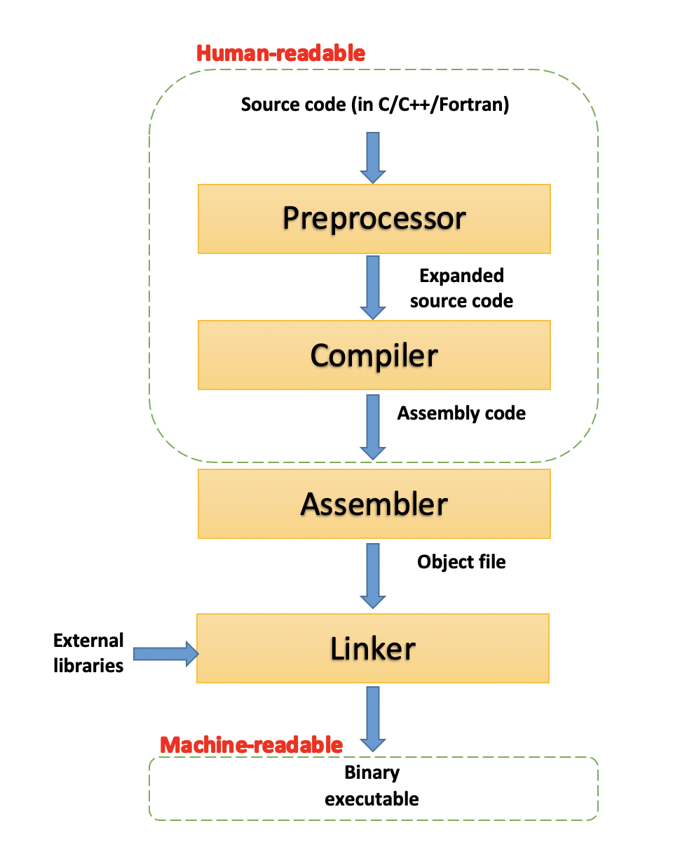
The compilation process
Scripts - programs (or interpreters), such as Perl, Python or Bash, interpret the script lines to perform complex tasks. Do not need to be compiled.
Codes - files containing code, such as C, C++ or Fortran, are used to build programs in the process of compilation (see diagram below). C, C++ or Fortran are low-level languages, and have little abstraction between them and machine language.
Compilation - The process of converting a text file with human-readable code into a binary and executable program.
4 compilation phases:
Pre-processing - the source code is processed with some text modifications such as comment removal and macros expansions.
Compilation - the code is converted into assembly-level instructions. This allows direct hardware modifications, access to specialized hardware instructions (AVX-512 for example), and addresses performance issues.
Assembly - the stage where the assembler takes the assembly code and turns it into an object file, containing machine-level instructions.
Linking - the final phase in which all the linking of function calls with their definitions is done.

Slide 26
Table 2 – Useful compilation flags
Each compiler comes with various compilation flags. Some flags are vendor specific, while others are general. Can be used with: CFLAGS, CXXFLAGS, FFLAGS and CPPFLAGS.
You can often find the list of flags and options by typing: <compilername> --help
Vendor | Flag | Description
GNU/Intel | -O/-O2/-O3/-Ofast | Optimized compile/ extensive optimization(recommended)/ aggressive optimization (should be used with caution)/ -O3 plus some extras – only Intel
GNU/Intel | -mtune=<cpu>/ -march=<cpu>/ -xHost | additional tuning for specific processor types/ additional tuning for specific processor types for SIMD/ generate code most compatible with the current host type
GNU/Intel | -fpic, -fPIC | generate position independent code (not default)
Intel | -qopenmp | enable the compiler to generate multi-threaded code based on the OpenMP* directives

Slide 27
Table 3 – MPI on Discovery
Discovery supports multiple MPI (Message Passing Interface) implementations: OpenMPI, MVAPICH2, MPICH & Intel MPI.
Note that some support the InfiniBand (IB) network (on newer skylake/cascadelake/zen2 nodes).
MPI module names will include the compiler, unless compiled with the default GNU 4.8.5 OS compiler.
MPI | modules on discovery | Version description
OpenMPI | module avail openmpi | module show openmpi/<version> Newer modules will show the compatible compiler in their name. Older (<4.X) version do not support IB. Newer versions support IB using UCX.
MVAPICH2 | module avail mvapich2 | module show mvapich2/<version> All versions support IB, without UCX support.
MPICH | module avail mpich | module show mpich/<version>
Intel MPI | module avail intel module avail intel/mpi-* module avail intel_mpi/2018u5 | Intel MPI only works with Intel compilers. You can load all of them together or separately. Supports iB without UCX.

Slide 28
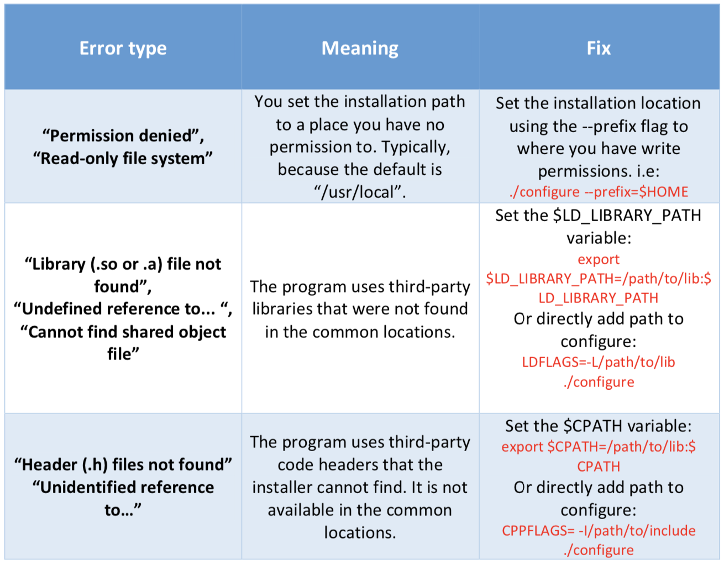
Table 4 - Troubleshooting compilation errors
Here's a summary of common compilation errors, that can be solved by providing correct paths:

