Slide 1
Using GPUs On Discovery
Training Module - 10/12/2021
Instructors: Dr. Manasvita Joshi
Notes:
In this session we will introduce you to the concept of parallel computing through graphic processing units (GPUs). We will cover the following topics.

Slide 2
Create Conda Environment – Tensorflow (TF) – Exercise 1
Introduction to GPUs
CPUs vs GPUs
Various GPUs on Discovery and how to access them – Exercise 2
GPU Computing & CUDA
GPUs + Jupyter Notebook on OOD
PyTorch & Tensorflow Examples – Matrix Multiplication

Slide 3
Accessing the training material
Download the Using_GPUs_on_Discovery-1021.zip to your local machine.
Copy training material to your $HOME (~) directory on Discovery. You can use one of these options:
File Explorer on OOD: https://ood.discovery.neu.edu/ Instructions: https://rc-docs.northeastern.edu/en/latest/using-ood/fileexplore.html
’scp’ through terminal/shell: https://rc-docs.northeastern.edu/en/latest/using-discovery/transferringdata.html?highlight=scp# From the location of downloaded material on your local machine’s terminal, execute: scp Using_GPUs_on_Discovery-1021.zip username@xfer.discovery.neu.edu:~

Slide 4
Exercise 1 Access GPUs on Discovery
Login to Discovery with/without X11 forwarding, resp:
Request a specific GPU compute node through reservation:
Request a specific GPU compute node outside of reservation:
ssh -Y username@login.discovery.neu.edu
OR
ssh username@login.discovery.neu.edu
$ srun --partition=reservation --reservation=octtraining2021gpu --nodes=1 –-cpus-per-task=1 --pty --gres=gpu:p100:1 --mem=10G --time=02:00:00 /bin/bash
$ srun --partition=gpu --nodes=1 –-cpus-per-task=1 --pty --gres=gpu:p100:1 --mem=10G --time=02:00:00 /bin/bash

Slide 5
Exercise 1 Create Conda (Tensorflow) Environment
Build GPU-enabled Tensorflow (TF) env in ~ – Matrix Multiplication
See https://rc-docs.northeastern.edu/en/latest/using-discovery/workingwithgpu.html
https://docs.conda.io/projects/conda/en/latest/commands.html
module list ## See the module(s) that are already present in your env
module load cuda/11.0 ## Load the CUDA module
module load anaconda3/2021.05 ## Load the Anaconda module
## create virtual conda environment named “TF_env“ & not ask for confirmation:
conda create --name TF_env python=3.7 anaconda -y
## remove a virtual conda environment:
conda remove --name TF_env --all

Slide 6
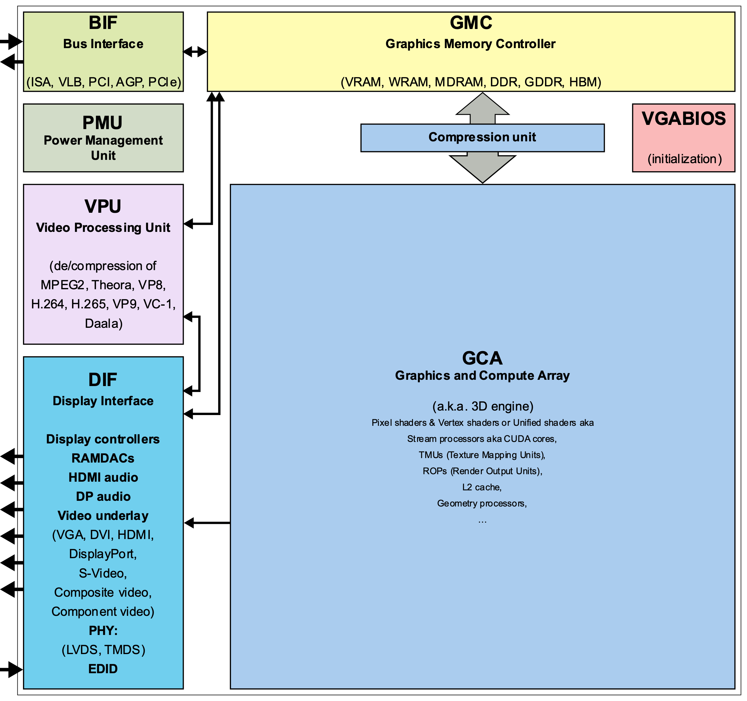
What Are GPUs
Graphics processing unit (GPU) - specialized microprocessor designed to accelerate graphics rendering to a display device [1,2].
Highly parallel structure, process large blocks of data simultaneously.
Machine Learning (ML), High-Performance Computing (HPC), video editing, gaming applications.
Mobile phones, laptops, workstations, game consoles as embedded systems.
Integrated into computer’s central processing unit (CPU) or offered as a discrete hardware unit.
By ScotXW - Own work, CC0,
https://commons.wikimedia.org/w/index.php?curid=61055349
Notes:
A graphics processing unit (GPU) is a specialized microprocessor that is originally designed to accelerate graphics rendering to a display device [1,2]. They have highly parallel structure, which makes them very efficient in simultaneously processing large blocks of data. This is the reason why they are extremely useful for parallel computing that is used in areas, such as machine learning, high-performance computing, video editing, gaming applications, etc. GPUs are used in embedded systems, mobile phones, personal computers, workstations, and game consoles. Modern GPUs are very efficient at manipulating computer graphics and image processing and are more efficient than general-purpose central processing units (CPUs) for parallel computing. GPUs may be integrated into the computer’s CPU or offered as a discrete hardware unit.
The figure shows a generic block diagram of a GPU along with its various components.

Slide 7
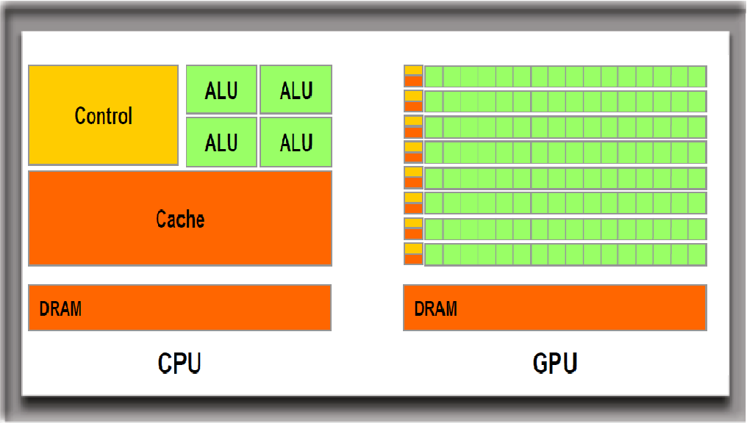
CPUs vs GPUs
CPU - millions of transistors [3], ~ 4-8 cores.
GPU - 100s of smaller processing cores [4], known as Arithmetic Logic Units [ALUs]).
CPU - Low latency & reasonable throughput. Computes a job as fast as possible.
GPU - High throughput & reasonable latency (delay between a user's action and an application's response to that action). Computes many jobs within a reasonable timeframe.
Notes:
The CPU is the logical thinking part of a computer's silicon brain, while the GPU can be considered as its creative side that helps render graphical user interfaces into visually appealing entities and designs.
A CPU is constructed from millions of transistors [3] and, typically, consists of four to eight cores, while a GPU consists of hundreds of smaller processing cores [4], known as Arithmetic Logic Units [ALUs]) (see the figure below).
It has low latency and reasonable throughput but computes a job as fast as possible.
A GPU, on the other hand, has high throughput and reasonable latency (delay between a user's action and an application's response to that action) but computes many jobs within a reasonable timeframe.
CPUs and GPUs work together to increase the throughput (amount of data that can be transferred from one location to another in a given amount of time) of data and the number of simultaneous calculations within an application [5]. The main program runs on the CPU while the GPU carries out repetitive calculations within an application in parallel.

Slide 8
What are GPUs & CPUs Good For?
GPUs have many cores, handle high throughput.
Known for parallel processing with performing thousands of operations at once [6].
Highly optimized for carrying out mathematical calculations, such as matrix multiplication, on large data sets.
CPUs have several cores, offer low latency.
Good for serial programming but do only handful of operations at once.
Logical processing better suited for CPUs.
Check out: https://www.youtube.com/watch?v=ZrJeYFxpUyQ
Notes:
To summarize, CPUs have several cores, offer low latency, and are good for serial programming but they can only do a handful of operations at once. GPUs, on the other hand, have many cores, handle high throughput, and are known for parallel processing with performing thousands of operations at once [6].
Check out this cool video by NVIDIA that shows the difference between CPUs and GPUs using visual aid: https://www.youtube.com/watch?v=ZrJeYFxpUyQ

Slide 9
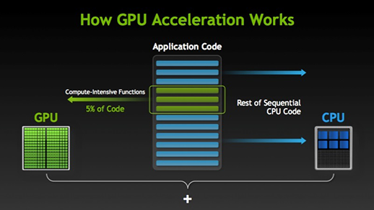
How massively parallel programming is executed using GPUs with CPUs [28].
GPU has multiple cores without control unit. CPU controls GPU through control unit
Notes:
Figure above shows how massively parallel programming is executed using GPUs along with CPUs [28].
Memory sharing between CPU & GPU - GPU have multiple cores without control unit but the CPU controls the GPU through control unit. Dedicated GPU have its own DRAM=VRAM=GRAM faster then integrated RAM. Integrated GPU means that GPU is placed on same chip with CPU, and CPU & GPU used same RAM memory (shared memory ).

Slide 10
Various GPUs on Discovery (shared partitions)
Discovery offers NVIDIA GPUs on shared gpu partitions. Some faculty partitions also have AMD GPUs.
k40m - Launched in Nov 2013 [8]. Kepler.
k80 - Professional graphics card launched in Nov 2014 [9, 10]. Kepler.
p100 - Launched in June 2016 [11, 12]. Pascal.
v100-pcie & v100-sxm2 - Professional graphics card launched in March 2018 [13, 14, 15]. Volta.
T4 - Professional graphics card launched in Sept 2018 [16, 17]. Turing.
A100 – launched in May 2020 (coming soon). Ampere.
More specs on: https://en.wikipedia.org/wiki/List_of_Nvidia_graphics_processing_units
Notes:
Discovery cluster supports a variety of GPUs that offer a wide range of functionalities and capabilities.
k40m - The Tesla K40m is an enthusiast-class professional graphics card developed by NVIDIA, which was launched in November 2013. It is built on 28 nm process, based on the GK110B graphics processor, and supports DirectX 12. For full specifications, see [8].
k80 - The Tesla K80 is a professional graphics card developed by NVIDIA, which was launched in November 2014. It is built on 28 nm process, is based on the GK210 graphics processor, and supports DirectX 12. Advertized as the world's most popular GPU on NVIDIA website, it delivers exceptional performance with fewer, more powerful servers that tremendously reduces data center costs and boosts throughput 5-10 times more in real-world applications. For full specifications and details, see [9, 10].
p100 - The Tesla P100 is an enthusiast-class professional graphics card developed by NVIDIA, which was launched in June 2016. It is Built on 16 nm process, is based on the GP100 graphics processor, and supports DirectX 12. Advertised as the world's first AI supercomputing data center GPU on NVIDIA website, it offers a unified platform for accelerating both HPC and AI, and dramatically increases throughput. For full specifications and details, see [11, 12].
v100-pcie & v100-sxm2 - The Tesla V100 series is a professional graphics card developed by NVIDIA, which was launched in March 2018. It is built on 12 nm process, is based on the GV100 graphics processor, and supports DirectX 12. Advertised as the first tensor core GPU on NVIDIA website, it is the most advanced data center GPU for AI. It comes in 16 and 32GB configurations. It offers performance of up to 32 CPUs wrapped up in a single GPU. For full specifications and details, see [13, 14, 15].
T4 - The Tesla T4 is a professional graphics card developed by NVIDIA, which was launched in September 2018. It is built on 12 nm process, is based on the TU104 graphics processor, and supports DirectX 12 Ultimate. This GPU offers breakthrough performance by accelerating various computing environments ranging from cloud to AI & graphics. It is energy-efficient and features multi-precision Turing Tensor Cores, providing up to 500 trillion tensor operations per second, and new RT Cores, for performing ray tracing operations with extraordinary efficiency. For full specifications and details, see [16, 17].
The latest Tesla 20-series GPUs are based on the latest implementation of the CUDA platform called the "Fermi architecture". Fermi has key computing features such as 500+ gigaflops of IEEE standard double-precision floating-point hardware support, L1 and L2 caches, ECC memory error protection, local user-managed data caches in the form of shared memory dispersed throughout the GPU, coalesced memory accesses, and more.

Slide 11
How to access them?
Access gpu partition using --gres= flag while running srun or sbatch.
Only a single gpu (--gres=gpu:1) can be accessed on gpu partition.
Various types of GPUs can be accessed using option: --gres=gpu:gpu-type:1
Check the GPU device info that’s available to your job: nvidia-smi (non-GPU devices will return ‘command not found’).
For details go to: https://rc-docs.northeastern.edu/en/latest/using-discovery/workingwithgpu.html

Slide 12
Multi GPU Partition Access
Multiple GPUs can be accessed on multigpu partition by filling out Partition Access Request form.
Justify the need for using multiple GPUs for your scientific calculation.
Best to optimize the code first for multi gpu usage before submitting the request.
For details go to: https://rc-docs.northeastern.edu/en/latest/hardware/partitions.html

Slide 13
Exercise 2
Accessing GPUs On Discovery

Slide 14
Exercise 2 Access GPUs on Discovery
Login to Discovery with/without X11 forwarding, resp:
Request a GPU compute node, execute: nvidia-smi
Request a specific type of GPU compute node, execute: nvidia-smi
ssh -Y username@login.discovery.neu.edu
OR
ssh username@login.discovery.neu.edu
$ srun --partition=gpu --nodes=1 --cpus-per-task=1 --pty --gres=gpu:1 --mem=2G --time=00:05:00 /bin/bash
$ nvidia-smi
$ exit
$ srun --partition=gpu --nodes=1 –-cpus-per-task=1 --pty --gres=gpu:k80:1 --mem=1G --time=00:30:00 /bin/bash
$ nvidia-smi
$ exit
Notes:
Note that copy+paste some commands may not work on Discovery since the ‘dash’ characters are not copied correctly from Microsoft applications.
Either type the commands directly, or use the commands file in: ~/Using_GPUs_on_Discovery/commands_for_exercises.txt

Slide 15
Exercise 2 Accessing different GPU types
Check available features on the ‘gpu’ partition nodes using ‘sinfo’:
For full list of features: https://slurm.schedmd.com/sinfo.html
$ sinfo -p gpu --Format=nodes,cpus,nodelist,gres,features
NODES CPUS NODELIST GRES AVAIL_FEATURES
1 28 c2188 gpu:p100:4 broadwell,prod
1 28 d1009 gpu:v100-sxm2:4 ib,skylake_avx512,pr
1 28 d1025 gpu:t4:4 ib,cascadelake,prod
1 28 d1001 gpu:v100-sxm2:4(S:0-ib,skylake_avx512,ne
8 28 c[2176-2183] gpu:k80:8(S:0-1) broadwell,prod
11 28 c[2184-2187,2189-219gpu:p100:4(S:0-1) broadwell,prod
20 28 d[1002-1004,1006-100gpu:v100-sxm2:4(S:0-ib,skylake_avx512,pr
1 28 d1013 gpu:v100-sxm2:3(S:0-ib,skylake_avx512,pr
15 24 c[2160,2162-2175] gpu:k40m:1 haswell,prod
4 32 c[2204-2207] gpu:v100-pcie:2(S:0-zen,prod
1 28 d1005 gpu:t4:4(S:0-1) ib,cascadelake,prod
Try:
$ sinfo -p gpu --Format=nodes,cpus,nodelist,gres,statecompact,features
Notes:
Note that copy+paste some commands may not work on Discovery since the ‘dash’ characters are not copied correctly from Microsoft applications.
Either type the commands directly, or use the commands file in: ~/Using_GPUs_on_Discovery/commands_for_exercises.txt

Slide 16
Exercise 1 Activate GPU-enabled TF environment
Did TF environment creation work? If not, use
module load cuda/11.1 (if not already loaded)
module load anaconda3/2021.05
## Load the virtual conda environment “TF_env”:
source activate TF_env
## OR
source activate /work/bootcamp/gpu_training/tf_env ## Install gpu-enabled TF inside the virtual environment:
conda install -c anaconda tensorflow-gpu -y

Slide 17
Exercise 1 Activate GPU-enabled TF environment
Once the env is loaded, check if TF recognizes the GPU device. True => ready to start working with GPU-supported TF functions:
To deactivate an environment
## Test if GPU device is detected with TF:
(TF_env) $ python -c 'import tensorflow as tf; print(tf.test.is_built_with_cuda())'
## Deactivate conda environment:
(TF_env) $ conda deactivate

Slide 18
Exercise 3
Submitting GPU-enabled Program (TF) On Discovery Shell

Slide 19
Exercise 3 Submitting GPU-enabled TF Program – Tensor Multiplication
import tensorflow as tf
print("Num GPUs Available: ", len(tf.config.experimental.list_physical_devices('GPU')))
# Place tensors on the CPU
with tf.device('/CPU:0'):
a = tf.constant([[1.0, 2.0, 3.0], [4.0, 5.0, 6.0]])
b = tf.constant([[1.0, 2.0], [3.0, 4.0], [5.0, 6.0]])
print(“tensor a is:”); print(a) print(‘tensor b is:’); print(b)
# Run on the GPU
c = tf.matmul(a, b)
print(‘product tensor is:’); print(c)
#!/bin/bash
#SBATCH --job-name=TFmult
#SBATCH --nodes=1 #request 1 node
#SBATCH --cpus-per-task=1 #request 1 cpu
#SBATCH --time=00:10:00
#SBATCH --partition=reservation
#SBATCH --reservation=octtraining2021gpu
#SBATCH --gres=gpu:p100:1 #request 1 gpu
module load anaconda3/2021.05
module load cuda/11.1
source activate TF_env
python tf-gpu.py
sbatch main_tf.bash

Slide 20
Exercise 4
Accessing GPU-supported environments on Jupyter Lab with Discovery’s Open OnDemand (OOD)

Slide 21
Exercise 4 Accessing GPU-supported environments on Jupyter Lab
Login to Discovery OOD JupyterLab Notebook [Custom Anaconda Environment] : https://ood.discovery.neu.edu/pun/sys/dashboard/batch_connect/sys/jupyter_advanced/session_contexts/new
Have a Conda virtual environment ready:
Create the environment in advance using the Linux shell as shown in Exercise 1
Install your desired packages inside the environment
Install jupyterlab package (if not present) with: conda install jupyterlab
E.g: Use “TF_env” from Ex. 1, anaconda3/2021.05 module.
For more details: https://rc-docs.northeastern.edu/en/latest/using-ood/interactiveapps.html#working-with-jupyter-notebook-custom-anaconda-environment

Slide 22
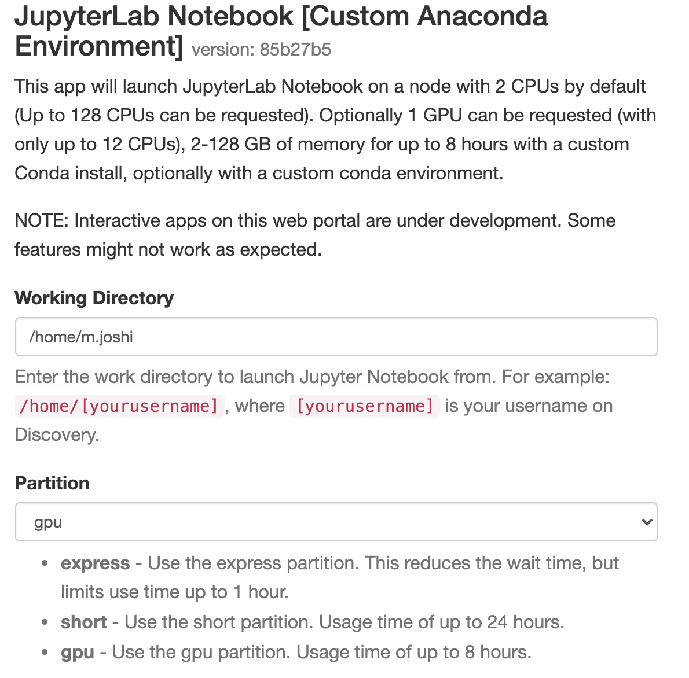
Exercise 4 Accessing GPU-supported environments on Jupyter Lab
Select your working directory (e.g.: /home/<yourusername>).
Select partition to be gpu.

Slide 23
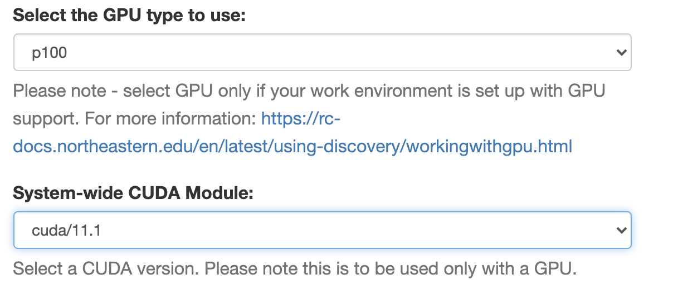
Exercise 4 Accessing GPU-supported environments on Jupyter Lab
Select time, memory (in GBs) & # CPUs. Keep default values for this exercise.
Select GPU type as p100 and CUDA version to be cuda/11.1:

Slide 24
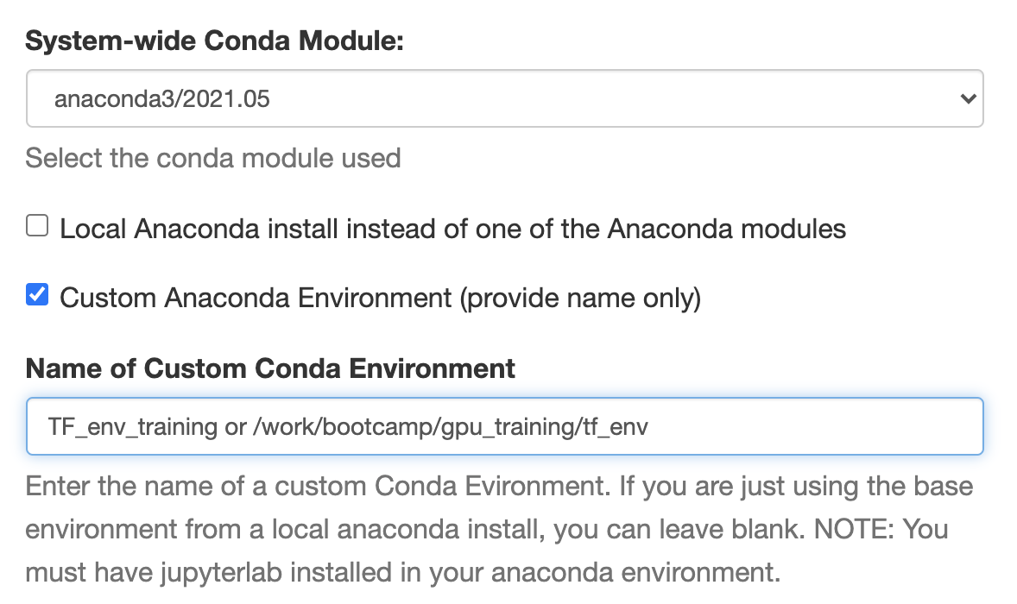
Exercise 4 Accessing GPU-supported environments on Jupyter Lab
System-wide conda module – using env built with Anaconda module “anaconda3/2021.05”
Local Anaconda install – will be checked iff you use an Anaconda built locally (e.g., miniconda in ~).
Check Custom Anaconda Environment (provide name only), & fill the name:

Slide 25
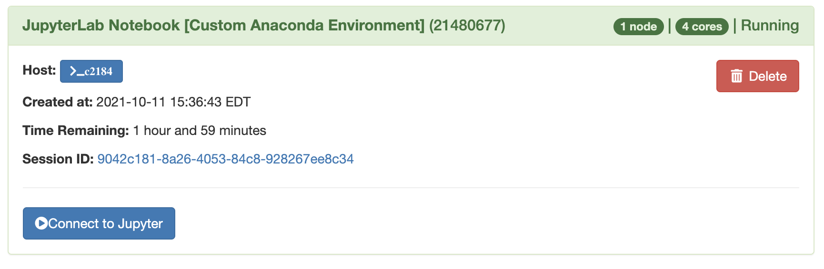
Exercise 4 Accessing GPU-supported environments on Jupyter Lab
Shell script (optional) – keep blank for this exercise. Use if additional shell commands need to be executed (e.g., loading other modules into the env, or updating shell variables etc.).
Hit the “Launch” button and wait for the session to start.
Once the session starts, click on “Connect to Jupyter”:

Slide 26
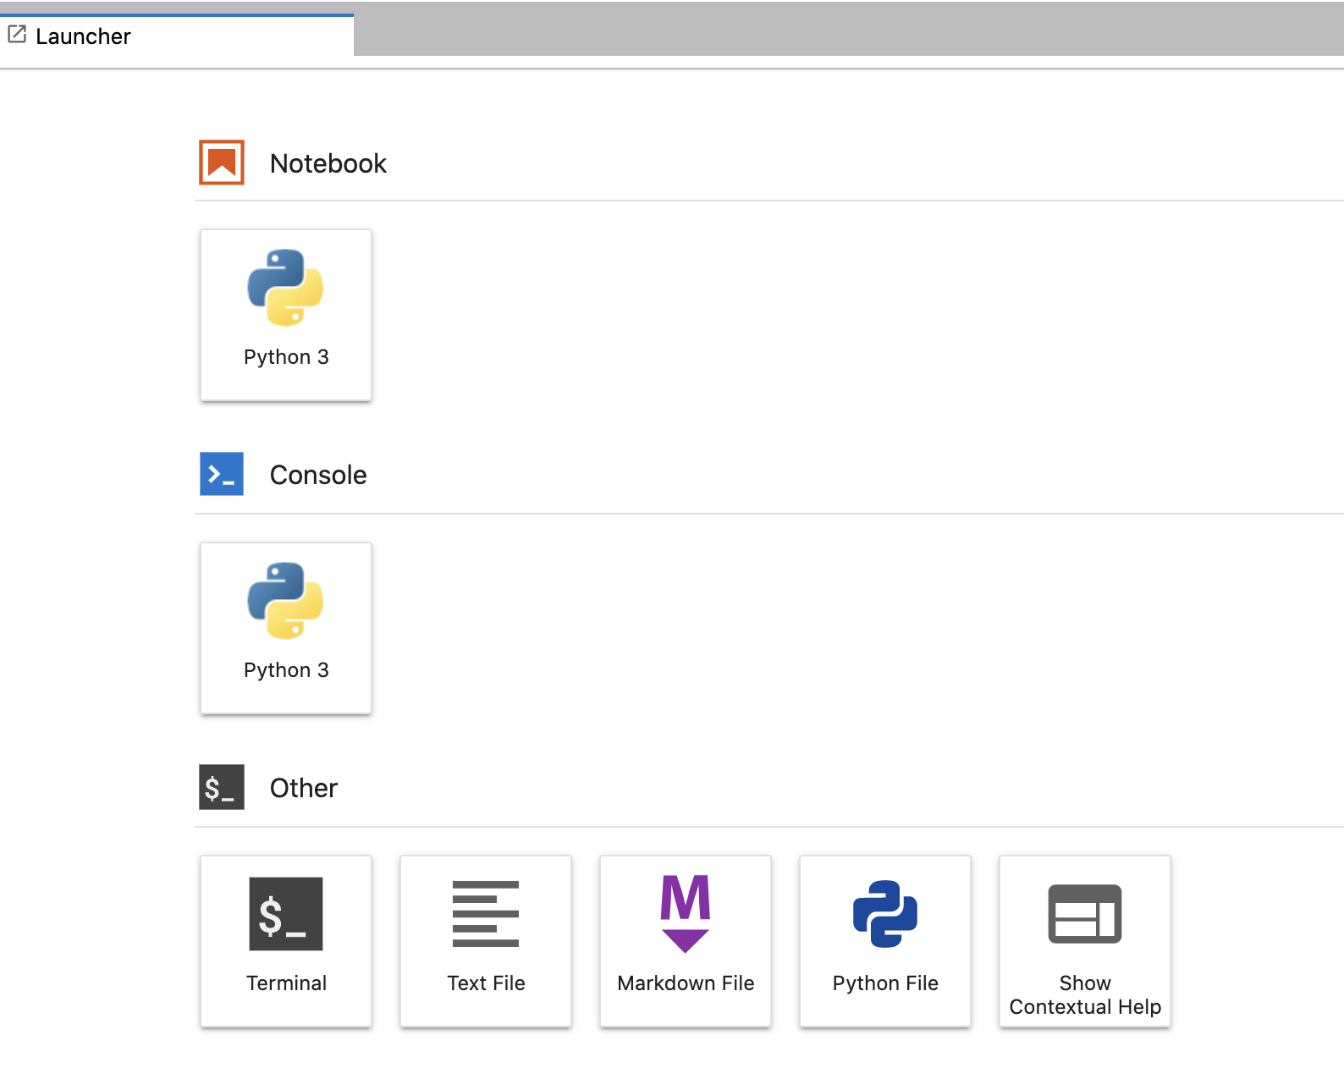
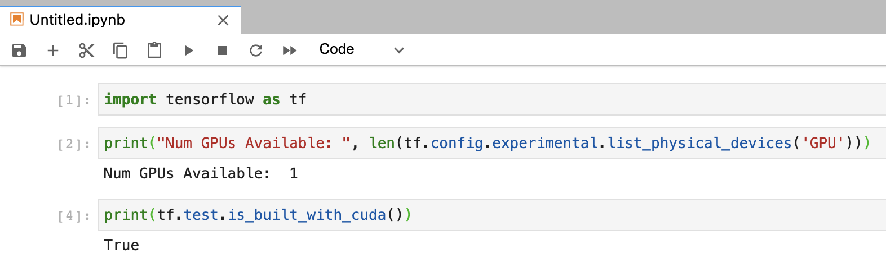
Exercise 4 Accessing GPU-supported environments on Jupyter Lab
Access the ”Notebook” and run a similar command to check the device:

Slide 27
Exercise 5
Submitting GPU-enabled Program (TF) On OOD

Slide 28
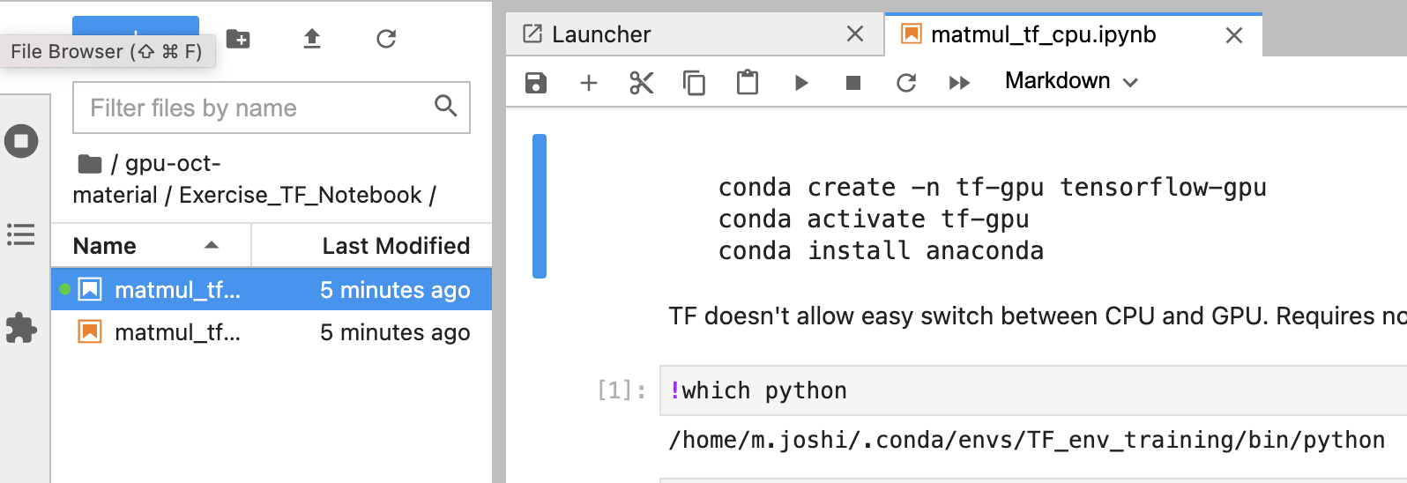
Exercise 5 Running GPU-supported programs on Jupyter Lab
Access notebooks to compare speeds between CPU & GPU-enabled matrix multiplication:

Slide 29
GPU Computing
Applications
GPU-accelerated libraries,
GPU compiler directives, &
GPU programming languages.
Look into software documentation for GPU support.
Libraries
Directives
Programming Languages
“Drop-in” acceleration. Seamless linking to GPU-enabled libraries.
Simple compiler instructions for easy acceleration of applications.
Maximum performance. Powerful way to design GPU accelerated applications.
cuFFT, cuBLAS, Thrust, NPP, IMSL, CULA, cuRAND.
OpenACC, OpenCL.
C/C++, Fortran, Python, Java.
Notes:
Three ways to carry out GPU computing or adding GPU acceleration to your applications:
GPU-accelerated libraries,
GPU compiler directives, and
GPU programming languages.
One should look into the documentation of their software to see if it supports GPU and if not then they can't do anything to do GPU computing

Slide 30
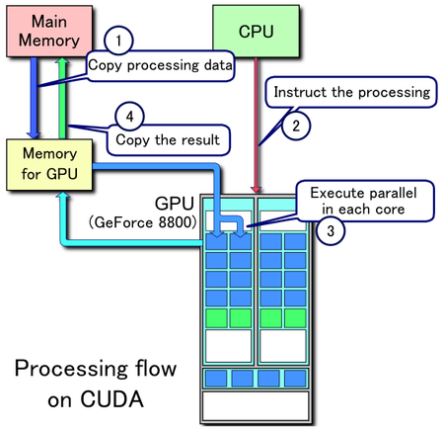
Processing Flow
Copy input from CPU to GPU
Load GPU program and execute it
Copy back from GPU to CPU
Notes:
Copy input from CPU to GPU
Load GPU program and execute it
Copy back from GPU to CPU

Slide 31
GPU Programming Languages & Directives
CUDA (Compute Unified Device Architecture) - Computing platform and language developed by NVIDIA [22, 23].
Halide - Programming language for writing digital image processing code for multi-core CPUs and GPUs [24].
OpenACC (Open Accelerators) - Programming directive for parallel computing developed by Cray, CAPS, NVIDIA and PGI [25].
OpenCL (Open Computing Language) - Low-level Application Programming Interface (API) or directive to launch compute kernels, written in C, on a GPU [26].
For this training, focus on CUDA.
Notes:
CUDA (Compute Unified Device Architecture) - Computing platform and language developed by NVIDIA for harnessing the performance of a GPU in general purpose computing [22, 23].
Halide - Programming language for writing digital image processing code for multi-core CPUs and GPUs [24].
OpenACC (Open Accelerators) - Programming directive for parallel computing developed by Cray, CAPS, Nvidia and PGI [25].
OpenCL (Open Computing Language) - Low-level application programming interface (API) or directive to launch compute kernels, written in C, on a GPU [26].

Slide 32
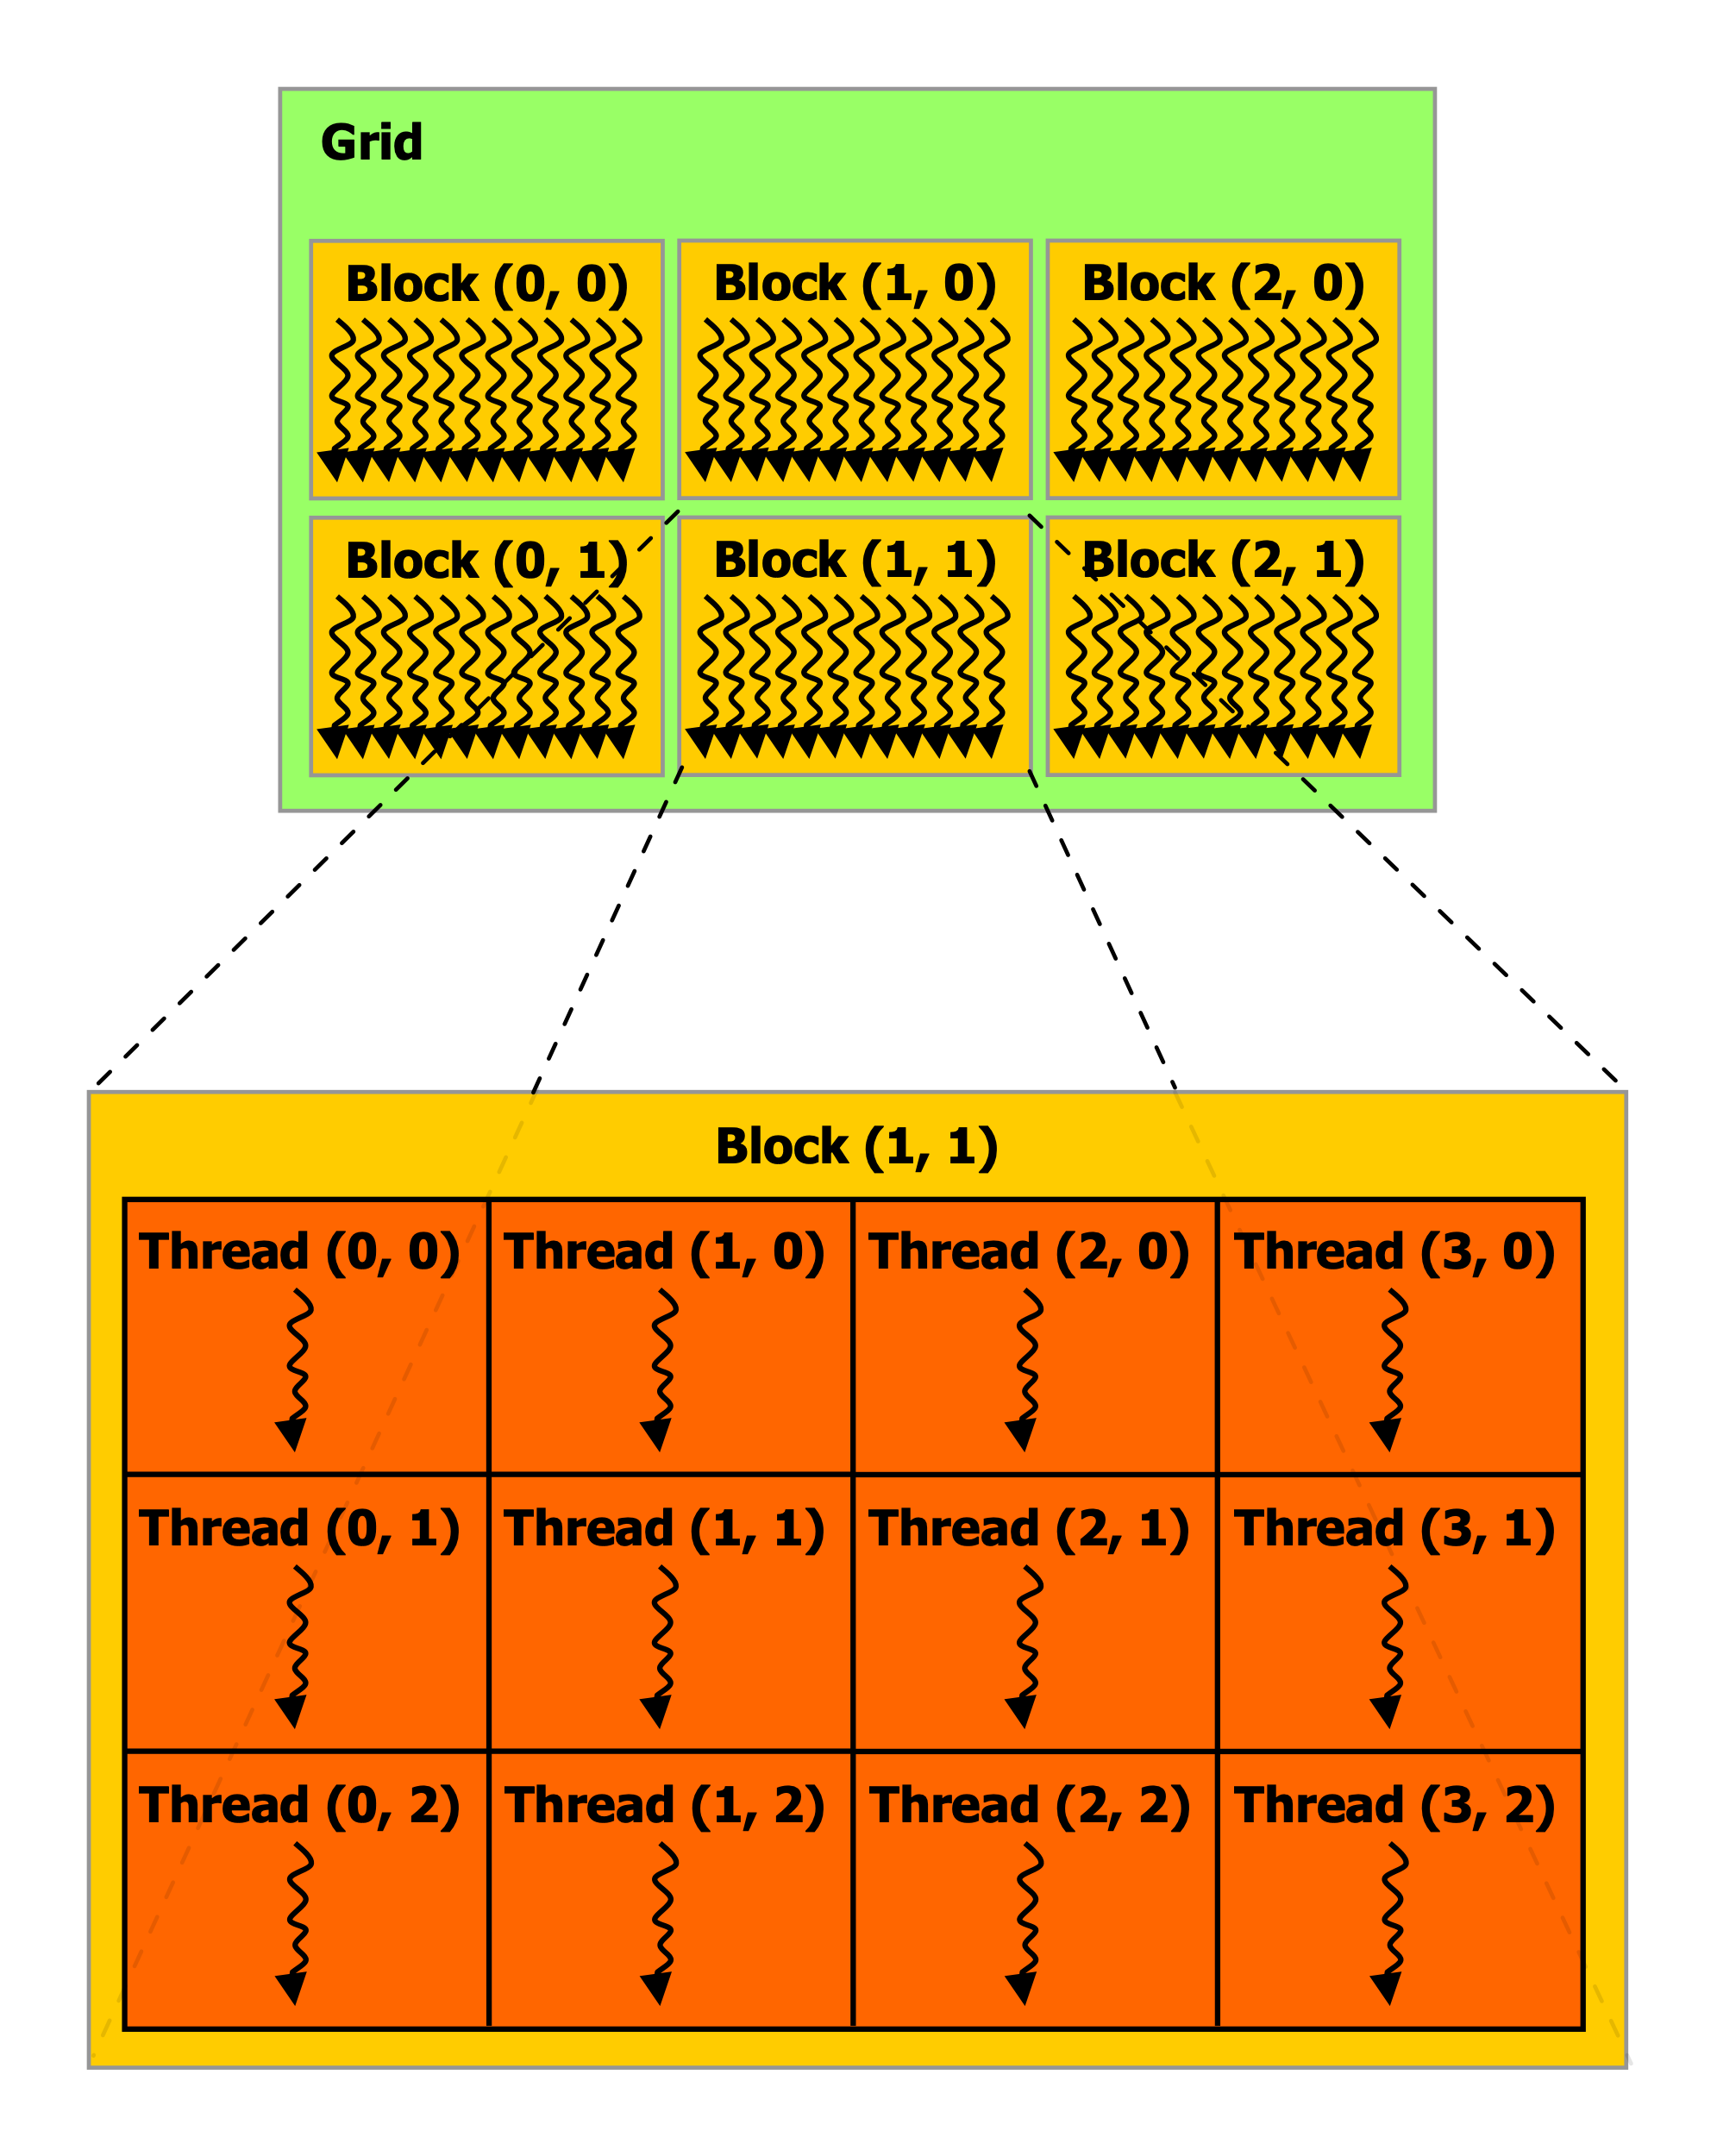
CUDA Basics
Threads
Execute kernels (simple C programs).
Executed by GPU cores.
Each thread has its own ID.
Warp
Group of 32 threads.
Blocks
Groups of threads.
Threads in a block can synchronize execution.
Executed by multiprocessors (MPs).
Grids
Groups of blocks. Blocks are independent.
Execute on GPU units (several MPs).
By NVIDIA - NVIDIA CUDA Programming Guide version 3.0, CC BY 3.0, https://commons.wikimedia.org/w/index.php?curid=17625645
Notes:
Several warps constitute a thread block. Several thread blocks are assigned to a Streaming Multiprocessor (SM). Several SM constitute the whole GPU unit (which executes the whole Kernel Grid).
Each architecture in GPU (say Kepler or Fermi) consists of several SM or Streaming Multiprocessors. These are general purpose processors with a low clock rate target and a small cache. An SM is able to execute several thread blocks in parallel. As soon as one of its thread block has completed execution, it takes up the serially next thread block. In general, SMs support instruction-level parallelism but not branch prediction
Ref: https://en.wikipedia.org/wiki/Thread_block_(CUDA_programming)

Slide 33
CUDA Programming Workflow
Memory Allocation For Host (CPU) & Device (GPU)
Initialize Host Data
Transfer Data From CPU -> GPU
Kernel Call
Transfer Results From GPU -> CPU
Free GPU Memory
Notes:
Typical work flow for CUDA programming model [31]
Memory allocation for host and device.
Initialize host data
Transfer data from host to device: Host -> GPU
Kernel call
Transfer results from device to host: GPU -> Host
Free GPU memory.

Slide 34
Thank you

Slide 35
Supplemental Material

Slide 36
CPUs vs GPUs contd.
GPUs used as co-processors to accelerate CPUs for computing.
Accelerates by offloading compute-intensive, time consuming portions of code.
Massively parallel architecture of GPU is responsible for its high compute performance.
CPU cores smarter than individual GPU cores. They process large & broad instruction sets, manage I/O of a computer.
GPU cannot do that but processes data several orders of magnitude faster than a CPU due to massive parallelism.
Notes:
GPUs are used as co-processors to accelerate CPUs for general-purpose scientific and engineering computing.
A GPU accelerates applications running on a CPU by offloading some of the compute-intensive and time consuming portions of the code.
As shown in the last figure, the massively parallel architecture of GPU is what is responsible for its high compute performance. CPU cores are smarter than individual GPU cores and can process large and broad instruction sets, manage every input and output of a computer that a GPU cannot do. On the other hand, GPUs can process data several orders of magnitude faster than a CPU due to massive parallelism.

Slide 37
CPUs & GPUs work together to increase throughput (amount of data that can be transferred from one location to another in a given amount of time) of data & number of simultaneous calculations within an application [5].
GPU cannot fully replace a CPU but complements it and completes more work in same time compared to a CPU.
GPU performs a narrower range of more specialized tasks (usually mathematical).
Notes:
The CPU coordinates a wide range of general-purpose computing tasks, while the GPU performs a narrower range of more specialized tasks (usually mathematical). In that sense, a GPU can never fully replace a CPU but rather complements CPU architecture and completes more work in the same amount of time as compared to a CPU. Since GPUs can perform concurrent operations on multiple sets of data, they are also used for non-graphical tasks such as machine learning (ML), artificial intelligence(AI), and high performance computation (HPC).
In a server environment, there might be 24 to 48 very fast CPU cores. Adding 4 to 8 GPUs to this same server can provide up to 40,000 additional cores. While individual CPU cores are faster (as measured by CPU clock speed), the sheer number of GPU cores and the massive amount of parallelism that they offer more than make up for the single-core clock speed difference and limited instruction sets [5].

Slide 38
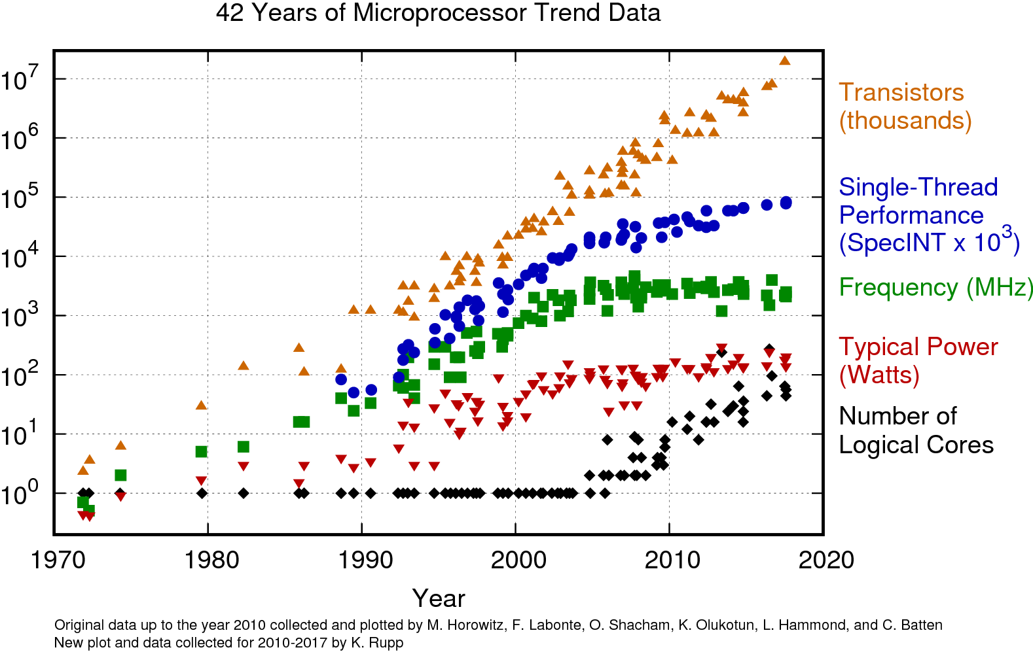
Parallel Computation Using GPUs
Serial computing dependent on Moore’s law.
Number of transistors in a dense circuit doubles every 2 years [18, 19].
Dependence started to weaken ~ 2004.
Single core performance (serial execution), clock frequency (speed), & power management roughly plateaued.
Number of transistors, and hence # of cores, continued to increase.

Slide 39
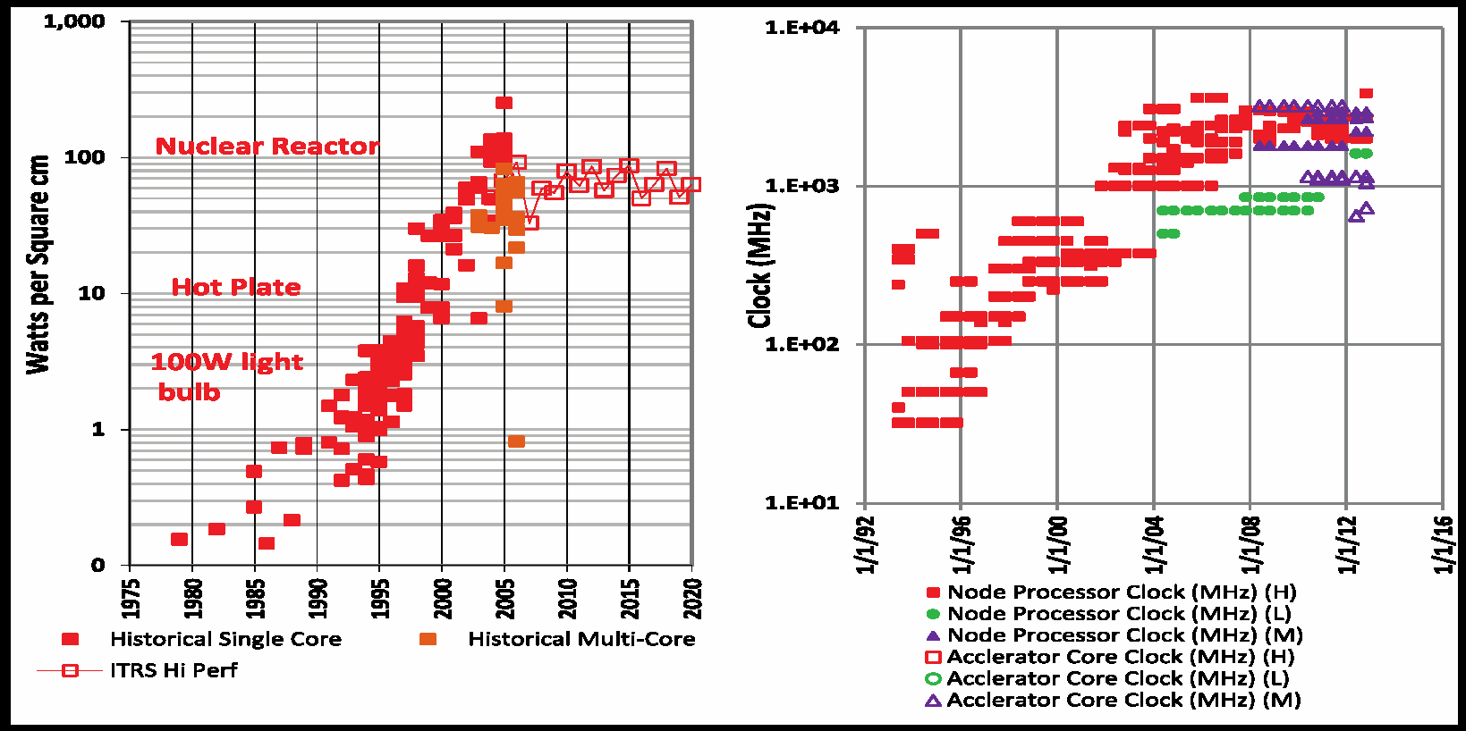

Parallel Computation contd.
Reason for plateauing of serial computation – Heat Dissipation.
Heat dissipated by a modern microprocessor ~ 100 $W/{{cm}^{2}}$ .
Hotter than a hotplate! [20]
Max. limit of transistors that can be put on a microchip without melting, given the constraints of viable cooling options.
Parallel computing - way to address computing power issue and to get around the laws of Physics.
Notes:
The reason of this plateau is heat dissipation. Heat dissipated by a modern microprocessor in a typical desktop machine is ~ 100 W/cm^2 (hotter than a hotplate), see the figure below [20].
Clock speed is a fair indicator of how fast a serial code is going to run. The clock speed plateaus and temperatures sore to 100 W/cm^2 right around 2004. This means that if we want to make our serial code run any faster the chips would actually start to melt, given the constraints of using a viable cooling option. Hence, parallel computing became a way to address the computing power issue and as a way around the laws of Physics.

Slide 40
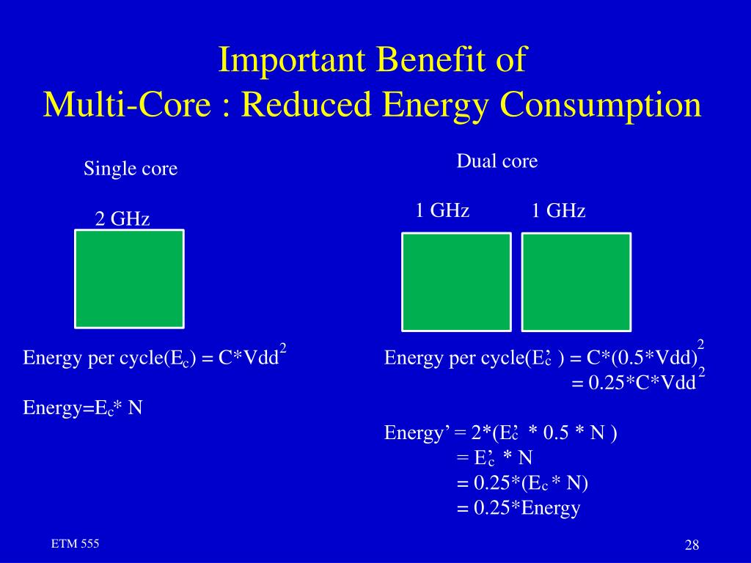
Double the area, use more transistors, & get more performance with same power [21].
Birth of parallel computing and using GPUs to perform that.
Notes:
The figure above shows the reduced power consumption of using a dual-core processor [21].
Area = 1 Single Core
Voltage = 1
Freq= 1
Power = 1
Perf= 1
Area = 2 Dual Core
Voltage = 0.85
Freq= 0.85
Power = 1
Perf= ~1.8

Slide 41
Exercise Create PyTorch Environment
Needed for PyTorch example – Matrix Multiplication
Last command creates a virtual conda environment that will be loaded prior to running the PyTorch example.
See https://rc-docs.northeastern.edu/en/latest/using-discovery/workingwithgpu.html
module load cuda/11.0
module load anaconda3/2021.05
conda create --name pytorch_env python=3.7 anaconda -y
source activate pytorch_env
conda install pytorch torchvision torchaudio cudatoolkit=11.0 -c pytorch python -c'import torch; print(torch.cuda.is_available())’

Slide 42
Did PyTorch environment creation work? If not, use
module load anaconda3/2021.05
source activate /work/bootcamp/gpu_training/pytorch_env

Slide 43
CUDA
General purpose parallel computing platform and programming model to solve complex computational problems in more efficient way than on a CPU.
All NVIDIA GPUs - GeForce®, Quadro®, and Tesla® - support CUDA®
Supports C, C++, Fortran, Python. Compatible with OpenCL & OpenACC.
Compatible with Windows, Linux, OS X.
Automatic Thread management (can handle +100k threads)
Multithreading: hides latency and helps maximize GPU utilization.
Transparent for the programmer.
Limited synchronization between threads is provided.
Difficult to dead-lock. Disadvantage of Message Passing.
Notes:
Invented by NVIDIA in Nov. 2006.
General purpose parallel computing platform and programming model to solve complex computational problems in more efficient way than on a CPU.
All NVIDIA GPUs - GeForce®, Quadro®, and Tesla® - support CUDA® parallel-programming model.
Supports C, C++, Fortran, Python. Compatible with both OpenCL and OpenACC.
Compatible with Windows, Linux, OS X.
Automatic Thread management (can handle +100k threads)
Multithreading: hides latency and helps maximize the GPU utilization.
Transparent for the programmer.
Limited synchronization between threads is provided.
Difficult to dead-lock. Disadvantage of Message Passing.

Slide 44
CUDA toolkit provides ways to obtain best performance from NVIDIA GPUs [27].
Optimized for various GPU hardware & software. Hence, GPU performance is not too different across various GPUs.
CUDA code is forward compatible with future hardware.
Number crunching: Modern graphics cards are capable of performing few teraflops (TFLOPS) of operation.
Floating-point operations per second (FLOPS) - Effective benchmark for GPU performance that measures how much math a GPU can do in a very short amount of time.
Power and cooling important factors for GPU computing.
Notes:
CUDA toolkit provides ways to obtain the best performance from NVIDIA GPUs [27]. It is optimized for various GPU hardware & software. Hence, GPU performance is not too different across various GPUs. Users may not see too much of performance difference across various gpu hardwares. But still good to benchmark your application for various GPUs.
Requires special programming but similar to C.
CUDA code is forward compatible with future hardware.
Number crunching: Modern graphics cards are capable of performing few teraflops (TFLOPS) of operation. Floating-point operations per second (FLOPS) is an effective benchmark for GPU performance that measures how much math a GPU can do in a very short amount of time.
Power and cooling important factors for GPU computing.

Slide 45
Cuda Examples
Hello World
cd /work/bootcamp/gpu_training/Exercise_HelloWorld
// Device Code
/* Function executed on device GPU */
__global__
void hello()
{
printf("\tHello from GPU: thread %d and block %d\n", threadIdx.x, blockIdx.x);
}
// Host Code
/* Main function, executed on host CPU */
int main() {
/* print message from CPU */
printf( "Hello Cuda From CPU!\n" );
/* execute function on device */
hello<<<NUM_BLOCKS, BLOCK_WIDTH>>>();
/* wait until all threads finish their job */
cudaDeviceSynchronize();
/* print message from CPU */
printf( "Welcome back to CPU!\n" );
}

Slide 46
Result
Hello Cuda From CPU!
Hello from GPU: thread 0 and block 1 Hello from GPU: thread 1 and block 1 Hello from GPU: thread 2 and block 1 Hello from GPU: thread 3 and block 1 Hello from GPU: thread 4 and block 1 Hello from GPU: thread 5 and block 1 Hello from GPU: thread 6 and block 1 Hello from GPU: thread 7 and block 1 Hello from GPU: thread 0 and block 0 Hello from GPU: thread 1 and block 0 Hello from GPU: thread 2 and block 0 Hello from GPU: thread 3 and block 0 Hello from GPU: thread 4 and block 0 Hello from GPU: thread 5 and block 0 Hello from GPU: thread 6 and block 0 Hello from GPU: thread 7 and block 0 Hello from GPU: thread 0 and block 3 Hello from GPU: thread 1 and block 3 Hello from GPU: thread 2 and block 3 Hello from GPU: thread 3 and block 3 Hello from GPU: thread 4 and block 3 Hello from GPU: thread 5 and block 3 Hello from GPU: thread 6 and block 3 Hello from GPU: thread 7 and block 3 Hello from GPU: thread 0 and block 2 Hello from GPU: thread 1 and block 2 Hello from GPU: thread 2 and block 2 Hello from GPU: thread 3 and block 2 Hello from GPU: thread 4 and block 2 Hello from GPU: thread 5 and block 2 Hello from GPU: thread 6 and block 2 Hello from GPU: thread 7 and block 2
Welcome back to CPU!
Submit job using sbatch:
sbatch main_c.bash

Slide 47
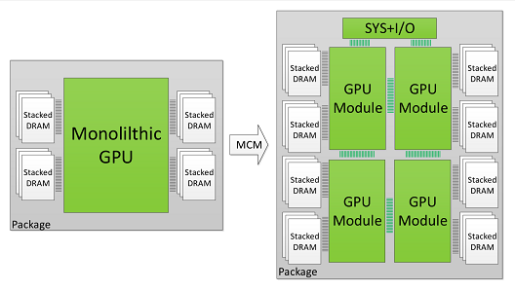
Multi GPU Programming
Comparison of single with multiple GPU modules [29].
Combining multiple GPUs together enhances performance scaling beyond Moore's law.
Multiple GPU code, needs to be optimized & made suitable for inter-GPU communication before implementation [30].
Notes:
The figure above shows a comparison of a single gpu with multiple gpu modules [29].
Combining multiple gpus together to form a larger logical GPU can enhance performance scaling beyond Moore's law.
However any code, meant to use multiple GPUs, needs to be optimized first and made suitable for inter-GPU communication before it can be implemented for that purpose [30].

Slide 48
References
https://en.wikipedia.org/wiki/Graphics_processing_unit
https://www.intel.com/content/www/us/en/products/docs/processors/what-is-a-gpu.html
https://www.intel.com/content/www/us/en/products/docs/processors/cpu-vs-gpu.html
https://www.boston.co.uk/info/nvidia-kepler/what-is-gpu-computing.aspx
https://www.omnisci.com/technical-glossary/cpu-vs-gpu
https://blogs.nvidia.com/blog/2009/12/16/whats-the-difference-between-a-cpu-and-a-gpu/?ncid=afm-chs-44270&ranMID=44270&ranEAID=a1LgFw09t88&ranSiteID=a1LgFw09t88-f.sbMZrKc2uBE1vsFxyu6w
https://www.techpowerup.com/gpu-specs/tesla-k20m.c2029
https://www.techpowerup.com/gpu-specs/tesla-k40m.c2529
https://www.techpowerup.com/gpu-specs/tesla-k80.c2616
https://www.nvidia.com/en-gb/data-center/tesla-k80/?ncid=afm-chs-44270&ranMID=44270&ranEAID=a1LgFw09t88&ranSiteID=a1LgFw09t88-_qFy8Z5gnAykrfpPWVrG6Q
https://www.techpowerup.com/gpu-specs/tesla-p100-pcie-16-gb.c2888
https://www.nvidia.com/en-us/data-center/tesla-p100/?ncid=afm-chs-44270&ranMID=44270&ranEAID=a1LgFw09t88&ranSiteID=a1LgFw09t88-yrGtdekAO3N2TJ.zF60rFA

Slide 49
https://www.techpowerup.com/gpu-specs/tesla-v100-pcie-32-gb.c3184
https://www.nvidia.com/en-us/data-center/v100/?ncid=afm-chs-44270&ranMID=44270&ranEAID=a1LgFw09t88&ranSiteID=a1LgFw09t88-osKIXys4ipWkL71z9CX6Mw
https://www.techpowerup.com/gpu-specs/tesla-v100-sxm2-32-gb.c3185
https://www.techpowerup.com/gpu-specs/tesla-t4.c3316
https://www.nvidia.com/en-us/data-center/tesla-t4/?ncid=afm-chs-44270&ranMID=44270&ranEAID=a1LgFw09t88&ranSiteID=a1LgFw09t88-OeJNemEieaA9ySKjMmtBlA
https://en.wikipedia.org/wiki/Moore%27s_law
https://www.karlrupp.net/2018/02/42-years-of-microprocessor-trend-data/
https://www.r-ccs.riken.jp/r-ccssite/wp-content/uploads/2019/10/campus_mapmr.JohnUrbanic-1.pdf
https://www.slideserve.com/gram/etm-555-supplementary-lecture-notes-version-5-201-2-contents-powerpoint-ppt-presentation
https://en.wikipedia.org/wiki/CUDA
https://blogs.nvidia.com/blog/2012/09/10/what-is-cuda-2/?ncid=afm-chs-44270&ranMID=44270&ranEAID=a1LgFw09t88&ranSiteID=a1LgFw09t88-Q_jh59H99YMEYsRxTy2Oeg
https://en.wikipedia.org/wiki/Halide_(programming_language)
https://en.wikipedia.org/wiki/OpenACC
https://developer.nvidia.com/opencl?ncid=afm-chs-44270&ranMID=44270&ranEAID=a1LgFw09t88&ranSiteID=a1LgFw09t88-xBHt2AswA25NHd3UnN0jbQ
https://docs.nvidia.com/cuda/cuda-c-best-practices-guide/index.html?ncid=afm-chs-44270&ranMID=44270&ranEAID=a1LgFw09t88&ranSiteID=a1LgFw09t88-Ykc6GLrcM_KaPvdcP3eo4w
https://people.duke.edu/~ccc14/sta-663/CUDAPython.html
https://research.nvidia.com/publication/2017-06_MCM-GPU%3A-Multi-Chip-Module-GPUs
https://medium.com/gpgpu/multi-gpu-programming-6768eeb42e2c
https://developer.nvidia.com/blog/easy-introduction-cuda-c-and-c/?ncid=afm-chs-44270&ranMID=44270&ranEAID=a1LgFw09t88&ranSiteID=a1LgFw09t88-IKbgke2Ie3siiYxpJZGAog

