Slide 1
Using GPUs On Discovery Training Module 08/18/2021
Instructor: Mariana Levi
Notes:
In this session we will introduce you to the concept of parallel computing through graphic processing units (GPUs). We will cover the following topics.

Slide 2
Overview:
Introduction to GPUs
CPUs vs GPUs
Various GPUs on Discovery and how to access them
Conda environments + GPU support
GPUs + Jupyter Notebook on OOD
GPU Computing – CUDA (NVIDIA) with C
NOTE: This tutorial is designed to be interactive.
We recommend using a shell on Discovery to execute the commands.

Slide 3
Accessing the training material
Download the Using_GPUs_on_Discovery.zip to your local machine.
Copy the training material to your $HOME directory on Discovery. You can use one of these options:
Using the File Explorer on OOD: https://ood.discovery.neu.edu/ Instructions: https://rc-docs.northeastern.edu/en/latest/using-ood/fileexplore.html
Using ’scp’ through the terminal/shell: https://rc-docs.northeastern.edu/en/latest/using-discovery/transferringdata.html?highlight=scp#
Access a Discovery Linux shell/terminal (use one of the following options):
Terminal/shell SSH: https://rc-docs.northeastern.edu/en/latest/get_started/connect.html
OOD shell: https://ood.discovery.neu.edu/pun/sys/shell/ssh/ood.discovery.neu.edu
You can also copy the material directly from a Discovery location:
$ unzip ~/Using_GPUs_on_Discovery.zip ~

Slide 4
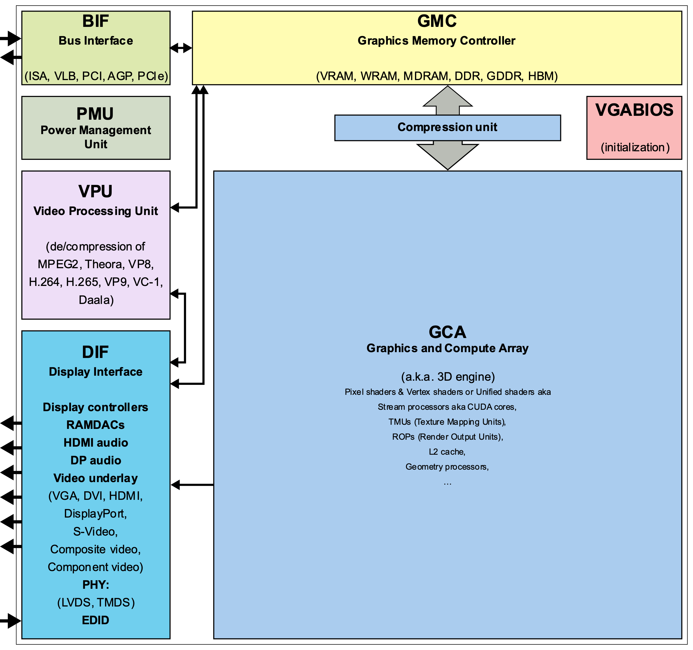
What Are GPUs
Graphics processing unit (GPU) - specialized microprocessor designed to accelerate graphics rendering to a display device [1,2].
Highly parallel structure, process large blocks of data simultaneously.
Machine Learning (ML), High-Performance Computing (HPC), video editing, gaming applications.
Mobile phones, laptops, workstations, game consoles as embedded systems.
Integrated into computer’s central processing unit (CPU) or offered as a discrete hardware unit.
By ScotXW - Own work, CC0,
https://commons.wikimedia.org/w/index.php?curid=61055349
Notes:
A graphics processing unit (GPU) is a specialized microprocessor that is originally designed to accelerate graphics rendering to a display device [1,2]. They have highly parallel structure, which makes them very efficient in simultaneously processing large blocks of data. This is the reason why they are extremely useful for parallel computing that is used in areas, such as machine learning, high-performance computing, video editing, gaming applications, etc. GPUs are used in embedded systems, mobile phones, personal computers, workstations, and game consoles. Modern GPUs are very efficient at manipulating computer graphics and image processing and are more efficient than general-purpose central processing units (CPUs) for parallel computing. GPUs may be integrated into the computer’s CPU or offered as a discrete hardware unit.
The figure shows a generic block diagram of a GPU along with its various components.

Slide 5
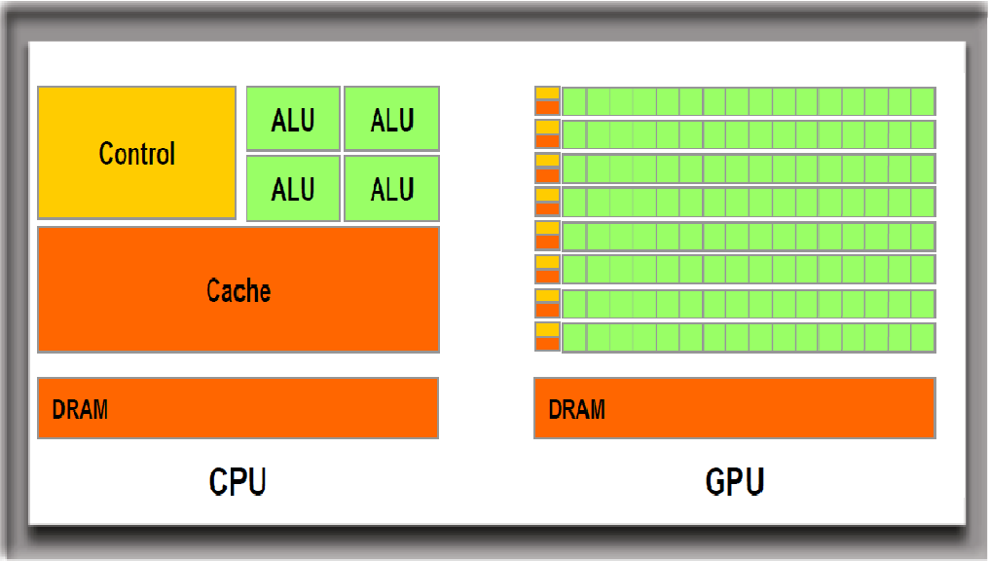
CPUs vs GPUs
CPU - millions of transistors [3], ~ 4-8 cores.
GPU - 100s of smaller processing cores [4], known as Arithmetic Logic Units [ALUs]).
CPU - Low latency & reasonable throughput. Computes a job as fast as possible.
GPU - High throughput & reasonable latency (delay between a user's action and an application's response to that action). Computes many jobs within a reasonable timeframe.
Notes:
The CPU is the logical thinking part of a computer's silicon brain, while the GPU can be considered as its creative side that helps render graphical user interfaces into visually appealing entities and designs.
A CPU is constructed from millions of transistors [3] and, typically, consists of four to eight cores, while a GPU consists of hundreds of smaller processing cores [4], known as Arithmetic Logic Units [ALUs]) (see the figure below).
It has low latency and reasonable throughput but computes a job as fast as possible.
A GPU, on the other hand, has high throughput and reasonable latency (delay between a user's action and an application's response to that action) but computes many jobs within a reasonable timeframe.
CPUs and GPUs work together to increase the throughput (amount of data that can be transferred from one location to another in a given amount of time) of data and the number of simultaneous calculations within an application [5]. The main program runs on the CPU while the GPU carries out repetitive calculations within an application in parallel.

Slide 6
What are GPUs & CPUs Good For?
GPUs have many cores, handle high throughput.
Known for parallel processing with performing thousands of operations at once [6].
Highly optimized for carrying out mathematical calculations, such as matrix multiplication, on large data sets.
CPUs have several cores, offer low latency.
CPUs are good for serial programming - do handful of operations at once.
Logical processing better suited for CPUs.
Check out: https://www.youtube.com/watch?v=ZrJeYFxpUyQ
Notes:
To summarize, CPUs have several cores, offer low latency, and are good for serial programming but they can only do a handful of operations at once. GPUs, on the other hand, have many cores, handle high throughput, and are known for parallel processing with performing thousands of operations at once [6].
Check out this cool video by NVIDIA that shows the difference between CPUs and GPUs using visual aid: https://www.youtube.com/watch?v=ZrJeYFxpUyQ

Slide 7
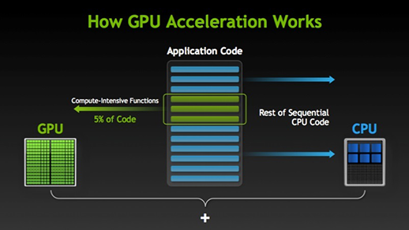
Illustration of CPU+GPU computing
Massively parallel programming is executed using GPUs with CPUs [28].
CPU orchestrates the parallelism, since GPU does not have a control unit:
Notes:
Figure above shows how massively parallel programming is executed using GPUs along with CPUs [28].
Memory sharing between CPU & GPU - GPU have multiple cores without control unit but the CPU controls the GPU through control unit. Dedicated GPU have its own DRAM=VRAM=GRAM faster then integrated RAM. Integrated GPU means that GPU is placed on same chip with CPU, and CPU & GPU used same RAM memory (shared memory ).

Slide 8
Various GPUs on Discovery (shared partitions)
Discovery offers NVIDIA GPUs on ‘gpu’ and ‘multigpu’ partitions. Some faculty partitions also have AMD GPUs.
k40m - Launched in Nov 2013 [8], Kepler architecture.
k80 - Professional graphics card launched in Nov 2014 [9, 10], Kepler architecture.
p100 - Launched in June 2016 [11, 12], Pascal architecture.
v100-pcie & v100-sxm2 - Professional graphics cards launched in March 2018 [13, 14, 15], Volta architecture.
T4 - Professional graphics card launched in Sept 2018 [16, 17], Turing architecture.
A100 – launched in May 2020 (coming soon), Ampere architecture.
See more specs here: https://en.wikipedia.org/wiki/List_of_Nvidia_graphics_processing_units
Notes:
The Discovery cluster supports a variety of NVIDIA GPUs that offer a wide range of functionalities and capabilities.
k40m - The Tesla K40m is an enthusiast-class professional graphics card developed by NVIDIA, which was launched in November 2013. It is built on 28 nm process, based on the GK110B graphics processor, and supports DirectX 12. For full specifications, see [8].
k80 - The Tesla K80 is a professional graphics card developed by NVIDIA, which was launched in November 2014. It is built on 28 nm process, is based on the GK210 graphics processor, and supports DirectX 12. Advertized as the world's most popular GPU on NVIDIA website, it delivers exceptional performance with fewer, more powerful servers that tremendously reduces data center costs and boosts throughput 5-10 times more in real-world applications. For full specifications and details, see [9, 10].
p100 - The Tesla P100 is an enthusiast-class professional graphics card developed by NVIDIA, which was launched in June 2016. It is Built on 16 nm process, is based on the GP100 graphics processor, and supports DirectX 12. Advertised as the world's first AI supercomputing data center GPU on NVIDIA website, it offers a unified platform for accelerating both HPC and AI, and dramatically increases throughput. For full specifications and details, see [11, 12].
v100-pcie & v100-sxm2 - The Tesla V100 series is a professional graphics card developed by NVIDIA, which was launched in March 2018. It is built on 12 nm process, is based on the GV100 graphics processor, and supports DirectX 12. Advertised as the first tensor core GPU on NVIDIA website, it is the most advanced data center GPU for AI. It comes in 16 and 32GB configurations. It offers performance of up to 32 CPUs wrapped up in a single GPU. For full specifications and details, see [13, 14, 15].
T4 - The Tesla T4 is a professional graphics card developed by NVIDIA, which was launched in September 2018. It is built on 12 nm process, is based on the TU104 graphics processor, and supports DirectX 12 Ultimate. This GPU offers breakthrough performance by accelerating various computing environments ranging from cloud to AI & graphics. It is energy-efficient and features multi-precision Turing Tensor Cores, providing up to 500 trillion tensor operations per second, and new RT Cores, for performing ray tracing operations with extraordinary efficiency. For full specifications and details, see [16, 17].
The latest Tesla 20-series GPUs are based on the latest implementation of the CUDA platform called the "Fermi architecture". Fermi has key computing features such as 500+ gigaflops of IEEE standard double-precision floating-point hardware support, L1 and L2 caches, ECC memory error protection, local user-managed data caches in the form of shared memory dispersed throughout the GPU, coalesced memory accesses, and more.

Slide 9
How to access GPUs on Discovery?
Access the gpu partition using the --gres= flag while running srun or sbatch.
Only a single gpu (--gres=gpu:1) can be accessed on gpu partition. To access multiple GPUs (if they are needed and efficiently used), apply for multigpu. For more details: https://rc-docs.northeastern.edu/en/latest/hardware/partitions.html#partition-access-request
To access any type of GPU, use: --gres=gpu:1 To access a specific type of GPU, use: --gres=gpu:<gpu-type>:1
Check the GPU device info that’s available to your job: nvidia-smi (non-GPU devices will return ‘command not found’).
For details go to: https://rc-docs.northeastern.edu/en/latest/using-discovery/workingwithgpu.html

Slide 10
Exercise 1
Accessing different GPU types

Slide 11
Exercise 1 Accessing different GPU types
Login to Discovery using a Linux Shell. For more info read: https://rc-docs.northeastern.edu/en/latest/get_started/connect.html Or use the Open OnDemand web shell: https://ood.discovery.neu.edu/pun/sys/shell/ssh/ood.discovery.neu.edu
Request a K80 GPU through the training reservation, and execute nvidia-smi to get the GPU info:
Outside the reservation time window, use the gpu partition:
For details regarding the srun option commands, read: https://rc-docs.northeastern.edu/en/latest/using-discovery/srun.html
$ srun --partition=reservation --reservation=Training-GPU --nodes=1 –-cpus-per-task=1 --gres=gpu:k80:1 --mem=2G --time=00:02:00 nvidia-smi
$ srun --partition=gpu --nodes=1 –-cpus-per-task=1 --gres=gpu:k80:1 --mem=2G --time=00:02:00 nvidia-smi
Notes:
Note that copy+paste some commands may not work on Discovery since the ‘dash’ characters are not copied correctly from Microsoft applications.
Either type the commands directly, or use the commands file in: ~/Using_GPUs_on_Discovery/commands_for_exercises.txt

Slide 12
Exercise 1 Accessing different GPU types
Repeat this command with P100 and V100 GPUs:
Outside the reservation time window, use the gpu partition:
$ srun --partition=reservation --reservation=Training-GPU --nodes=1 –-cpus-per-task=1 --gres=gpu:p100:1 --mem=2G --time=00:02:00 nvidia-smi $ srun --partition=reservation --reservation=Training-GPU --nodes=1 –-cpus-per-task=1 --gres=gpu:v100-sxm2:1 --mem=2G --time=00:02:00 nvidia-smi
$ srun --partition=gpu --nodes=1 –-cpus-per-task=1 --gres=gpu:p100:1 --mem=2G --time=00:02:00 nvidia-smi $ srun --partition=gpu --nodes=1 –-cpus-per-task=1 --gres=gpu:v100-sxm2:1 --mem=2G --time=00:02:00 nvidia-smi
Notes:
Note that copy+paste some commands may not work on Discovery since the ‘dash’ characters are not copied correctly from Microsoft applications.
Either type the commands directly, or use the commands file in: ~/Using_GPUs_on_Discovery/commands_for_exercises.txt

Slide 13
Exercise 1 Accessing different GPU types
Check the available features on the ‘gpu’ partition nodes using ‘sinfo’:
For the full list of features, read: https://slurm.schedmd.com/sinfo.html
$ sinfo -p gpu --Format=nodes,cpus,gres,features
NODES CPUS GRES AVAIL_FEATURES
1 28 gpu:p100:4 broadwell,prod
2 28 gpu:t4:4(S:0-1) ib,cascadelake,prod
1 28 gpu:v100-sxm2:4 ib,skylake_avx512,pr
11 28 gpu:p100:4(S:0-1) broadwell,prod
4 32 gpu:v100-pcie:2(S:0-zen,prod
1 28 gpu:v100-sxm2:4(S:0-ib,skylake_avx512,ne
20 28 gpu:v100-sxm2:4(S:0-ib,skylake_avx512,pr
1 28 gpu:v100-sxm2:3(S:0-ib,skylake_avx512,pr
15 24 gpu:k40m:1 haswell,prod
8 28 gpu:k80:8(S:0-1) broadwell,prod
Notes:
Note that copy+paste some commands may not work on Discovery since the ‘dash’ characters are not copied correctly from Microsoft applications.
Either type the commands directly, or use the commands file in: ~/Using_GPUs_on_Discovery/commands_for_exercises.txt

Slide 14
Exercise 2
Accessing GPUs On Discovery & Creating GPU-Enabled Conda environment (PyTorch example)

Slide 15
Exercise 2 Access GPUs on Discovery
Login to Discovery using a Linux Shell: https://rc-docs.northeastern.edu/en/latest/get_started/connect.html Or use the Open OnDemand web shell: https://ood.discovery.neu.edu/pun/sys/shell/ssh/ood.discovery.neu.edu
Request a GPU compute node through the training reservation:
For details regarding the srun option commands, read: https://rc-docs.northeastern.edu/en/latest/using-discovery/srun.html
$ srun --partition=reservation --reservation=Training-GPU --nodes=1 –-cpus-per-task=1 --pty --export=All --gres=gpu:1 --mem=10G --time=01:00:00 /bin/bash
Notes:
Note that copy+paste some commands may not work on Discovery since the ‘dash’ characters are not copied correctly from Microsoft applications.
Either type the commands directly, or use the commands file in: ~/Using_GPUs_on_Discovery/commands_for_exercises.txt

Slide 16
Exercise 2 Create GPU-enabled PyTorch Conda Environment
Build a GPU-enabled Pytorch environment in your $HOME directory:
Since it’s a long installation (15-20 minutes), we’ll use a pre-made installation.
For other CUDA versions, see instructions in the developers’ page: https://pytorch.org/get-started/previous-versions/
$ module load cuda/11.1 ## Load the CUDA module
$ module load anaconda3/2021.05 ## Load the Anaconda module ## create a virtual conda environment named “pytorch_env“:
$ conda create --name pytorch_env python=3.7 anaconda -y
## Load the virtual conda environment “pytorch_env”:
$ source activate pytorch_env
## Install Pytorch inside the virtual environment: (pytorch_env) $ conda install pytorch==1.8.0 torchvision==0.9.0 torchaudio==0.8.0 cudatoolkit=11.1 -c pytorch -c conda-forge -y
Notes:
Note that copy+paste some commands may not work on Discovery since the ‘dash’ characters are not copied correctly from Microsoft applications.
Either type the commands directly, or use the commands file in: ~/Using_GPUs_on_Discovery/commands_for_exercises.txt

Slide 17
Exercise 2 Activate and test the GPU-enabled Pytorch Conda environment
We’ll use an existing conda environment for the next exercises: pytorch_env_training
Once the conda virtual environment is loaded, you can check if Pytorch recognizes the GPU device. If this returns True, you’re ready to start working with GPU-supported Pytorch functions:
Check Pytorch CUDA API: https://pytorch.org/docs/stable/cuda.html
$ module load cuda/11.1 ## Load the CUDA module
$ module load anaconda3/2021.05 ## Load the Anaconda module ## Load the virtual conda environment “pytorch_env_training”:
$ source activate pytorch_env_training
## Test if the GPU device detected with Pytorch:
(pytorch_env_training) $ python -c 'import torch; print(torch.cuda.is_available())'
Notes:
Some applications such as Pytorch can give you much more details about the GPU device such as a device ID/name, device type etc.
Check their API here: https://pytorch.org/docs/stable/cuda.html
Note that copy+paste some commands may not work on Discovery since the ‘dash’ characters are not copied correctly from Microsoft applications.
Either type the commands directly, or use the commands file in: ~/Using_GPUs_on_Discovery/commands_for_exercises.txt

Slide 18
Exercise 3
Accessing GPU-supported environments on Jupyter Lab with Discovery Open OnDemand (OOD)

Slide 19
Exercise 3 Accessing GPU-supported environments on Jupyter Lab
Login to the Discovery OOD JupyterLab Notebook [Custom Anaconda Environment] : https://ood.discovery.neu.edu/pun/sys/dashboard/batch_connect/sys/jupyter_advanced/session_contexts/new
Make sure to have a ready Conda virtual environment:
Create the environment in advance using the Linux shell as shown in Exercise 1
Install your desired packages inside the environment
Install the jupyterlab package with: conda install jupyterlab
We’ll demonstrate with “pytorch_env_training” from the previous exercise, using the anaconda3/2021.05 module.
For more details: https://rc-docs.northeastern.edu/en/latest/using-ood/interactiveapps.html#working-with-jupyter-notebook-custom-anaconda-environment

Slide 20
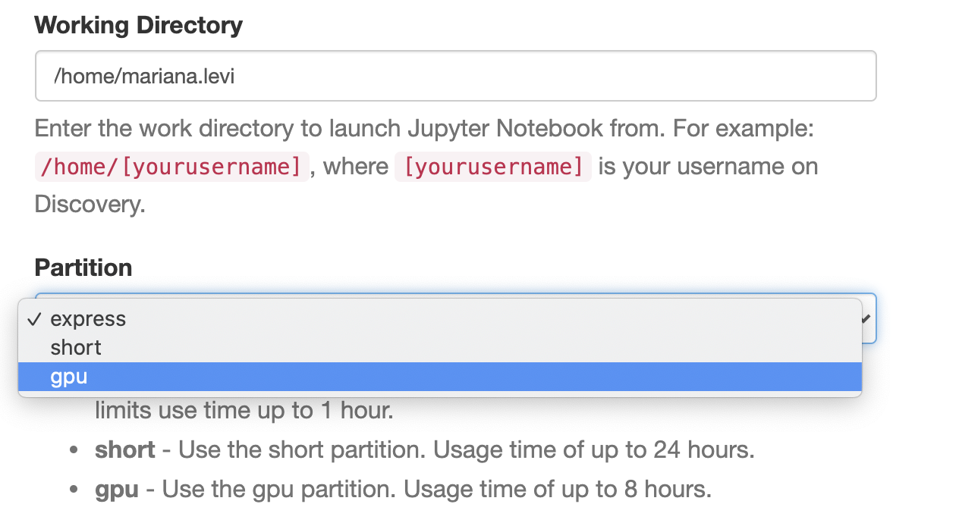
Exercise 3 Accessing GPU-supported environments on Jupyter Lab
Select your working directory (for example: /home/[yourusername]).
Select the partition to be gpu:

Slide 21
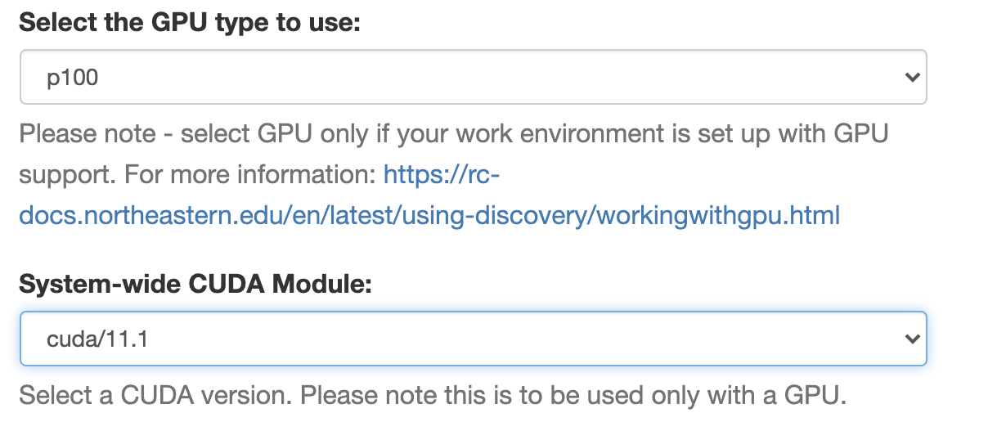
Exercise 3 Accessing GPU-supported environments on Jupyter Lab
Select amount of time to run the job, memory (in GBs) and number of CPUs. Keep those at the default values for this exercise.
Select GPU type as p100 and CUDA version to be cuda/11.1:

Slide 22
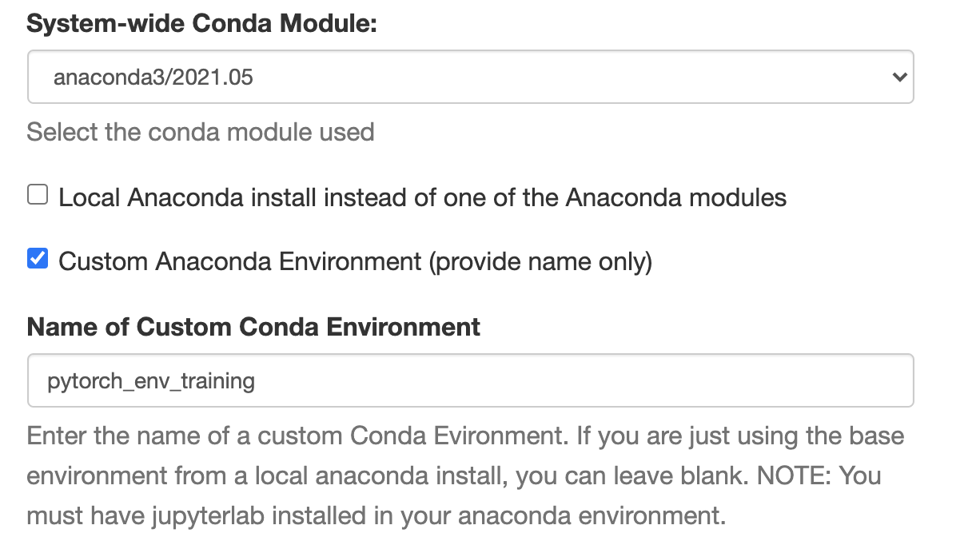
Exercise 3 Accessing GPU-supported environments on Jupyter Lab
System-wide conda module – since we’re using an environment build with the Anaconda module “anaconda3/2021.05”, select it.
Local Anaconda install – will need to be check only if you use an Anaconda built locally (for example, in your /home).
Check the Custom Anaconda Environment (provide name only), and fill in the name:

Slide 23
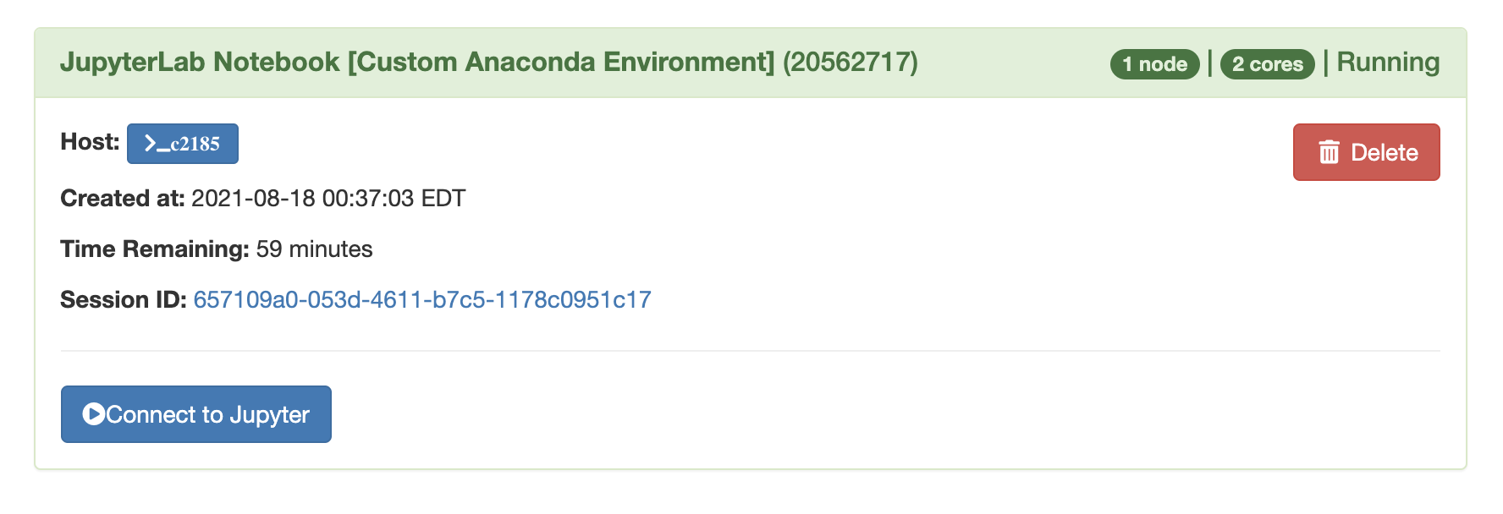
Exercise 3 Accessing GPU-supported environments on Jupyter Lab
Shell script (optional) – keep blank for this exercise. Use if any additional shell commands need to be executed (for example, loading other modules into the environment, updating shell variables etc.).
Hit the “Launch” button and wait for the session to start.
Once the session started, click on “Connect to Jupyter”:

Slide 24
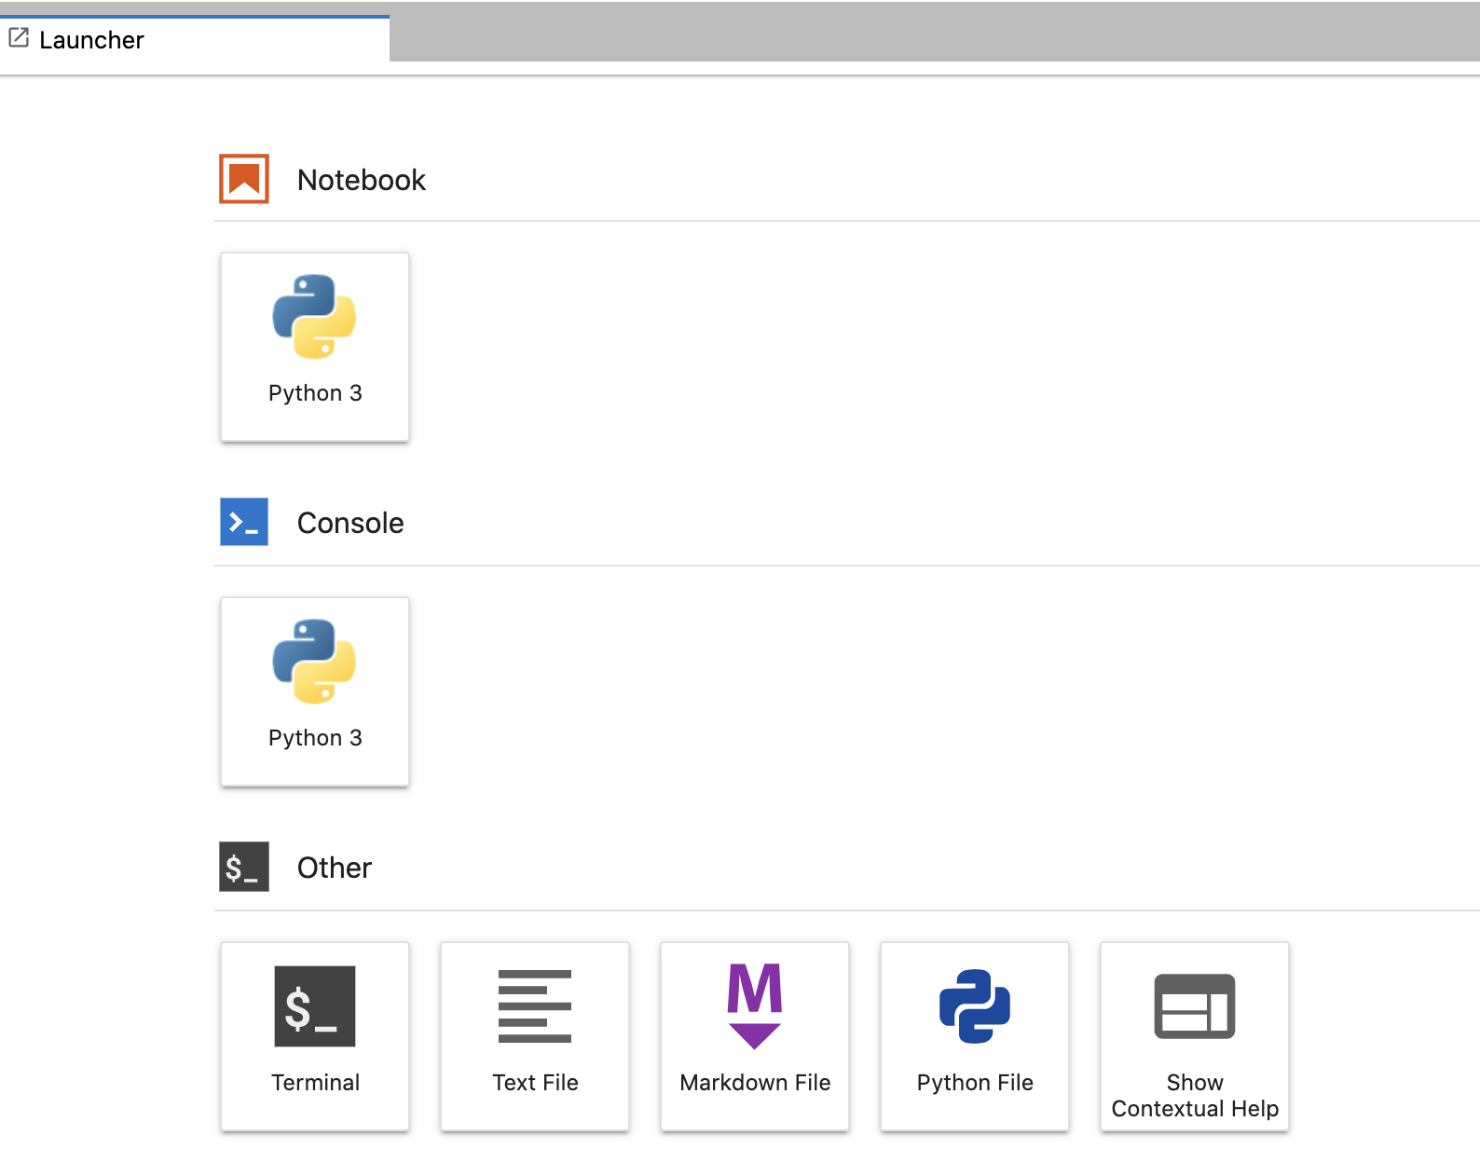
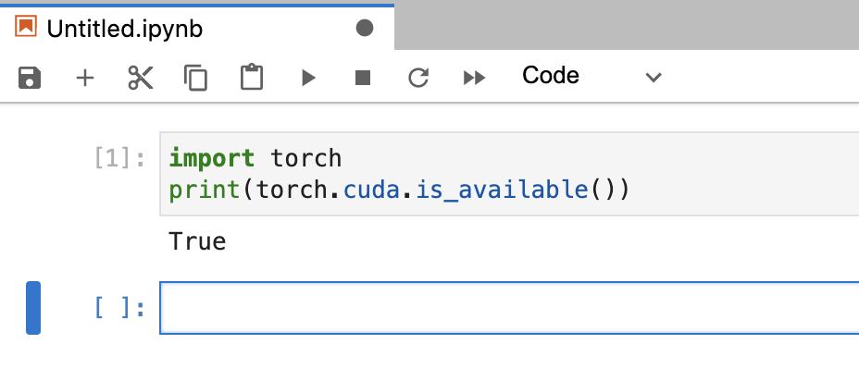
Exercise 3 Accessing GPU-supported environments on Jupyter Lab
Access the ”Notebook” and run a similar command to check the device:

Slide 25
GPU Computing options
Applications
GPU-accelerated libraries
GPU compiler directives
GPU programming languages
Check if your software supports GPU by looking into the developer’s documentation.
Libraries
Directives
Programming Languages
“Drop-in” acceleration. Seamless linking to GPU-enabled libraries.
Simple compiler instructions for easy acceleration of applications.
Maximum performance. Powerful way to design GPU accelerated applications.
cuFFT, cuBLAS, Thrust, NPP, IMSL, CULA, cuRAND.
OpenACC, OpenCL.
C/C++, Fortran, Python, Java.
Notes:
Three ways to carry out GPU computing or adding GPU acceleration to your applications:
GPU-accelerated libraries,
GPU compiler directives, and
GPU programming languages.
One should look into the documentation of their software to see if it supports GPU and if not then they can't do anything to do GPU computing

Slide 26
GPU Programming Languages & Directives
CUDA (Compute Unified Device Architecture) - Computing platform and language developed by NVIDIA [22, 23].
Halide - Programming language for writing digital image processing code for multi-core CPUs and GPUs [24].
OpenACC (Open Accelerators) - Programming directive for parallel computing developed by Cray, CAPS, NVIDIA and PGI [25].
OpenCL (Open Computing Language) - Low-level Application Programming Interface (API) or directive to launch compute kernels, written in C, on a GPU [26].
For this training, focus on CUDA.
Notes:
CUDA (Compute Unified Device Architecture) - Computing platform and language developed by NVIDIA for harnessing the performance of a GPU in general purpose computing [22, 23].
Halide - Programming language for writing digital image processing code for multi-core CPUs and GPUs [24].
OpenACC (Open Accelerators) - Programming directive for parallel computing developed by Cray, CAPS, Nvidia and PGI [25].
OpenCL (Open Computing Language) - Low-level application programming interface (API) or directive to launch compute kernels, written in C, on a GPU [26].

Slide 27
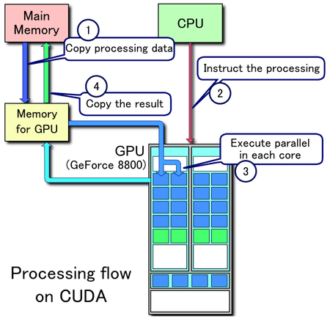
Processing Flow
Copy input from CPU to GPU
Load GPU program and execute it
Copy processed back from GPU to CPU.
Notes:
CUDA Programming Model Basics:
The CUDA programming model is a heterogeneous model in which both the CPU and GPU are used.
Host - refers to the CPU and its memory
Device - refers to the GPU and its memory
Kernels - functions executed on the device by many GPU threads in parallel
Code which runs on the host can manage the memory on both host and device, and also launches kernels.
Due to the heterogenous nature of CUDA programming, a typical sequence of operations for CUDA C programming is:
1. Declare and allocate host and device memory
2. Initialize host data
3. Transfer data from host to device
4. Execute one or more kernels
5. Transfer results from device to host

Slide 28
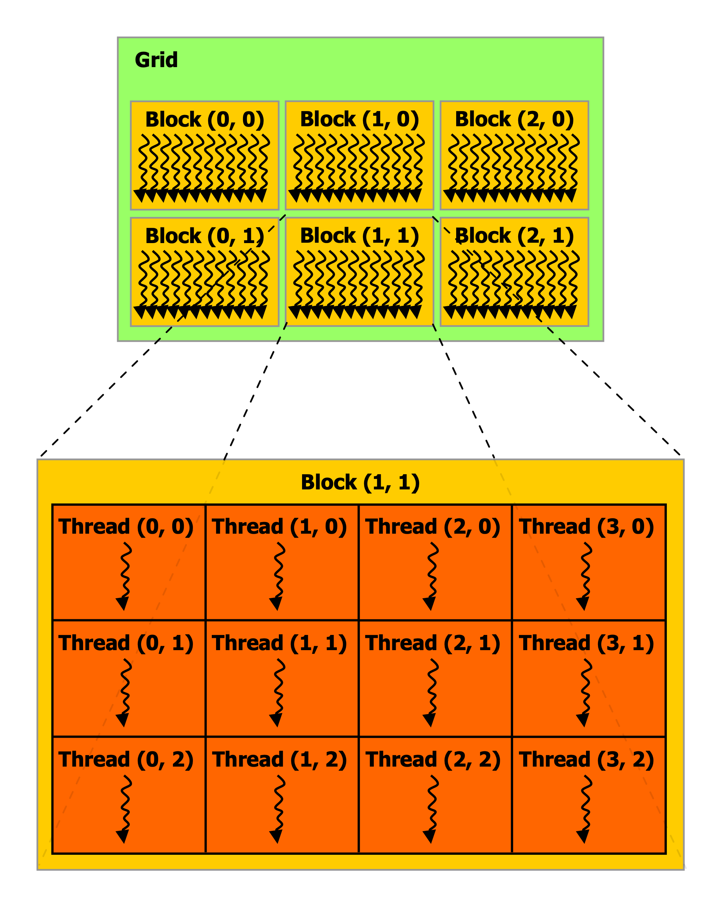
CUDA Basics
Threads
Execute kernels (simple C programs).
Executed by GPU cores.
Each thread has its own ID.
Warp
Group of 32 threads.
Blocks
Groups of threads.
Threads in a block can synchronize execution.
Executed by multiprocessors (MPs).
Grids
Groups of blocks. Blocks are independent.
Execute on GPU units (several MPs).
By NVIDIA - NVIDIA CUDA Programming Guide version 3.0, CC BY 3.0, https://commons.wikimedia.org/w/index.php?curid=17625645
Notes:
Several warps constitute a thread block. Several thread blocks are assigned to a Streaming Multiprocessor (SM). Several SM constitute the whole GPU unit (which executes the whole Kernel Grid).
Each architecture in GPU (say Kepler or Fermi) consists of several SM or Streaming Multiprocessors. These are general purpose processors with a low clock rate target and a small cache. An SM is able to execute several thread blocks in parallel. As soon as one of its thread block has completed execution, it takes up the serially next thread block. In general, SMs support instruction-level parallelism but not branch prediction
Ref: https://en.wikipedia.org/wiki/Thread_block_(CUDA_programming)
K40 - 2880 CUDA Cores
K80 - 4992 CUDA cores
P100 - 3584 CUDA cores
T4 - 2560 CUDA Cores
V100 - 640 Tensor Cores
A100 – 6912 CUDA cores

Slide 29
CUDA Programming Workflow
Memory Allocation For Host (CPU) & Device (GPU)
Initialize Host Data
Transfer Data From CPU -> GPU
PCI Bus
Kernel Call
Transfer Results From GPU -> CPU
Free GPU Memory
Notes:
Typical workflow for CUDA programming model [31]
1. Copy input data from CPU memory to GPU memory (PCI Bus)
2. Load GPU code and execute it, caching data on chip for performance.
3. Copy results from GPU memory to CPU memory

Slide 30
Exercise 4
CUDA C computing – programming with GPU:
Hello World
GPU addition – serial & parallel

Slide 31
Exercise 4 Cuda C – “Hello World” example code
$ cat ~/Using_GPUs_on_Discovery/Exercise_HelloWorld/helloworld.cu
// Host Code
#include <stdio.h>
#define NUM_BLOCKS 4 //Number of blocks
#define BLOCK_WIDTH 8 //Number of threads per block
int main() {
/* print message from CPU */
printf( "Hello Cuda From CPU!\n" );
/* execute function on device */
hello<<<NUM_BLOCKS, BLOCK_WIDTH>>>();
/* wait until all threads finish their job */
cudaDeviceSynchronize();
/* print message from CPU */
printf( "Welcome back to CPU!\n" );
}
// Device Code
/* Function executed on device GPU */
__global__
void hello()
{
printf("\tHello from GPU: thread %d and block %d\n", threadIdx.x, blockIdx.x);
}
Notes:
CUDA C/C++ keyword __global__ indicates a function that:
Runs on the device
Is called from host code
nvcc separates source code into host and device components:
Device functions (e.g. hello()) processed by NVIDIA compiler
Host functions (e.g. main()) processed by standard host compiler (gcc)
hello<<<NUM_BLOCKS, BLOCK_WIDTH>>>();
Triple angle brackets mark a call from host code to device code (Also called a “kernel launch”)
NUM_BLOCKS - each parallel invocation of hello() is referred to as a block
set of blocks is referred to as a grid
Each invocation can refer to its block index using blockIdx.x
BLOCK_WIDTH – threads per block

Slide 32
Exercise 4 Compiling and Running CUDA
Hello Cuda From CPU!
Hello from GPU: thread 0 and block 1 Hello from GPU: thread 1 and block 1 Hello from GPU: thread 2 and block 1 Hello from GPU: thread 3 and block 1 Hello from GPU: thread 4 and block 1 Hello from GPU: thread 5 and block 1 Hello from GPU: thread 6 and block 1 Hello from GPU: thread 7 and block 1 Hello from GPU: thread 0 and block 0 Hello from GPU: thread 1 and block 0 Hello from GPU: thread 2 and block 0 Hello from GPU: thread 3 and block 0 Hello from GPU: thread 4 and block 0 Hello from GPU: thread 5 and block 0 Hello from GPU: thread 6 and block 0 Hello from GPU: thread 7 and block 0 Hello from GPU: thread 0 and block 3 Hello from GPU: thread 1 and block 3 Hello from GPU: thread 2 and block 3 Hello from GPU: thread 3 and block 3 Hello from GPU: thread 4 and block 3 Hello from GPU: thread 5 and block 3 Hello from GPU: thread 6 and block 3 Hello from GPU: thread 7 and block 3 Hello from GPU: thread 0 and block 2 Hello from GPU: thread 1 and block 2 Hello from GPU: thread 2 and block 2 Hello from GPU: thread 3 and block 2 Hello from GPU: thread 4 and block 2 Hello from GPU: thread 5 and block 2 Hello from GPU: thread 6 and block 2 Hello from GPU: thread 7 and block 2
Welcome back to CPU!
Look into the shell script: The script uses NVIDIA compiler (nvcc) to compile C programs with or without device code. Then it runs the compiled binary.
Submit job using sbatch:
Inspect the result - right hand side shows an output from a V100 GPU.
$ cat Exercise_HelloWorld/helloworld.bash
$ cd Exercise_HelloWorld $ sbatch helloworld.bash
Notes:
Note that copy+paste some commands may not work on Discovery since the ‘dash’ characters are not copied correctly from Microsoft applications.
Either type the commands directly, or use the commands file in: ~/Using_GPUs_on_Discovery/commands_for_exercises.txt

Slide 33
Exercise 4 Two integer addition - serial: material adopted from: https://www.nvidia.com/docs/IO/116711/sc11-cuda-c-basics.pdf
We’ll run a simple kernel to add two integers: add(int *a, int *b, int *c)
Inspect the CUDA C code “addition_serial.cu”:
Add() runs on device, so we use pointers for the variables - a,b,c must point to device memory.
We also need to allocate memory on GPU, for the result.
We use CUDA API for simple device memory handling:
cudaMalloc(), cudaFree(), cudaMemcpy()
The following line indicates add() is being executed once (serial): add<<< 1, 1 >>>();
$ cd ~/Using_GPUs_on_Discovery/Exercise_Addition/
$ cat addition_serial.cu
Notes:
CUDA C/C++ keyword __global__ indicates a function that:
Runs on the device
Is called from host code
nvcc separates source code into host and device components:
Device functions (e.g. hello()) processed by NVIDIA compiler
Host functions (e.g. main()) processed by standard host compiler (gcc)
hello<<<NUM_BLOCKS, BLOCK_WIDTH>>>();
Triple angle brackets mark a call from host code to device code (Also called a “kernel launch”)
NUM_BLOCKS, BLOCK_WIDTH are the parameters

Slide 34
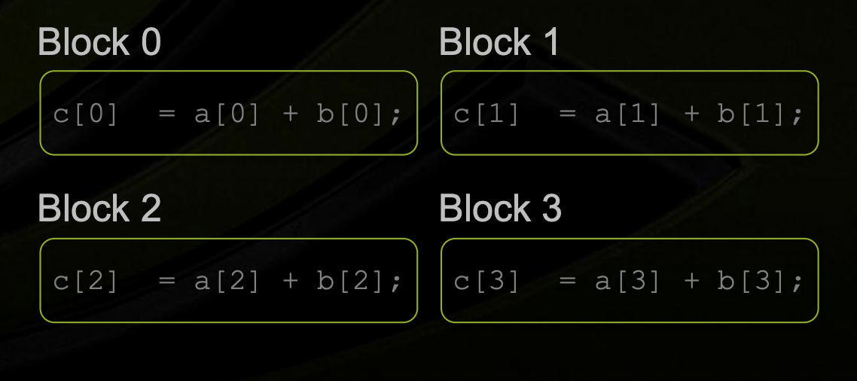
Exercise 4 Two integer addition – parallel using blocks: material adopted from: https://www.nvidia.com/docs/IO/116711/sc11-cuda-c-basics.pdf
Now, instead of executing add() once, we execute N times in parallel:
Inspect the CUDA C code “addition_parallel_blocks.cu”:
When add() runs in parallel, we can do vector addition - each parallel invocation of add() is referred to as a block, and corresponds to a different array index (blockIdx.x):
Launch N copies of add() with add<<<N,1>>>(…);
$ cd ~/Using_GPUs_on_Discovery/Exercise_Addition/
$ cat addition_parallel_blocks.cu
Notes:
CUDA C/C++ keyword __global__ indicates a function that:
Runs on the device
Is called from host code
nvcc separates source code into host and device components:
Device functions (e.g. hello()) processed by NVIDIA compiler
Host functions (e.g. main()) processed by standard host compiler (gcc)
hello<<<NUM_BLOCKS, BLOCK_WIDTH>>>();
Triple angle brackets mark a call from host code to device code (Also called a “kernel launch”)
NUM_BLOCKS, BLOCK_WIDTH are the parameters

Slide 35
Exercise 4 Two integer addition – parallel using threads: material adopted from: https://www.nvidia.com/docs/IO/116711/sc11-cuda-c-basics.pdf
We can also execute add() N times in parallel using N threads within a single block:
Inspect the CUDA C code “addition_parallel_blocks.cu”:
Each block can be split into parallel threads
We use threadIdx.x instead of blockIdx.x to indicate the array index.
Launch N threads which execute add() with add<<<1,N>>>(…);
$ cd ~/Using_GPUs_on_Discovery/Exercise_Addition/
$ cat addition_parallel_threads.cu
Block 0
c[0]=a[0]+b[0]
…
c[n]=a[n]+b[n]
Notes:
CUDA C/C++ keyword __global__ indicates a function that:
Runs on the device
Is called from host code
nvcc separates source code into host and device components:
Device functions (e.g. hello()) processed by NVIDIA compiler
Host functions (e.g. main()) processed by standard host compiler (gcc)
hello<<<NUM_BLOCKS, BLOCK_WIDTH>>>();
Triple angle brackets mark a call from host code to device code (Also called a “kernel launch”)
NUM_BLOCKS, BLOCK_WIDTH are the parameters

Slide 36

Exercise 4 Two integer addition – blocks+threads material adopted from: https://www.nvidia.com/docs/IO/116711/sc11-cuda-c-basics.pdf
We’ll split and index the array by blocks and threads:
The built-in variable blockDim.x is used to specify threads per block.
A unique index for each thread is given by: int index = threadIdx.x + blockIdx.x * blockDim.x ;
Note that typical problems are not friendly multiples of blockDim.x , so additional checks should be made to avoid accessing beyond the array size.
Notes:
Why use threads?
Unlike parallel blocks, threads have mechanisms to efficiently:
Communicate
Synchronize
Within a block, threads share data via shared memory. By opposition to device memory, referred to as global memory.
Extremely fast on-chip memory - like a user-managed cache
Declare using __shared__, allocated per block
Data is not visible to threads in other blocks

Slide 37
Exercise 4 Two integer addition – compiling and running material adopted from: https://www.nvidia.com/docs/IO/116711/sc11-cuda-c-basics.pdf
Request a node with a GPU:
Load a CUDA module and compile the code:
Run the executable program and inspect the output file produced:
## During training:
$ srun –p reservation --reservation=Training-GPU –N 1 –n 1 –-gres=gpu:1 --pty /bin/bash
## Outside of training:
$ srun –p gpu –N 1 –n 1–-gres=gpu:1 --pty /bin/bash
$ cd ~/Using_GPUs_on_Discovery/Exercise_Addition/
$ module load cuda/11.1
$ nvcc addition_serial.cu -o addition_serial
$ ./addition_serial &> addition_serial.output
$ cat addition_serial.output

Slide 38
Exercise 4 Two integer addition – compiling and running material adopted from: https://www.nvidia.com/docs/IO/116711/sc11-cuda-c-basics.pdf
Repeat the same process for the parallel code with blocks:
Repeat the same process for the parallel code with threads:
Repeat the same process for the parallel code with threads+blocks :
$ nvcc addition_parallel_blocks.cu -o addition_parallel_blocks
$ ./addition_parallel_blocks &> addition_parallel_blocks.output
$ cat addition_parallel_blocks.output
$ nvcc addition_parallel_threads.cu -o addition_parallel_threads
$ ./addition_parallel_threads &> addition_parallel_threads.output
$ cat addition_parallel_threads.output
$ nvcc addition_parallel_combined.cu -o addition_parallel_combined
$ ./addition_parallel_combined &> addition_parallel_combined.output
$ cat addition_parallel_combined.output

Slide 39
Thank you

Slide 40
Supplemental Material

Slide 41
Multi GPU Partition Access Process (optional)
Multiple GPUs can be accessed on multigpu partition by filling out Partition Access Request form: https://bit.ly/NURC-PartitionAccess :
Select the Multigpu – Testing access first to gain temporary access to a multi-GPU node.
Perform benchmarking on multiple GPUs, calculate performance (usually in terms of run times).
Compare the performance with the run time on a single GPU. Calculate efficiency.
Fill the Multigpu – Post Testing form (https://bit.ly/NURC-PartitionAccess) and report the performance compared to a single GPU:
Justify the need for using multiple GPUs for your scientific calculation.
Best to optimize the code first for multi gpu usage before submitting the request.
Note – your code MUST support multi-GPU computing to use multi-GPUs.

Slide 42
Optional Exercise Tensorflow Environment
Needed for Tensorflow (TF) example – Matrix Multiplication
Last command creates a virtual conda environment that will be loaded prior to running the TF example.
See https://rc-docs.northeastern.edu/en/latest/using-discovery/workingwithgpu.html
Pre-build version in anaconda3/2021.07-TF
module load cuda/11.0
module load anaconda3/2021.05
conda create --name TF_env python=3.7 anaconda
source activate TF_env
conda install -c anaconda tensorflow-gpu
python -c 'import tensorflow as tf; print(tf.test.is_built_with_cuda())'

Slide 43
CPUs vs GPUs contd.
GPUs used as co-processors to accelerate CPUs for computing.
Accelerates by offloading compute-intensive, time consuming portions of code.
Massively parallel architecture of GPU is responsible for its high compute performance.
CPU cores smarter than individual GPU cores. They process large & broad instruction sets, manage I/O of a computer.
GPU cannot do that but processes data several orders of magnitude faster than a CPU due to massive parallelism.
Notes:
GPUs are used as co-processors to accelerate CPUs for general-purpose scientific and engineering computing.
A GPU accelerates applications running on a CPU by offloading some of the compute-intensive and time consuming portions of the code.
As shown in the last figure, the massively parallel architecture of GPU is what is responsible for its high compute performance. CPU cores are smarter than individual GPU cores and can process large and broad instruction sets, manage every input and output of a computer that a GPU cannot do. On the other hand, GPUs can process data several orders of magnitude faster than a CPU due to massive parallelism.

Slide 44
CPUs & GPUs work together to increase throughput (amount of data that can be transferred from one location to another in a given amount of time) of data & number of simultaneous calculations within an application [5].
GPU cannot fully replace a CPU but complements it and completes more work in same time compared to a CPU.
GPU performs a narrower range of more specialized tasks (usually mathematical).
Notes:
The CPU coordinates a wide range of general-purpose computing tasks, while the GPU performs a narrower range of more specialized tasks (usually mathematical). In that sense, a GPU can never fully replace a CPU but rather complements CPU architecture and completes more work in the same amount of time as compared to a CPU. Since GPUs can perform concurrent operations on multiple sets of data, they are also used for non-graphical tasks such as machine learning (ML), artificial intelligence(AI), and high performance computation (HPC).
In a server environment, there might be 24 to 48 very fast CPU cores. Adding 4 to 8 GPUs to this same server can provide up to 40,000 additional cores. While individual CPU cores are faster (as measured by CPU clock speed), the sheer number of GPU cores and the massive amount of parallelism that they offer more than make up for the single-core clock speed difference and limited instruction sets [5].

Slide 45
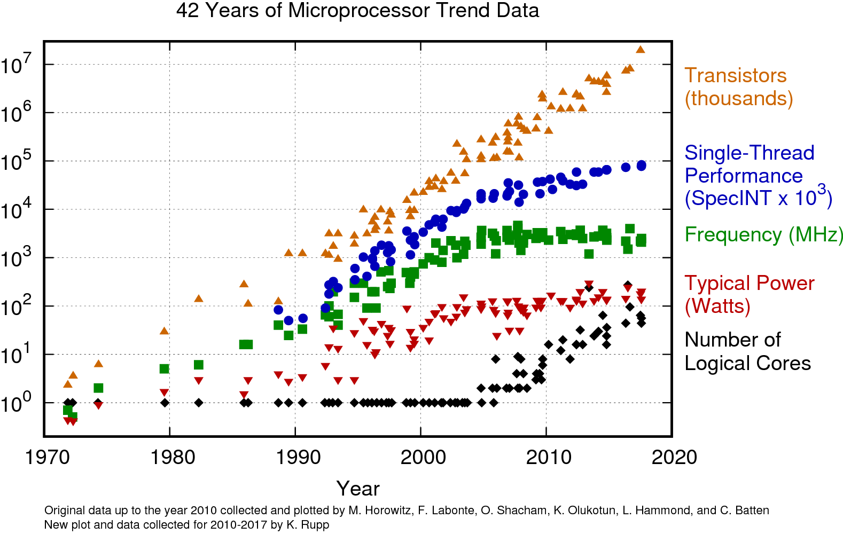
Parallel Computation Using GPUs
Serial computing dependent on Moore’s law.
Number of transistors in a dense circuit doubles every 2 years [18, 19].
Dependence started to weaken ~ 2004.
Single core performance (serial execution), clock frequency (speed), & power management roughly plateaued.
Number of transistors, and hence # of cores, continued to increase.

Slide 46
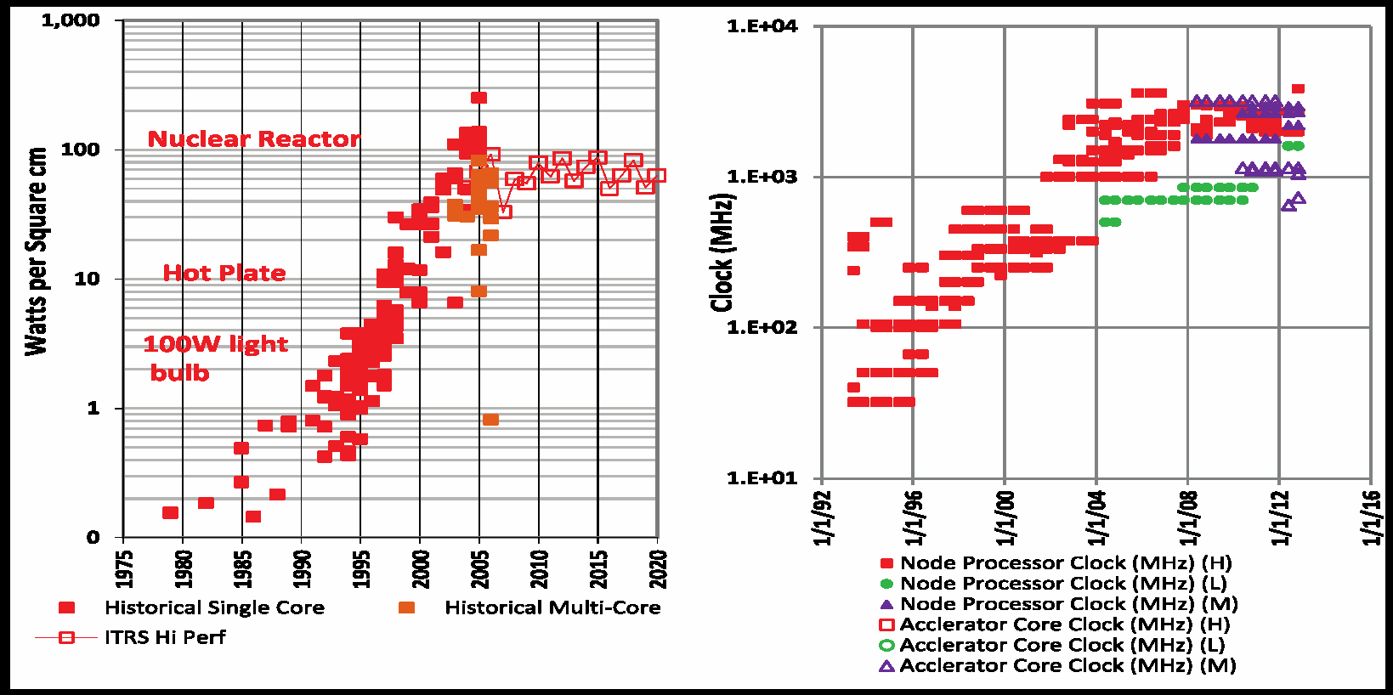

Parallel Computation contd.
Reason for plateauing of serial computation – Heat Dissipation.
Heat dissipated by a modern microprocessor ~ 100 $W/{{cm}^{2}}$ .
Hotter than a hotplate! [20]
Max. limit of transistors that can be put on a microchip without melting, given the constraints of viable cooling options.
Parallel computing - way to address computing power issue and to get around the laws of Physics.
Notes:
The reason of this plateau is heat dissipation. Heat dissipated by a modern microprocessor in a typical desktop machine is ~ 100 W/cm^2 (hotter than a hotplate), see the figure below [20].
Clock speed is a fair indicator of how fast a serial code is going to run. The clock speed plateaus and temperatures sore to 100 W/cm^2 right around 2004. This means that if we want to make our serial code run any faster the chips would actually start to melt, given the constraints of using a viable cooling option. Hence, parallel computing became a way to address the computing power issue and as a way around the laws of Physics.

Slide 47
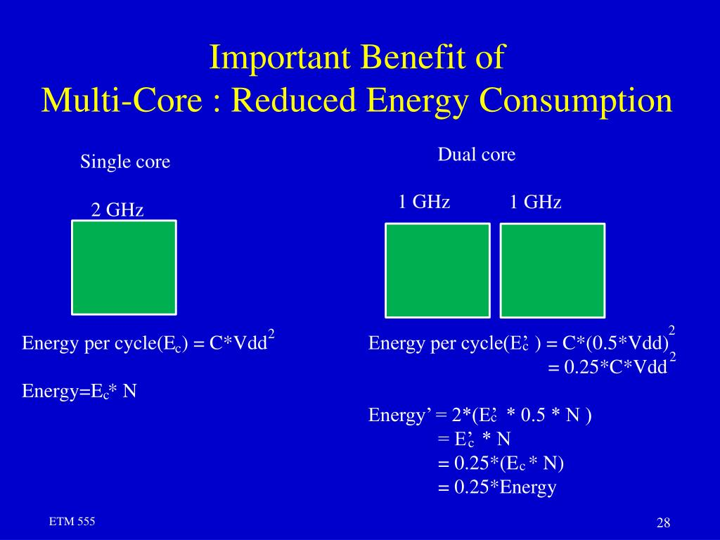
Double the area, use more transistors, & get more performance with same power [21].
Birth of parallel computing and using GPUs to perform that.
Notes:
The figure above shows the reduced power consumption of using a dual-core processor [21].
Area = 1 Single Core
Voltage = 1
Freq= 1
Power = 1
Perf= 1
Area = 2 Dual Core
Voltage = 0.85
Freq= 0.85
Power = 1
Perf= ~1.8

Slide 48
CUDA
General purpose parallel computing platform and programming model to solve complex computational problems in more efficient way than on a CPU.
All NVIDIA GPUs - GeForce®, Quadro®, and Tesla® - support CUDA®
Supports C, C++, Fortran, Python. Compatible with OpenCL & OpenACC.
Compatible with Windows, Linux, OS X.
Automatic Thread management (can handle +100k threads)
Multithreading: hides latency and helps maximize GPU utilization.
Transparent for the programmer.
Limited synchronization between threads is provided.
Difficult to dead-lock. Disadvantage of Message Passing.
Notes:
Invented by NVIDIA in Nov. 2006.
General purpose parallel computing platform and programming model to solve complex computational problems in more efficient way than on a CPU.
All NVIDIA GPUs - GeForce®, Quadro®, and Tesla® - support CUDA® parallel-programming model.
Supports C, C++, Fortran, Python. Compatible with both OpenCL and OpenACC.
Compatible with Windows, Linux, OS X.
Automatic Thread management (can handle +100k threads)
Multithreading: hides latency and helps maximize the GPU utilization.
Transparent for the programmer.
Limited synchronization between threads is provided.
Difficult to dead-lock. Disadvantage of Message Passing.

Slide 49
CUDA toolkit provides ways to obtain best performance from NVIDIA GPUs [27].
Optimized for various GPU hardware & software. Hence, GPU performance is not too different across various GPUs.
CUDA code is forward compatible with future hardware.
Number crunching: Modern graphics cards are capable of performing few teraflops (TFLOPS) of operation.
Floating-point operations per second (FLOPS) - Effective benchmark for GPU performance that measures how much math a GPU can do in a very short amount of time.
Power and cooling important factors for GPU computing.
Notes:
CUDA toolkit provides ways to obtain the best performance from NVIDIA GPUs [27]. It is optimized for various GPU hardware & software. Hence, GPU performance is not too different across various GPUs. Users may not see too much of performance difference across various gpu hardwares. But still good to benchmark your application for various GPUs.
Requires special programming but similar to C.
CUDA code is forward compatible with future hardware.
Number crunching: Modern graphics cards are capable of performing few teraflops (TFLOPS) of operation. Floating-point operations per second (FLOPS) is an effective benchmark for GPU performance that measures how much math a GPU can do in a very short amount of time.
Power and cooling important factors for GPU computing.

Slide 50
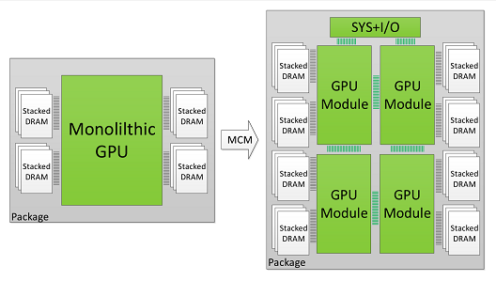
Multi GPU Programming
Comparison of single with multiple GPU modules [29].
Combining multiple GPUs together enhances performance scaling beyond Moore's law.
Multiple GPU code, needs to be optimized & made suitable for inter-GPU communication before implementation [30].
Notes:
The figure above shows a comparison of a single gpu with multiple gpu modules [29].
Combining multiple gpus together to form a larger logical GPU can enhance performance scaling beyond Moore's law.
However any code, meant to use multiple GPUs, needs to be optimized first and made suitable for inter-GPU communication before it can be implemented for that purpose [30].

Slide 51
CPU vs GPU Performance using Matrix Multiplication
cd /shared/rc/training/GPU_training/Exercise_MATLAB
% Declare a function that performs matrix multiplication on CPU and GPU, function matmult(A, B).
% Declare variables and arrays, say A & B. Arrays should be large in size. Here, 1 M.
% Perform matrix multiplication on CPU
tic
C = A*B;
tC = toc;
% Copy A and B from CPU to GPU using gpuArray() functionality of MATLAB.
a = gpuArray(A); b = gpuArray(B);
% Perform matrix multiplication on GPU
tic
c = a*b;
tgpu = toc;
% Copy data from GPU to CPU using gather().
% Display Results by running the job using sbatch: sbatch main_m.bash

Slide 52
Tensorflow For GPU
cd /shared/rc/training/GPU_training/Exercise_Tensorflow
# Create a conda environment using steps given in create_tf-env_interactive.txt
# Use srun to start an interactive session on a GPU compute node
srun -p gpu --nodes=1 --x11 --pty --gres=gpu:1 --time=01:00:00 --export=ALL /bin/bash
# Load required modules to create the environment
module load anaconda3/3.7 cuda/10.2
# Create the environment using conda create
conda create --name TF_env python=3.7 anaconda #where TF_env is the name of the conda environment
#Activate the environment using source activate
source activate TF_env
# Install gpu version of tensorflow using conda install
conda install -c anaconda tensorflow-gpu
# Details on https://rc-docs.northeastern.edu/en/latest/using-discovery/workingwithgpu.html
# Run the sample program on matrix multiplication using tensors on GPU using sbatch.
sbatch main_tf.bash

Slide 53
SAXPY - Single-precision A*X Plus Y
SAXPY stands for “Single-precision A*X Plus Y”, and is a good “hello world” example for parallel computation (cat ~/Using_GPUs_on_Discovery/Exercise_SAXPY/saxpy.cu):
// Device Code
/* Function executed on device GPU */
// Kernels defined using __global__ declaration specifier
__global__
void saxpy(int n, double a, double *x, double *y)
{
int i = blockIdx.x * blockDim.x + threadIdx.x;
/*
for dimensions of each thread block, index of each block within the grid, & index of thread within its block, resp.
*/
if (i < n) {
y[i] = a*x[i] + y[i];
}
}
// Host Code
/* Main function, executed on host CPU */
int main() {
// Declare Variables;
// Allocate Host Memory using malloc();
// Allocate Device Memory using cudaMalloc();
// Initialize Host Data;
// Transfer Data from CPU to GPU using cudaMemcpy();
// Launch Kernel, similar to calling a C function
saxpy<<<(size+255)/256, 256>>>(size, 2.0, device_x, device_y);
/* <<<“configuration execution”>>> 1st argument for # of thread blocks in the grid; 2nd for # of threads in a thread block.
*/
// Transfer Results from GPU to CPU using cudaMemcpy();
// Free GPU & CPU memory using cudaFree() & free(), resp.;
}
Notes:
SAXPY stands for “Single-precision A*X Plus Y”, and is a good “hello world” example for parallel computation.
Adopted from:
https://developer.nvidia.com/blog/easy-introduction-cuda-c-and-c/?ncid=afm-chs-44270&ranMID=44270&ranEAID=a1LgFw09t88&ranSiteID=a1LgFw09t88-IKbgke2Ie3siiYxpJZGAog

Slide 54
References
https://en.wikipedia.org/wiki/Graphics_processing_unit
https://www.intel.com/content/www/us/en/products/docs/processors/what-is-a-gpu.html
https://www.intel.com/content/www/us/en/products/docs/processors/cpu-vs-gpu.html
https://www.boston.co.uk/info/nvidia-kepler/what-is-gpu-computing.aspx
https://www.omnisci.com/technical-glossary/cpu-vs-gpu
https://blogs.nvidia.com/blog/2009/12/16/whats-the-difference-between-a-cpu-and-a-gpu/?ncid=afm-chs-44270&ranMID=44270&ranEAID=a1LgFw09t88&ranSiteID=a1LgFw09t88-f.sbMZrKc2uBE1vsFxyu6w
https://www.techpowerup.com/gpu-specs/tesla-k20m.c2029
https://www.techpowerup.com/gpu-specs/tesla-k40m.c2529
https://www.techpowerup.com/gpu-specs/tesla-k80.c2616
https://www.nvidia.com/en-gb/data-center/tesla-k80/?ncid=afm-chs-44270&ranMID=44270&ranEAID=a1LgFw09t88&ranSiteID=a1LgFw09t88-_qFy8Z5gnAykrfpPWVrG6Q
https://www.techpowerup.com/gpu-specs/tesla-p100-pcie-16-gb.c2888
https://www.nvidia.com/en-us/data-center/tesla-p100/?ncid=afm-chs-44270&ranMID=44270&ranEAID=a1LgFw09t88&ranSiteID=a1LgFw09t88-yrGtdekAO3N2TJ.zF60rFA

Slide 55
https://www.techpowerup.com/gpu-specs/tesla-v100-pcie-32-gb.c3184
https://www.nvidia.com/en-us/data-center/v100/?ncid=afm-chs-44270&ranMID=44270&ranEAID=a1LgFw09t88&ranSiteID=a1LgFw09t88-osKIXys4ipWkL71z9CX6Mw
https://www.techpowerup.com/gpu-specs/tesla-v100-sxm2-32-gb.c3185
https://www.techpowerup.com/gpu-specs/tesla-t4.c3316
https://www.nvidia.com/en-us/data-center/tesla-t4/?ncid=afm-chs-44270&ranMID=44270&ranEAID=a1LgFw09t88&ranSiteID=a1LgFw09t88-OeJNemEieaA9ySKjMmtBlA
https://en.wikipedia.org/wiki/Moore%27s_law
https://www.karlrupp.net/2018/02/42-years-of-microprocessor-trend-data/
https://www.r-ccs.riken.jp/r-ccssite/wp-content/uploads/2019/10/campus_mapmr.JohnUrbanic-1.pdf
https://www.slideserve.com/gram/etm-555-supplementary-lecture-notes-version-5-201-2-contents-powerpoint-ppt-presentation
https://en.wikipedia.org/wiki/CUDA
https://blogs.nvidia.com/blog/2012/09/10/what-is-cuda-2/?ncid=afm-chs-44270&ranMID=44270&ranEAID=a1LgFw09t88&ranSiteID=a1LgFw09t88-Q_jh59H99YMEYsRxTy2Oeg
https://en.wikipedia.org/wiki/Halide_(programming_language)
https://en.wikipedia.org/wiki/OpenACC
https://developer.nvidia.com/opencl?ncid=afm-chs-44270&ranMID=44270&ranEAID=a1LgFw09t88&ranSiteID=a1LgFw09t88-xBHt2AswA25NHd3UnN0jbQ
https://docs.nvidia.com/cuda/cuda-c-best-practices-guide/index.html?ncid=afm-chs-44270&ranMID=44270&ranEAID=a1LgFw09t88&ranSiteID=a1LgFw09t88-Ykc6GLrcM_KaPvdcP3eo4w
https://people.duke.edu/~ccc14/sta-663/CUDAPython.html
https://research.nvidia.com/publication/2017-06_MCM-GPU%3A-Multi-Chip-Module-GPUs
https://medium.com/gpgpu/multi-gpu-programming-6768eeb42e2c
https://developer.nvidia.com/blog/easy-introduction-cuda-c-and-c/?ncid=afm-chs-44270&ranMID=44270&ranEAID=a1LgFw09t88&ranSiteID=a1LgFw09t88-IKbgke2Ie3siiYxpJZGAog

