Slide 1
Machine Learning On Discovery
Training Module
Instructors: Dr. Manasvita Joshi

Slide 2
Conda Environment & OOD – Exercise 1
Basic introduction to Data Science
Introduction to Machine Learning
Machine Learning Algorithms
Relation between Data Science and Machine Learning
Multi-classification problem using supervised learning – Exercise 2
Image net problem using PyTorch – Exercise 3

Slide 3
Accessing the training material
Download the ML_on_Discovery-1021.zip to your local machine.
Copy training material to your $HOME (~) directory on Discovery. You can use one of these options:
File Explorer on OOD: https://ood.discovery.neu.edu/ Instructions: https://rc-docs.northeastern.edu/en/latest/using-ood/fileexplore.html
’scp’ through terminal/shell: https://rc-docs.northeastern.edu/en/latest/using-discovery/transferringdata.html?highlight=scp# From the location of downloaded material on your local machine’s terminal, execute: scp ML_on_Discovery-1021.zip username@xfer.discovery.neu.edu:~

Slide 4
Exercise 1 Access a GPU on Discovery
Login to Discovery with/without X11 forwarding, resp:
Request a GPU compute node:
Request a GPU compute node outside of reservation:
ssh -Y username@login.discovery.neu.edu
OR
ssh username@login.discovery.neu.edu
$ srun --partition=reservation --reservation=octtraining2021ml --nodes=1 –-cpus-per-task=4 --pty --gres=gpu:1 --mem=10G --time=02:00:00 /bin/bash
$ nvidia-smi
$ srun --partition=gpu --nodes=1 –-cpus-per-task=4 --pty --gres=gpu:1 --mem=10G --time=02:00:00 /bin/bash
$ nvidia-smi

Slide 5
Exercise 1 Create Conda Environment
Build GPU-enabled PyTorch env in ~ – Image net data with PyTorch
See https://rc-docs.northeastern.edu/en/latest/using-discovery/workingwithgpu.html
https://docs.conda.io/projects/conda/en/latest/commands.html
module list ## See the module(s) that are already present in your env
module load cuda/11.0 ## Load the CUDA module
module load anaconda3/2021.05 ## Load the Anaconda module
## create virtual conda environment named “pytorch_env“ & not ask for confirmation:
conda create --name pytorch_env python=3.7 anaconda -y
## remove a virtual conda environment:
conda remove --name TF_env --all

Slide 6
What is Data Science (DS)?
Art of gathering, understanding, processing, & extracting value from data.
To visualize & communicate insights from it to your organization.
Insights are used to further the cause of the organization, improve its workflow, & drive strategic decision making in the organization.
Notes:
It is the art of gathering, understanding, processing, and extracting value from data in order to be able to visualize and communicate insights from it to your organization. The insights are then used to further the cause of the organization, improve its workflow, and drive strategic decision making in the organization.

Slide 7
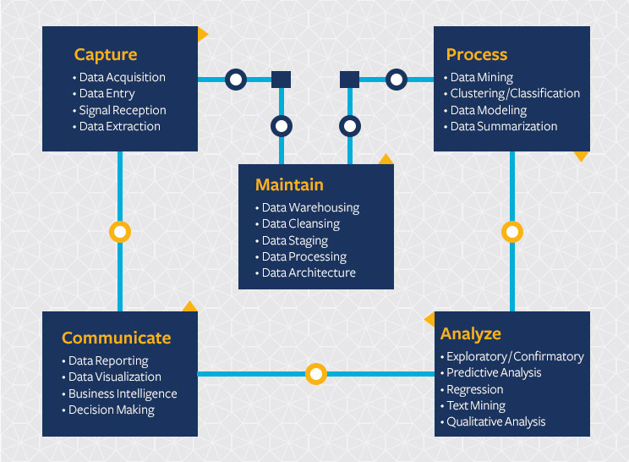
Data Science Life Cycle
Capture - Data Collection/Gathering
Maintain - Data Processing/Cleaning
Process - Data Exploration/Mining
Analyze - Data Analysis/Interpretation
Communicate - Data Communication/Visualization
https://datascience.berkeley.edu/about/what-is-data-science/
Notes:
The main steps involved in carrying out a data science project can be summarized as follows:
Capture - Data Collection/Gathering
Maintain - Data Processing/Cleaning
Process - Data Exploration/Mining
Analyze - Data Analysis/Interpretation
Communicate - Data Communication/Visualization
In other words, the entire life cycle of data science can be summed up according to the figure above.

Slide 8
What is Machine Learning (ML)?
Extracting knowledge from data, finding & applying patterns to data to make highly educated guesses about what one might want next.
Data can include numbers, words, images, clicks, or anything that can be digitally stored.
ML algorithms use statistics to find patterns in huge amounts of such data.
From movie recommendations, to what food to order, or which product to buy - modern websites and devices have ML algorithms at their core.
Facebook, Amazon, Netflix, contain multiple ML models in nearly every part of their site.
https://www.technologyreview.com/2018/11/17/103781/what-is-machine-learning-we-drew-you-another-flowchart/
Notes:
It is about extracting knowledge from data, finding and applying patterns to data in order to make highly educated guesses about what one might want next. Data can include numbers, words, images, clicks, or anything that can be digitally stored and machine learning algorithms use statistics to find patterns in huge amounts of such data. From automatic recommendations of which movies to watch, to what food to order or which products to buy, to personalized online radio and recognizing your friends in your photos, many modern websites and devices have machine learning algorithms at their core. Complex websites, such as Facebook, Amazon, Netflix, contain multiple machine learning models in nearly every part of their site.

Slide 9
ML Algorithms
3 major machine learning algorithms
Supervised Learning
Unsupervised Learning
Reinforcement Learning
Notes:
There are three major machine learning algorithms - supervised, unsupervised, and reinforcement.

Slide 10
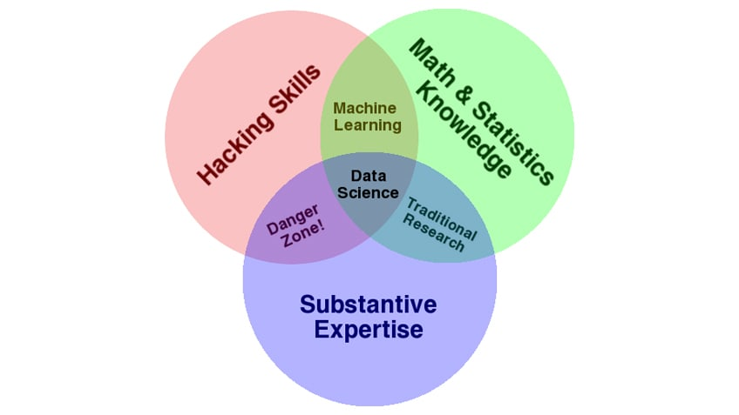
How is ML connected to DS?
DS is a multi-disciplinary field that includes ML, data analytics, predictive analytics, data visualization, etc.
Entire life cycle of a DS project goes through 5 steps.
ML techniques get used in Process & Analysis part of DS life cycle.
Data analytics and ML are two of the many tools and processes that DS uses.

Slide 11
Exercise 2
Access ML Resources Through OOD

Slide 12
Demo
Open OnDemand (OOD) – web portal to Discovery cluster.
Various Interactive Apps available on OOD, including Jupyter notebook, JupyterLab, Knime, & WEKA ML platforms.
https://rc-docs.northeastern.edu/en/latest/using-ood/introduction.html
Manage files on Discovery using OOD
https://rc-docs.northeastern.edu/en/latest/using-ood/fileexplore.html

Slide 13
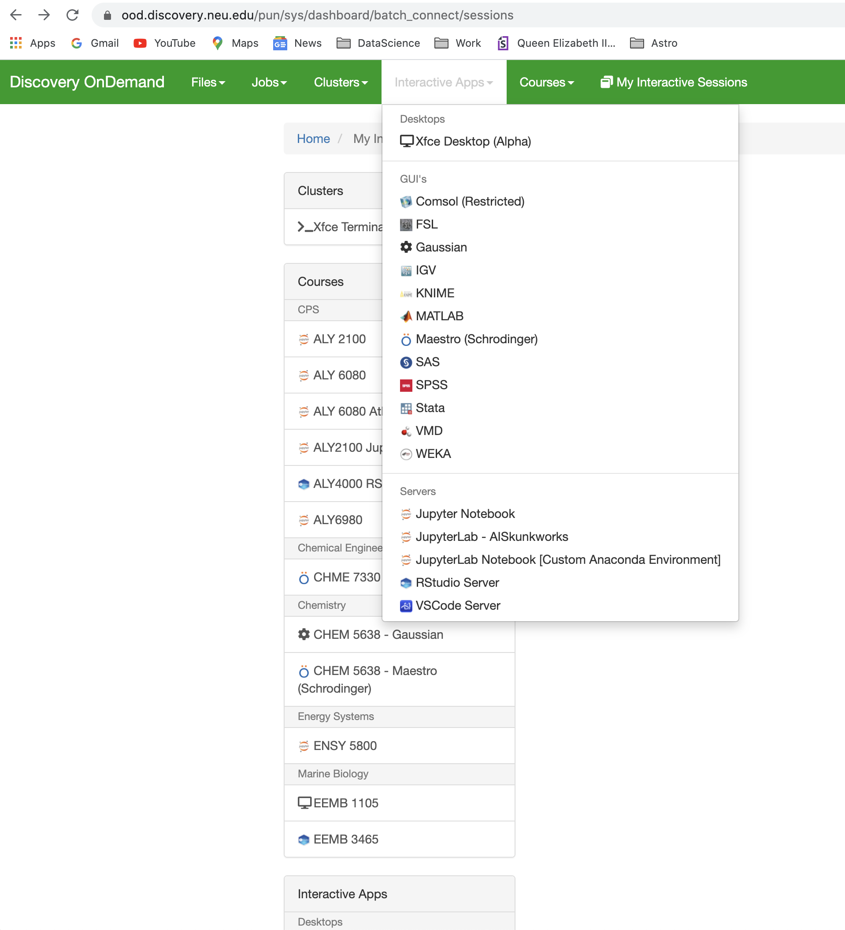
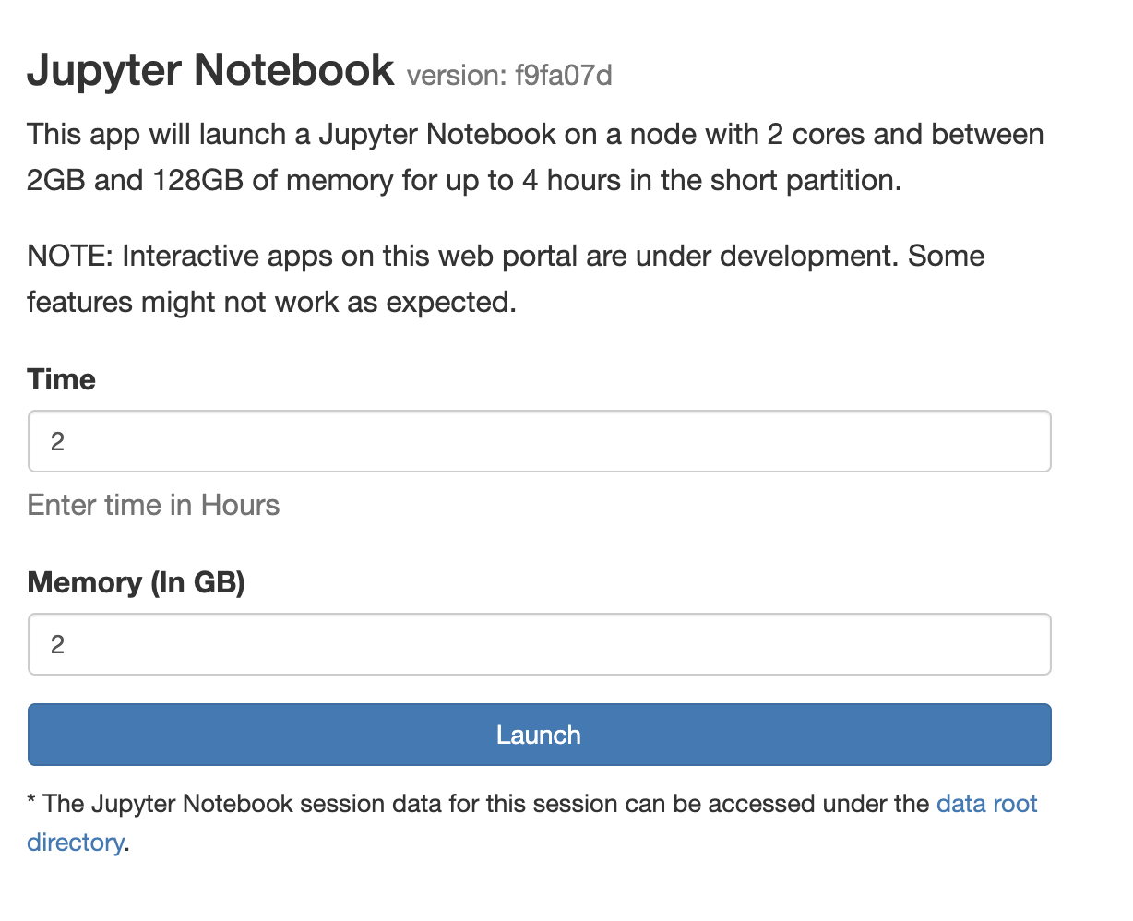
Demo

Slide 14
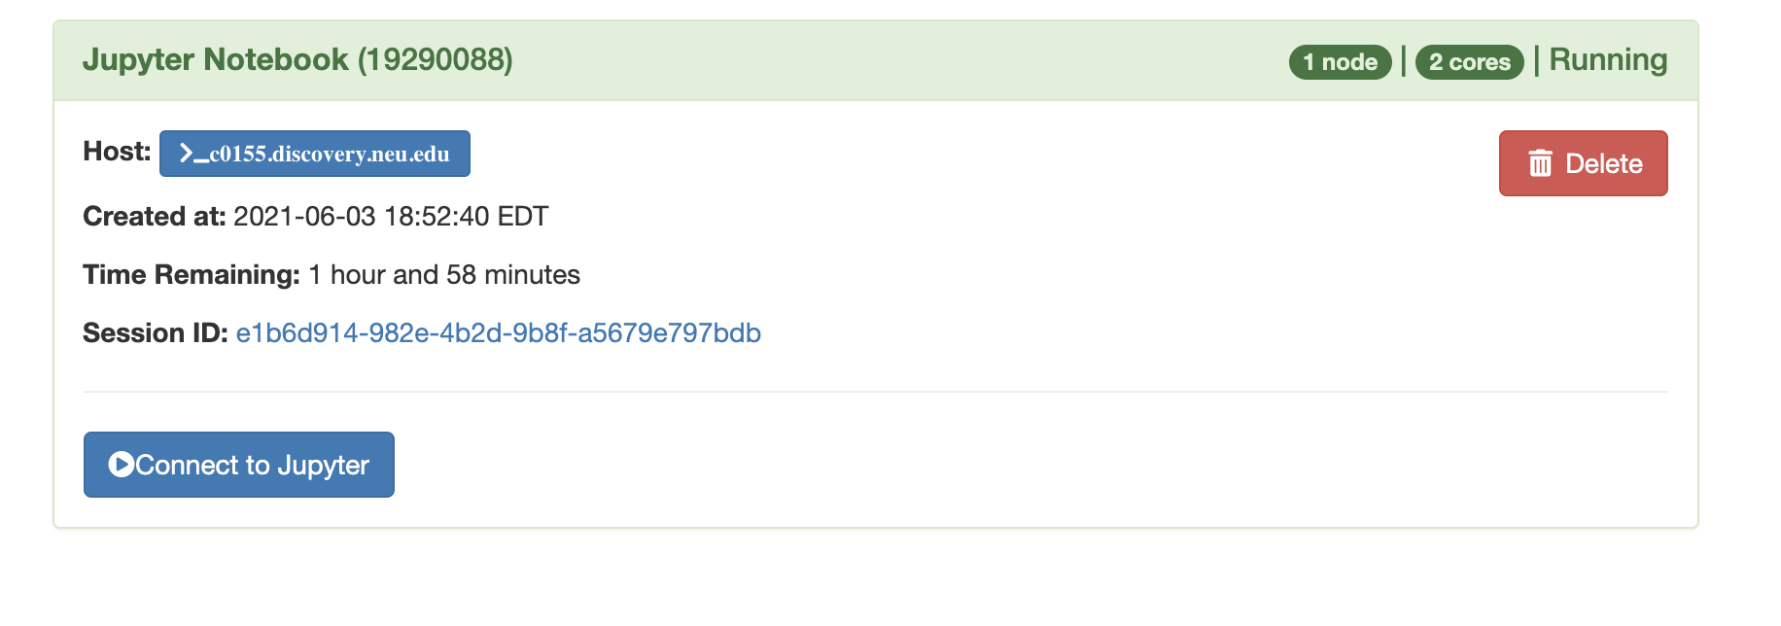
Demo

Slide 15
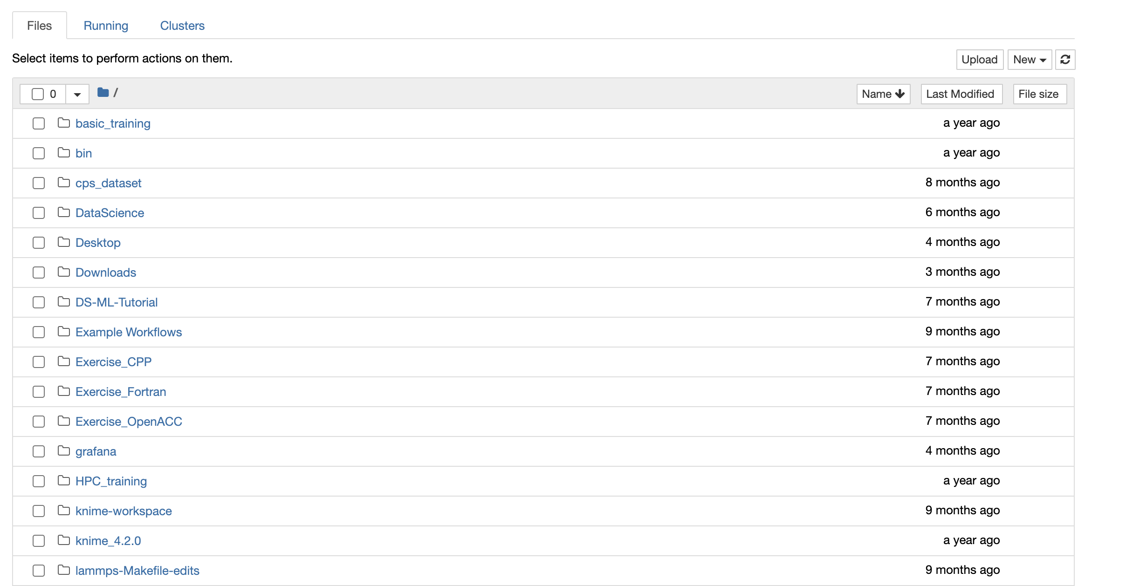
Demo

Slide 16
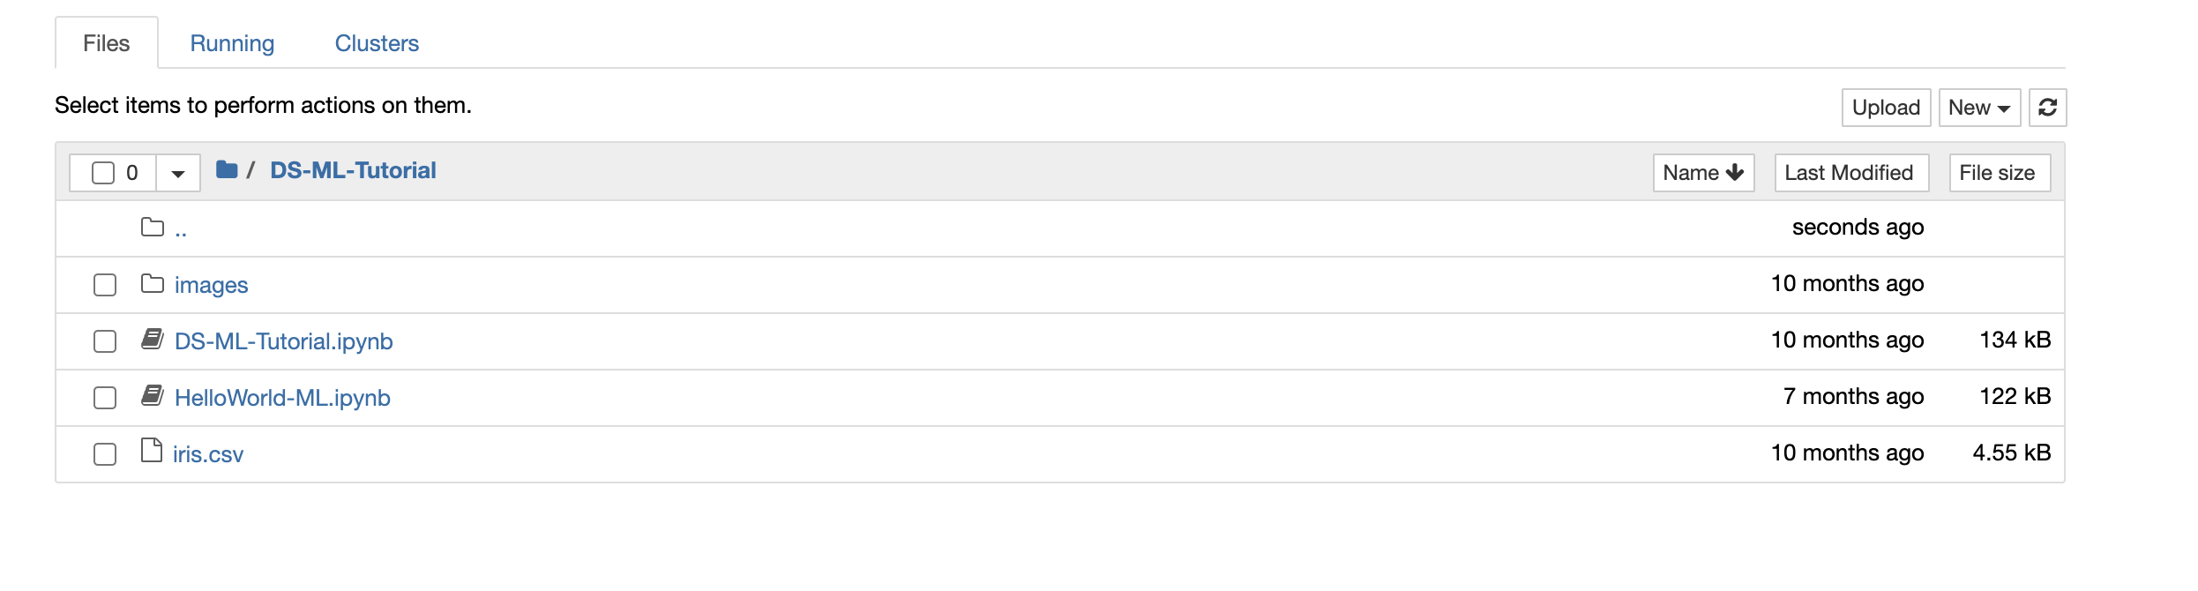
Demo

Slide 17
Exercise 3
ML on OOD

Slide 18
Iris Classification
Small "Hello World" of machine learning.
Based on supervised learning.
It is a multi-class classification problem – data set contains 3 classes of iris plant with 50 instances of each class.
Features of data set are all numeric or nominal.
Storing this data doesn't require much memory because it only has 4 attributes/features and 150 rows.
All numeric attributes are in same units & scale – no scaling or transforms needed.
For this data set most ML algorithms are straightforward to apply.
Notes:
We will start with a very small machine learning project that can be considered the "Hello World" of machine learning. It is based on supervised learning and is a multi-class classification problem because the data set contains 3 classes, 50 instances each, of iris plant. Features of the data set are all numeric or nominal and storing this data doesn't require much memory because it only has 4 attributes/features and 150 rows. All of the numeric attributes are in the same units and the same scale, not requiring any special scaling or transforms to get started. This means that for this data set most machine learning algorithms will be straightforward to apply.

Slide 19
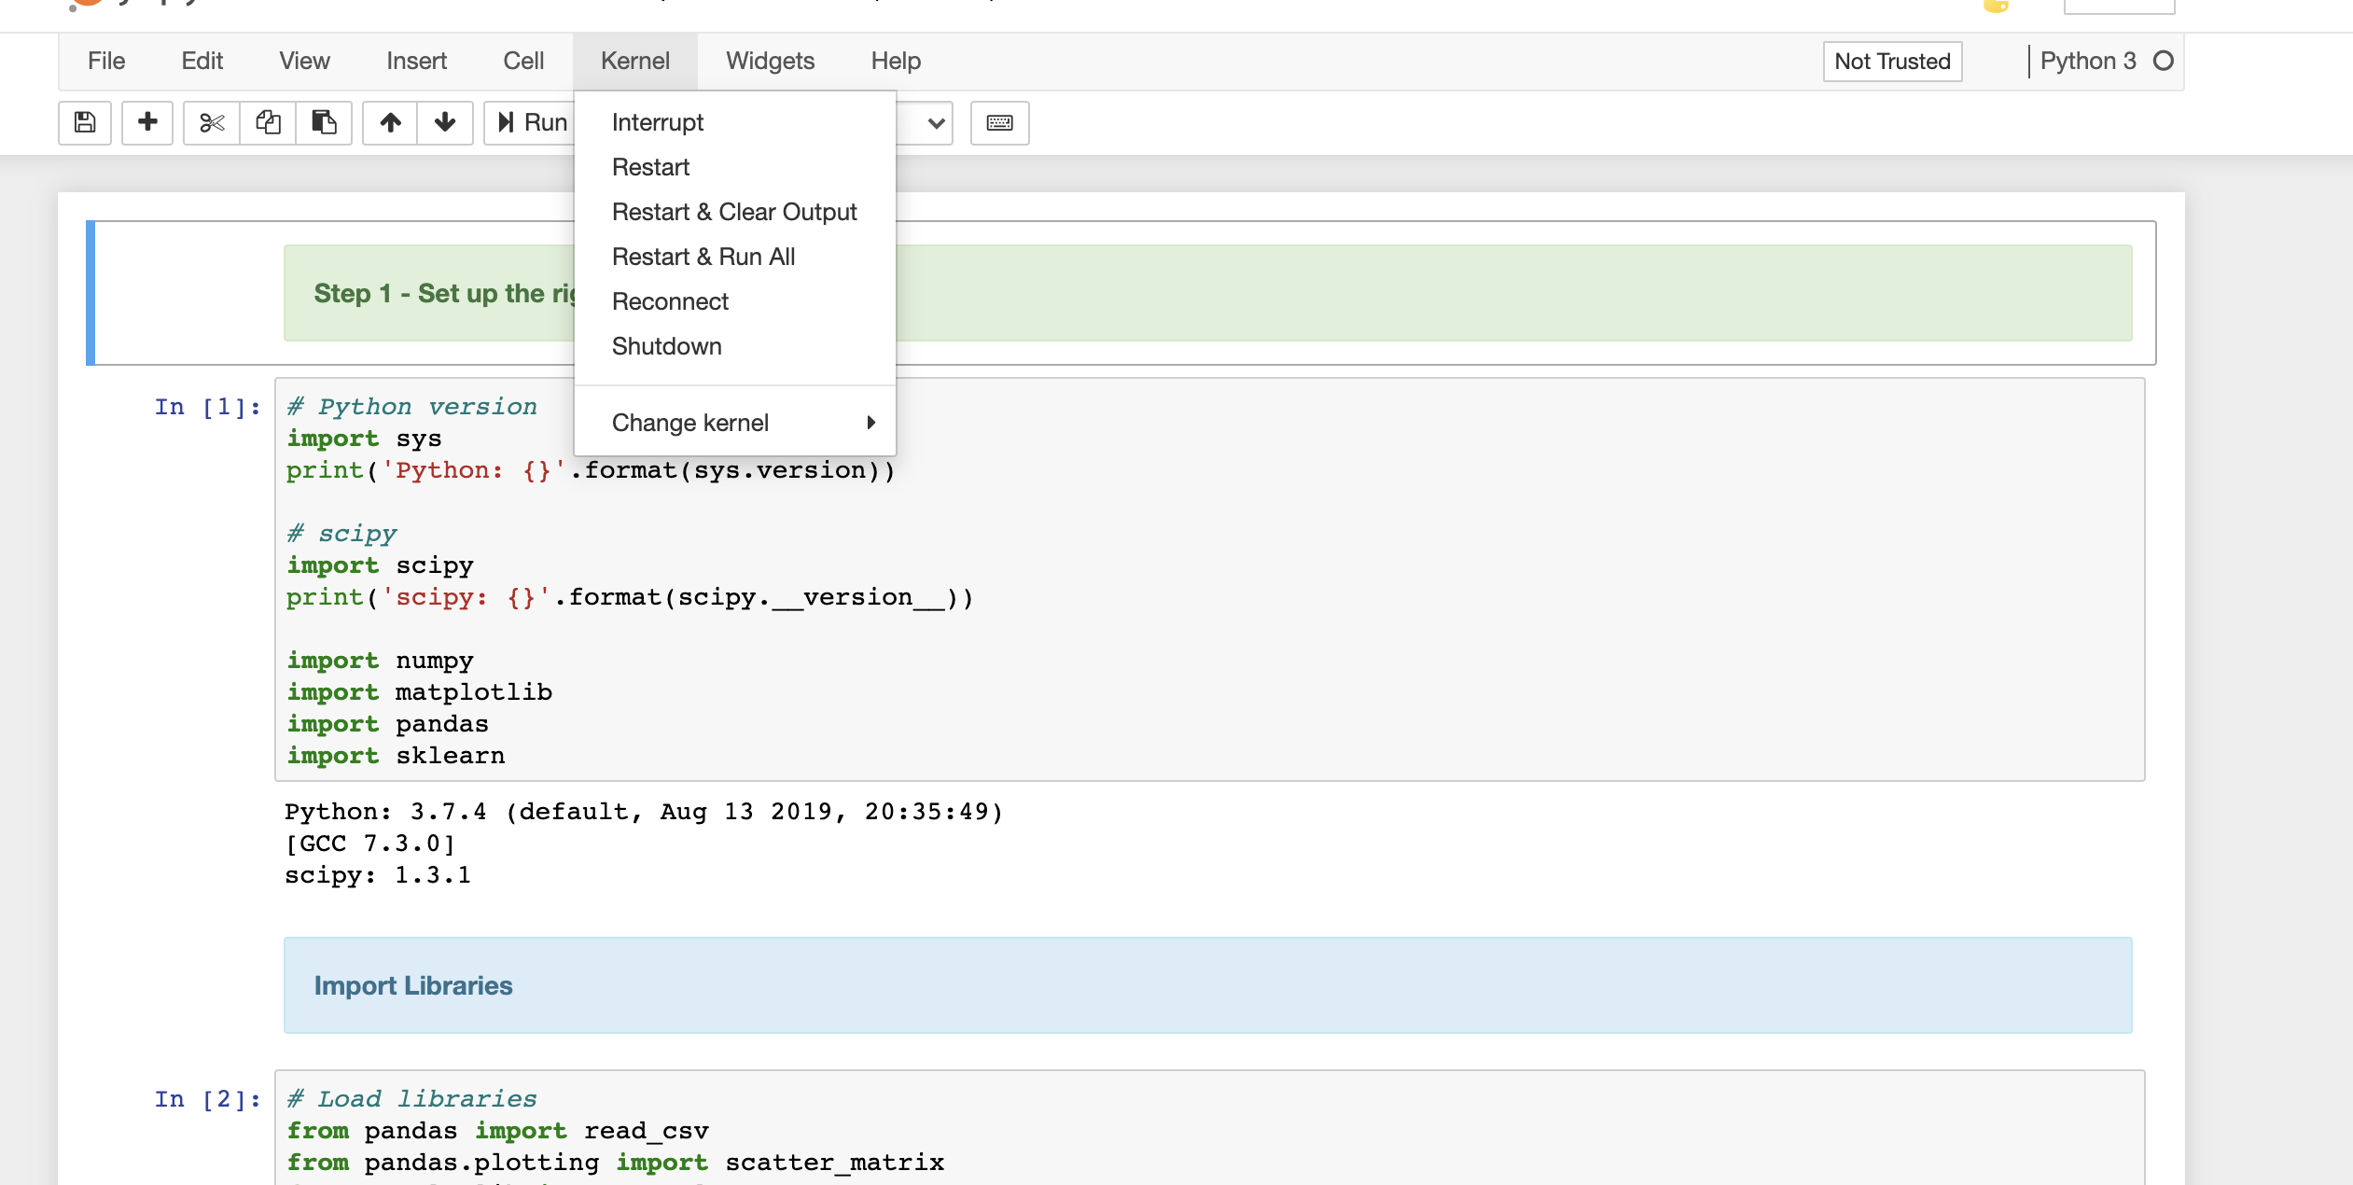
Demo

Slide 20
Step 1
Set up the right environment & import libraries
# Python version
import sys
print('Python: {}'.format(sys.version))
# scipy
import scipy
print('scipy: {}'.format(scipy.__version__))
import numpy
import matplotlib
import pandas
import sklearn
# Load libraries
from pandas import read_csv
from pandas.plotting import scatter_matrix
from matplotlib import pyplot
from sklearn.model_selection import train_test_split
from sklearn.model_selection import cross_val_score
from sklearn.model_selection import StratifiedKFold
from sklearn.metrics import classification_report
from sklearn.metrics import confusion_matrix
from sklearn.metrics import accuracy_score
from sklearn.linear_model import LogisticRegression
from sklearn.tree import DecisionTreeClassifier
from sklearn.neighbors import KNeighborsClassifier
from sklearn.discriminant_analysis import LinearDiscriminantAnalysis
from sklearn.naive_bayes import GaussianNB
from sklearn.svm import SVC

Slide 21
Step 2
Data Collection
No need for Data Cleaning/Processing in this case.
# Load dataset
url = "https://raw.githubusercontent.com/jbrownlee/Datasets/master/iris.csv"
#Declare column or feature names
names = ['sepal-length', 'sepal-width', 'petal-length', 'petal-width', 'class']
#Dataset can be read in two ways - directly using the url
dataset = read_csv(url, names=names)
#or from a locally downloaded copy of iris.csv
#dataset = read_csv("./iris.csv", names=names)

Slide 22
Step 3
Data Exploration/Summary
# Dimensions or shape of the data set
dataset.shape
# Peek at the, say first 20 rows, of the data set using head
dataset.head(20)
# Statistical summary of each attribute
# Pandas describe() is used to view basic statistical details, like count, mean, min and max,
# & some percentiles
dataset.describe()
# Number of instances (rows) that belong to each class => class distribution
dataset.groupby('class').size()

Slide 23
Step 4
Data Visualization
Univariate plots to better understand each attribute.
Multivariate plots to better understand the relationships between attributes.
https://machinelearningmastery.com/machine-learning-in-python-step-by-step/

Slide 24
Step 5
Data Modeling/Analysis
Create Training & Testing/Validation Set
Build & Evaluate Models - Better to apply several models on data set, compare accuracy against one another, and then select final model to apply on testing data set.
# Split-out training & validation datasets
array = dataset.values
X = array[:,0:4]
y = array[:,4]
X_train, X_validation, Y_train, Y_validation = train_test_split(X, y, test_size=0.20, random_state=1)

Slide 25
Six Algorithms Applied
Logistic Regression (LR).
Linear Discriminant Analysis (LDA).
K-Nearest Neighbors (KNN).
Classification and Regression Trees (CART).
Gaussian Naive Bayes (NB).
Support Vector Machines (SVM).
Good mixture of simple linear (LR and LDA), and nonlinear (KNN, CART, NB and SVM) algorithms.
Select the best model based on accuracy.

Slide 26
Step 6
Make & Evaluate Predictions and Communicate
# Fit the SVM model on the entire training dataset # and make predictions on the validation dataset.
model = SVC(gamma='auto')
model.fit(X_train, Y_train)
predictions = model.predict(X_validation)
# Evaluate predictions
print(accuracy_score(Y_validation, predictions))
print(confusion_matrix(Y_validation, predictions))
print(classification_report(Y_validation, predictions))

Slide 27
Exercise 4
ML on Command Line using Image net Data

Slide 28
Exercise 1 Create Conda Environment
Did PyTorch environment creation work? If not, use
module load cuda/11.0 (if not already loaded)
module load anaconda3/2021.05
## Load the virtual conda environment “pytorch_env”:
source activate pytorch_env
## OR
source activate /work/bootcamp/ml_training/pytorch_env
## Install gpu-enabled PyTorch inside the virtual environment:
conda install pytorch torchvision torchaudio cudatoolkit=11.0 -c pytorch -y

Slide 29
Exercise 1 Activate GPU-enabled PyTorch environment
Once the env is loaded, check if PyTorch recognizes the GPU device. True => ready to start working with GPU-supported PyTorch functions:
To deactivate an environment
## Test if GPU device is detected with PyTorch:
(pytorch_env) $ python -c'import torch; print(torch.cuda.is_available())’
## Deactivate conda environment:
(pytorch_env) $ conda deactivate

Slide 30
ImageNet Dataset
Train Dataset : 1000 categories. 1,281,167 million images, 732-1300 images per category
Validation Dataset : 1000 categories. 50,000 images, 50 images per category.

Slide 31
ImageNet Dataset
train/ ├── n01440764 │ ├── n01440764_10026.JPEG │ ├── n01440764_10027.JPEG │ ├── ...... ├── ...... val/ ├── n01440764 │ ├── ILSVRC2012_val_00000293.JPEG │ ├── ILSVRC2012_val_00002138.JPEG │ ├── ...... ├── ......

Slide 32
ImageNet Dataset
Directory Structure
1000 classes
1300 images of a sample class n02138441 (meerkat)

Slide 33
Exercise 4 Run Image Net Data Using PyTorch
Execute following commands on compute node you got when you created conda environment, which should be activated.
$ cd /scratch/<user_name>
$ mkdir pytorch_imagenet
$ cd pytorch_imagenet
$ cp /work/bootcamp/ml_training/pytorch_imagenet/create_data.sh .
$ cp /work/bootcamp/ml_training/pytorch_imagenet/main.py .
$ #source create_data.sh #script command for reference. Do not run. Dataset is already downloaded
$ python main.py --arch resnet18 --batch 2048 --pretrained --evaluate /work/bootcamp/ml_training/pytorch_imagenet/imagenet_untar
$ python main.py --help
$ conda deactivate
$ exit

Slide 34
DS Tools
Jupyter & JupyterLab Notebook [Custom Anaconda Environment] – OOD
KNIME & WEKA – OOD
VSCODE & Spyder – OOD
Pycharm – command line & OOD
RAPIDS – command line & OOD
Plotly – singularity container located on: /shared/container_repository/plotly-ds

Slide 35
Pycharm - Demo
srun --partition=short --nodes=1 --cpus-per-task=1 --mem=10G --time=00:30:00 --pty /bin/bash
wget https://download-cdn.jetbrains.com/python/pycharm-community-2021.2.2.tar.gz
tar -xzf pycharm-community-2021.2.2.tar.gz
cd pycharm-community-2021.2.2/bin
Open ~/.bashrc
export PYCHARM=/path-to-pycharm-tarball/pycharm-community-2021.2.2/bin/pycharm.sh
OOD -> Xfce Desktop (Alpha) -> $PYCHARM

Slide 36
Plotly Container – Demo
On OOD, click on Interactive Apps tab, choose Xfce Desktop (Alpha)
Fill the form with desired time & # of CPUs. Tensorflow-CPU installed in the container.
Submit the form and click on the button to launch the Xfce Desktop (Alpha) button once it appears.
Start a terminal application. Right click on the mouse and click on "Open terminal here".
In the terminal, type: bash /shared/container_repository/plotly-ds/run_container_plotly.sh

Slide 37
Demo Contd.
On Singularity> prompt, type the following to start miniconda3 environment: source /opt/miniconda3/bin/activate
Prompt will change to: (base) Singularity>
Command line test – to see if images can be saved using Plotly: (base) Singularity> python3 test_plotly_training.py
Notebook test – to see if Plotly works with Jupyter: (base) Singularity> jupyter notebook Run plotly_test.ipynb
$HOME, $PWD, /scratch, /work, & /shared accessible from within the container.

Slide 38
Thank you

Slide 39
Supplemental Material

Slide 40
Supervised Learning
Most prevalent of the ML algorithms.
User provides algorithm with pairs of inputs & desired outputs, algorithm finds a way to produce desired output given an input (training data set).
Data is labeled to tell the machine exactly what patterns to look for.
Algorithm then creates an output for an input it has never seen before (testing data set) without any help from a human and based on its training.
Since the algorithm learns from I/O pairs, it is called supervised.
A "teacher" provides supervision to the algorithms in the form of the desired outputs for each example that they learn from.
https://machinelearningmastery.com/supervised-and-unsupervised-machine-learning-algorithms/
Notes:
This is the most prevalent of the machine learning algorithms. In this case, the user provides the algorithm with pairs of inputs and desired outputs, and the algorithm finds a way to produce the desired output given an input (training data set). The data is labeled to tell the machine exactly what patterns it should look for. The algorithm is then able to create an output for an input it has never seen before (testing data set) without any help from a human and based on the training it received. Since the algorithm learns from input/output pairs, it is called supervised because a "teacher" provides supervision to the algorithms in the form of the desired outputs for each example that they learn from.

Slide 41
Unsupervised Learning
Only the input data is known, and no known output data is given to the algorithm.
We have no information on how the output data might look like.
Data has no labels and algorithm just looks for whatever patterns it can find.
There is no supervision provided to the algorithm in the form of desired outputs, hence called unsupervised.
Unsupervised learning isn't as popular because they have less obvious applications.
Combination of supervised & unsupervised techniques, implemented correctly, can give very accurate predictions.
Notes:
In this type of learning, only the input data is known, and no known output data is given to the algorithm. we don't have any information on how the output data might look like. The data has no labels and the algorithm just looks for whatever patterns it can find. Since there is no supervision being provided to the algorithm in the form of desired outputs, this kind of learning is called unsupervised. However, unsupervised learning isn't as popular because they have less obvious applications but a combination of supervised and unsupervised techniques, implemented correctly, can give very accurate predictions.

Slide 42
Reinforcement Learning
Algorithm learns by trial and error to achieve a clear objective.
Tries out different paths and is either rewarded or penalized depending on whether the path taken helps or hinders in achieving its pre-defined goal.
Like giving or withholding treats when teaching a dog a new trick.
Reinforcement learning is the basis of Google’s AlphaGo, the program that famously beat the best human players in the complex game of Go.
https://en.wikipedia.org/wiki/Reinforcement_learning
Notes:
In this case, the algorithm learns by trial and error to achieve a clear objective. It tries out different paths and is either rewarded or penalized depending on whether the path taken helps or hinders the algorithm from reaching its goal, which has already been defined. In layman terms, this is like giving or withholding treats when teaching a dog a new trick. Reinforcement learning is the basis of Google’s AlphaGo, the program that famously beat the best human players in the complex game of Go.

Slide 43
Features
Should represent input data that a computer can understand.
Helpful to think of the input data as a table.
Each data point forms the row of the data set, and each property that describes that data point is a column.
Each entity or row can be called as a sample/ data point/ an instance in ML.
Columns—the properties that describe these entities—are called features.
Building a good representation of the input data is called feature extraction or feature engineering.
Notes:
For any machine learning task, it is important to have a representation of the input data that a computer can understand. Often it is helpful to think of the input data as a table. Each data point forms the row of the data set, and each property that describes that data point is a column. In other words, each entity or row can be called as a sample or data point or an instance in machine learning, while the columns—the properties that describe these entities—are called features. The topic of building a good representation of the input data is called feature extraction or feature engineering.

