Slide 1
Accessing and Installing Software on Discovery
Summer Bootcamp 2021

Slide 2
Overview:
Introduction to modules
Introduction to software on OOD (Open OnDemand)
Python and conda on Discovery
Software installation on Discovery:
Requesting a system-wide software installation
Installing your own software (using Spack, conda, make etc.)
NOTE: This tutorial is designed to be interactive.
We recommend using a shell on Discovery to execute the commands.

Slide 3
Accessing the training material
Download the Accessing_and_Installing_Software.zip to your local machine.
Copy the training material to your $HOME directory on Discovery. You can use one of these options:
Using the File Explorer on OOD: https://ood.discovery.neu.edu/ Instructions: https://rc-docs.northeastern.edu/en/latest/using-ood/fileexplore.html
Using ’scp’ through the terminal/shell: https://rc-docs.northeastern.edu/en/latest/using-discovery/transferringdata.html?highlight=scp#
Access a Discovery Linux shell/terminal (use one of the following options):
Terminal/shell SSH: https://rc-docs.northeastern.edu/en/latest/get_started/connect.html
OOD shell: https://ood.discovery.neu.edu/pun/sys/shell/ssh/ood.discovery.neu.edu
Unzip and access the material using these commands:
$ unzip Accessing_and_Installing_Software.zip $ cd Accessing_and_Installing_Software

Slide 4
Software options on Discovery
Pre-installed ready-to-use software:
Modules – can be used in the Linux Command Line Interface (CLI). https://rc-docs.northeastern.edu/en/latest/software/modules.html
OOD interactive apps - can be used through Discovery's web portal. Offers graphical interface to many familiar software (Rstudio, Jupyter, MATLAB, etc.). https://rc-docs.northeastern.edu/en/latest/using-ood/interactiveapps.html
Installing your own software:
Check if the software is already available - as a module or on OOD apps.
Use package managers - such as Conda/Spack to install it. https://rc-docs.northeastern.edu/en/latest/software/spack.html
Install from source code - using “make”, or as directed by the developer manual: https://rc-docs.northeastern.edu/en/latest/software/softwareoverview.html#using-make

Slide 5
System-wide vs. user software
System-wide software: All users can read/execute but cannot write into these locations.
Discovery modules – available in the /shared file system for more info: https://rc-docs.northeastern.edu/en/latest/software/modules.html
Local to each compute node – the /usr directory has some common libraries and tools.
User-owned software:
Available only to users who own the directory.
The file systems /home & /scratch can be used for user software installations with read/write/execute privileges.
Group-owned software: Software can be set up with read/write/execute privileges for group members only.
The file system /work can be used to install software that can be shared by multiple group members (that belong to the same unix group).
For more info on storage on Discovery: https://rc-docs.northeastern.edu/en/latest/storage/discovery_storage.html

Slide 6
Modules overview
Discovery modules include many commonly-used scientific software packages. To view the entire available list, type:
To search for a specific software package name, for example:
where you can see the list of available packages and versions: [name]/[version].
To see the information on a specific module, for example “anaconda3/2021.05”, use:
To load a specific module, for example “anaconda3/2021.05”, use:
To see the list of modules loaded:
To remove a module, for example “anaconda3/2021.05”, use:
$ module avail
$ module avail anaconda3
$ module show anaconda3/2021.05
$ module load anaconda3/2021.05
$ module list
$ module unload naconda3/2021.05

Slide 7
Open On Demand (OOD) software overview
You can access some scientific software applications through the OOD web portal: https://ood.discovery.neu.edu -> Interactive Apps
Available apps include:
Jupyter Notebook
RStudio
MATLAB
Gaussian
Schrodinger (Maestro)
FSL
VMD
When you select the application to use, fill in the form with the resources you need, and click “Launch”.
Once the resources are allocated, connect to your application in the session window. A new tab will be opened on your browser to work on.
Additional training video: https://www.screencast.com/t/Dnhm6pbWc

Slide 8
Python and conda on Discovery
Python modules – offer the Python programming language libraries, together with the Python-based package manager “pip” (limited control – cannot perform “pip update…”, libs in $HOME):
Anaconda/Miniconda modules – distributions of Python and R which simplify software management and deployment using “conda environments” (limited control – cannot perform “conda update…”, new environments created in $HOME):
Spack conda/Python – Spack offers the ability to install a local version of Python or Anaconda/Miniconda for more flexibility and control.
Install Conda locally – As Spack, will install conda locally for more flexibility and control. https://rc-docs.northeastern.edu/en/latest/software/conda.html#working-with-a-miniconda-environment
Using Python with JupyterLab Notebook on OOD – using either a module or a local conda environment with JupyterLab Notebook: https://rc-docs.northeastern.edu/en/latest/using-ood/interactiveapps.html#working-with-jupyter-notebook-custom-anaconda-environment
$ module avail python
$ module avail anaconda; module avail miniconda

Slide 9
Exercise 1 Installation using conda

Slide 10
Exercise 1 Task 1 - Installing a package using conda
Here, we demonstrate the installation of NumPy (a fundamental package for scientific computing with Python) using the anaconda3/2021.05 module:
Login into an interactive node:
Load the module anaconda3/2021.05 into your environment (clear env first):
Create a virtual conda environment “myenv” with python 3.9 (in $HOME), then activate the environment:
Install NumPy:
Note that copy+paste of some commands may not work due to Microsoft font formatting.
Please use the commands provided in the “interactive_commad_list” instead
$ srun –-partition=express –-nodes=1 –-ntasks=2 --pty --time=00:30:00 /bin/bash
$ conda deactivate; module purge; module load discovery anaconda3/2021.05
$ conda create -n myenv python=3.9 -y $ conda env list; source activate myenv
$ conda install -c anaconda numpy -y
Notes:
## NOTE:
If you already have a conda version loaded (in ~/.bashrc) – use:
$ conda deactivate
$ module purge
As a best practice, NEVER load a conda environment into your ~/.bashrc
See: https://rc-docs.northeastern.edu/en/latest/using-discovery/bashrc.html?highlight=bashrc
Note that copy+paste of some commands may not work due to Microsoft font formatting.
Please use the commands provided in the “interactive_commad_list” instead

Slide 11
Exercise 1 Task 2 – Using the program within your environment
Here’s an example sbatch shell script that loads, activate and uses your conda environment with the installed software (Exercise_1/run_sample.bash):
#!/bin/bash
#SBATCH --partition=express
#SBATCH --job-name=my-python-test
#SBATCH --time=00:05:00
#SBATCH –-nodes=1
#SBATCH --ntasks=1
## load the anaconda package: module load discovery anaconda3/2021.05
## activate the environment:
source activate myenv
## run the python script which uses NumPy:
python sample_NumPy_script.py
Notes:
Submit the job using the command:
$ sbatch run_sample.bash
## NOTE:
If you already have a conda version loaded (in ~/.bashrc) – add these two lines:
conda deactivate
module purge
As a best practice, NEVER load a conda environment into your ~/.bashrc
See: https://rc-docs.northeastern.edu/en/latest/using-discovery/bashrc.html?highlight=bashrc

Slide 12
Exercise 2 Installation using Spack

Slide 13
Exercise 2 Task 1 – Setting up Spack
In this example, we’ll set up Spack and then install the zlib compression package. https://rc-docs.northeastern.edu/en/latest/software/spack.html
Download Spack to your $HOME directory:
Set up the Spack environment by sourcing the following shell script (or add to ~/.bashrc):
(OPTIONAL) Now you can run some basic Spack commands. For example:
Check available software; check available software with name “sql”:
Get more information about a particular package (versions, options, dependencies etc.):
$ git clone https://github.com/spack/spack.git
$ source ~/spack/share/spack/setup-env.sh
$ spack list $ spack list sql
$ spack info mysql; spack info gromacs;
For the full Spack tutorial, visit: https://spack-tutorial.readthedocs.io/en/latest/

Slide 14
Exercise 2 Task 2 – Install a package with Spack
Now, we’ll use Spack to install zlib (compression library):
First, lets login into a compute node to make the build faster. Then find zlib:
To see the full dependency tree, versions and options we can use the “spec” command: zlib does not contain many dependencies, so it’ll be quick to install.
Let's install zlib, of version 1.2.11 (will use the default gcc 4.8.5 compiler available):
For more Spack options and features: 24. Spack - additional features
Note that copy+paste of some commands may not work due to Microsoft font formatting.
Please use the commands provided in the “interactive_commad_list” instead
$ srun –-partition=express –-nodes=1 –-ntasks=2 --pty --time=00:30:00 /bin/bash $ spack info zlib
$ spack spec zlib
$ spack install zlib@1.2.11
Notes:
Note that copy+paste some of those commands may not work due to Microsoft font formatting.
Please use the commands provided in the “interactive_commad_list” instead

Slide 15
Exercise 2 Task 3 – Load & use the software
To use the Spack-installed software, it is necessary to first activate Spack, and then load the software module:
Re-source the Spack script to add the new module to your environment:
Alternatively, if you added this line to your ~/.bashrc file, re-source ~/.bashrc (or exit and re-open the Discovery window):
Check your available module list, which should now include Spack modules (most top):
Alternatively, you can use Spack commands to find, load/unload packages:
For usage with sbatch, inspect script:
$ source ~/spack/share/spack/setup-env.sh
$ source ~/.bashrc
$ module avail
$ spack find zlib
$ spack load zlib
$ cat Exercise_2/zlib_spack.sh

Slide 16
Thank you for your participation in this RC tutorial! Visit our website: https://rc.northeastern.edu/ Enjoy your computing!

Slide 17
Supplemental Material

Slide 18
Exercise 3 (Optional) Build from source

Slide 19
Exercise 3 Task 1 – Setup before compilation
In this example, we’ll show how to build a program from source. The program used will be XaoS (real-time interactive fractal zoomer, generating images from fractal formula calculations).
Allocate an interactive node with x11 forwarding enabled (for graphics):
Enter Exercise_3 directory and untar the xaos-3.6.tar.gz compressed source code:
Load the GNU 8.1 compiler (see supplemental material for additional compiler info):
Note that copy+paste of some commands may not work due to Microsoft font formatting.
Please use the commands provided in the “interactive_commad_list” instead
$ srun –-partition=express –-nodes=1 –-ntasks=16 --pty --time=00:30:00 --x11 /bin/bash
$ cd Exercise_3
$ tar -zxvf xaos-3.6.tar.gz
$ gcc --version $ module load gcc/8.1.0
$ gcc --version

Slide 20
Exercise 3 Task 2 – Compile & install the code
Enter the source code directory and review the installation instructions:
Typically, a configure script is provided to setup the compilation process (e.g. finding all needed libraries and passing any compilation flags/ build-options): Where --prefix specifies the path where the executable program will be built to.
Build the software using the “make –j 16” command, to be built in parallel on 16 Cores, followed by “make install” to copy the executables:
$ cd xaos-3.6
$ less INSTALL
$ ./configure –h
$ ./configure --prefix=$HOME/xaos-3.6-myinstall
There is a small bug in the software's Makefile, which prevents some directories from being created. Please ignore this error.
$ make –j 16
$ make install
Notes:
Note - most contemporary software packages come with build instructions, often in files named "README" or "INSTALL", where specific instructions are given for different OS systems and compilers used.

Slide 21
Exercise 3 Task 3 – Set up environment & run program
After the build is complete, you should be able to see a new directory created (~/xaos-3.6-myinstall/bin) with the XaoS program (executable) in it.
Option 1 - Run the program directly by entering the full path:
Option 2 – update your environment to be able to run XaoS from any directory by pre-pending the path to the $PATH variable. i.e:
Or, run a shell script, i.e (you can edit the path inside to a different one):
$ cd ~/xaos-3.6-myinstall/bin
$ ./xaos &
$ cd $HOME #change directories to $HOME
$ which xaos $ export PATH=~/xaos-3.6-myinstall/bin:$PATH $ which xaos
$ ./xaos &
$ source Exercise_3/env.sh $ xaos &

Slide 22
Additional notes on environment setup
Important: We do not recommend setting environment variables inside shell files such as .bashrc, .bash_profile, .login, or .profile:
The wrong environment setup can lead to conflicting settings, which may cause your program to not work properly or not work at all.
Have more control inside your work environment by "turning off" settings.
You can accidently modify important variables such as $PATH and may need admin permissions to retrieve your environment. https://rc-docs.northeastern.edu/en/latest/using-discovery/bashrc.html?highlight=bashrc
Best practice advice - create different environment setup scripts that can be loaded into each different project you run. As an example, you can refer to the follow shell script which you can run instead of the former commands:
$ source Exercise_3/env.sh
$ xaos &

Slide 23
Spack - additional features
Spack allows fine-grained control over package installations:
Each package descriptor that defines its configuration is called a “spec”
Spack has its own syntax for controlling dependencies – how they are configured and built. For example:
0 - the package to install 1 - a dependency of the package is perfixed using ^ 2 - the dependency version, denoted by @ following by the version. Can also be a range of versions (e.g. 1.2:1.4) 3 - a compile-time variant of the package (debug mode) 4 - the name of the compiler to build with 5 - the version/s of the compiler to build with 6 - the architecture to build with – needed on machines where cross-compilation is required.
$ spack spec mpileaks $ spack install mpileaks ^openmpi @1.2:1.4 +debug %intel@12.1 target=zen 0 1 2 3 4 5 6
For more info: https://spack.readthedocs.io/en/latest/basic_usage.html#specs-dependencies

Slide 24
Getting to know the Operating System (OS)
The Discovery OS is Linux CentOS 7. The main components are:
Bootloader - the software that boots the OS
Linux Kernel - the core software that runs Linux on the lowest level of communication with hardware.
Init system - the sub-system that bootstraps the user space and controls daemons
Daemons – the background services
Interface between users and the OS (shell, Desktop etc.)
Applications – software that is not directly related to the OS and runs as an executable on as an OS process.
Notes:
To install and run a software application requires some level of knowledge of the computer it will run on. This includes knowledge of the architecture and the operating system (OS), which manages communication between software and hardware. HPC systems typically consist of Intel 64-bit processors (x86_64 architecture) and use CentOS 7/8 OS (a free open-source OS, which is a detivative of the Red Hat Enterprise Linux).
The main Linux components are:
Bootloader - the software that boots the OS
Linux Kernel - the core software that runs Linux on the lowest level of communication with hardware. Some of its functions include managing the CPUs/GPUs, memory and peripheral devices.
Init system - the sub-system that bootstraps the user space and controls daemons
Daemons – the background services (for example, SchedMD which is the Slurm workload manager software) that either start up during boot or after you log into the OS at user/root.
Graphical server – a sub-system which displays graphics (commonly referred to as the X server).
Desktop/Shell environment – the interface between users and the OS. There are many desktop environments such as GNOME, Cinnamon, Mate, Pantheon, Enlightenment, KDE, Xfce, etc. While for HPC, it is common to use the Shell environment, where a program called "bash" acts as the shell program. Besides bash, there are other shell programs that can be installed in a Linux system. These include: ksh, tcsh and zsh.
Applications – software that is not directly related to the OS and runs as an executable on as a OS process.

Slide 25
Setting up your installation environment
The following shell environment variables store important locations to help access different programs and libraries:
$PATH - usually points to <path>/bin directories with executable programs.
$LIBRARY_PATH - stores locations of static/shared libraries that can be linked to a program during installation (<path>/lib, <path>/lib64)
$LD_LIBRARY_PATH - used during runtime to locate linked shared libraries (<path>/lib, <path>/lib64)
$CPATH/$C_INCLUDE_PATH/$CPLUS_INCLUDE_PATH - specifies a list of directories to be searched for header files (<path>/include).
Notes:
Setting up your environment
Shell scripts can make use of environment variables, storing important paths and locations of libraries in the OS. Some common ones include $HOME, $SHELL and $USER. Additionally, the following environment variables are used for compilers to find packages and libraries:
$PATH - specifying a set of directories where executable programs (binaries) are located.
$LIBRARY_PATH - used by the compiler prior to compilation to find static and shared libraries so that they can be linked to the program being installed.
$LD_LIBRARY_PATH - is used by your program to search directories containing shared libraries after it has been successfully compiled and linked.
$CPATH - this environment variable affects the behavior of the pre-processor. It specifies a list of directories to be searched for header files (like the -I option used for controlling the C preprocessor and run on each C source file before actual compilation), but after any paths given with -I options on the command line. Used regardless of which language is being preprocessed. For more details on CPATH and -I, refer to following websites:
https://gcc.gnu.org/onlinedocs/gcc/Environment-Variables.html
https://gcc.gnu.org/onlinedocs/gcc-3.4.6/gcc/Preprocessor-Options.html#Preprocessor-Options

Slide 26
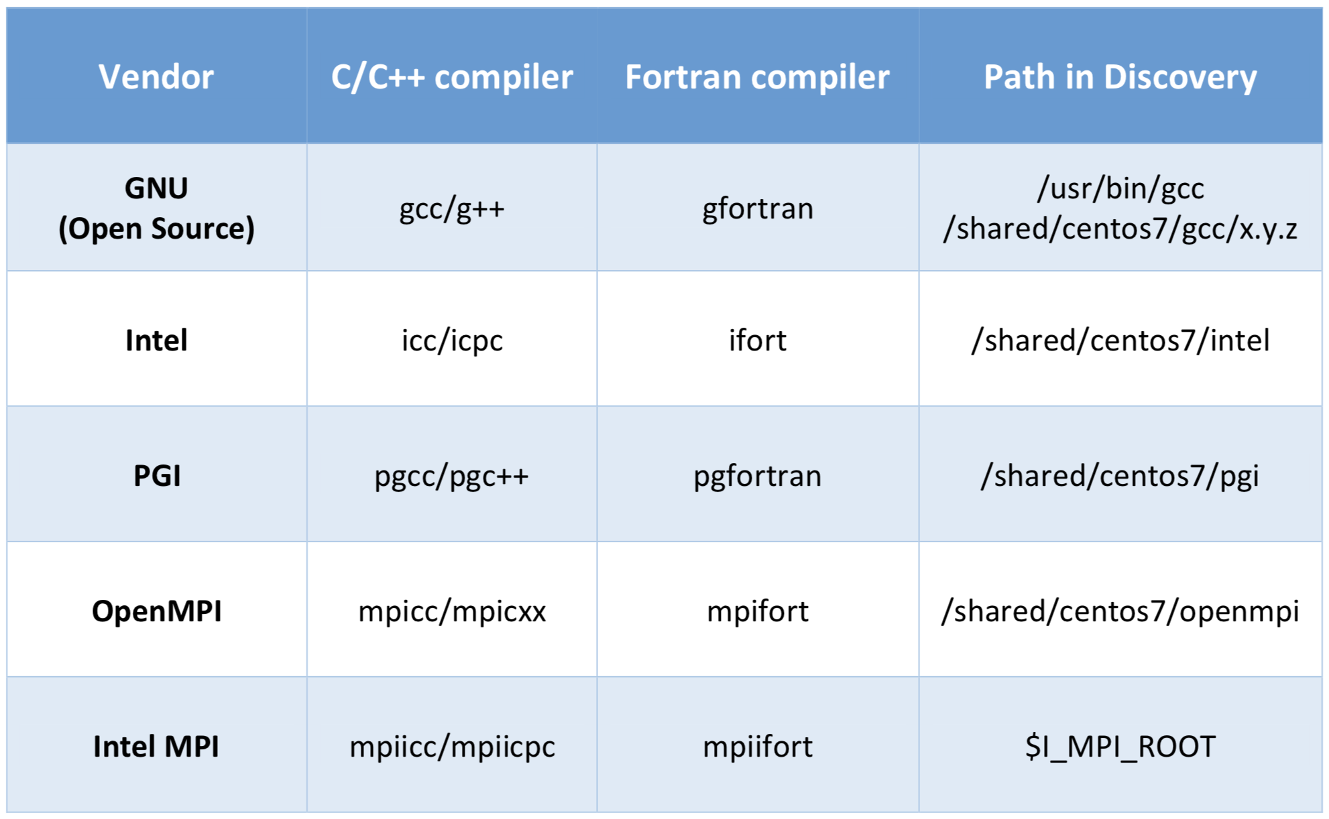
Compilers on Discovery
Discovery supports multiple compilers: GNU, Intel, PGI etc. You can view the different versions by: module avail gcc, module avail intel or module avail pgi.
Additionally, there are programs such as OpenMPI, MPICH, MVAPICH2 and Intel MPI that serve as wrappers for compilers for parallel computing code:

Slide 27
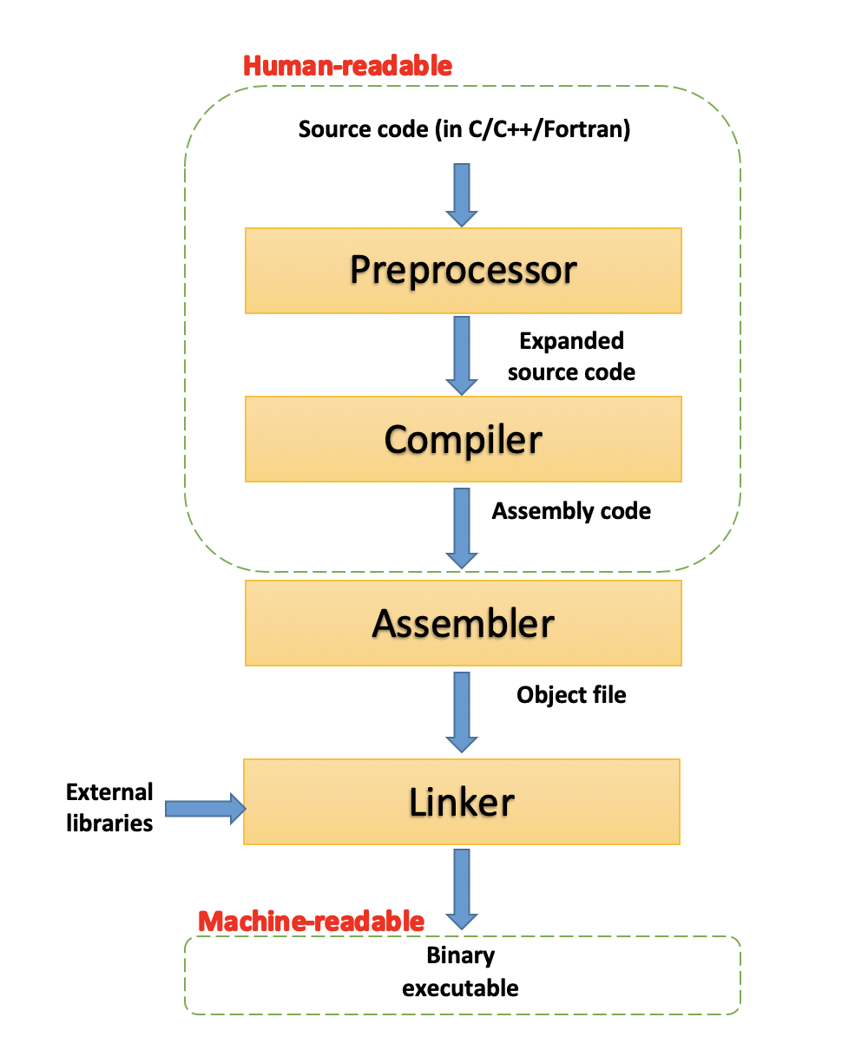
The compilation process
Scripts - programs (or interpreters), such as Perl, Python or Bash, interpret the script lines to perform complex tasks. Do not need to be compiled.
Codes - files containing code, such as C, C++ or Fortran, are used to build programs in the process of compilation (see diagram below). C, C++ or Fortran are low-level languages, and have little abstraction between them and machine language.
Compilation - The process of converting a text file with human-readable code into a binary and executable program.
4 compilation phases:
Pre-processing - the source code is processed with some text modifications such as comment removal and macros expansions.
Compilation - the code is converted into assembly-level instructions. This allows direct hardware modifications, access to specialized hardware instructions (AVX-512 for example), and addresses performance issues.
Assembly - the stage where the assembler takes the assembly code and turns it into an object file, containing machine-level instructions.
Linking - the final phase in which all the linking of function calls with their definitions is done.

Slide 28
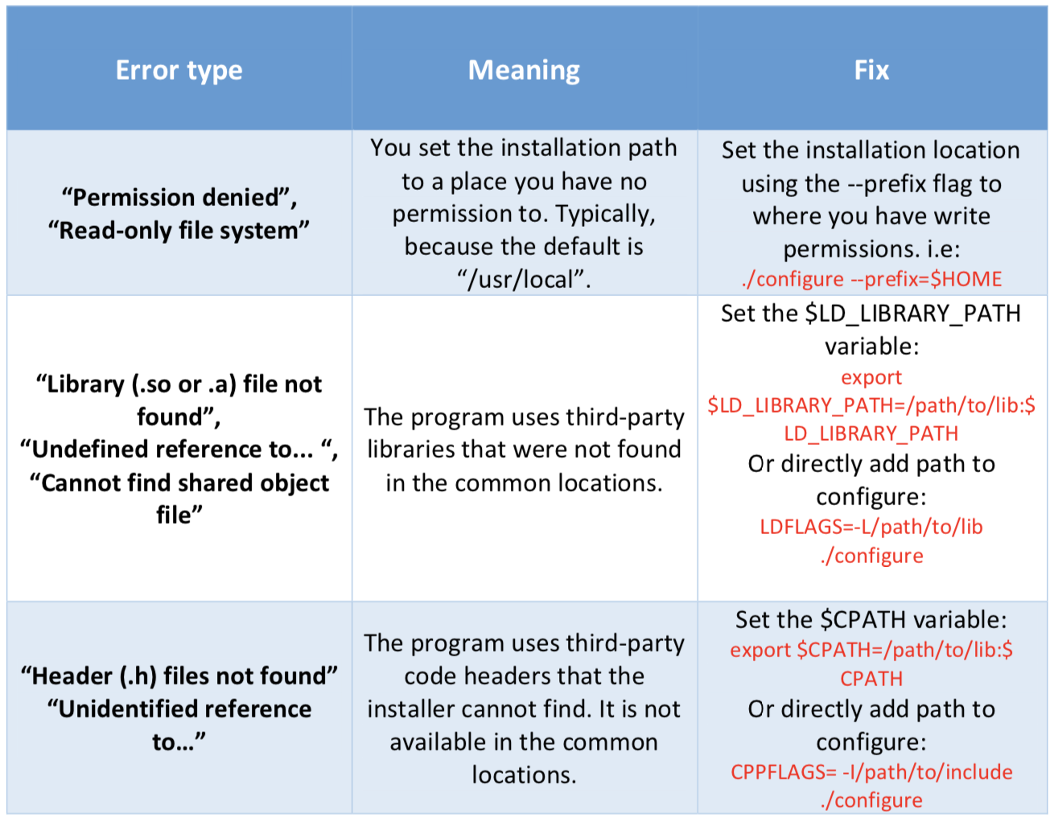
Troubleshooting compilation errors
Here's a summary of common compilation errors, that can be solved by providing correct paths:

