Slide 1
Introduction to software installation on Discovery
Training Module

Slide 2
Software installation overview:
Introduction to compilers
Environment variables for installations
Installation process using make
Installation using package managers: Spack, conda, pip
Using containers to run programs on Discovery.
NOTE: This tutorial is designed to be interactive.
We recommend using a shell on Discovery to execute the commands.
Notes:
This session will introduce you to software installations on Discovery using interactive examples. We will cover the following topics:
Compilers: C/C++/Fortrun compiler flags
Parallel libraries: OpenMP and Intel MPI as compilation wrappers
Setting up user environment before installation
Installation using package managers: Spack and Anaconda
Advanced topics:
The installation process: Pre-processing, Compilation, Assembly and Linking
Installation with dependencies
Optimized compiling

Slide 3
Access the training material:
RC will provide a compressed file: software_training.zip at the beginning of the tutorial. Download this file to your local machine.
Copy the training material to your $HOME directory on Discovery. You can use one of these options:
Using the File Explorer on OOD: https://ood.discovery.neu.edu/ for more info: https://rc-docs.northeastern.edu/en/latest/using-ood/fileexplore.html
Using a terminal/shell (see instructions: https://rc-docs.northeastern.edu/en/latest/using-discovery/transferringdata.html?highlight=scp# )
Access a Discovery Linux shell/terminal (use one of the following options):
Terminal/shell app: https://rc-docs.northeastern.edu/en/latest/get_started/connect.html
OOD shell: https://ood.discovery.neu.edu/pun/sys/shell/ssh/ood.discovery.neu.edu
Notes:
Parallel examples in C/C++ and Python.

Slide 4
Why build your own software?
Create a controlled and consistent software environment that allows reproducibility of results
Leverage the full power of the cluster through usage of hardware optimizations and parallel libraries.
Flexibility - benchmark performance of different versions/configurations and build software to fit your scientific needs.
Familiarize with the open-source scientific package managers that help with the heavy lifting of software installations.
Notes:
The Discovery HPC cluster contains powerful and sophisticated hardware, consisting of multiple cutting-edge processors and fast interconnect network. However, this hardware is completely useless without software that is able to leverage the full potential of a supercomputer. The cluster offers some software packages through the module system (https://rc-docs.northeastern.edu/en/latest/software/modules.html), yet their already-compiled configuration may not always suite your needs. Here are a few other reasons to compile your own code:
Better control the conditions of your research - create a controlled and consistent working environment that allows reproducibility of results.
Get to know your "lab" equipment - understand and troubleshoot your code and results by getting familiar with the different software and hardware configurations.
Leverage the full power of the cluster - incorporate parallel libraries and powerful compilers. Learn about different compilation options such as compiling with parallel libraries and switching compilers.
Flexibility of use - install your code locally, try multiple code variations, benchmark performance and control of any code updates and bugs fixes.
Familiarize with the open-source scientific software community - get to know about the multiple useful collaborative programs that handle the vast majority of the heavy lifting of software installations.

Slide 5
System-wide vs. user software
system-wide software: All users can read/execute but cannot write into these locations.
Discovery modules – available in the /shared file system for more info: https://rc-docs.northeastern.edu/en/latest/software/modules.html
Local to each compute node – the /usr directory has some common libraries and tools.
User software:
Available only to users owning the directory:
The file systems /home & /scratch can be used for user software installations with read/write/execute privileges.
Group software:
The file system /work can be used to install software that can be shared by multiple group members (that belong to the same unix group).
Software can be set up with read/write/execute privileges to group members only.
Notes:
System-wide vs. user installations:
Users on Discovery get to be the owners of directories /home/<username> and /scratch/<username>, with read/write/execute privileges. This allows user to install software "locally" in their directories. The software access will be exclusive to the user, even on compute nodes.
"Global"/"System-wide" installs are located in system locations owned by the "root" user, such as /usr/bin or /usr/local. On Discovery, the /shared filesystem also contains global installs such as modules at /shared/centos7. All users are allowed to read and execute from this location, with no write permissions. For system-wide Discovery Cluster Software Requests (including OOD software): https://bit.ly/NURC-Software
Group-accessible locations - we encourage groups using same software to have it installed in group directories (such as /work/groupname). Group members can then access, modify, install and benchmark their own code without the need to have it system-wide. For Storage Space Extension Requests (expanding /work capacity or other solutions): https://bit.ly/NURC-StorageExtension.

Slide 6
Installing locally with package managers & containers
There are many useful open-source package managers that can help to install software. Here are a few common ones:
Conda – A package management and environment management system that is included in all versions of Anaconda and Miniconda.
Pip – a package installer specific for Python.
Spack – Package manager desgiend for supercomputers to easily install scientific software.
Container repositories – contain many pre-built images to be used without installation. Popular repositories: Docker Hub and Singularity Hub.
Notes:
YUM (Yellowdog Updater, Modified) – package management utility that comes with CentOS. Requires root privileges on the cluster.

Slide 7
Installing software from source code
Reasons to compile from source:
The software is not available in the package manager repositories.
The user prefers compile manually to include specific features such as optimization flags, parallel builds (MPI), link dependent libraries, etc.
build using proffered compilers and libraries for specific hardware types.
The compilation process from source requires:
Knowledge of the system (hardware, network, drivers, kernals).
Knowledge of the environment and software stack available (compilers and libraries.)
Knowledge of the compilation options (configuration, compilation and optimization flags).

Slide 8
Installing software approach
Search your software in one of the package manager repositories.
If it exists, install it using the default options first (as described in the following exercises).
Once installed, test the performance on Discovery.
Re-install with advanced options if necessary.
If the software is only available to install from source, follow the basic instructions in the developer documentation page.
You can use the supplementary material of this tutorial for general guidelines of installation from source.
Reach out to RC:
Software consultation: https://rc.northeastern.edu/support/consulting
Software request: https://bit.ly/NURC-Software

Slide 9
Exercise 1 Installation using conda

Slide 10
Exercise 1 Task 1 - Installing your own conda
It is recommended to install your own conda package rather then using the existing anaconda/miniconda modules.
Here, we demonstrate the installation of SAMtools (a suite of programs for interacting with high-throughput sequencing data) using miniconda3 local build:
Login into an interactive node and download miniconda3 (Linux 64 version 3.8 version):
Install miniconda3 in your $HOME directory using the installer shell script:
Where the options “-b -y” will install miniconda3 in batch mode (no prompts) and the option “-p $HOME/miniconda3” will install miniconda3 in that path.
$ srun -p express -N 1 -n 16 --pty -t 01:00:00 /bin/bash
$ wget https://repo.anaconda.com/miniconda/Miniconda3-latest-Linux-x86_64.sh -O ~/miniconda3.sh
$ cd $HOME; bash miniconda3.sh –b -y –p miniconda3
Notes:
Reasons to use your own conda build:
You own the conda build, which means you can update it frequently. Note - ‘conda update conda’ is not allowed for non-admin users on the cluster anaconda/miniconda modules.
You can install and maintain packages on the base environment (which is located in your directory rather than the system directory).

Slide 11
Exercise 1 Task 2 - Installing software with conda
Now you can activate miniconda3 within each shell environment using the command:
Next, lets update conda prior to any new installations:
For organizational purposes, we’ll create a virtual conda environment and build SAMtools inside (not necessary, but recommended):
Finally, lets install SAMtools within the virtual environment, and check its location and version:
$ source ~/miniconda3/bin/activate
(base) $ conda update conda -y
(base) $ conda create --name myenv
(myenv) $ conda activate myenv
(myenv) $ conda install -y -c biconda samtools
(myenv) $ which samtools
(myenv) $ conda list -c samtools
Notes:
Reasons to use your own conda build:
You own the conda build, which means you can update it frequently. Note - ‘conda update conda’ is not allowed for non-admin users on the cluster anaconda/miniconda modules.
You can install and maintain packages on the base environment (which is located in your directory rather than the system directory).

Slide 12
Conda installation – additional notes
Conda does not compile software - rather it downloads the packages from a web repository.
Conda “guesses” your hardware - and tries to fit the best version to it. This may mean less optimized code for your hardware.
Same environment - conda will install each package and its dependency libraries in the same environment, unless you create different environments manually. This can sometimes create version conflicts.
Conda is a self-contained environment – conda can’t use loaded modules, or use pre-installed packages from the outside. Instead, it will try to install the libraries it needs and use those.

Slide 13
Exercise 2 Installation using Spack

Slide 14
Exercise 2 Task 1 – Setting up Spack
In this example, we’ll set up Spack and then install a software package.
Download Spack to your $HOME directory:
Set up the Spack environment by sourcing the following shell script (or add to ~/.bashrc):
Now you can run some basic Spack commands. For example:
Check available software; check available software with name “sql”:
Get more information about a particular package (versions, options, dependencies etc.):
Add a compiler:
$ git clone https://github.com/spack/spack.git
$ source ~/spack/share/spack/setup-env.sh
$ spack list $ spack list sql
$ spack info mysql; spack info gromacs;
$ module load gcc/10.1.0
$ spack compiler find
$ spack compilers
For the full Spack tutorial, visit: https://spack-tutorial.readthedocs.io/en/latest/
Notes:
srun -p express -N 1 -n 16 --pty -t 01:00:00 --x11 /bin/bash
https://spack-tutorial.readthedocs.io/en/latest/

Slide 15
Exercise 2 Task 2 – Install a package with Spack
Now, we’ll use Spack to install zlib (compression library):
First, lets login into a compute node to make the build faster. Then find zlib:
To see the full dependency tree, versions and options we can use the “spec” command: zlib does not contain many dependencies, so let’s check a more complex case:
Lets install zlib, using the latest version, with all options “on” and using the compiler gcc/10.1.0:
$ srun –p express –-nodes=1 –-ntasks=2 –pty /bin/bash $ spack info zlib
$ spack spec zlib
$ spack spec samtools
$ spack install zlib@1.2.11 %gcc@10.1.0
For the full Spack tutorial, visit: https://spack-tutorial.readthedocs.io/en/latest/
Notes:
srun -p express -N 1 -n 16 --pty -t 01:00:00 --x11 /bin/bash
https://spack-tutorial.readthedocs.io/en/latest/

Slide 16
Exercise 2 Task 3 – load & use the software
To use the Spack-installed software, it is necessary to first activate Spack, and then load the software module:
Re-source the Spack script to add the new module to your environment:
Alternatively, if you added this line to your ~/.bashrc file, re-source ~/.bashrc (or exit and re-open the Discovery window):
Check your available module list, which should now include Spack modules (top):
Alternatively, you can use Spack commands to find, load/unload packages:
$ source ~/spack/share/spack/setup-env.sh
$ source ~/.bashrc
$ module avail
$ spack find zlib
$ spack load zlib
For the full Spack tutorial, visit: https://spack-tutorial.readthedocs.io/en/latest/
Notes:
srun -p express -N 1 -n 16 --pty -t 01:00:00 --x11 /bin/bash
https://spack-tutorial.readthedocs.io/en/latest/

Slide 17
Spack installation – spec features
Spack allows fine-grained control over package installations:
Each package descriptor that defines its configuration is called a “spec”
Spack has its own syntax for controlling dependencies – how they are configured and built. For example:
0 - the package to install 1 - a dependency of the package is perfixed using ^ 2 - the dependency version, denoted by @ following by the version. Can also be a range of versions (e.g. 1.2:1.4) 3 - a compile-time variant of the package (openmen with the debug mode) 4 - the name of the compiler to build with 5 - the version/s of the compiler to build with 6 - the architecture to build with – needed on machines where cross-compilation is required.
$ spack spec mpileaks $ spack install mpileaks ^openmpi @1.2:1.4 +debug %intel@12.1 target=zen 0 1 2 3 4 5 6
For more info: https://spack.readthedocs.io/en/latest/basic_usage.html#specs-dependencies

Slide 18
Spack installation – additional notes
Spack builds the full dependency tree from source – installations may take a while! (parallel builds can be used to speed up installs: https://spack.readthedocs.io/en/latest/packaging_guide.html#parallel-builds).
Each program lives in a self-contained environment – all needed libraries will be installed from source each time. Be aware of the memory space it consumes in your $HOME, and move to /work if needed.
Use the garbage collection feature to remove software not use at runtime: https://spack.readthedocs.io/en/latest/basic_usage.html?highlight=garbage#garbage-collection
Spack also provides the ability to create virtual environments with multiple programs – helps to save space and deploy containers: https://spack.readthedocs.io/en/latest/environments.html

Slide 19
Spack – advanced configuration
Spack allows to further control software installation by overwriting its configuration files with user-specific options.
The default configuration will be located at ~/spack/etc/spack/defaults, and user files can be placed inside ~/.spack to overwrite it.
Check the customized examples provided at: ~/software_training/Exercise_2/spack_config_templates
Some useful configuration files are:
config.yaml – can be used to define installation configuration options such as installation path, installation name, number of cores to use per installation, etc.
modules.yaml – configure spack to use existing cluster modules by providing their name and full path variables.
packages.yaml – define how packages are built (which compiler, their dependencies, whether they need to be built or not etc. ).
compilers.yaml – defines the available compilers.
https://spack.readthedocs.io/en/latest/configuration.html

Slide 20
Exercise 3 Using a container image

Slide 21
Using containers in HPC environments
This tutorial will focus on Singularity containers – designed for scientific computing on HPC, developed in LBNL.
Users can run applications without having to install it. The programs inside the containers are already built!
Containers support multiple Linux environments.
Enables reproducible environments and workflows.
Supports creating pipelines of applications, even when they are built on multiple different platforms.
NOTE – we will not cover how to build a container, but rather how to find a container you need and run it on Discovery.
For the Singularity documentation, visit: https://sylabs.io/guides/3.5/user-guide/

Slide 22
Exercise 3 Task 1 – Set up your container
In this example, we’ll demonstrate how to search, download and use a container on Discovery. The software we’ll use is GROMACS (a popular molecular dynamics application).
To avoid the lengthy and complex installation to support GPU, we’ll simply use the pre-built GROMACS container provided by NVIDIA.
Load the singularity module:
Download the container from Docker Hub, and name it “gromacs.sif”:
$ module load singularity/3.5.3
$ cd software_training/Exercise_3/gromacs_run
$ singularity build groamcs.sif docker://nvcr.io/hpc/gromacs:2020.2
Simulation details taken from tutorial: http://www.mdtutorials.com/gmx/lysozyme/05_EM.html

Slide 23
Exercise 3 Task 2 – Run your container interactively
Run a GROMACS energy minimization simulation of Lysozyme in Water:
Interactive run – allocate a V100 gpu:
Load the singularity module:
Run the container (using an interactive singularity shell), where --nv exposes the host GPU(s) to the container (also, automatically mounts $HOME, $PWD & /tmp):
Then, run the gromacs command (gmx mdrun) inside the container, then exit:
$ srun -p gpu --gres=gpu:v100-sxm2:1 -N 1 –n 4 --pty -t 00:10:00 /bin/bash
$ module load singularity/3.5.3
$ cd ~/software_training/Exercise_3/gromacs_run
$ singularity run --nv gromacs.simg /bin/bash
Singularity> gmx mdrun -v -deffnm em
Singularity> exit

Slide 24
Exercise 3 Task 3 – Run your container using sbatch
We will now run the same container using a sample SLURM sbatch script to run in the background.
Inspect the SLURM submit script submit.bash:
SLURM will allocate 1 GPU and 4 CPUs.
The $SIF variable holds the container name, $SINGULARITY was set to define the run options.
Flag -B will mount the host $PWD to /host_pwd in the container.
Flag --nv will expose the host GPU(s) to the container.
then submit the job:
Check the job status and view the slurm-*.out file when the job runs:
$ cat submit.bash
$ sbatch submit.bash
$ squeue –u $USER
$ cat slurm-*.out

Slide 25
Containers – additional notes
Containers have modular layers - you can create a new container using an existing one by adding more things into it. NOTE- cannot be done on Discovery, as it requires root privileges.
You can create containers using your local machine, or build on Sylabs.io (https://cloud.sylabs.io/builder). To build from scratch:
First option – interactive build with $singularity build --sandbox mycontainer.sif <source> Then, you can use the shell to install your software: $singularity shell --writable mycontainer.sif
Second option – create a container using a definition file. For example: $singularity build mycontainer.sif my_definition_file.def
Mount your /scratch or /work directories to the container – use the --bind/-B option to have directories appear inside the container.
You can pass multiple environment variables and run entire scripts inside containers: https://sylabs.io/guides/3.5/user-guide/environment_and_metadata.html#environment
Singularity MPI - currently supports OpenMPI and MPICH to run MPI-enabled programs inside containers. To learn more: https://sylabs.io/guides/3.5/user-guide/mpi.html?highlight=mpi

Slide 26
Exercise 4 Build from source
Notes:
The easiest approach, though a rare case in HPC, is to get a pre-compiled binary application that is ready-to-use. Typically, they come in a compressed (.zip, .tar, .tar.gz) form and can be downloaded/copied over to your $HOME directory.
The basic steps are:
acquire the compressed file
extract the compressed elements
set your environment
launch application

Slide 27
Exercise 4 Task 1 – Setup before compilation
In this example, we’ll show how to build a program from source. The program used will be XaoS (realtime interactive fractal zoomer, generating images from fractal formula calculations).
Allocate an interactive node with x11 forwarding enabled (for graphics):
Enter directory ~/software_training/Exercise_4 and untar the xaos-3.6.tar.gz compressed (uncompiled) source code.
Load the GNU 8.1 compiler (see supplemental material for additional compiler info):
$ srun -p debug -N 1 –n 16 --pty --x11 /bin/bash
$ cd ~/software_training/Exercise_4
$ tar -zxvf xaos-3.6.tar.gz
$ gcc --version $ module load gcc/8.1.0
$ gcc --version
Notes:
Load the gcc/8.1.0 module, and confirm the gcc version is now 8.1.0. What environment variables have changed? (hint: check with module show gcc/8.1.0 to see what all variables are being updated. The command prepend-path implies that the corresponding string will be attached to the beginning of the environment variables shown).
Makefiles are a simple way to organize multiple code files for compilation. A makefile is a file that contains a set of instructions executed by a build automation tool, such as make, to generate a desired result. Understanding and writing makefiles is beyond the scope of this tutorial. However, more information on make and makefile can be found at:
https://www.gnu.org/software/make/manual/make.html
Most software packages already come with a Makefile, which we need to use in order to compile the code. Here, we will look at the Xaos software once again, but this time we will build the software using GNU compilers version 8.1.0 (module gcc/8.1.0).

Slide 28
Exercise 4 Task 2 – Compile & install the code
Enter the source code directory and review the installation instructions:
Typically, a configure script is provided to setup the compilation process (e.g. finding all needed libraries and passing any compilation flags/ build-options): Where --prefix specifies the path where the executable program will be built to.
Build the software using the “make –j 16” command, to be built in parallel on 16 Cores, followed by “make install” to copy the executables:
$ cd xaos-3.6
$ less INSTALL
$ ./configure –h
$ ./configure --prefix=$HOME/software_training/Exercise_4/xaos-3.6-build
There is a small bug in the software's Makefile, which prevents some directories from being created. Please ignore this error.
$ make –j 16
$ make install
Notes:
Note - most contemporary software packages come with build instructions, often in files named "README" or "INSTALL", where specific instructions are given for different OS systems and compilers used.

Slide 29
Exercise 4 Task 3 – Set up environment & run program
After the build is complete, you should be able to see a new directory created (~/software_training/Exercise_4/xaos-3.6-build/bin) with the xaos program in it.
Option 1 - Run the program directly by entering the full path:
Option 2 – update your environment to be able to run xaos from any directory by pre-pending the path to the $PATH variable. i.e:
$ cd ~/software_training/Exercise_4/xaos-3.6-build/bin
$ ./xaos &
$ cd #change directories
$ which xaos $ export PATH=~/software_training/Exercise_4/xaos-3.6-build/bin:$PATH $ which xaos
$ ./xaos &

Slide 30
Additional notes on environment setup
Important: We do not recommend setting environment variables inside shell files such as .bashrc, .bash_profile, .login, or .profile:
The wrong environment setup can lead to conflicting settings, which may cause your program to not work properly or not work at all.
Have more control inside your work environment by "turning off" settings.
You can accidently modify important variables such as $PATH and may need admin permissions to retrieve your environment.
Best practice advice - create different environment setup scripts that can be loaded into each different project you run. As an example, you can refer to the follow shell script which you can run instead of the former commands:
$ cd ~/software_training/Exercise_4
$ bash env.sh

Slide 31
Supplemental material

Slide 32
Getting to know the Operating System (OS)
The Discovery OS is Linux CentOS 7. The main components are:
Bootloader - the software that boots the OS
Linux Kernel - the core software that runs Linux on the lowest level of communication with hardware.
Init system - the sub-system that bootstraps the user space and controls daemons
Daemons – the background services
Interface between users and the OS (shell, Desktop etc.)
Applications – software that is not directly related to the OS and runs as an executable on as a OS process.
Notes:
To install and run a software application requires some level of knowledge of the computer it will run on. This includes knowledge of the architecture and the operating system (OS), which manages communication between software and hardware. HPC systems typically consist of Intel 64-bit processors (x86_64 architecture) and use CentOS 7/8 OS (a free open-source OS, which is a detivative of the Red Hat Enterprise Linux).
The main Linux components are:
Bootloader - the software that boots the OS
Linux Kernel - the core software that runs Linux on the lowest level of communication with hardware. Some of its functions include managing the CPUs/GPUs, memory and peripheral devices.
Init system - the sub-system that bootstraps the user space and controls daemons
Daemons – the background services (for example, SchedMD which is the Slurm workload manager software) that either start up during boot or after you log into the OS at user/root.
Graphical server – a sub-system which displays graphics (commonly referred to as the X server).
Desktop/Shell environment – the interface between users and the OS. There are many desktop environments such as GNOME, Cinnamon, Mate, Pantheon, Enlightenment, KDE, Xfce, etc. While for HPC, it is common to use the Shell environment, where a program called "bash" acts as the shell program. Besides bash, there are other shell programs that can be installed in a Linux system. These include: ksh, tcsh and zsh.
Applications – software that is not directly related to the OS and runs as an executable on as a OS process.

Slide 33
Setting up your installation environment
The following shell environment variables store important locations to help access different programs and libraries:
$PATH - usually points to <path>/bin directories with executable programs.
$LIBRARY_PATH - stores locations of static/shared libraries that can be linked to a program during installation (<path>/lib, <path>/lib64)
$LD_LIBRARY_PATH - used during runtime to locate linked shared libraries (<path>/lib, <path>/lib64)
$CPATH/$C_INCLUDE_PATH/$CPLUS_INCLUDE_PATH - specifies a list of directories to be searched for header files (<path>/include).
Notes:
Setting up your environment
Shell scripts can make use of environment variables, storing important paths and locations of libraries in the OS. Some common ones include $HOME, $SHELL and $USER. Additionaly, the following environment variables are used for compilers to find packages and libraries:
$PATH - specifying a set of directories where executable programs (binaries) are located.
$LIBRARY_PATH - used by the compiler prior to compilation to find static and shared libraries so that they can be linked to the program being installed.
$LD_LIBRARY_PATH - is used by your program to search directories containing shared libraries after it has been successfully compiled and linked.
$CPATH - this environment variable affects the behavior of the pre-processor. It specifies a list of directories to be searched for header files (like the -I option used for controlling the C preprocessor and run on each C source file before actual compilation), but after any paths given with -I options on the command line. Used regardless of which language is being preprocessed. For more details on CPATH and -I, refer to following websites:
https://gcc.gnu.org/onlinedocs/gcc/Environment-Variables.html
https://gcc.gnu.org/onlinedocs/gcc-3.4.6/gcc/Preprocessor-Options.html#Preprocessor-Options

Slide 34
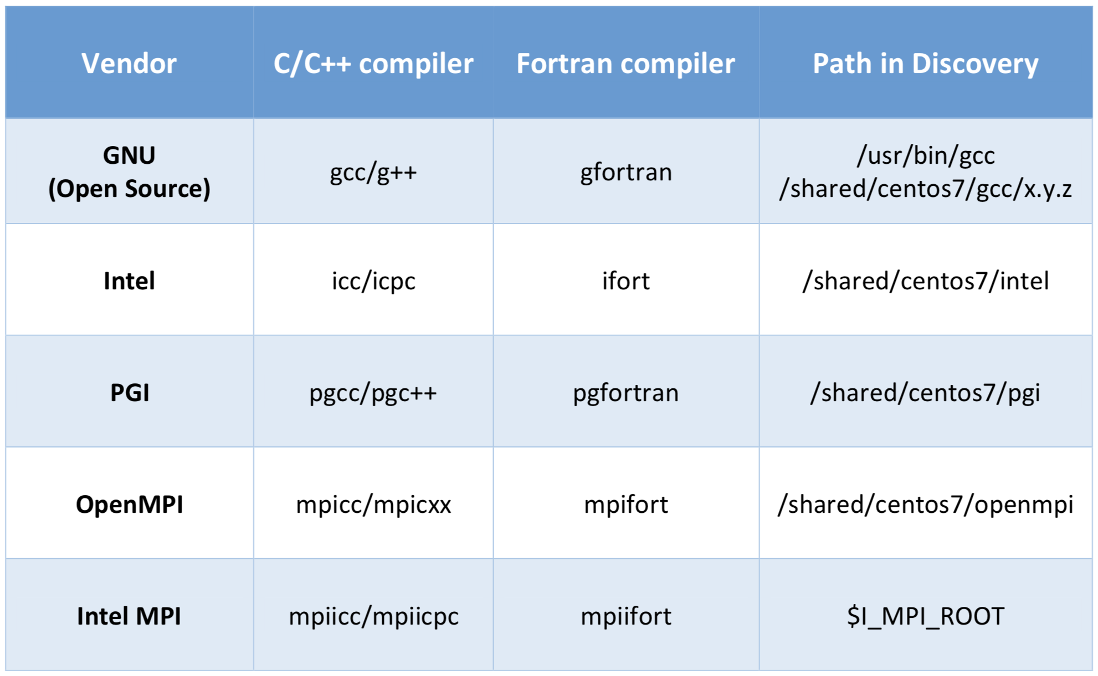
Compilers on Discovery
Discovery supports multiple compilers: GNU, Intel, PGI etc. You can view the different versions by: module avail gcc, module avail intel or module avail pgi.
Additionally, there are programs such as OpenMPI, MPICH, MVAPICH2 and Intel MPI that serve as wrappers for compilers for parallel computing code:

Slide 35
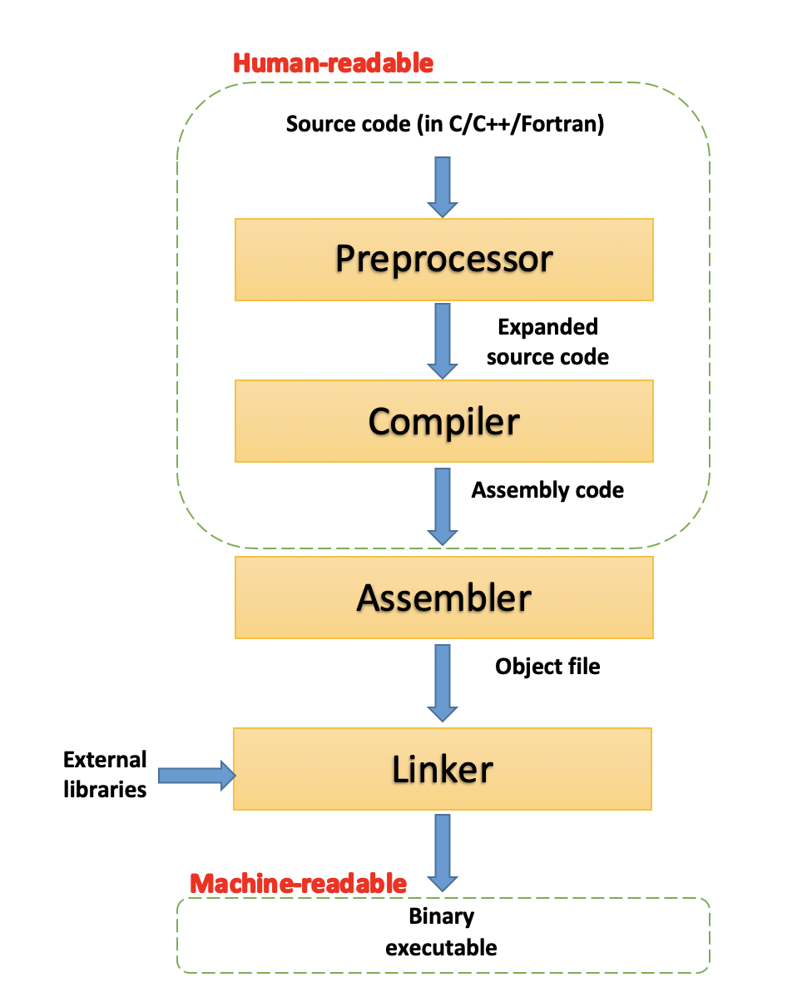
The compilation process
Scripts - programs (or interpreters), such as Perl, Python or Bash, interpret the script lines to perform complex tasks. Do not need to be compiled.
Codes - files containing code, such as C, C++ or Fortran, are used to build programs in the process of compilation (see diagram below). C, C++ or Fortran are low-level languages, and have little abstraction between them and machine language.
Compilation - The process of converting a text file with human-readable code into a binary and executable program.
4 compilation phases:
Pre-processing - the source code is processed with some text modifications such as comment removal and macros expansions.
Compilation - the code is converted into assembly-level instructions. This allows direct hardware modifications, access to specialized hardware instructions (AVX-512 for example), and addresses performance issues.
Assembly - the stage where the assembler takes the assembly code and turns it into an object file, containing machine-level instructions.
Linking - the final phase in which all the linking of function calls with their definitions is done.

Slide 36
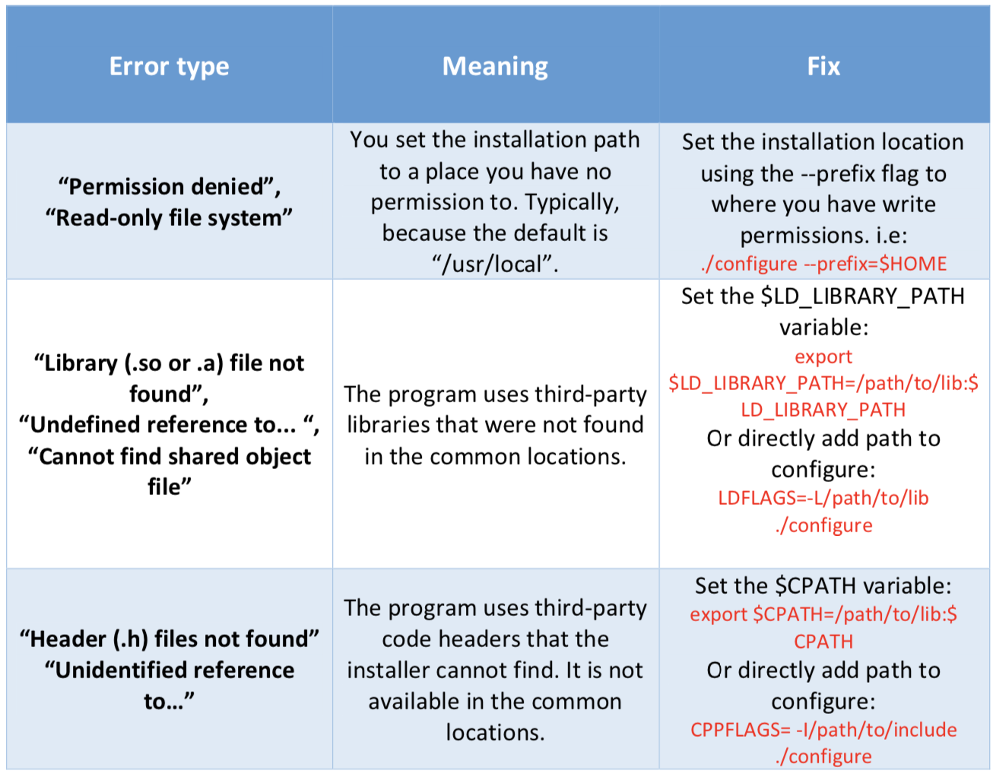
Troubleshooting compilation errors
Here's a summary of common compilation errors, that can be solved by providing correct paths:

Slide 37
Optimized compiling
It is possible to increase performance through using specific compilers, libraries and compilation flags. Here are some tips:
Use optimized mathematical libraries such as FFTW, Intel MKL, OpenBLAS etc.
For Intel-chip based machines, use Intel compilers that can tailor optimizations based on specific architectures.
Compile code on the machine architecture you plan to run your code on - the compilation process will detect the architecture and will select the best instruction set to use.
Run performance tests (see HPC tutorial) on binaries compiled with different compilers and different optimization flags (use with caution):
Use compiler optimization flags (-O2/-O3)
Add advanced vectorization optimization flags (SSE/AVX)
Add architecture specific optimization flags (--march=)

Slide 38
Thank you for your participation in this RC tutorial! Visit our website: https://rc.northeastern.edu/ Enjoy your computing!

