Slide 1



RESETTING STAFF PERFORMANCE MANAGEMENT
Information for Staff
Spring 2010
Copyright ©2010 by The Segal Group, Inc., parent of The Segal Company and its Sibson Consulting Division. All Rights Reserved.
Notes:
INFORMATION FOR STAFF
Spring 2010
RESETTING STAFF PERFORMANCE MANAGEMENT
Copyright ©2008 by The Segal Group, Inc., parent of The Segal Company and its Sibson Consulting Division. All Rights Reserved

Slide 2

Introduction
1
1
Why are we making changes to the staff performance management system?
What’s New and What’s Changing?
What are the tools and resources for managers and staff?
The University is adopting a more robust staff performance management system:
Foster a climate of staff accountability and development
Support a high performance culture
Success requires
Resetting the way managers and staff think about and execute performance management
Leadership support
Managerial expertise
Staff engagement
Notes:
1
1

Slide 3
Leadership Support
In the fall the University chartered a Committee of Senior Leaders to develop a phased plan to accomplish these goals
Committee Members:
Judith Pitney – Vice Provost for Budget, Planning & Administration
Tom Nedell – Vice President and Chief Financial Officer
Madeleine Estabrook – Director of UHCS
Kater Pendergast – Vice President, HRM
Tim Kenneally – Senior Director of Finance and Administration for Advancement
Cheryl Whitfield – Director of HR Programs & Employee Relations
Susan Batutis – Compensation Manager, HRM
Committee partnered with external consultant
Karen Hutcheson, Senior Vice President, Sibson Consulting
Broad expertise in consulting to higher education
Leader of Sibson’s Higher Education Consulting Team
2
Notes:
2
2

Slide 4

What’s New and What’s Changed
What’s New?
New, clear Performance Rating definitions
Self-Assessment form and suggested preparation questions to engage staff more fully in the performance management process
Training for managers to build expertise in performance management skills
What’s Changed?
Minor modifications to current Appraisal Forms to support the new performance rating definitions
3
Notes:
3

Slide 5

New Staff Performance Rating Definitions
New, clear staff performance rating definitions are the foundation of the effort to strengthen the performance review cycle.
Moving from numerical ratings – labels but no definitions – to narrative definitions
Narrative definitions
Are more complete
More fully describe different levels of performance
Provide greater clarity
Provide greater opportunity for discussions about performance
4
4
Notes:
4

Slide 6
New Staff Performance Rating Definitions continued
Intended to convey the University’s performance standards across a wide variety of roles and responsibilities. Specific definitions are provided for the sections below:
Major Responsibility Areas
Standards to be used in assessing employee performance in his/her major responsibility areas
Overall Rating
Standards to be used in assessing employee performance in:
Achievement of overall job responsibilities and goals
Customer service
Contribution to the University/department
Interactions with colleagues and others
Professional growth
New or Recently Promoted Employees
Similar standards as those for continuing employees, with consideration for the normal acclimation of the employee to a new role and workplace
5
5
Notes:
5

Slide 7
New Staff Performance Rating Definitions continued
Additional Performance Ratings
Consistently Exceeds Expectations
Northeastern’s Core Standard for Staff Performance defines a competent, successful, valued contributor to the University
Frequently Exceeds Expectations
Fully Meets Expectations
Partially Meets Expectations
Does Not Meet Expectations
6
6

Slide 8
New Staff Performance Rating Definitions continued
CORE STANDARD FOR STAFF PERFORMANCE
FULLY MEETS EXPECTATIONS
As Applied to Major Responsibility Areas | Consistently and completely meets established expectations for major responsibility area(s), in terms of quality, timeliness, processes, results, etc. Uses understanding and experience to assess situations, prioritize and solve problems, and make appropriate decisions to reach a satisfactory conclusion, especially in situations that are outside the usual definition of the job. Develops and maintains effective relationships with customers and colleagues, as appropriate for the role, and is responsive to their needs. Demonstrates a command of job responsibilities to execute own work and a commitment to quality.
As Applied to the Overall Rating (All elements must be achieved for the rating to apply) | Consistently and completely meets expectations. Contributes to the broader goals of the department/function and/or Northeastern. AND Understands impact and implications of how individual job and department responsibilities relate to other departments/functions and working relationships with other employees across and outside (if applicable) of the University. AND Establishes and maintains effective colleague relationships both internally and externally. AND Uses understanding and experience to assess situations, prioritize and solve problems, and make appropriate decisions to reach a satisfactory conclusion, especially in situations that are outside the usual definition of the job. AND Demonstrates a commitment to quality. AND Keeps customer (internal or external or both) as the focal point of work and responds in a timely manner to customer needs and concerns. AND Effectively handles both predictable and unpredictable situations within context of job responsibilities. AND Demonstrates command of job responsibilities to execute own work with minimal guidance from manager and utilizes resources appropriately to achieve results. AND Demonstrates ownership for work and strengthens own expertise through an active commitment to continuous learning.
As Applied to a New or Recently Promoted Employee | This would be an appropriate designation for new employees still learning the job, if their performance is consistent with the normal expectations for a new employee with similar skills, experience and capabilities.
7
7
Notes:
7
7

Slide 9
New Staff Performance Rating Definitions continued
ADDITIONAL PERFORMANCE RATINGS
FREQUENTLY EXCEEDS EXPECTATIONS
As Applied to Major Responsibility Areas | Frequently exceeds established expectations for major responsibility area(s), in terms of quality, timeliness, processes, results, etc. Frequently takes the initiative in organizing, prioritizing and solving problems and makes appropriate decisions to reach a satisfactory conclusion, especially in situations for which little precedent exists. Demonstrates a strong commitment to the quality and effectiveness for self and others. Develops and maintains effective customer and colleague relationships, as appropriate for the role, anticipating and responding to their needs. Exhibits strong knowledge, skills and competencies for the job and is well-regarded by others.
As Applied to the Overall Rating (All elements must be achieved for the rating to apply) | Frequently exceeds expectations. Contributes considerably to the broader goals of the department/function and/or Northeastern. AND Frequently anticipates the implications of working with other departments/functions and understands how it relates to own area/function. AND Develops and maintains effective working relationships across and outside (if applicable) of the University. AND Frequently takes initiative in organizing, prioritizing and solving problems, and makes appropriate decisions to reach a satisfactory conclusion, especially in situations for which little precedent exists. AND Demonstrates a strong commitment to quality and effectiveness for self and others. AND Frequently strives to keep customer (internal or external or both) as the focal point of work, responds in a timely manner to customer needs and concerns, and understands customer perspectives. AND Frequently anticipates and takes on additional duties beyond core job with the same degree of seriousness, care and thoroughness as demonstrated in regular job responsibilities. AND Exhibits strong knowledge, skills and competencies. AND Regularly seeks opportunities to build and/or strengthen own knowledge and skills.
As Applied to a New or Recently Promoted Employee | The rating “Frequently Exceeds” reflects a high level of performance and while new or newly promoted employees are not prohibited from being rated “Frequently Exceeds”, this designation should be used with caution. This rating is difficult to achieve as it requires observation of performance over time and high levels of performance in a variety of areas that may not be observable within the first year in a new job.
8
8
Notes:
8
8

Slide 10
New Staff Performance Rating Definitions continued
ADDITIONAL PERFORMANCE RATINGS
CONSISTENTLY EXCEEDS EXPECTATIONS
As Applied to Major Responsibility Areas | Clearly and consistently exceeds established expectations for major responsibility area(s), in terms of quality, timeliness, processes, results, etc. Takes the initiative in organizing, prioritizing and solving problems and makes appropriate decisions to reach a satisfactory conclusion, especially in complex or unprecedented situations. Demonstrates a strong commitment to the highest standards of quality and effectiveness, and expects the same of others. Develops and maintains effective customer and colleague relationships, as appropriate for the role, anticipating and responding to their needs in an exemplary manner. Consistently exhibits mastery of knowledge, skills and competencies and is considered a role model of excellence for others.
As Applied to the Overall Rating (All elements must be achieved for the rating to apply) | Clearly and consistently exceeds all job expectations in an exemplary manner. Contributes significantly to the broader goals of the department/function and/or Northeastern. AND Is consistently proactive in collaborating with and identifying implications of working with other departments/functions. AND Develops new and maintains existing working relationships with other employees across and outside (if applicable) of the University, and effectively utilizes those networks to enhance performance of self and others. AND Takes initiative in organizing, prioritizing and solving problems, and makes appropriate decisions to reach a satisfactory conclusion, especially in complex or unprecedented situations. AND Demonstrates a strong commitment to the highest standards of quality and effectiveness, and expects the same of others. AND Consistently keeps customer (internal or external or both) as the focal point of work by anticipating customer perspectives, proactively addressing customer needs and concerns, following up to ensure customer satisfaction, and providing customers with additional support. AND Anticipates and takes on additional duties beyond core job with the same degree of seriousness, care and thoroughness as demonstrated in regular job responsibilities. AND Consistently exhibits mastery of knowledge, skills and competencies and is considered a valuable resource to others. AND Is considered a role model of excellence for others. AND Proactively and frequently identifies and suggests new opportunities for continuous learning and development (e.g., tools, resources).
As Applied to a New or Recently Promoted Employee | The designation of “Consistently Exceeds” reflects a level of performance that is far beyond normal expectations. It is a difficult designation to achieve and is only given in rare and exceptional circumstances. It requires observation of performance over time and at consistently high levels that may not be observable within the first year of a new job.
9
9
Notes:
9
9

Slide 11
New Staff Performance Rating Definitions continued
ADDITIONAL PERFORMANCE RATINGS
PARTIALLY MEETS EXPECTATIONS
As Applied to Major Responsibility Areas | Does not consistently meet established expectations for major responsibility area(s), in terms of quality, timeliness, processes, results, etc. Is not consistently reliable in handling own job responsibilities and needs more supervision than is expected. May not develop or maintain effective working relationships with customers or colleagues. Needs to further build his/her knowledge, skills and competencies to become more proficient in handling the work.
As Applied to the Overall Rating | Does not consistently meet expectations. This may mean that some expectations are achieved and others are not, or that expectations are only partially met. OR Does not satisfactorily or consistently contribute to the department/function’s performance. OR Is not consistently reliable in handling own job responsibilities appropriately. OR Does not consistently keep customer (internal or external or both) as the focal point of work. OR Needs more supervision than is expected for the nature of the job, either to ensure that the work gets done or to ensure quality. OR Needs further building of knowledge, skills and competencies to becoming more proficient.
As Applied to a New or Recently Promoted Employee | While new employees may not effectively perform all job responsibilities in their first year with Northeastern, this designation should only be used if the new employee is not meeting the normal expectations for someone with similar skills, experience and capabilities who is still learning the job and becoming acclimated to the institution.
This performance rating reflects performance that does not fully meet expectations and as such indicates the need for follow-up discussions, development of an improvement plan, and/or consultation with HR.
10
10
Notes:
10
10

Slide 12
New Staff Performance Rating Definitions continued
ADDITIONAL PERFORMANCE RATINGS
DOES NOT MEET EXPECTATIONS
As Applied to Major Responsibility Areas | Does not meet established expectations for major responsibility area(s), in terms of quality, timeliness, processes, results, etc. Does not demonstrate the knowledge, skills or competencies to handle job responsibilities and requires significant supervisor involvement to ensure work is correctly completed. Does not develop or maintain effective customer or colleague relationships.
As Applied to the Overall Rating | Does not meet job responsibilities, expectations and goals. OR Does not demonstrate the knowledge, skills or competencies to handle job responsibilities. OR Does not effectively contribute to the department’s performance. OR Does not keep customer (internal or external or both) as the focal point of work. OR May require significant involvement of supervisor to ensure that work is done completely and correctly, and to fix problems/potential problems.
As Applied to a New or Recently Promoted Employee | Unsatisfactory performance could have a number of possible causes. It is important to quickly identify the cause, determine if it can be resolved, and develop a plan to improve performance. The timeframe and process for improving performance as well as the consequences of not improving should be clearly articulated.
This performance rating indicates a serious misalignment between the employee and the job. Consultation with HR is required.
11
11
Notes:
11
11

Slide 13
Self-Assessment
Self assessment is an effective tool in fostering greater employee engagement in the performance evaluation process
It helps to facilitate a comprehensive review of progress and accomplishments over the past year
It is an effective tool for helping staff self-identify strengths and expertise, areas of interest, and areas for improvement and development
Two tools have been developed for use as determined by department management
The Self-Assessment Form can be completed in advance by the employee and formally shared with the manager as part of the appraisal process
The Suggested Self-Assessment Questions tool is a series of questions that can help the employee prepare for the appraisal conversation
Use of one or both of these tools is strongly encouraged across the University
12

Slide 14
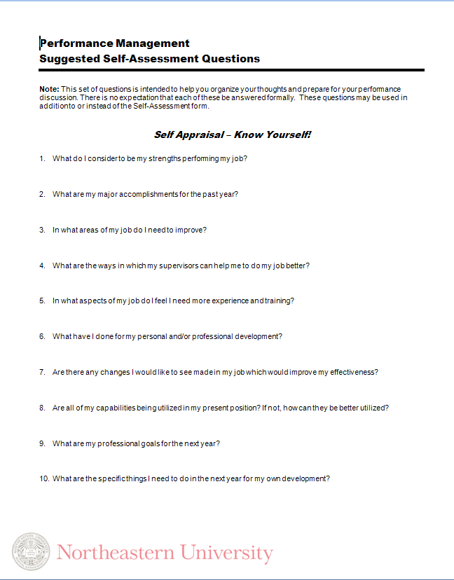
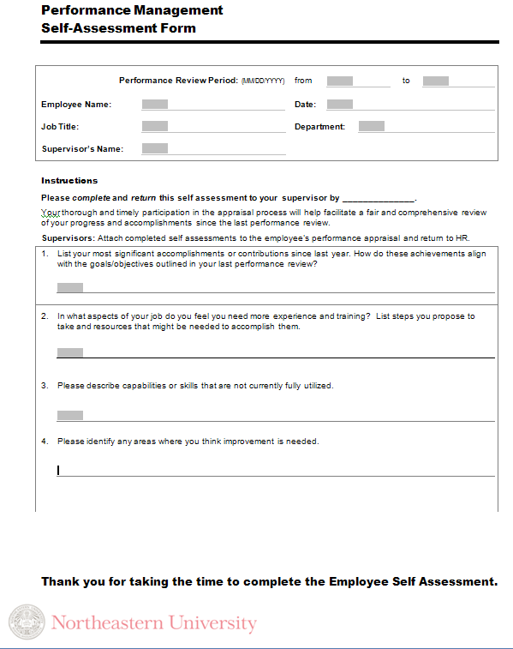
Self-Assessment Form & Questions

Slide 15
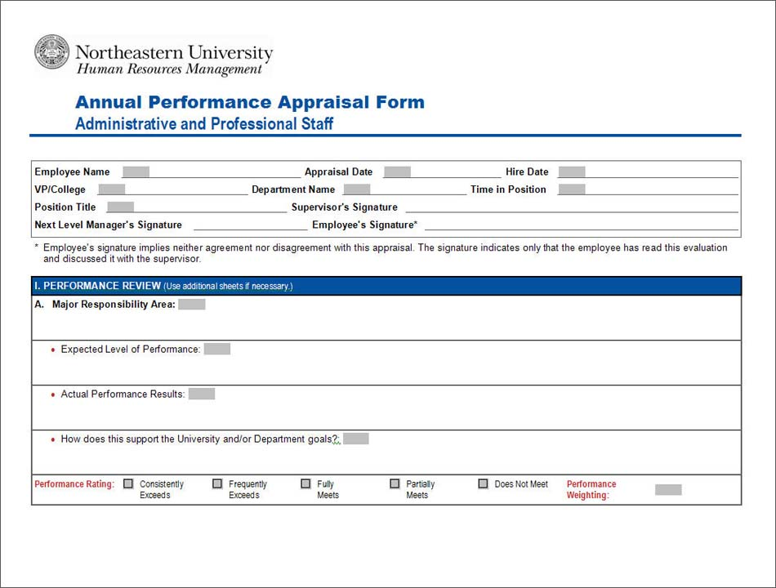
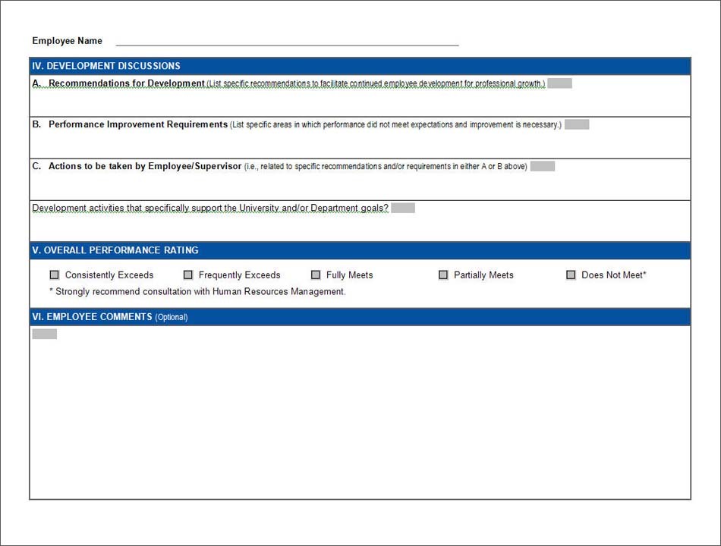
Administrative/Professional Appraisal Form
The format of the ratings on the Annual Appraisal Form have been modified slightly, but the form itself will continue to be used as a primary component in the performance management process.
The format of the performance ratings changed from rating name and number (e.g., consistently meets 3) to rating name. Performance rating names were also modified slightly.
14

Slide 16
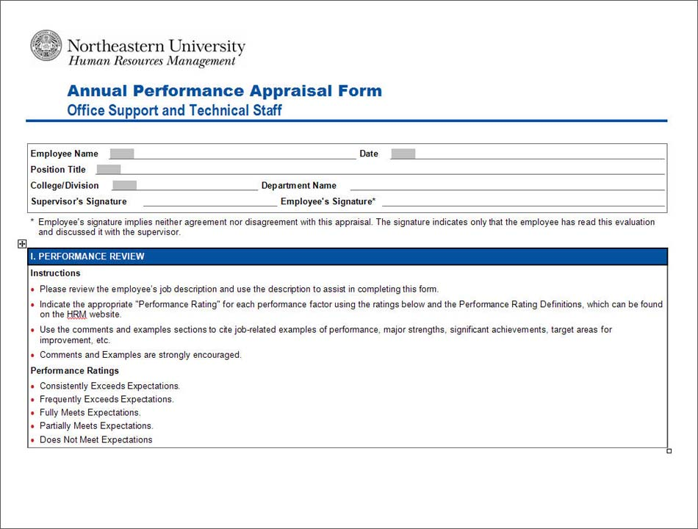
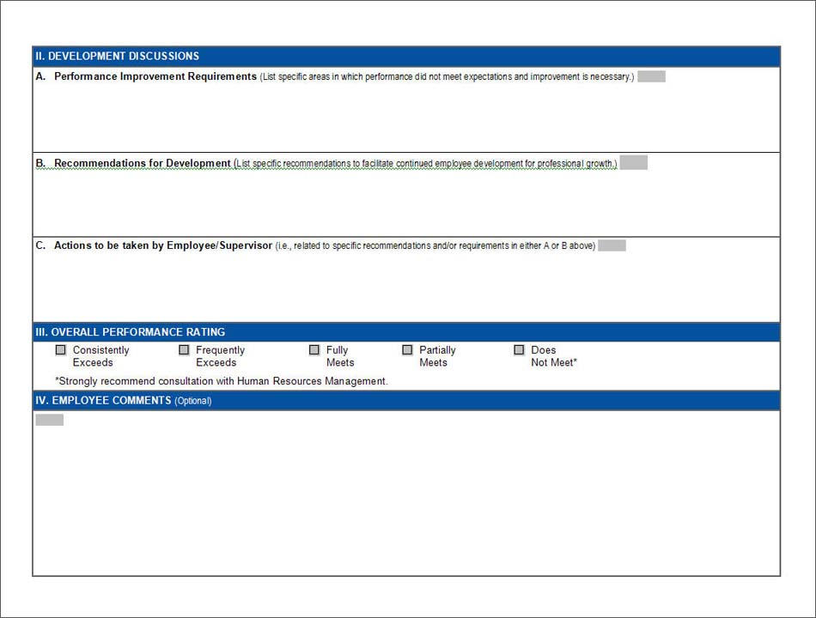

Office Support and Technical Staff Appraisal Form
The format of the ratings on the Annual Appraisal Form have been modified slightly, but the form itself will continue to be used as a primary component in the performance management process.
The format of the performance ratings changed from rating name and number (e.g., consistently meets 3) to rating name. Performance rating names were also modified slightly.
15

Slide 17

Next Steps
The 2010 performance evaluation process will begin once managers and staff have been briefed
Managers may utilize self-assessment tools
Performance evaluations and conversations should be conducted by May 4, 2010
Remember, salary increase decisions are merit- based and ultimately managers will make salary increase determinations based on overall contribution and performance, using the definitions

