Slide 1
Northeastern University
2015 Medical Benefits

Slide 2
Northeastern’s 2015 Open Enrollment
Effective Date: January 1, 2015
2015 Medical Plan Options
    Blue Choice New England – Core POS Plan ^{New Plan}
    Blue Choice New England – Enhanced POS Plan ^{New Plan}
    Blue Care Elect Preferred – High Deductible PPO Plan with Health Savings Account (HSA)
Health Savings Account (HSA)
  Available to only employees enrolled in high deductible health plan
  Administered by Health Equity
  Northeastern University contributes $500 for individual coverage / $1,000 family coverage. Full contribution made in January
Visit www.bluecrossma.com set-up your on-line Member Central account and take advantage of our discounts, tools & other resources (including Coverage Advisor)
No cost preventive care on all plans
Dependents covered to age 26
No pre-existing conditions or waiting periods

Slide 3
Glossary of Terms
Copayment: The fixed amount you pay directly to the provider when you receive some in-network services. (example: you may see a copayment for office visits or prescription drugs)
Deductible: The amount you will pay for certain services before Blue Cross Blue Shield pays out benefits on your behalf. The deductible is based on your calendar year and will reset each January 1st. (example, you may need to meet your deductible if you are having outpatient surgery or diagnostic testing)
Coinsurance: The percentage you will be responsible for paying for certain covered medical services. The insurance carrier will pay the higher percentage and you pay the lower percentage. (example, most out-of-network services after your deductible will have coinsurance)
Out-of-Pocket Maximum: The most you will pay for covered services in a calendar year. Your deductible, co-insurance and all copayments, including pharmacy copayments are calculated to your out-of-pocket maximum. Once you have reached your out-of-pocket maximum, the Blue Cross Blue Shield will then provide 100% coverage for the remainder of the calendar year for covered services.

Slide 4
Core POS Plan
Enhanced POS Plan

Slide 5
Core & Enhanced POS Plans – NEW!!
Two Levels of Benefit: PCP/Plan Approved Services or Self-Referred
PCP / Plan Approved Services: Highest level of benefit with lower out-pocket expenses
  Use HMO Blue New England network providers – six New England States
  PCP required – change anytime
  Referrals to most network specialists
  No referrals to network providers:
      OB/GYN Care
      Chiropractors
      Routine Vision
      Behavioral Health Visits
    Coverage for Emergency or Out-of-Area Urgent Care world-wide

Slide 6
Core & Enhanced POS Plans, continued
Self-Referred Benefits: Higher out-of-pocket expenses
  Use any provider with a payment arrangement with the local BCBS (no benefits will be paid if a payment arrangement is not in place)
  Benefits are paid based on BCBS’s allowed charge and if provider is charging more, then they can balance bill
To Find Participating Providers:
  Visit www.bluecrossma.com/findadoctor
  Call toll-free Physician Selection Service 1-800-821-1388
  Ask your provider if they’re in HMO Blue New England network or have a payment arrangement with BCBS

Slide 7
Core & Enhanced Plan In-Network Comparison
 | CORE PLAN | ENHANCED PLAN
 | PCP/PLAN APPROVED | PCP/PLAN APPROVED
BENEFIT | YOUR COST | YOUR COST
DEDUCTIBLE | $250 MEMBER / $500 FAMILY | NONE
OUT-OF-POCKET MAXIMUM | $2,500 MEMBER /$5,000 FAMILY | $2,000 MEMBER / $4,000 FAMILY
PREVENTIVE EXAMS & RELATED TEST | NO CHARGE | NO CHARGE
OFFICE VISITS - PCP | $25 COPAY | $20 COPAY
OFFICE VISITS - SPECIALISTS | $35 COPAY | $30 COPAY
LABS, X-RAYS & OTHER TESTS | 10% COINS AFTER DEDUCTIBLE | NO CHARGE
HIGH TECH IMAGING SERVICES | 10% COINS AFTER DEDUCTIBLE | $100 HOSPITAL / $0 OTHER PROVIDERS
SHORT TERM REHAB - PT, OT & ST | $35 COPAY | $30 COPAY
PROSTHETIC & DME | 10% COINS AFTER DEDUCTIBLE | NO CHARGE
EMERGENCY ROOM | $100 COPAY (WAIVED IF ADMITTED) | $100 (WAIVED IF ADMITTED)
AMBULATORY SURGERY | 10% COINS AFTER DEDUCTIBLE | NO CHARGE
INPATIENT ADMISSION | 10% COINS AFTER DEDUCTIBLE | NO CHARGE
PRESCRIPTION DRUGS
RETAIL - 30 DAY SUPPLY | $5/$30/$50 | $5/$30/$50
MAIL SERVICE - 90 DAY SUPPLY | $10/$60/$100 | $10/$60/$100
(Refer to benefit literature for out-of-network benefits)

Slide 8
High Deductible Health Plan (HDHP) with Health Savings Account (HSA)

Slide 9
HDHP with HSA
PPO Platform: This means:
  Choose any doctor or hospital
  No primary care physician (PCP) or referrals required
Two Levels of Benefit: In-Network or Out-of-Network - where you choose to go determines benefit level
In-Network benefits: Highest level of benefit with lower out-pocket expenses
  Use a BCBS National PPO Preferred Provider or use emergency room
Out-of-Network: Higher out-of-pocket expenses
  Use any licensed provider
  Out-of-network providers may balance bill if they charge more than BCBS's allowed reimbursement

Slide 10
HDHP with HSA
To Find Participating Providers
  Visit www.bluecrossma.com/findadoctor
  Call toll-free Physician Selection Service 1-800-821-1388
  Ask your provider if they’re in BCBS PPO national network

Slide 11
HDHP with HSA
 | BLUE CARE ELECT PPO - HDHP
 | IN-NETWORK | OUT-OF-NETWORK
BENEFIT | YOUR COST | YOUR COST
DEDUCTIBLE | $1,500 IND/$3,000 FAMILY CONTRACT | $2,500 IND/$5,000 FAMILY CONTRACT
OUT-OF-POCKET MAXIMUM | $2,500 IND/$5,000 FAMILY CONTRACT | $4,000 IND/$8,000 FAMILY CONTRACT
PREVENTIVE EXAMS & RELATED TEST | NOTHING (NO DEDUCTIBLE) | 20% COINS (NO DEDUCTIBLE)
OFFICE VISITS - PCP | 10% COINS * | 30% COINS *
OFFICE VISITS - SPECIALIST | 10% COINS * | 30% COINS *
LABS, X-RAYS & OTHER TESTS | 10% COINS * | 30% COINS *
HIGH TECH IMAGING SERVICES | 10% COINS * | 30% COINS *
PROSTHETIC & DME | 10% COINS * | 30% COINS *
EMERGENCY ROOM | 10% COINS *
AMBULATORY SURGERY | 10% COINS * | 30% COINS *
INPATIENT ADMISSION | 10% COINS * | 30% COINS *
PRESCRIPTION DRUGS
RETAIL - 30 DAY SUPPLY | $5/$30/$60 * | $10/$60/$100 *
MAIL SERVICE - 90 DAY SUPPLY | $10/$60/$100 * | NOT COVERED
* AFTER DEDUCTIBLE

Slide 12

Health Savings Account (HSA)
A Health Savings Account (HSA) is a tax-advantaged personal savings account that works With a HSA-compatible health plan, such as Northeastern’s HDHP
Use it to pay for qualified medical, dental & vision expenses with tax-free dollars
Deposits to account are tax free based on IRS guidelines for contribution limits
The accountholder owns it; account stays with you even if you switch plans or leave employer
No “use-it-or-lose-it” requirement; balance plus earning carries over year to year – tax free
Investments & interest on account are tax free
Eligibility requirements based on IRS guidelines
Administration of HSA portion of plan is through a BCBSMA partner, Health Equity
Northeastern contributes $500 individual contract /$1,000 family contract
New for 2015: Full contribution made in January!

Slide 13
Member Cost Share Type by Plan
 | 2015 Northeastern Medical Plans
Type of care | Enhanced | Core | HDHP with HSA
Routine exams for preventive care including immunizations and routine vision exams | no charge | no charge | no charge
Office visits for non-preventive care (PCP and specialist) | copay | copay | deductible then coinsurance
Rehabilitation, speech, occupational, chiropractic and physical therapy | copay | copay | deductible then coinsurance
Outpatient mental health services | copay | copay | deductible then coinsurance
Urgent Care / Emergency room care | copay | copay | deductible then coinsurance
Non-preventive labs, tests and x-rays | no charge | deductible then coinsurance | deductible then coinsurance
High tech radiology (CT, PET, MRI) | no charge or copay in hospital setting | deductible then coinsurance | deductible then coinsurance
Outpatient surgery | no charge | deductible then coinsurance | deductible then coinsurance
Inpatient hospitalization (e.g. acute care, maternity, rehabilitation, mental health) | no charge | deductible then coinsurance | deductible then coinsurance
Prescriptions | copay | copay | deductible then copay
Note: Reflects in-network/PCP-referred benefits only

Slide 14
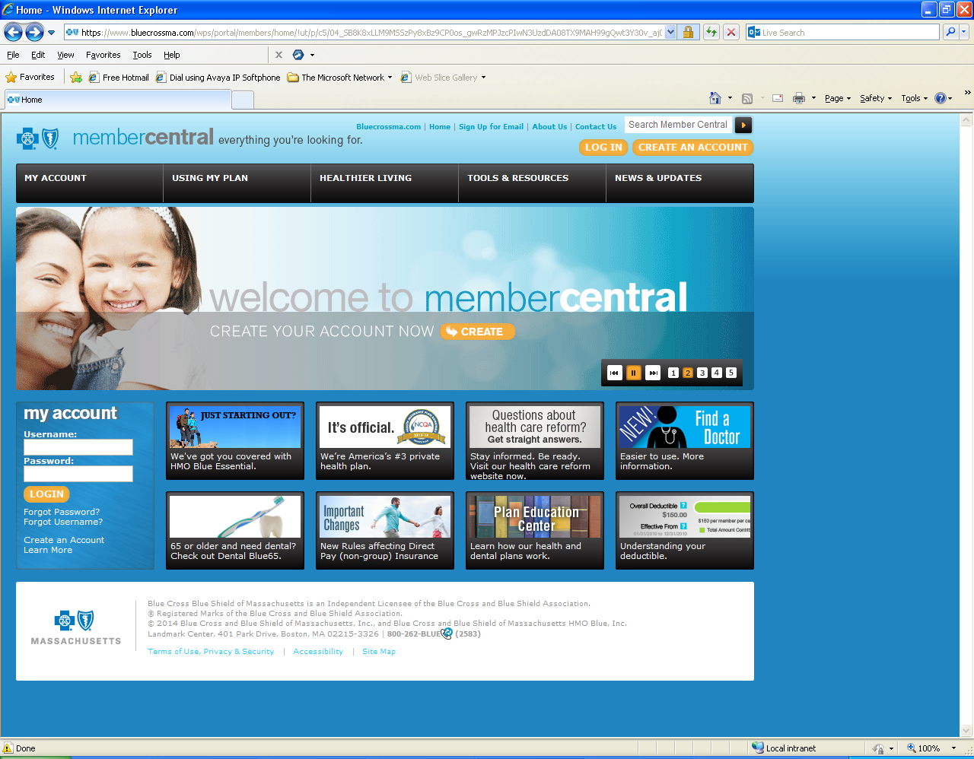
Blue Cross Member Support Tools

Slide 15


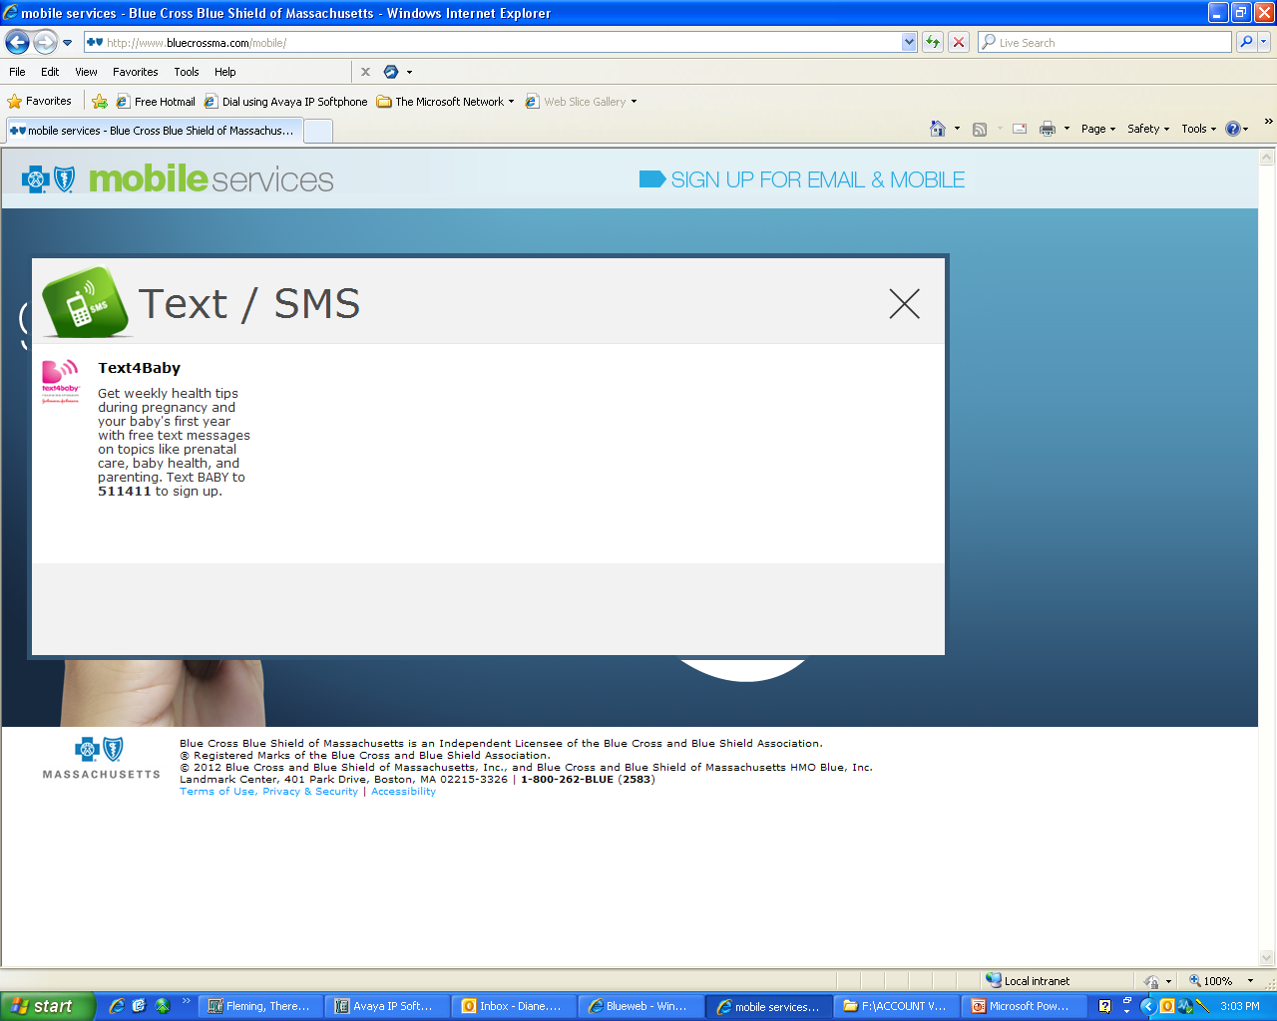
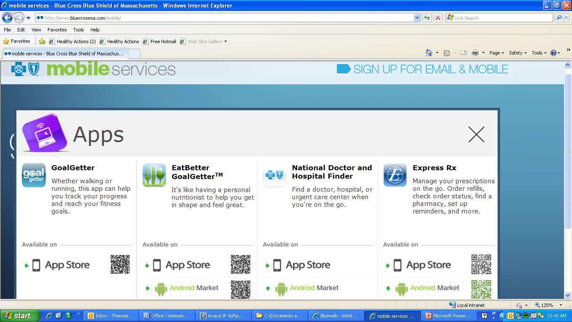

Blue Cross Mobile Services

Slide 16
Questions?
Call Member Service toll-free number on ID card:
  1-888-543-8770
  Monday - Friday, 8am - 8pm (Eastern Standard Time)
Visit www.bluecrossma.com

