Slide 1
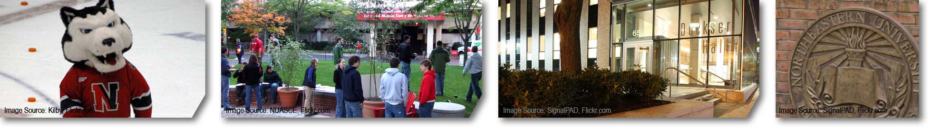
RESETTING PERFORMANCE MANAGEMENT – MANAGER AS COACH Manager Briefing & Discussion Sessions Winter 2013

Slide 2
Today’s Agenda
The Performance Cycle
Goals of Today’s Program
Group Discussion – Your Most Memorable Coach
What is Coaching?
Coaching Techniques
Group Discussion – Practice Coaching Sessions
Q&A

Slide 3
The Performance Cycle
Expectation Setting
Clarify job requirements
Establish annual goals
Link goals to larger departmental or college goals
Staff Development
Discuss goals and associated learning needs
Plan professional development
I. Performance Planning/ Expectation Setting
III. End of Year Evaluation
End of Year Evaluation
Summarize critical goals and achievements
Establish overall rating based on performance throughout the year
II. Ongoing Review and Feedback

Slide 4
High Level Timeline for this Year
Review Goals & Self-Assessments
Write & Deliver Performance Reviews by April 1st
Merit Increases are due by
May 6th

Slide 5
Goals of Today’s Coaching Program
Understand why coaching is so critical to performance, both team & individual
Learn more about the key skills and attributes of a good coach
Share several tools and techniques for effective coaching

Slide 6
The Performance Cycle – Put Coaching in Perspective
Expectation Setting
Clarify job requirements
Establish annual goals
Link goals to larger departmental or college goals
Staff Development
Discuss goals and associated learning needs
Plan professional development
I. Performance Planning/ Expectation Setting
III. End of Year Evaluation
End of Year Evaluation
Summarize critical goals and achievements
Establish overall rating based on performance throughout the year
II. Ongoing Review and Feedback
Coaching and Feedback
Confirm and review areas of focus
Provide coaching
Offer constructive feedback

Slide 7
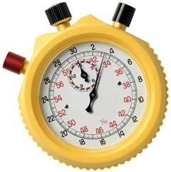
Group Discussion: Your Memorable Coaches
Reflect back on coaches that you’ve had and determine what made the coaching memorable, either in a positive or a negative way.
Purpose
What did your coach do that worked for you?
What did your coach do that they shouldn’t have?
Think About
TIME
5 minutes

Slide 8
What does a Good Coach do?
Listen actively
Observe
Identify opportunities for improvement
Effectively communicate opportunities to his/ her direct report
Encourage staff and recognize good performance
Coach continuously

Slide 9
What is Coaching?
A focused and interactive conversational process that facilitates learning and raises performance at work

Slide 10
Why do it?
Creates a commitment to the individual
Encourages good performance and creativity
Creates a sense of accountability
Creates real time job satisfaction
Challenges and develops the individual’s skills and abilities
Supports the individual in areas where he/she may lack confidence

Slide 11
Exercise: Practice Coaching
See examples of coaching in action and engage in discussion on strategies and success
Purpose
Watch the scenario
Answer the Observer Questions
Look for what went well
Look for what went wrong
Observe coaching techniques
Discuss in your group
Have someone report out
Process
TIME
20 minutes

Slide 12
Debrief– Scenario
Include specific examples of statements made, questions asked, approaches used
Area/ Skill | Your Observations
How did the manager start?
What was the response to the coaching?
What went well?
What else could the manager have tried?
Any suggestions or insights to share?

Slide 13
Techniques
Prepare for the conversation
Make sure you have the individual’s attention
Get to the point
Always coach privately
Allow the individual to respond
Develop a plan together to move forward
Create clear expectations about what the next steps are
Don’t smother

Slide 14
Wrap Up
Toolkit
Getting Ready to Coach
Planning the Coaching Discussion
Conducting the Coaching Discussion
Additional Techniques: What If …
Employee Self-Assessment
Manager Self-Review

Slide 15
Summary Points
Coaching is a “Win-Win” Proposition
Helps you to be a better manager
Helps an individual to be a more valuable team member
You get more out of coaching than you put in, so be prepared to make the investment
Coaching never ends….it is an ongoing process that has continuous improvement as its real goal

