Slide 1

Performance Management
A briefing for new managers

Slide 2
Today’s Agenda
Overview – Performance Management at Northeastern
Feedback Framework
Introduction of Performance Ratings/ Activity
Self Assessment
Merit Increases – Correlating Pay to Performance
Timeline and Wrap Up
2

Slide 3
Key Components of the Process
Working with New Hires
Set goals & expectations
90 day review
The Annual Performance Cycle
12 months period
Goal Setting
Ongoing Coaching & Feedback
End of Year Appraisal
Spring merit planning
Reviews written and merit recommended in April/ May
Merit has a July 1st effective date
3

Slide 4
The Performance Management Cycle
Planning & Goals
Clarify expectations
Establish annual goals
Link to college/ division goals
Plan professional development
I. Performance Planning/ Expectation Setting
III. End of Year Evaluation
II. Ongoing Review and Feedback
End of Year Evaluation
Summarize critical goals and achievements
Establish overall rating based on performance throughout the year
Ongoing Review, Coaching and Feedback
Confirm areas for focus
Provide constructive feedback Documentation
4

Slide 5
Feedback Framework
Feedback is an essential component of a performance culture
Most beneficial if on-going
Intended to support staff performance and development
Applies to both positive and constructive situations
On-going feedback ensures no surprises
Framework assists in preparing to deliver feedback effectively
FEEDBACK FRAMEWORK©
Expectations
Observations
Observations
Consequences
Assessments
5
5
Notes:
5
5

Slide 6
Performance Ratings
Additional Performance Ratings
Northeastern’s Core Standard for Staff Performance defines a competent, successful, valued contributor to the University
Consistently Exceeds Expectations
Frequently Exceeds Expectations
Fully Meets Expectations
Partially Meets Expectations
Does Not Meet Expectations
A description of all ratings can be found on the HRM site
6
6

Slide 7
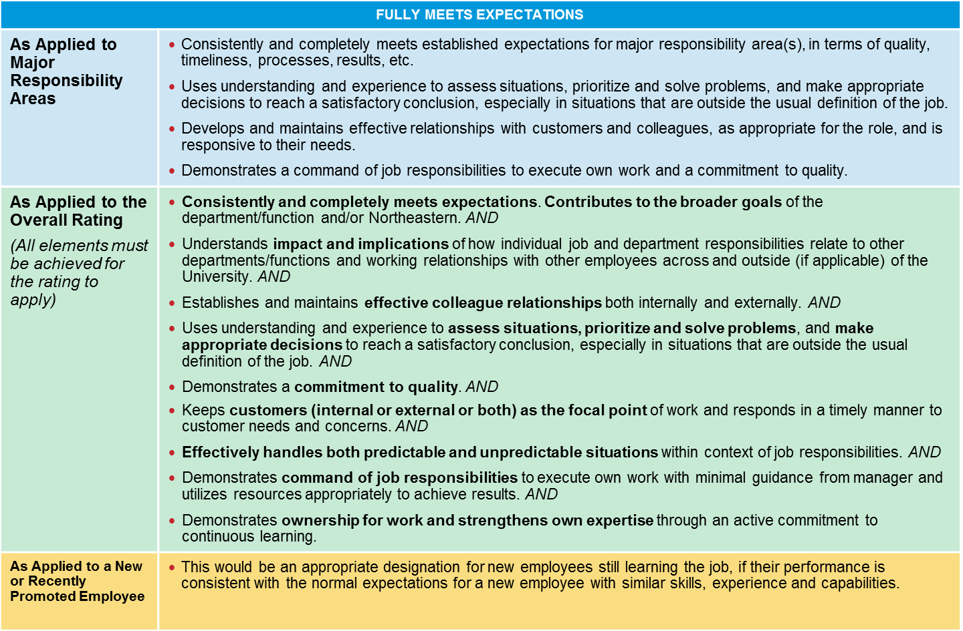
Fully Meets Further Explained
7

Slide 8
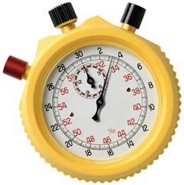
Activity: Using Rating Descriptions
Become familiar with the performance rating descriptions
Purpose
TIME
20 minutes
Review a set of goals for one key role
Review 2 performance scenarios and discuss potential ratings
Review how an overall performance rating is determined
Overview
A description of all ratings can be found on the HRM site
8

Slide 9
Example – Academic Advisor
Performance Goals
Goal #1: Academic Advising (Wtg: 60%) | Provide support and guidance concerning college and university policies, co-op scheduling, course selection, registration and preparation for graduation. Advise individual students regarding academic issues; concerns and personal issues, which may be interfering with academic success. Manage and assign caseload of students based on class year. Serve as liaison to academic program directors who oversee the assigned academic programs. Review academic progress of each student and determine academic status (e.g., probation, etc.), and work with individuals to meet academic goals and objectives.
Goal #2: Program Management (Wtg: 30%) | Work with student class council or focus groups to identify needs of the student level and develop programs which address those class developmental needs. Coordinate and lead workshops with faculty. Prepare materials for orientations and student work shops.
Goal #3: Operational Management (Wtg: 10%) | Maintain and update student records with key data changes within 48 hours of a change and ensure that all records are up to date for the monthly review cycle. Perform degree audits for students within 5 business days of a request in writing. Track program expenditures annually and prepare projections for upcoming year. Track individual items within the month incurred and revise projections on a quarterly basis.
9

Slide 10
Example – Academic Advisor: Reviewing Performance
Performance Goal
Goal #1: Academic Advising (Wtg: 60%) | Provide support and guidance concerning college and university policies, co-op scheduling, course selection, registration and preparation for graduation. Advise individual students regarding academic issues; concerns and personal issues, which may be interfering with academic success. Manage and assign caseload of students based on class year. Serve as liaison to academic program directors who oversee the assigned academic programs. Review academic progress of each student and determine academic status (e.g., probation, etc.), and work with individuals to meet academic goals and objectives.
Scenario #1
Maria is consistently available to meet with students for advising by both appointments and walk-ins. She adapted readily to the curriculum changes in the college and successfully communicated these changes to the students in her unit. As the leader of the academic probation process, Maria updated, mailed and emailed letters to students and held appointments with the students to develop a plan of action for the following term. She also worked to build strong, effective relationships with faculty.
Scenario #2
Maria is particularly focused on being proactive, and regularly reaches out to students. She meets regularly with academic program directors. She regularly reviews her files and follows-up with students with whom she has met and develops creative ways to promote her services to all students. She demonstrates concern for their overall well being and makes appropriate referrals to on-campus resources. Feedback from students is consistently very positive and her students tend to do very well academically and personally.
10

Slide 11
Example: Overall Performance Rating
Goals and Performance Ratings
Goal #1: Academic Advising (Wtg: 60%) | Performance Rating: Fully Meets
Goal #2: Program Management (Wtg: 30%) | Performance Rating: Fully Meets
Goal #3: Operational Management (Wtg: 10%) | Performance Rating: Frequently Exceeds
Overall Performance Rating:
11

Slide 12
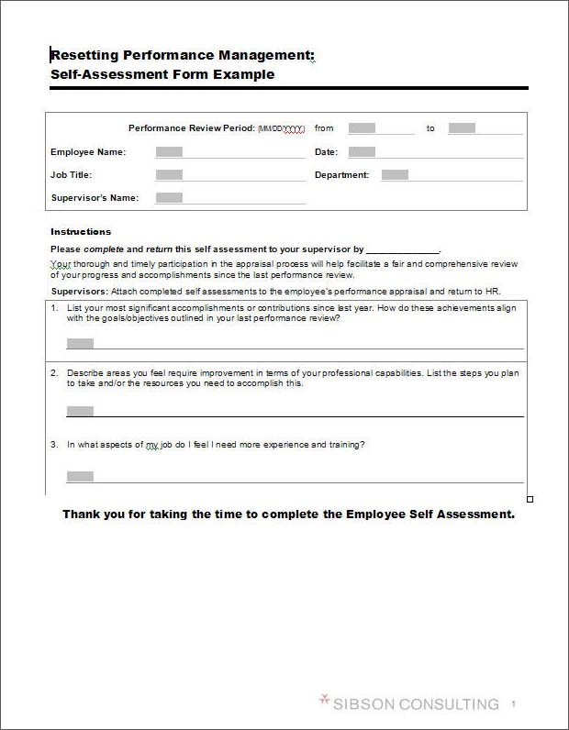
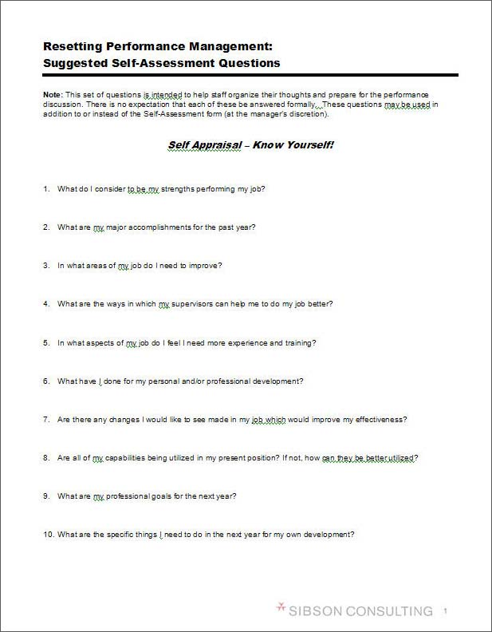
Self-Assessment
Self assessment is an effective tool in fostering greater employee engagement in the performance evaluation process
This is strongly encouraged across the University
12

Slide 13
Merit Guidelines—Differentiating
Salary increases are determined by the manager and leadership of the area
Relevant factors
Primary factor is the overall performance rating
Other contributions may impact the merit increase percentage or may justify a bonus
Completion of special projects or other achievements that were not included in the planned performance expectations
Extraordinary contributions towards department or unit initiatives/projects
Additional considerations
Review within the context of “similarly situated” peers
Employees in the same department or unit in a similar job, with similar levels of performance, skills and experience should have reasonably similar salaries
More experienced and/or more highly skilled staff should be paid higher than less experienced/skilled staff, provided that
Performance is meeting or exceeding expectations
Employee maintains currency of skills and knowledge, and is contributing at a higher level than the lesser experienced/skilled staff

Slide 14

Evaluating Performance
Review self-assessment
Review goals and outcomes
Compare results against the job description and …
Identify areas of development
14

Slide 15
Next Steps
Attend a Setting Expectations session
Review the performance management program with your staff
Materials can be provided for you to present at staff meetings or, as an option, you may request that HRM present with you.
All materials can be found at:
http://www.northeastern.edu/hrm/resources/for-managers/performance-management.html
The 2014 performance process has already begun.
Complete goals for yourself and your staff
Discuss your expectations and the self-assessment process
Guidelines and timeframes are announced in early spring
along with merit increase recommendations
15
Notes:
15

