Slide 1

Performance Management
Setting Goals & Expectations
Presented by: HRM

Slide 2
Agenda
Performance Cycle
Setting Goals
Alignment
SMART
Practice
Draft & Align
Metrics
Key Points

Slide 3
The Performance Management Cycle
I. Performance Planning/ Expectation Setting
Goal Setting
Clarify expectations
Establish annual goals
Link to college/ division goals
Plan professional development
III. End of Year Evaluation
II. Ongoing Review and Feedback

Slide 4

Goals & Setting Expectations Scenarios

Slide 5
It’s all about alignment
University Goals
College or Divisional Goals
Department Goals
Individual Goals
Drivers that impact performance
Understanding of performance standards
Understanding how the systems work
Accountability for “things that matter”
Linking individual work to “things that matter”
Know what organizational issues influence work
Know how the unit contributes to the University
Know how the team contributes
Know how the individual contributes
Corporate Leadership Council – Building High-Performance Workforce: Chapter Two-Seven Keys to High Performance
Corporate Leadership Council - Driving employee performance and retention through engagement

Slide 6
Key Tips on Writing Goals
Focus on the individual’s work to ensure their actions are directed at achieving results critical to the organization's success
Connect the individual’s work to the goals of the department, division and Northeastern overall
Do not encapsulate the entire job, only the key goals, projects, and accountabilities. Set one professional development goal each year.
Typically goals start with a verb and focus on the end results
Goals should be SMART
SMART Goals
S
Specific
M
Measurable
A
Achievable
R
Results Focused
T
Time Focused

Slide 7

Key Points about Performance
Setting Expectations
Being Consistent
Be clear & specific
Review job responsibilities
Discuss “fully meets”
Create a plan
Check in regularly
Ask for input
Provide frequent feedback
Review goals regularly
Discuss expectations
Assess results
Foster open environment
Gather feedback, too
don’t just give it

Slide 8
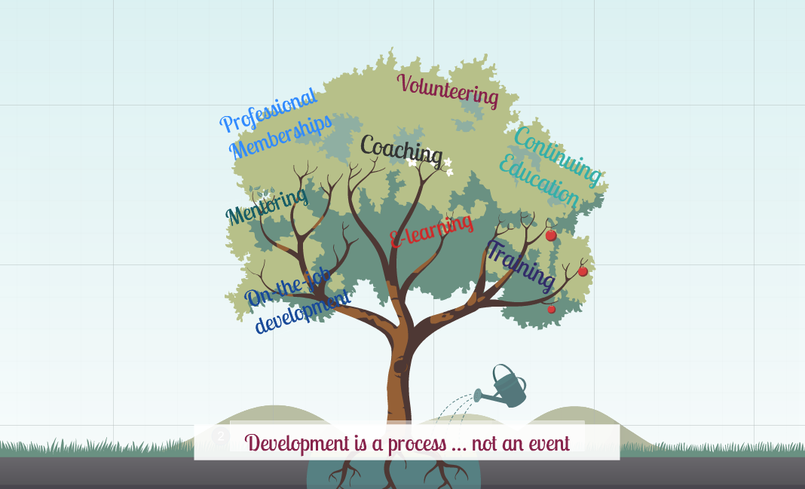

Slide 9
Creating a Development Goal
Step | Action
1 | Define the development need. Define in behavioral detail. Ask yourself what is the evidence that this is a development need? What are the consequences if I don’t address this? What are the root skills?
2 | Create a timeline. Include due dates. Deadlines anchor your intentions to daily activities. Include action/by when/resources.
3 | Add measures. When development occurs, how will you know it? How will you measure your progress?
4 | Add “backstage” actions. How do I find out more about ___? Locate a course, attend it, and extract learning from it to put in your development plan. Read a book or talk to a subject matter expert.
5 | Add “onstage” actions. These are the things you do on the job. Things you will do DIFFERENTLY.

Slide 10
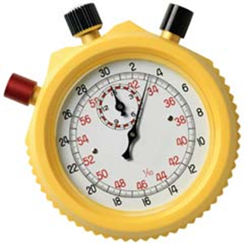
Improving Goals: Why SMART?
GOAL: | S | M | A | R | T
I want to lose weight
I want to lose 20 lbs. by April. I will perform a half hour of cardio and half hour of strength training per day, 5 times a week and I will only eat starchy carbohydrates 3 times a week.

Slide 11
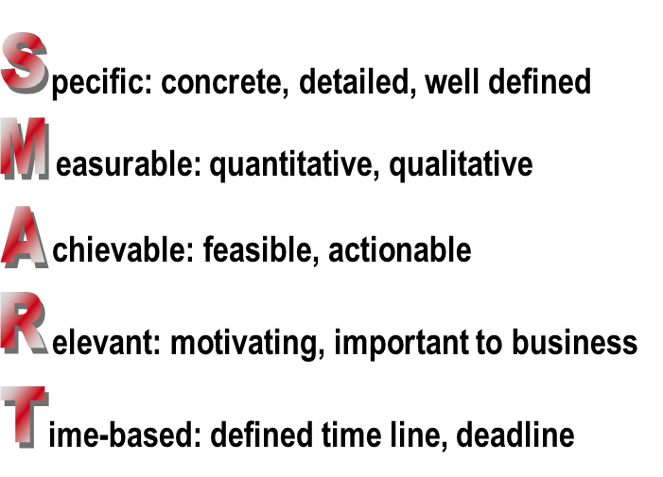
Summary Points
Goals & How to get there
Be sure to spend focused time with all of your direct reports to determine their key goals for the year, to determine their unit, division or department, and organization-wide impact and to discuss their development goals, including learning action plans and measurements for success.
Development
Spending time discussing and documenting your direct report’s development needs can be both a short- and long-term benefit to you in terms of motivation and growth.
Feedback, feedback, feedback
For development to occur, individuals have to
DO something NEW,
DO something DIFFERENTLY than before, or
STOP doing something currently being done.

Slide 12
Tools & Resources

Slide 13
Key Questions about Development
Below are several suggested questions to ask to get you started in conducting a development conversation with your direct report.
Where should he/she be a year from now in terms of job satisfaction, skill development, accomplishments, and readiness for other jobs?
Have changes recently occurred in your unit -- how will they affect him/ her?
Is development needed to create challenge and personal growth or as a solution to a performance problem?
Is development needed to prepare for new responsibilities?
What strengths does the individual demonstrate that you want to leverage?
Which skills, if improved, would impact performance the most?
Does your direct report have an up-to-date development plan?

Slide 14
Resources
lynda.com – accessed through myNEU
Managing Your Team
Section One: Motivating Your Team: 7 minutes
Mastering the goal setting process
Elements of effective goals
Leading Productive One on One Meetings
Section Two: Setting up a One on One: 2 ½ minutes
Determining the agenda
HRM
For Managers – Performance Mgt.– copies of previous presentations, forms, tips
Discussion & Practice - we’re here to assist you with this!
Reach out to your HRM Consultant or Training & Development with questions or to practice.

