Slide 1

Performance Management
Delivering Performance Feedback

Slide 2
Agenda
Importance of Feedback
How To/ When To
Tips
Performance Management Cycle
Where are we now?
Writing Feedback & Delivering It
Documenting Performance
Delivering the Review
2

Slide 3

I have some feedback for you …
Listen to the statements and answer the following:
What did it feel like?
How effective was it?
How would you have done it?
Situation
Behavior
Impact

Slide 4
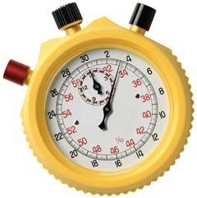
Exercise: Providing Real Time Feedback
Purpose
To practice providing feedback to a colleague
Overview
Within each group, one volunteer stands facing the others in the group.
Place an empty container 3 to 5 feet behind the volunteer—out of view of the volunteer
The volunteer tosses crumpled balls of paper into the container behind him/her without looking, aiming to get 3 in. Group members provide feedback to guide the volunteer. Repeat exercise with a new volunteer—move box to a different position for the new volunteer
TIME
15 minutes
Notes:
4

Slide 5
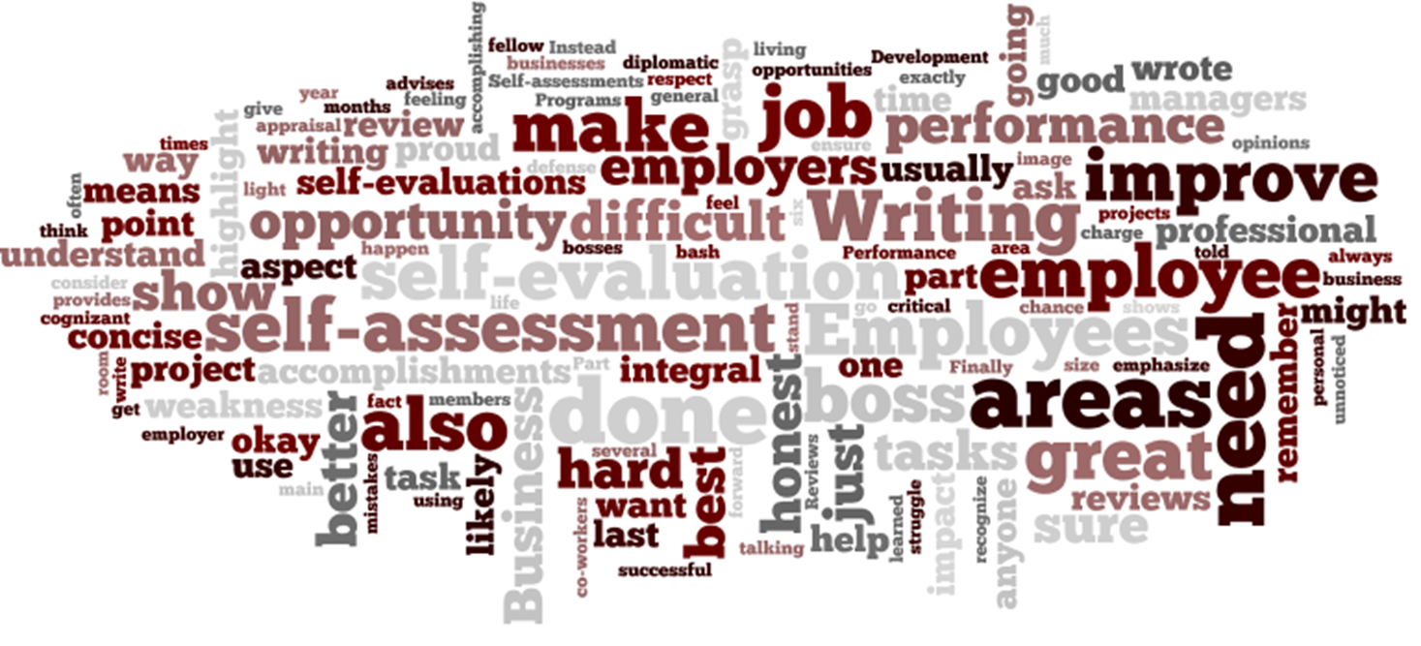
Feedback is the purposeful sharing of observations about job performance or work-related behaviors to continue good results or facilitate change or improvement

Slide 6
Performance Management Cycle
I. Performance Planning/ Expectation Setting
III. End of Year Evaluation
End of Year Evaluation
Summarize critical goals and achievements
Establish overall rating based on performance throughout the year
II. Ongoing Review and Feedback
6

Slide 7
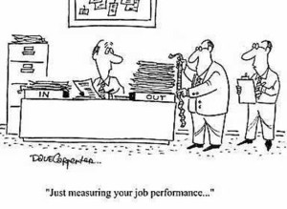
Tips for Documenting
Provide the details
Give specific examples
Include outcomes
Describe “how”
“Just Measuring your job performance…”

Slide 8
Wording
What you say?
How you say it?
Clear & Concise
Articulate the impact
Use examples
Provide specifics
Address the Impact
Make sure to highlight the effect on all parties involved
Engage in a dialogue
Ask the person to comment
Articulate what’s done well
How to leverage strengths
Don’t sugarcoat what’s not
Identify improvement areas

Slide 9
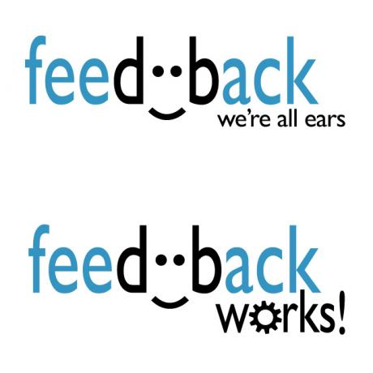
Fishbowl Role Play

Slide 10
Delivering the Review
Preparing
Review the appraisal
Practice your points
Think about the impact
Remember how you feel during your appraisal
In Practice
It’s about the employee
Conversational
Address the entire year
No surprises
Plan for next year
http://www.lynda.com/Business-Business-Skills-tutorials/How-give-great-feedback/141501/158984-4.html

Slide 11
Summary
Feedback is a critical component of performance
Ongoing feedback is the best way to coach others
Focus on desired future

Slide 12
Resources
lynda.com – accessed through myNEU
Communication Fundamentals
Section Four: Managing Common Communication Challenges
How to give great feedback: 7 minutes
Coaching and Developing Employees
Section Two: Building Your Coaching Skills
Giving Future Focused Feedback : 2 ½ minutes
HRM
For Managers – Performance Mgt.
Copies of previous presentations, forms, tips
Discussion & Practice - we’re here to assist you with this!
Reach out to your HRM Consultant or Arlene Walsh or me with any questions.

