Slide 1

Object-oriented design Pattern
Java CoP 2018.06

Slide 2
What we will do … ?
What is design pattern… ?
Before going into design pattern
- Basic concept of object-oriented programming
(inheritance, polymorphism, delegation(??))
Types of design patterns
Design pattern hands-on practice
- Singleton design pattern
- Factory pattern & factory method pattern
- Adapter pattern

Slide 3
What is a design pattern ?
Reusable solutions to commonly occurring problems in many different situations
-> Not only for Java! Also for other programming language, infrastructure.
-> but we focus OOP language(because of java CoP)
Not a finished design or programming language
-> It cannot be transformed directly into source code.
-> Helps the developer in getting to the right design faster!

Slide 4
Advantage of Design Patterns
Reliable
- Design pattern allows objects to have isolated behavior and responsibility
- Easily make changes to one part without affecting other parts
Reusable, Maintainable, Extendable
- Design patterns make use of object-oriented language features, you can reuse objects in many different programs
- Inheritance allows to extend existing objects
- Polymorphism allows to write generic code
Timely
- Design pattern can model a problem at functional level, not at the implementation level.
- With design pattern, you can break down a solution into several objects , then the development of each piece can go on in parallel.

Slide 5
Basic concept of OOP (1) (Object-oriented programming)
Inheritance
- inheritance enables new objects to take on the properties of existing objects.
- A class that is used as the basis for inheritance is called super class or base class
- A class that inherits from a superclass is called a subclass or derived class.
Overriding
Declaring a method in sub class which is already present in parent class
The benefit : ability to define a behavior that's specific to the subclass type,

Slide 6
Basic example of inheritance & overriding
We have a employee class
- properties : firstName, lastName, salary
Now we need to create the new manager class but difference is only to add new property “bonus”
What should we do ???
Bonus
Only for him!

Slide 7
Basic concept of OOP (2) (Object-oriented programming)
Polymorphism
Polymorphism means …
- a state of having many shapes
- the capacity to take on different forms
- It allows us to perform a single action in different ways.
- Give us an ability to process objects of various types and classes through a single, uniform interface

Slide 8
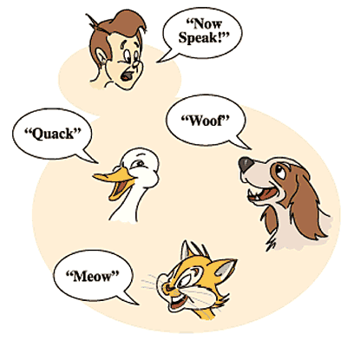
Basic example of polymorphism
We want all animals to speak, but each animal has different speaking pattern.
What should we do ?

Slide 9
How to implement… ?
Polymorphism
Polymorphism
Interface method Speak()
Save to List of Animals!!!

Slide 10
Types of polymorphism
Polymorphism in Java has two types:
Compile time polymorphism (static binding / Ad hoc polymorphism/ function overloading)
Runtime polymorphism (dynamic binding / Inclusion polymorphism / subtyping) <- Our example!!!
Parametric Polymorphism (generics)

Slide 11
Basic concept of OOP (3) (Object-oriented programming)
Delegation (we learn though the adapter design pattern)

Slide 12
Type of design patterns

Slide 13
Creational design patterns
How objects can be created
Singleton
Factory Method
Factory
Abstract Factory
Object pool
Prototype
etc..

Slide 14
Structural design patterns
Describe best relationship among different objects to achieve a design goal!
- How subclass and classes interact through inheritance
- How different objects have relationship
**Like foodparing. Such as wine & cheese, coffee & sugar, seaweed & rice etc..
Adapter
Proxy
Bridge
Decorator
Facade
Flyweight Composite
etc…

Slide 15
Behavioral design patterns
Describe how independent objects work towards a common goal!!
- How each object does a single cohesive function and responsibility
**Like building construction. Design team, financial advisors, procurement, construction, handover etc..)
Observer
Template method
Visitor
Chains of responsibility
Command
Interpreter
Meditetor
etc…

Slide 16
The Singleton design pattern
Intent
- To ensure that only one instance of a class is allowed within a system
Provide a global point of access to the object
Examples
Logger Classes
Configuration Classes
Accessing resources in shared mode

Slide 17
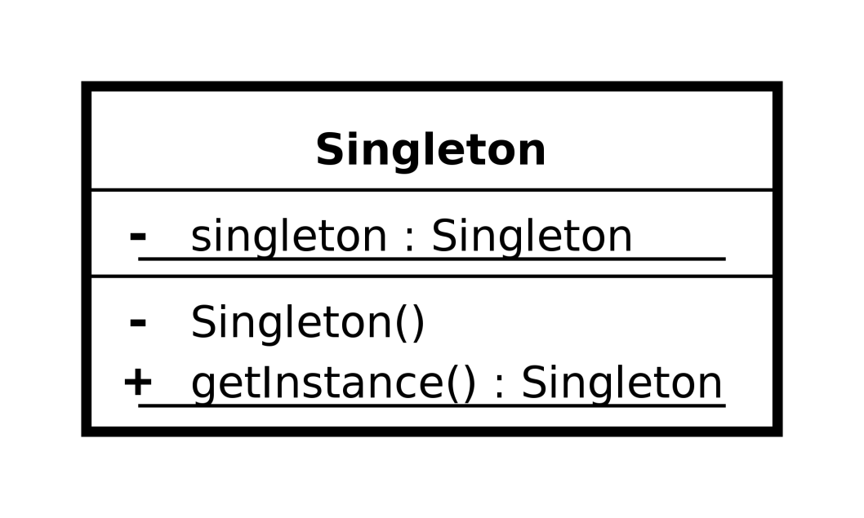
The Singleton design pattern
Implementation (UML)
Object creation can’t be done outside the class itself
-> Therefore constructor must be private!!!

Slide 18
The Factory & factory method design pattern
Intent
- Create objects without exposing the instantiation logic to the client
Refers to the newly created object through a common interface / super class (Polymorphism)
Examples
Defining a “virtual” constructor
The “new” operator considered harmful
Get DB Connections, XML Parsers without being aware of actual implementation

Slide 19
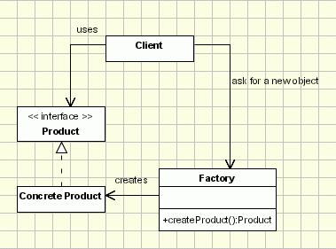
The Factory pattern
One static method to create a concrete object based on the condition

Slide 20
Example : The factory pattern
We have several data sources to retrieve data. Each data source has different interfaces and accessor.
- Database, SOAP, RestFul
We want to get data from these data sources at runtime
What should we do ???

Slide 21
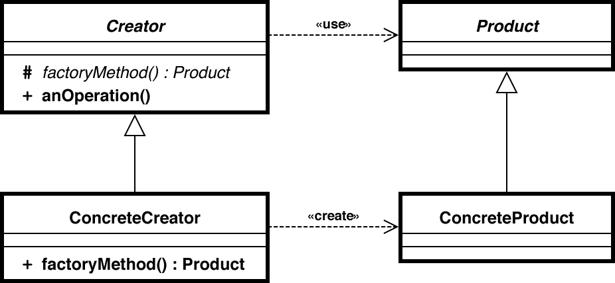
The Factory method pattern
- Factory method -> a simple method used to create objects in a class
Example to see how effective this pattern

Slide 22
Example : The factory method pattern
We have several data sources to retrieve data. Each data source has different interfaces and accessor.
- Database, SOAP, RESTful
We want to get data from these data sources at runtime
After retrieving data, each data should be saved into the corresponding log file.
- Database : database.log , SOAP : soap.log, RESTful : rest.log
What should we do ???

Slide 23
The adapter pattern
Intent
To convert the interface of a class into another interface
To let two or more classes with incompatible interface work together
To wrap an existing class with a new one
Examples
A wrapper of a complex Java library in order to expose only the APIs that you need in your system
A class uses a native library/system, but you want to mask it and show a more straightforward design or function

Slide 24
Example : the adapter pattern
We want to create a print function for specific contents
(print method)
To get contents to print, existing components should be used.
(Hello : to print “hello”, GoodBye : to print “goodbye”)
What should we do ???

Slide 25
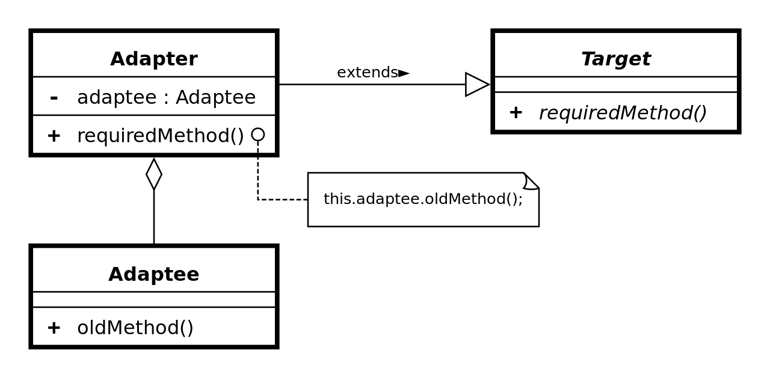
The Adapter pattern (delegate)

Slide 26
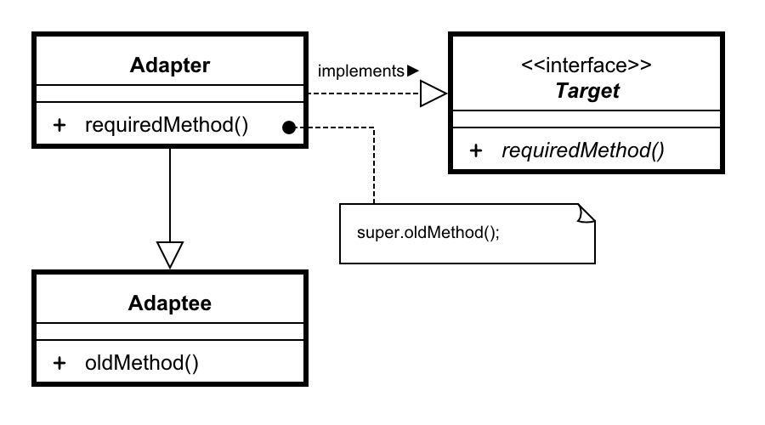
The Adapter pattern (extend)

Slide 27

Thanks a lot ☺

