Slide 1

Harnessing the Power of Redis
Tanner Varrelman | RCDS | University of Idaho

Slide 2
Agenda
Introduction to Redis and in-memory databases
Redis data structures
Benefits of Redis
Installation
Connecting to Redis
Code example in Python

Slide 3


What is Redis?
Redis is an in-memory database that is often used as a:
cache*
vector database
document database*
Notable companies that use Redis:
GitHub, StackOverflow
* indicates use cases that we explore via code

Slide 4
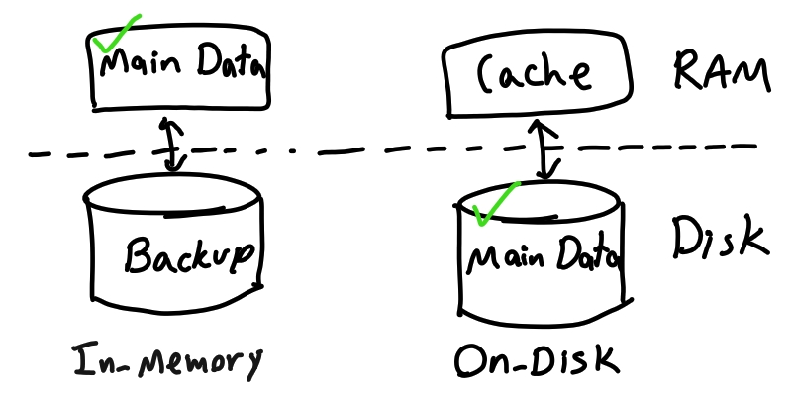
In-Memory Databases
Why in-memory databases?
In-memory databases eliminate the need to query data from disk, which results in faster response times.
https://www.mydistributed.systems/2020/07/an-overview-of-storage-engines.html

Slide 5
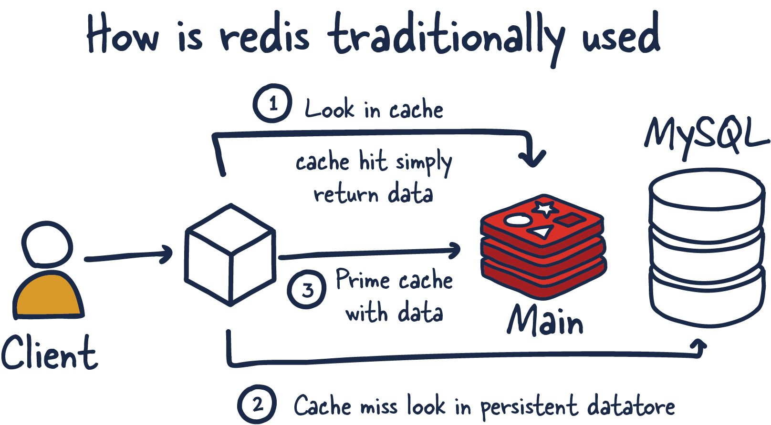
Data Cache*
Source: https://architecturenotes.co/redis/

Slide 6
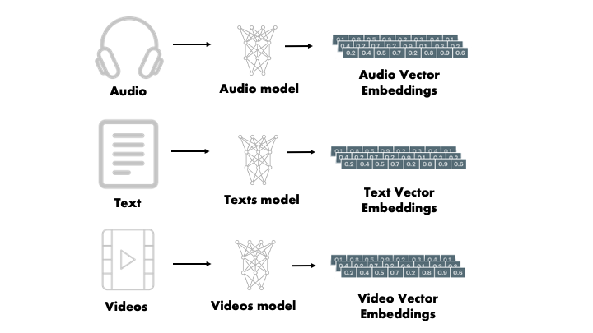
Vector Database
A vector database stores vector embeddings
Embeddings are the numeric representation of words, sentences, etc.
Redis supports the storage and searching of these vector embeddings
Source: https://mlops.community/vector-similarity-search-from-basics-to-production/
Full example in Python:
https://redis.io/docs/get-started/vector-database/

Slide 7
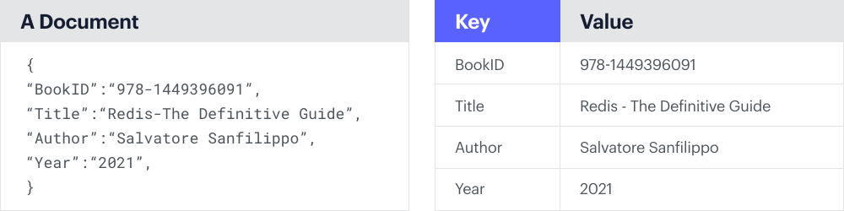
Document Database*
Source: https://redis.com/nosql/document-databases/

Slide 8
Redis Data Structures
Key-value data model.
Supports lists, hashes, sets, sorted sets, and geospatial indices.
With additional modules, redis can support storage and indexing of JSON structures.

Slide 9
Why Redis?
Flexible data model
Much faster than traditional databases
Allows for fast geographic queries
Open source
Python client so we can easily connect to our data!!

Slide 10
Getting Started
Can be downloaded via apt, brew, or the official docker image.
(https://redis.io/docs/install/install-redis/)
I prefer the Redis Stack docker image:
https://redis.io/docs/install/install-stack/docker/
Contains additional modules such as Redis Search and Redis JSON.

Slide 11
Getting Started
To connect to a Redis database, you can use one of the community-driven clients.
(https://redis.io/docs/connect/clients/)
Today’s examples we will use redis-py in Python
You can also connect to the database directly with the command line interface

Slide 12

Python Code

