Slide 1
B A C K U P · S U P P L E M E N T A R Y M A T E R I A L
Backup Slides
Ordered to follow the main presentation: simulation core, perception, concepts, the generative stage, evidence.

Slide 2


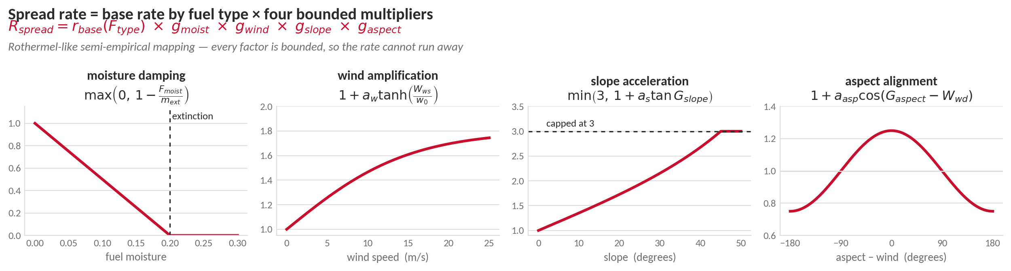
SIMULATION FRAMEWORK : SIMULATION CORE
Inside the Spread Rate
Base rate is set by the fuel type
grass 2.00, shrub 0.80, pine litter 0.80, hardwood 0.30 cells per step
one cell per step is 3 m/min at 90 m cells and 30 min steps
Every multiplier is bounded
wet fuel damps to zero, wind saturates, slope is capped at three
parameters calibrated per fuel type, not fitted to the fires we predict
Notes:
EXPLAIN — this is where the Rothermel heritage sits. The spread rate is a semi-empirical product: a base rate set by fuel type, multiplied by moisture damping, wind amplification, slope acceleration and aspect-wind alignment (Appendix A, equations 76 to 81).
Moisture damping is max(0, 1 - moisture / extinction moisture): at the extinction threshold the spread rate is exactly zero, so wet fuel stops the fire without a special case.
Wind amplification is 1 + a_w tanh(wind / w0). The tanh saturates, so doubling an already strong wind does not double the spread rate; this is what keeps the model stable under extreme forcing.
Slope acceleration is min(3, 1 + a_s tan(slope)) - uphill preheating, capped at three so steep terrain cannot produce an unbounded rate. Aspect alignment is 1 + a_asp cos(aspect - wind direction): terrain facing into the wind spreads faster, terrain facing away spreads slower.
The output is expressed in normalised cells per step rather than metres per minute. At the reference discretisation (90 m cells, 30 min steps) one cell per step equals 3 m/min, so the base rates carry a direct physical reading.
Per-fuel-type parameters are on the backup slide: base rate, extinction moisture, wind, slope and aspect coefficients, calibrated against standard fire-behaviour literature rather than fitted to the fires being predicted.

Slide 3
BACKUP · APPENDIX A
Rate of Spread : the Rothermel-like Semi-Empirical Mapping
A grid-consistent, DSS-oriented abstraction inspired by semi-empirical fire-behavior models (Rothermel, 1972): output in normalized cells-per-step, every factor tied to an already-defined state or input.
$$R_{spread,k} \left(x,y\right)=r_{base} \left(F_{type}\left(x,y\right)\right)×g_{moist}\left(x,y\right)×g_{wind}\left(x,y\right)×g_{slope}\left(x,y\right)× g_{aspect}\left(x,y\right)$$
Moisture damping: spread is suppressed at the extinction threshold $m_{ext}$; the max(0, ·) keeps rates non-negative.
Wind: tanh saturation, scaling constant 10 m/s — amplification grows but stays bounded in extreme wind.
Slope: preheating on the upslope side; capped at ×3 so near-vertical DEM cells do not diverge.
Aspect–wind alignment: cos(·) ≈ 1 accelerates, opposed wind decelerates.
$$g_{moist}\left(x,y\right)=\max\left(0,1−\frac{F_{moist,k}\left(x,y\right)}{m_{ext}\left(F_{type}\left(x,y\right)\right)}\right)$$
$$g_{wind}(x,y)=1+a_{w}(F_{type}(x,y))⋅tanh\left(\frac{W_{ws,k}\left(x,y\right)}{w_{0}}\right)$$
$$g_{slope}\left(x,y\right)=\min\left(3, 1+a_{s}\left(F_{type}\left(x,y\right)\right)⋅\tan\left(G_{slope}\left(x,y\right)\right)\right)$$
$$g_{aspect}\left(x,y\right)=1+a_{asp}\left(F_{type}\left(x,y\right)\right)∙\cos\left(G_{aspect}\left(x,y\right)−W_{wd,k}\left(x,y\right)\right)$$
Fuel type | $$r_{base}$$ | $$m_{ext}$$ | $$a_{w}$$ | $$a_{s}$$ | $$a_{asp}$$
Grass | 2.00 | 0.15 | 25.0 | 2.0 | 0.30
Shrub | 0.80 | 0.20 | 15.0 | 2.0 | 0.25
Pine litter | 0.80 | 0.25 | 6.0 | 2.2 | 0.20
Hardwood | 0.30 | 0.30 | 4.0 | 1.8 | 0.15
Calibration. At 90 m cells and 30 min steps, one cell/step = 3 m/min, so the base rates carry a metric reading and reproduce benchmark head-fire rates: grass tens of m/min, shrub 5–10, litter 2–4, hardwood < 1. Other discretizations rescale by (90 m/$Δx$)·($Δt$/30 min).
Notes:
EXPLAIN — Backup - Appendix A: the full Rothermel-like spread formulation (base rate x moisture x wind x slope x aspect) with the fuel-type calibration table and the metric interpretation (1 cell/step = 3 m/min at 90 m / 30 min).

Slide 4
BACKUP · APPENDIX B
Fuel Mass Evolution : Combustion Consumption
The consumption ratio is not a stored state: it is computed algebraically each step as a bounded function of fuel type and surface moisture.
$$F_{burn,k}\left(x,y\right)={sat}_{\left[0 , 1\right]}\left(b_{base}\left(F_{type}\left(x,y\right)\right)⋅\left(1−F_{moist,k}\left(x,y\right)\right)\right)$$
Calibration. Coefficients are chosen so that, in dry conditions without suppression, fuel mass falls significantly over several steps without numerical instability.Structural differences — density, packing ratio, heat release — are abstracted into the fuel-dependent coefficient rather than modeled separately.
$b_{base}$ is the baseline combustion coefficient of the fuel class — a fraction of fuel consumed per step, calibrated to the time resolution, not a universal constant.
The linear moisture factor sends the burn fraction to zero as moisture approaches one; the saturation operator keeps the ratio in [0, 1].
Fuel type | $b_{base}$ (per step) | Typical burn duration
Grass | 0.85 | short, fast consumption
Shrub | 0.35 | moderate consumption
Pine litter | 0.15 | sustained surface burn
Hardwood | 0.08 | slow combustion
Notes:
EXPLAIN — Backup - Appendix B: combustion consumption - the algebraic burn fraction with per-fuel baseline coefficients.

Slide 5
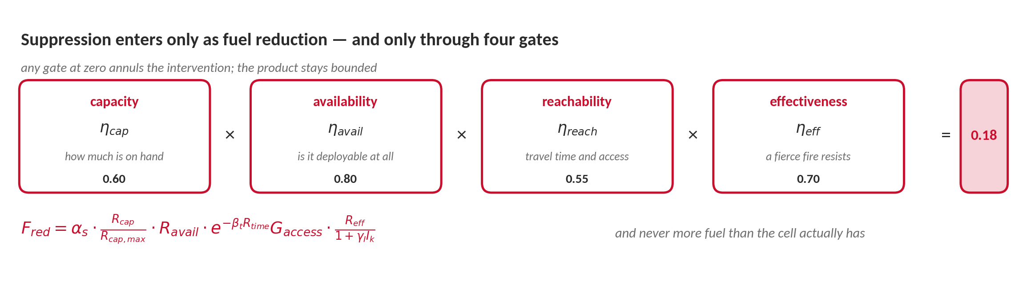
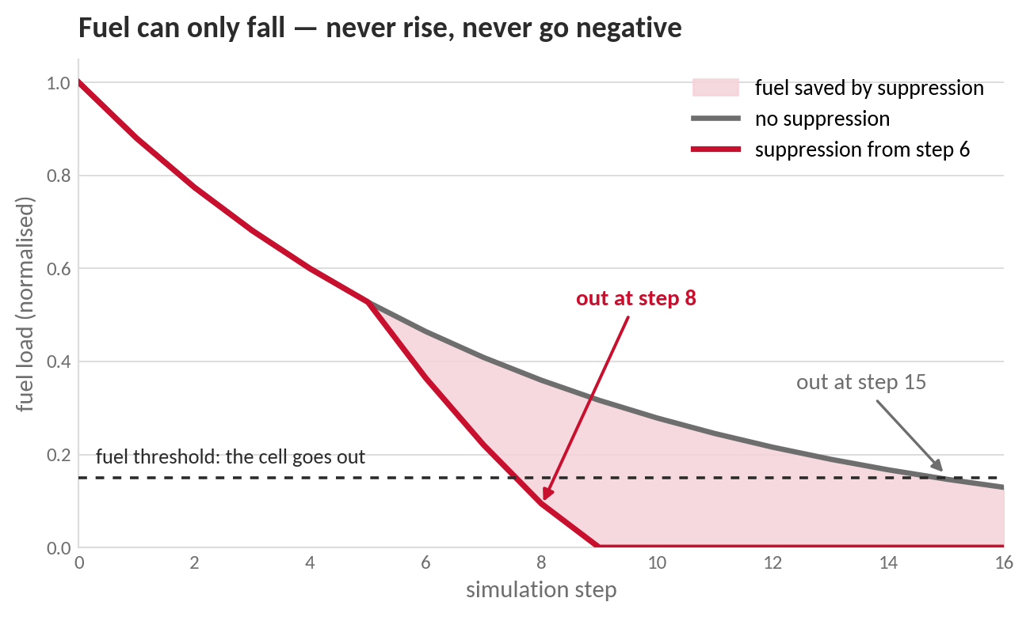
SIMULATION FRAMEWORK : SIMULATION CORE
How Suppression Reaches the Fire
the decision layer never touches the physics: it only lowers fuel, through gates that can each veto it
Notes:
EXPLAIN — fuel mass is the only channel through which the decision layer touches the physics. Fuel falls by combustion (a fuel-type fractional burn rate, damped by moisture) minus a suppression-driven reduction, and the result is floored at zero: fuel can never rise and never go negative.
The suppression map (Appendix B, equations 83 to 88) is a product of four gates, each in [0,1]: capacity (how much of the maximum is actually on hand), availability (whether the resource is deployable at all), reachability (exponential decay in travel time, scaled by terrain accessibility), and effectiveness (nominal efficiency divided by 1 + gamma_I times current intensity).
Because the gates multiply, any single zero annuls the whole intervention. Resources that exist but cannot deploy, or that arrive too late, or that face inaccessible terrain, produce no fuel reduction at all. This is the formal statement of 'orders must be operationally feasible, not merely optimal'.
The effectiveness gate encodes an operational fact: a fierce fire resists suppression, so as intensity rises the marginal impact of the same resource falls.
A final saturation rule caps the reduction at the fuel actually present, which keeps the fuel state non-negative and consistent with the evolution equation.
WORKED EXAMPLE on the slide: gates 0.60 x 0.80 x 0.55 x 0.70 give 0.18 - the same crew delivers less than a fifth of nominal effect once distance and fire behaviour are accounted for. The curve shows the consequence: with suppression from step 6 the cell falls below the fuel threshold at step 8 instead of step 15.

Slide 6
BACKUP · APPENDIX B
Suppression Mapping : Five Multiplicative Factors
$$F_{red,k}\left(x,y\right)=α_{s}⋅η_{cap,k}⋅η_{avail,k}⋅η_{reach,k}\left(x,y\right)⋅η_{eff,k}\left(x,y\right)$$
$α_{s}$ — global gain: how strong one step of suppression can be; dimensionless fraction per step.
Capacity and availability — magnitude vs a strict necessary condition: undeployable resources contribute zero.
Reachability — exponential decay with travel time ($β_{t}$, reference 0.03 per minute) times static terrain access.
Effectiveness — high intensity resists suppression ($γ_{I}$): the denominator grows with the current-state intensity.
Saturation: reduction never exceeds the remaining fuel load — no negative fuel states.
$$η_{cap,k}=\frac{R_{cap,k}}{R_{cap,max}}$$
$$η_{avail,k}=R_{avail,k}$$
$$η_{reach,k}\left(x,y\right)=exp\left(−β_{t} R_{time,k}\left(x,y\right)\right)⋅G_{access}\left(x,y\right)$$
$$η_{eff,k}\left(x,y\right)=\frac{R_{eff,k}\left(x,y\right)}{1+γ_{I} I_{k}\left(x,y\right)}$$
$$F_{red,k}^{raw}\left(x,y\right)=α_{s}⋅\left(\frac{R_{cap,k}}{R_{cap,max}}\right)⋅R_{avail,k}⋅\exp\left(−β_{t}R_{time,k}\left(x,y\right)\right)⋅G_{access}\left(x,y\right)⋅\frac{R_{eff,k}\left(x,y\right)}{1+γ_{I}I_{k}\left(x,y\right)}$$
Parameter | Typical range | Effect when increased
Global gain $α_{s}$ | 0.01 – 0.30 | stronger mitigation per step
Travel-time decay $β_{t}$ | 0.01 – 0.10 /min | faster decay of effectiveness with delay
Intensity resistance $γ_{I}$ | 0.5 – 5.0 | intense fires progressively harder to suppress
Each factor enters multiplicatively: vanishing capacity, availability, or reachability annuls the mitigation; intensity attenuates it; the product stays bounded for discrete-time simulation. Calibration: historical response data, doctrine constraints, or structured sensitivity analysis.
Notes:
EXPLAIN — Backup - Appendix B: the suppression mapping - five multiplicative factors (gain, capacity, availability, reachability, effectiveness) with calibration ranges; the only channel through which orders touch fuel.

Slide 7
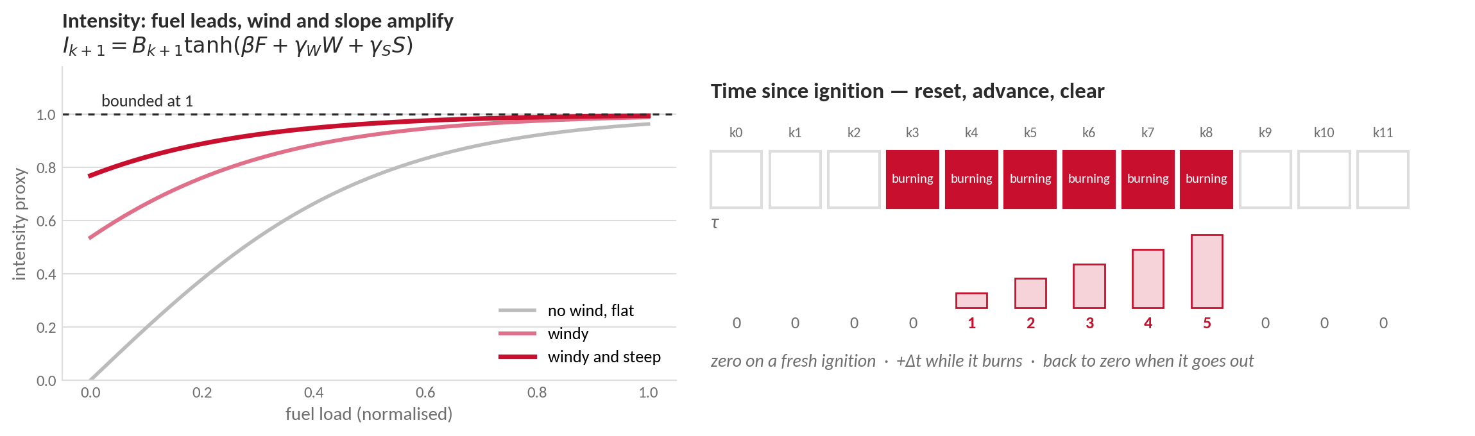
SIMULATION FRAMEWORK : SIMULATION CORE
Intensity and the Clock
Intensity is an ordinal proxy, not flame physics
it ranks cells for priority and makes a fierce fire resist suppression
time since ignition feeds persistence, extinction and intensity, and costs nothing to keep
Notes:
EXPLAIN — intensity is a bounded proxy, not flame physics. It is the hyperbolic tangent of a weighted sum of normalised fuel load, wind and slope, multiplied by the burning status, so it lives in [0,1] and is zero wherever the cell is not burning (Appendix C, equations 89 and 90).
Fuel load leads the expression; wind and slope enter as amplifying modifiers with smaller weights (beta = 2.0, gamma_W = 0.5, gamma_S = 0.3). The bound matters: intensity is used for ordinal prioritisation across cells and for the suppression resistance term, so what is needed is a consistent ranking, not a calibrated kilowatt per metre.
Time since ignition is pure bookkeeping: zero on a fresh ignition, advanced by one step while the cell keeps burning, cleared when the cell goes out. It costs one number per cell and supports persistence, extinction timing and the intensity dynamics.
If asked why intensity is not a physical fireline intensity: the decision layer never needs an absolute energy value, only a comparable severity across cells within the same run, and a bounded quantity keeps the suppression resistance term well behaved.

Slide 8
BACKUP · APPENDIX C
Fire Intensity Proxy : Normalized, Bounded, Interpretable
A bounded indicator of local combustion strength — not flame temperature. Used for suppression resistance, risk prioritization, decision-layer features, and visualization.
$${\tilde{F}}_{k}\left(x,y\right)=\frac{F_{load,k}\left(x,y\right)}{F_{load,\max{}}}$$
$${\tilde{W}}_{k}\left(x,y\right)=\frac{W_{ws,k}\left(x,y\right)}{W_{ws,\max{}}}$$
$$\tilde{S}\left(x,y\right)=\frac{\tan\left(G_{slope}\left(x,y\right)\right)}{\tan\left(G_{slope,\max{}}\right)}$$
$$I_{k+1}\left(x,y\right)=B_{k+1}\left(x,y\right)∙\tanh\left(β\left({\tilde{F}}_{k}\left(x,y\right)+γ_{W}{\tilde{W}}_{k}\left(x,y\right)+γ_{S}\tilde{S}\left(x,y\right)\right)\right)$$
Inputs are normalized by their reference maxima (fuel load, 20 m/s wind, maximum terrain slope), so the proxy is scale- and resolution-consistent.
The burning-status factor forces zero intensity on non-burning cells; tanh bounds the proxy in [0, 1].
Fuel load remains the dominant contributor; wind and slope act as amplifying modifiers.
 | Range | Value | Interpretation
$β$ global gain | 1 – 3 | 2.0 | moderate amplification
$γ_{W}$ wind weight | 0 – 0.7 | 0.5 | wind moderately increases intensity
$γ_{S}$ slope weight | 0 – 0.5 | 0.3 | slope has secondary influence
Why a proxy: the decision layer needs a stable, comparable severity signal across cells and scenarios — not a heat-flux model. Suppression effectiveness reads this proxy at the current state, before the transition, so mitigation decisions rest on observable conditions.
Notes:
EXPLAIN — Backup - Appendix C: the fire intensity proxy - normalized inputs, tanh bound, parameter table; why a proxy rather than heat flux.

Slide 9
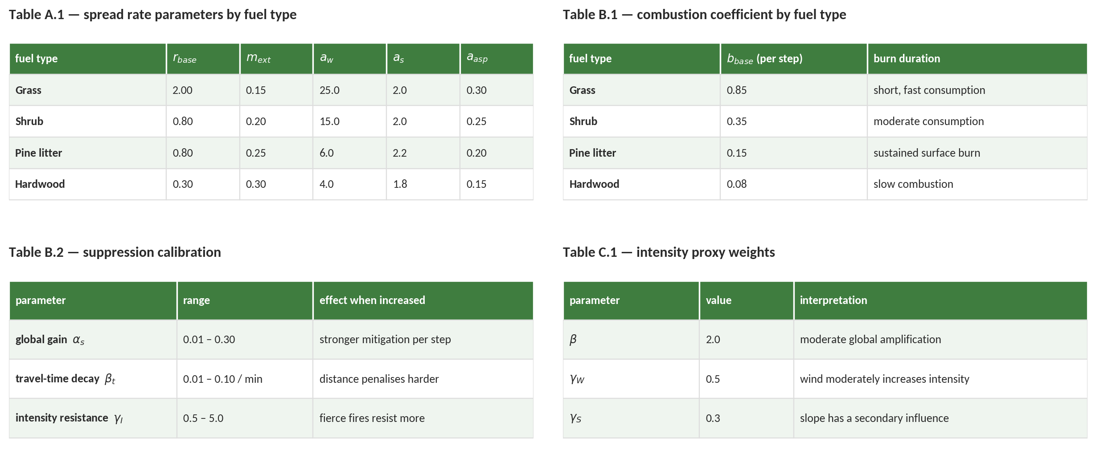
BACKUP
Calibration of the Simulation Core
parameter values behind the spread rate, the burn rate, the suppression map and the intensity proxy
Notes:
BACKUP — parameter tables from Appendices A, B and C.
Table A.1 (spread rate): base rate in cells per step, extinction moisture, and wind, slope and aspect coefficients per fuel type. Grass spreads fastest and dries first; hardwood is slow and tolerates the most moisture.
Table B.1 (combustion): the fraction of fuel consumed per step by fuel type, chosen to give realistic residence times at 30 min steps without numerical instability.
Table B.2 (suppression): the three calibration parameters and what happens when each is increased.
Table C.1 (intensity): the three weights of the intensity proxy.
All values are calibrated against standard fire-behaviour literature and operational doctrine, not fitted to the fires used for validation.

Slide 10
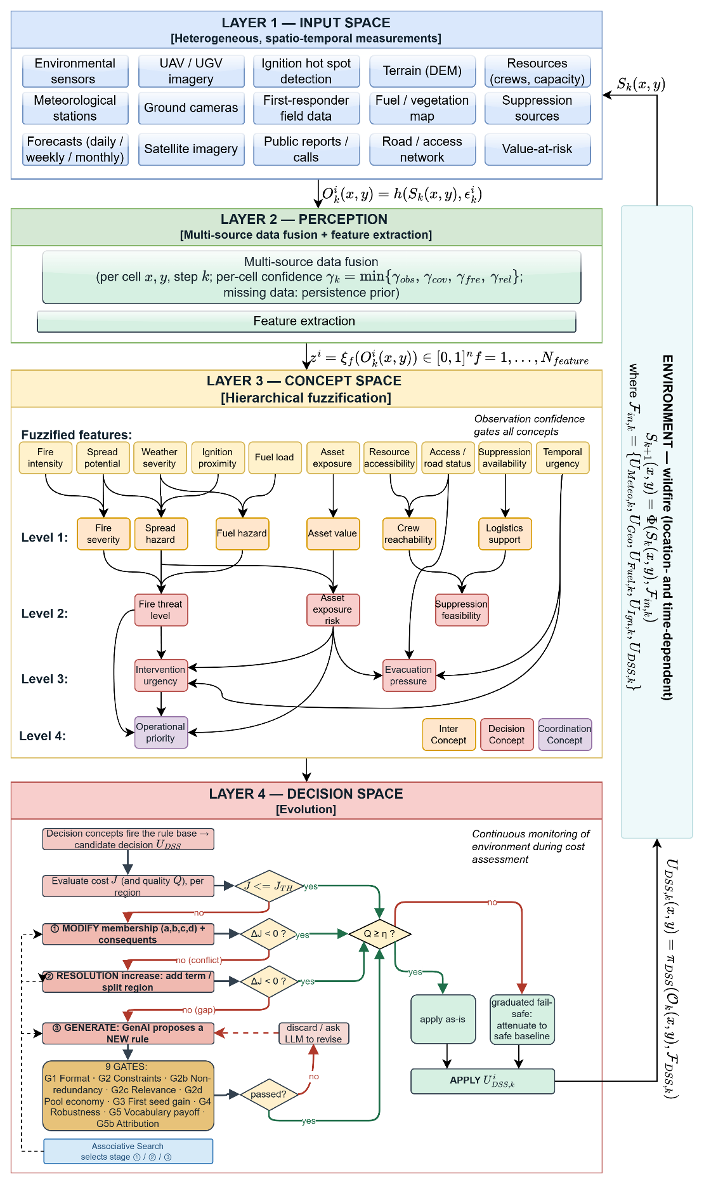
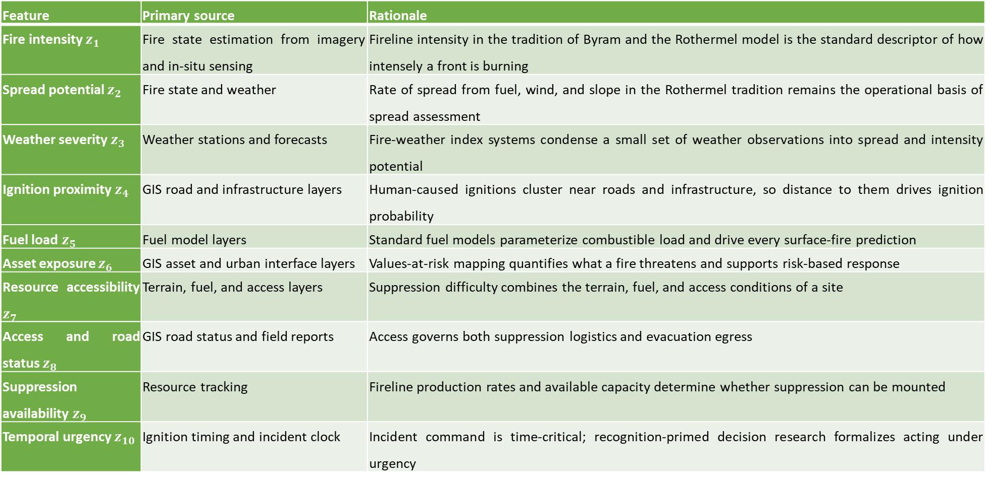
DSS FRAMEWORK : LAYER 2 OF 4
Layer 2 : Perception - Features with Explicit Confidence
Feature | Primary source | Rationale
Fire intensity $z_{1}$ | Fire state estimation from imagery and in-situ sensing | Fireline intensity in the tradition of Byram and the Rothermel model is the standard descriptor of how intensely a front is burning
Spread potential $z_{2}$ | Fire state and weather | Rate of spread from fuel, wind, and slope in the Rothermel tradition remains the operational basis of spread assessment
Weather severity $z_{3}$ | Weather stations and forecasts | Fire-weather index systems condense a small set of weather observations into spread and intensity potential
Ignition proximity $z_{4}$ | GIS road and infrastructure layers | Human-caused ignitions cluster near roads and infrastructure, so distance to them drives ignition probability
Fuel load $z_{5}$ | Fuel model layers | Standard fuel models parameterize combustible load and drive every surface-fire prediction
Asset exposure $z_{6}$ | GIS asset and urban interface layers | Values-at-risk mapping quantifies what a fire threatens and supports risk-based response
Resource accessibility $z_{7}$ | Terrain, fuel, and access layers | Suppression difficulty combines the terrain, fuel, and access conditions of a site
Access and road status $z_{8}$ | GIS road status and field reports | Access governs both suppression logistics and evacuation egress
Suppression availability $z_{9}$ | Resource tracking | Fireline production rates and available capacity determine whether suppression can be mounted
Temporal urgency $z_{10}$ | Ignition timing and incident clock | Incident command is time-critical; recognition-primed decision research formalizes acting under urgency
Notes:
EXPLAIN — Features with explicit confidence, part 1: the ten features listed with how each confidence is computed.

Slide 11
DSS FRAMEWORK : LAYER 2 OF 4
Layer 2 : Perception - Features with Explicit Confidence
fire intensity · spread potential · weather severity · ignition proximity · fuel load · asset exposure · resource accessibility · access / road status · suppression availability · temporal urgency
$$z_{f,k}^{i}=ξ_{f}\left(O_{k}^{i}\right)∈[0,1], f=1,…,N_{feature}$$
A quantity is admitted to the feature set only if it satisfies all four conditions:
1. ObservabilityComputable from what sensors and reports actually deliver — never from hidden simulator state.
2. BoundednessAdmits normalization to a fixed interval, so membership functions remain stable across scenarios.
3. Operational meaningAn expert can read it and phrase rules over it without translation.
4. Non-redundancyContributes discriminative information the remaining features do not already carry.
Why 10 feature set is sufficient?
Coverage: Every operational question has a supporting feature
Grounding: Each feature rests on cited wildfire science
Non-duplication: No feature repeats information carried by another.
Notes:
EXPLAIN — Features with explicit confidence, part 2: worked feature examples - observed vs effective values under the persistence prior.
The concept mappings require no further input, and the closed loop is exercised under biased parameters and degraded observation (S5).

Slide 12
BACKUP · APPENDIX D
The Complete Concept Wiring : Every Weight of the Hierarchy
Concept | Contributors | Weights $ω$
L1 fire severity | fire intensity, spread potential | 0.60, 0.40
L1 spread hazard | spread potential, weather severity, ignition proximity | 0.45, 0.35, 0.20
L1 fuel hazard | weather severity, fuel load | 0.40, 0.60
L1 asset value | asset exposure | 1.00
L1 crew reachability | resource accessibility, access & road status | 0.55, 0.45
L1 logistics support | suppression availability | 1.00
L2 fire threat level | fire severity, spread hazard, fuel hazard | 0.50, 0.30, 0.20
L2 asset exposure risk | spread hazard, asset value | 0.40, 0.60
L2 suppression feasibility | crew reachability, logistics support | 0.50, 0.50
L3 intervention urgency | fire threat level, asset exposure risk, temporal urgency | 0.40, 0.35, 0.25
L3 evacuation pressure | asset exposure risk, inverted access & road status, temporal urgency | 0.45, 0.25, 0.30
L4 operational priority | fire threat level, asset exposure risk | 0.55, 0.45
the full aggregation wiring of levels 1–4. Two constants close the layer : persistence decay $ρ = 0.90$ and coverage floor $α_{min} = 0.05$. The one exception in the wiring: evacuation pressure uses the complement of access & road status.
Notes:
EXPLAIN — Backup - Appendix D: the complete aggregation wiring of the concept hierarchy - every weight of levels 1-4, plus rho = 0.90 and alpha_min = 0.05.

Slide 13
BACKUP · APPENDIX D
Shared Five-Term Partition and Vector Semantics
Term | Trapezoid (a, b, c, d)
very low | (0.00, 0.00, 0.15, 0.30)
low | (0.15, 0.30, 0.35, 0.50)
medium | (0.35, 0.50, 0.55, 0.70)
high | (0.55, 0.70, 0.75, 0.90)
very high | (0.75, 0.90, 1.00, 1.00)
Membership is computed with vectors, exactly as in the code.Each input value fuzzifies into a five-term membership vector; the aggregation combines these vectors term by term. A concept activation is therefore a five-term vector, not a single number. Rule antecedents read the vector directly — the membership of a linguistic term is its matching component.A scalar is needed only three times: the priority sent to the coordinator, the quality measure, and reporting — the expected value over the term centers. The worked examples follow the highest component of each vector, which passes through the same weighted sums and is a faithful sample of the full computation.Per-pair term tables are not required; adaptation refines the shared partition by splitting terms where the field needs it.
one partition for all features and concepts, on the unit interval; the end terms saturate at the boundaries. Overlaps guarantee the coverage floor $α_{min} = 0.05$.
Notes:
EXPLAIN — Backup - Appendix D: the shared five-term trapezoidal partition and the vector semantics of membership (activation is a five-term vector; a scalar only for priority, quality, reporting).

Slide 14
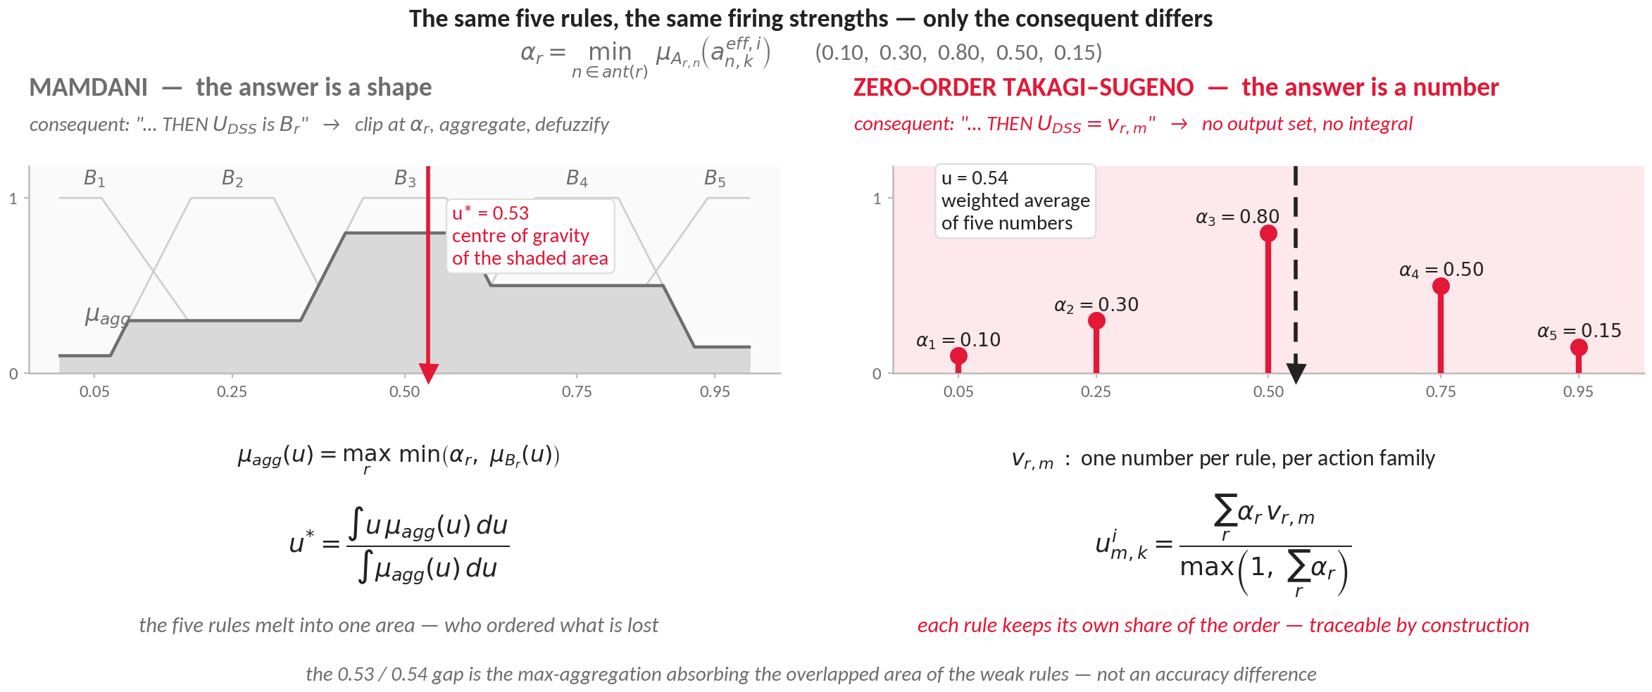
DSS FRAMEWORK : LAYER 3 OF 4
Layer 3 : Concept Space – Mamdani or Takagi–Sugeno
Both are fuzzy, and the conditions are identical — only the consequent differs: a word, or a number.
Both return about the same number. The difference is what survives the computation.
Notes:
EXPLAIN - both families are fuzzy and they share exactly the same antecedent side: the same five gated decision concepts, the same five-term trapezoidal partition, the same min-conjunction firing strength alpha_r. The only difference is the consequent - and that difference propagates through everything the framework does afterwards.
MAMDANI (left) - the consequent is a fuzzy set B_r: 'THEN U_DSS is B_r'. Each rule clips its output set at its own firing strength, the clipped sets are aggregated by max into mu_agg, and the crisp order is the centre of gravity of that area. Its genuine strength is linguistic output: it is the natural choice when the answer people want is a phrase.
ZERO-ORDER TAKAGI-SUGENO (right) - the consequent is a single number v_{r,m}: 'THEN U_DSS = 0.75'. There is no output set and no integral; the order is the activation-weighted average of those numbers, with the denominator floored at one so that weak evidence produces weak action instead of being renormalised back up to full strength.
READ THE FIGURE - the same five rules fire with strengths 0.10, 0.30, 0.80, 0.50 and 0.15. Mamdani clips the five output sets, aggregates and defuzzifies, returning 0.53. Takagi-Sugeno averages the five singletons 0.05, 0.25, 0.50, 0.75 and 0.95, returning 0.54.
WHY 0.53 AND NOT EXACTLY 0.54 - the two operators are different, so exact equality is not expected. Takagi-Sugeno averages only the peak positions. Mamdani takes the centre of gravity of an area, and three things move it: max-aggregation absorbs the overlapped parts (B1 sits almost entirely under the plateau of B2, B5 partly under B4, so those areas never count), the output sets have width so the centroid depends on areas rather than peaks, and the end sets are truncated at 0 and 1. Together these pull the centroid slightly left. The two would coincide exactly only for symmetric, equal-width, non-overlapping output sets. The gap of 0.005 is itself the argument: the choice is not about accuracy.
THE POINT - the two numbers are practically the same. The choice is therefore not about accuracy. It is about what is still available after the computation: on the left, one number and nothing else; on the right, one number plus the decomposition that produced it. The next slide turns that into three concrete requirements.
IF ASKED why the denominator is max(1, sum alpha_r) rather than sum alpha_r: with the usual normalisation, five rules firing at 0.05 would give the same order as five rules firing at 1.0. The unit floor removes that - weak evidence orders weak action.

Slide 15
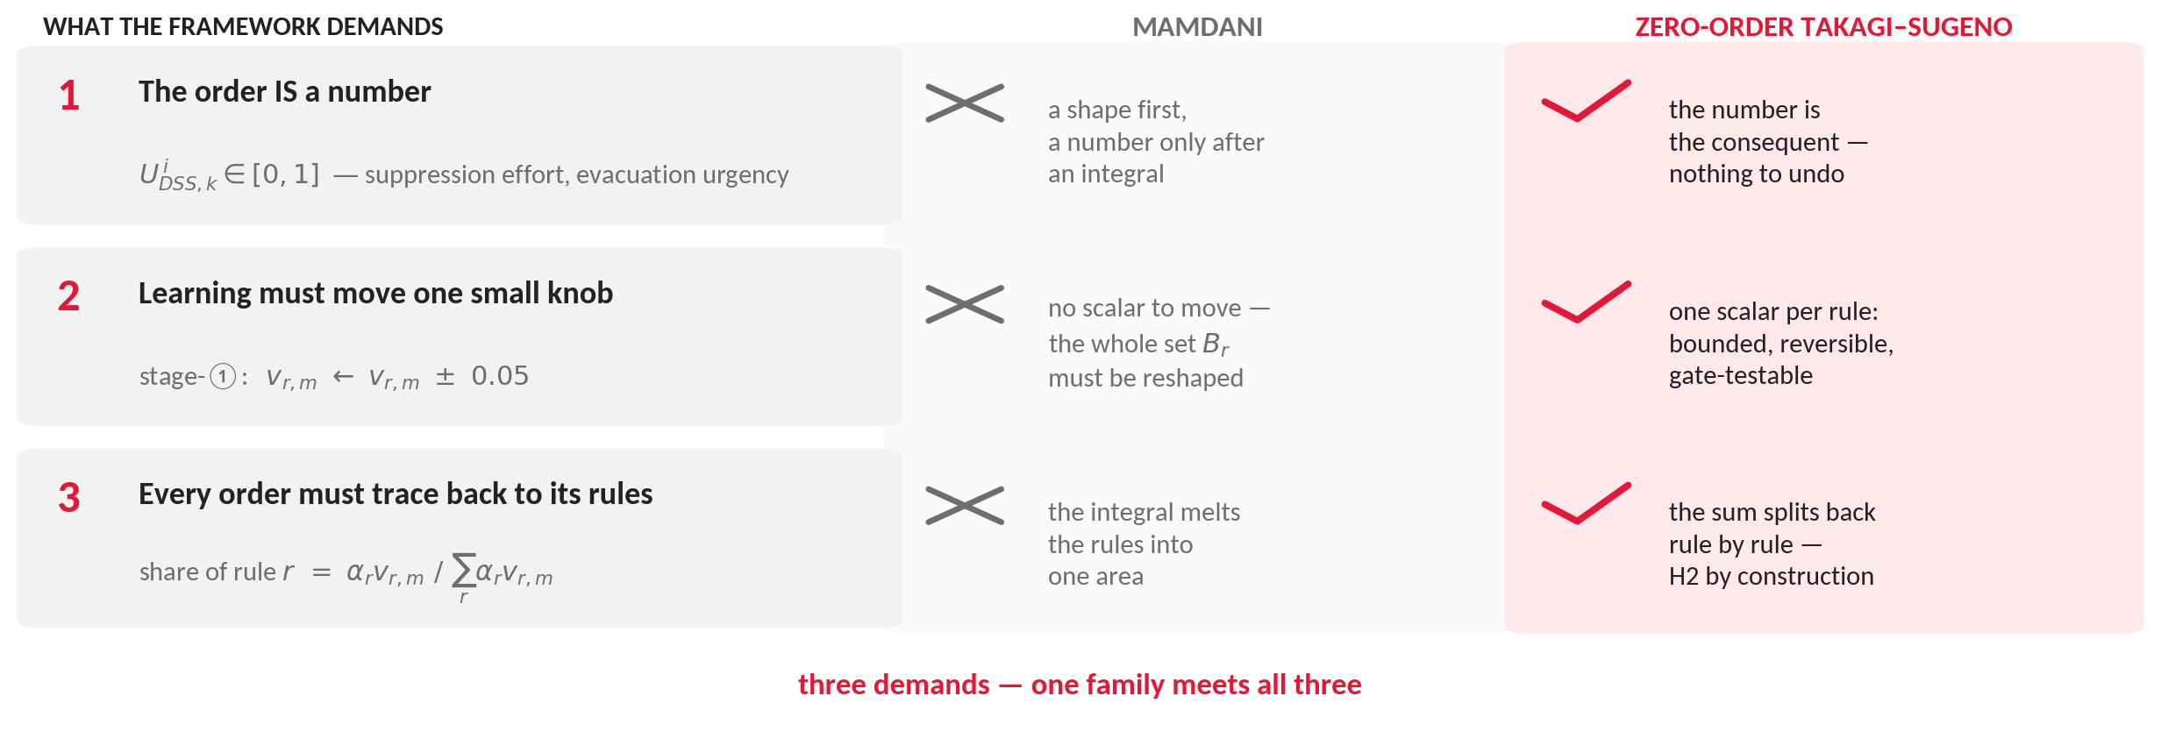
DSS FRAMEWORK : LAYER 3 OF 4
Layer 3 : Concept Space – Why Zero-Order Takagi–Sugeno
Three things the framework demands of the inference — and only one family gives all three.
The choice follows from the framework, not from taste.
Notes:
EXPLAIN - the three rows are not preferences, they are requirements the rest of the framework imposes. Take them one at a time and show that Mamdani fails each one for a structural reason, not a performance reason.
1. THE ORDER IS A NUMBER. The consequents here are numeric intervention intensities in [0,1] - suppression effort, evacuation urgency, resource commitment. Singletons are their natural form. Mamdani would wrap that number in an output set and then integrate it back out; the fuzzy output set is an artifact of the method, not a property of the problem.
2. ADAPTATION NEEDS A HANDLE. Stage-1 adaptation moves the singleton of the strongest-firing rules by plus or minus 0.05. The change is bounded, it is reversible, and it can be tested against the gate before it is kept. Mamdani has no scalar to move: tuning means reshaping a whole output set B_r, and the effect of that on any single order cannot be isolated or undone cleanly.
3. TRACEABILITY. Hypothesis H2 requires that every issued order be attributable to named rules with visible strengths. The weighted average is literally a sum of per-rule terms, so the share of rule r is alpha_r v_{r,m} divided by the total - it can be read off directly. The centroid integral destroys that: once the clipped sets are aggregated by max, which rule contributed what is no longer recoverable.
SAY IT PLAINLY - any one of these three would already be a strong argument. Together they leave one option. This is why the thesis does not present the choice as a matter of taste.
IF ASKED whether a Mamdani system could be made traceable by bookkeeping the rule strengths separately: you could record them, but the order itself would still not decompose into them - the centroid is a nonlinear functional of the aggregated shape, so the recorded strengths would be an annotation, not an explanation of the number that was issued.

Slide 16
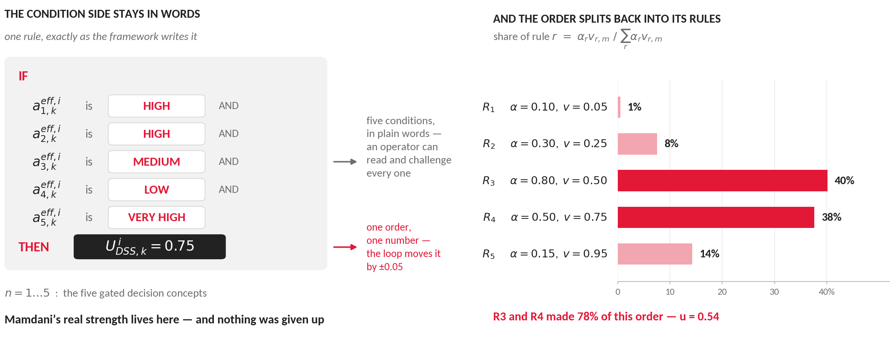
DSS FRAMEWORK : LAYER 3 OF 4
Layer 3 : Concept Space – What Is Not Given Up
The conditions stay in words. Only the order is a number.
Mamdani’s strength is kept exactly where it matters — on the condition side.
Notes:
EXPLAIN - the natural objection to Takagi-Sugeno is that it gives up the linguistic character of fuzzy control. This slide answers that objection directly: the linguistic content lives on the condition side, and the condition side is untouched.
LEFT - one rule exactly as the framework writes it. Five antecedents, one per gated decision concept, each compared against a linguistic term of the shared five-term partition. An operator can read the rule as a sentence and challenge any one of its five conditions. That is the property Mamdani is praised for, and it is fully present here.
Only the consequent is numeric - and that is precisely the half the framework needs as a number, because it is an intervention intensity that will be executed and, in the adaptation loop, moved by plus or minus 0.05.
RIGHT - the same worked example, decomposed. The share of each rule is alpha_r v_{r,m} over the sum, so for this order R3 contributes 40 per cent and R4 38 per cent: two rules account for 78 per cent of what was issued. That is the audit trail H2 asks for, produced by the arithmetic itself rather than by extra logging.
SAY IT PLAINLY - nothing linguistic was traded away. The conditions stay in words; only the output side became numeric, which is where the framework needed a number anyway.
IF ASKED about first-order Takagi-Sugeno: a linear consequent would add parameters per rule without adding operational meaning - the intensities are ordinal commitments, not regression targets - and it would weaken this very decomposition, since a rule's contribution would then depend on the input point as well as on its firing strength.

Slide 17
BACKUP · APPENDIX F
The Proposer Contract : One Fixed, Auditable Interface
Input — A deterministic situation summary — concept activations, observation confidence, recent cost trajectory, rule-base statistics, residual-cost location — plus the complete current vocabulary and an actuator library annotated with map availability (a water tactic on a dry map cannot be ordered by construction).
Output — Exactly one minified JSON object: one rule (≤ 3 antecedents, ≤ 3 consequents, intensities in [0, 1]) — optionally a package with exactly one new object (concept ≤ 4 inputs, macro ≤ 3 channels, or clause actuator over the seven verified effects × seven sectors) that the rule must use.
Discipline — No tools, no free text, 90-second wall-clock budget: a slow call is a skipped stage in the log, never a stalled cycle. Notation slips (a number where a term belongs) are repaired to the nearest term, and every repair is stamped into the rule's provenance note.
Authority — None. The physical basis is fixed — observation features, decision axes, seven verified effects — and every proposal passes gates G1–G5b before any order can be influenced by it. Model identifier and transport are pinned per campaign and recorded in every run log.
System instruction (abstract): "Propose a single candidate rule that reduces residual decision cost. Use only the concepts, interventions, terms, and map-available actuators given to you. A new clause actuator must compose only the verified effects, be drawn from real wildfire practice, and be named honestly. Output one minified JSON object — nothing else."
Notes:
EXPLAIN — Backup - Appendix F: the proposer contract - deterministic input, one-JSON output, 90-second discipline, zero authority.

Slide 18
BACKUP · APPENDIX F
Anatomy of the Standing Mission Brief (One Recorded Run)
Map affordances — 100 × 70 cells at 30 m; land cover shares; 206 water cells centred near (52,17) — "engines and aircraft can draft there, so sustained capacity near the water is real".
Assets by value and life — town of ~12 600 with hospital, power plant, water treatment (values 0.8–1.0); a village of ~3 150; one evacuation route — protection priorities: critical 0.40, population 0.25, building 0.20, evacuation 0.15.
The two weight sets — WHERE effort goes (protection priorities) vs WHAT counts as a bad outcome (loss weights of J: burn 0.29, asset 0.29, population 0.29, response 0.06, delay 0.06); trials are judged on the physical part.
Doctrine vs library — six seeded families — and the actuator library no seed rule orders (tactical_burn, water_drafting, retardant_drop): "discovering a use is your job", each with its real-fire caveat.
When to invent what — plain rule / new concept (recurring unnameable situation) / composite (two channels as one) / clause actuator (the tactic needs its own geometry) — "use only what THIS map supports".
Standing rules — every proposal must fire in the situation it is proposed for; orders must move a 45-minute forecast; a rejected proposal returns once with the failing gate named — fix exactly that.
Built once per incident, sent verbatim on every generative call of that run, and written to the run log for audit.
Notes:
EXPLAIN — Backup - Appendix F: anatomy of the standing mission brief of one recorded run - map affordances, assets, the two weight sets, doctrine vs library, when to invent what, standing rules.

Slide 19
DSS FRAMEWORK : LAYER 4 OF 4
Stage ③ in the Record : Admitted and Refused
ADMITTED, AND WHY IT WAS KEPT
REFUSED, WITH THE FAILING GATE NAMED
Rule G6 : IF fire threat ≥ HIGH AND feasibility VERY HIGH THEN head_knockdown 0.95, resource deployment 0.8. A generated rule ordering a generated macro.
Macro head_knockdown : drafting 1.0 + suppression 0.9 + retardant 0.6. Three channels the seed doctrine never ordered, acting as one.
Concept interface_exposure : 0.5 asset exposure risk + 0.5 evacuation pressure. Rule G14 fires on it to protect the urban interface.
Actuator lakeside_capacity_bridge : draft at the fire, draft at the head, evacuate behind. Written at minute 48, ordered again at minute 114 by a later, separately admitted rule.
G2b : proposed concept weights (0.60, 0.40) against an existing (0.62, 0.38): cosine near 1.0, a near duplicate.
G2c : a rule requiring spread potential HIGH while the reading is 0.15, inside LOW: it cannot fire now.
G2d : suppression 0.30 on top of a fully claimed budget: it would only re-divide committed capacity.
G3 : heavy deployment on a contained cell: the forecast physical cost does not fall.
G5 : seven actuators whose gain failed the margin on both futures: six changed nothing the forecast records, one raised the cost.
The record: 232 invocations, 47 admissions (36 rules, 11 packages). The dedicated actuator campaign: 35 proposals, 19 admissions, with the refusals at G3 (6), G4 (1), G5 (9).
Notes:
EXPLAIN - the gates in action, on real recorded objects. The left column is what entered doctrine and why it earned its place; the right column is what was turned away and which gate did it. Refusals are cheap where possible: the first four kinds cost no simulation.
ADMITTED - G6 and head_knockdown show the composed case: a generated rule ordering a generated macro, built on the action-list channels (drafting, retardant) that no seed rule ever ordered. interface_exposure is the one admitted concept, and G14 is the rule that fires on it. lakeside_capacity_bridge shows the vocabulary being used, not merely grown: a later rule, admitted separately, ordered the same actuator again at minute 114.
REFUSED - each example is from the thesis text. The G2b cosine near 1.0 is the near-duplicate concept; the G2c case cannot fire now, so it cannot answer the shortfall that called the stage; the G2d case adds no real effort on a spent pool; the G3 case helps nothing the physical forecast records; the G5 group is the actuator campaign, where six of seven refused tactics compiled to orders that touched nothing (an empty sector, a coating below extinction moisture, a spent pool) and one made things worse.
THE COUNTS - low acceptance is the intended behavior of a gated design: proposals are cheap and rejected safely on the forecast, and the selectivity of the gates is what makes the admitted edits trustworthy. About one in five proposals was admitted over the campaign.
IF ASKED where the numbers live - Table 5.12 for the products, Table 5.14 for the generative rules, Table 5.15 for the proposed and admitted counts by kind, Table 5.16 for the actuator definitions.

Slide 20
DSS FRAMEWORK : LAYER 4 OF 4
Gate by Gate : the preemptive_asset_coating Package
One admitted package, read gate by gate: coat the assets and the populated cells before the front arrives.
CHECKED FREE, NO SIMULATION
PAID WITH THE TWO ROLLOUTS
G1, format : the reply parses; one well formed JSON object.
G2, constraints : names from the fixed lists, amount in [0, 1], the antecedent cell unoccupied.
G2b, novelty : applies only to a new concept; not applicable to an actuator.
G2c, relevance : asset exposure risk VH is active exactly where residual cost sits.
G2d, economy : the coating fits inside the funded allocation.
G3, future a : the coated band holds the head fire off the assets; the forecast physical cost falls.
G4, future b : the same strict check on an independent seed; the gain is not an artifact of one future.
G5, payoff : both futures beat the margin δv = 0.0001; the growth pays.
G5b, attribution : with the actuator struck out, the cost rises on both; the payoff belongs to the actuator itself.
ADMITTED : the actuator enters the vocabulary with full provenance.
a refusal at a free gate is returned to the proposer once, with the failing gate named
a refusal that has already spent a rollout (G3 to G5b) ends the stage for this cycle
Notes:
EXPLAIN - one real admitted package, preemptive_asset_coating, walked through every gate in order. The point of the walk: five of the nine verdicts cost nothing at all, and the whole verification spends exactly two simulated futures.
THE FREE GATES - format, constraints, novelty, relevance, economy are algebraic checks against the reply, the vocabulary, the current reading, and the standing allocation. A failure here is returned to the proposer once, with the failing gate named, so the revision fixes exactly what failed.
THE PAID GATES - G3 and G4 are the two reseeded rollouts. G5 and G5b reuse those same two futures: G5 asks whether the growth beats the margin on both, G5b strikes the actuator out of its rule and asks whether the cost rises on both.
THIS PACKAGE - the actuator coats the assets and the populated cells before the front arrives, a preventive tactic with no counterpart in the seed doctrine: the base asset protection family raises a defensive posture but lays no retardant.
G2b ROW - shown as not applicable on purpose: the non-redundancy cosine applies only when the new object is a concept. Keeping the row makes the full chain visible for every kind of object.
IF ASKED why G5b was never the refusing gate in the campaign - the situation given to the proposer states that a new object must stand on its own, so packages did not arrive padded with ordinary orders, and the ablation was never put to work. That is reported as a fact of the campaign, not as a property of the gate.

Slide 21
BACKUP · APPENDIX E
Generative Rules Admitted over the Recorded Runs (G1–G13)
ID | IF (gated decision concepts) | THEN (intensities)
G1 | fire threat H ∧ feasibility VH | suppression 0.9; retardant drop 0.8; deployment 0.7
G2 | feasibility VH ∧ urgency VH | suppression 0.9; retardant drop 0.8; deployment 0.7
G3 | feasibility VH ∧ fire threat H ∧ urgency VH | suppression 0.95; retardant drop 0.85; deployment 0.9
G4 | feasibility VH ∧ urgency VH ∧ fire threat M | downwind_containment_shield 0.9; retardant drop 0.8; asset prot. 0.6
G5 | asset risk VH ∧ feasibility VH | downwind_retardant_shield 0.9; asset prot. 0.7; deployment 0.7
G6 | fire threat ≥ H ∧ feasibility VH | head_knockdown 0.95; deployment 0.8
G7 | feasibility VH ∧ fire threat ≥ H ∧ evac. pressure VH | wet_containment_line 0.9; deployment 0.8
G8 | feasibility H ∧ fire threat H | counterfire_strip 0.9; deployment 0.8
G9 | feasibility VH ∧ asset risk H ∧ evac. pressure H | suppression 0.9; water drafting 0.8; deployment 0.7
G10 | asset risk VH ∧ feasibility VH ∧ urgency VL | asset prot. 0.9; containment 0.8; retardant drop 0.7
G11 | feasibility VH ∧ asset risk VH ∧ fire threat VL | suppression 0.9; water drafting 0.8; deployment 0.8
G12 | feasibility VH ∧ asset risk VH ∧ evac. pressure VH | suppression 0.9; water drafting 0.8; retardant drop 0.7
G13 | feasibility VH ∧ asset risk VH ∧ urgency VH | suppression 0.95; water drafting 0.8; retardant drop 0.7
VL/L/M/H/VH terms; "≥ X" = satisfied at level X or above; intensities on [0, 1], reproduced verbatim from the store. Every rule remains permanently marked machine-proposed in its provenance trail.
Notes:
EXPLAIN — Backup - Appendix E: generative rules G1-G13 verbatim from the persistent store.

Slide 22
BACKUP · APPENDIX E
Generative Rules (G14–G20) and Admitted Vocabulary Objects
ID | IF | THEN
G14 | interface_exposure VH ∧ feasibility VH | asset prot. 0.90; containment 0.80; deployment 0.70
G15 | fire threat H ∧ asset risk VH ∧ feasibility VH | suppression 0.9; retardant drop 0.8; asset prot. 0.7
G16 | asset risk VH ∧ feasibility VH ∧ evac. pressure VL | containment 0.8; retardant drop 0.7; deployment 0.7
G17 | fire threat H ∧ feasibility L | containment 0.9; retardant drop 0.8
G18 | feasibility VH ∧ fire threat VL ∧ urgency VL | suppression 0.9; water drafting 0.8; containment 0.7
G19 | urgency H ∧ feasibility L ∧ asset risk H | retardant drop 0.9; containment 0.8; water drafting 0.7
G20 | asset risk H ∧ evac. pressure VH ∧ feasibility L | water drafting 0.9; suppression 0.8; retardant drop 0.7
Vocabulary objects with their recorded definitions (examples)
Kind | Name | Recorded definition
Concept | capacity_starved_head_pressure | fire_threat 0.50, urgency 0.30, feasibility 0.20
Concept | head_run_pressure | fire_threat 0.40, urgency 0.30, evac. pressure 0.20, feasibility 0.10
Concept | village_interface_pressure | urgency 0.40, evac. pressure 0.30, fire_threat 0.30
Macro | waterborne_relay_and_shelter | water_drafting 1.00, evacuation 0.60, public_warning 0.50
The seven admitted clause actuators are on the Discovered Tactics slide; a rule citing a name not listed here refers to an admitted object whose definition is recorded in the same lineage store.
Notes:
EXPLAIN — Backup - Appendix E: rules G14-G20 and the admitted vocabulary objects with recorded definitions.

Slide 23
BACKUP · SCOPE OF THE SENSITIVITY EVIDENCE
What Is Swept, What Is Fixed by Design
Swept — one bias at a time
Fixed and known for a run (by design)
Fire load (1–12 ignitions) and resource level (0.10–1.00) — the situational axes that locate the operating point
Local regions (1–16), attention threshold $τ_{att}$, no-harm horizon (45–90 min)
Satisficing bound $J_{TH}$ (0.15–0.60) and quality gate $η$ (0.30–0.90)
Observation coverage (1–9 sensors), decision cycle (2–20 min)
Loss weights of J: burn / asset / population 0.29 each; response / delay 0.06 each (1.0-1.0-1.0-0.2-0.2 normalized)
Protection priorities: critical 0.40, population 0.25, building 0.20, evacuation 0.15
The spread parameters of Appendix A — frozen at literature-calibrated values before any experiment
Why the priority and cost weights are not swept. They are doctrine, not loop parameters: the thesis states them as a fixed-and-known assumption of every run, and the sensitivity design biases the parameters of the decision loop around one operating point. A bias of the objective itself — different loss weights, different protection priorities, a mis-specified fuel map or wind field — changes what "good" means rather than how well the loop pursues it; the thesis notes such plant-side biases enter the evidence only through the degraded-observation scenario S5 and would require dedicated runs to separate. If the jury asks "what if the priorities change": the honest answer is that the weights are configuration, every result is conditional on them, and a weight-sweep is exactly the kind of dedicated campaign the boundary statement of Chapter 5 anticipates.
Notes:
EXPLAIN — Backup - scope of the sensitivity evidence: what is swept (loop parameters) vs what is fixed by design (cost weights, protection priorities, frozen spread parameters); the honest answer if the jury asks what happens when the priorities change.

Slide 24
BACKUP · ONE DECISION IN FULL
A Single Decision, Line by Line
Step | What the record holds
Observation | fire intensity 0.97 (conf. 0.97) · ignition proximity 1.00 (0.97) · asset exposure 1.00 (1.00) · fuel load 0.70 (0.12) · suppression availability 1.00 (1.00) — five of the ten features; the full vector is in the cycle record
Concept gate | fire threat 0.12 · asset exposure risk 0.97 · feasibility 1.00 · urgency 0.12 · evacuation pressure 0.97
Effective activation | fire threat 0.36 · asset risk 0.85 · feasibility 0.79 · urgency 0.38 · evac. pressure 0.62
Rules fired | G5 0.50 · R20 0.19 · G2 0.19 · G4 0.19 · G1 0.17 · G3 0.17 · G6 0.17 · G7 0.17 · G8 0.17 · G9 0.17 · R26 0.11 · R7 0.07
Candidate orders | water drafting 0.84 · containment 0.83 · retardant drop 0.82 · suppression 0.80 · asset prot. 0.75 · deployment 0.70 · evacuation 0.66
Satisficing test | forecast 0.0490 vs no-action 0.2568, bound 0.2500 → accepted
Quality gate | 0.776 vs 0.60 → no derating
Fielded order | the candidate as written, at attention share 1.00 (region attended)
Five minutes after ignition, the attended region of a recorded incident. Each line is produced by the line above it — the row order is the order the layer works in.
Notes:
EXPLAIN — Backup - Table 5.13 in full: a single decision line by line, each row produced by the row above it.

