Slide 1
DOCTORAL DISSERTATION DEFENSE
Enhanced Decision Support System for
Wildfire Disaster Response and Management
DISASTERAWARE
PRESENTED BY
Çağlar Akman
SUPERVISOR
Prof. Dr. Mehmet Kemal Leblebicioğlu
DEPARTMENT OF
Electrical and Electronic Engineering
Graduate School of Natural and Applied Sciences
Middle East Technical University · Ankara

Slide 2
OUTLINE
Presentation Roadmap
01
Motivation & Research Gaps
Ch. 1
05
System Specification
Ch. 5
Wildfire DSS landscape · G1–G8 architectural gaps
6 features · fuzzy design · 4 concepts · 9× rule reduction
02
Research Question & Hypotheses
Ch. 1
06
Implementation Architecture
Ch. 6
Central RQ · main hypothesis · H1 · H2 · H3
Layered DSS · coordination · explainability & governance
03
Problem Formulation & Background
Ch. 2–3
07
Experiments & Results
Ch. 7
Formal DSS problem · fuzzy reasoning · distributed DSS
3 scenarios · centralized baseline · H1/H2/H3 evaluation
04
DisasterAware Simulation Framework
Ch. 4
08
Conclusion & Future Work
Ch. 8
Grid domain · hybrid fire model · external data layers
C1–C8 ↔ G1–G8 closure · directions forward
DisasterAware · PhD Defense

Slide 3
AT A GLANCE · 01
Motivation, Gaps, Research Question & Hypotheses
MOTIVATION
Wildfires are among the most consequential 21st-century hazards — yet existing DSS architectures remain structurally mismatched with dynamic, partially observable, resource-constrained wildfire response.
EIGHT ARCHITECTURAL GAPS IN EXISTING WILDFIRE DSS
G1
G2
G3
G4
G5
G6
G7
G8
Closed
decision space
Centralized
architecture
Epistemic
uncertainty
Limited
explainability
Sim–decision
coupling
Operational
constraints
Spatio-temporal
integration
Hierarchical
coordination
RESEARCH QUESTION
How can a distributed, explainable DSS generate adaptive and operationally feasible intervention guidance under partial observability in dynamic wildfire environments?
MAIN HYPOTHESIS · three testable sub-claims
H1 ADAPTABILITY
H2 INTERPRETABILITY
H3 FEASIBILITY
Distributed agents yield faster spatial response and better resource allocation than centralized DSS.
Concept-driven fuzzy reasoning enables traceable, inspectable decisions at cell level.
Cost-aware fuzzy evaluation keeps interventions operationally executable under dynamic constraints.
targets G1 · G2 · G7 · G8
targets G3 · G4 · G5
targets G3 · G6

Slide 4
CONTRIBUTIONS · 02
Eight Architectural Contributions of DisasterAware
Each contribution targets a specific gap identified in Chapter 1.
C1 Open decision space
C2 Distributed architecture
C3 Epistemic uncertainty
C4 Explainable reasoning
Concept-driven fuzzy reasoning generates intervention guidance dynamically — no predefined alternatives.
Layered DSS with region-local fuzzy reasoners + global coordination layer.
Fuzzy inference encodes partial observability via graded membership — no prior distributions required.
Rule-level traceability + AI governance layer (audit log, operator override).
closes G1
closes G2
closes G3
closes G4
C5 Sim / decision separation
C6 Operational constraints
C7 Spatio-temporal reasoning
C8 Hierarchical coordination
Simulation Core and DSS Core are architecturally independent; DSS never writes to system state.
Cost-aware fuzzy evaluation integrates resource availability, travel time, and access.
Propagation field Ψₖ and ignition time τₖ feed spatially-directional, time-sensitive features.
Local → coordination → governance levels mirror operational, tactical, and strategic decision layers.
closes G5
closes G6
closes G7
closes G8

Slide 5
GAP ↔ CONTRIBUTION MAPPING · 03
One-to-One Structural Closure of the Eight Gaps
ONE-TO-ONE ARCHITECTURAL MAPPING
HYPOTHESES ↔ CONTRIBUTIONS
G1 Closed decision space
→
C1 Open decision space
H1 Adaptability
G2 Centralized architecture
→
C2 Distributed architecture
addressed by C1 · C2 · C7 · C8 · covering G1 · G2 · G7 · G8
G3 Epistemic uncertainty
→
C3 Fuzzy uncertainty encoding
G4 Limited explainability
→
C4 Explainable reasoning
H2 Interpretability
G5 Sim–decision coupling
→
C5 Sim / DSS separation
addressed by C3 · C4 · C5 · covering G3 · G4 · G5
G6 Operational constraints
→
C6 Cost-aware evaluation
→
H3 Feasibility
G7 Spatio-temporal integration
C7 Spatio-temporal fuzzy
addressed by C3 · C6 · covering G3 · G6
G8 Hierarchical coordination
→
C8 Multi-level architecture
Every gap G1–G8 is closed by ≥1 contribution and evaluated by ≥1 hypothesis.

Slide 6
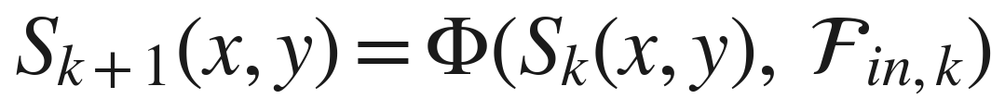
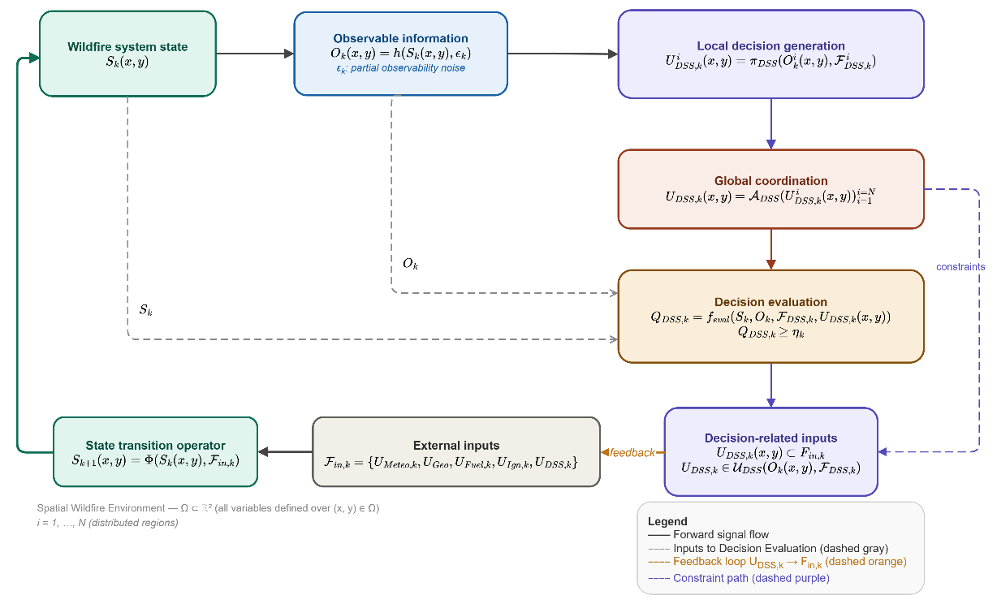
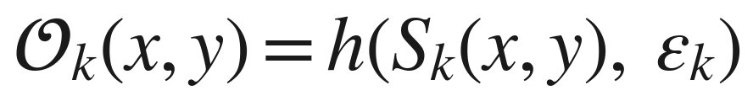
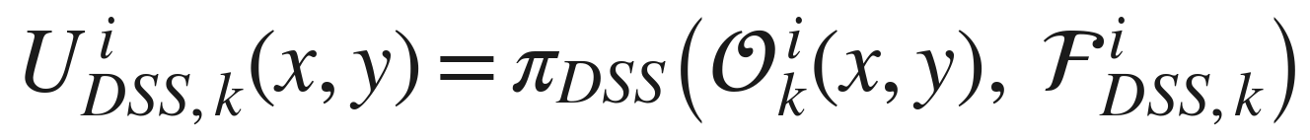

PROBLEM FORMULATION · 04
Wildfire DSS as a Distributed, Partially Observable Decision Process
CLOSED-LOOP STRUCTURE (Figure 2.1)
SYSTEM EVOLUTION (physical dynamics)
DECISION GENERATION
State → Observation → Distributed local DSS → Global coordination → Feasibility / quality check → Feedback into external inputs.
FEASIBILITY & QUALITY
Remark 2.1 The problem is computationally intractable under exact optimization — single-step action space ≥ 5⁷⁵⁰⁰ · state is continuous · ε_{k} lacks known distribution. Hence satisficing Q_{DSS,k} ≥ η_{k}, not global optimization.

Slide 7
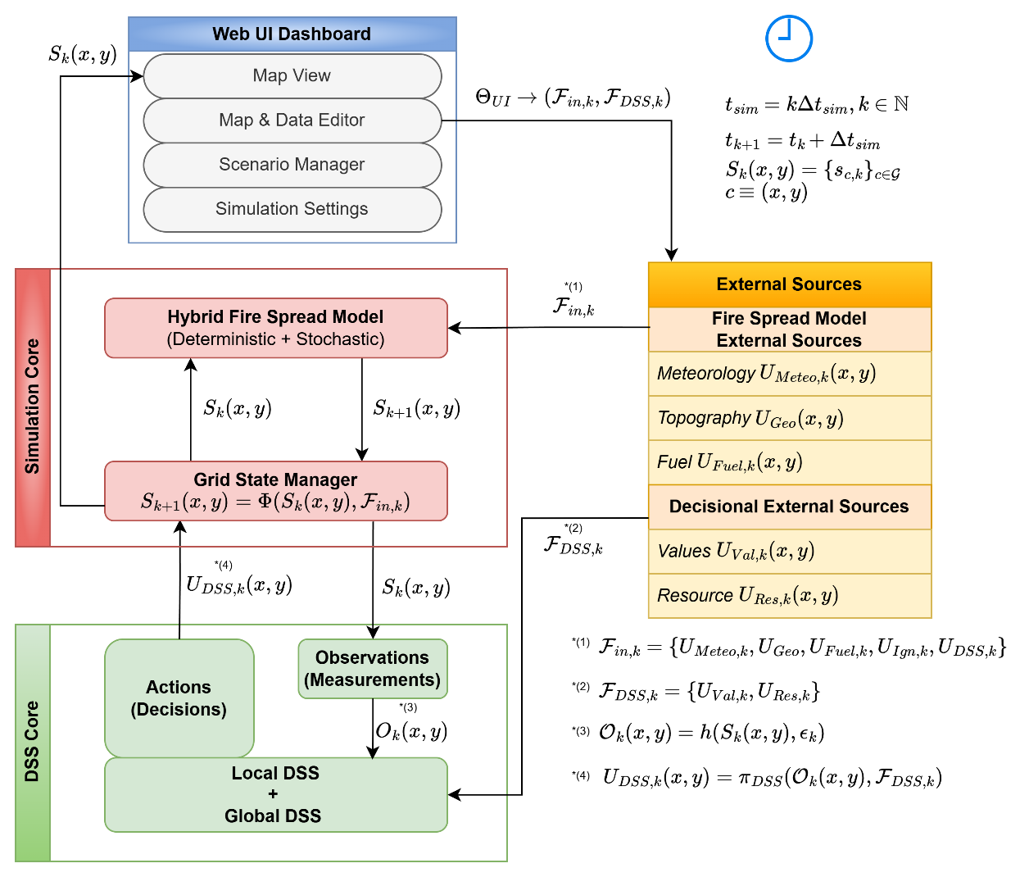
SIMULATION FRAMEWORK · 05a
Layered Architecture — Physics, Decision, Interaction Separated
1
External Data Sources
input layer
Meteorology · topography · fuel · ignition · DSS output. Boundary conditions — never written by DSS core.
2
Simulation Core
physics
Authoritative physics engine. Grid State Manager + Hybrid Fire Spread Model update Sₖ → Sₖ₊₁.
3
Decision Support Core
cognition
Observes 𝒪ₖ from Sₖ; produces intervention U_DSS,k. Separate from physics (Contribution C5).
4
Web UI Dashboard
supervision
Asynchronous operator interface. Scenario control via ΘUI — inputs only, no state overwrite.
Figure 4.1 · Simulation Framework block diagram

Slide 8
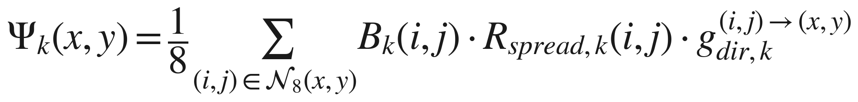
SIMULATION FRAMEWORK · 05b
Hybrid Fire Spread Model — Deterministic + Stochastic Dynamics
Per-cell state sₖ(x,y) evolves through four coupled updates. Physical realism comes from three mechanisms: persistence · propagation from neighbours · external ignition.
BURNING STATUS persistence · propagation · ignition
FUEL MASS combustion + suppression
Cell ignites if cumulative neighbour influence Ψₖ exceeds Θ_ign, or if externally triggered.
Simultaneous depletion: combustion B·F_burn and DSS-driven suppression F_red (through f_supp).
FIRE INTENSITY bounded combustion proxy
IGNITION TIME temporal memory τₖ
Bounded strength indicator; modulates suppression resistance and DSS features — does NOT drive propagation directly.
Records time since combustion began; feeds feature z₆ (urgency) and explainability, not fire physics.
Transition is deterministic; stochasticity enters only through exogenous inputs (e.g., wind gusts). All DSS-driven influence is mediated by F_red (suppression) — the DSS never writes state variables directly.

Slide 9
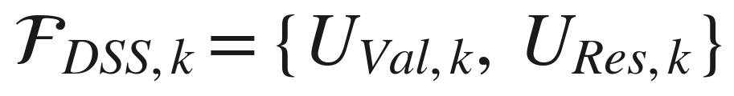
SIMULATION FRAMEWORK · 05c
External Data Layers & Spatio-Temporal State Representation
INPUT STRUCTURE (Eq. 31 · Eq. for F_DSS)
CELL STATE sₖ(x,y)
Bₖ burning status
∈ {0,1}
FIVE FORCING LAYERS + TWO DECISION CONTEXTS
F_load,k available fuel mass
∈ [0,1]
U_Meteo,k
U_Geo
U_Fuel,k
U_Ign,k
Meteorology
Topography
Fuel
Ignition
Iₖ intensity proxy
∈ [0,1]
wind speed, direction, gust · humidity · temperature · precipitation
elevation · slope · aspect · accessibility
vegetation class · combustible mass · moisture
binary spatio-temporal injection field
U_DSS,k
U_Val,k
U_Res,k
τₖ time since ignition
discrete-time memory
DSS actions
Asset values
Resources
suppression capacity · availability · effectiveness · travel time
priority score V_prio · critical facility index V_crit
contextual resource state used for decision evaluation
grid-based Ω ⊂ ℝ²

Slide 10
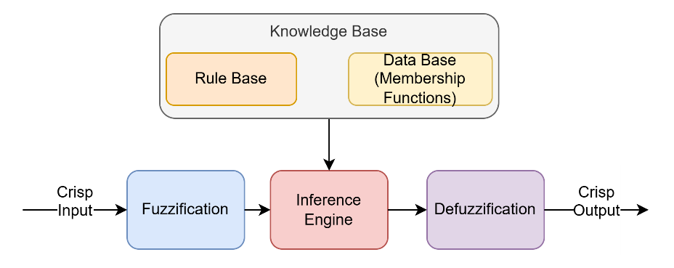
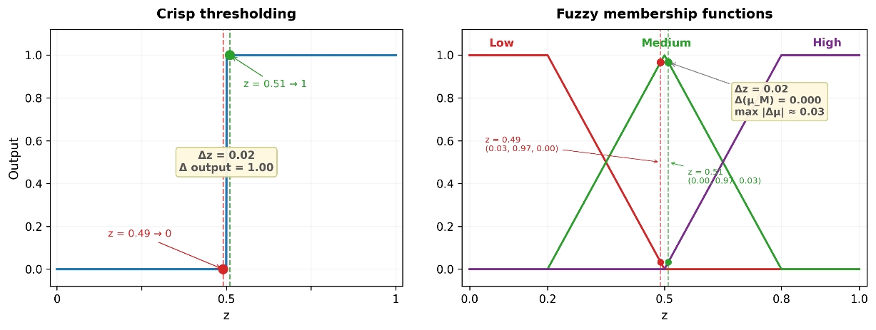
THEORETICAL BACKGROUND · 06
Why Fuzzy Reasoning for Wildfire DSS?
FUZZY INFERENCE SYSTEM (FIS)
COMPARATIVE ASSESSMENT (Table 5.2)
Criterion
Bayes
D–S
NN
Fuzzy
No prior distribution required
○
●
●
●
Handles epistemic uncertainty
○
●
○
●
Rule-level traceability
○
○
○
●
Linguistic interpretability
○
○
○
●
Real-time feasibility
○
●
◐
●
No training data required
●
●
○
●
Operator override at rule level
○
○
○
●
● supports ◐ partial ○ not supported
Crisp thresholds are brittle near boundaries — fuzzy membership is smooth and robust to observation noise.
TAKEAWAY Fuzzy logic is the only paradigm satisfying all seven DisasterAware requirements — directly closing G3, G4 and enabling rule-level operator override.

Slide 11
SYSTEM SPECIFICATION · 07a
From Operational Questions to a 6-Feature Input Space
FOUR OPERATIONAL QUESTIONS
SIX DERIVED FEATURES z₁…z₆ ∈ [0,1]
Q1 How severe is the fire threat?
z₁
Fire intensity
I_k
Q1
Combustion intensity + spread potential
uses I_k, Ψ_k
z₂
Fuel load
F_load,k
Q1·Q2
Q2 Can we effectively intervene?
z₃
Spread potential
min(1, Ψ_k / Ψ_ref)
Q1·Q3
Travel time, access, availability, fuel resistance
uses R_time, R_avail, G_access, F_load
z₄
Asset exposure
V_prio · B_k^δ
Q3
Q3 What is the asset exposure?
z₅
Resource accessibility
R_avail · exp(-β_t·R_time) · G_access
Q2
Priority-weighted proximity to active fire front
uses V_prio, Ψ_k, B_k
z₆
Temporal urgency
1 − exp(−λ·τ_k/τ_ref)
Q4
Q4 How urgent is the action?
Temporal fire progression + composite threat
uses τ_k, c1·c2·c3
All features bounded in [0,1] via physically meaningful normalizations — a uniform fuzzy variable design applies to every feature (Section 5.2.1).

Slide 12
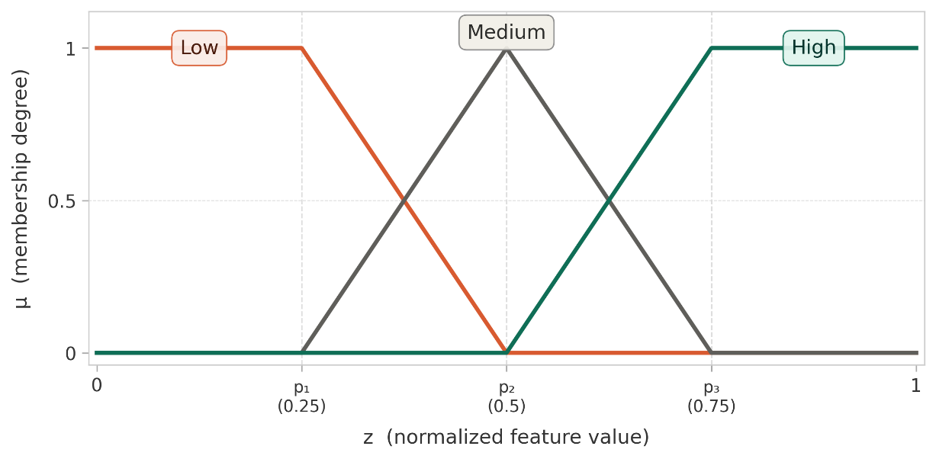
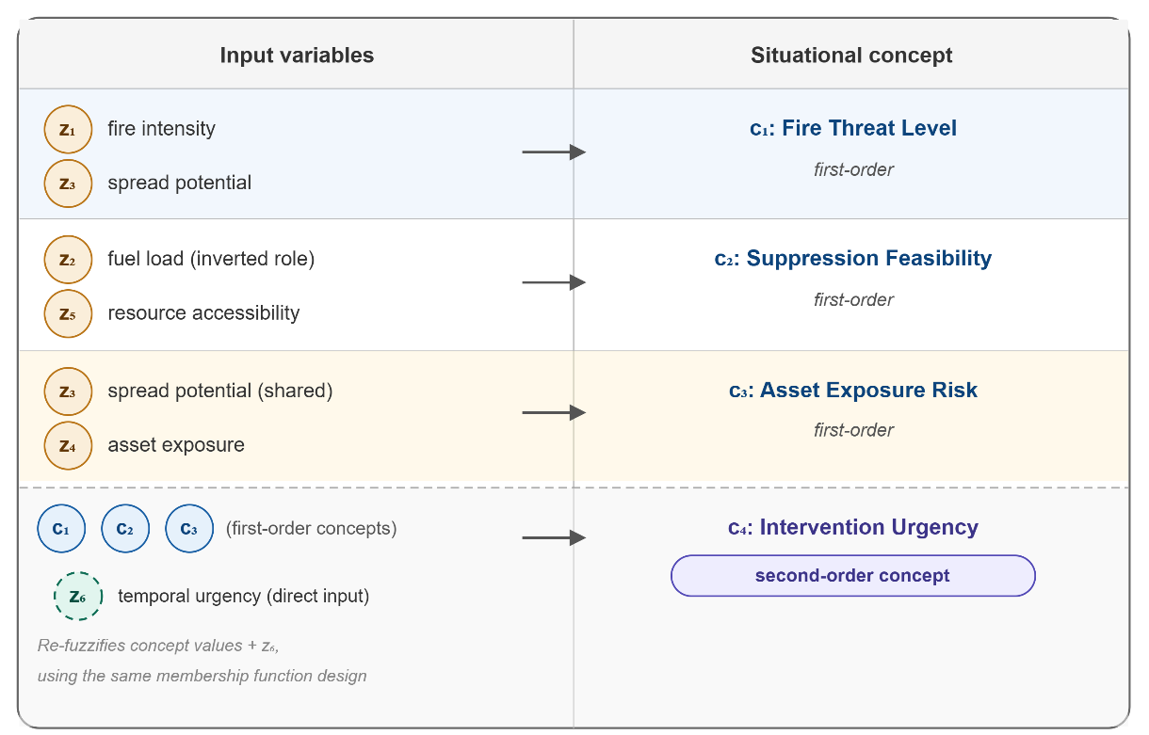
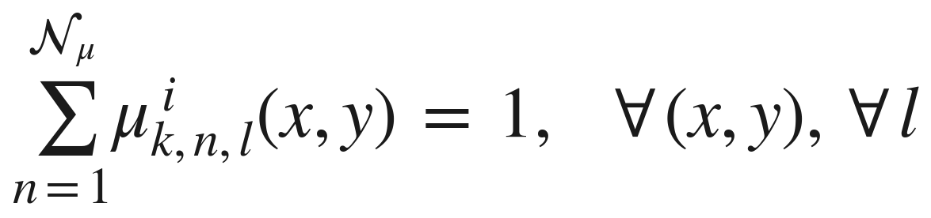
SYSTEM SPECIFICATION · 07b
Fuzzification & Four Situational Concepts
MEMBERSHIP FUNCTION TEMPLATE (uniform design, Nμ = 3)
CONCEPT CONSTRUCTION (Section 5.2.3)
Partition of unity: every feature value is resolved into Low/Medium/High with membership summing to 1 — ensures deterministic aggregation at the concept layer.
Figure 5.x · Features → situational concepts (first-order c₁·c₂·c₃; second-order c₄)
c₄ is a second-order concept — it re-fuzzifies c₁,c₂,c₃ together with temporal urgency z₆, closing the threat → feasibility → exposure → urgency reasoning chain.

Slide 13
SYSTEM SPECIFICATION · 07c
Rule Base Complexity — A Proven 9× Reduction
Naive direct-FIS design would require Nμ^Nfeat rules per intervention. Concept abstraction reduces the inference space from 6 features to 4 concepts (Proposition 5.3).
DIRECT FIS (BASELINE)
CONCEPT-MEDIATED (DISASTERAWARE)
729
81
9×
reduction
rules per intervention · 3⁶
rules per intervention · 3⁴
total rule base: 2,187
total rule base: 351
FORMAL DERIVATION
TAKEAWAY Concept abstraction makes the rule base manageable, validatable, and distributed — without sacrificing expressiveness. Each of 81 rules is hand-inspectable by domain experts.

