Slide 1


PhD THESIS DEFENSE — SUMMARY VERSION
DisasterAware
An AI-Powered Decision Support System for Wildfire Disaster Response and Management
Çağlar Akman
Supervisor: Prof. Dr. Mehmet Kemal Leblebicioğlu
Middle East Technical University · Electrical and Electronics Engineering
August 2026
Open where tactics live, closed where physics rules.

Slide 2
PROBLEM → CLAIMS → ANSWERS
Three Gaps, Three Hypotheses, Three Contributions
Closed decision spaces in centralized architectures H1 / C1 — the open decision space: a hierarchically distributed, concept-abstracted layer that generates adaptive interventions over an open space, at a latency compatible with the cycle.
G1
Unrepresented epistemic uncertainty; limited explainability H2 / C2 — built-in explanation: confidence-gated reasoning whose every order traces to its concepts, rules, and per-feature confidence — no post-hoc attribution.
G2
Simulation–decision coupling without an end-to-end workflow H3 / C3 — end-to-end over separated cores: an independently validated simulator and a decision core that fields only gate-passing orders, ignition to containment.
G3
Every slide of this summary serves one of these three lines; the full deck carries the derivations and the complete evidence.
2 / 15

Slide 3
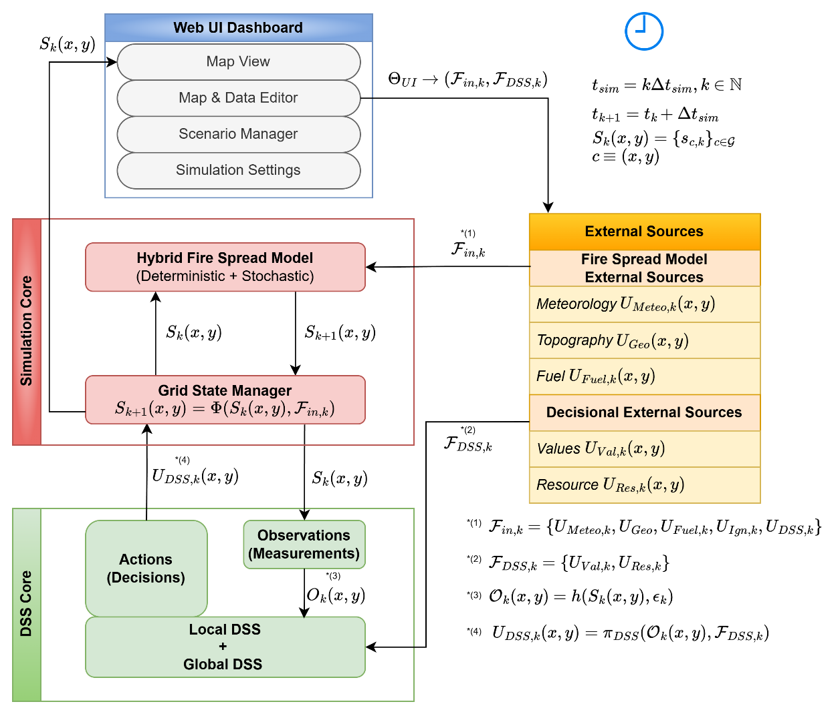
ARCHITECTURE
Two Cores, One Typed Boundary
The simulation core advances the physical state; the decision core reads it only through the observation model and acts on it only through the intervention field.
Downward payload: intensities over six intervention families, compiled from orders. Upward payload: observations with confidence, plus the coordination summary (priority, resource request, confidence).
No rule, concept, or confidence ever crosses the boundary — which is what lets each core be validated on its own.
The global coordinator ranks regions and shares the pool; it performs no inference and never rewrites a local decision.
3 / 15

Slide 4
SIMULATION CORE
Per-Cell State, One Transition Operator
Four state variables per cell — burning status, fuel mass, intensity proxy, time since ignition — advanced by one operator, once per step, deterministic given the seed: identical worlds replay under different decision configurations.
Burning status: deterministic persistence ⊕ stochastic wind-anisotropic propagation ⊕ ignition injection. The spread rate is a Rothermel-like semi-empirical mapping — base rate by fuel type × moisture damping × tanh-saturated wind × slope × aspect–wind alignment (Rothermel, 1972; full formulation in Appendix A).
Fuel mass: combustion depletion minus suppression-driven reduction — the only channel through which orders touch the physics.
Intensity: bounded tanh combination of fuel, wind, slope. Ignition time: bookkeeping for persistence and extinction.
Why cellular rather than vector-front: locality of interventions, exact replay, and per-cell observation with confidence — a controllable surface that perimeter models do not expose.
Kept honest by design: normalized cells-per-step with a metric reading (1 cell/step = 3 m/min at 90 m / 30 min), calibrated to benchmark head-fire rates per fuel class; a proxy faithful enough to price decisions, not a contribution to fire science.
4 / 15

Slide 5
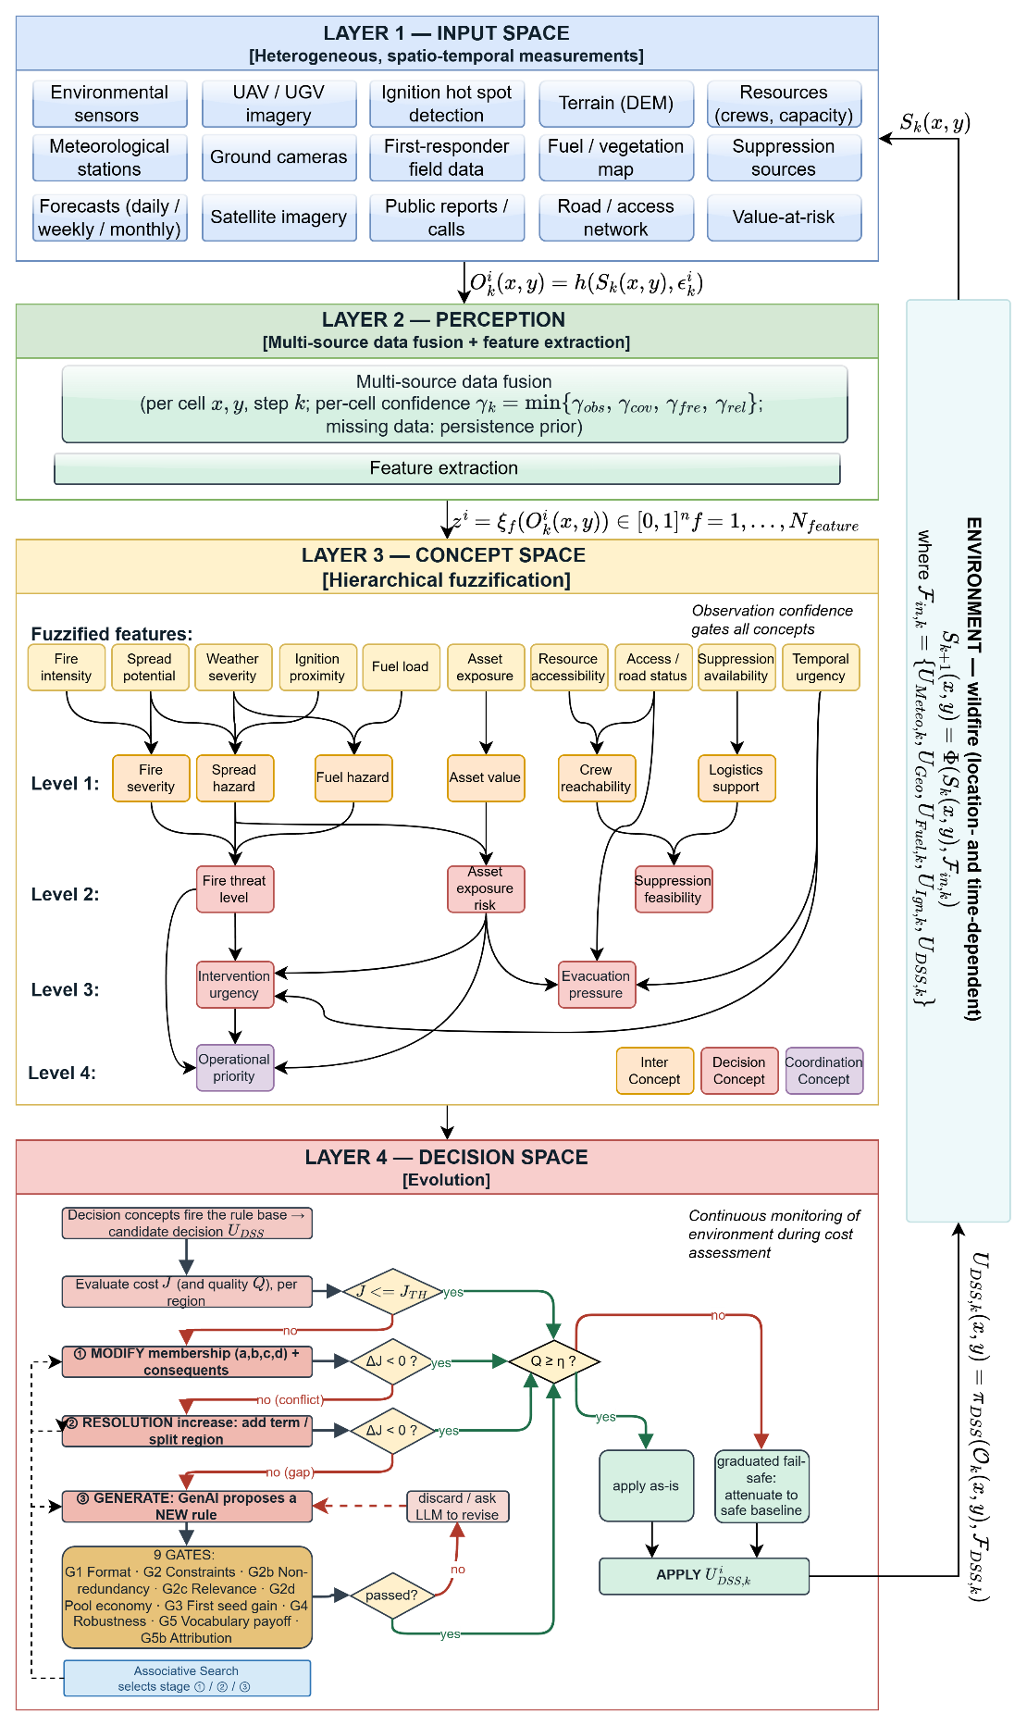
DECISION FRAMEWORK
One Agent, Four Layers, One Loop
Layer 1 — Input space — ten observation features from heterogeneous sensing, each with physical provenance
Layer 2 — Perception — features are estimates: bounded per-channel errors, and a confidence from coverage, freshness, channel quality, agreement
Layer 3 — Concept space — five decision concepts compress the features; a closed catalog would need 3 125 rules — the hierarchy makes five seeds sufficient
Layer 4 — Decision space — a sparse zero-order Takagi–Sugeno rule base decides; cost and quality tests price and admit; adaptation grows the doctrine
5 / 15

Slide 6

LAYERS 2 & 3 : THE ESSENCE
Uncertainty In, Language Out
Every feature carries its confidence
Concepts kill the rule explosion
Per-channel maximum errors from the implementation: in-situ 0.02, UAV 0.03, satellite 0.05, camera 0.06, field 0.10, public 0.20; bounded (not Gaussian) noise; freshness half-life 90 min.
Confidence γ = the minimum of four factors; it gates what a concept may claim.
Gated activation decays toward a persistence prior ($ρ = 0.90$) instead of jumping on weak evidence: low confidence slows belief, never fabricates it.
Ten features → five decision concepts in a weighted hierarchy (every weight stated in Appendix D): fire threat level, asset exposure risk, suppression feasibility, intervention urgency, evacuation pressure.
The concepts are the questions a commander asks — and the language every rule is written in.
Zero-order Takagi–Sugeno over one shared five-term partition: singleton consequents, weighted-average defuzzification — auditable, cheap, directly numeric.
Why this matters for H2: the trace of any order reads directly — sensors (with confidence) → gated concepts → fired rules → intensities. Explanation is the data path itself, not an attribution method applied afterwards. Under degraded observation (scenario S5) this machinery is priced: the system loses 10% and remains the best configuration tested.
6 / 15

Slide 7
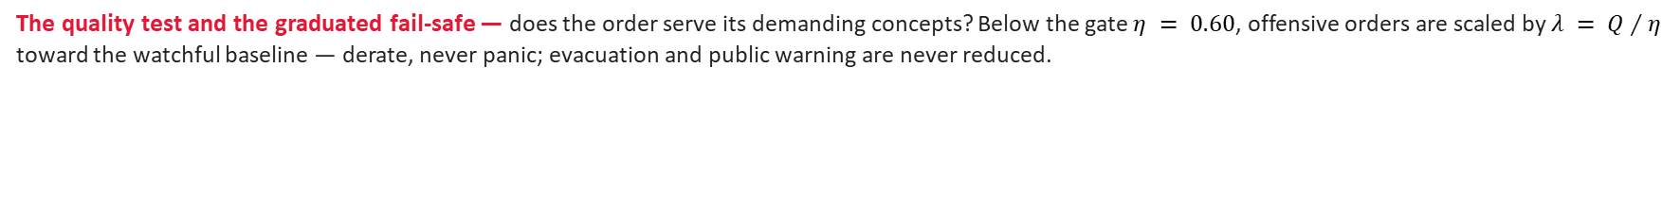
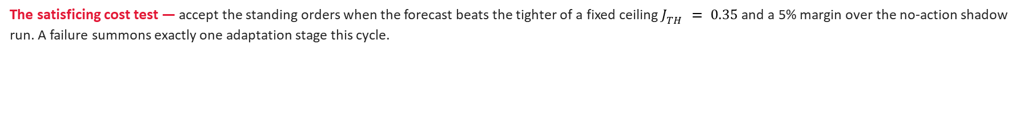
LAYER 4 : THE ESSENCE
Decide, Price, Test — and Fail Safely
The decision cost J — one number in [0, 1] pricing the forecast end state on the shadow copy: burned area, asset loss, population exposure, response effort, delay — weights 0.29 / 0.29 / 0.29 / 0.06 / 0.06. Physical part for trials and comparisons; total for acceptance.
The satisficing cost test — accept the standing orders when the forecast beats the tighter of a fixed ceiling $J_{TH} = 0.35$ and a 5% margin over the no-action shadow run. A failure summons exactly one adaptation stage this cycle.
The quality test and the graduated fail-safe — does the order serve its demanding concepts? Below the gate $η = 0.60$, offensive orders are scaled by $λ = Q∕η$ toward the watchful baseline — derate, never panic; evacuation and public warning are never reduced.
Two tests, two orthogonal failures: cost failures summon adaptation, quality deficits summon the fail-safe — each failure visible, attributable, separately repairable.
7 / 15

Slide 8
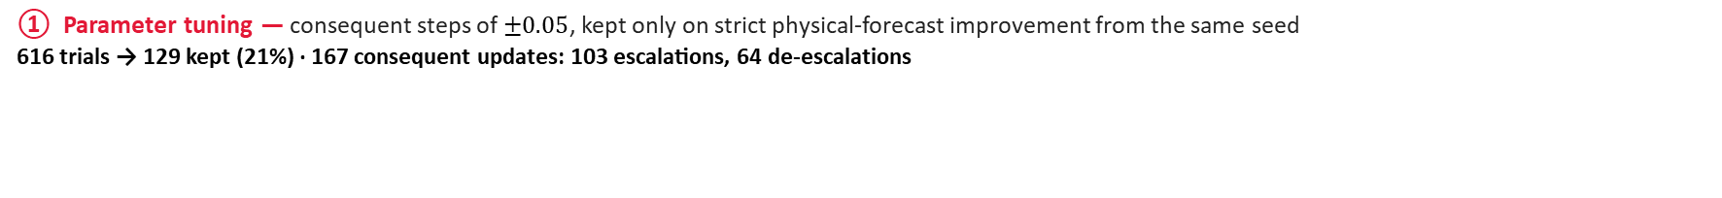
THE OPEN DECISION SPACE
Five Seed Rules, Three Adaptation Stages
The doctrine starts from five rules — one per operational regime — and grows only on demand, behind forecast gates. Coverage decides between tuning and growing; a persistent deficit escalates.
① Parameter tuning — consequent steps of $±0.05$, kept only on strict physical-forecast improvement from the same seed 616 trials → 129 kept (21%) · 167 consequent updates: 103 escalations, 64 de-escalations
② Resolution growth — a rule instantiated on an uncovered cell — consequents seeded from what the strongest concepts demand — or a narrow term splitting an ambiguous reading 359 trials → 40 rules kept (11%) · 4 term insertions, 5 boundary shifts
③ Generative vocabulary — one proposal per invocation: a plain rule, or a package adding exactly one new object — macro, concept, or clause actuator — that the rule must use 232 invocations → 47 admitted (36 rules + 11 packages) · 42 survive dedup and pruning
Low acceptance is the design working: trials are cheap and rejected safely on the forecast; the selectivity is what makes admitted edits trustworthy.
8 / 15

Slide 9
THE OPEN DECISION SPACE
Stage ③ Is a Search Problem; the Gates Decide, Not the Model
The formal problem: minimize the forecast physical cost change over the vocabulary-closed admissible space — where every evaluation is one reseeded rollout and the cycle budget is two.
$$c^{⋆} = \underset{c ∈ ���(V_{k})}{arg min} Δ{\hat{J}}_{Phy}(c)$$
The LLM is formally a learned proposal distribution over that closed space: it carries the prior of wildfire practice, so its two candidates per cycle land in the gate-passing region — classical solvers (enumeration, evolutionary search, Bayesian optimization, RL) each fail the two-rollout budget.
Acceptance is exact and model-free: six free admissibility predicates, then strict cost decrease on two independent seeds; packages also clear a payoff margin and the ablation test — struck out, the cost must rise in both futures.
Products in the campaigns: 7 macro interventions, 1 + 4 intermediate concepts, 7 clause actuators (tactics with their own geometry) — one later re-ordered by a rule that had no part in creating it: vocabulary used, not merely grown.
The reply has no authority; the interface is proposer-agnostic — an evolutionary or a human proposer plugs into the same gate chain.
9 / 15

Slide 10
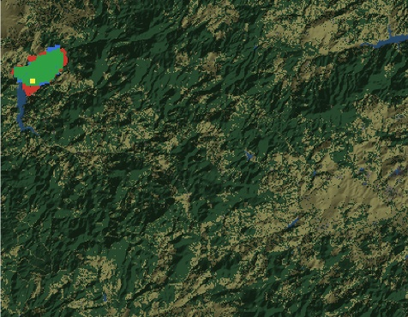
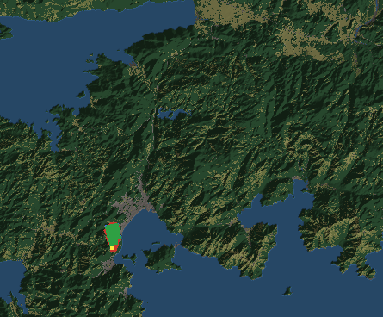
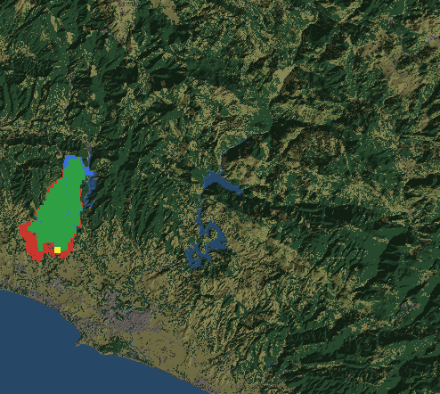
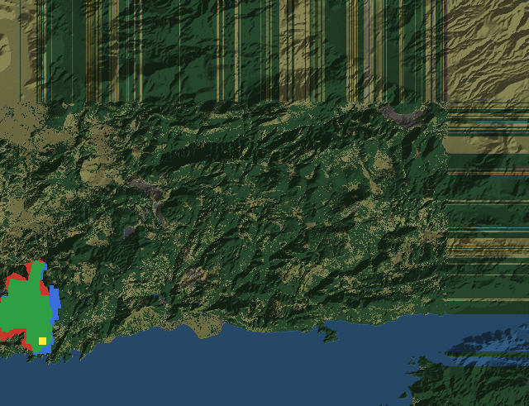
EVIDENCE : VERIFICATION
Four Blind Hindcasts Anchor the Simulator
Manavgat · Marmaris · Milas · Kayadere — real terrain, fuel, and weather from independent public data; all spread parameters frozen before any run; 50 replicates per case.
Scored on front propagation, not area overlap (the suppression-free core overpredicts final area by design): POD 85–97%, front-position score 82–90%, arrival-time score 71–98%.
Overall agreement 86–94% — every criterion passes its pre-set acceptance level in every case.
Green: correct burn · red: simulated only · blue: observed only · yellow: ignition.
10 / 15

Slide 11
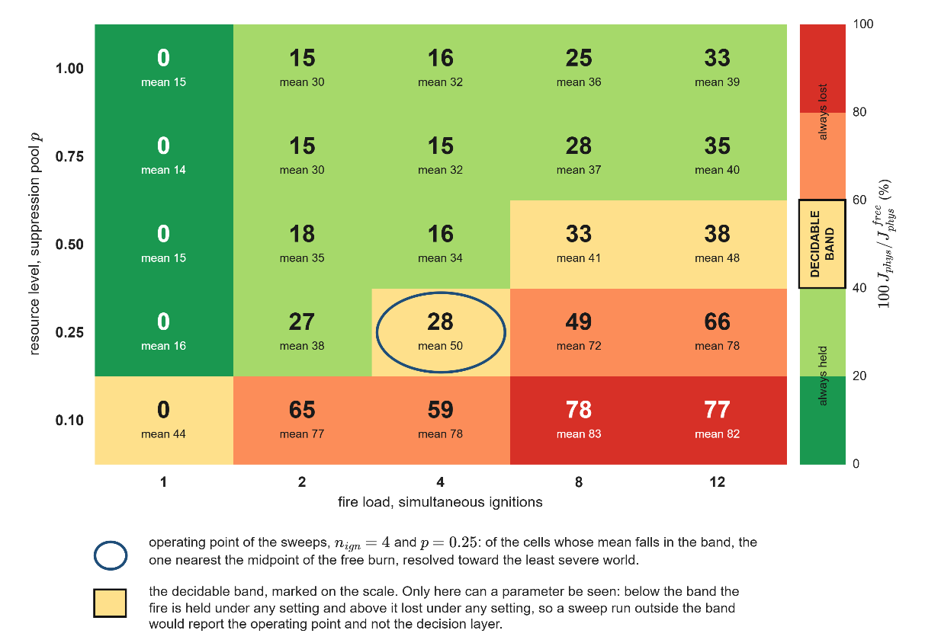
EVIDENCE : PARAMETER ANALYSES
What Moves the Outcome, What the Loop Tolerates
880 runs, one bias at a time, five worlds per level — around an operating point where the fire is neither won nor lost outright (4 ignitions, quarter pool).
Steep directions: the decision cycle (replanning late degrades the gain monotonically) and a resource pool below one half.
Tolerant directions: observation coverage down to five sensors at no measurable cost; the satisficing ceiling above its nominal; the quality gate inside the band quality actually occupies.
Observation and resource are complementary, not interchangeable: a blind map is not recovered by resource, a scarce pool not by observation.
11 / 15

Slide 12
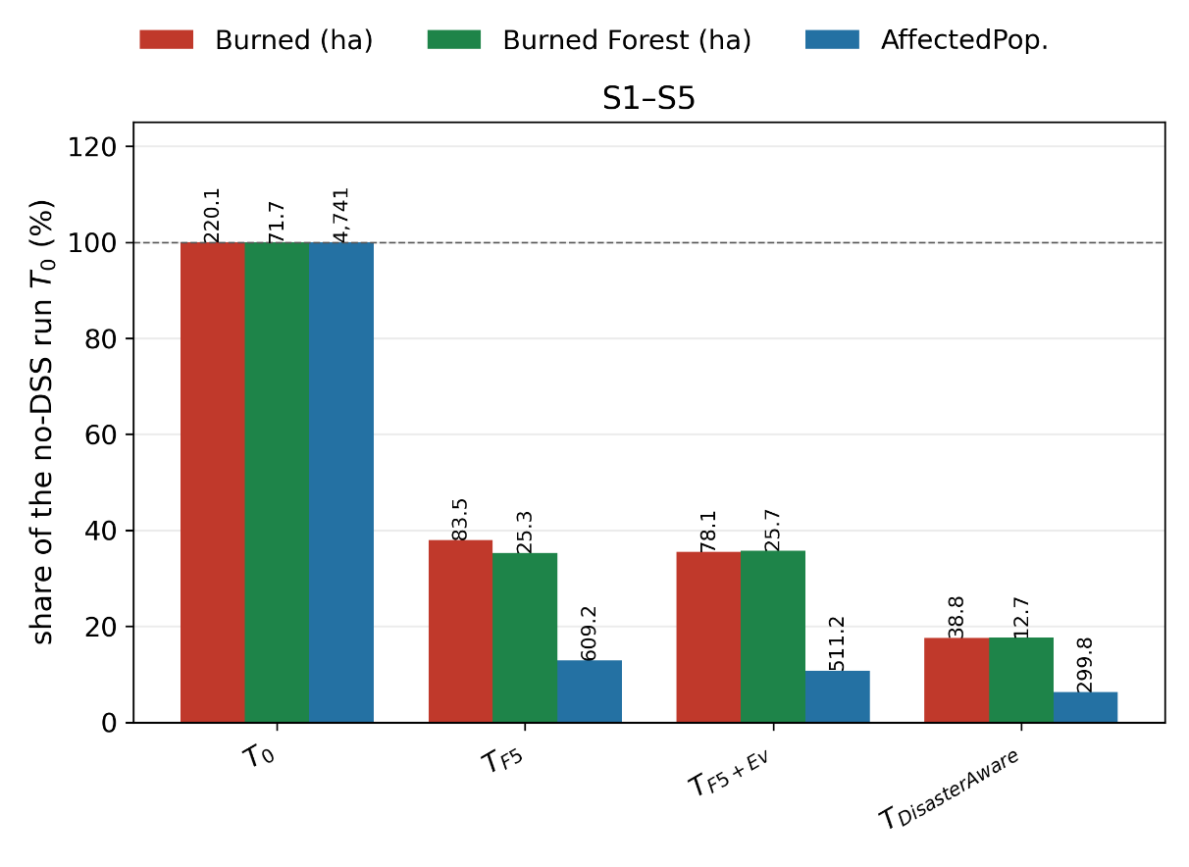
EVIDENCE : PERFORMANCE
Every Rung of the Ladder Pays; the Open Space Pays Most
Four configurations on identical worlds, disjoint evaluation seeds, five scenario families, 6-hour checkpoint.
Seed base: 220 → 84 ha (−62%), physical cost 0.506 → 0.163.
+ evFIS stages ①②: 78 ha; the gain is the delay term (0.318 → 0.233) — the same resources committed sooner.
Full DisasterAware: 39 ha (−82%), physical cost 0.090, total 0.112 — lowest in every scenario.
S5 (degraded observation): +10% burned area, still the best of the four — degradation, not breakage.
12 / 15

Slide 13
EVIDENCE : TEMPO, SCALE, VERDICT
Milliseconds Against Minutes; the Rubric Honored
Timeliness and scalability
The eight-criterion rubric, fixed in advance
One decision: median 274 ms, p90 909 ms — 0.04% of a 12-minute cycle; first offensive order at minute 2 in all ten worlds.
Sixteen times the agents cost at most ×1.29; the binding driver is domain size (grid ×4 → ×6.9), not agent count.
Met in full: predictive fidelity, timeliness, adaptability, scalability.
Met but bounded, stated openly: decision quality (no external baseline exists), robustness (noise and comms untested), uncertainty (no ensemble), explainability (operator side unevaluated).
All three hypotheses supported by pre-registered criteria. H1 — lowest cost in all five scenario families at < 0.2% of the cycle from 1 to 16 agents. H2 — trace and adaptation ledgers complete over the recorded runs; the loop's sensitivity to its own parameters quantified. H3 — all 151 745 fielded orders passed the applicable pre-execution gates; 5 502 candidates withheld; first order at the first cycle.
13 / 15

Slide 14
CONCLUSION
Delivered, Bounded, and Pointed Forward
Delivered — an open decision space grown from five rules under exact gates, halving the burned area of the static base; explanation as the data path itself; an end-to-end demonstration on a simulator validated against four real fires.
Bounded — comparisons are internal (no like-for-like external system generates interventions over an open space); the validation base is four fires; LLM proposals are not bitwise reproducible — but nothing enters doctrine on the model's authority.
Forward — four studies, none requiring a change to the framework: an operator tabletop study, transfer to other spreading hazards, ensemble uncertainty propagation, and domain-size scaling.
Combinatorially open, physically closed: doctrine grows in rules, names, and tactics — the state vector, the decision axes, and the seven effects never change.
14 / 15

Slide 15
Thank you.
DisasterAware : open where tactics live, closed where physics rules.
WITH GRATITUDE TO THE EXAMINING COMMITTEE AND THE THESIS MONITORING COMMITTEE
Prof. Dr. Mehmet Önder Efe (Committee Chair) Prof. Dr. Mehmet Kemal Leblebicioğlu (Supervisor · Thesis Monitoring Committee) Prof. Dr. Klaus Werner Schmidt Assoc. Prof. Dr. Ahmet Güneş (Thesis Monitoring Committee) Assist. Prof. Dr. Kenan Ahıska (Thesis Monitoring Committee)
Questions welcome.
15 / 15

