Slide 1
DisasterAware
A Distributed, Concept-Driven Fuzzy Decision Support Framework for Wildfire Response
PhD Thesis · Summary for the Advisor
Six chapters · the problem, the framework, the decision layer, the evidence
Notes:
Opening frame: wildfire response is a decision problem under incomplete observation, not a prediction problem. The deck follows the thesis chapter by chapter.

Slide 2
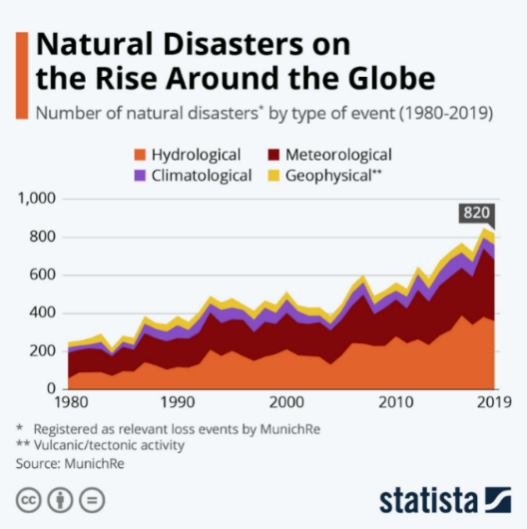
CHAPTER 1 · INTRODUCTION
The problem is getting larger, not smaller
Reported natural disasters have risen steadily for a century, and wildfire is among the fastest growing classes.
Response demands rapid decisions over a large, fast-changing area under incomplete and delayed observation.
Centralised fixed-rule systems scale poorly: every region competes for one inference engine and one rule base.
A closed menu of predefined alternatives cannot adapt while the fire evolves.
Figure 1.1 Reported natural disasters, 1900-2022
Notes:
Motivation. The point is not that fires are worse, it is that the decision load grows faster than the response capacity.

Slide 3
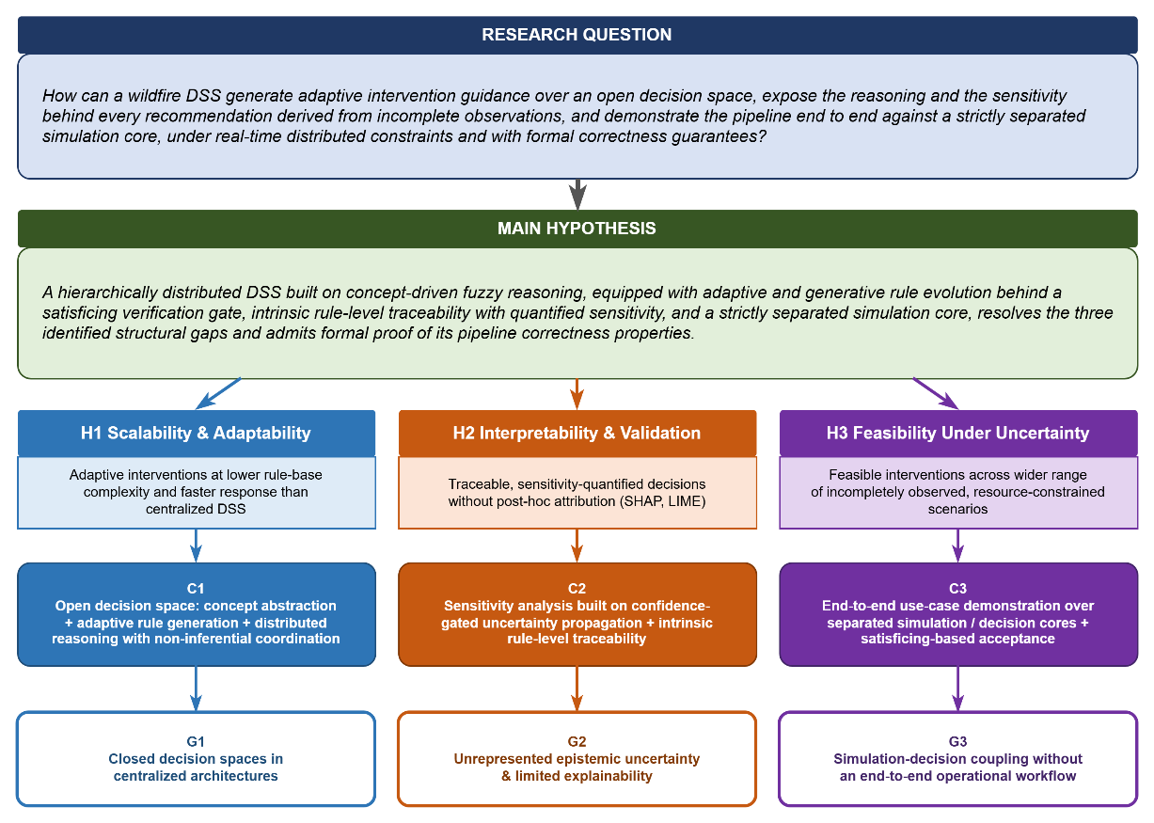
CHAPTER 1 · QUESTION AND HYPOTHESIS
One question, three testable claims
RQ: how can a wildfire DSS generate adaptive guidance over an OPEN decision space, expose the reasoning and the sensitivity behind it, and run end to end against a strictly separated simulation core?
H1 Scalability and adaptability: distributed concept-abstracted agents, lower rule-base complexity, faster response.
H2 Interpretability: traceability and confidence gating are structural, so no post-hoc SHAP or LIME is needed.
H3 Operational feasibility: satisficing acceptance and cost-aware constraints across incompletely observed, resource-limited fires.
Figure 1.2 Gaps, question, hypothesis and contributions
Notes:
Each sub-claim maps to one gap and is settled by a different part of Chapter 5.

Slide 4
CHAPTER 1 · CONTRIBUTIONS
Three contributions, one per gap
Open decision space
C1
Five concepts replace a fixed menu. The rule field is reshaped online by an evolving TS base and a gated generative stage.
Traceability and gated uncertainty
C2
Epistemic uncertainty is carried without priors, by blending each activation with a persistence estimate in proportion to confidence.
End-to-end over separated cores
C3
The simulation core is validated independently first; the decision core then runs on that validated ground.
Notes:
C1 answers G1, C2 answers G2, C3 answers G3. Chapter 6 returns to each and states whether it was delivered.

Slide 5
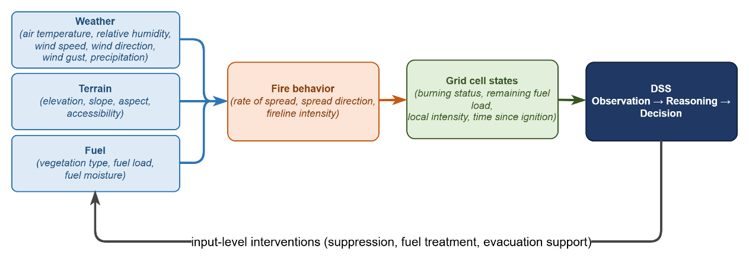
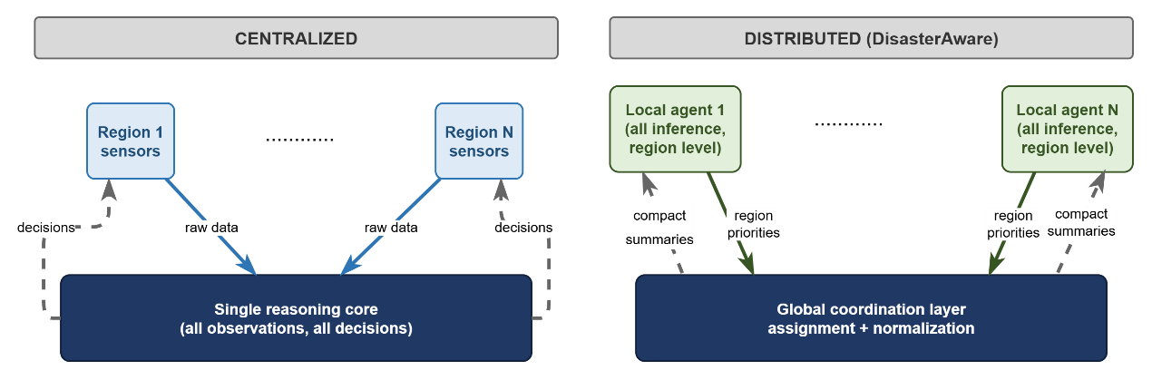
CHAPTER 2 · BACKGROUND
Fire behaviour and the decision layer are coupled
The grid state drives fire behaviour; the decision layer changes the grid state. Neither can be studied alone.
Centralised architectures put all inference in one place; distributed ones abstract each region to a few scalars.
That abstraction is what keeps the coordination channel narrow and auditable.
Figures 2.1 and 2.2 Coupling, and centralised vs distributed
Notes:
Chapter 2 establishes why a distributed concept layer is the right shape for this problem.

Slide 6
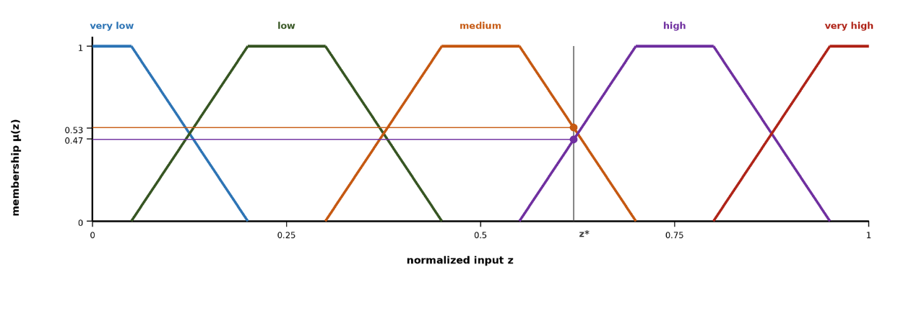
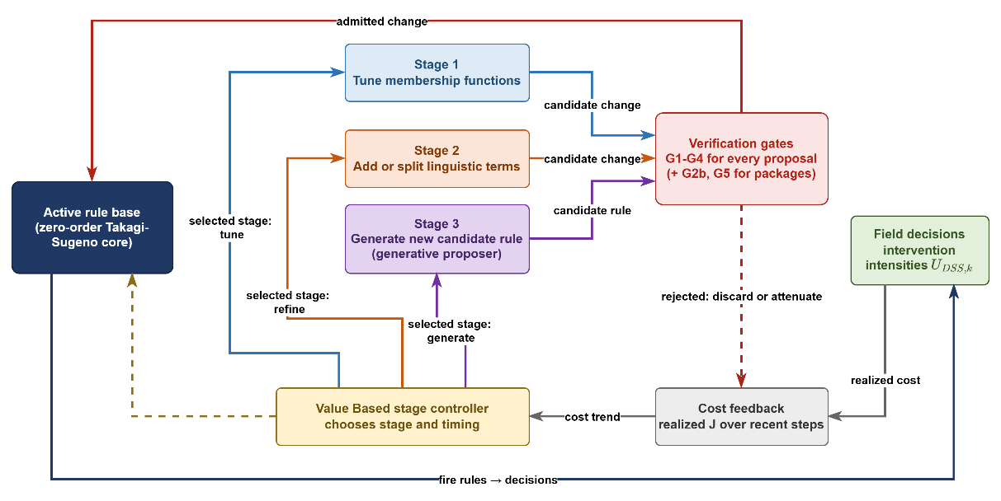
CHAPTER 2 · REASONING FOUNDATION
Why fuzzy, and why it must evolve
Five trapezoidal terms per variable give operational language: a threat is high, not 0.72.
Zero-order Takagi-Sugeno keeps the consequents numeric, so a rule can be tuned by moving one number.
A closed catalogue over five concepts with five terms each needs 3 125 rules, which no expert can author or audit.
So the base starts sparse and grows only where the field demands it.
Figures 2.3 and 2.5 Membership partition, staged adaptation
Notes:
3125 is the number that motivates the whole open-decision-space contribution.

Slide 7
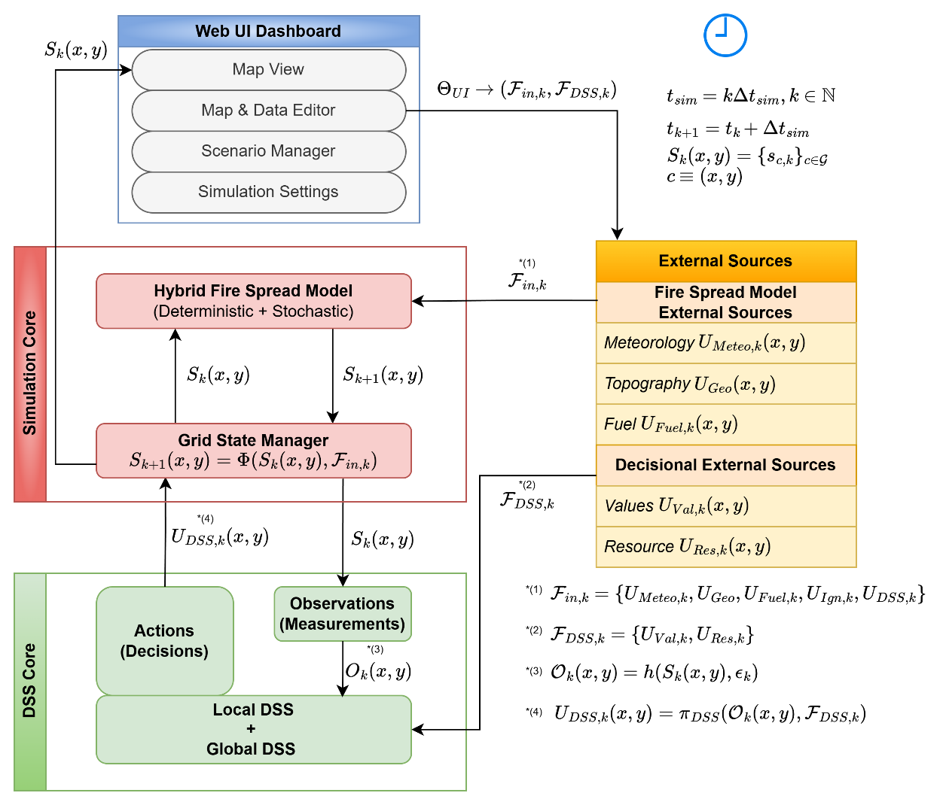
CHAPTER 3 · SIMULATION FRAMEWORK
A simulation core the decision layer cannot touch
Strict separation: the DSS reads the simulator and returns a resource allocation. It never writes the physics.
That separation is what makes the validation of Chapter 5 meaningful.
Cellular grid with per-cell fuel, moisture, terrain and value; wind-dependent directional propagation between neighbours.
Every intervention becomes a change in the resource field, exactly as a human-issued order would.
Figure 3.1 DisasterAware system block diagram
Notes:
The separation is the third contribution's precondition.

Slide 8
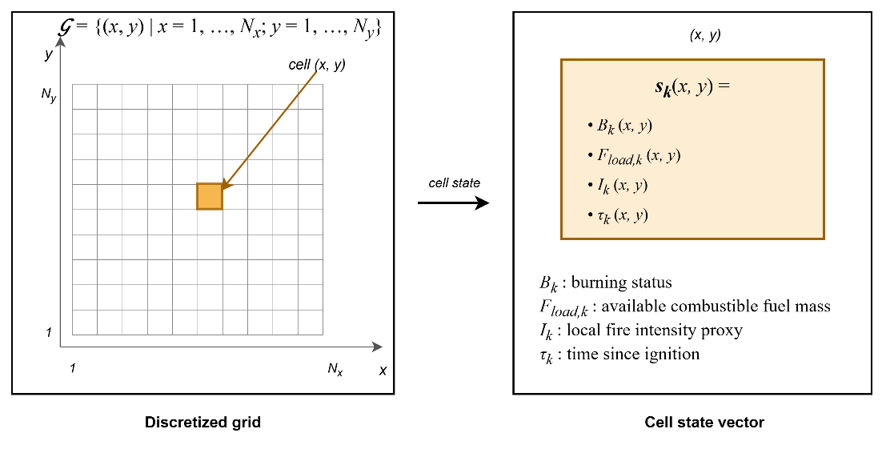
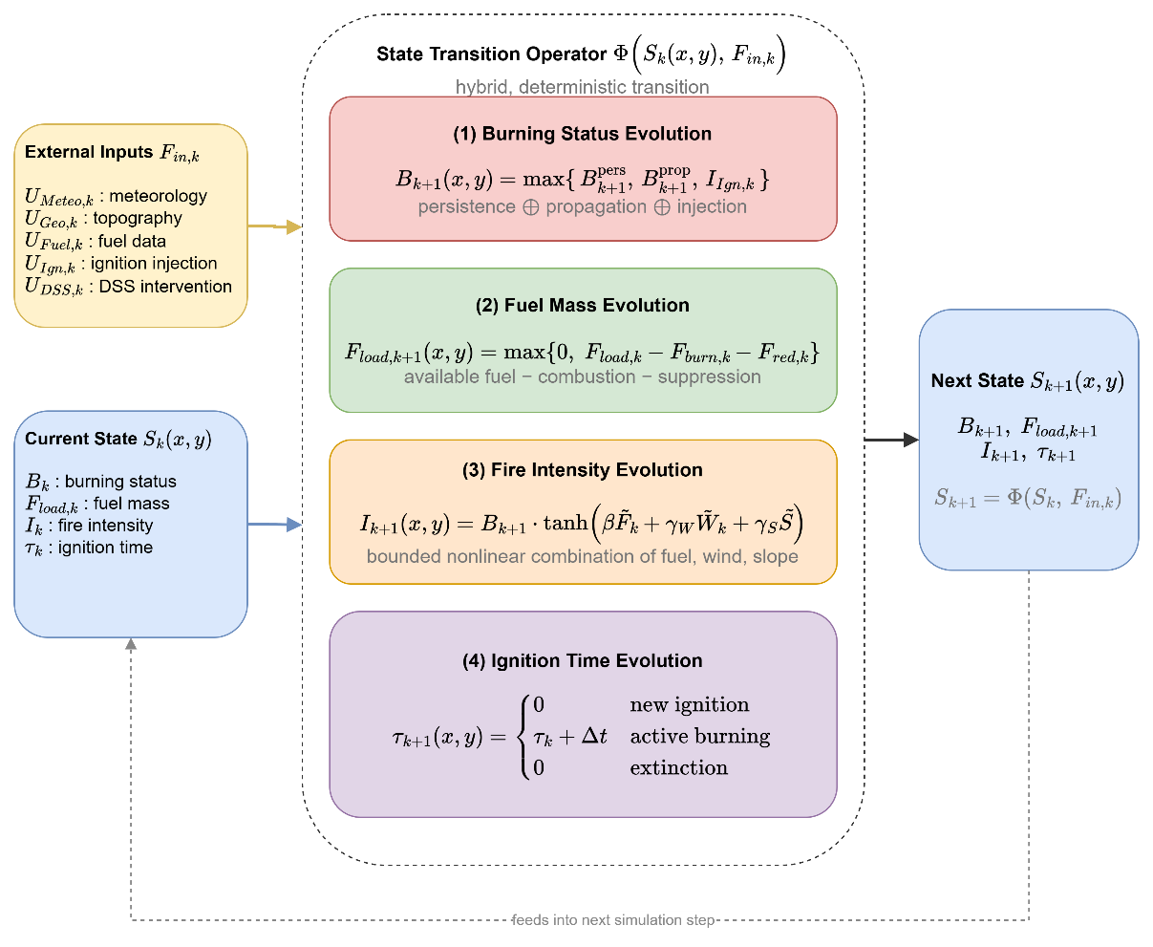
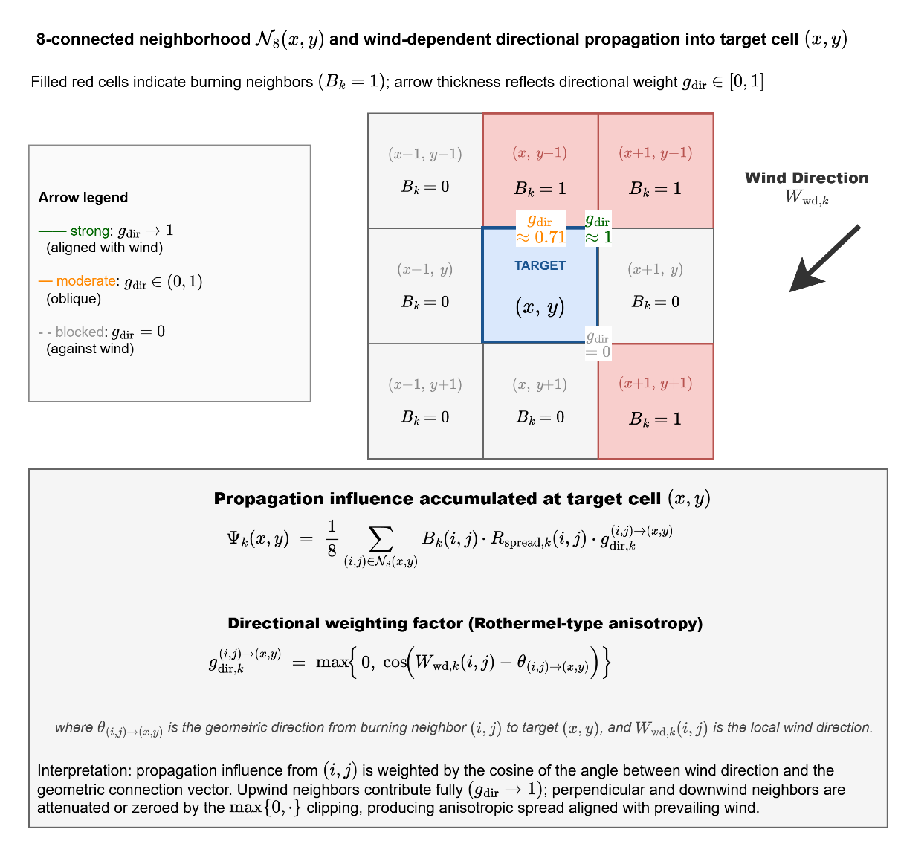
CHAPTER 3 · THE PHYSICS
Grid state, transitions, and wind-driven spread
Figure 3.2 Grid and cell state
Figure 3.3 State transitions
Figure 3.4 Directional propagation
Each cell carries its own fuel, moisture, slope and value. Spread into a target cell is weighted by the wind and the slope along that direction, so the front shape follows the terrain rather than a circle.
Notes:
Physics is standard and deliberately so: the contribution is the decision layer, not a new spread model.

Slide 9
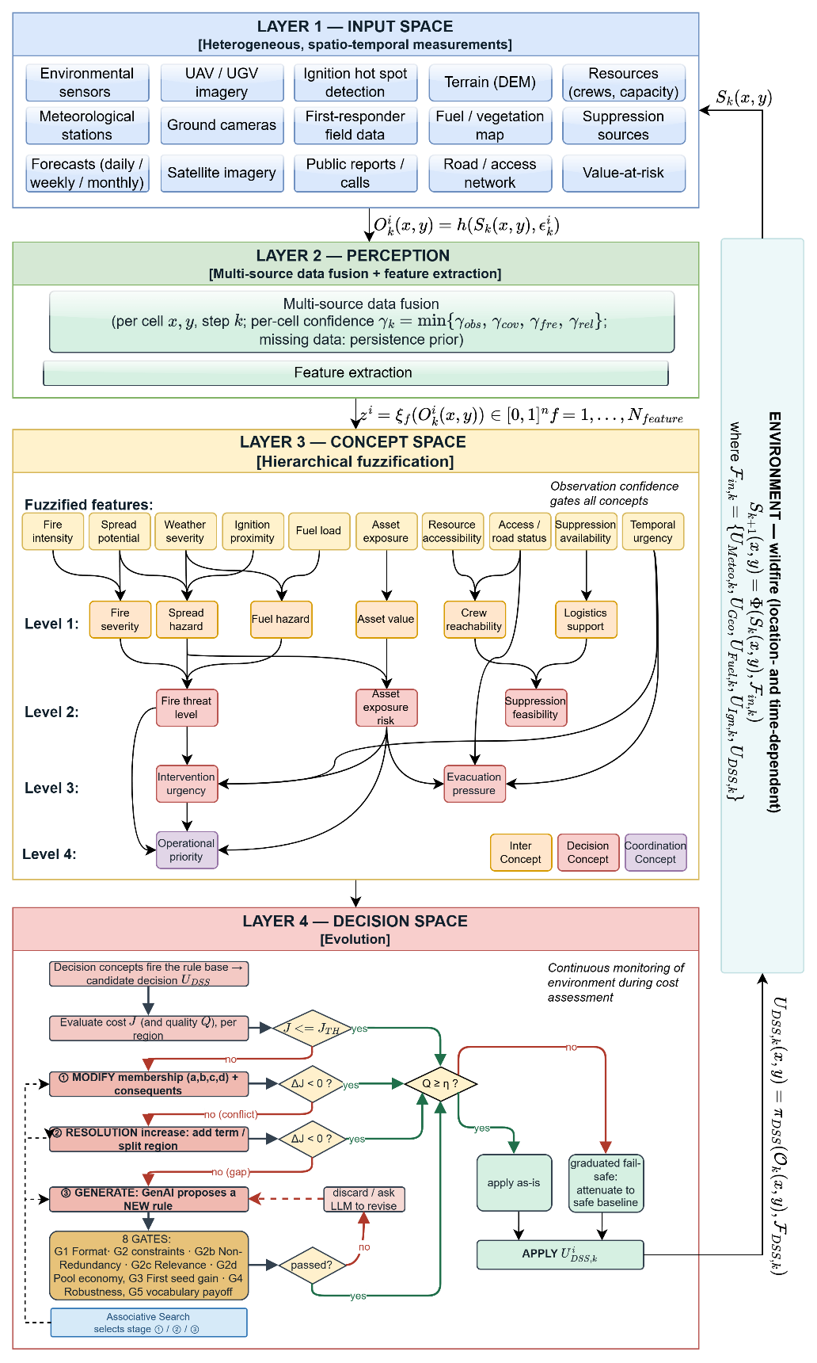
CHAPTER 4 · DECISION FRAMEWORK
Four layers from raw sensing to fielded orders
Input space
1
heterogeneous sensing, each reading with its own latency and quality
Observation and confidence
2
ten features, each carrying a confidence factor
Concept space
3
five decision concepts in operational language
Decision and coordination
4
rules fire, the candidate is priced and gated, the coordinator rations the pool
Figure 4.1 DisasterAware block diagram, DSS focused
Notes:
The layer numbering is used throughout Chapters 4 and 5.

Slide 10
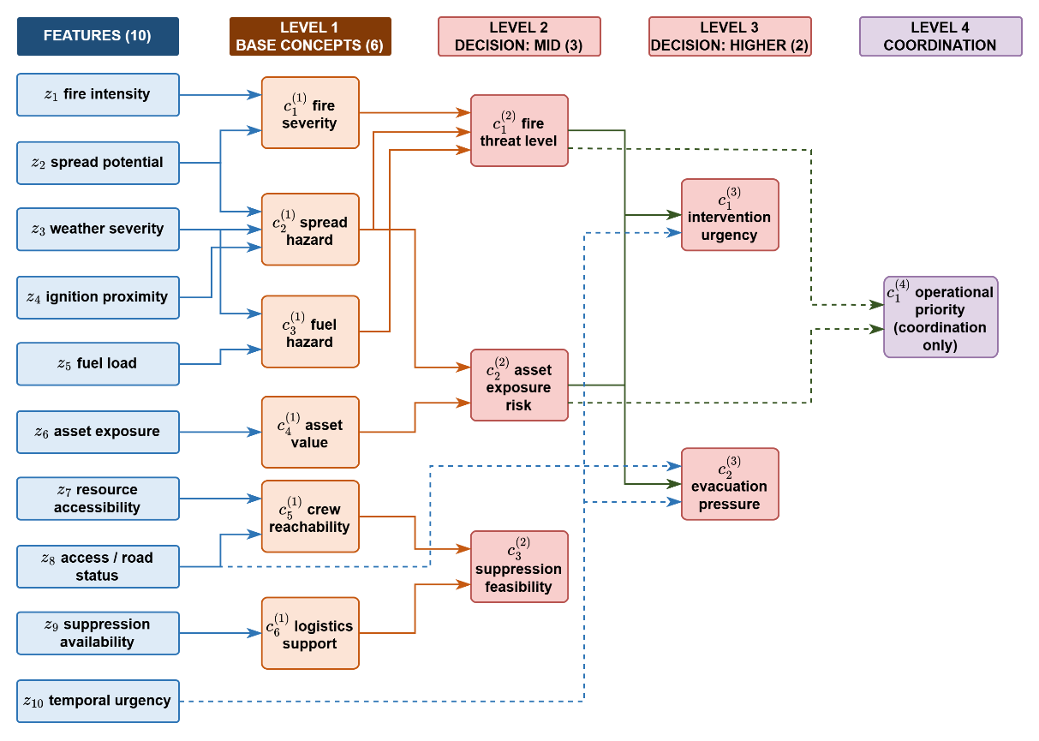
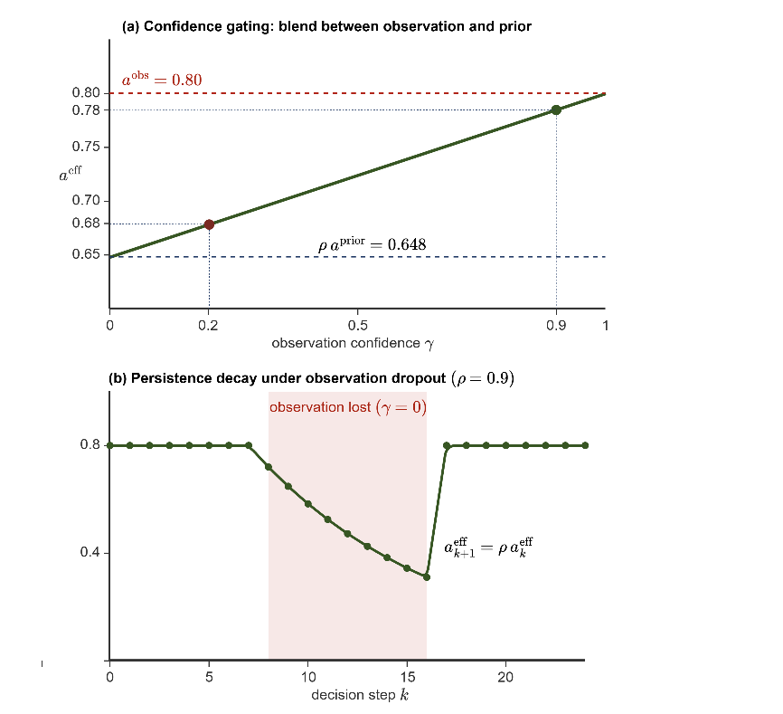
CHAPTER 4 · LAYERS 2 AND 3
Concepts carry the meaning, confidence carries the doubt
Ten features feed five decision concepts through a fixed hierarchy, so a rule speaks about threat and exposure, not about pixels.
Each activation is blended with a persistence estimate in proportion to the confidence of the observation behind it.
A degraded channel therefore weakens its own influence instead of silently asserting a stale value.
No prior distribution is assumed anywhere in this path.
Figures 4.2 and 4.4 Hierarchy, and confidence gating
Notes:
This is the H2 machinery: explanation is structural, not retrofitted.

Slide 11
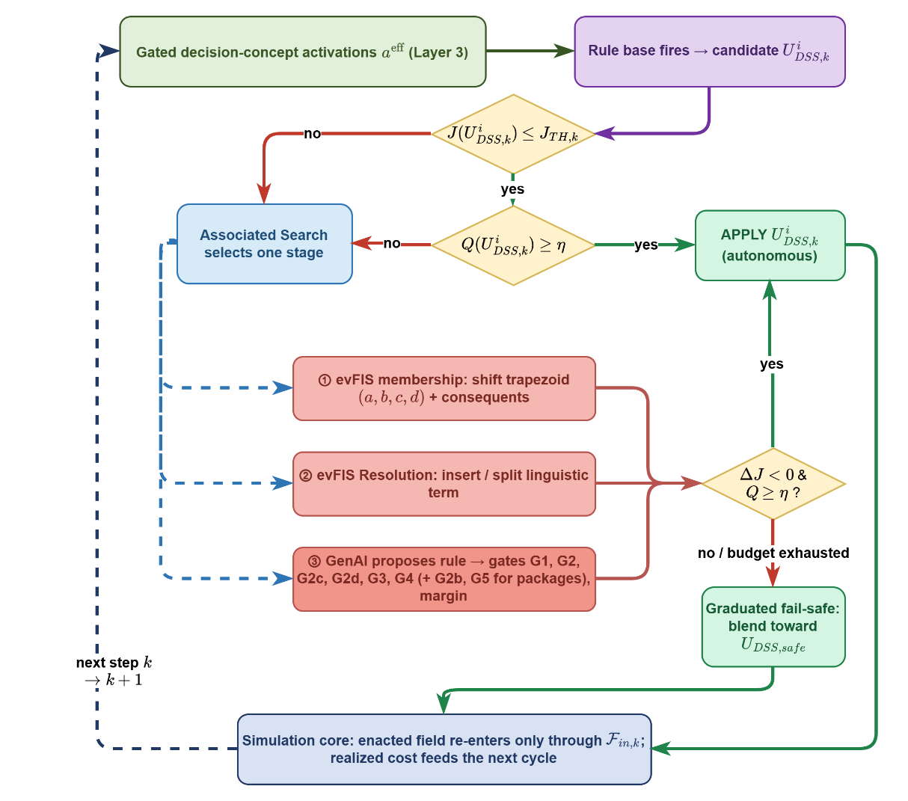
CHAPTER 4 · LAYER 4
Every candidate must clear two different tests
Cost · is it worth doing?
The candidate is held on a shadow forecast and priced against doing nothing. Acceptance is satisficing: it must beat a fixed ceiling or beat no action by a margin.
Quality · does it answer the demand?
Each concept is compared with the intensity ordered from the family that answers it. Ordering more than was asked for counts as much as ordering less. Below the gate the fail-safe attenuates the offensive orders; evacuation is never reduced.
Figure 4.5 Layer 4 decision and adaptation flow
Notes:
Cost is one number for the incident; quality is a verdict per region. That is why both are needed.

Slide 12
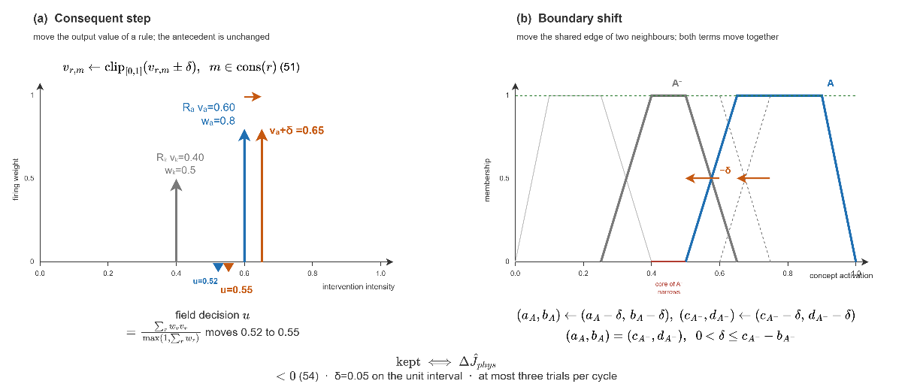
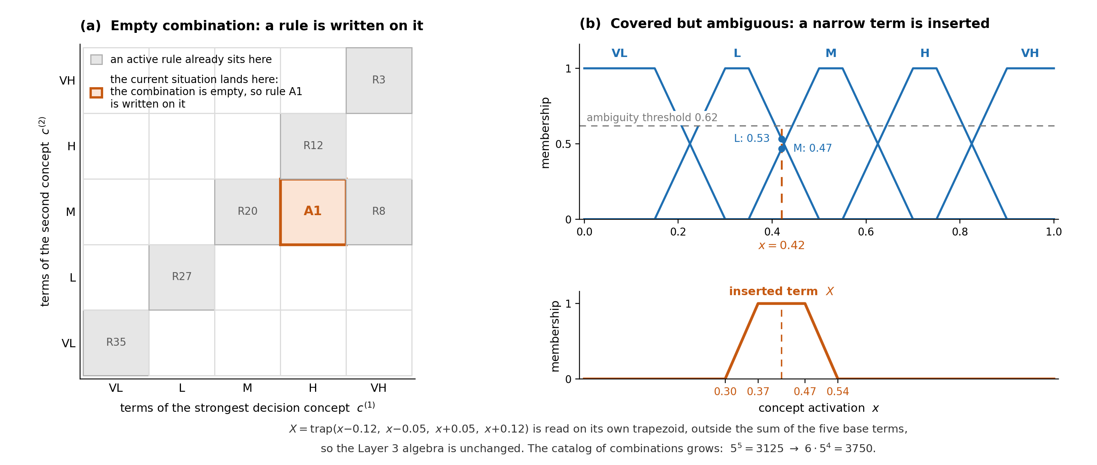
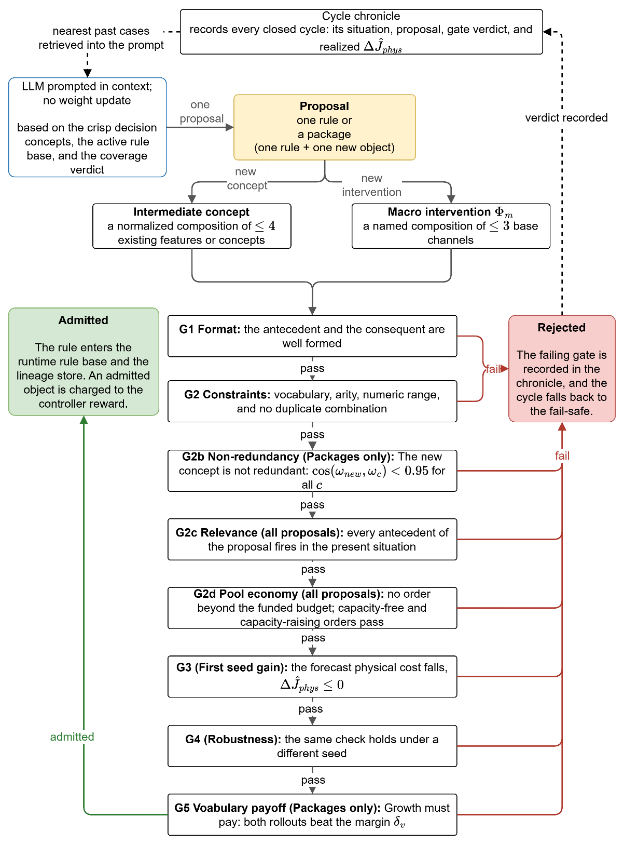
CHAPTER 4 · OPEN DECISION SPACE
Three stages of increasing invasiveness
A stage engages only when the standing decision demonstrably falls short, and every trial it produces is judged by the same forecast test the standing decision just passed.
1 Tuning
2 Resolution
3 Generation
consequents step, boundaries shift
rules instantiated, terms inserted
new rules and vocabulary, behind gates
Figures 4.6, 4.7 and 4.8
Notes:
Nothing a stage proposes reaches the field without passing the gate chain. That is the answer to the obvious objection about a generative model in a safety-critical loop.

Slide 13
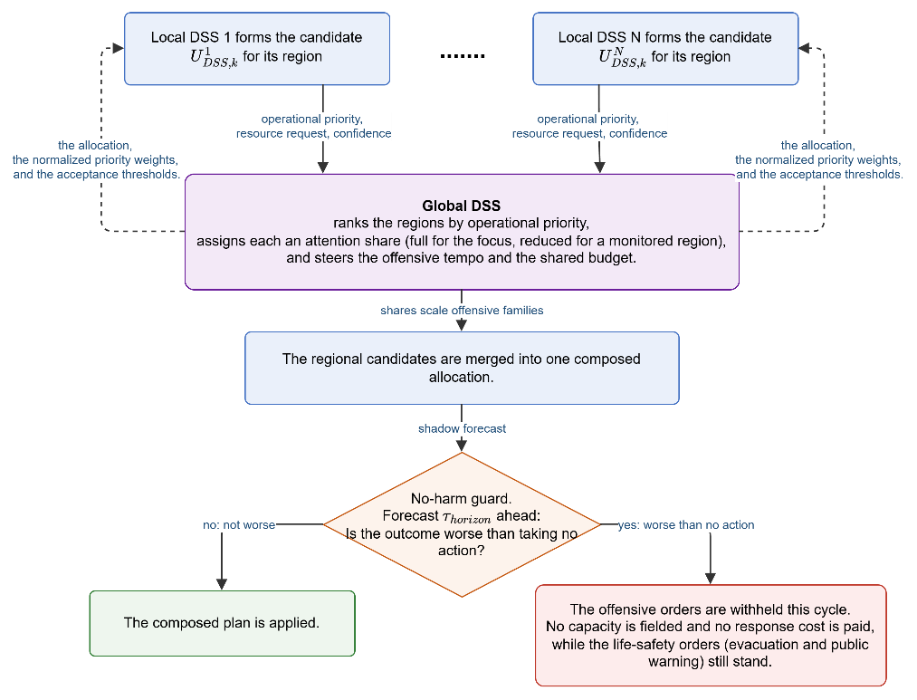
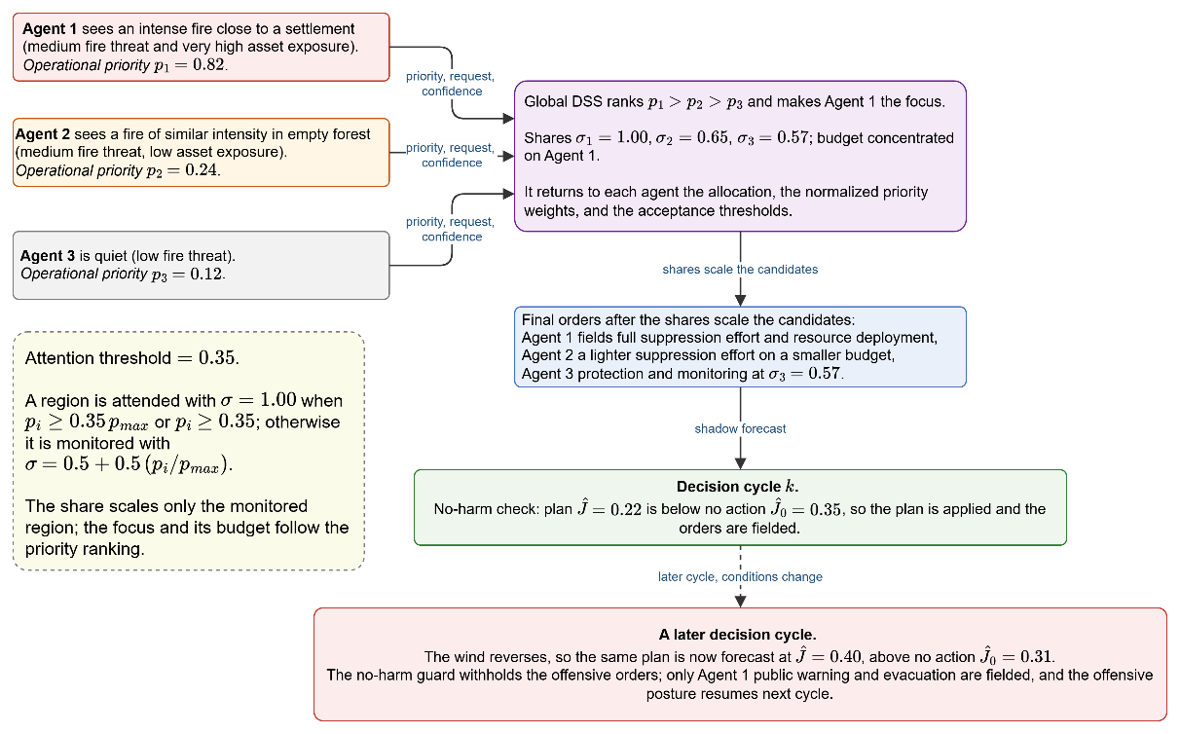
CHAPTER 4 · COORDINATION
Local decisions, global rationing, no global inference
Each local agent sends up three scalars: its priority, its request, and a short confidence summary. Nothing else leaves the region.
The coordinator ranks the regions and attends those whose priority reaches a fraction of the leader; the rest are monitored, not silenced.
The share scales the offensive orders and tightens the quality gate of a low-priority region.
A no-harm fail-safe withholds any composed order that the forecast says would make things worse.
Figures 4.11 and 4.12 Global coordination, worked example
Notes:
The coordinator performs no inference of its own. That is what keeps the architecture scalable, claim H1.

Slide 14
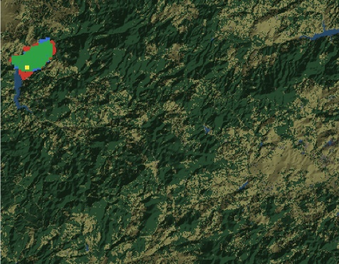
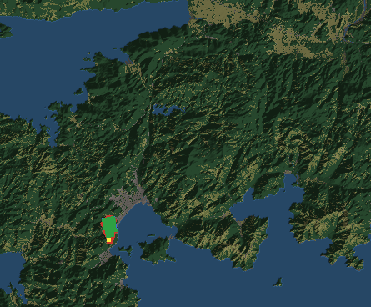
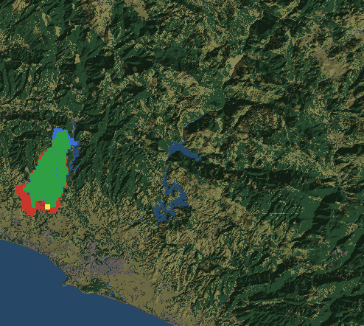
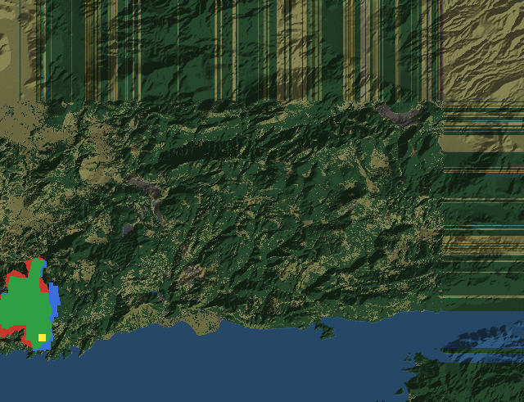
CHAPTER 5 · VALIDATION
The simulator is validated before it is trusted
Four blind hindcasts of documented wildfires, driven by real terrain, fuel and weather, with no tuning on the fire being predicted, scored against the satellite record.
Figure 5.1 Agreement maps. green: correctly predicted burn red: simulated only blue: observed only yellow: ignition
86-94%
4
0
spatial agreement
independent fires
parameters tuned on the fire
Only on that validated ground does the decision layer get measured.
Notes:
Validate the physics first, independently, then measure the decisions on top of it. A decision result on an unvalidated simulator would say nothing about fire.

Slide 15
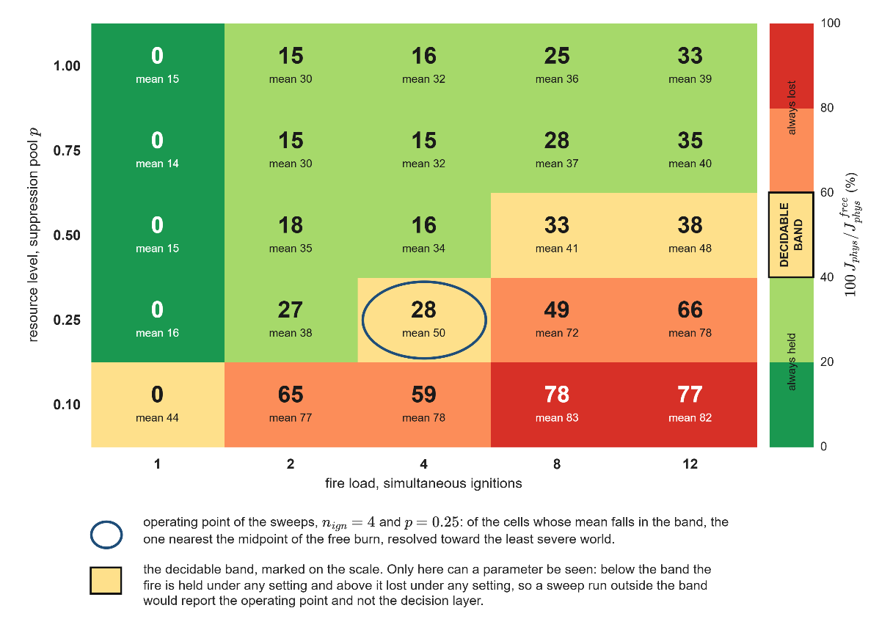
CHAPTER 5 · OPERATING ENVELOPE
Where the decision layer can be seen at all
The cost is read as a share of the free burn of the SAME world, so every cell is normalised by its own worst case.
At a tenth of the pool with more than one ignition the fire is lost whatever else is set: 77 to 83 per cent of the free burn.
With a full pool and up to four ignitions it stays at 14 to 32 per cent: the fire is won whatever else is set.
Only a narrow band in between can show a parameter at all. The sweeps are run at its midpoint: four ignitions, a quarter of the pool.
Figure 5.2 Physical cost over fire load and resource level
Notes:
This slide answers the methodological objection before it is raised: a sweep run outside the band measures the operating point, not the system.

Slide 16
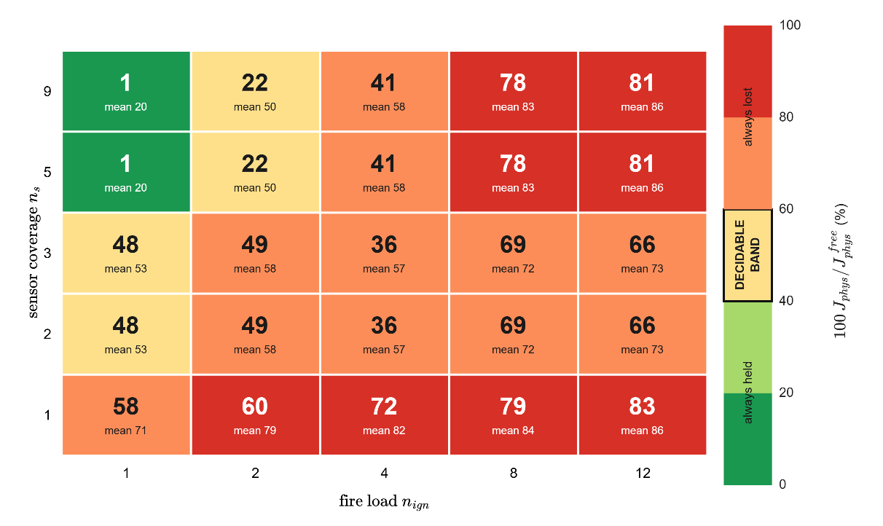
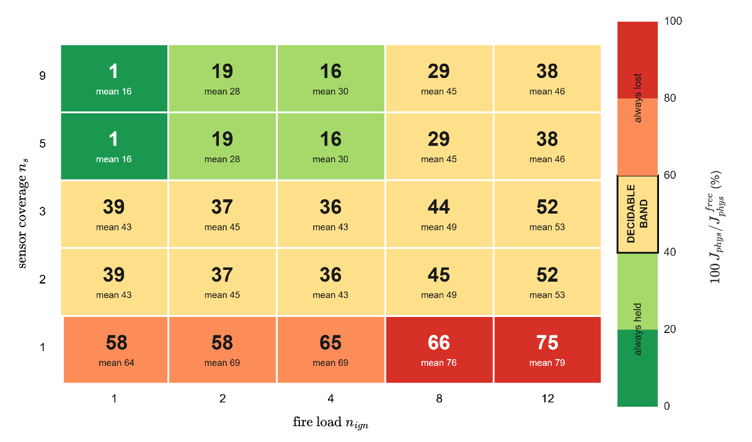
CHAPTER 5 · WHAT GOVERNS THE OUTCOME
Observation decides light fires, resources decide heavy ones
Figure 5.3 quarter pool
Figure 5.6 full pool
At a single ignition the cost falls from about 70 per cent of the free burn with one sensor to about 20 per cent with full coverage.
Coverage saturates early: five and nine sensors give the same result, and so do two and three.
At twelve ignitions with full coverage, the cost falls from 86 per cent at the quarter pool to about 46 per cent at the full pool.
Notes:
Suppression is aimed at the fire the network reports, so a map the network cannot see is a map the system cannot fight.

Slide 17
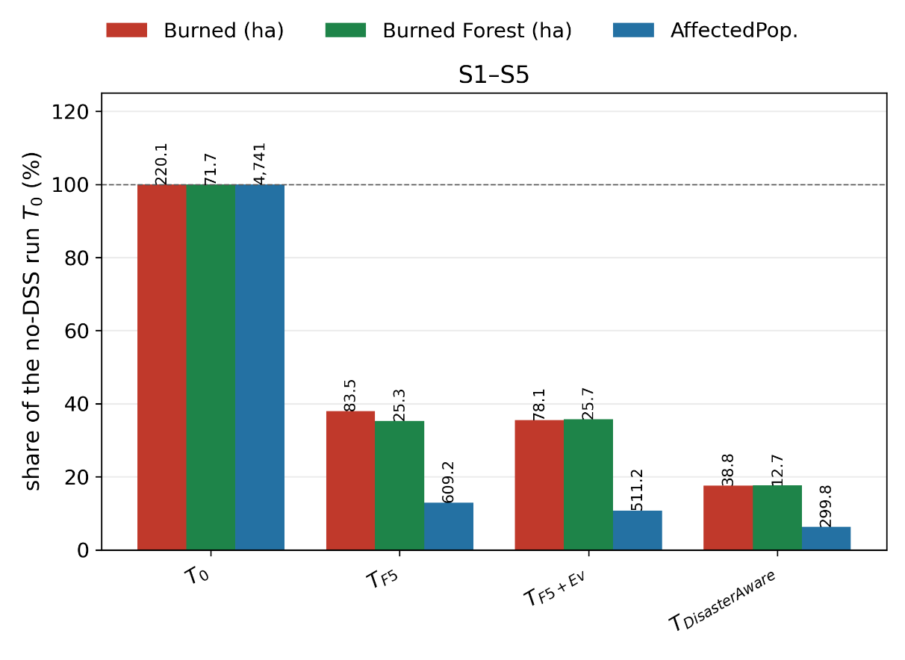
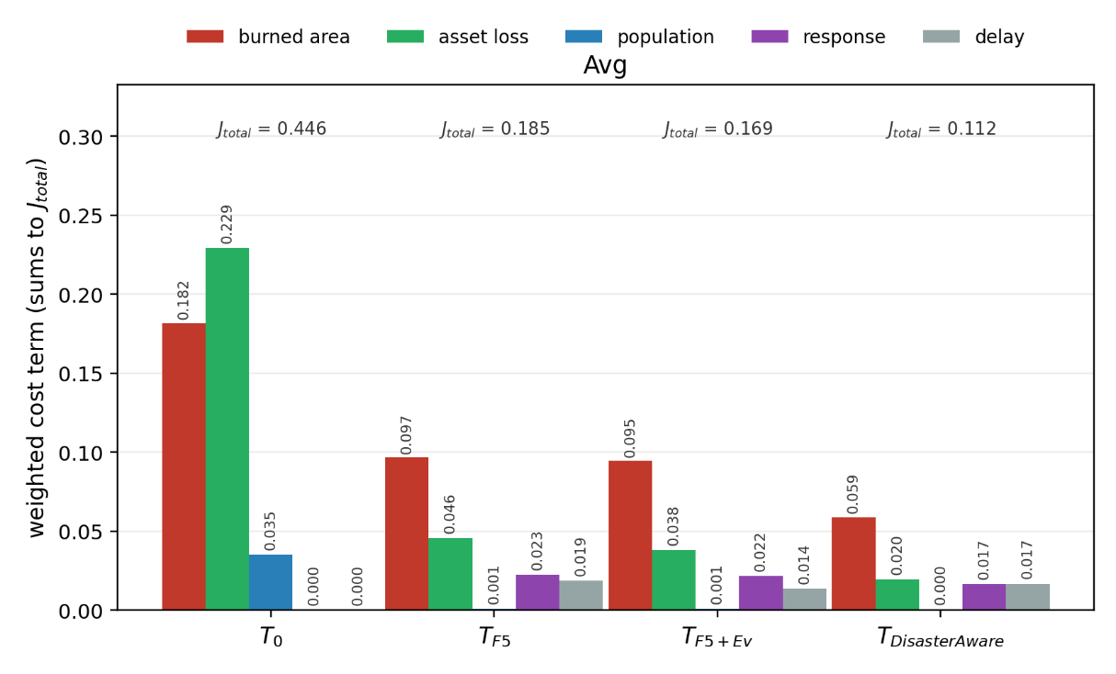
CHAPTER 5 · THE IMPROVEMENT LADDER
Each rung has to buy a visible gain over the one below
220 ha
84 ha
78 ha
39 ha
free burn
no decision layer
five static rules
62% reduction
+ evolving stages
lower in 4 of 5 scenarios
+ generative stage
82% reduction
Mean total decision cost falls 0.446 → 0.185 → 0.169 → 0.112, and the affected population from 609 to 511 to about 300. The lowest cost belongs to the open decision space even after its own response effort is charged.
Figures 5.16 and 5.18 Average physical outcome and total cost
Notes:
The ladder is the central empirical claim: the concept base beats no action, the evolving stages beat the static base, and the open decision space beats both.

Slide 18
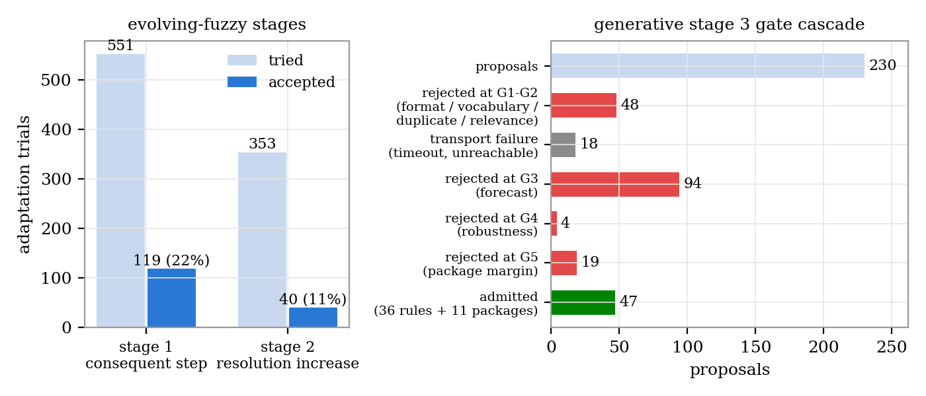
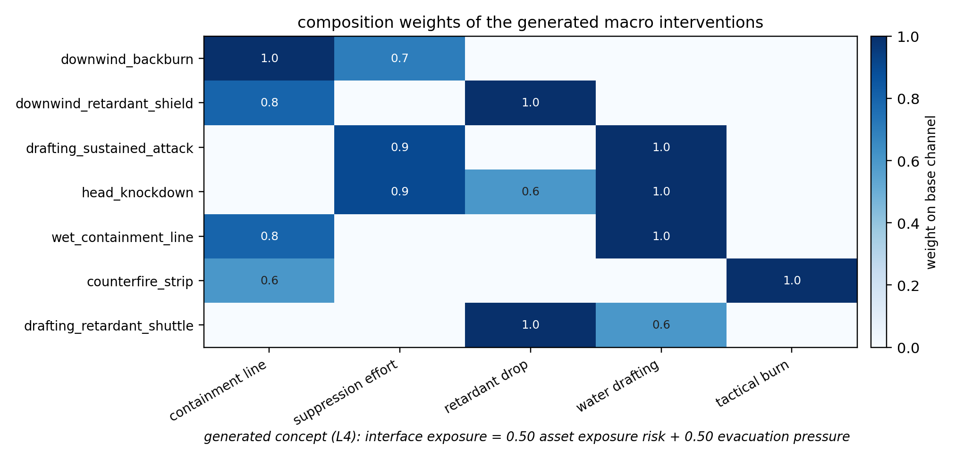
CHAPTER 5 · WHAT THE SYSTEM LEARNED
The base grew only where the field demanded it
41 rules instantiated on situations the seed base did not answer.
7 macro interventions composed from the base channels, and 1 new intermediate concept admitted into Layer 3.
Over roughly two hundred logged incidents, every addition carrying the deficit that triggered it.
Every rejected proposal is logged with the gate that refused it, which is what makes the funnel readable.
Figures 5.19 and 5.21 Adaptation funnel, macro compositions
Notes:
Compare with 3125 rules for the closed catalogue: the base reached 46 active rules, and each one is traceable to an incident.

Slide 19
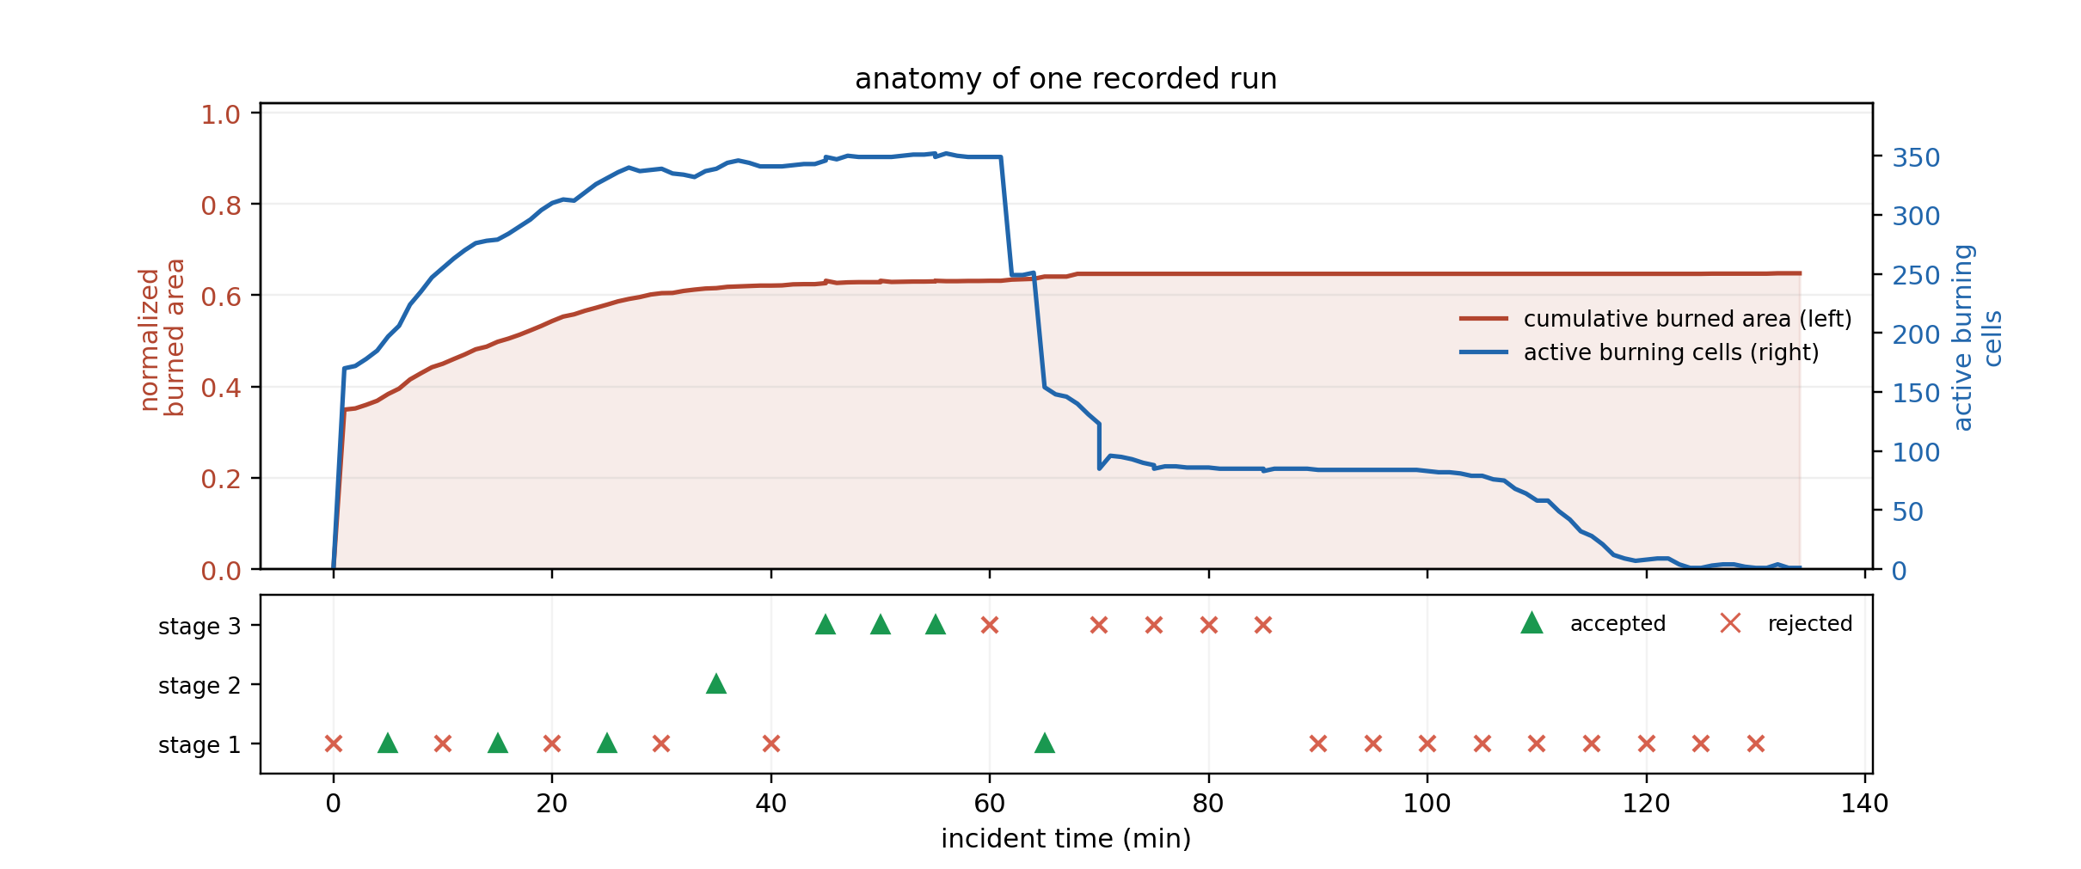
CHAPTER 5 · END TO END
One incident, ignition to containment
Observation, reasoning, coordination and adaptation run in the loop, not as separate studies.
Every fielded order traces to the concepts that demanded it, the rules that fired, and the confidence behind each feature.
No post-hoc attribution is used anywhere.
Figure 5.22
Notes:
This is the H3 evidence: the whole pipeline is operable, not just each part in isolation.

Slide 20
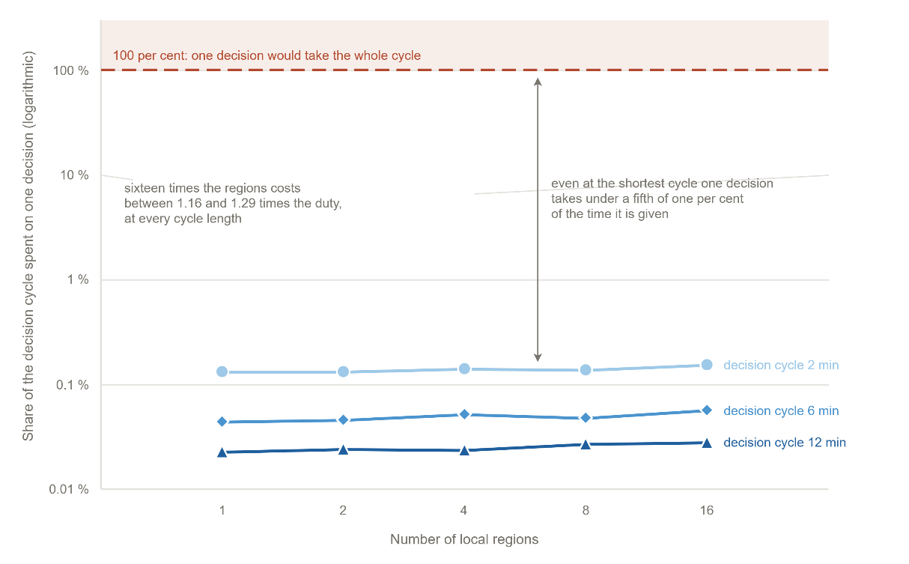
CHAPTER 5 · SCALING
The distributed decomposition does not cost performance
The decision cost is near flat in the number of local agents.
Rule-base complexity stays small because each agent reasons over five concepts, not over the whole grid.
Coordination adds no inference: three scalars per region per cycle.
This is the measured support for H1.
Figure 5.23 Decision cost against the number of local agents
Notes:
Degradation only appears once a region holds too few cells to carry a meaningful priority.

Slide 21
CHAPTER 6 · CONCLUSION
The three contributions are delivered
Open decision space
C1
5 seed rules grew to a field the expert never had to author. A closed catalogue would have needed 3 125.
Traceability and uncertainty
C2
Every order traces to concepts, rules and confidences. Every edit and every rejection is logged with its reason.
End-to-end over separated cores
C3
Physics validated independently at 86 to 94 per cent, then the decision core run on that ground.
H1, H2 and H3 are supported by the ladder, the traceability record and the end-to-end run respectively.
Notes:
Close by naming what would falsify each claim, and what the next chapter of work is.

Slide 22
CHAPTER 6 · FUTURE WORK
What the framework opens next
1
Live data
2
Wider actuators
Replace hindcast inputs with a live feed and measure the decision layer under real latency.
The discoverable actuator library can grow beyond drafting, retardant and tactical burn.
3
Operator study
4
Other hazards
The traceability record is built for a human reader; it has not yet been tested with one.
The concept layer is domain-shaped, not fire-specific: flood and earthquake response share the structure.
Notes:
Keep this short in the meeting; the advisor will have their own list.

