Slide 1
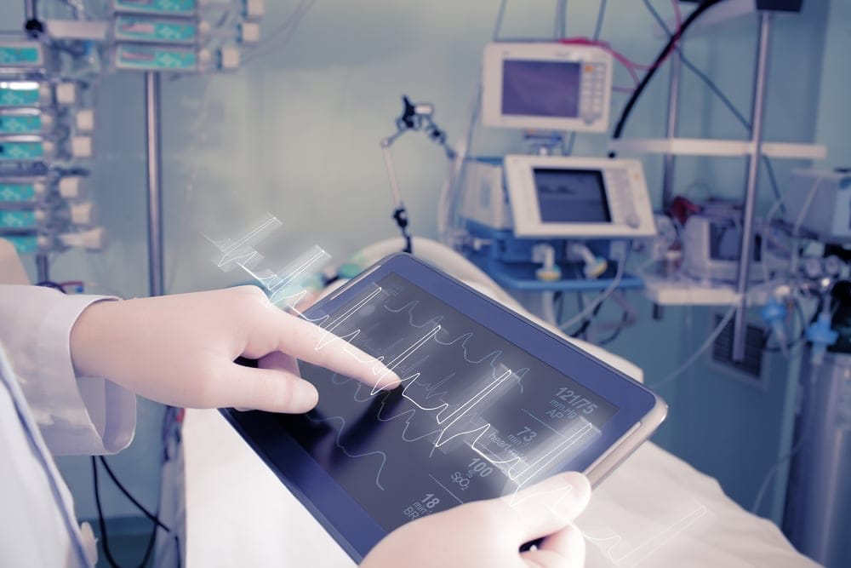
Technology in Medicine
Christian Norton
Source: Vantage MedTech

Slide 2
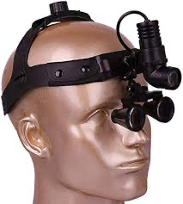
Early Medical Technology
One of the first advancements in medical technology was the magnifying glass in 1250
Other early advancements include…
Tools like eyeglasses and the stethoscope
Scans such as the x-ray
Other helpful things like anesthesia
Without these devices, an already complex field would be even more difficult
Source: Amazon

Slide 3
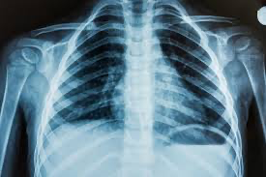
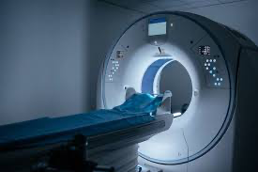
Radiology and Scans
The x-ray was created in the late 1800s
Energy beams passed through body → some bones and body parts block them from passing through
Silhouette appears on detectors and can be viewed by a radiologist
The computed tomography (CT) scan was invented in the late 1970s
Uses x-ray beams but rotates around the body to create a 3D picture
Magnetic resonance imaging (MRI) scans also invented in late 1970s
Use strong magnets and radio waves, which interact with atoms in the water molecules in body tissues
When radio waves are turned off, the atoms release energy which shows up on detector
Other scans include positron emission tomography, ultrasound, and nuclear imaging
Source: MedlinePlus
Source: Practice Plus Group

Slide 4
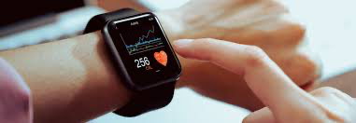
Wearable Devices
Source: HealthTech Magazine
Diagnostic devices include wearables like smart watches and fitness bracelets
Not new, but applications are continuing to develop
Used to record simple things like how many steps were taken in a day
Now collect data such as blood sugar levels, blood pressure, and heart rate
This can be shared with healthcare providers to construct personalized treatment plans

Slide 5
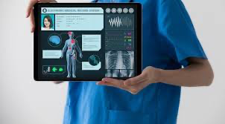
Electronic Health Records (EHRs)
Virtual storage of patient information has changed the way doctors interact with patients
EHRs are computer-based records that let doctors easily access history and information
Since the 1990s, common practice is to electronically record patient files
Now a central collection of everyone’s health data
Reduced cost → no printing, filing, paper storage
Reduced likelihood of errors
Source: AAMC

Slide 6
Blockchain and Cloud Technology
Blockchain allows participants to securely update and share data
Turns data transactions into an anonymous encoded block and adds it to a shared ledger accessible to those involved
Users can access information in real time
Secure → changes must first be approved by users with permission
Cloud technology is the foundation for the development of healthcare technology
Real-time access to information
Healthcare organizations can outsource system maintenance and management
These have improved the way information is managed, making it easier and more efficient to access medical data

Slide 7
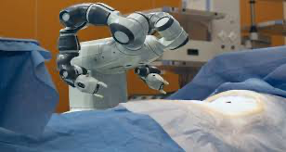
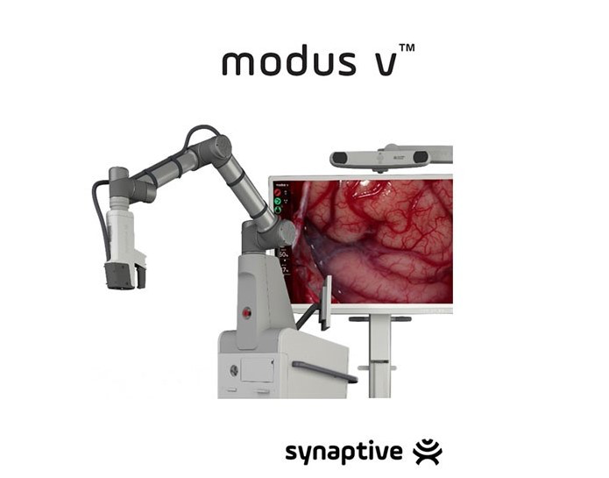
Robots
Source: Express Healthcare
Source: Tekim Medical
Began being used about 40 years ago, when a robot was used with CT navigation to insert a probe into the brain to get a biopsy specimen
Later robots followed, including those used to perform specific procedures
Models were designed to strictly operate under surgeons
Use computers and software to manipulate surgical instruments with precision
Smaller incisions, less blood loss, and quick recovery times
Modus V is an automated arm and microscope used in neurosurgery
Arm tracks instruments being used, automatically moves to the correct area, and projects a magnified image on a screen
Other robots double as protheses

Slide 8
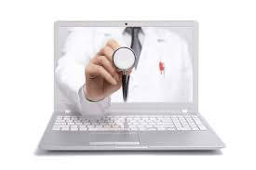
Telemedicine
Telemedicine is using electronic information and technology to support long-distance healthcare
Patients can talk to doctors, discuss results, take training courses, schedule appointments, etc.
Improves efficiency, engagement between clinician and patient, and treatment decisions
Reduces cost for patients
Source: News-Medical.Net

Slide 9
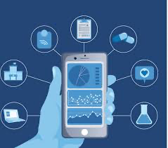
Remote Monitoring
Remote monitoring is a branch of telemedicine
As a result of this, patients don’t need to go to a hospital or clinic to provide their doctor with information
Medical devices can be attached to patients or held, allowing healthcare providers to track heart rate, blood pressure, glucose level, oxygen saturation, etc.
Saves times, keeps healthy patients away from those that are contagious, and allows for a simple flow of information to make treatment decisions
Smartphone apps, smart watches, or more specialized devices can assist with remote monitoring
Source: Nature Medicine

Slide 10

Benefits of Medical Technology
Source: AMN Healthcare
Improved efficiency
Processes are typically more efficient when using medical technology
EHRs can be accessed by everyone that needs to see them
Better communication
Online portals allow patients to access their test results and prescriptions whenever they choose
Another way for people to contact their medical team with questions or other concerns
Advanced diagnostics
Advanced systems help doctors and researchers determine the disease, infection, virus, or other condition affecting a patient
AI can model large amounts of data quicker than humans can

Slide 11
Benefits of Medical Technology
Personalized treatment
Clinicians customize treatment to each patient’s unique makeup, history, and needs
Patient empowerment
Patients are more informed, and can take steps to improve their diets and lifestyles
Reduced likelihood of medical errors
Cost savings
Telemedicine lets patients consult with doctors from home
EHRs avoid administrative costs

Slide 12

Access to Medical Technology
Some low-income countries still lack access to these tools
Donations are difficult because of a few barriers
Mismatch between equipment that’s needed and equipment that’s received
Difficult to sustain functions and costs of devices in the long-term
Some equipment is unsustainable or unused
Devices need to be delivered to many countries, increasing their cost
Source: MedTech Europe

Slide 13
Access to Medical Technology
If properly delivered, staff must be appropriately trained to keep the devices operating
Weather conditions impact these devices, often causing them to fail
Developing countries don’t have the necessary regulations set in place to implement and use advanced equipment
Donating equipment isn’t the solution
Proper planning and maintenance are the keys to success
Hopefully one day everyone will have access to the same technology, regardless of where in the world you are
Continued development of medical technology will play a critical role in shaping a more effective and reliable healthcare system in the future

Slide 14
References
Access to medical devices in low-income countries: Addressing sustainability challenges in medical device donations. NAM. (2024, November 8). https://nam.edu/perspectives/access-to-medical-devices-in-low-income-countries-addressing-sustainability-challenges-in-medical-device-donations/
Bakalar, N., Barrow, K., Huang, J., & Parker, D. (2012, October 10). Milestones in Medical Technology. The New York Times. https://archive.nytimes.com/www.nytimes.com/interactive/2012/10/05/health/digital-doctor.html#/#time15_375
Rampton, V., Böhmer, M., & Winkler, A. (2022, June). Medical Technologies Past and present: How history helps to understand the digital era. The Journal of medical humanities. https://pmc.ncbi.nlm.nih.gov/articles/PMC8260574/
The present and future of Healthcare Technology. What Is Healthcare Technology? (n.d.). https://www.oracle.com/health/healthcare-technology/
U.S. Department of Health and Human Services. (2024, June 17). Medical scans explained. National Institutes of Health. https://newsinhealth.nih.gov/2019/11/medical-scans-explained

