Slide 1
Git Intro

Slide 2
Learn git
https://git-scm.com/
https://git-scm.com/book/en/v2
https://try.github.io/levels/1/challenges/1

Slide 3
What is git
Git is a free and open source distributed version control system designed to handle everything from small to very large projects with speed and efficiency.
It’s a (distributed) VCS, like SVN, Perforce, CVS……
It’s a CLI tool

Slide 4
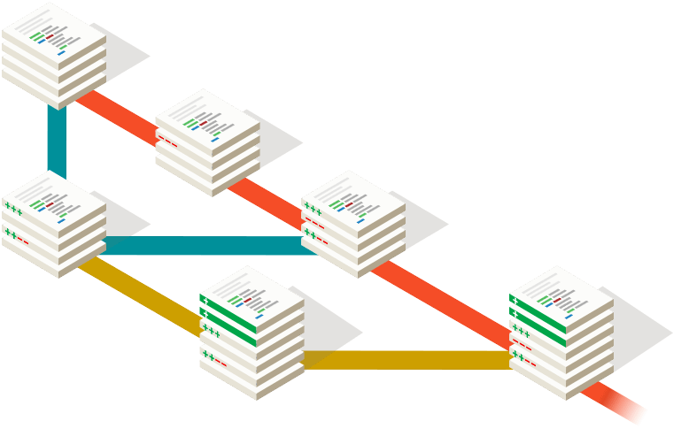
Key Concept
Unit
Repository
Branch
Commit

Slide 5
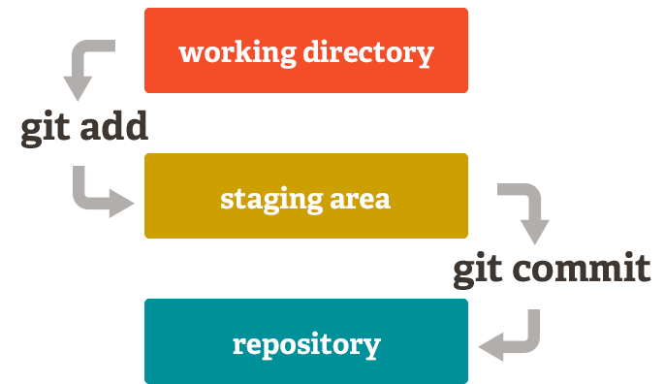
Key Concept
Three States
Working Directory
Stage Area
Repo

Slide 6
Key Concept
Actions
init/clone - create repo
add - push changes to staging area
diff - show changes
commit - push staged files to repo
stash - stash changes to have a clean working directory
log – see commit history
Branch/checkout – create/switch to a branch

Slide 7
Key Concept
Actions
fetch

Slide 8
Key Concept
Actions
merge

Slide 9
Key Concept
Actions
pull
fast-forward
merge
rebase

Slide 10
Key Concept
Actions
rebase

Slide 11
Key Concept
Actions
reset

