Slide 1
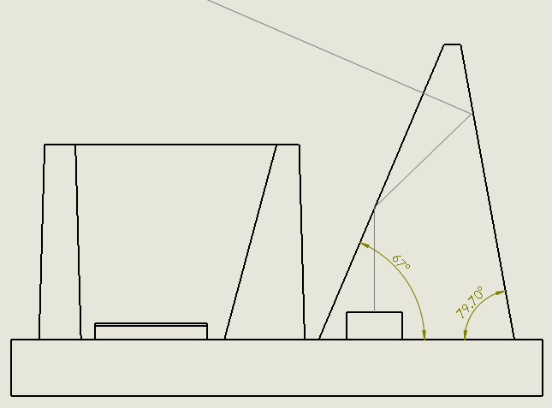
Ray path
Interface 1
Interface 2
Fence
Prism coat
Polarizer
& Color filter
Photodiode
VCSEL
Base

Slide 2
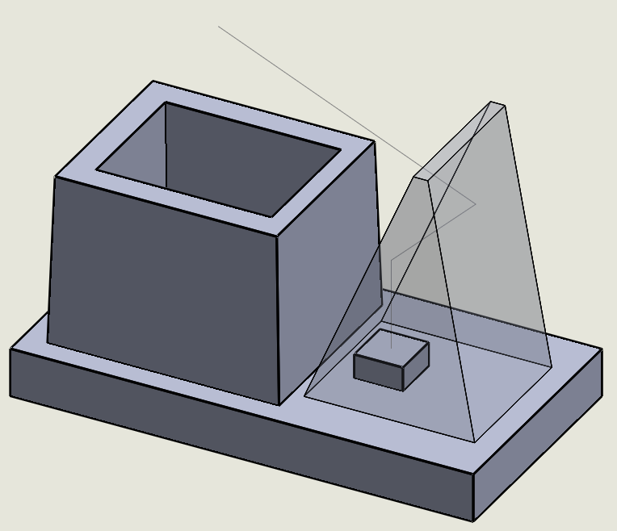

Slide 3
Spherical particle
Non-spherical particle
(aggregate)
Scattered light:
Not depolarized
Scattered light:
Depolarized

Slide 4
Aerosol
Polarizer 2
VCSEL(or LED)
Photodiode
(preferably avalanche diode)
Polarizer 1

