Slide 1
Where Science will lead me in the Future?
Nobuyoshi Hiramatsu

Slide 2

Personal Background
Major: Controlling Engineering
Toyama National College of Technology
Major: Applied Physics
University of Tokyo
Today's topic: Physics and its foundation
Research

Slide 3
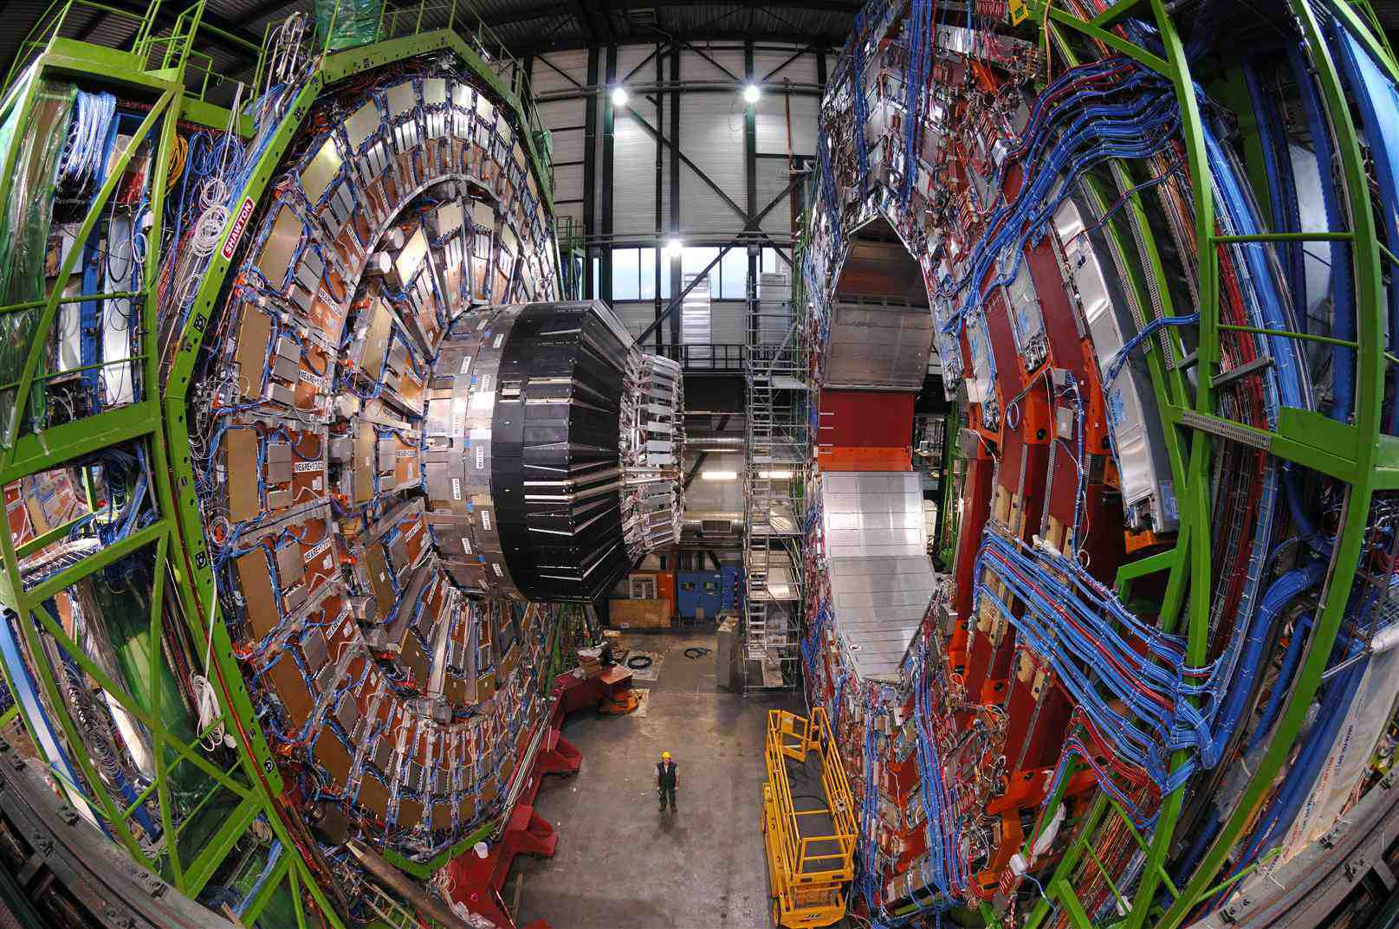
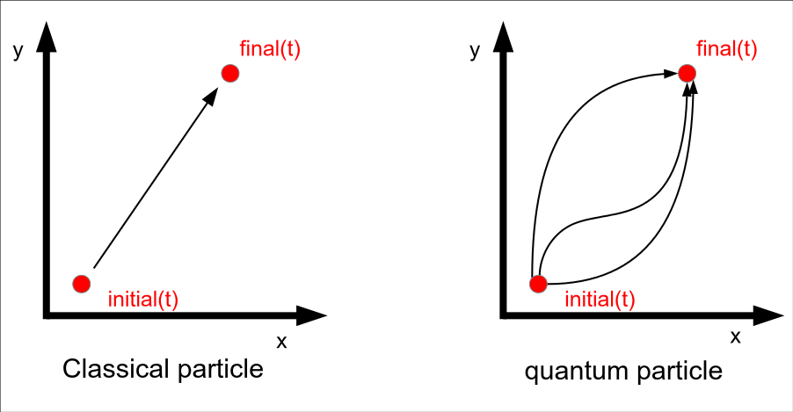
Physics
Both theoretical physics and experimental physics have developed interdependently.
theoretical
experimental

Slide 4
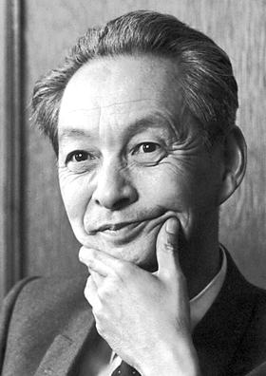
Experimentation
Experimentation constitutes a fundamental component of science as a whole.
Physics is a pursuit of a principle that underlies phenomenon in nature based on observable evidence.
Shin-ichiro Tomonaga,
What is Physics (1979)

Slide 5
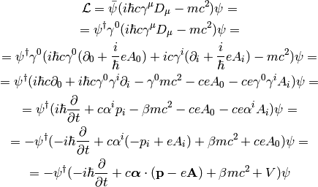
Theoretical Approach
Variational principle
Lagrangian of Dirac equation
For instance, we assume...
Invariance
- Poincare invariance, Gauge invariance
Locality
Vacuum state
Renormalizability, etc...

Slide 6


Physics
Theory
Experimentation
Physics maintains self-consistent structure.
Application
Change human society

Slide 7
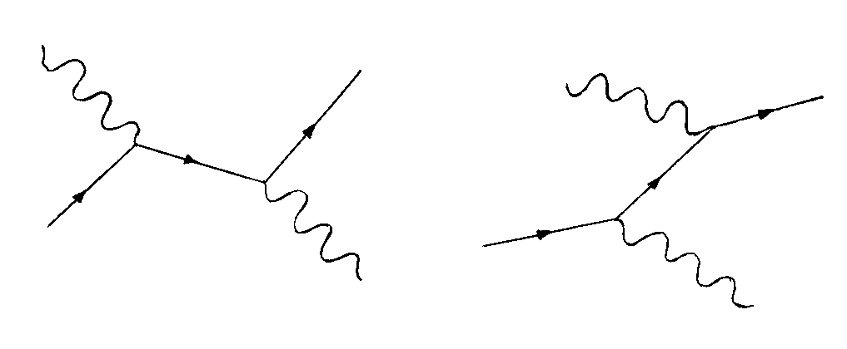
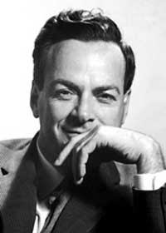
Quantum ElectroDynamics
QED is a quantum field theory regarding to ElectroDynamics.
- theoretically coherent
- experimentally agree with experiments
Compton scattering
Compton scattering
Rechard Fynmann called QED as “jewel of physics”, due to its accuracy and elegance.

Slide 8

Conclusion
The important feature of physics are …
- Robust basis
- A force that enhances human society significantly
In the acquisition of knowledge,
Physics gives us wings.

