Slide 1

Trustless Grid Computing in
Bor-Yuh Evan Chang, Karl Crary,
Margaret DeLap, Robert Harper, Jason Liszka,
Tom Murphy VII, Frank Pfenning
http://www.cs.cmu.edu/~concert/
18 Nov 2002 GRID 2002, Baltimore MD

Slide 2
The ConCert Project
Create a system and technologies for trustless grid computing in ad hoc, peer-to-peer networks.
  Trust model based on code certification.
  Grid framework using this model.
  Advanced languages for grid computing.
  Applications of trustless grid computing.
Interplay between basic research in type theory
and logic, programming practice.
This talk: code certification, grid framework

Slide 3
Why Peer-to-Peer?
Symmetric view of the network
  (giant computer with many keyboards:
  any programmer can run tasks on the grid)
Enables ad-hoc collaboration
No single point of failure
Lots of hard research problems!

Slide 4
Establishing Trust Relationships
Fundamental difficulty in peer-to-peer grid computing: establishing trust.
Code may be malicious (or simply buggy)
Cycle volunteers must trust that the code is safe to run
Native code is desirable: grid applications cycle-bound

Slide 5

Safety Policies
The ConCert system is policy-based.
“I only accept code that …”
  “… is memory safe.”
  “… does not write to my disk.”
  “… uses parsimonious resources.”
  “… comes from an educational institution.”
  etc.

Slide 6
Certifiable Policies
Certifiable now:
Memory safety, control-flow safety
Compliance with abstraction boundaries
  From these, many others (by controlled access to APIs and system calls)
Work in progress:
Resource usage (CPU, memory)
Privacy and information-flow properties
… how exactly are these certified?

Slide 7
Certification
Mathematical certification of policies
Proof (“certificate”) that the donor’s policy is met
Based on intrinsic properties of code, not the code producer’s reputation
Proofs in a specific machine-checkable form.
Basic technology: Certified Code

Slide 8
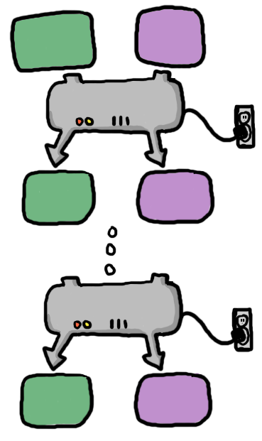
Certified Code: Certifying Compilers
code
certificate
Start with program in safe language: Java, SML, Safe C
Safe for some reason
Transform the code and simultaneously the reason that it is safe.
Finish with machine code, checkable certificate.
Doesn’t depend on compiler correctness.
No extra burden on app developer.
SML
IR
x86
(Bonus: great engineering benefits for compiler writers)

Slide 9
Certified Code
Several certified code systems.
Proof Carrying Code (PCC: Necula, Lee):
  Compiler produces a safety proof in logic
  Verification consists of proof checking
Typed Assembly Language (TAL: Morrisett, Crary et al.):
  Compiler produces type annotations for the machine code that imply safety
  Verification is type-checking
Both technologies work with native code
  No expensive/complicated JIT compilation step
  Allows for hand-tuned/proved inner loops

Slide 10
Typed Assembly Language
A taste of TAL code:
_fact:
LABELTYPE <F B4 B4::se junk 4::se>
MOV EDX, DWORD PTR [ESP+4]
MOV EAX, subsume(<B4>,1)
MOV ECX, subsume(<B4>,2)
FALLTHRU <a1,a2,a3,s1,s2,e1,e2>
forTest4:
LABELTYPE <L0 cap[] B4 junk4::se junk 4::se se {ECX:B4,EAX:B4,EDX:B4}>
CMP ECX, EDX
JGE forEnd6
IMUL EAX, ECX
ADD ECX, 1
JMP tapp(forTest4,<a1,a2,a3,s1,s2,e1,e2>)
forEnd6:
RETN
int fact(int i) {
int r = 1;
for(int j = 2; j < i; j ++) r *= j;
return r;
}

Slide 11
Typed Assembly Language
A taste of TAL code:
_fact:
MOV EDX, DWORD PTR [ESP+4]
MOV EAX, subsume(<B4>,1)
MOV ECX, subsume(<B4>,2)
FALLTHRU <a1,a2,a3,s1,s2,e1,e2>
forTest4:
LABELTYPE <L0 cap[] B4 junk4::se junk 4::se se {ECX:B4,EAX:B4,EDX:B4}>
CMP ECX, EDX
JGE forEnd6
IMUL EAX, ECX
ADD ECX, 1
JMP tapp(forTest4,<a1,a2,a3,s1,s2,e1,e2>)
forEnd6:
RETN
int fact(int i) {
int r = 1;
for(int j = 2; j < i; j ++) r *= j;
return r;
}

Slide 12
Typed Assembly Language
Size of certificates is a point of concern
For TAL, |certificate| ≈ |code|
lightharp.o (stripped) 122.5k (code)
lightharp.to 92.3k (cert)
Working on techniques to reduce this overhead
Code is cached; certificate can be deleted after it is verified once

Slide 13
Checkpoint!
A certified code system is:
  A way of supplying a proof that object code meets a safety policy
  A way of verifying that proof
Next: A peer-to-peer grid framework based around this technology.

Slide 14
The ConCert Framework
Difficult distributed computing task:
  Thousands of nodes
  Trustless environment
  High failure rate
Our engineering strategy:
  Intensely simple network abstraction
  Programming languages provide more convenient abstractions on top of the network

Slide 15
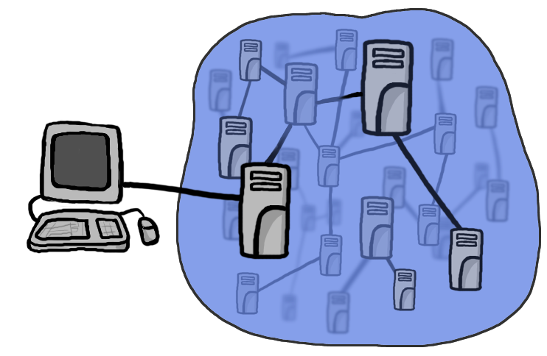

The ConCert Framework
The ConCert network looks like this:
120
Clients, that submit the initial work and collect and display the results.
A number of symmetric grid peers, that serve and run the work.

Slide 16
Cords
Cords are the unit of work on the grid.
Break up a program into smaller parts
  Can be scheduled more easily
  Can support failure recovery
Like compiler’s “basic blocks”
  Split by communication structure, not jmps
  Usually containing significant computation
    “… factor the number n.”
    “… evaluate this chess position 3 moves deep.”

Slide 17
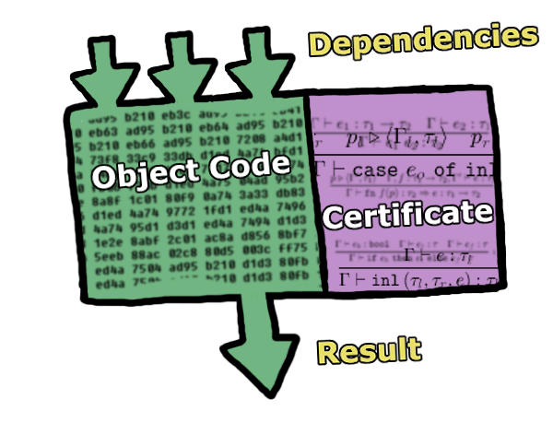
Cords
Cords can have dependencies on the results of other cords.
Identified by MD5 hash of code, certificate, dependencies.

Slide 18
Cords
Cords are simplified by three rules:
  Once a cord is ready to run, it does not block
    No “waiting” for another cord’s result
  Cords are idempotent
    Failed cords can be re-run
  Cords don’t rely on effects of other cords
    Communication explicit through dependencies

Slide 19
Cords
Not as restrictive as they may seem:
Cords can create new cords.
  (This is where certified code is really important!)
Some styles of parallelism can be coded up
  Continuation passing style ⇒ fork-join parallelism
  Compiler should be able to do this for you
Not yet clear what grid apps require more
This is validated by our prototype applications.

Slide 20
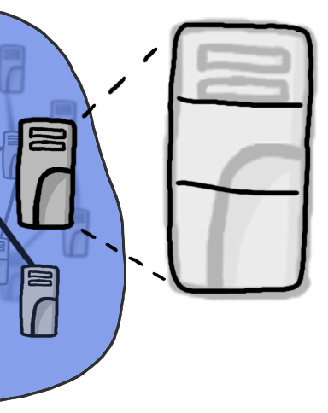
A Grid Participant (the Conductor software)
Locator
Discover other Participants.
Scheduler
Maintain a set of cords and their dependencies. Manage results returned by workers.
Worker(s)
Contact local and remote Schedulers to find cords. Download, verify the certificates, and run the code. Return the result.

Slide 21
Applications
Several Applications in the ConCert framework:
Lightharp: Ray Tracer
  Trivial branching with depth = 1
  External client “joins” on the cords it inserts
Iktara: Theorem Prover for Linear Logic
  Tougher: multiple results, functions as results
  Only runs on simulator now
Tempo: Chess Player
  Jamboree algorithm (Joerg, Kuszmaul)
  Fork-join style, depth > 1

Slide 22
Related/Future: Programming Languages
How to write grid applications?
  Language primitives for mobile code
  Code transformations and compilation techniques
  Compiler does the dirty work

Slide 23
Related/Future: Answer Verification
Certified code establishes trust in one direction.
But what about malicious volunteers?
  Might always give the same, wrong answer.
  Might collude with other donors to coordinate attacks!
Some problems have self-certifying results.
  Factorization: check that n * m = k
  Theorem proving: proof checking is easy
For other problems, use cryptography and voting or other techniques. (?) A work in progress!

Slide 24
Conclusion
Certified Code is the enabling technology for ad hoc peer-to-peer Grid computing.
ConCert is a policy-based framework where code comes with a proof (certificate) of safety within that policy. Proofs can be generated automatically by the compiler.
Cords are an appropriate basic unit of abstraction for such a network: They provide sufficient expressiveness while supporting failure recovery and straightforward scheduling algorithms.

Slide 25
http://www.cs.cmu.edu/~concert/

