Slide 1
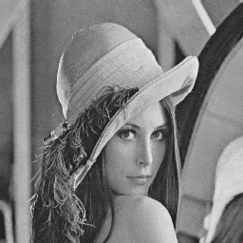
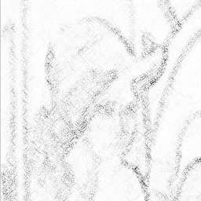

Copyright protection of digital images (authentication)
+
=
Original
Watermark
Watermarked
image
Robustness against all kinds of image distortion
Robustness to intentional removal even when all details
about the watermarking scheme are known (Kerckhoff’s
principle)
Watermark pattern must be perceptually transparent
Watermark depends on a secret key
Robustness to over-watermarking, collusion, and other attacks

Slide 2
Proving ownership using a digital watermark
Ownership is proved by showing that an image in question
contains a watermark that depends on owner’s secret key
If pirate embeds his own watermark, the ownership can be
resolved by producing the original image or the
watermarked image (neither contains pirate’s watermark)
Detectable watermark:
Pseudo-random sequence
is either present or not
present (1 bit embedded)
Readable watermark:
One can recover a short
message, e.g. info about
the owner (100 bits)

Slide 3



Fingerprinting or traitor tracing
Marking copies of one document with a customer signature.
original
+
…
W₁
W₂
W_{N}
…
N customers
Robust, secure, invisible watermark, resistant with respect
to the collusion attack (averaging copies of documents with
different marks).

Slide 4

Adding captions to images, additional information to videos
Typical application:
Adding subtitles in multiple languages
Additional audio tracks to video
Tracking the use of the data (history file)
Adding comments, captions to images
Watermark requirements:
Moderately robust scheme
Robustness with respect to lossy compression, noise adding,
and A/D D/A conversion
Original images (frames) not available for message extraction
Security requirement not so strong
Fast detection, watermark embedding can be more time
consuming

Slide 5

Watermarking principles
In spatial domain
watermark embedded
by directly modifying
the pixel values
In transform domain
watermark embedded in the transform space by modifying coefficients
+
=
DCT
Inverse DCT
Modify
DCT
Watermarking for color images
One or more selected color channels.
Luminance
Oblivious vs. non-oblivious watermarking
non-oblivious = original image is needed for extraction
oblivious = original image is not necessary

Slide 6

NEC Scheme
Watermark embedding:
1000 highest energy DCT coefficients are modulated with
a Gaussian random sequence w_{k} N(0,1). The watermark
is embedded by modifying the 1000 highest energy DCT
coefficients v_{k}
v_{k}’ = v_{k} (1 + aw_{k} ),
where v_{k}’ are the modified DCT coefficients, and a is the
watermark strength also directly influencing watermark
visibility.

Slide 7
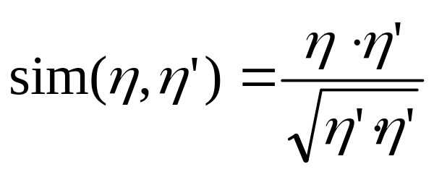
NEC Scheme
Watermark detection:
Subtract the original image from the watermarked (attacked)
image, and extract the watermark sequence η’ (may be
corrupted due to image distortion)
Correlate η with η’
η = original watermark sequence
sim(η, η’) is called similarity
sim(η, η’) > Th => watermark is present
sim(η, η’) < Th => watermark is not present

Slide 8
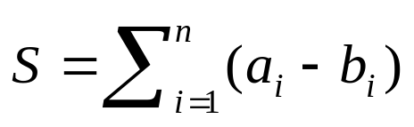
Direct Spread Spectrum in Spatial Domain
Patchwork, (Bender, Gruhl, and Morimoto)
Initialize a PRNG with a secret key
Randomly select n pixel pairs with grayscales a_{i} and b_{i}
Set a_{i} → a_{i} + 1 and b_{i} → b_{i} – 1
Use S to verify watermark presence
Hypotheses testing is used to confirm the presence of watermark
on a certain confidence level.
⟨S⟩ = 0 with σ = 104.5 × √n if no watermark is present
S ≈ 2n if watermark present
Set threshold Th to adjust probability of false alarms and missed detections
Using patches of pixels rather than single pixels improves robustness

Slide 9
Frequency Based Spread Spectrum Watermarking
Watermark embedding:
Transform image using DCT, DFT, Hadamard, wavelet,
key-dependent random transformations
Select n coefficients to be modified
- the most perceptually important coefficients
- fixed band depending on image size
- key-dependent selection (frequency hopping)
Generate pseudo-random watermark sequence w₁, …, w_{n}
Modulate selected coefficients v_{k}, k = 1, …, n
v_{k}’ = v_{k} + aw_{k}, (Ruanaidh et al.)
v_{k}’ = v_{k} + av_{k} w_{k}, (Cox et al.)
v_{k}’ = v_{k} + a|v_{k}|w_{k} (Piva et al.)
Use inverse transform to get the watermarked image

Slide 10
Watermark detection using correlation
Transform
coefficients
Original image v_{k}
Watermarked image v’_{k}
Attacked watermarked v’’_{k}
Non-oblivious schemes
Watermark approximation
v_{k}’ = v_{k} + aw_{k}, ⇒ u_{k} = (v’’_{k}– v_{k})/a
v_{k}’ = v_{k} + av_{k} w_{k}, ⇒ u_{k} = (v’’_{k}– v_{k})/av_{k}
v_{k}’ = v_{k} + a|v_{k}|w_{k} ⇒ u_{k} = (v’’_{k}– v_{k})/a|v_{k}|
Correlate u_{k} with w_{k}
Threshold the result
Make a decision about watermark presence

Slide 11
Watermark detection using correlation
Oblivious schemes
Correlate v’’_{k} with w_{k}
v_{k}’ = v_{k} + aw_{k},
v_{k}’ = v_{k} + a|v_{k}|w_{k}
If no distortion is present
corr = ∑ v’’_{k} w_{k} = ∑ (v_{k} + aw_{k})w_{k} ≅ anσ²
corr = ∑ v’’_{k} w_{k} = ∑ (v_{k} + a |v_{k}|w_{k})w_{k} ≅ an⟨|v|⟩σ²
If incorrect noise sequence is used
⟨corr⟩ = 0 with ⟨corr²⟩ ≅ n
which enables us to set a decision threshold

Slide 12
Frequency masking
The presence of a signal of one frequency can raise the
perceptual threshold of signals with frequencies close to
the masking frequency.
Masking signal
Masking threshold
Frequency
Masked signal
Spatial masking
Image discontinuities also have the ability to mask small
image distortions.
Luminance
Masking threshold
Edge

Slide 13

Perceptual Watermarking (Tewfik et al)
(1) Image divided into 8x8 blocks
(2) Each block is DCT transformed
(3) Frequency masking^{*)} determines JND for each freq. bin
(4) v_{k} = v_{k} + η_{k} JND(b, k)
(5) Block is inverse DCT transformed
(6) Spatial masking^{**)} model verifies invisibility
- If the changes are visible, JND is rescaled, goto (4)
Invisibility of the watermark guaranteed
Increased watermark energy leads to higher robustness
^{*)} Foley, Legge frequency masking model
^{**)} Girod’s spatial masking model

Slide 14


Data Embedding in Video (Tewfik et al)
Very high capacity with medium robustness
Useful for embedding video-in-video or audio-in-video
without increasing the bandwidth or requiring two separate
information streams.
Perceptual mask M
T = min M
8 x 8 block B
DCT
x
p
8 x 8 signature S
DCT
p’ = kT–T/4 ~ 0
p’ = kT+T/4 ~ 1
(k-1)T
kT
(k+1)T
Watermarked block B’ = B + (p’– p) DCT(S)

Slide 15
Robustness to geometric transformations
Easy if the original image is available (non-oblivious schemes)
Very challenging for oblivious schemes especially for a
combination of cropping, scaling, rotation, and shift
Approaches:
Watermarking by small blocks (good for cropping)
Embedding patterns with known geometry
Watermarking using Fourier-Mellin transform (scaling and
rotation converted to shift)
Embedding watermarks into image features or salient points
Weak points:
Computational complexity
More powerful geometric attacks - StirMark

Slide 16
Outline
Introduction
Covert communication (steganography)
Digital watermarking (robust message embedding)
Watermarking for tamper detection and authentication
- Fragile watermarks
- Semi-fragile and robust watermarks
- Hybrid watermarks
- Self-embedding
Attacks on watermarks
Open problems, challenges

Slide 17
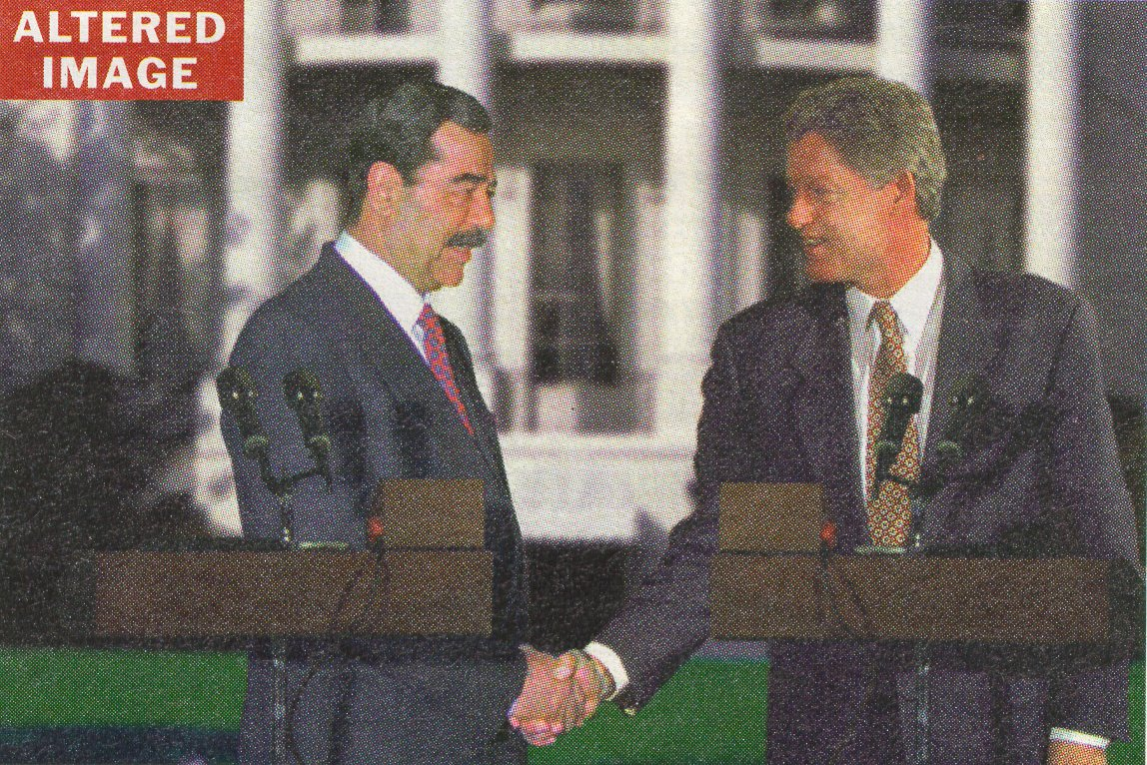
How to detect fakes like this?

Slide 18
Forensic analysis
Analysis of lighting and shadows
Localized analysis of
- noise
- histogram
- colors
Looking for discontinuities

Slide 19
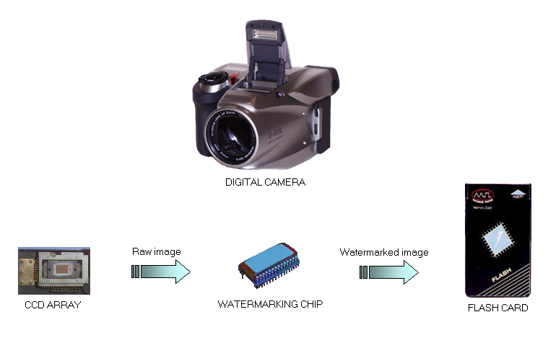

Slide 20
Fragile watermarks
Break easily
Computationally cheap
Good localization properties
Too sensitive for redundant data
Properties:
Embedding check-sums in the LSBs
Adding m-sequences to image blocks
Examples:
Steve Walton, “Information authentication for a slippery new age”, Dr. Dobbs Journal, vol. 20, no. 4, pp. 18–26, April 1995.

Slide 21
Fragile Watermarks for Tamper Detection
A set of key-dependent random walks covering the image
Choose a large integer N
For each walk, add the gray values determined by 7 most
significant bits; denote the sum by S
Embed the reminder S mod N into the LSB of the walk
Probability of making a compliant change is 1/N
S could be made walk-dependent to prevent exchanging
groups of pixels with the same check-sum
p₁: 1 0 1 0 0 0 1 1
p₂: 1 1 0 0 0 1 0 0
…
p₃: 1 1 0 0 1 0 0 1
7
1
2
6
5
3
4
S
Embedded check-sum
S mod N

Slide 22
2. Overlay the fragile watermark
Three key-dependent binary valued functions f_{R}, f_{G}, f_{B}
f_{R,G,B} : {0, 1, …, 255} → {0,1},
are used to encode a binary logo B. The gray scales are
perturbed in such a manner so that
B(i,j) = f_{R}(R(i,j)) ⊕ f_{G}(G(i,j)) ⊕ f_{B}(B(i,j)) for all (i,j)
The image authenticity is verified by checking the
relationship
B(i,j) = f_{R}(R(i,j)) f_{G}(G(i,j)) ⊕ f_{B}(B(i,j)) for each pixel (i,j)

Slide 23


Original image
f ( ) = 1
Perturb
Corresponding pixels
Authenticated image
Binary logo

Slide 24
Robust watermarks on small blocks
Medium robustness
Insensitive to small changes
Not as good localization properties
Can distinguish malicious and
non-malicious modifications
Properties:
Spread spectrum watermarks on
medium size blocks
Wavelet domain watermarks
Examples:
J. Fridrich, “Image Watermarking for Tamper Detection”,
Proc. ICIP ’98, Chicago, Oct 1998.

Slide 25



1. Insert robust watermark into every block
64 pixels
Robust
bit extractor
B
50 bits
Watermarked
block B
Secret
key K
W(K, B)
B
Synthesizing
Gaussian
sequence
+
=
Block #
B

Slide 26
Hybrid watermark
Fragile, sensitive, and robust
Good localization properties
Can distinguish malicious and
non-malicious modifications
Properties:
Robust watermarks on medium blocks
combined with a fragile watermark
Examples:

Slide 27
Self-embedding
Fragile
Security problems
Good localization properties
Tampered areas can be fixed
Easy to remove
Properties:
Coding quantized DCT transformed
blocks in distant blocks
Examples:
    J. Fridrich and M. Goljan “Protection of Digital Images Using Self Embedding”,
    Symposium on Content Security and Data Hiding in Digital Media, New Jersey
    Institute of Technology, May 14, 1999.

Slide 28
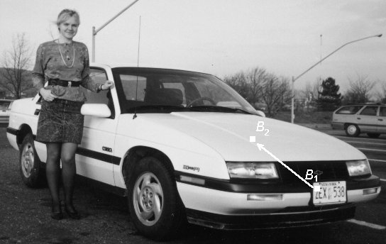
Images with Selfcorrecting Capabilities
Content of block B₁ is compressed and encoded in the
LSBs of B₂
B₁ and B₂ are separated by a random vector p

Slide 29
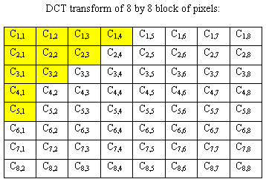
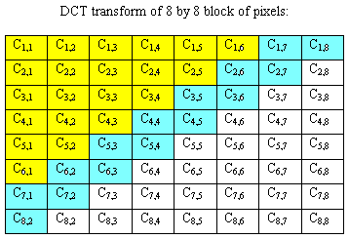
Selfembedding algorithm #1
QUANTIZATION
Binary encoding 11 coefficients
CODE1 : 64 bits per block
Selfembedding algorithm #2
QUANTIZATION
Binary encoding 21 coefficients
+ up to 2 next nonzero coefficients
CODE2 : 128 bits per block

Slide 30
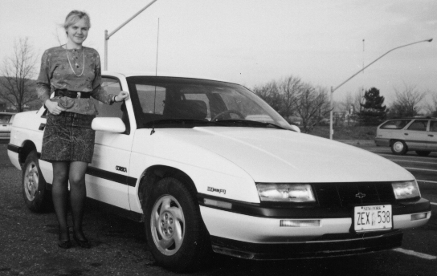
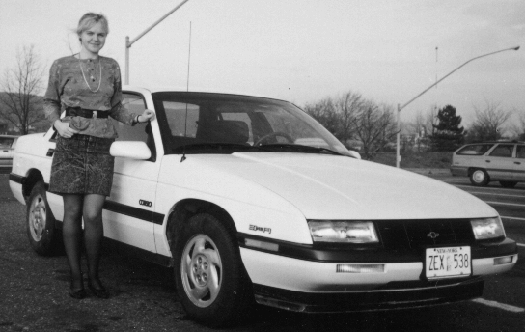


Original image
Original image embedded in itself
Embedded image (1 LSB encoding)
Embedded image (2 LSB encoding)

Slide 31
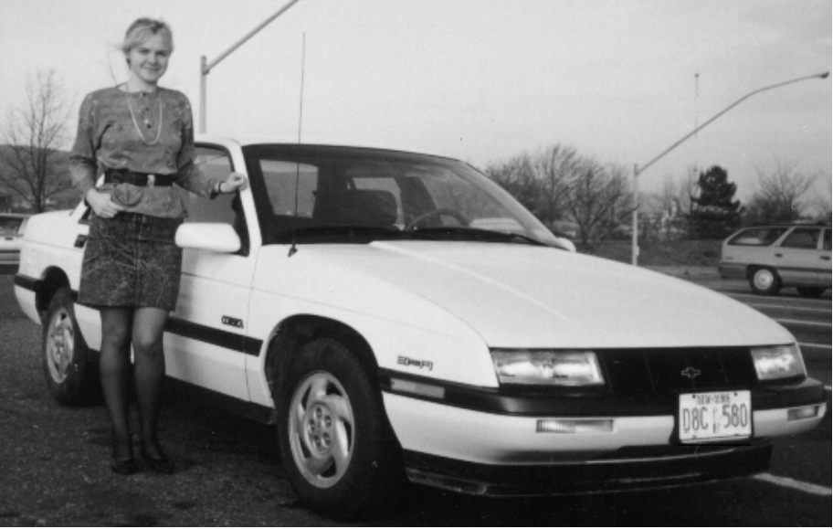

Reconstruction of a license plate
Tampered image - The license plate
has been replaced with a different one
The original license plate after
reconstruction
2 LSBs have been used for selfembedding

Slide 32
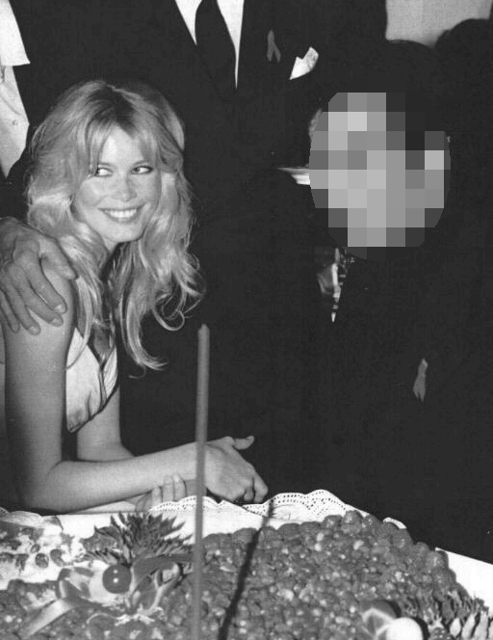

Reconstruction after mosaic filtering
Manipulated image
Reconstructed image
Secret key

Slide 33
Outline
Introduction
Covert communication (steganography)
Digital watermarking (robust message embedding)
Watermarking for tamper detection and authentication
Attacks on watermarks
- Desynchronizing detector with the image using geometric
deformations (StirMark)
- Combined effect of filters
- Watermark forgery (IBM attack)
- Collusion attack I (one image, many marks)
- Collusion attack II (one mark, many images)
- Attacks based on partial knowledge of the watermark
sequence or unwatermarked image
- Histogram attack, mosaic attack, attacks based on availability
of public detector
Open problems, challenges

Slide 34
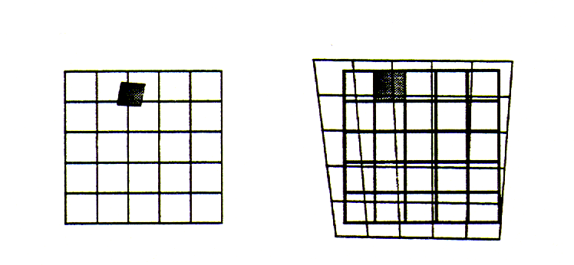
StirMark Attack
General, nonlinear (rubbersheet) deformation combined with resampling causes loss of synchronization between
the detector and the image

Slide 35
The IBM Attack (ownership deadlock)
Distributed image
+
=
Original X
belongs to Alice
Alice’s
watermark W₁
Watermarked
image Y
Bob generates a random watermark W₂
Subtracts Y–W₂ = X’ and creates a false original X’
X’ + W₂ = Y = X + W₁
X’ = X + W₁ – W₂ ⇒ X’ contains W₁
X = X’ + W₂ – W₁ ⇒ X contains W₂
identical
Distributed image
+
=
False original X’
belongs to Bob
Bob’s
watermark W₂
Watermarked
image Y

Slide 36
The IBM Attack - solution
Make the watermark dependent on the original image
in a non-invertible way
X + W₁(X) = Y
For example, W₁(X) is a watermark generated from a
PRNG seeded with a hash of X.
Creating a forgery amounts to solving the equation
Y – W₁(Z) = Z
for the unknown Z.
Another possibility is timestamping.

Slide 37

Secure public watermark detector
Detector is implemented as a tamper-proof black box
that takes integer matrices on its input and outputs one
bit (watermark present or not).
Application: Copy control in DVD players.
Assumptions: The attacker knows the watermarking
algorithm and the detection algorithm, has one
watermarked image available, but does not have the
secret built-in key.
Task: To obtain some knowledge about the secret key
or to remove the watermark

Slide 38
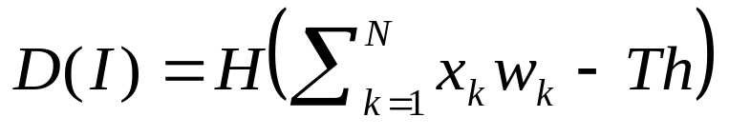
Secure public watermark detector
Many watermark detectors D correlate some quantities x_{k}
derived from the watermarked image I with a secret
sequence w_{k}:
Th … threshold
H … Heaviside step function, H(x)=1 for x > 0, H=0 otherwise
Attack: (Cox, Linnartz, Kalker, Dijk, ...)
(1) Find a critical image by progressively deteriorating the
image (for example, by replacing the pixel values
one-by-one by the average gray level)
(2) Feed the detector with special images to reconstruct w_{k} or
to learn the sensitivity of the detection function to various
pixels.

Slide 39

Secure public watermark detector
Statistical attacks (Kalker)
The culprit: Linearity of the watermark detector, and
the ability to purposely modify the derived quantities
through pixel modifications.
Sensitivity attacks (Cox, Linnartz et al.)
Determine the set of pixels with the largest influence
on the watermark detector; attempt to remove the
watermark by subtracting ×set_of_sensitive_pixels;
iterate.
The culprit: Sensitivity of the watermark detector at the
critical image is the similar or at least positively
correlated with that for the watermarked image.

Slide 40
Secure public watermark detector
Observation:
In order to design a watermarking method with a detector
that would not be vulnerable to those attacks, we need to
mask the quantities that are being correlated so that we
cannot purposely change them through pixel values and
we must introduce nonlinearity into the scheme to prevent
the sensitivity attack.
Key-dependent basis functions and a special nonlinear
detection function may solve the problem.

Slide 41
Outline
Introduction
Covert communication (steganography)
Digital watermarking (robust message embedding
Watermarking for tamper detection and authentication
Attacks on watermarks
Open problems, challenges
- Mathematical theory of steganography and watermarking
♦ Formalizing concepts, benchmarks, security proofs
- Oblivious secure watermarking - robustness to
♦ Geometrical operations
♦ Combinations of simple distortions
- Watermarking schemes with a secure public black-box
watermark detector
♦ Robust, nonlinear detector
- Secure image authentication with good localization
- Robust hash functions (robust bit extraction from images)

Slide 42
Mathematical theory of steganography
and watermarking
Analytical tool analogous to Shannon’s information theory
- Communication via noisy channel
- Noise is the image itself
Formalizing the concept of robustness and security
- Robustness with respect to blind attempts to
remove the watermark
- Security study should accept Kerckhoff’s principle
Creating a set of benchmark tests for watermarking
schemes
A method for comparing robustness of watermarking
schemes
- Set of standard tests
- Methodology for adjusting the watermarking strength
- Threshold setting

Slide 43
Oblivious secure watermarking
State of the art: Robustness with respect to changes in
gray levels and simple geometric transformations such as
shift, scaling, rotation, and cropping
Needs to be solved: Robust watermark with a computationally
efficient detector that can extract watermarks from images that
underwent a combination of gray level mapping and general
geometric distortions (StirMark)
Possible approaches:
Content Locked Coordinate Systems
Feature-based techniques
Embedding synchronization patterns

Slide 44
Watermarking schemes with a secure public
black-box watermark detector
State of the art: Virtually all watermark detectors are
thresholded correlators ⇒ vulnerable to a variety of general
attacks. Probabilistic thresholds somehow alleviate the
problem.
Needs to be solved: Clarify which properties of the watermark
detector are important. Is it nonlinearity, discreteness, or
non-invertibility? Design a robust watermarking technique and
a secure black-box detector
Possible approaches: Key-dependent basis, embedding a
pattern into the projections onto the basis functions, robust
nonlinear detector.

Slide 45
Secure steganographic authentication scheme with good
localization properties
- Watermark has to be a strong, key-dependent function
of the image content to prevent attacks based on
availability of multiple watermarked images
- Robust hash functions (robust bit-extraction)

