Slide 1


Adventure Works Cycles reports and analyses
Project done by Akhmedova Shakhnoza

Slide 2


INTRODUCTION Adventure Work is a large, multinational manufacturing company. The company produces and sells: Bicycle, accessories, clothing, components, bikes. Targeted areas for sale promotion: North American, European, Australian commercial markets. Adventure works company has 290 employees. base location is in Bothell, Washington

Slide 3

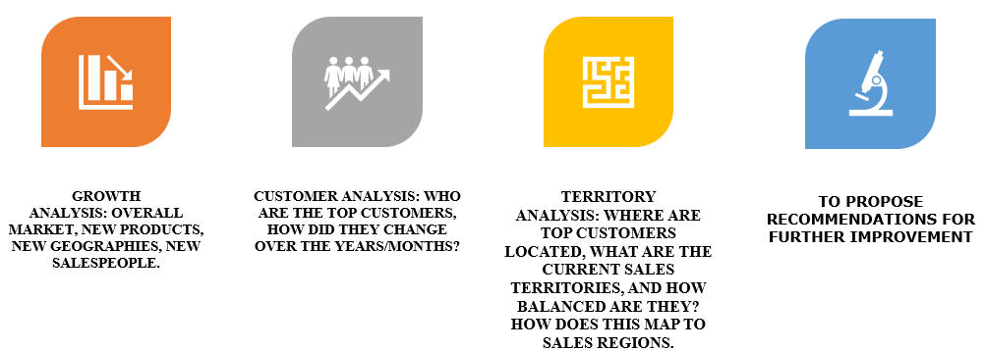
Research objectives:

Slide 4
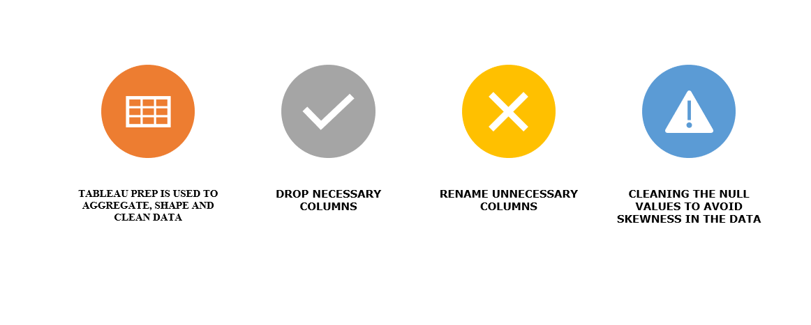
Data cleaning

Slide 5
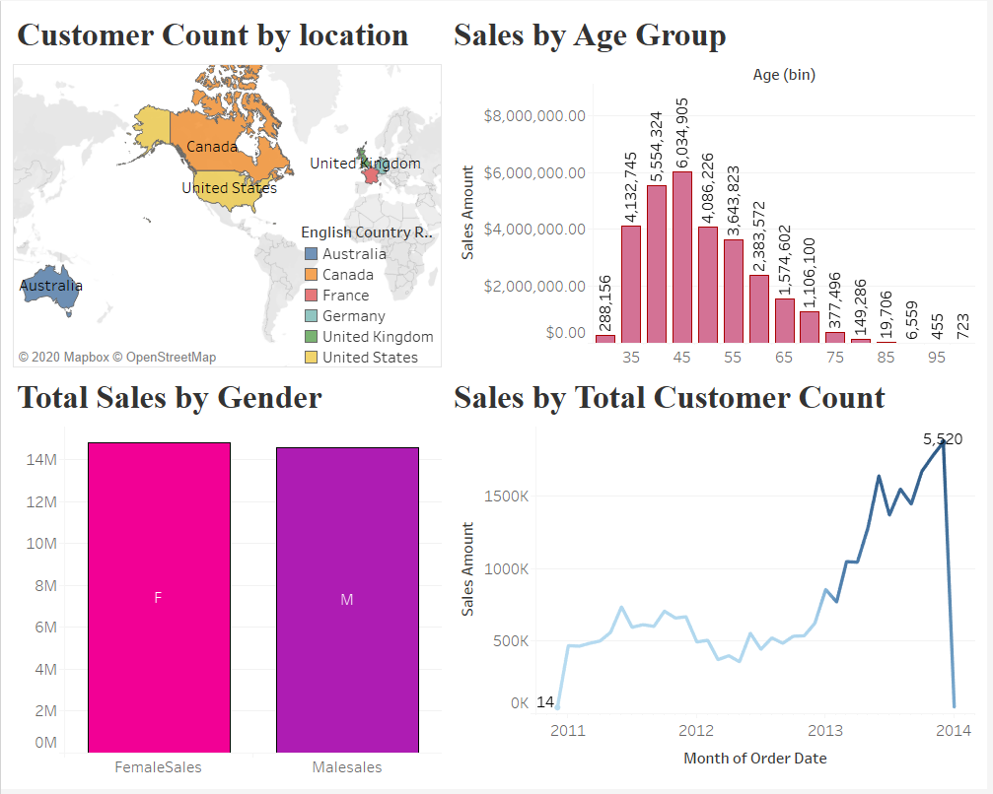
CUSTOMER ANALYSIS DASHBOARD

Slide 6
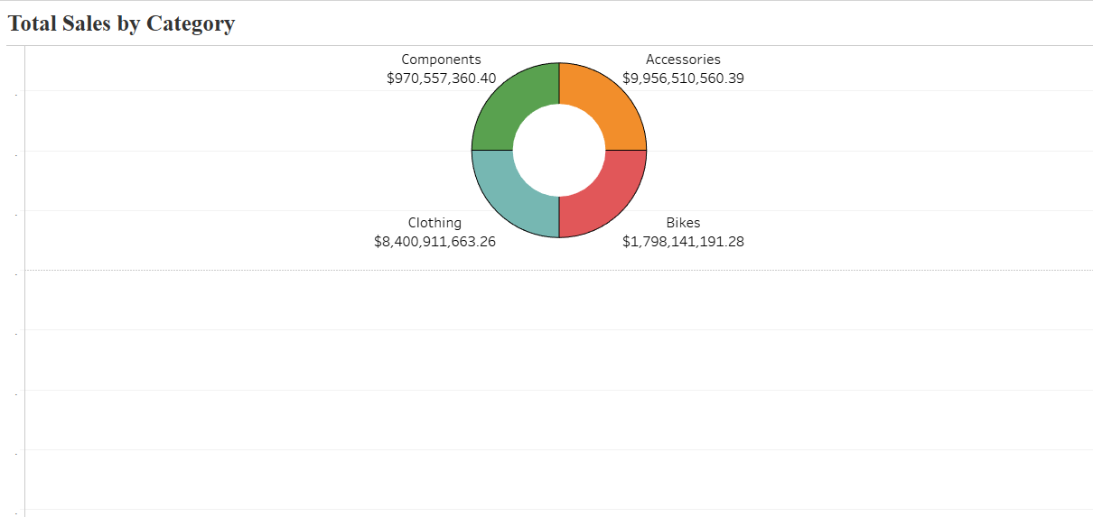
Total sales by Category of production offered by adventure works: Components: $ 970,557, 360 accessories: $9,956,510,560 clothing:$8,400,911,663 bikes:$1,798,141,191 insights: Accessories and clothing generate the largest sales.

Slide 7
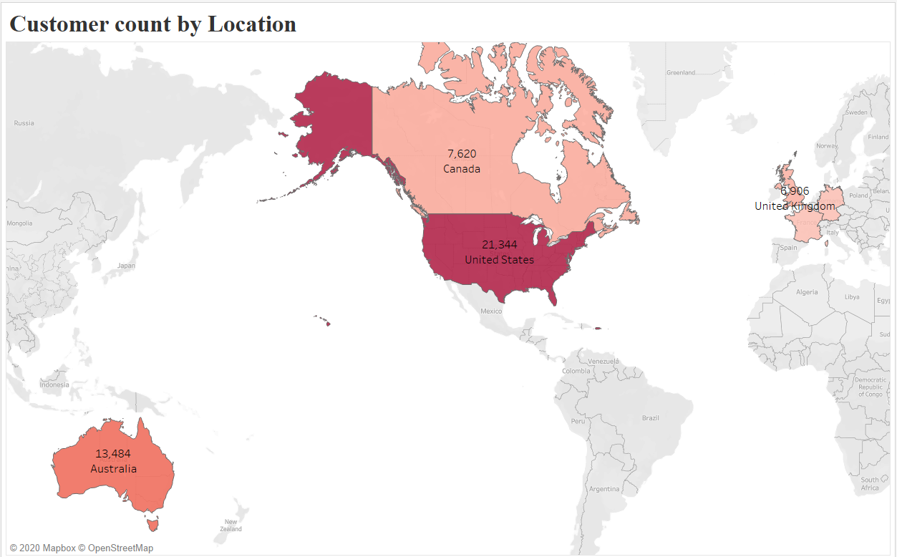
Demographics:
*expand the sales to Asian region, increase total number of customers in European and Canadian regions.

Slide 8
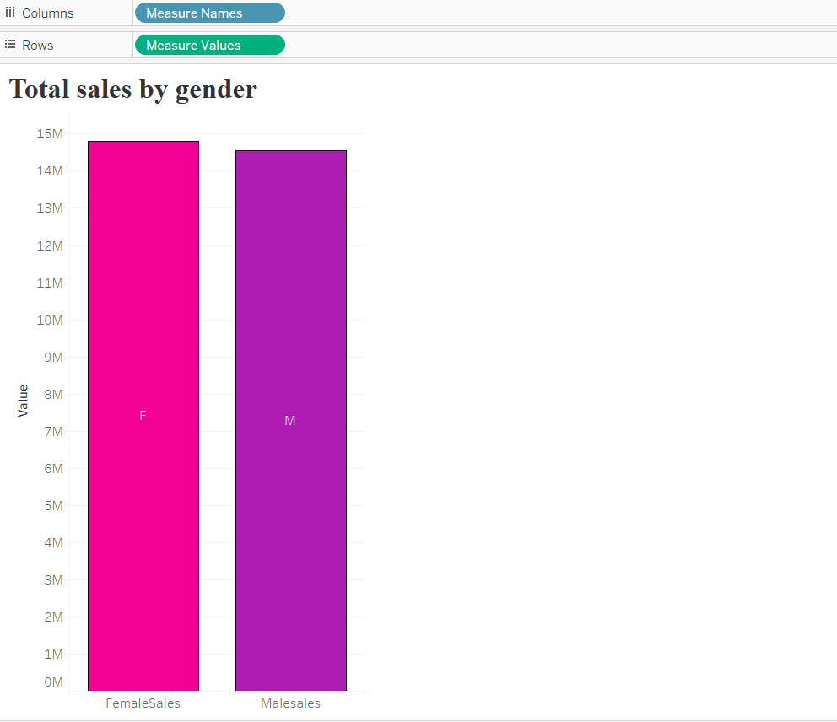
Gender-wise insights on sales amount: Sales amount based on gender is almost balanced: Total female sales: $14,813, 619 TOTAL MALE SALES: $14, 545, 059

Slide 9
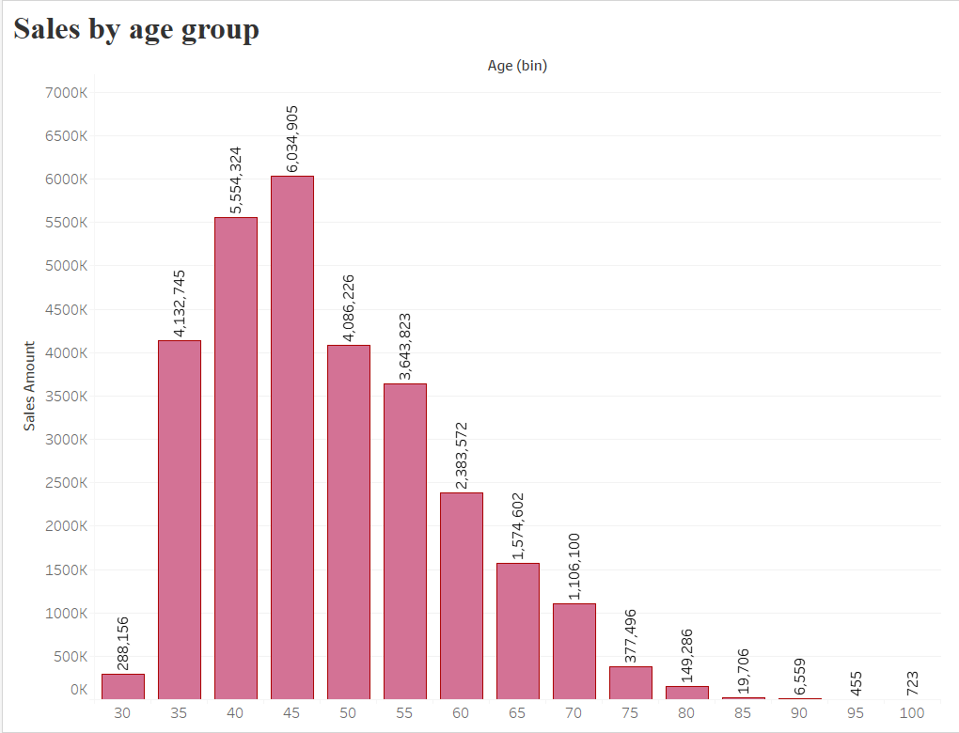
Sales by age group: most sales are generated by age group of 35-60-year OLDS. THE COMPANY CAN EXTEND ITS PRODUCTION OF GOODS AND SERVICES TO PEOPLE UNDER 30 years old.

Slide 10
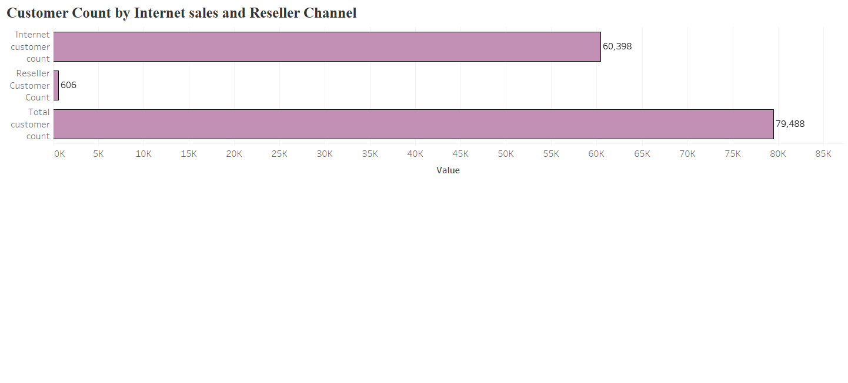
Calculated fields: Internet customer count: count(customer key(internet fact table)) Reseller customer count: Count(Customer key(reseller customer key)) Total customer count: (Internet customer count + Reseller customer count)

Slide 11
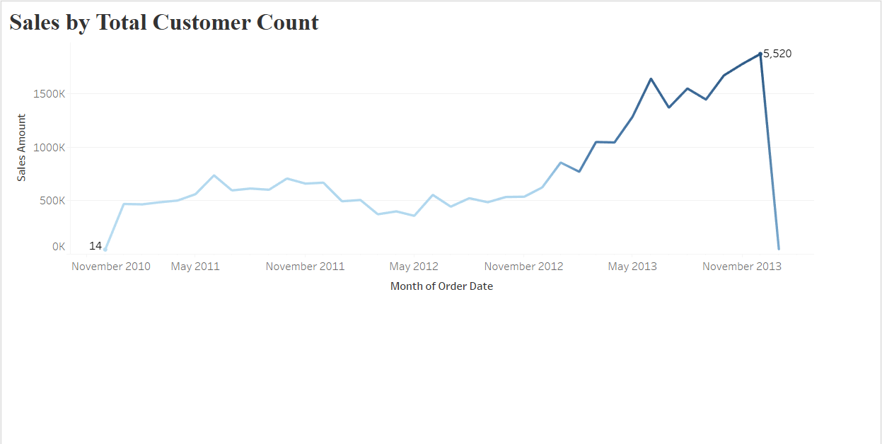
AS of November 2010, the company had only 14 customers, and we can see how this figure and sales have got improved over three years.

Slide 12
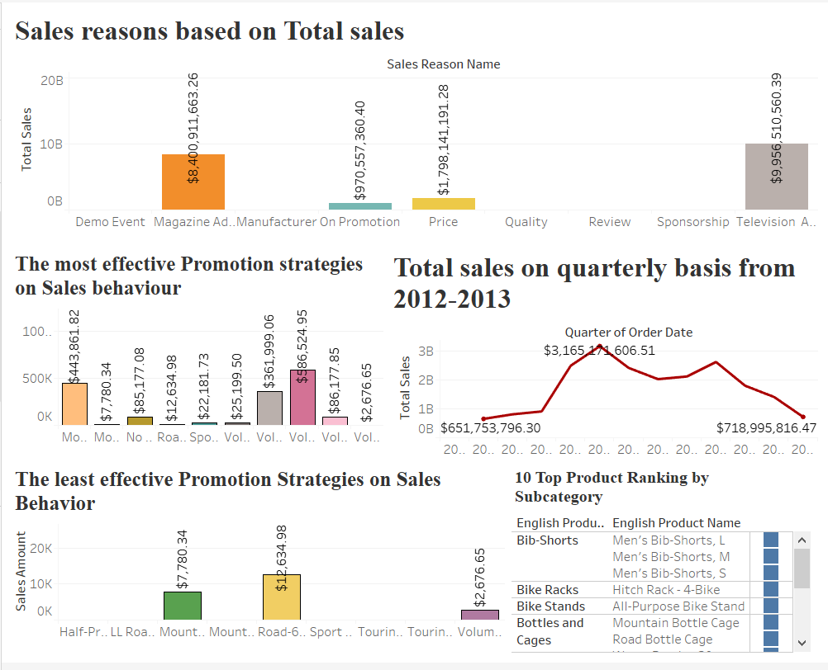
Growth ANALYSIS DASHBOARD

Slide 13
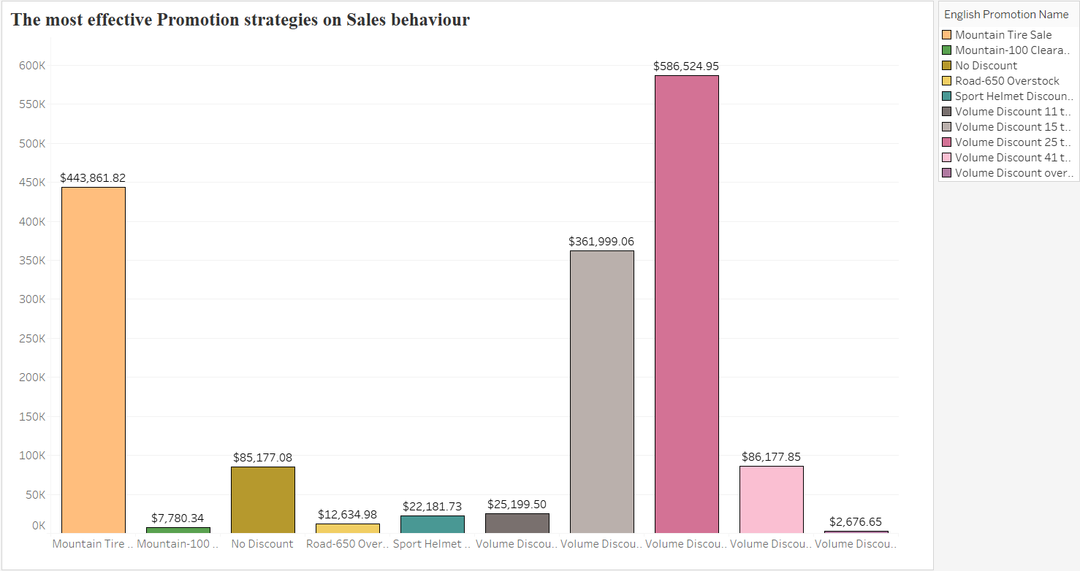
Top 5 promotion sales names: 1. Volume discount 25-40 2. Volume discount 41-60. 3. Mountain tire sale 4. Volume discount 41-60 5. No discount

Slide 14
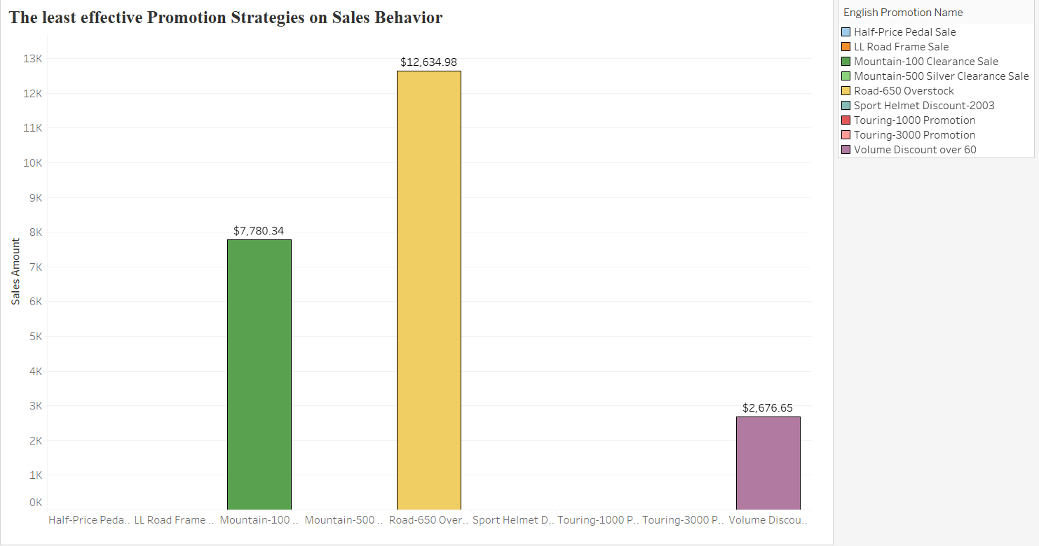
Top 5 failed promotion strategies 1. Half-price pedal sale 2. ll road frame sale 3. mountain- 500 silver clearance sale 4. sport helmet discount 5. Touring 1000-3000 promotion

Slide 15
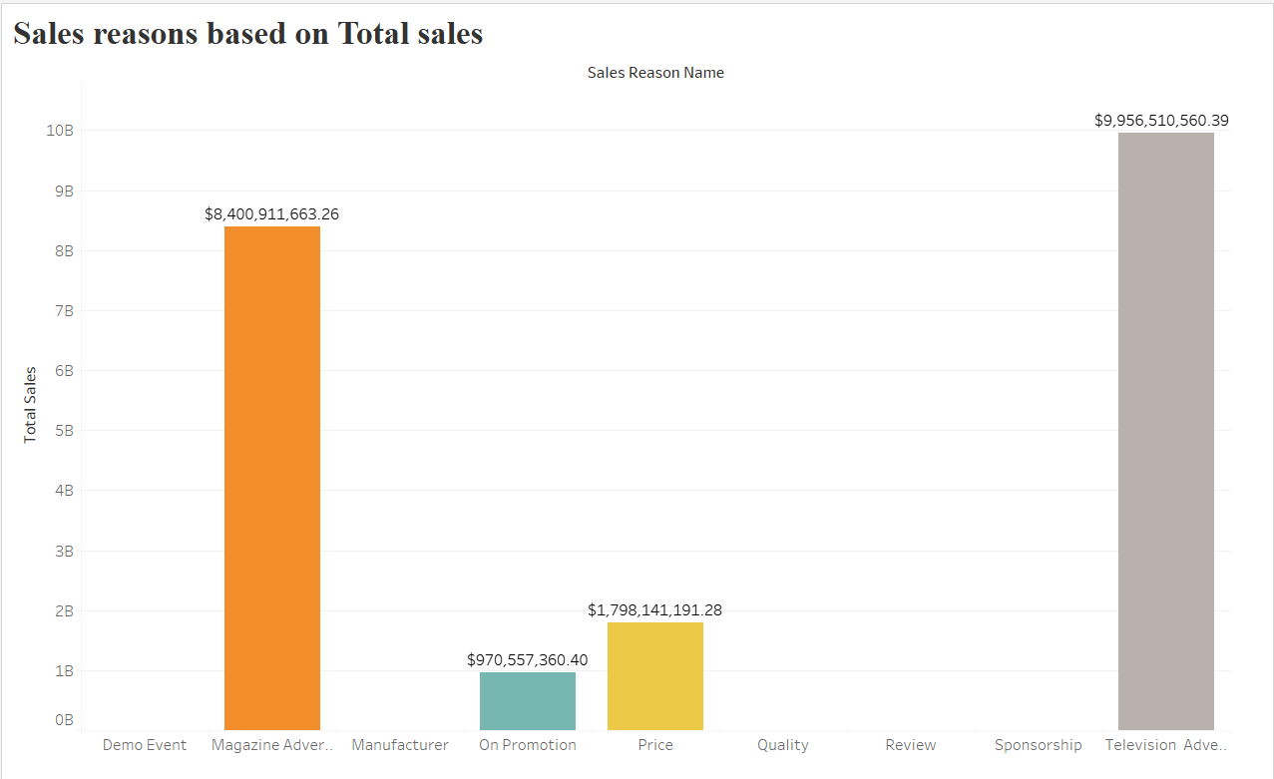
Top 4 Sales reasons that generated the most revenue 1.Television advertisement 2. magazine advertisement 3. Price 4. on promotion

Slide 16
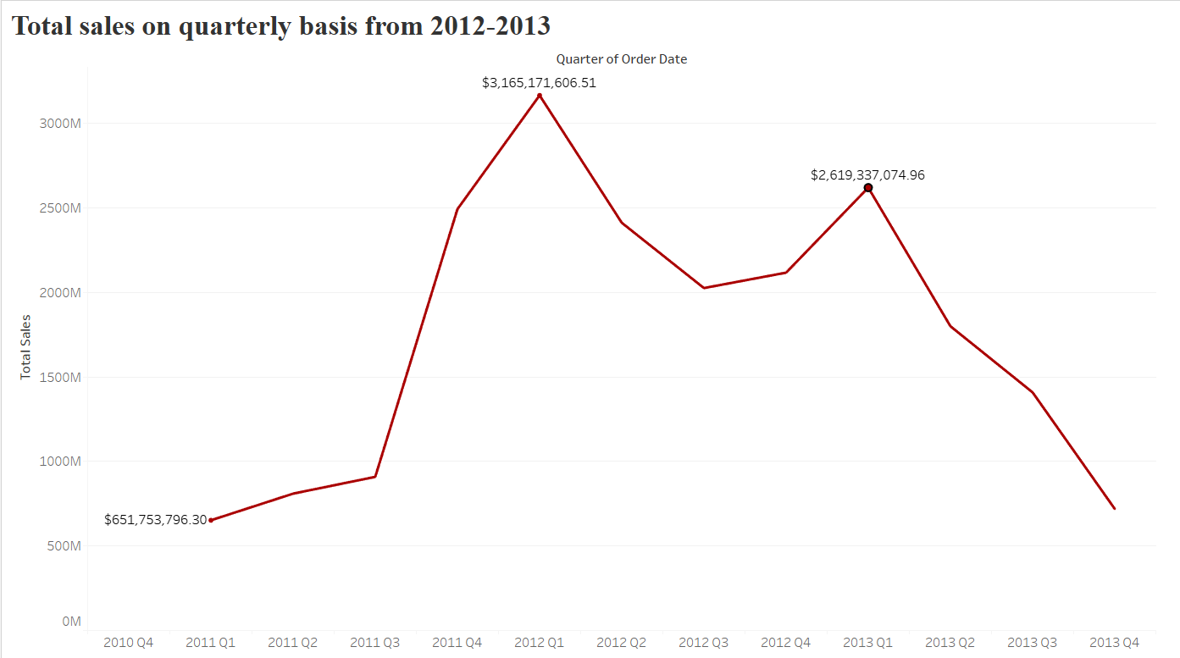
FEASIBLE REASONS FOR DECREASE IN SALES: 1. Rising costs in production 2. ignoring customer needs(people under 30 age group ignored) 3. Ineffective marketing and promotion strategies

Slide 17
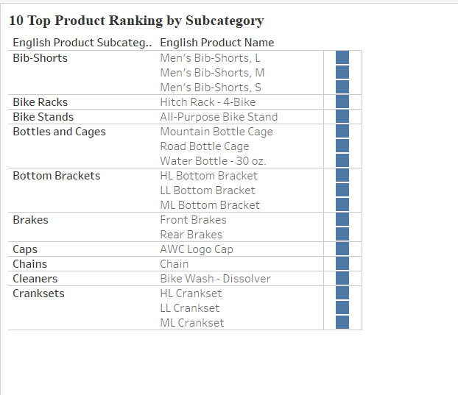
10 top products by subcategory

Slide 18
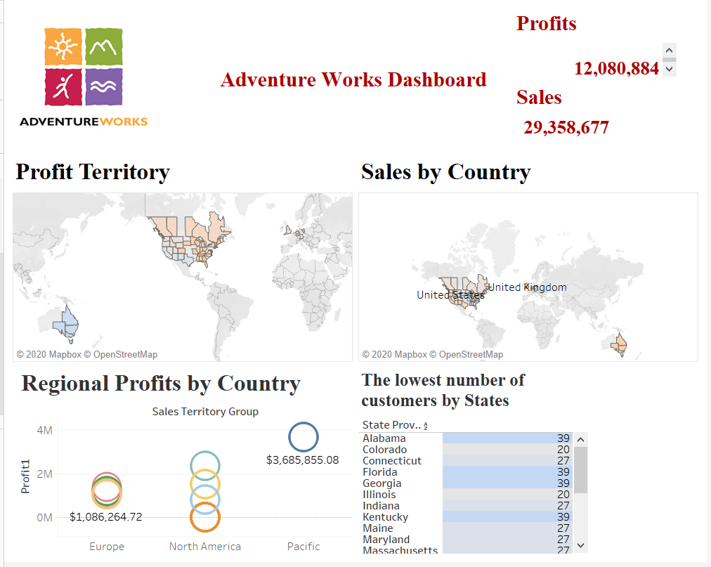
territory ANALYSIS DASHBOARD

Slide 19
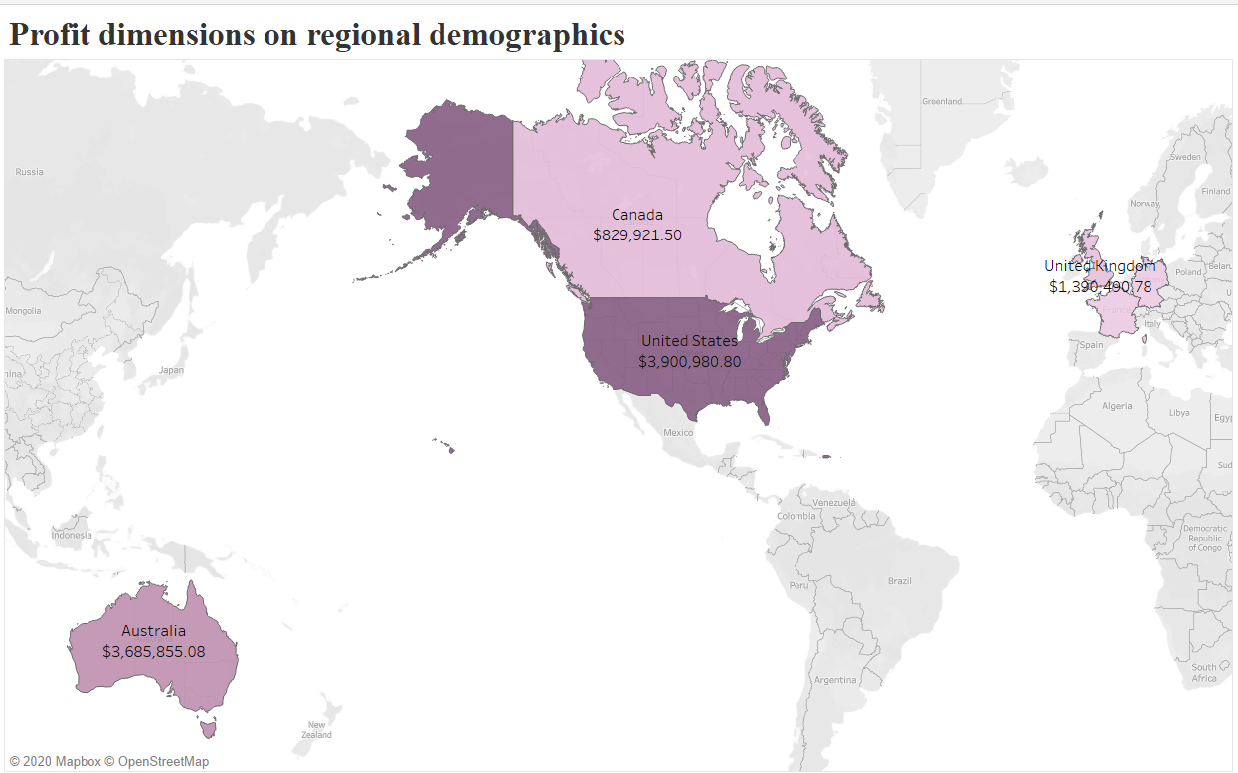

Slide 20
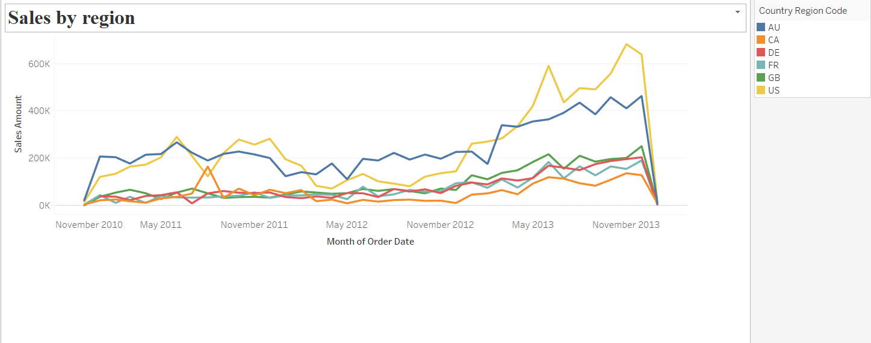
Top 5 Sales by regions: 1. united states of America 2. Australia 3. Germany 4. France 5.united kingdom 6. Canada

Slide 21
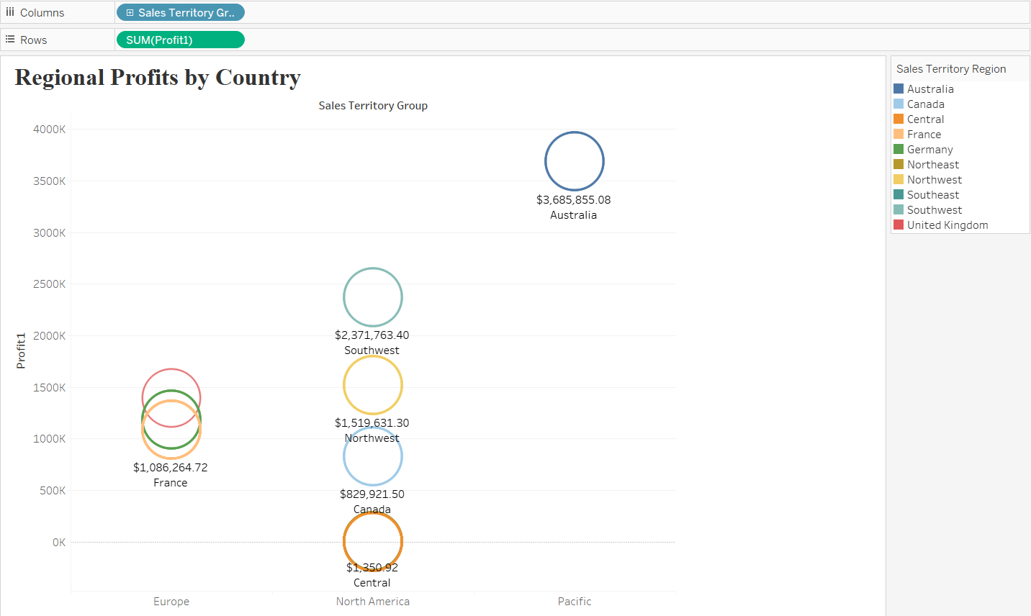
Top 5 Regional profits: 1. Australia 2. southwest 3. northwest 4. united kingdom 5. Germany

Slide 22
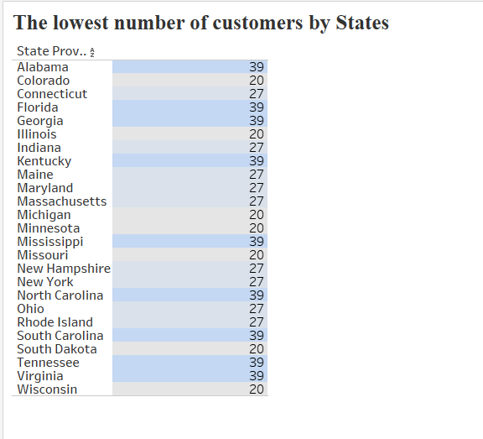
Top 10 Lowest customer count by states: 1. Colorado 2. Illinois 3. Michigan 4. Minnesota 5. Missouri 6. south Dakota 7. Wisconsin 8. Connecticut 9. Indiana 10. Maine

Slide 23
recommendations for increasing profitability: tips to improve company performance, sales and profits: *Demographics: to proliferate the distribution of productions to Asian region. * Age group: To accommodate provision of products to age group below 30 years old, taking age-constraints into account, such as teenager-targeted bikes and accessories. *Marketing strategies: To improve marketing and promotion strategies. * Age group constraint: to Improve customer needs(expanding the production of good to all age groups) * Customer count: Increase the number of customers in lowest customer count locations by promoting the sales campaigns.

Slide 24
Conclusion: Adventure Works Cycles should look to broaden its market share by targeting their sales to their best customers, extending their product availability through age groups, demographics, and customer needs.

Slide 25
Thank you so much for attention! ^_^

