Slide 1
Multi-modal Multi-network Key Driver Analysis (MM-KDA)
Ryan Neff
BMSE Software Architecture Update
11/1/2017

Slide 2
Context
MM-KDA enables the fusion of multiple gene-gene interaction network datasets into a unified graph that provides an estimate of a gene’s importance in a disease process
Input Networks
Unified Graph

Slide 3
Context
Should be able to identify key drivers on an individual level and cohort level by comparing them to the unified graph
Disease Network
Unified Graph

Slide 4
Context
Combines data from multiple data sources:
RNA-sequencing gene expression
DNA variants (SNV/CNV/indels)
Proteomics
Methylation status
DTI (diffuse tensor imaging) data correlated with other features
Accepts network graphs by default

Slide 5
Application – Alzheimer’s Disease
Amyloid-beta plaques and Tau tangles hypothesis disproven by multiple recent high-profile drug failures (e.g: solanezumab)
Multiple genetic risk factors identified by GWAS across multiple disease processes:
APP processing
Immune Response and microglia
Mitochondria and oxidative phosphorylation
Ab clearance
Tau toxicity
Genes: APP, PSEN1/2, SorL1, ApoE, CLU, PICALM, others investigating in lab

Slide 6
Application – Alzheimer’s Disease
Likely that subtypes of Alzheimer’s disease exist:
Clinical presentation: LOAD, EOAD, MCI
Biopsy: Ab and Tau pathology
Genetic background: Familial AD
Goal is to discover multiple driver genes that defines subtypes across all AD patients!

Slide 7
Users/stakeholders
Me / my thesis project
Other lab members
My PI
The AMP-AD R01 working group at Mount Sinai

Slide 8
Requirements elicitation techniques
Initial requirements: User stories
Refinement: Scientific method
Agile = scientific process
Built from the inside out (each step further defines requirements)
Feedback:
Meetings with PI
Working alongside lab member

Slide 9
User stories
1: MEGENA = Multiscale embedded gene expression network analysis
Me/my thesis project:
“I need a way to identify subtypes of Alzheimer’s Disease”
“It should be something new but can leverage existing statistical tools.”
Other lab members:
“We have too many MEGENA¹ networks, and we can’t make sense of Bayesian nets.”
“We need a way to unify AD data from multiple modalities together, including DTI data and ApoE status, in a programming language we can use (R).”
My PI:
“We have a ton of studies we need to integrate. I want to use all the data we have on all projects.”
“We would like to have a database of significant findings across the lab”
“Must interface with our R libraries”
Grant team:
“We need everyone to succeed and find lots of new things together.”

Slide 10
Requirements
Brief Description | Functional or non-functional | Priority | Status
Identify subtypes of AD | Functional: Group samples into AD subtypes using a statistical model Non-functional: Should be reproducible across different data sets Should be clear and validatable | High | Statistics – done Reproducibility – researching
Find key drivers of unified gene networks | Functional: Apply a statistical model to the network to find key drivers Non-functional: Should be able to use existing and new tools | Med. | Research stage
Build a database for the lab to analyze gene networks | Functional: Store gene networks in a database R client is a must Perform statistics on the data Non-functional: Does not need to be accessible by web | Low | Model created and some network data loaded No way to perform stats on the data

Slide 11
Requirements conflict resolution
Resolved: Python vs. R – do I need to support both?
I can code well in Python and can build complex statistical tools with the language, so everything I need can be done in Python
Rest of lab and lab’s libraries coded in R
How I’m going to solve this?? R library that I will build to interface with Python software
Unresolved: Needs of lab (database) vs. needs of my thesis (AD subtypes)
How will I split my time and resources?
How will I continue to advance on my thesis while being able to pursue bigger projects that may not return results right away?

Slide 12



Architecture Design
Compute:
Minerva LSF cluster (centos)
Biological DBMSes:
Ensembl
MSigDB
Backend database model and abstraction layer
Python ver. 3.4
packages: networkx, sqlalchemy, pyensembl, pandas, requests, scikit-learn, numpy, json, others as needed
R library for accessing MM-KDA functions
Python analysis functions
packages: various
R analysis functions
packages: various
Database:
MySQL
implemented by MariaDB v. 10
Access via imported library/module in IDE of choice

Slide 13
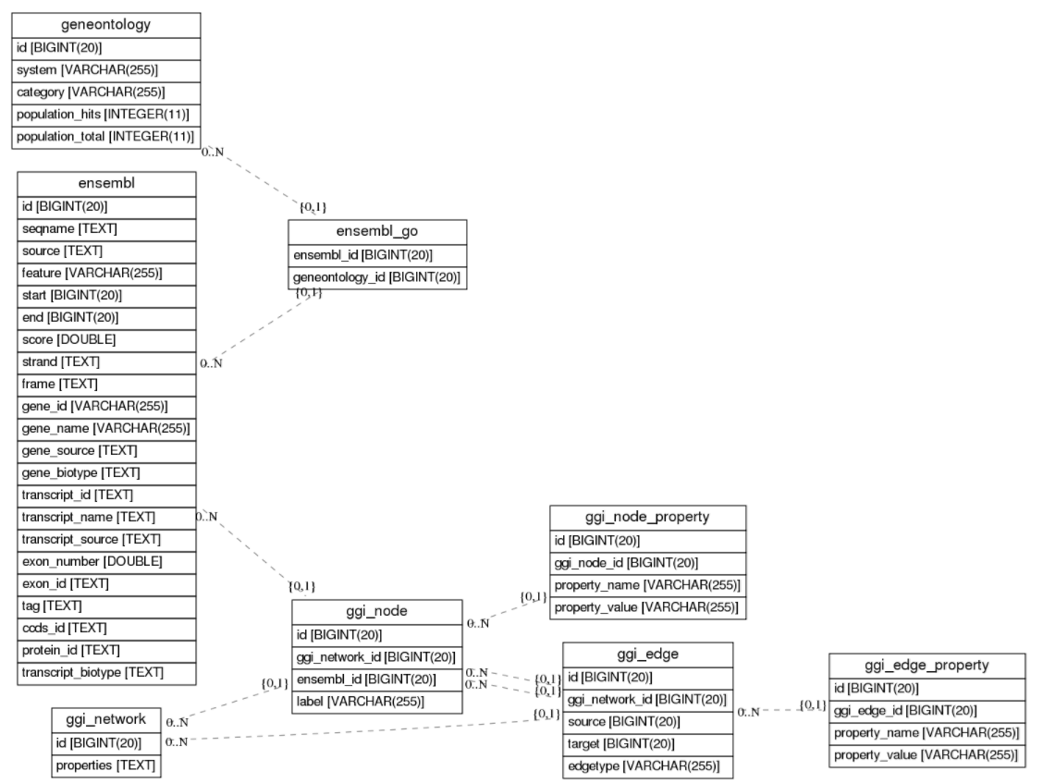
Database Construction
Status: Ready for loading MEGENA networks for comparisons!

Slide 14
How will USERS INTERACT with the SOFTWARE?
Access via imported library/module in IDE of choice which can be run on the compute cluster, alternatively
Example R library (similar use from Python):
>>> library(mmKDA)
>>> import_graph_to_db(“MEGENA.graphml”)
>>> calculate_unified_graph(center_node, sql_conn)
>>> match_to_subtypes(input_network, sql_conn)
>>> estimateKDAImportance(input_network, sql_conn)
..etc

Slide 15
Needs that must be solved
What algorithmic problems/statistical analyses do we need to solve?
How to calculate the unified graph
How to define subtypes from the database that uses multiple networks
Multiple network/subnetwork comparison tools and metrics
How to match input data to subtypes
How to best look at differences between networks to find key drivers
... and lots more that haven’t been defined yet!

Slide 16
Next steps
What’s the timeline for the next few months?
Investigate subtype definition from single network data
Thesis proposal drafting
break
Build out MMKDA
Refine key driver analysis identification
Fix Differential Gene Correlation Code to Support Whole GGI networks
Nov 2 5 Nov 15 Dec 1st Dec 15th Jan 2nd

