Slide 1

W4T Function

Slide 2
What this presentation is about?
Aim and objectives of the session:
Python – basic usage coordinate change
Python functions and modules - build your workshop
Parse data and read files - make it useful
Plot data and display on the map – make it pretty
After the session you should have some idea what Python is about.

Slide 3
Simple possible scripts – Fancy calculator
'''
Simple script for working with coordinates
Translate coordinates in degree decimal representation to
degree, minutes, seconds
>>> deg_to_dms(50.084522)
[50, 5, 4.27919999999915]
'''
deg_dec = 50.084522
degrees = int(deg_dec)
minutes_dec = abs(deg_dec - degrees) * 60
minutes = int(minutes_dec)
seconds = (minutes_dec - minutes) * 60
print('my decimal coordinatees %f are: %i degres, %i minutes and %f seconds'%(deg_dec, degrees, minutes, seconds))

Slide 4
Function– Something useful
def dec_to_deg_min_sec(deg):
'''Translate coordinates decimal representation to degree, minutes, seconds.
Examples:
>>> dec_to_deg_min_sec(50.084522)
[50, 5, 4.27919999999915]
>>> dec_to_deg_min_sec(-5.699057)
[-5, 51, 56.60519999999934]
'''
deg_dec = deg
degrees = int(deg_dec)
minutes_dec = abs(deg_dec - degrees) * 60
minutes = int(minutes_dec)
seconds = (minutes_dec - minutes) * 60
return [degrees, minutes, seconds]

Slide 5
Testing output
Check if you have what you expect to have
if __name__=="__main__":
import doctest
doctest.testmod()
Unexpected result
**********************************************************************
File "C:\Users\funcDecToDeg.py", line 12, in __main__.dec_to_deg_min_sec
Failed example:
dec_to_deg_min_sec(-5.699057)
Expected:
[-5, 51, 56.60519999999934]
Got:
[-5, 41, 56.60519999999934]
**********************************************************************
1 items had failures:
1 of 2 in __main__.dec_to_deg_min_sec
***Test Failed*** 1 failures.

Slide 6
Function– Something useful Slide 1
def deg_min_str_to_dec(position):
''' Convert a coordinate from a string decimal degree.
Examples:
>>> pos = '50 05.0713061 N'
>>> deg_min_str_to_dec(pos)
50.08452177
>>> deg_min_str_to_dec('005 41.9434092 W')
-5.69905682
>>> deg_min_str_to_dec('50 05.0713061 N')
50.08452177
>>> deg_min_str_to_dec('55;18.7116860N')
55.31186143
>>> deg_min_str_to_dec('5023.1994,N')
50.38665667
>>> deg_min_str_to_dec('00408.6421,W')
-4.144035
>>> deg_min_str_to_dec('5023.1994,S')
-50.38665667
>>> deg_min_str_to_dec('00408.6421,E')
4.144035
'''

Slide 7
Function– Something useful Slide 2
if " " in position:
l = position.split(" ")
deg = int(l[0])
minut = float(l[1])
if l[-1] in ['S', 'W']:
sph = -1
else:
sph = 1
elif ";" in position:
l = position.split(";")
deg = int(l[0])
minut = float(l[1][0:-1])
if l[-1] in ['S', 'W']:
sph = -1
else:
sph = 1

Slide 8
Function– Something useful Slide 3
elif ',' in position[-2]:
if position[-1] == 'N':
deg = int(position[0:2])
minut = float(position[2:-2])
sph = 1
elif position[-1] == 'S':
deg = int(position[0:2])
minut = float(position[2:-2])
sph = -1
elif position[-1] == 'W':
deg = int(position[0:3])
minut = float(position[3:-2])
sph = -1
elif position[-1] == 'E':
deg = int(position[0:3])
minut = float(position[3:-2])
sph = 1
else:
deg = 0
minut = 0
sph = 1
coord = ((deg + minut/60)*sph)
return round(coord, 8)

Slide 9
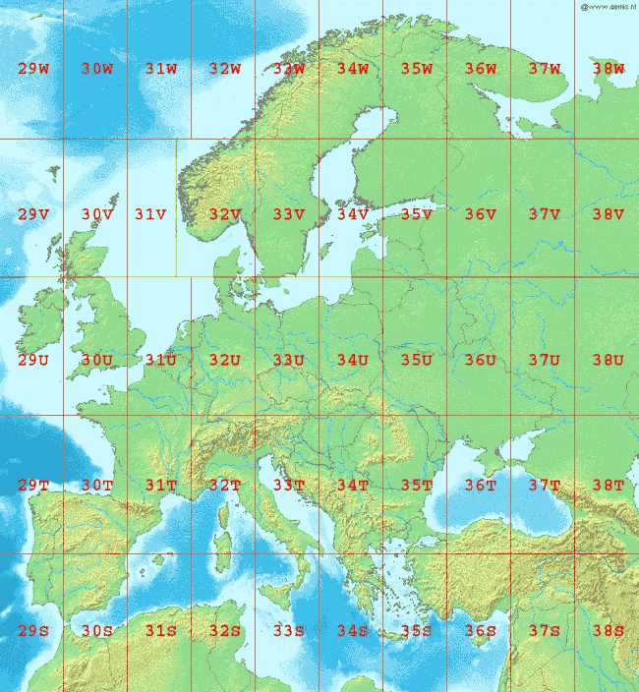
Something about coordinates
The Universal Transverse Mercator (UTM) conformal projection uses a 2-dimensional Cartesian coordinate system to give locations on the surface of the Earth.
The UTM system divides the Earth between 80°S and 84°N latitude into 60 zones, each 6° of longitude in width
UTM. Easier to estimate position, easier to learn. No need to carry a scale card or ruler.

Slide 10
Use modules– Make your life easier Slide 1
def lon_lat_to_utm(lat, lon):
''' Function converts from any [Lat, Long] to [East, North, Grid]
>>> lon_lat_to_utm(50.084522, -5.699057)
['30U 306918.367 5551517.614', 306918.367, 5551517.614]
>>> lon_lat_to_utm('50 05.0713061 N', '005 41.9434092 W')
['30U 306918.379 5551517.588', 306918.379, 5551517.588]
>>> lon_lat_to_utm(50.0845217683, -5.69905682)
['30U 306918.379 5551517.588', 306918.379, 5551517.588]
'''
# Convert from strings if required.
if type(lat) == str:
lat = deg_min_str_to_dec(lat)
if type(lon) == str:
long = deg_min_str_to_dec(lon)
# Check if correct range
if not -80.0 <= lat <= 84.0:
raise OutOfRangeError('latitude out of range (must be between 80 deg S and 84 deg N)')
if not -180.0 <= lon <= 180.0:
raise OutOfRangeError('longditude out of range (must be between 180 deg W and 180 deg E)')

Slide 11
Use modules– Make your life easier Slide 2
utm_pos = utm.from_latlon(lat, lon)
# print('my utm postition from the function: {} with Lat: {} and Long: {} as input'.format(utmPos, Lat, Long))
# Google Earth does not accept this format. Translation for Google Earth:
east = '%.3f' % (utm_pos[0])
north = '%.3f' % (utm_pos[1])
grid1 = str(utm_pos[2])
grid2 = str(utm_pos[3])
google_earth = (grid1 + grid2+' '+east+' '+north)
# returns Google Earth format and Easting and Northing as float
return [google_earth, float(east), float(north)]

Slide 12
Implement algorithm – Do what you need
def calc_distance_short(utm_pos_1, utm_pos_2):
''' Calculate straight line distance between two points: works
but is difficult to read!'''
return ((utm_pos_1[0]-utm_pos_2[0])**2+(utm_pos_1[1]-tm_pos_2[1])**2)**(0.5)
But !! Please not this ..
Do it in good way !!

Slide 13
def calc_distance(utm_pos_1, utm_pos_2):
''' Easier to read function to calculate the line distance between two points.
:param arg1: Easting and Northing of the first position
:param arg2: Easting and Northing of the second position
:type arg1: tuple (Easting, Northing)
:type arg1: tuple (Easting, Northing)
:return: return distance in metres
:rtype: float
'''
try:
# x,y coordinates of the first point
x_1 = utm_pos_1[0]
y_1 = utm_pos_1[1]
# x,y coordinates of the second point
x_2 = utm_pos_2[0]
y_2 = utm_pos_2[1]
# cartesian distance
distance = math.sqrt((x_1-x_2)**2 + (y_1-y_2)**2)
return distance
except Exception as e: print('Check if coordinates in correct form as Easting, Northing)\n becasue: {}'.format(e))

Slide 14
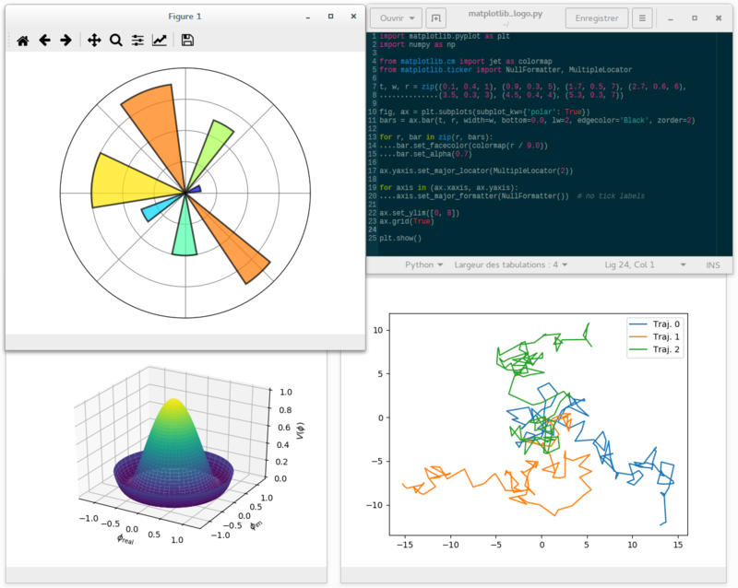
Matplolib
matplotlib is a plotting library for the Python programming language and its numerical mathematics extension NumPy. It provides an object-oriented API for embedding plots into applications using general-purpose GUI toolkits like Tkinter, wxPython, Qt, or GTK+.
Default plot styles with built-in code
Deep integration with Python
MATLAB-style programming interface (this is an advantage for some, but a disadvantage for others).

Slide 15
Matplotlib examples
import matplotlib.pyplot as plt
import numpy as np
def linePlot():
a = np.linspace(0,10,100)
b = np.exp(-a)
plt.plot(a,b)
def histogram():
fig = plt.figure()
x = np.random.normal(size=200)
plt.hist(x,bins=30)
# SCATTER
def scatter():
fig = plt.figure()
xVal = np.random.rand(100)
yVal = np.random.rand(100)
plt.scatter(xVal, yVal)
linePlot()
histogram()
scatter()
plt.show()
There is huge amount of possibilities.
Try adding:
Axis Labels
Legend
Title
Grid
Change plot appearance
Plot all three in one figure

Slide 16
Matplotlib examples
'''
from: https://en.wikipedia.org/wiki/Matplotlib
'''
import matplotlib.pyplot as plt
import numpy as np
from matplotlib import cm # for 3D plot
from mpl_toolkits.mplot3d import Axes3D # for 3D plot
def plot3D():
fig = plt.figure()
ax = fig.gca(projection='3d')
X = np.arange(-5, 5, 0.25)
Y = np.arange(-5, 5, 0.25)
X, Y = np.meshgrid(X, Y)
R = np.sqrt(X**2 + Y**2)
Z = np.sin(R)
surf = ax.plot_surface(X, Y, Z, rstride=1, cstride=1, cmap=cm.coolwarm)
plot3D()
plt.show()

Slide 17
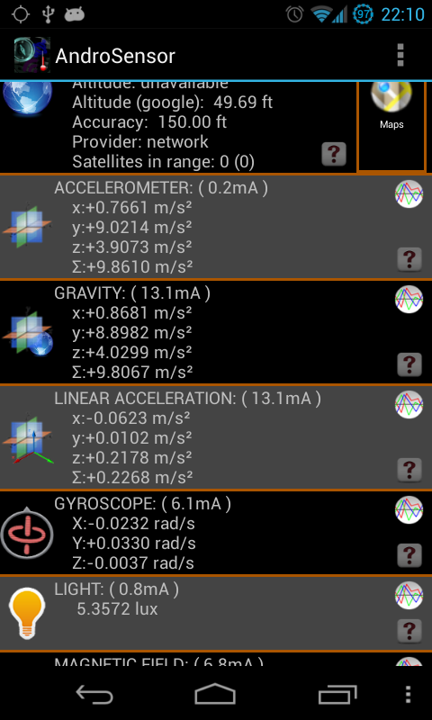
Reading and writing Data Files
def fileWriter():
file = open("testfile.txt","w")
file.write("Hello World")
file.write("This is our new text file")
file.write("and this is another line.")
file.write("Why? Because we can.")
file.close()
def fileReader():
file = open("testfile.txt", "r")
print(file.read())
fileReader()
Data are often stored in comma separated value files (.csv)
An example of such file can be data created by application

Slide 18
Parse .csv– some real work
import csv
from CoordConversions_Func import lon_lat_to_utm
import matplotlib.pyplot as plt
def readAndroSensor(fileToRead, sensorColumn = 12):
''' Reads data from Andro sensor in csv file
:param arg1: file name or path to read
:param arg2: number representing column used for the sensor
:type arg1: string
:type arg1: int starting from 0
:return: lists of latit, longit, easting, northing, sensor
:rtype: [float,], [float,], [float,], [float,], [float,]
'''
with open(fileToRead) as csvfile:
sensorReader = csv.reader(csvfile, delimiter=',')
coord = [] # hold coordinates as tuple
easting = [] # hold empty list for easting after conversion
northing = [] # hold empty list for northing after conversion
sensor = [] # hold empty list for sensor data
next(sensorReader) # skip the first row
for row in sensorReader: # iterate over each row and append lists
coord.append((float(row[23]),float(row[22])))
utmCoord = lon_lat_to_utm(float(row[22]), float(row[23]))
easting.append(utmCoord[1])
northing.append(utmCoord[2])
sensor.append(row[sensorColumn])
return coord, easting, northing, sensor

Slide 19
Look what you’ve done
def plotPath(easting, northing):
''' basic plot for path '''
plt.figure()
plt.plot(easting, northing, label='path')
plt.axis('equal')
plt.xlabel('Easting [m]')
plt.ylabel('Northing [m]')
plt.legend()
plt.title('Path from Uni to ThinqTanq')
def plotSensor(sensor):
''' basic sensor plot '''
plt.figure()
plt.plot(sensor, label='senosr')
plt.xlabel('sample point')
plt.ylabel('Sensor reading')
plt.title('Sensor reading along the path')

Slide 20
Look what you’ve done
The script converts data to a file for Google Earth
One of many modules dealing with coordinates conversion
http://simplekml.readthedocs.io/en/latest/index.html
'''
import simplekml # if not installed: pip install simplekml
from readSensorsData import readAndroSensor
#file = 'Sensor_record_20170426_194909_AndroSensor.csv'
file = 'Uni2ThinqTanq.csv'
coord, easting, northing, light = readAndroSensor(file)
kml = simplekml.Kml()
ls = kml.newlinestring(name='Path From Uni to ThinqTanq')
ls.coords = coord
ls.extrude = 1
ls.altitudemode = simplekml.AltitudeMode.relativetoground
ls.style.linestyle.width = 5
ls.style.linestyle.color = light #simplekml.Color.blue
kml.save("Uni2ThinqTanq.kml")

Slide 21
Challenge !?!?
Read csv file
Sensor_record_20170426_194909_AndroSensor.csv
Check data
Perform data presentation

