Slide 1

W4T General Info

Slide 2
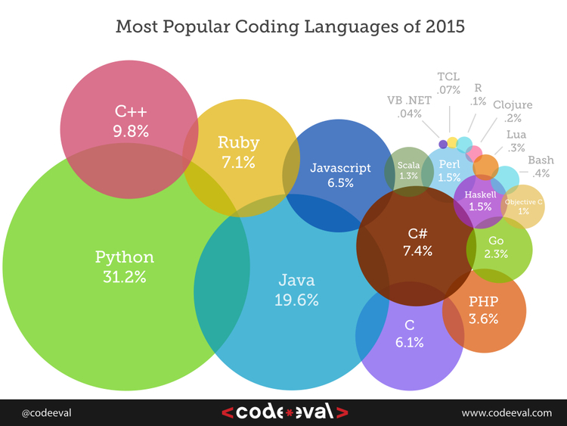
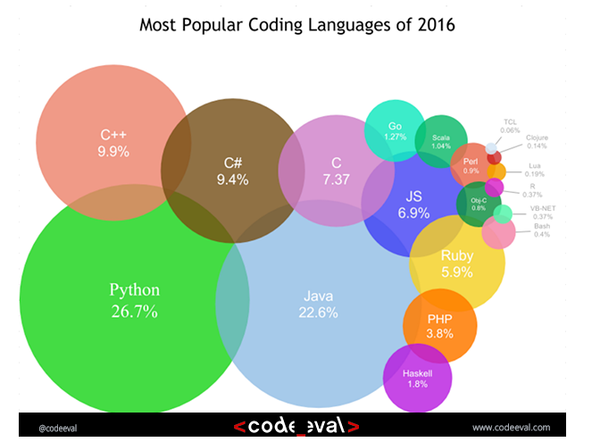
What is Python about
Python Programming Language – Official Website http://www.python.org/
Python is a programming language that lets you work more quickly and integrate your systems more effectively.
You can learn to use Python and see almost immediate gains in productivity and lower maintenance costs.
You can teach others as see amazing projects in a matter of hours

Slide 3
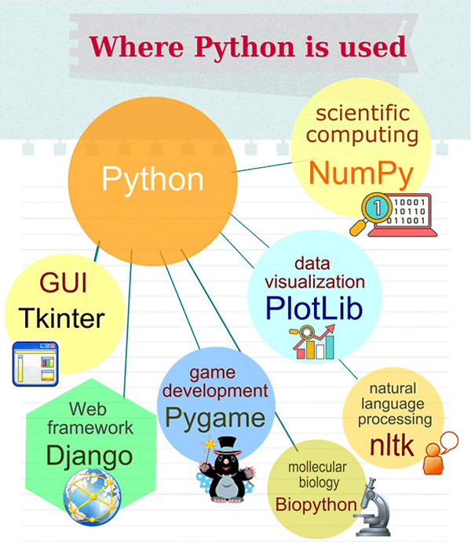
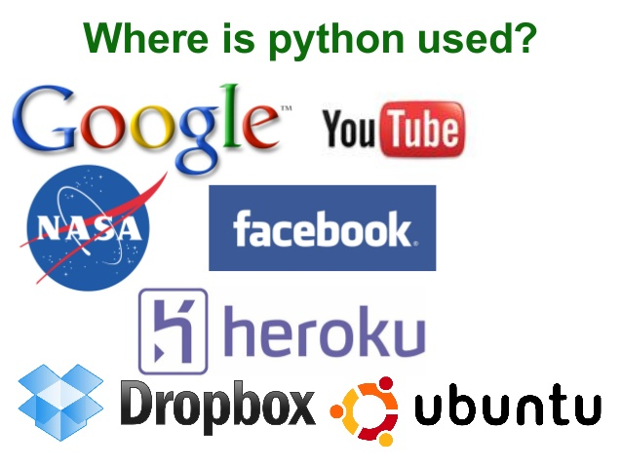
Who and Where and What Is Python really used?

Slide 4
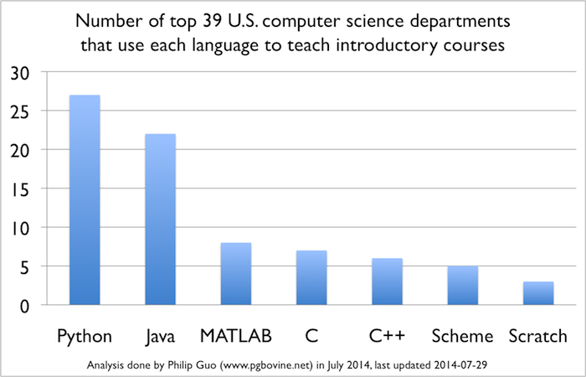
Python in teaching computer science
Python is Now the Most Popular Introductory Teaching Language at Top U.S. Universities
https://cacm.acm.org/blogs/blog-cacm/176450-python-is-now-the-most-popular-introductory-teaching-language-at-top-u-s-universities/fulltext

Slide 5
Why choose Python as the first language
It fulfils many of the essential features of “My first programming language”: case sensitivity, functions, traditional control structures (if/for), etc.
Basic input-handling is simpler than in any non-scripting language out there. This lets students rapidly start writing basic input code.
The small amount of syntax means students can more rapidly type in code by “read it and copy it”.
The major IDE vendors generally support Python directly by now, so anything (insert language of choice here) does, also exists for Python.

Slide 6
Python in teaching
„Programming is hard, but we should strive to make it no harder than it needs to be“
Positive aspects of Python in teaching:
Indentation
Minimal overhead
Intuitive
Does not burden pupils with formalities (such as Form.create, etc.)
Scripting language, OOP, functional – universal language supporting different ways of programming Interface – useful in practice
Negative aspects in teaching:
The types of variables are not declared
value can change during runtime

Slide 7
Day 1
Introduction
How to run python programs
Integrated Development Environment (IDE)
Version controls
Codding and scripts
Basic command
Making a scripts
A few words about modules
Basic Tkinter for Graphical User Interface
“Hello World”
GUI elements
Program execution concepts
Producing executables

Slide 8
Day 2
Elements of programming (make your life easier)
Functions
Modules
Basic automated testing
Data Structures
int, float, char, string
Lists, Tuples and Dictionaries
Reading CSV files
Making Use of programming – play with data
Interpreting and presenting data
Plotting and counting
A few words about modules, APIs and other code
PyGame, Tweetpy, GoogleEarth …

Slide 9
Day 3
Warm up
What do we know already
Hands on and Heads up
Creating application
Advanced GUI
Tkinter and others
What next
Planning for future

Slide 10
Workshop Rules
If you want to learn, code it
Try to experiment with your code
If something does not work “google it”
Try to help others
Ask questions
Share your experience
Have fun

