Slide 1

W4T GUI basic

Slide 2
Tkinter – what and why?
Python’s standard GUI
Wrapper around Tcl/Tk (the same in rubby, perl …)
Traditionally thought as and ugly one but there are many extensions.
Easy, loads of resources …
It is not the only choice (PyQt, wxPython …)

Slide 3
Tkinter – labels (packing)
Basic place holder for displaying text
import tkinter as tk
root = tk.Tk() # make a base for the app
# create labels
lblOne = tk.Label(root, text="This is my first label")
lblTwo = tk.Label(root, text="Second", bg='green', fg='black')
lblThree = tk.Label(root, text="Three", bg='blue', fg='black')
# place labels inside application
lblOne.pack()
lblTwo.pack(fill="x")
lblThree.pack(side='left', fill="y")
if __name__ == '__main__':
root.mainloop() # start application
Play with windows expanding, create different font

Slide 4
Tkinter – Entry (grid)
import tkinter as tk
root = tk.Tk() # make a base for the app
def myEntries(): # function to be called after tick
print(entry1.get(), entry2.get())
lbl1 = tk.Label(root, text='name')
lbl1.grid(row=0, sticky='E')
lbl2 = tk.Label(root,text='Password')
lbl2.grid(row=1)
entry1 = tk.Entry(root) # field for input
entry1.grid(row=0, column=1)
entry1.focus_set() # be the first field to fill
entry2 = tk.Entry(root, show='*', bg='white')
entry2.grid(row=1, column=1)
chk = tk.Checkbutton(root, text="Keep me logged", command=myEntries)
chk.grid(columnspan=2)
if __name__ == '__main__':
root.mainloop() # start application

Slide 5
Python - basic of function
FUNCTION:
- reusable block of code
CALLING
- call function by using brackets
PARAMETERS
- some functions take parameters
- place parameters within the brackets
- parameters and variables live only within the function
RETURN VALUES
- you may want to return from function but don’t need to
- use a variable to store return

Slide 6
Tkinter - grid
import tkinter as tk
colours = ['red','green','orange','white','yellow','blue']
r = 0
for c in colours:
tk.Label(text=c, relief='ridge',width=15).grid(row=r, column=0)
tk.Entry(bg=c, relief='sunken',width=10).grid(row=r, column=1)
r = r+1
tk.mainloop()
Grid places widgets in 2-dimentional table.
Widgets with the same column but different row are on top of each other
Widgets with the same row but different column are side by side
The size of the grid does not have to be defined.
The size is determined automatically
Some additional options:
rowspan, columnspan, padx, pady, sticky

Slide 7
Tkinter – Button
def printName(): print('Hello')
def print2Name(event): print(event, 'from event')
def print3Name(event): print(event, 'btn 3')
def leftClick(event): print('left')
def rightClick(event): print('right')
def middleClick(event): print('Middle')
btn1 = tk.Button(root, text="Print name", command=printName).pack()
btn2 = tk.Button(root, text='Second btn')
btn2.bind("<Button-1>", print2Name) # bind to left click
btn2.pack()
btn3 = tk.Button(root, text='Third button')
btn3.bind("<Button-3>", print3Name) # bind to right click
btn3.pack()
frame = tk.Frame(root, width=300, height=250, bd=1, relief="sunken")
frame.bind("<Button-1>", leftClick)
frame.bind("<Button-2>", rightClick)
frame.bind("<Button-3>", middleClick)
frame.pack()

Slide 8
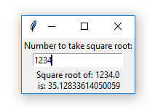
Tkinter – first useful application -challenge
Build a helper application
to display a square root of a number

Slide 9
Tkinter - first useful application
import tkinter as tk
import math
from numpy import square
def evaluate(event): # function to evaluate square root
number = float(inputNumber.get()) # read what variable entry stores
print(number, type(number)) # and convert it to float
squareRoot = math.sqrt(number) # calculate square root
result.configure(text="Square root of: "+str(number)+'\n is: '+str(squareRoot))
root = tk.Tk()
lbl = tk.Label(root, text="Number to take square root:").pack()
inputNumber = tk.Entry(root)
inputNumber.bind("<Return>", evaluate)
inputNumber.pack()
result = tk.Label(lbl)
result.pack()
root.mainloop()

Slide 10
Python – string formating
Create simply by enclosing characters in quotes.
single quotes are treated the same as double quotes.
Creating strings is as simple as assigning a value to a variable.
The % operator is unique to strings and makes up for the pack of having functions from C's printf() family
print "My name is %s and weight is %d kg!" % (‘Tom', 21)
New style of formatting is even more powerful
Old
'%s %s' % ('one', 'two')
New
'{} {}'.format('one', 'two')
https://pyformat.info/

Slide 11
Tkinter – Menu & MainWindow
mn = tk.Menu(root) # menu bar
root.config(menu=mn)
subMn = tk.Menu(mn) # submenu
mn.add_cascade(label="File", menu=subMn)
subMn.add_command(label="new project", command=doNothing)
subMn.add_command(label="New", command=doNothing)
subMn.add_separator()
subMn.add_command(label="Exit", command=root.quit)
editMn = tk.Menu(mn)
mn.add_cascade(label="Edit", menu=editMn)
toolBar = tk.Frame(root, bg='blue')
insertButt = tk.Button(toolBar, text="imande", command=doNothing)
insertButt.pack(side="left", padx=2, pady=2)
printButt = tk.Button(toolBar, text="print", command=doNothing)
printButt.pack(side="left", padx=2, pady=2)
toolBar.pack(side="top", fill="x")
# statusbar
status = tk.Label(root, text="Prepare to do nothing..", bd=1, relief="sunken", anchor="w")
status.pack(side="bottom", fill="x")

Slide 12
Tkinter – Popup msg
import tkinter.messagebox
# does not work without explicit import
# basic messagebox
tkinter.messagebox.showinfo("WindTilte", message="this is some message")
# question to answer yes/no
answer = tkinter.messagebox.askquestion("Question 1", "what do anser")
if answer == "yes":
print("clicked yes")
# another type of message
ans2 = tkinter.messagebox.askyesnocancel('title', 'Triple question')
print(ans2)

Slide 13
Tkinter – graphics
canvas = tk.Canvas(root, width=200, height=100, bg="white")
canvas.pack()
blackline = canvas.create_line(0, 0, 200, 50)
redline = canvas.create_line(0, 100, 200, 50, fill="red")
grenbox = canvas.create_rectangle(25,25,130,60, fill="green")
# canvas.delete(redline)
# canvas.delete('all')
photo = tk.PhotoImage(file='C:\\Users\\T\\Pictures\\yacht.png')
lbl = tk.Label(root, image=photo)
lbl.pack()

Slide 14
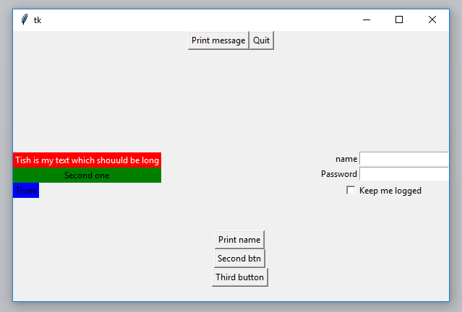
Tkinter – Challenge – design and build usefull app
Try to use different widget
Experiment
Look for other
Draw it first
Make practical
Have fun

