Slide 1

Senior Project Defense
Karina Quick

Slide 2
Problem Statement and purpose
The problem is that the client only has Facebook as a way of communication and word-by-mouth. For the client to expand their business, they need a website to read a bigger audience.
The purpose for this project is to have a working e-commerce (online shopping) website that can handle sales transactions, inventory tracking, and saves information/receipts in a database.
Notes:
- The reason for a bigger audience is so that they can sell premade clothes, display the products, and another way for the clients’ customers to contact them to ask questions or for alterations.
- The customer should be able to view products and make a purchase and with the purchase, see that the transaction is a success and money is taken from the source of pay provided. Along with a purchase, the admin of the website should see that a transaction was made and see the purchases.

Slide 3

Languages, software, and hardware
HTML
CSS
JAVASCRIPT
VELO APIs
Wix

Slide 4
Research and background
I used the website called Wix where it offers free web hosting and a built-in open development platform called Velo.
I did research on e-commerce websites and read about what made them successful, how to make it look appealing, and what the basic needs are for the website to be easy to use.
Notes:
- I watched videos and studied how to use the platform and applied what I learned into my website. - I had some previous background with working with websites for Systems Analysis & Software Design class but had used the site infinityfree.com.

Slide 5
Project Requirements
The system must allow users to contact the owner by entering their email in communication box
The system must store past purchases in database.
The system must handle transactions of sales.
The system must display and won’t allow any purchases to be made on out-of-stock items from user.
The system must notify the owner when a new chat is happening, or an email has been sent from a customer.
The system must display how many items are in the cart.
Notes:
- The system must notify owner when stock is low or out-of-stock.
- The system must allow users to order items by entering card and billing information.
- The system must keep track of inventory.
- The system must send receipt of purchase through entered email.

Slide 6
Project Requirements
The website shall have a shop page where it lists products for users to buy.
The website shall have a product page to show the product up close and list more detail.
The website shall have a portfolio page where it displays works done by the owner.
The website shall have an about us page where the user can directly contact the owner and display other sources of contact.
The website shall have a little chat bubble for a faster way of conversation with owner.
Notes:
- The website shall have a thank you page with receipt of purchase and telling user an email with confirmation will be sent.
- The website shall have a page to show products that was added to cart from user.
- The website shall have an about page where it displays information about the owner of the business and shows where on the google map the business is located.

Slide 7
Testing And test results
I went through the website and tested each function. Majority of the test results were expected and some failed since I would have to have the paid plan on Wix for the purchases to be made.

Slide 8
Challenges overcome
The challenges that I had to overcome is building a website in general and making it work the way you want to. I also had to learn how to use the platform Velo which works similarly to the development platform Apache Netbeans. I was able to overcome the challenge of hosting my website by using Wix which hosted the site for free and even has integrated code snippets and APIs for you to use.

Slide 9
Future enhancements
Flesh out an admin page.
Consider paid plan.
Notes:
- the admin doesn't have to go to the dashboard of Wix and can just do things on the admin side from the website itself.

Slide 10
Design and features

Slide 11
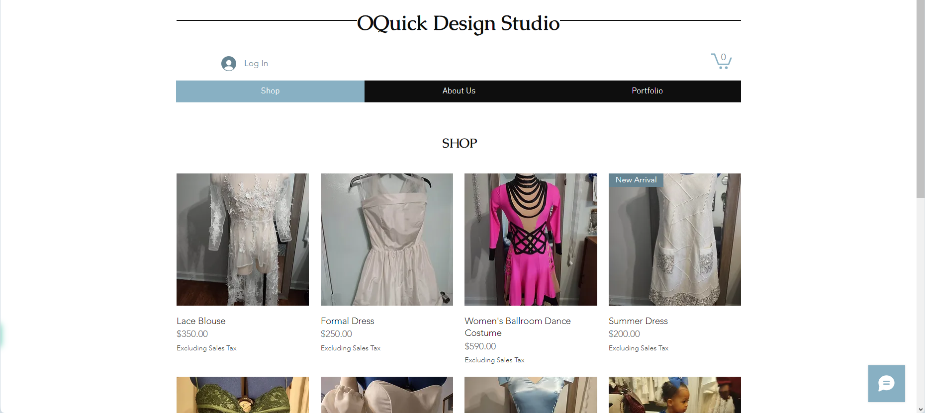
Home/shop page

Slide 12
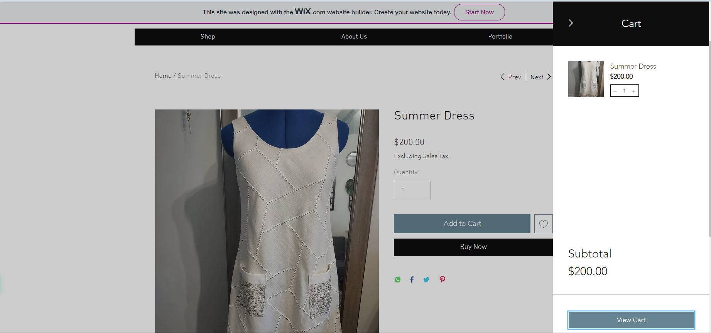
Adding to cart

Slide 13
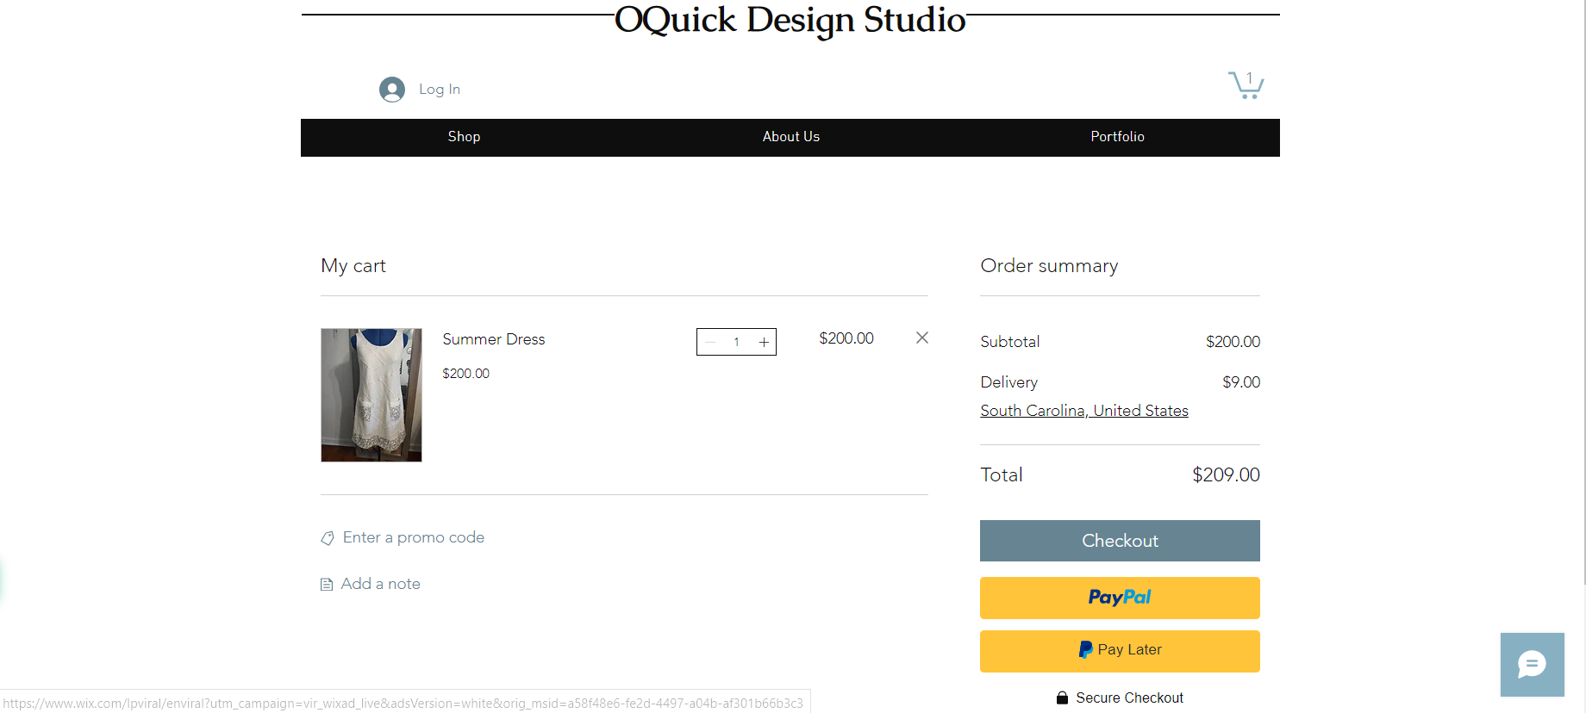
Cart/checkout

Slide 14
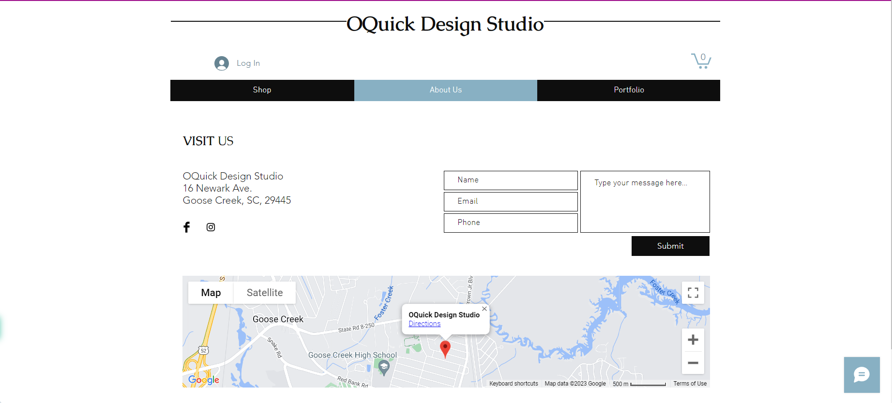
About us page

Slide 15
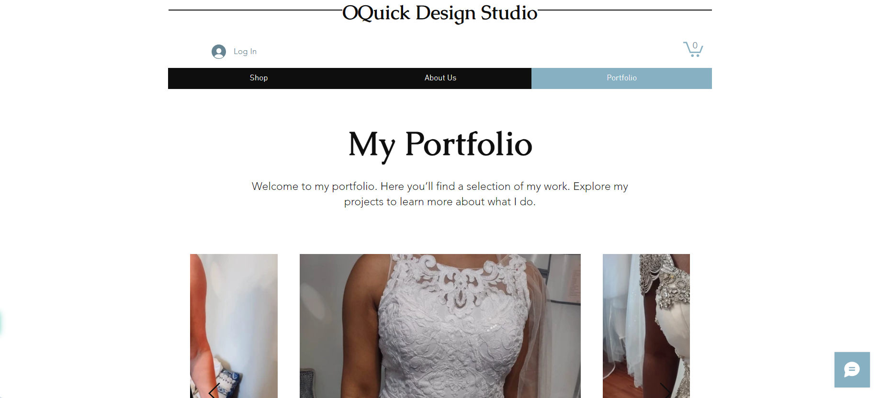
Portfolio page

Slide 16
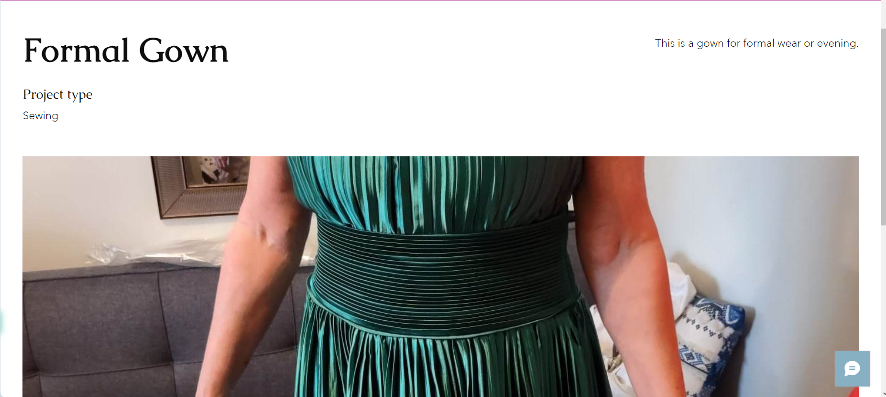
closer look

Slide 17

Questions? Comments?

