Slide 1

MULTI-CLASS ANIMAL IMAGE CLASSIFICATION
Creating a custom image classification dataset featuring five classes: dog, cow, cat, lamb, and
zebra, each with 100 images sourced from the internet or captured using our phone.
Developing a classification model to classify these classes with at least 90% accuracy.
|
|
|
|
Your paragraph text
Mubashshira Kaisar
2221070642
Noshin Nawar
2221507042
Group No. - 1
Md Shihabul Alam Shihab
2233115642
Md. Thaminuzzaman
2312877642

Slide 2
IMPLEMENTATION
USING CNN
|
|
|
|
Your paragraph text
Mubashshira Kaisar
2221070642
Noshin Nawar
2221507042
Group No. - 1
Md Shihabul Alam Shihab
2233115642
Md. Thaminuzzaman
2312877642

Slide 3
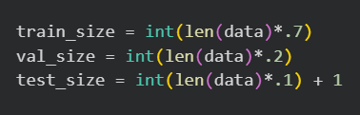
DATA PREPARATION & PROCESSING
Objective
Dataset Setup
Preparing an image dataset for training a deep learning model to classify animals.
  Dataset contains 5 classes: cat, cow, dog, lamb, zebra
  100 images per class → total 500 images
  Stored in class-wise folders (required by TensorFlow)
→
Automatically detects class
labels from folder names
  Loads images
  Normalizes pixel values from 0–255 → 0–1
→
  70% Training
  20% Validation
  10% Testing
→
Output
✅
Confirms dataset loaded correctly
Data Splitting
|
|
|
|
Your paragraph text
Mubashshira Kaisar
2221070642
Noshin Nawar
2221507042
Group No. - 1
Md Shihabul Alam Shihab
2233115642
Md. Thaminuzzaman
2312877642

Slide 4


CNN MODEL ARCHITECTURE
Why CNN?
Model Structure
  Convolutional Neural Networks are effective for image feature extraction
  Automatically learn edges, textures, and shapes
  Extracts low-level features (edges)
  Pooling reduces image size &
computation
→
→
Convolution
& Pooling
Layers
→
→
  Learns more complex patterns
|
|
|
|
Your paragraph text
Mubashshira Kaisar
2221070642
Noshin Nawar
2221507042
Group No. - 1
Md Shihabul Alam Shihab
2233115642
Md. Thaminuzzaman
2312877642

Slide 5
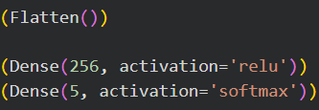
CNN MODEL ARCHITECTURE (CONT.)
Fully Conne
-cted Layers
  Converts feature maps into vectors
  Softmax outputs class probabilities
(5 classes)
→
→
→
Compilation
  Adam optimizer
  Correct loss function for multi-class classification
→
Output
→
→
3.69 million trainable parameters
Model summary confirms correct layer flow
|
|
|
|
Your paragraph text
Mubashshira Kaisar
2221070642
Noshin Nawar
2221507042
Group No. - 1
Md Shihabul Alam Shihab
2233115642
Md. Thaminuzzaman
2312877642

Slide 6
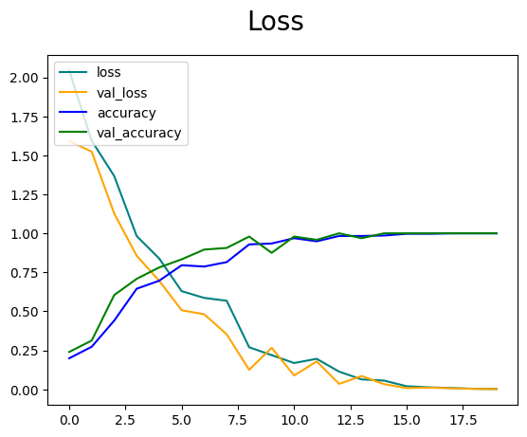
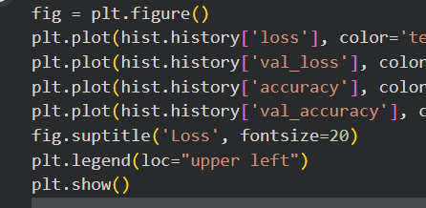
TRAINING & PERFORMANCE ANALYSIS
Model Training
Training Results
  Training accuracy → 100%
  Validation accuracy → 100%
  Loss → approaches 0
  Trained for 20 epochs,
  Validation data monitors overfitting
Loss & Accuracy Graph
Graph Interpretation
  Loss decreases smoothly → good learning
  Validation loss closely follows training loss → no overfitting
  Accuracy increases steadily → model convergence
Key Observation:
✔ Model learned class features very effectively
✔ Dataset is clean and well-structured
|
|
|
|
Your paragraph text
Mubashshira Kaisar
2221070642
Noshin Nawar
2221507042
Group No. - 1
Md Shihabul Alam Shihab
2233115642
Md. Thaminuzzaman
2312877642

Slide 7



EVALUATION, TESTING & PREDICTION
Model Training
Evaluation Output
  Accuracy: 100%
  Precision, Recall, F1-score = 1.00 for all classes
  Confusion matrix shows zero misclassifications
✔ Perfect classification on test set
Testing on New Image
Prediction Output
  Uploaded image correctly classified
  Image displayed with predicted label
  CNN successfully classifies animal images
  Proper preprocessing + balanced dataset = excellent performance
  Model is ready for real-world testing or deployment
→
Final Conclusion
|
|
|
|
Your paragraph text
Mubashshira Kaisar
2221070642
Noshin Nawar
2221507042
Group No. - 1
Md Shihabul Alam Shihab
2233115642
Md. Thaminuzzaman
2312877642

Slide 8
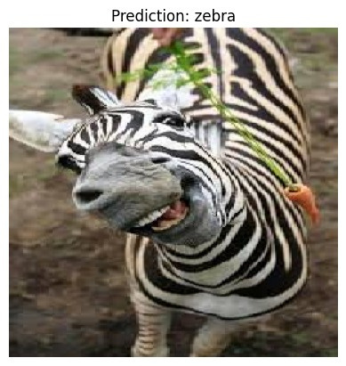
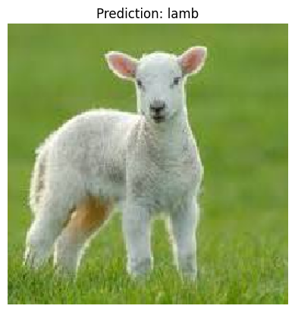
OUTPUT SCREENSHOTS
|
|
|
|
Your paragraph text
Mubashshira Kaisar
2221070642
Noshin Nawar
2221507042
Group No. - 1
Md Shihabul Alam Shihab
2233115642
Md. Thaminuzzaman
2312877642

Slide 9
IMPLEMENTATION
USING YOLOV11
|
|
|
|
Your paragraph text
Mubashshira Kaisar
2221070642
Noshin Nawar
2221507042
Group No. - 1
Md Shihabul Alam Shihab
2233115642
Md. Thaminuzzaman
2312877642

Slide 10
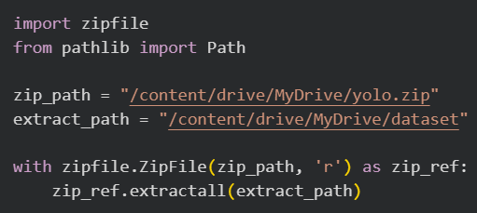


DATA PREPARATION & PROCESSING
Objective
YOLO Classification
expects:
Dataset Setup
Preparing a raw image dataset stored in Google Drive into a YOLO-compatible classification dataset with train, validation, and test splits.
Dataset Structure Requirement
(YOLO Classification)
  Folder name = class label
  Images only (no annotation files)
dataset_yolo/
├── train/
├── val/
└── test/
├── cat/
├── cow/
├── dog/
├── lamb/
└── zebra/
→
→
Unzips dataset containing class
folders only.
Output
Auto Dataset Splitting
train: 350 images in 5 classes
val: 100 images in 5 classes
test: 50 images in 5 classes
  70% Training
  20% Validation
  10% Testing
→
✔ No manual splitting required
✔ Balanced dataset
✔ Each class contains equal samples
|
|
|
|
Your paragraph text
Mubashshira Kaisar
2221070642
Noshin Nawar
2221507042
Group No. - 1
Md Shihabul Alam Shihab
2233115642
Md. Thaminuzzaman
2312877642

Slide 11

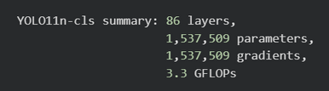

YOLOV11 MODEL
Model Used
✔ YOLOv11 Nano – Classification
variant
✔ Lightweight & efficient for CPU
✔ Pretrained on ImageNet
Model Summary Output
→
  Small model
  Fast inference
  Suitable for real-time use
Architecture Overview
YOLOv11-cls is a Convolutional Neural Network (CNN) consisting of:
  Convolution Layers
    Extract low-level features (edges, textures)
  C3k2 & C2PSA Blocks
    Learn complex spatial patterns
  Classification Head
Transfer Learning
  Uses learned features from large datasets
  Faster convergence
  Higher accuracy with fewer epochs
Outputs probability for 5 animal classes
|
|
|
|
Your paragraph text
Mubashshira Kaisar
2221070642
Noshin Nawar
2221507042
Group No. - 1
Md Shihabul Alam Shihab
2233115642
Md. Thaminuzzaman
2312877642

Slide 12
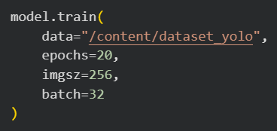
TRAINING & PERFORMANCE ANALYSIS
Training Configuration
Parameter | Purpose
epochs=20 | Number of full training cycles
imgsz=256 | Image resized to 256×256
batch=32 | Images per iteration
optimizer | AdamW (auto-selected)
|
|
|
|
Your paragraph text
Mubashshira Kaisar
2221070642
Noshin Nawar
2221507042
Group No. - 1
Md Shihabul Alam Shihab
2233115642
Md. Thaminuzzaman
2312877642

Slide 13



TRAINING & PERFORMANCE ANALYSIS (CONT.)
Training Progress
Loss Reduction
Accuracy Metrics
✔ Indicates successful learning
✔ No overfitting observed
  Top-1 → Correct class ranked first
  Top-5 → Correct class within top 5 predictions
  Excellent classification performance
Best Model Shows
→
→
  Combined metric for performance
  Best weights saved automatically
|
|
|
|
Your paragraph text
Mubashshira Kaisar
2221070642
Noshin Nawar
2221507042
Group No. - 1
Md Shihabul Alam Shihab
2233115642
Md. Thaminuzzaman
2312877642

Slide 14

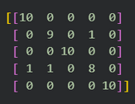

EVALUATION, TESTING & PREDICTION
Evaluation on Test Dataset
Confusion Matrix
Interpretation:
  Diagonal values = Correct predictions
  Minor confusion between cow ↔ lamb
  Dog & zebra achieved 100% accuracy
✔ Predicts class with highest probability
✔ Compared against true labels
Classification Report Highlights
Single Image Prediction
Overall Accuracy
→
94%
✔ Strong generalization
✔ Slight ambiguity in visually similar animals
✔ Model correctly classified unseen image
✔ Visual confidence scores displayed
|
|
|
|
Your paragraph text
Mubashshira Kaisar
2221070642
Noshin Nawar
2221507042
Group No. - 1
Md Shihabul Alam Shihab
2233115642
Md. Thaminuzzaman
2312877642

Slide 15
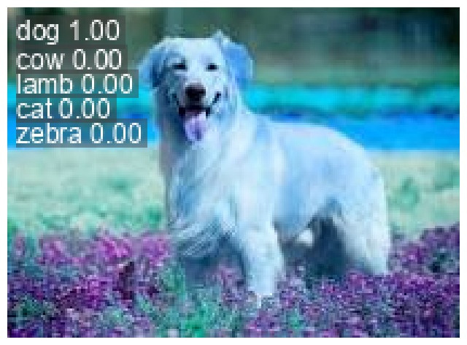
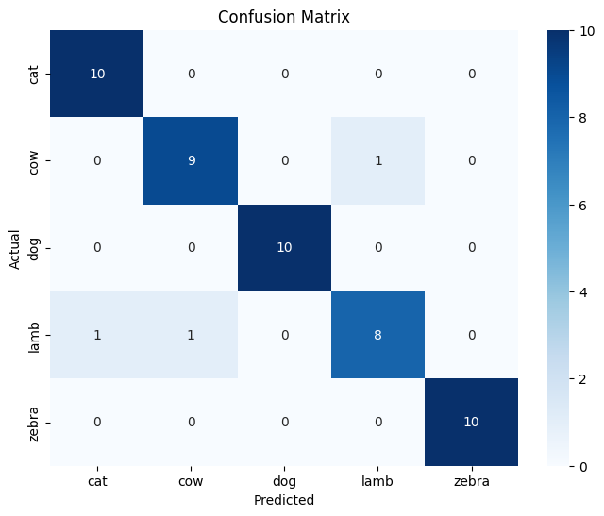
OUTPUT SCREENSHOTS
Output
Confusion Matrix
|
|
|
|
Your paragraph text
Mubashshira Kaisar
2221070642
Noshin Nawar
2221507042
Group No. - 1
Md Shihabul Alam Shihab
2233115642
Md. Thaminuzzaman
2312877642

Slide 16
THANK YOU
|
|
|
|
Your paragraph text
Mubashshira Kaisar
2221070642
Noshin Nawar
2221507042
Group No. - 1
Md Shihabul Alam Shihab
2233115642
Md. Thaminuzzaman
2312877642

