Slide 1
ECUE 2 Démarche de modélisation
Introduction à la modélisation de l’efficience d’interception lumineuse des plantes
R.PEREZ C. FOURNIER

Slide 2
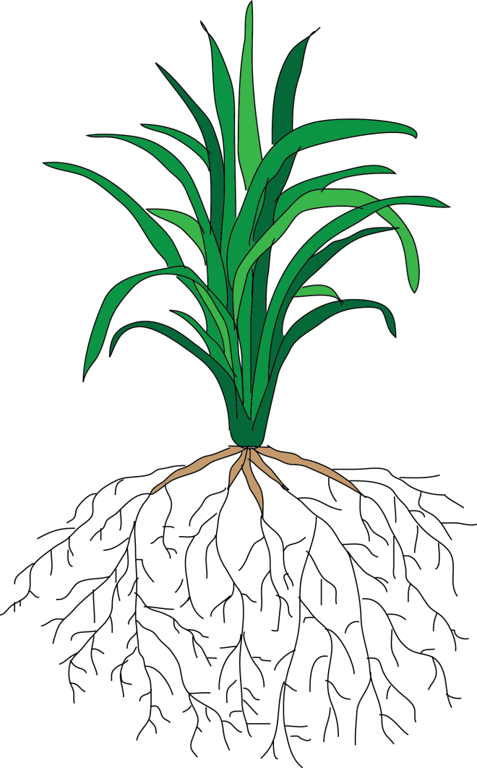


Plants resources
Sun light
CO₂
Minerals
H₂O
Notes:
Lister les ressources des plantes (eau, minéraux, lumière)
dans un système agricole controlé, seule la ressource lumineuse et en CO2 est incontrolée

Slide 3



Improving plant productivity
Environment (E)
Management practices (M)
Resources management
Cultural practices
Plant breeding (G)
Interaction between environment, genetic and management (G x E x M )
Notes:
Comment optimiser la ressource lumineuse?
Conduite culturale + selection variétiale

Slide 4
Light resource
Sun light
→ How to improve light capture?
Notes:
Lister les ressources des plantes (eau, minéraux, lumière)
dans un système agricole controlé, seule la ressource lumineuse et en CO2 est incontrolée

Slide 5


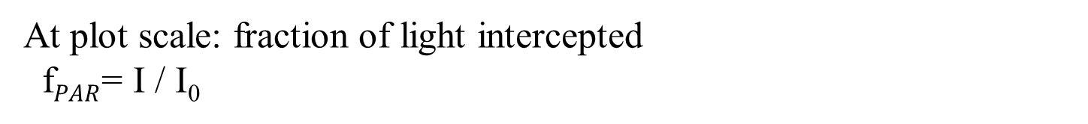

Light interception & Breeding
Light interception efficiency (LIE or $ε_{i}$) plays a key role in plant production (Monteith, 1977)
$$Yield= \sum_{t}{{PAR . ε_{i}.ε}_{b}\text{ . }ε_{p}}$$
I₀
At plot scale: fraction of light intercepted
f$PAR$= I / I₀
At plant scale:
Irradiance = light intercepted per unit leaf area
I₀-I
Notes:
Monteith: décomposition du rendement
Exemple de l’évolution de l’architecture arérienne du riz avec la sélection

Slide 6
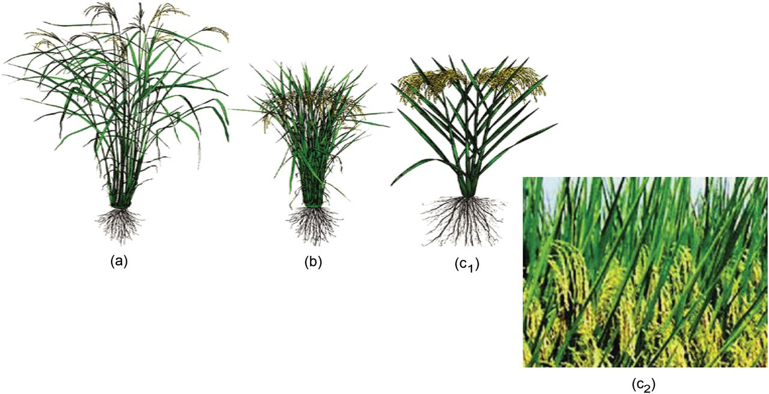
Light interception & Breeding
The optimisation of light interception have been a significant source of yield improvement (Khush, 2001; Koester et al., 2014, Dingkhuhn et al., 2015)
Concept of ideotype (Donald, 1968) and selection of specific plant architecture (in interaction with managment practices)
(a) Traditional plant type
(b) Semi dwarf
plant type
(c) New plant type
1990’s
R. P. Rötter et al., 2015
Notes:
Monteith: décomposition du rendement
Exemple de l’évolution de l’architecture arérienne du riz avec la sélection

Slide 7
Genetic control of plant architecture
Plant height
Plomion et al., 1996 (QTL), Yang and Hwa, 2008 (mutant)
Branching pattern
Sakamoto and Matsuoka, 2004 (mutant); Segura et al., 2008 (H²)
Leaf geometry
Frary et al., 2004 (QTL) ; Li et al., 2015 (QTL)
Yang and Hwa, 2008
Frary et al., 2004
But phenotyping architecture in relation with light interception is still a bottleneck
Use of Functional-structural plant models (FSPM)
Notes:
Verrou méthodologique: difficulté de mesurer les relations entre architecture et interception
→Mise en place des essais
→ Utilité de la modélisation FSPM

Slide 8
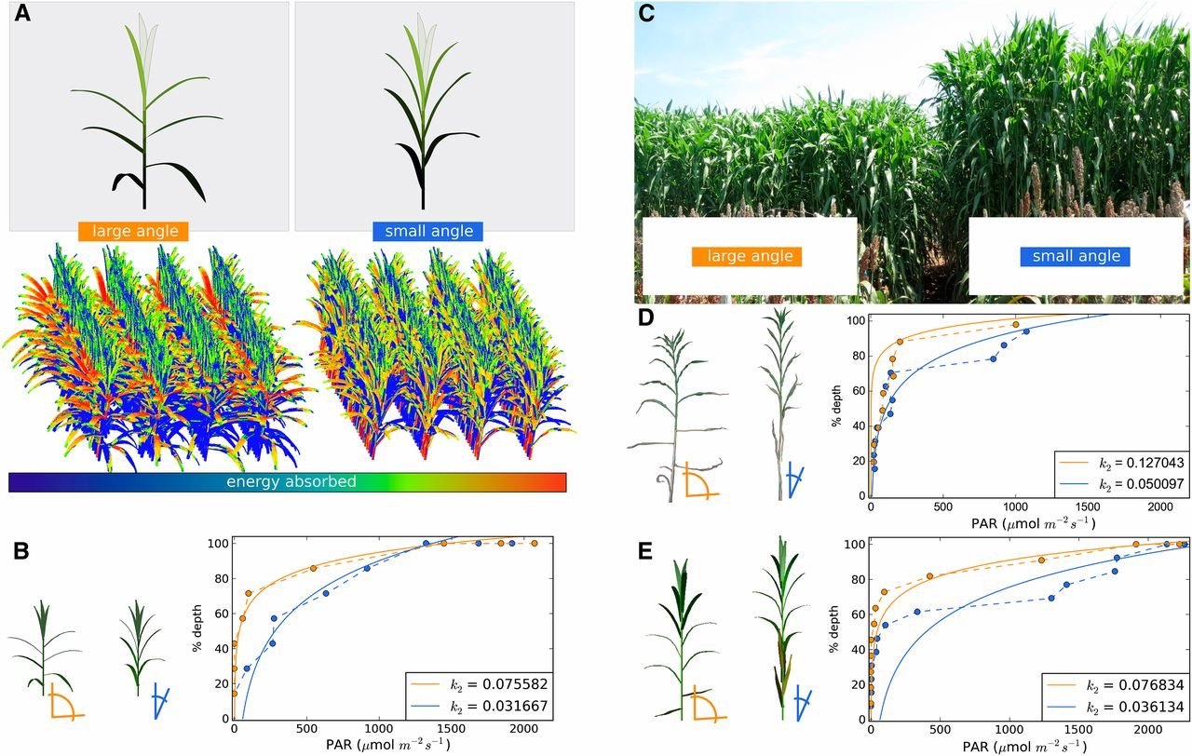
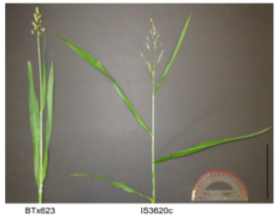
Plant architecture & Light interception
Truong et al. 2015
Notes:
Leaf inclination angle affects light distribution in sorghum canopies. (A) Virtual sorghum plants and sorghum plots that vary in their leaf inclination angles (orange represents a larger leaf inclination angle relative to blue). (B) Light extinction curves for virtual plots from panel A simulated under solar conditions representing 13:00 on July 13, 2013, in College Station, Texas (W96°20", N30°37"). (C) Field plots of RIL 63 and RIL 73 from which light measurements were taken. (D) Light extinction curves for field plots from panel C assayed around 15:30 on July 22, 2014, in College Station, Texas. (E) Light extinction curves for virtual plots representing RIL 63 and RIL 73 simulated under solar conditions representing 15:30 on July 22, 2014, in College Station, Texas. In both simulation and field studies, plots with smaller leaf inclination angles fit a smaller light extinction coefficient k₂ relative to plots with larger leaf inclination angles (panels B, D, and E). k₂ values are derived from fits to equation (2) (see Materials and Methods).

Slide 9
References
Monteith, J. (1977). Climate and the effeciency of crop production in britain. Phyllosophical transactions of the Royal Society of London, series B Biological Sciences, 281:277–294.
Khush, G. S. (2001). Green revolution: the way forward. Nature Genetics, 2:815–821.
Dingkuhn, M., Laza, M. R. C., Kumar, U., Mendez, K. S., Collard et al. (2015). Improving yield potential of tropical rice: Achieved levels and perspectives through improved ideotypes. Field Crops Research, 182:43–59.
Donald, C. (1968). The design of a wheat ideotype. Finlay, KW and Shepherd.
Koester, R. P., Skoneczka, J. A., Cary, T. R., Diers, B. W., and Ainsworth, E. A. (2014). Historical gains in soybean (Glycine max Merr.) seed yield are driven by linear increases in light interception, energy conversion, and partitioning efficiencies. Journal of Experimental Botany, 65(12):3311–3321.
Rotter, R., Tao, F., Hohn, J., and Palosuo, T. (2015). Use of crop simulation modelling to aid ideotype design of future cereal cultivars. Journal of Experimental Botany, page erv098.
Plomion, C., Durel, C.-E., and O’Malley, D. M. (1996). Genetic dissection of height in maritime pine seedlings raised under accelerated growth conditions. Theor Appl Genet, 93:849–858.
Yang, X.-C. and Hwa, C.-M. (2008). Genetic modification of plant architecture and variety improvement in rice. Heredity, 101:396–404.
Sakamoto, T. and Matsuoka, M. (2004). Generating high-yielding vari- eties by genetic manipulation of plant architecture. Current Opinion in Biotechnology, 15:144–147.
Segura, V., Cilas, C., and Costes, E. (2008). Dissecting apple tree architecture into genetic, ontogenetic and environmental effects: mixed linear modelling of repeated spatial and temporal measures. New Phytologist, 178:302–314.
Frary, A., Fritz, L. A., and Tanksley, S. D. (2004). A comparative study of the genetic bases of natural variation in tomato leaf, sepal, and petal morphology. Theor Appl Genet, 109:523–533
Li, C., Li, Y., Shi, Y., Song, Y., Zhang, D., Buckler, E. S., Zhang, Z., Wang, T., and Li, Y. (2015). Genetic control of the leaf angle and leaf orientation value as revealed by ultra-high density maps in three connected maize populations. PloS ONE, 10(3):e0121624.
Truong, S. K., McCormick, R. F., Rooney, W. L., & Mullet, J. E. (2015). Harnessing genetic variation in leaf angle to increase productivity of Sorghum bicolor. Genetics, 201(3), 1229-1238.

