Slide 1
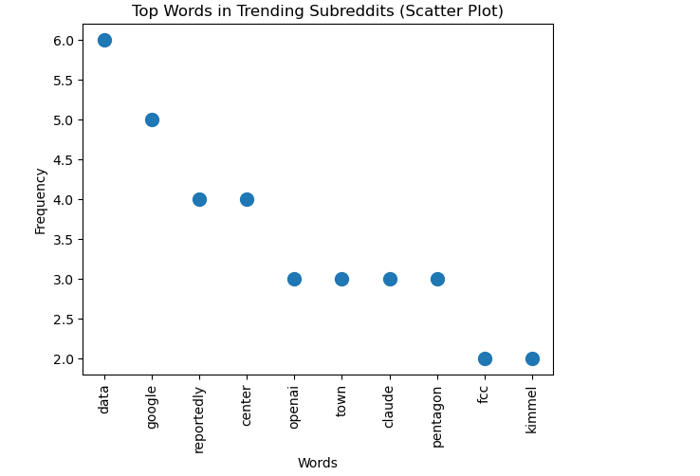
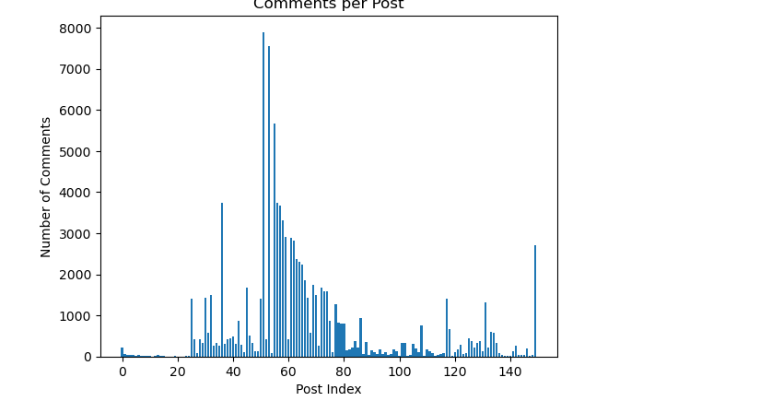
Analysis of Trending Topics on Reddit
Noshitha Reddy Gudhibandi
Introduction
Data Analysis and Results
Conclusion
Reddit is a popular social media platform where users can post content and comment on a variety of topics. This project involves collecting data from various Reddit subreddits to gain insights about popular topics and user interaction. Through the analysis of post titles and comments counts, the project seeks to discover popular topics. Through data analysis and visualization, the project offers insights into the success of content and user interactions on Reddit.
The data is made up of the titles of Reddit posts and the number of comments received. It's in JSON form and stored as Python lists. The graphs display the top words in titles and number of comments. There appears to be a distribution of comments among posts, with some receiving more than others.
We found that hot topics can be found by looking in post titles for commonly used words.
Further, reader engagement is skewed with some posts having more comments than others.
This project analyzed Reddit data to identify trends and user engagement patterns. The results showed that a small number of keywords appear frequently in post titles, highlighting common topics across subreddits.
The analysis of comments revealed that engagement is uneven, with some posts receiving significantly more interaction than others.
Overall, the project demonstrates how data analysis and visualization can be used to understand online trends and user behavior on platforms like Reddit.
Methodology
Data collected with Python using the Reddit API. Title and number of comments were collected. Used spaCy to clean the text and matplotlib to generate to the plots

Slide 2
Where did you find it?
Data was obtained from Reddit
Accessed Reddit’s public JSON API
Got data from subreddit such as news, games, and technology
How did you extract it?
Used Python programming language
Created the GET request with the request library
Accessed Reddit JSON endpoints
Included a user-agent in the request
Analyzed the JSON response
Extracted interesting fields (titles, comments)
Stored data in Python lists
What data was available?
Post titles
Number of comments

Slide 3
What did you have to do to clean the data?
Made all text lowercase
Removed stop words (spaCy)
Eliminated stop or short words
Removed unnecessary fields (user, content and date)
Stored data in Python lists
What statistics did you look at ?
most common words in titles
Number of comments per post
Comparison of engagement across posts
Distribution of comments

Slide 4
Improvements:
Use more subreddits to increase the size of the dataset
Analyze how trends change over time
Use more advanced visualizations
The word frequency graph shows that a few words like “data” and “google” appear more often, indicating common trending topics.
This answers the question of what topics are trending, showing that only a few keywords dominate.
The comments per post graph shows that most posts have low to moderate comments, while a few posts have very high comment counts.
This indicates that user engagement is uneven, with only certain posts attracting a lot of discussion.
This answers the question of how users interact with posts, showing that some posts are much more popular than others.
Overall, the graphs show that trends and engagement are not evenly distributed across Reddit posts.

