Slide 1



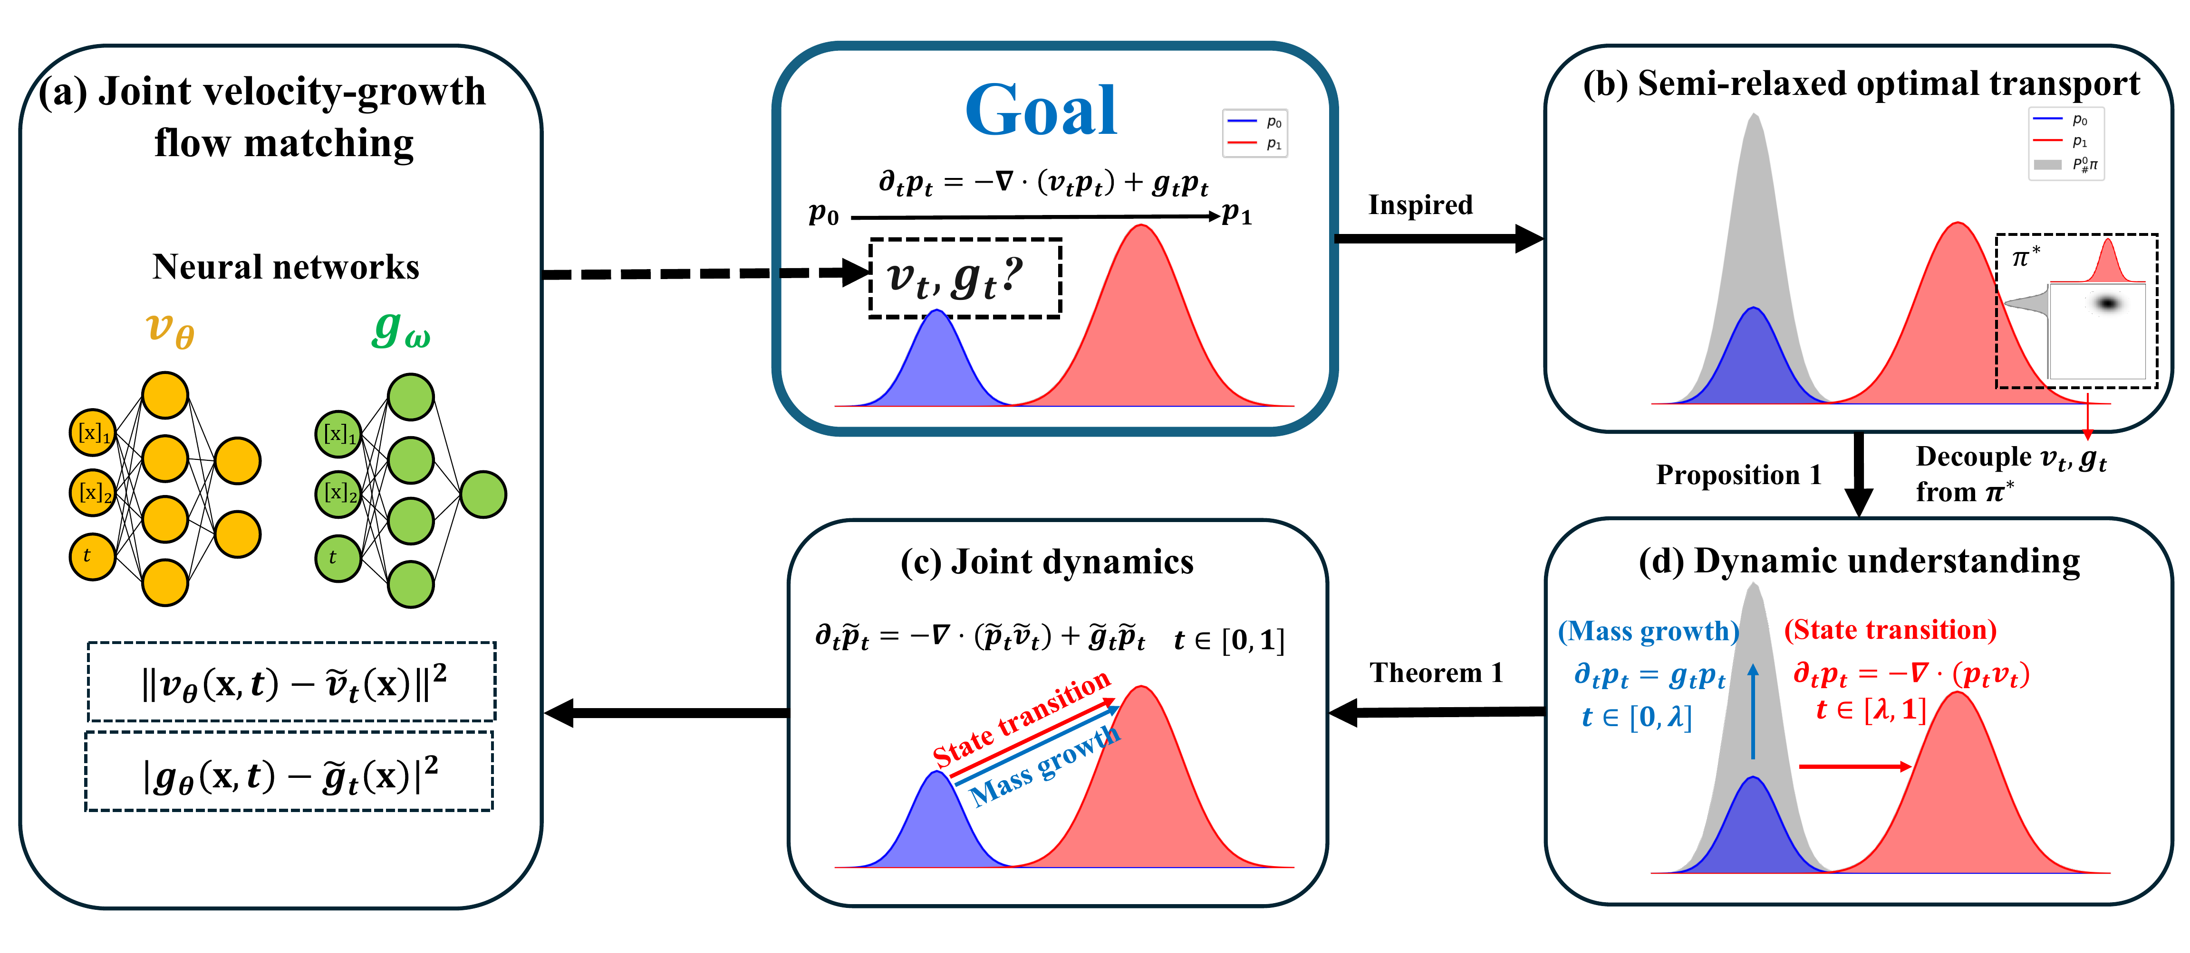


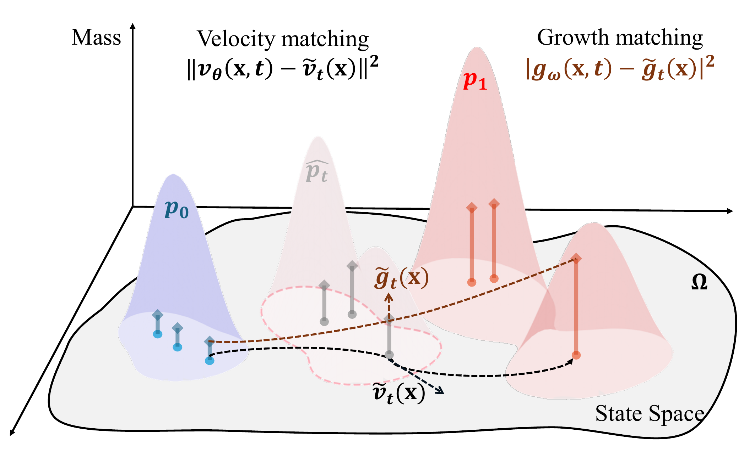

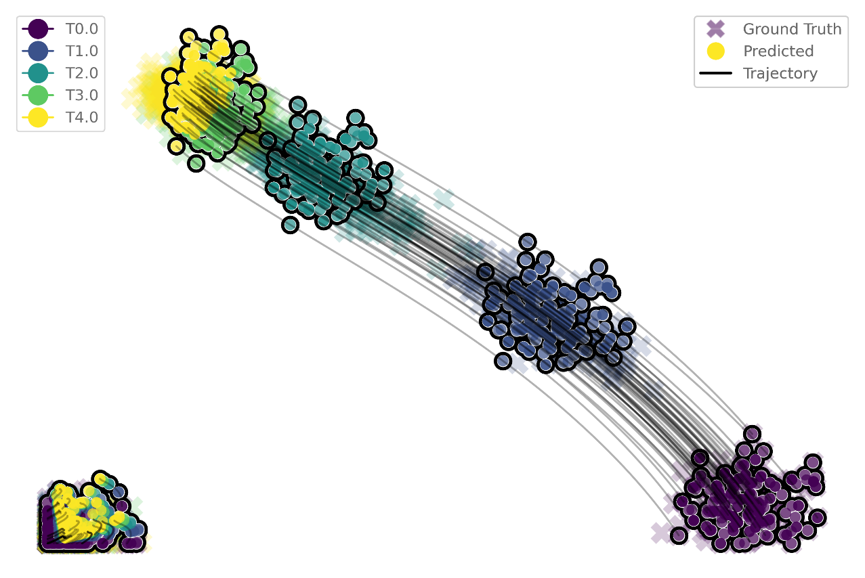
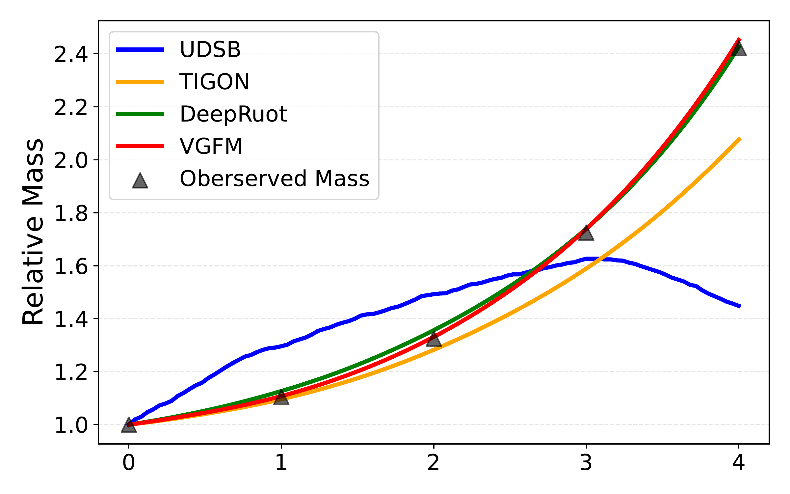
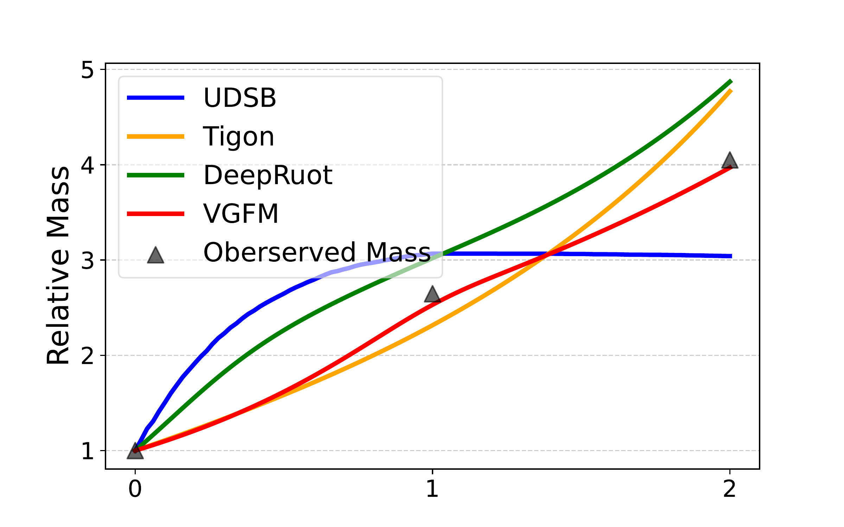
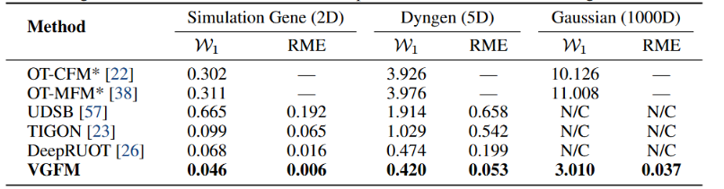
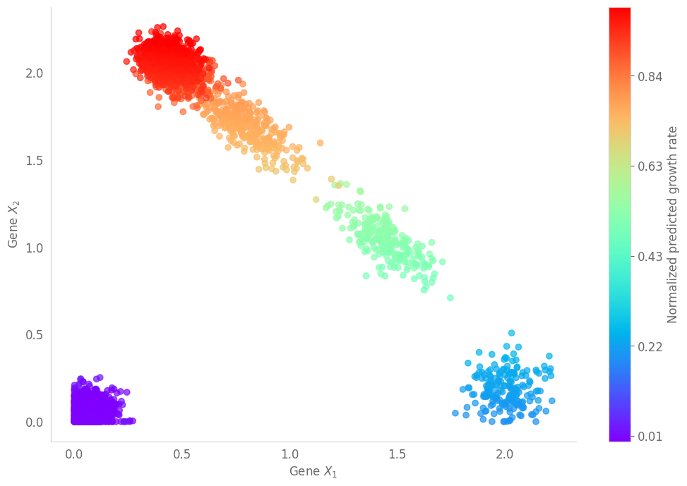
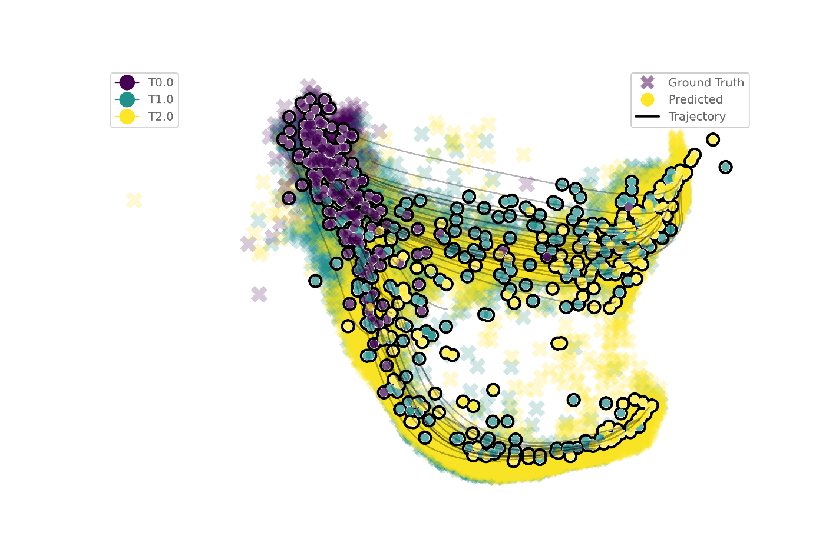
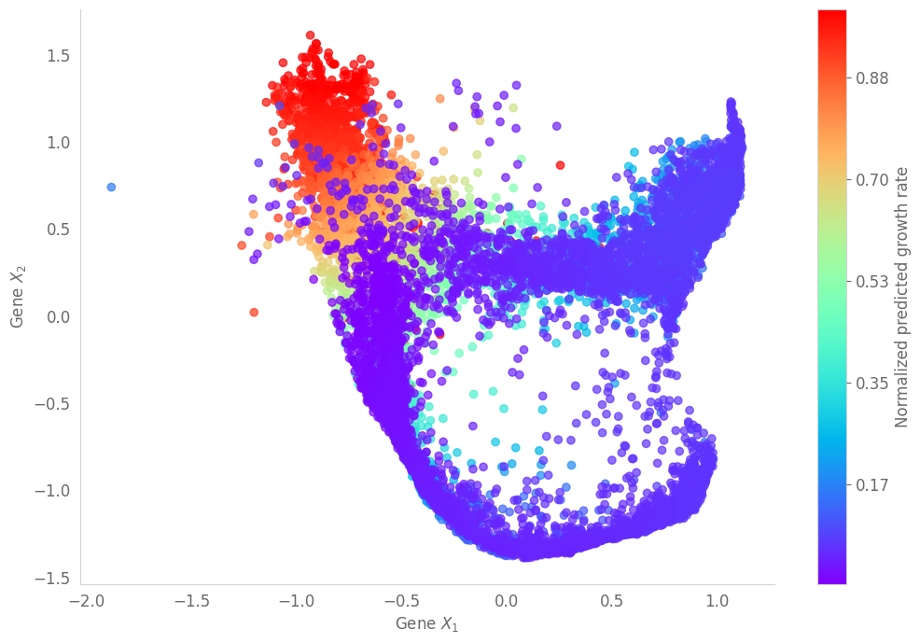
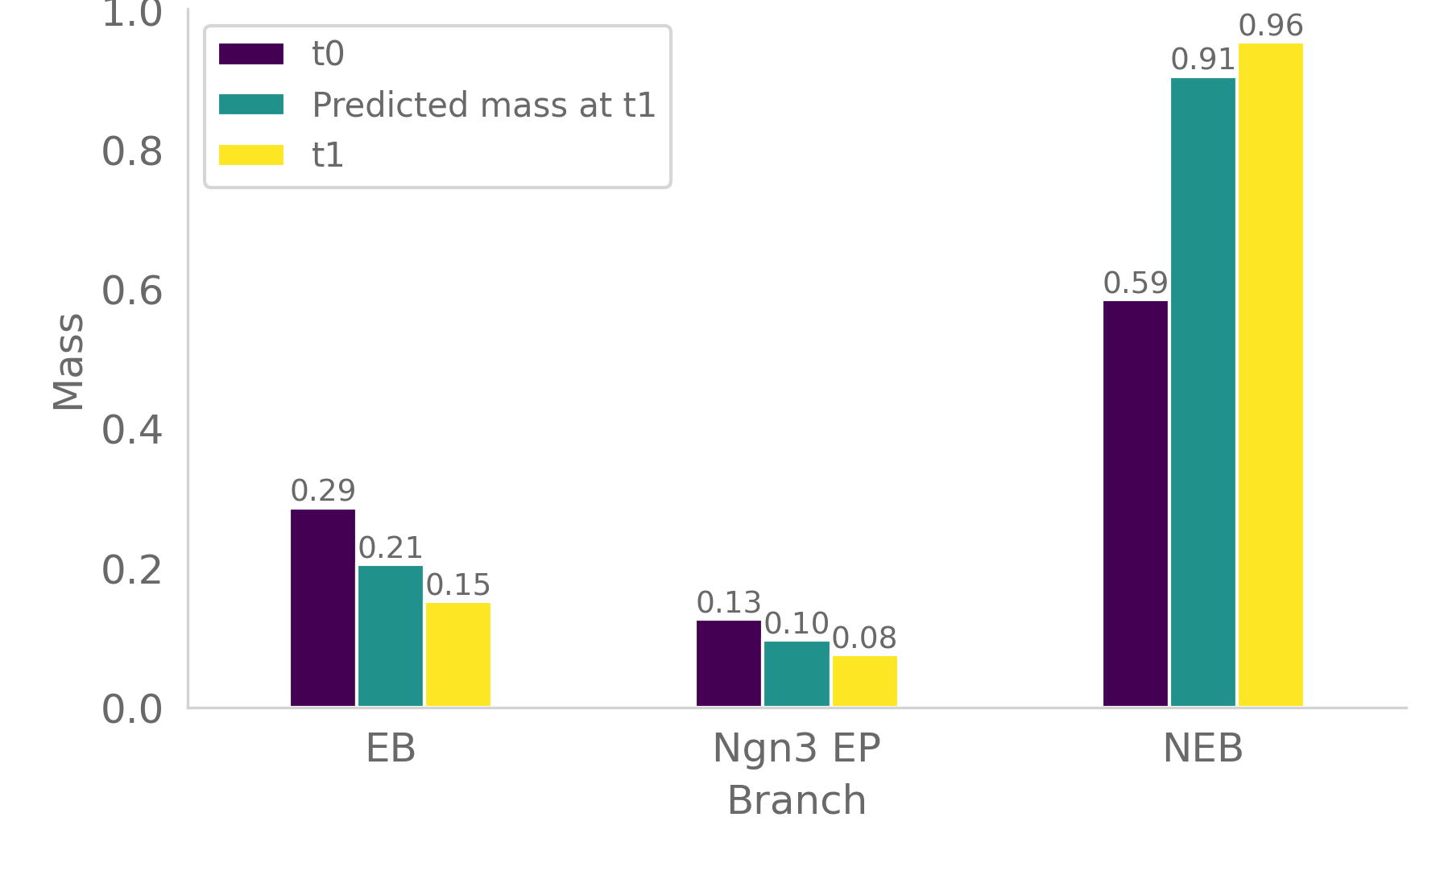
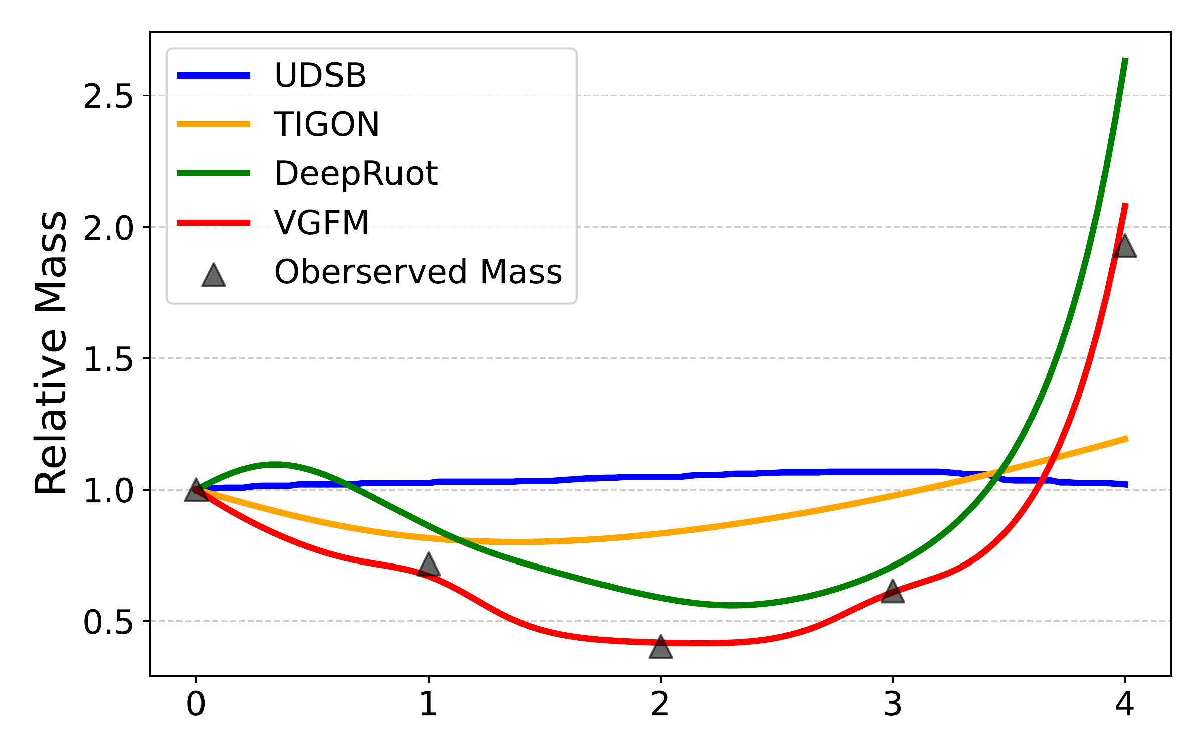
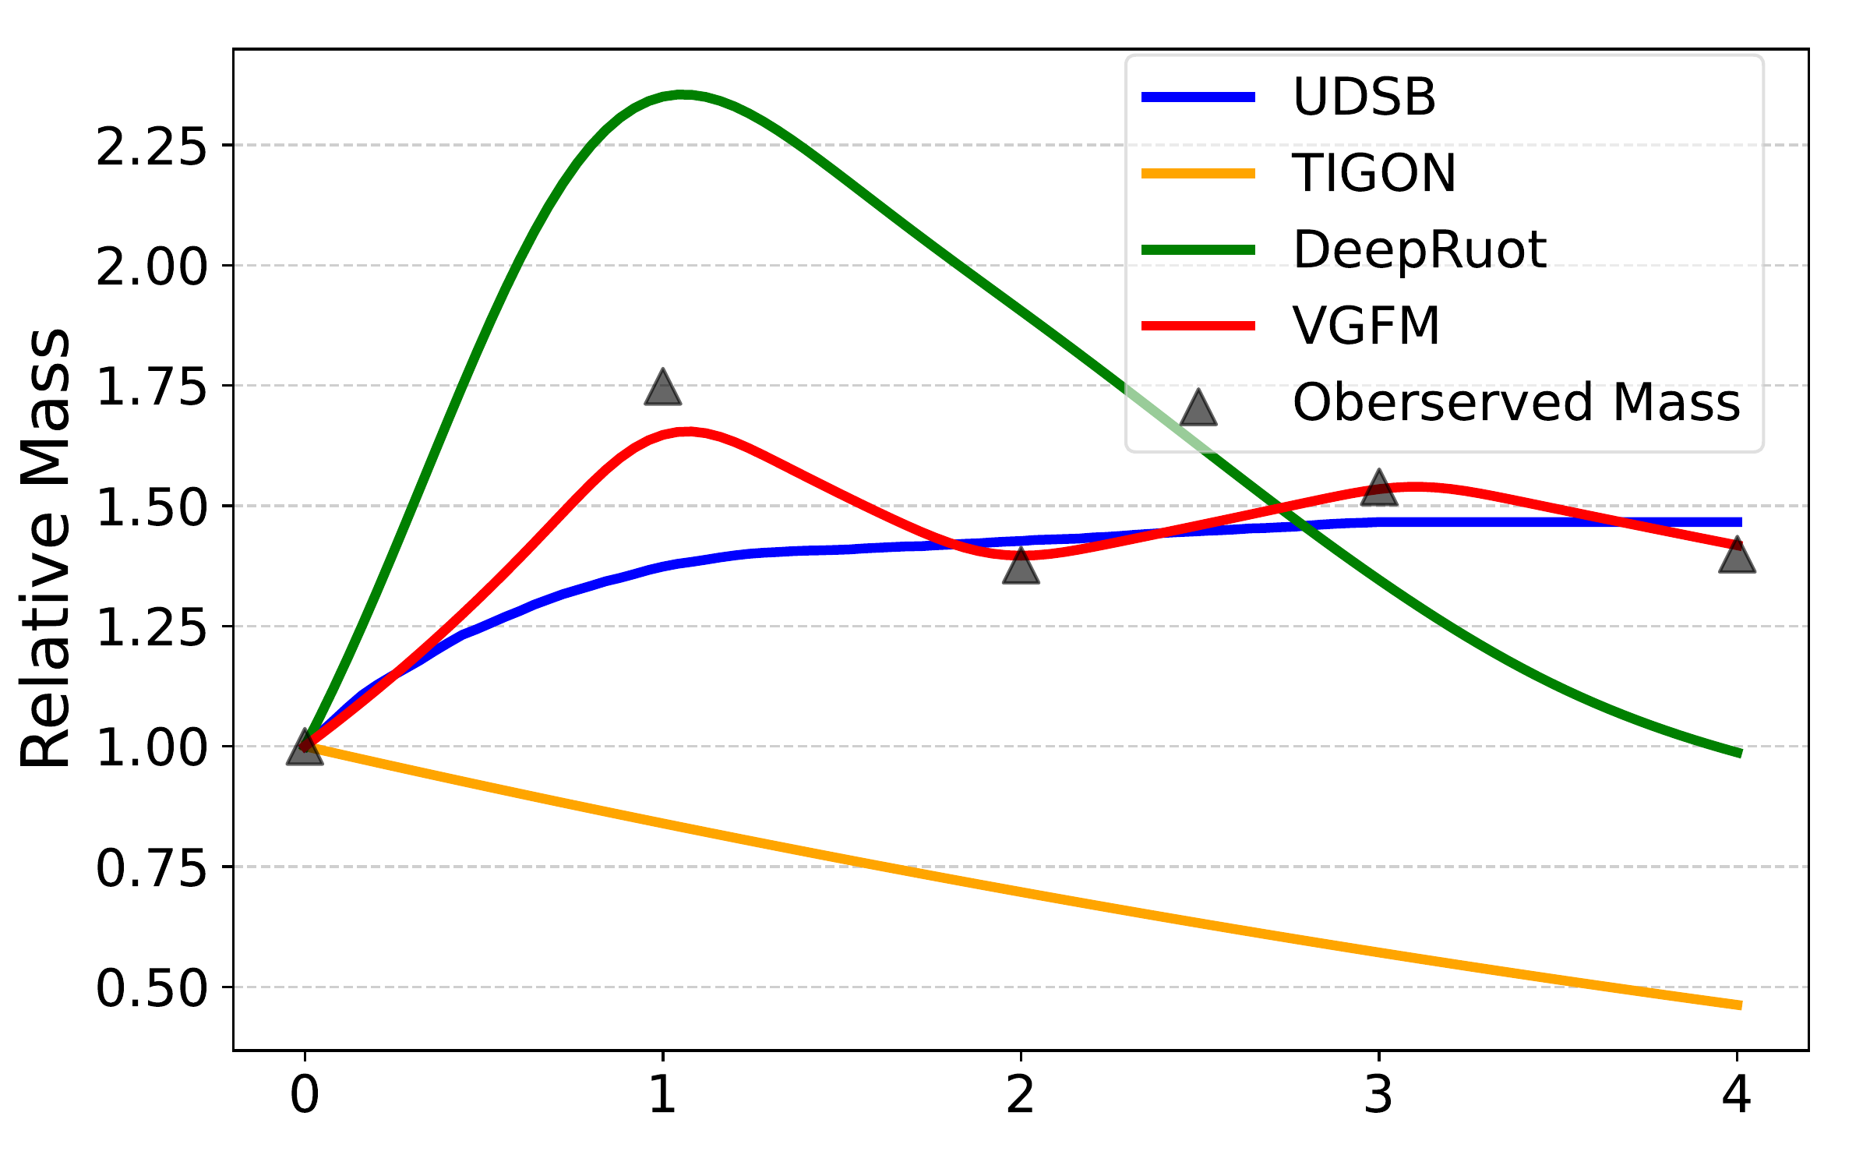
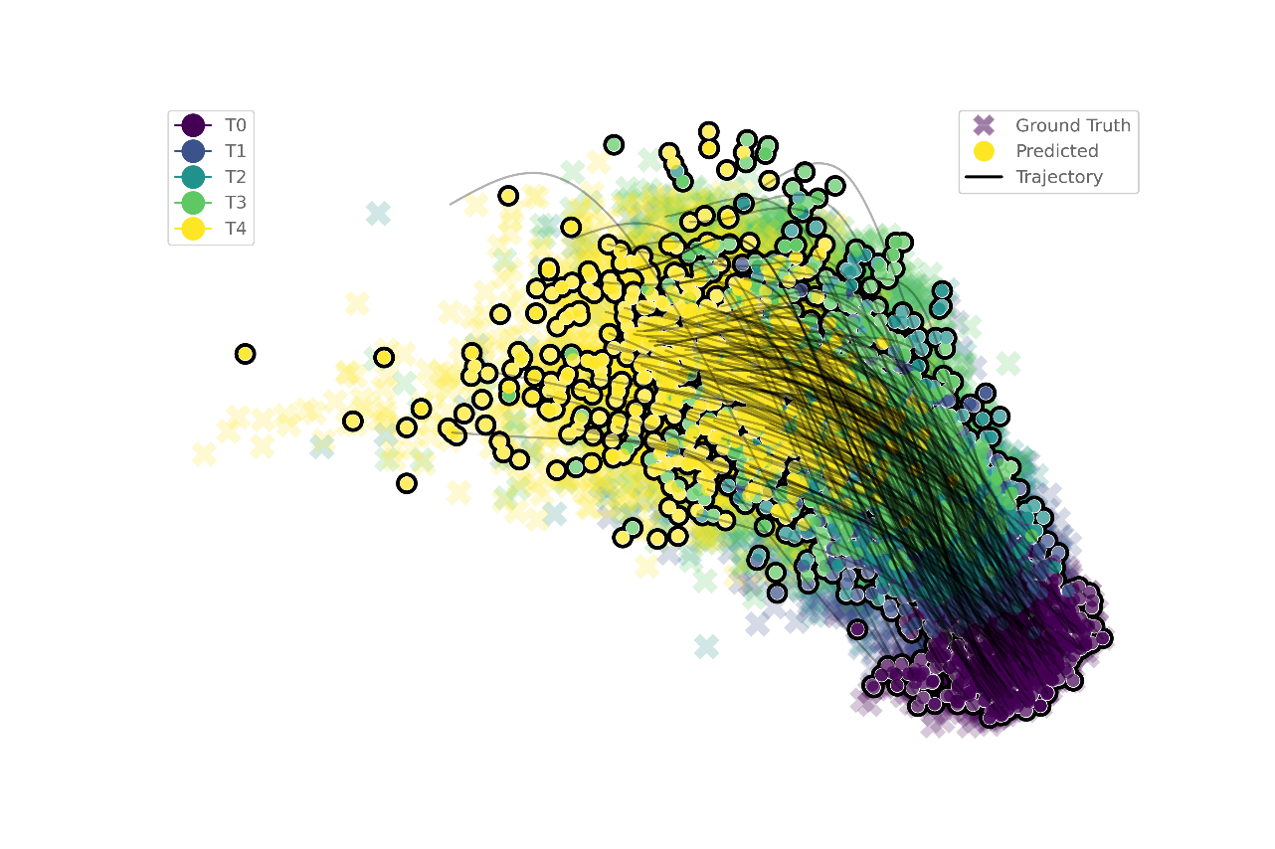
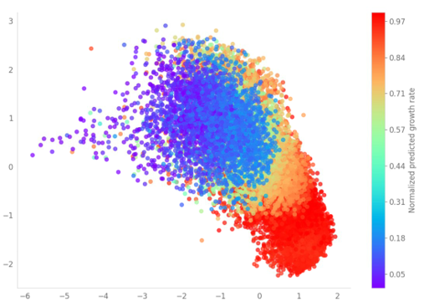
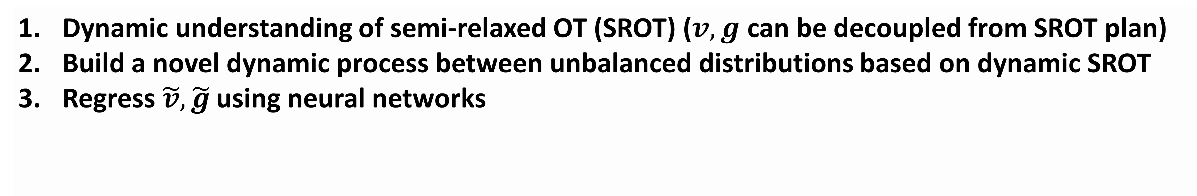
Joint Velocity-Growth Flow Matching for Single-Cell Dynamics Modeling
Dongyi Wang, Yuanwei Jiang, Zhenyi Zhang, Xiang Gu, Peijie Zhou, Jian Sun
School of Mathematics and Statistics, Xi'an Jiaotong University, China
School of Mathematical Sciences, Peking University, Beijing, China
Background & Motivation
Our Approach: Velocity-Growth Flow Matching via SROT
=
Single-cell RNA seq yields unpaired and unbalanced data.
Simulation-based models (e.g., TIGON, DeepRUOT)
Growth rate
Scalability
Simulation-free models (e.g., OT-CFM, SF2M)
Growth rate
Scalability
Our approach:
VGFM jointly learns the state transition and mass growth of single-cell evolution by flow matching.
Dynamic understanding of semi-relaxed OT (SROT) ($v,g$ can be decoupled from SROT plan)
Build a novel dynamic process between unbalanced distributions based on dynamic SROT
3. Regress $\tilde{v},\tilde{g}$ using neural networks
Growth rate
Scalability
Flow matching loss
Distribution fitting loss
Experiments
Trajectory and growth reconstruction
Mass matching
Wasserstein-1 distance and Relative mass error
Simulation gene
Simulation gene
Mouse Hematopoiesis
Mouse Hematopoiesis
Training and analysis on 2k gene space
Dyngen
EB 50D
EB

