Slide 1
City waste Management Or Recycling System Group Name: Hello World Group No:12
Member 1:
Name: Showmen Sarker
ID: 19301188
Section: 09
Member 2:
Name: Rafid Rahman
ID: 18301151
Section: 09

Slide 2
System Request
Project Sponsor-
Sheikh Fazle Noor Taposh [Mayor Of Dhaka South City Corporation]
Atiqul Islam [Mayor Of Dhaka North City Corporation]

Slide 3
Business Need-
Full details of waste seller, Full details of waste buyer, Waste seller address, Waste buyer’s address, Complaint system if any kind of issues arrive, Money transaction system, Ads based system on website for extra revenue.

Slide 4
Business Requirements:
Updated database to gather how much new users coming and how much leaving from the website.
Admins with proper knowledge of maintaining difficulties.
Emergency contact numbers.
Emergency support system panel.
Transaction system.
Other revenue generators in the website.

Slide 5
Business Value:
The problem of city people growing day by day and at this moment if the waste management becomes another big problem it will be very difficult for city people to lead a healthy life. Also, the wastes can be a great source of income for both buyer (recycler) and seller(city people). And that’s the reason we came up with this idea.
Decreasing the rate of problems in city people life.

Slide 6
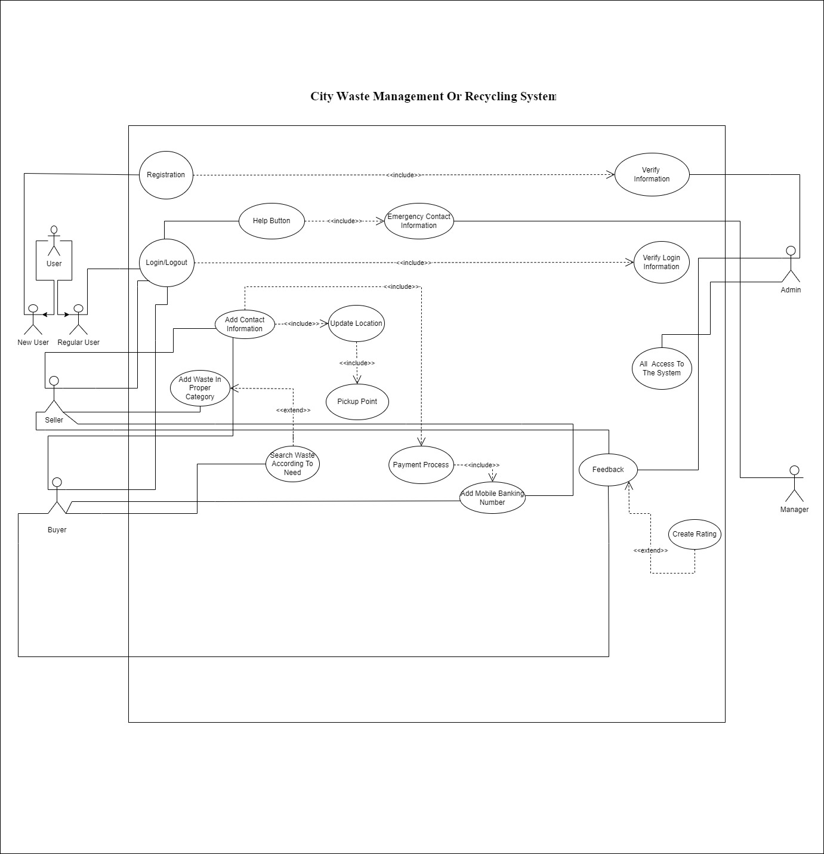
Use Case Diagram

Slide 7
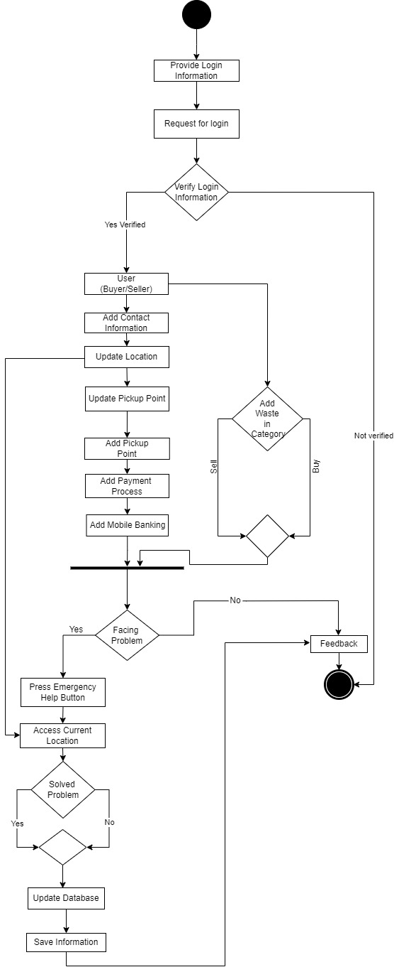
Activity Diagram

Slide 8
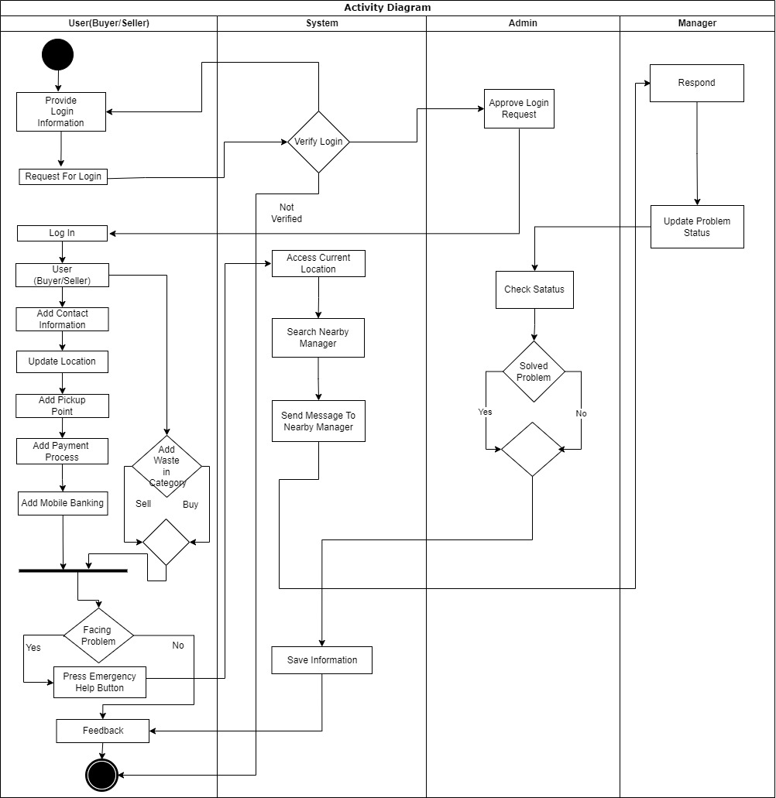
Activity Diagram:

Slide 9
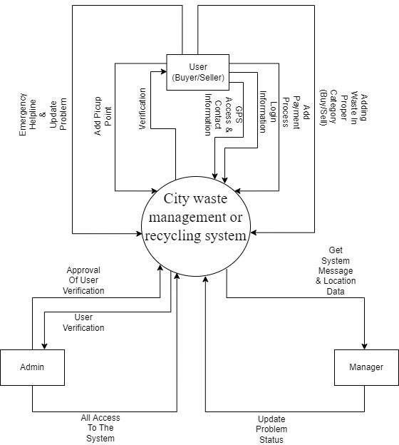
Data Flow Diagram
DFD LEVEL-0

Slide 10
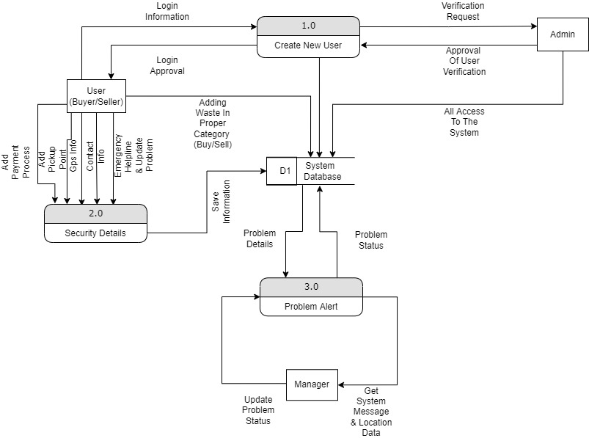
Data Flow Diagram
DFD LEVEL-1

Slide 11
Summary and Conclusion
A system that can help to reduce the waste made in city area which is harmful for the environment.
Make money out of the things which people thinks useless.
Reduce various kind of pollution.
Establish a secure platform and make the waste management in a systematic way.

Slide 12
Thank You Everyone!

