Slide 1
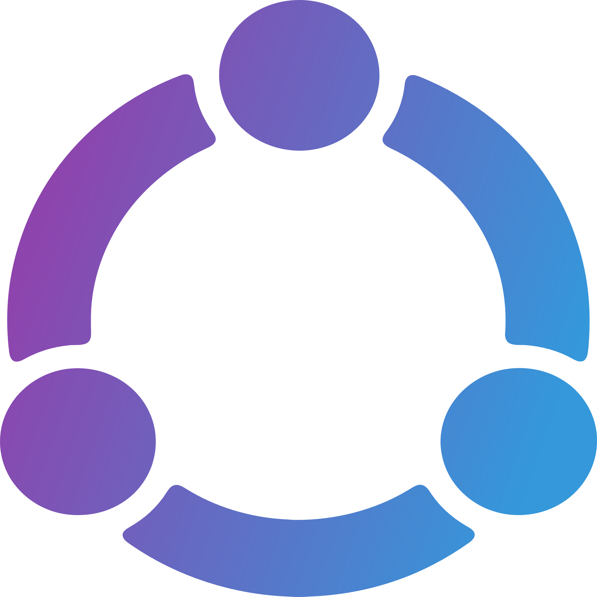















Nostria Infrastructure v1.0
Users
Nostria supports
local keys,
extension keys
and remote signing
US
ASIA
Discovery Relay
discovery.nostria.app
User Relays
ribo.nostria.app
rilo.nostria.app
rifu.nostria.app
...
Media Servers
mibo.nostria.app
milo.nostria.app
mifu.nostria.app
...
Lightning Server
pay.nostria.app
Health Monitoring
status.nostria.app
Premium Support
support.nostria.app
User Analytics
analytics.nostria.app
Nostria App
nostria.app
LMDB
Relay Lists
Accounting
Internal App for
Account Management
Notification Service
Push notifications
for Premium Users
Server Analytics
Monitoring
Nostria Website
www.nostria.app
Backup Storage
Backup and Restore
EU Region

Slide 2
Nostria Architecture v1.0
1. Discovery of users
When looking up a user on Nostria, a request is sent to the Discovery Relay to find the User Relays. The Discovery relay holds a global list of all Nostr users, not just Nostria users.
Discovery Relay
discovery.nostria.app
Nostria User
When signing up, users is
assigned user relay
and media server
2. User Profiles
After discovery of a user’s relays on the Discovery Relay, Nostria will connect to that user’s relays to retrieve their updated profile and other information that is relevant. User’s does not need to utilize a large centralized relay to be discovered, they only need a small set of reliable relays and media servers.
Media Servers
mibo.nostria.app
milo.nostria.app
mifu.nostria.app
...
User Relays
ribo.nostria.app
rilo.nostria.app
rifu.nostria.app
...
3. Interacting with users
When Nostria user’s interact with other users, commenting on their posts, send direct messages or join group chats, Nostria will publish events both to the receivers and the the current user’s relays. This ensures the user always has a full set of their data, accessible on their user relays.

Slide 3
Nostria Architecture v1.0
1. Discovery of users
When looking up a user on Nostria, a request is sent to the closests Discovery Relay to find the User Relays. The Discovery relay holds a global list of all Nostr user’s Relay Lists, not just Nostria users.
Nostria in Cap Town
When signing up, users is
assigned user relay
and media server
Nostria in Tokyo
When signing up, users is
assigned user relay
and media server
2. User Profiles
After discovery of a user’s relays on the Discovery Relay, Nostria will connect to that user’s relays to retrieve their updated profile and other information that is relevant. User’s does not need to utilize a large centralized relay to be discovered, they only need a small set of reliable relays and media servers.
3. Interacting with users
When Nostria user’s interact with other users, commenting on their posts, send direct messages or join group chats, Nostria will publish events both to the receivers and the the current user’s relays. This ensures the user always has a full set of their data, accessible on their user relays.
Discovery Relay
discovery-af.nostria.app
Discovery Relay
Discovery-jp.nostria.app
User Relays
milo-af.nostria.app
4. Global Relay Distribution
Individuals with large amount of followers, can subscribe to global relay distribution, giving their followers the best possible experience by being able to retireve their posts and media from a geographically closer location.
User Relays
ribo-jp.nostria.app
Media Servers
milo-af.nostria.app
Media Servers
mibo-jp.nostria.app

